Slide 1
MATCH MAKER
SHAHABAS AHAMMED AK
22PMC150

Slide 2
ABSTRACT
Our app revolves around creating and managing user profiles. Users can create and edit their profiles, providing personal information. Users can send connection requests to profiles they find interesting, and upon acceptance, gain access to other's WhatsApp numbers. This enables messaging, allowing users to initiate conversations and get to know each other better. Privacy and security measures are in place to ensure the confidentiality of user information. The user-friendly interface contribute a smooth and enjoyable user experience. With an admin panel to manage profiles and requested user details. our Match Maker app offers a comprehensive solution for users seeking meaningful connection to know others.

Slide 3
REQUIREMENTS
CREATE AND MANAGE PROFILE.
WATCH OTHER USERS AND SEND REQUEST TO USERS.
ACCEPT REQUESTS SEND BY OTHER USERS.
REJECT REQUESTS SEND BY OTHER USERS.
SEE ACCEPTED USERS IN ACCEPTED PAGE.
EDIT PROFILE DETAILS .

Slide 4
FEATURES AND HIGHLIGHTS
User Profile Creation and Editing:
  Users can create their profiles with personal information and interests.
Profiles can be edited to reflect updated information.
Connection Requests:
Users can send connection requests to other profiles they are interested in.
This allows users to express their interest and initiate potential connections.
WhatsApp Number sharing:
Once the user accept someone’s request, they can see their WhatsApp number in the accepted page.

Slide 5
FEATURES AND HIGHLIGHTS
Privacy and Security:
The app ensures user privacy by limiting WhatsApp visibility to accepted connections only.
User-friendly Interface:
The app features an intuitive and user-friendly interface for easy navigation and profile _ _management.
Users can effortlessly navigate through the app and access its various features.
Admin Panel:
An admin panel is available to manage user profiles, handle issues, and ensure app functionality.
This provides an efficient way to manage the app's operations and address any concerns.

Slide 6
THIRD-PARTY LIBRARIES
In our application, we mainly used Django’s in-build libraries, other libraries we used _includes:
Jazzmin:
Jazzmin is a third-party Django admin theme that enhances the visual appearance and user experience of the Django administration interface.
It provides a modern and customization interface with additional features such as a dark mode, responsive design, and improved navigation.

Slide 7
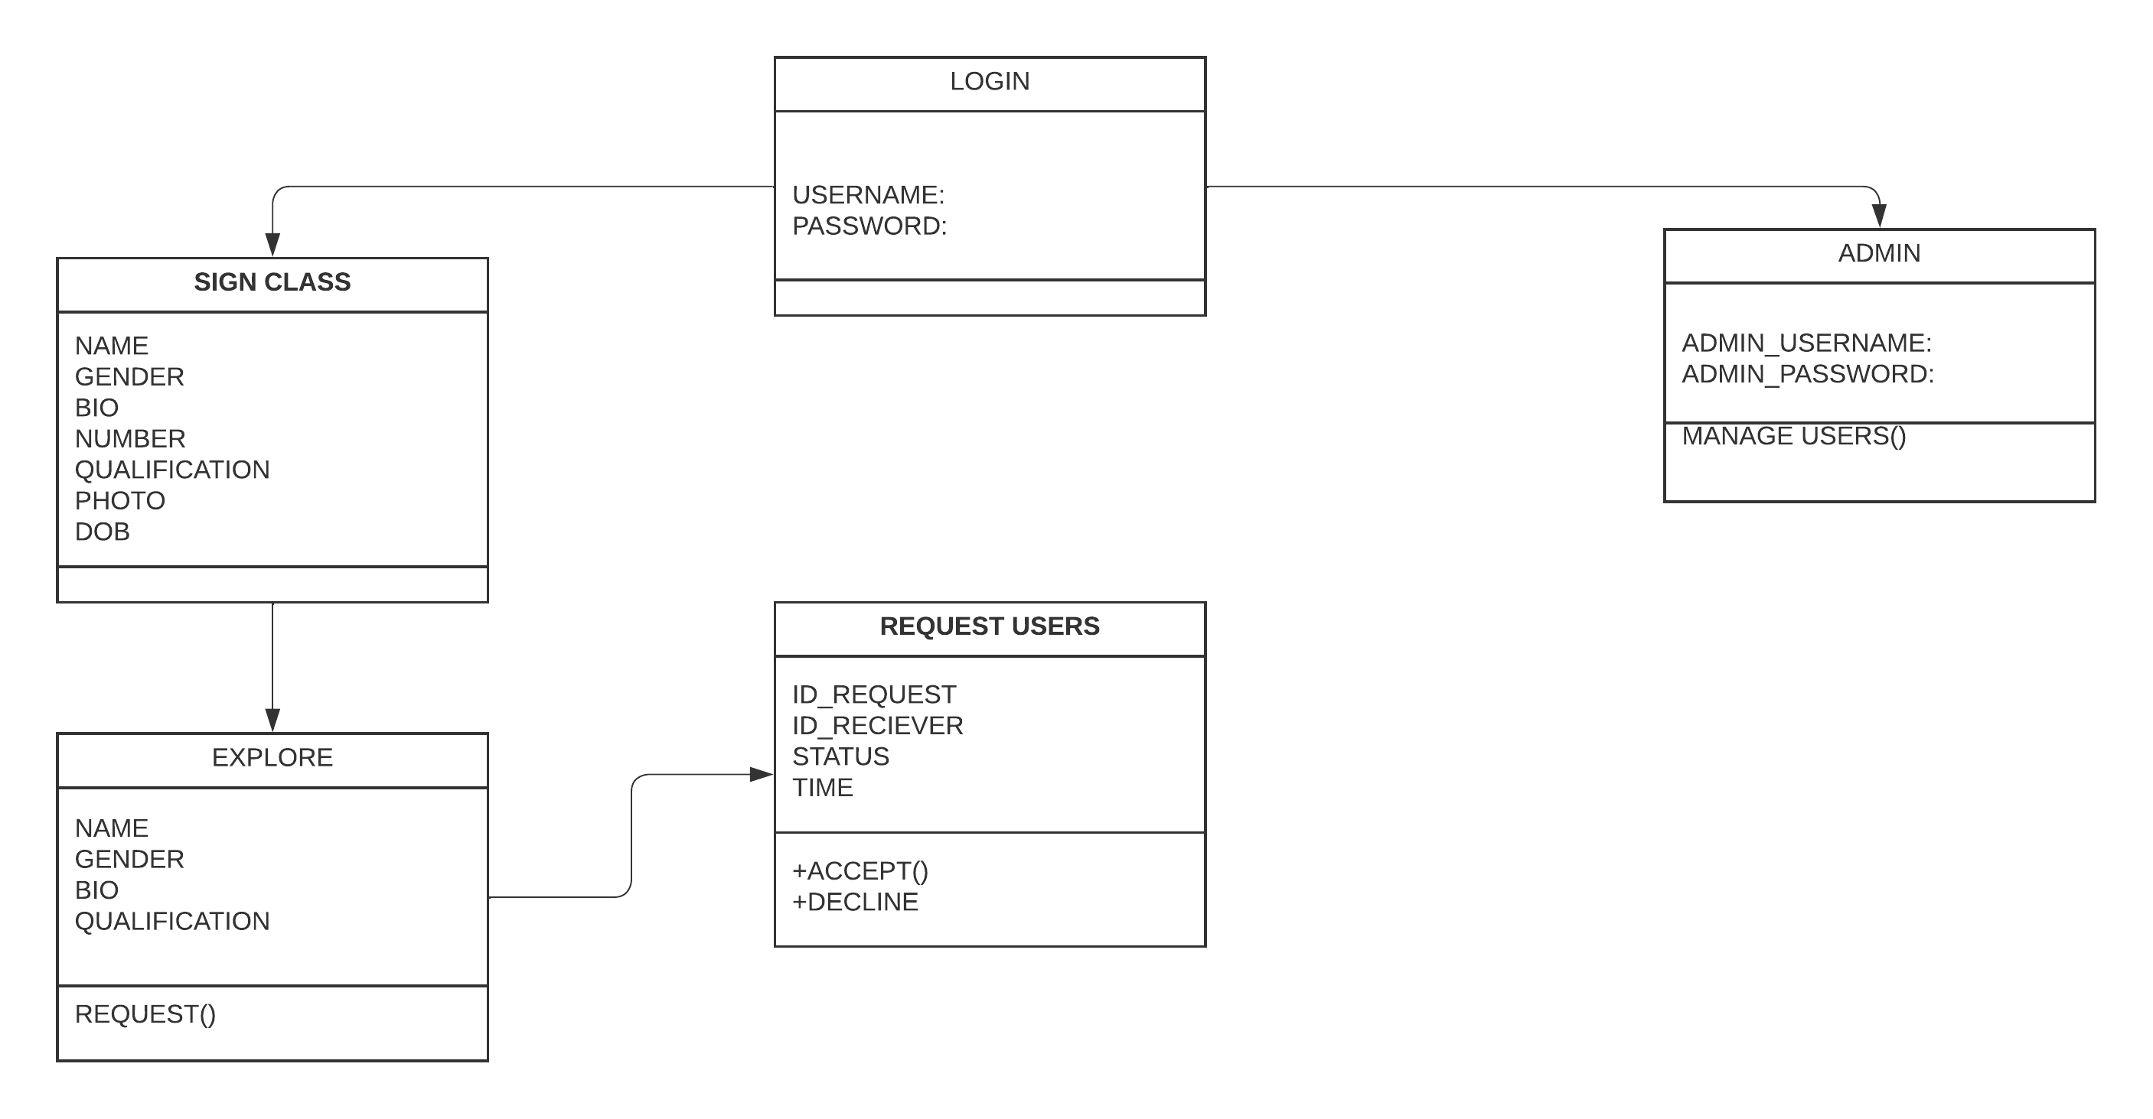
CLASS DIAGRAM

Slide 8
CHALLENGES FACED
  The challenges I faced while creating this project:
  Showing the users, who’s request is accepted by the user in only the profile of accepted user. In order keep their privacy.
  Creating an intuitive and user-friendly interface that enhances the overall user experience.
  While showing details of users, in the accepted page, I was unable to show them until I figured by calling it along with the session names, it took some time to catch it.

Slide 9
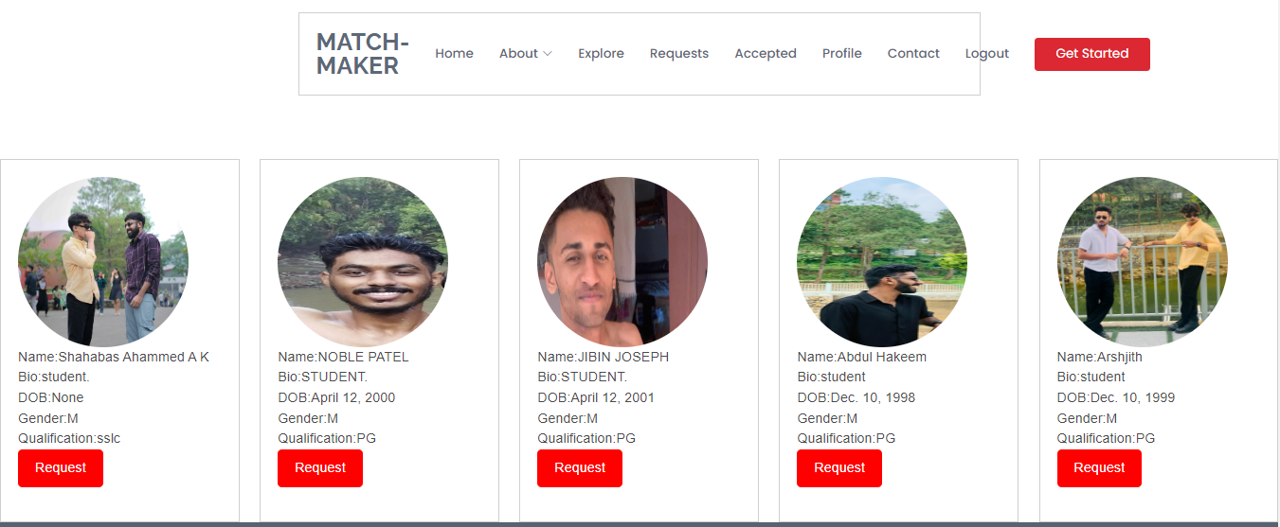
SCREENSHOTS
The explore page, which is dynamic which fetches data from the database.

Slide 10
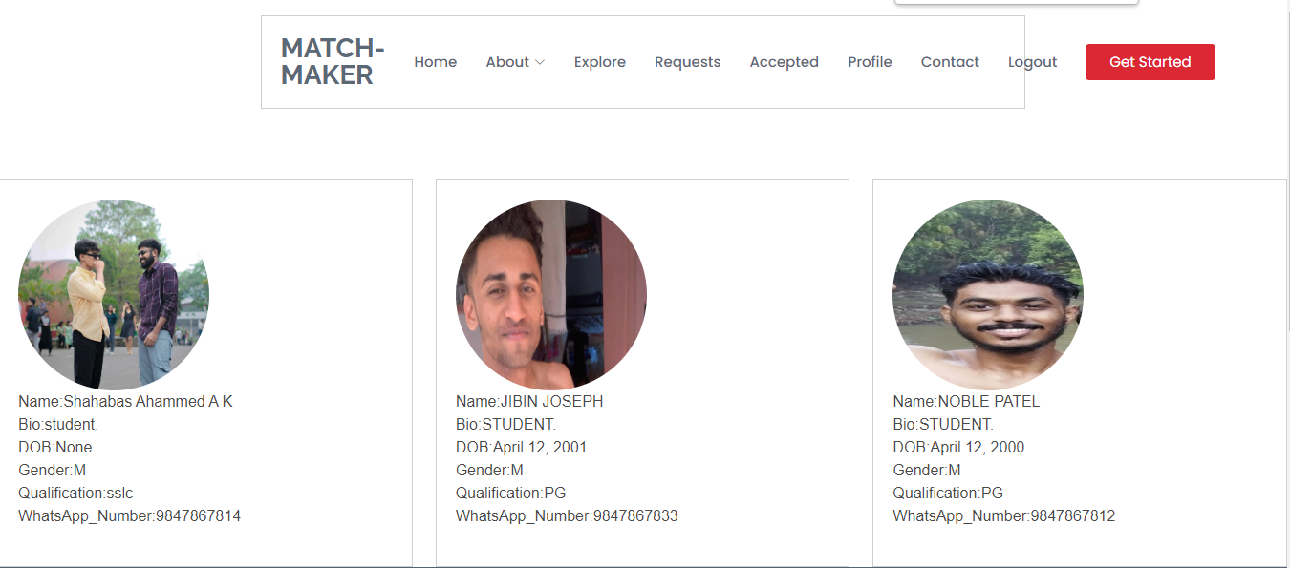
SCREENSHOTS
The accepted page, which only shows accepted users, which fetches data from the database.

Slide 11
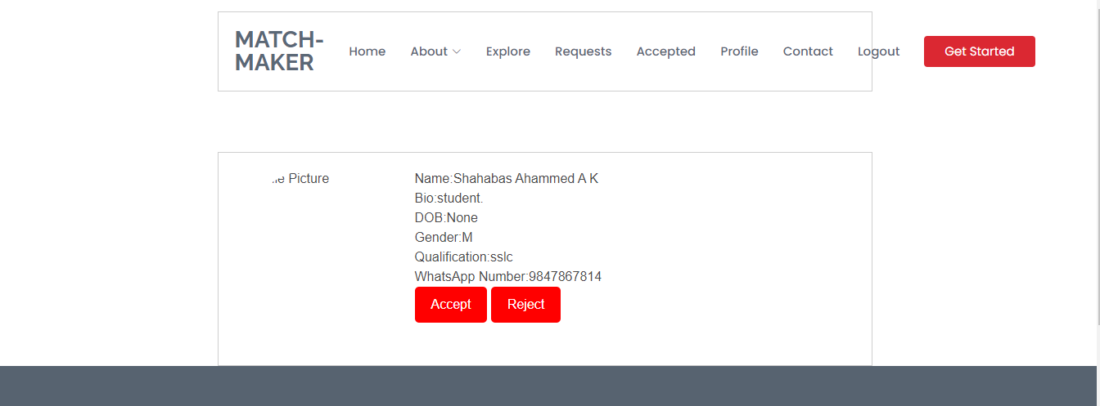
SCREENSHOTS
The request page, where user can accept and reject other users’ requests.

Slide 12
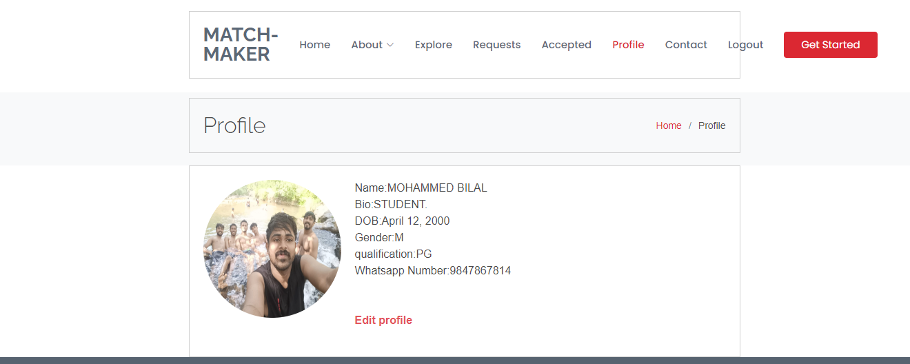
SCREENSHOTS
The profile page, where user can see the details along with edit profile option.

Slide 13
FUTURE ENHANCEMENT
MESSAGING: Where user can message to others within the application.
BUTTON VALUE: Where the button value changes once the user already requested to a particular user.
LIKING PROFILES: Where user can like profile photos of other users.
FRIENDS NUMBER: Where user can see how many friends does they have with their profile itself.

Slide 14
CONCLUSION
MATCH MAKER is a web application , where users can create and manage their profile. Using MATCH MAKER users can send request other users, and when they are interested in you, they may be able to contact you with the WhatsApp number provided in the accepted page along with other details. Users can only see someone’s number while they send requests to you,in order to keep their privacy and importance to their likes and unlike. Admin will able to see all the record of the application where admin uses Jazzmin for admin side.

Slide 15
REFERENCES
List the links used for research:
https://bumble.com/
https://www.meetup.com/
https://docs.djangoproject.com/en/4.2/

