Slide 1

University of Rajshahi “House Renting” Shahabuddin Ahmed Dept. of CSE Roll: 14095415 Session: 2013-14

Slide 2
What is House Renting?
House renting is a web application that is people can advertise their own house and people can view house advertisement who want to rent house.

Slide 3
Scope of the Project
the project is built an online platform specially for house renting purpose.
This is an E-commerce platform.
This project is chosen for business purposes.

Slide 4
Objective of my Project
It is simple and easiest way to give an advertisement.
An advertiser advising his house with picture and description and other necessary things and other people view advertise who want to house rent.
House renter and house advertiser will communicate throw phone number.
Real time communication is included.
It is reduced time and cost both renter and advertiser.

Slide 5
Background Study
Local market:
As I know, there is one website available name as “bproperty”.
It is no more popular and effective.
Link: https://www.bproperty.com/
Global market:
In development countries about 96% people find their house in online.
House renting system is most popular.
Link: https://www.lacartedescolocs.fr/
Link: https://www.spotahome.com/

Slide 6
Feasibility Study
Technical:
I have 1year experience on angular for Front-End design and 6month experience on node.js framework for Back-End design.
Economical:
This is business purpose project.
There is no more competitive web application for house renting. So, expected benefit will coming soon.
Environmental:
This is such as project that is good impact of all class of professionals.
Trustworthy provide transaction.
To give wrong information by cheat people will be prevent.

Slide 7
Application Area
This Project is used as business purposes.
Actually, this project will be get popularity who live in urban area.
All class of professionals will be most popularities.

Slide 8
Use Technology
Client Side
HTML
CSS
Bootstrap 4 Angular Materials
Angular 6
Server Side
Language
JavaScript
Framework
Node JS
Database
MongoDB

Slide 9
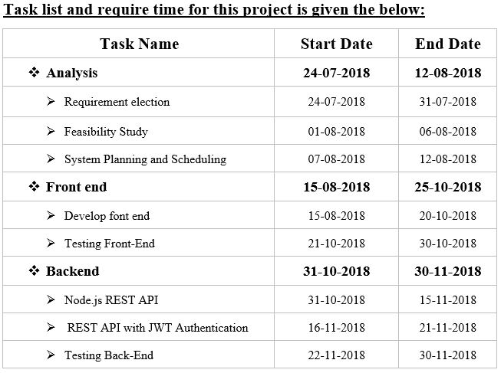
Implementation Plan

Slide 10
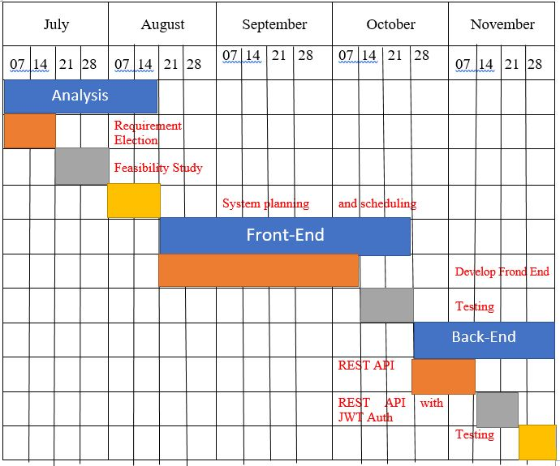
Gantt Chart

Slide 11
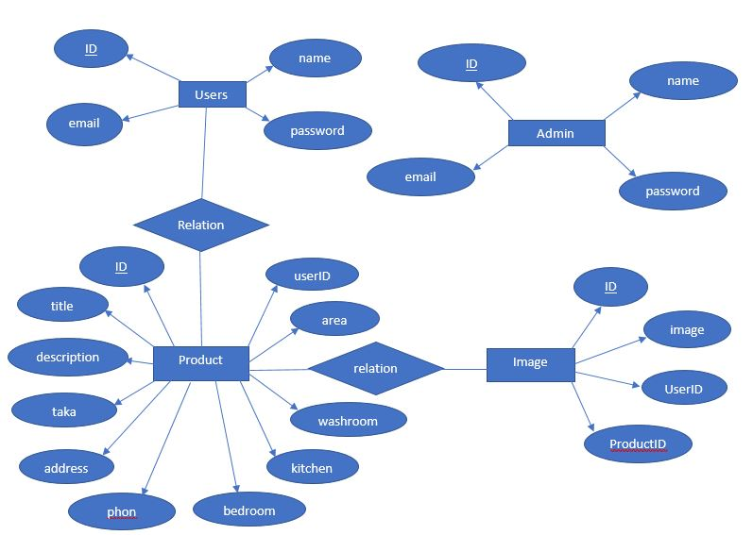
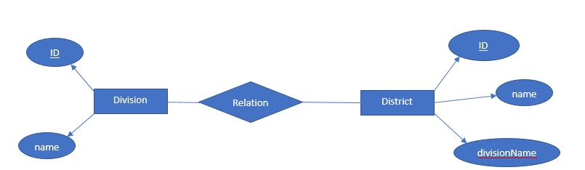
Relational Database(ER Diagram)

Slide 12
Expected Outcome
Complete business Platform.
It is reduce time and cost for both renter and advertiser.
It is help to hurry up to find a house for rent.

Slide 13
Thank You

