Slide 1

House Renting University of Rajshahi Shahabuddin Ahmed Dept. of CSE Roll: 14095415 Session: 2013-14

Slide 2
What is House Renting?
House renting is a web application that is the house owner can advertise their house and house renter who wants to rent house can view house advertisement.

Slide 3
Scope of the Project
the project is built an online platform specially for house renting purpose.
This is an E-commerce platform.
This project is chosen for business purposes.

Slide 4
Objective of my Project
To provide simple and easiest way to give an advertisement.
To provide Real time communication.
To reduce time and cost both renter and advertiser.

Slide 5
Application Area
This Project is used as business purposes.
Actually, this project will be get popularity who live in urban area.
All class of professionals will be most popularities.

Slide 6
Use Technology
Client Side
HTML
CSS
Bootstrap 4 Angular Materials
Angular 6
Server Side
Language
JavaScript
Framework
Node JS
Database
MongoDB

Slide 7
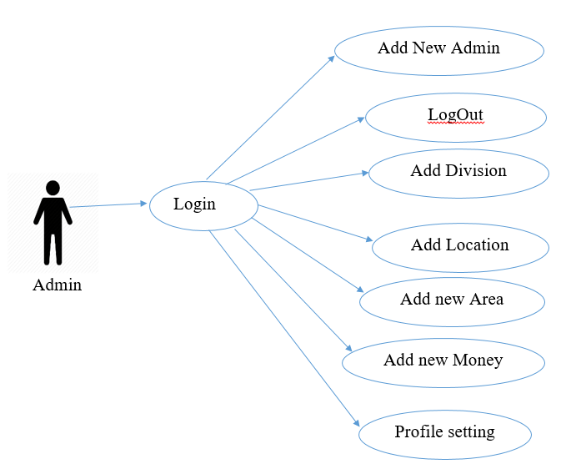
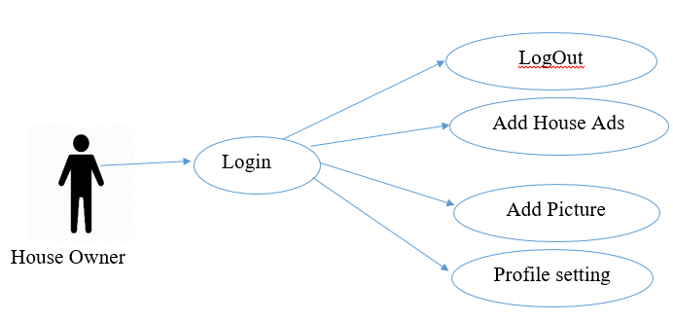
Use Case(UML) Diagram

Slide 8
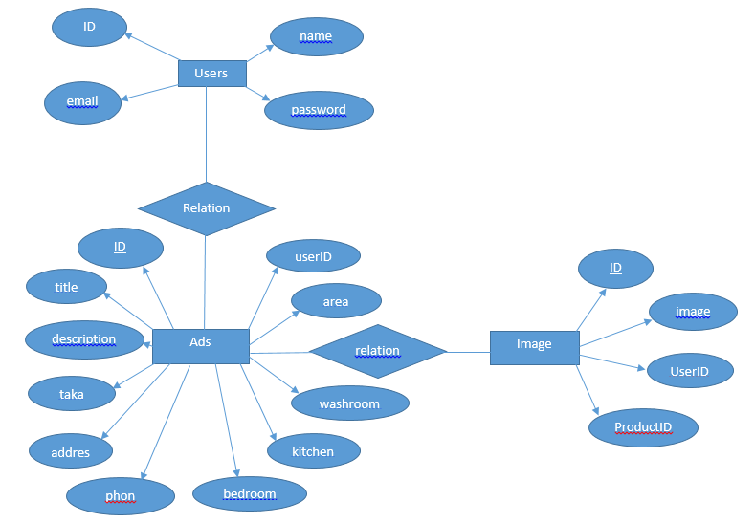
Relational Database(ER Diagram)

Slide 9
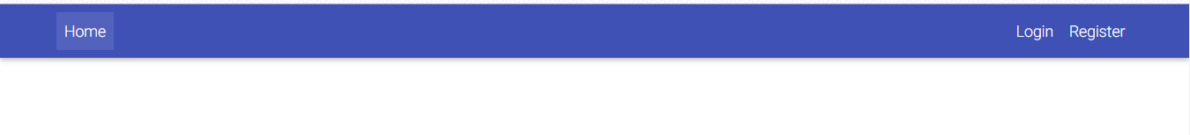
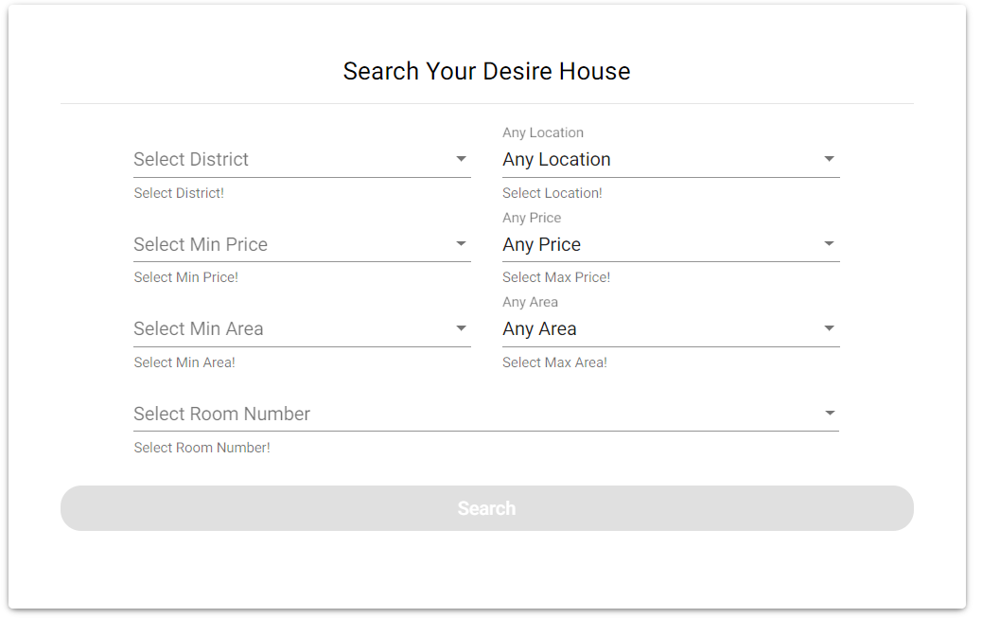
User Interface( House Renter )

Slide 10
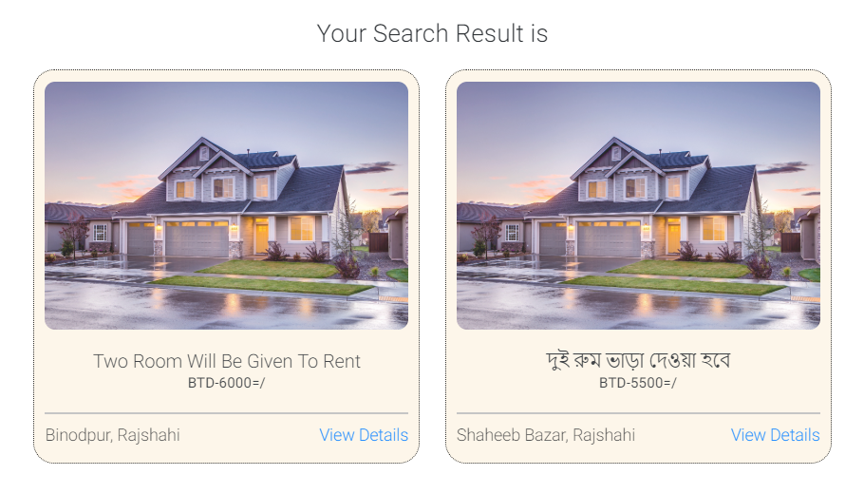
User Interface( House Renter )

Slide 11
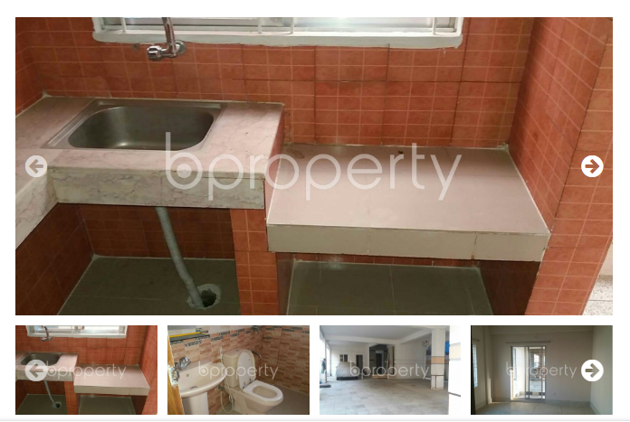
User Interface( House Renter )
Image Gallery without Zoom in:

Slide 12
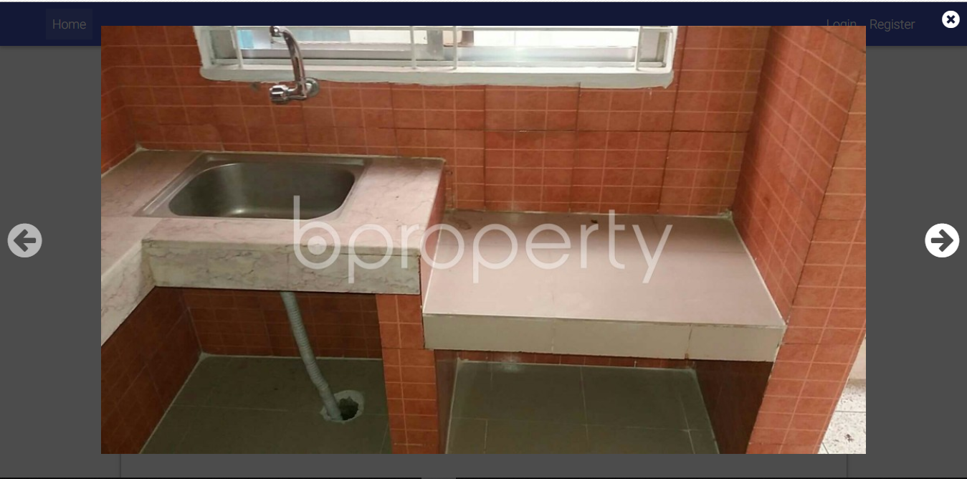
User Interface( House Renter )
Image Gallery with zoom in:

Slide 13
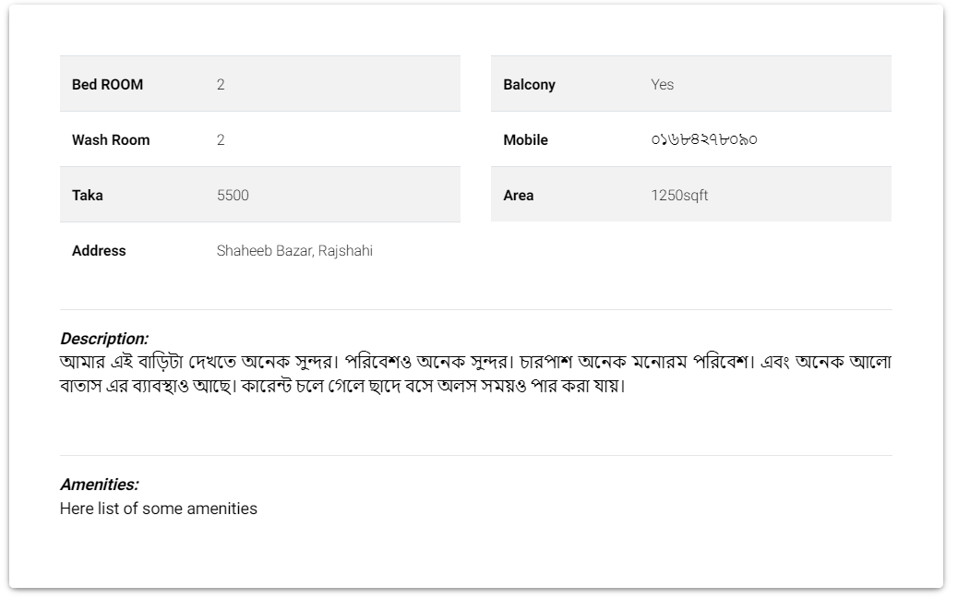
User Interface( House Renter )
Details about Ads:

Slide 14
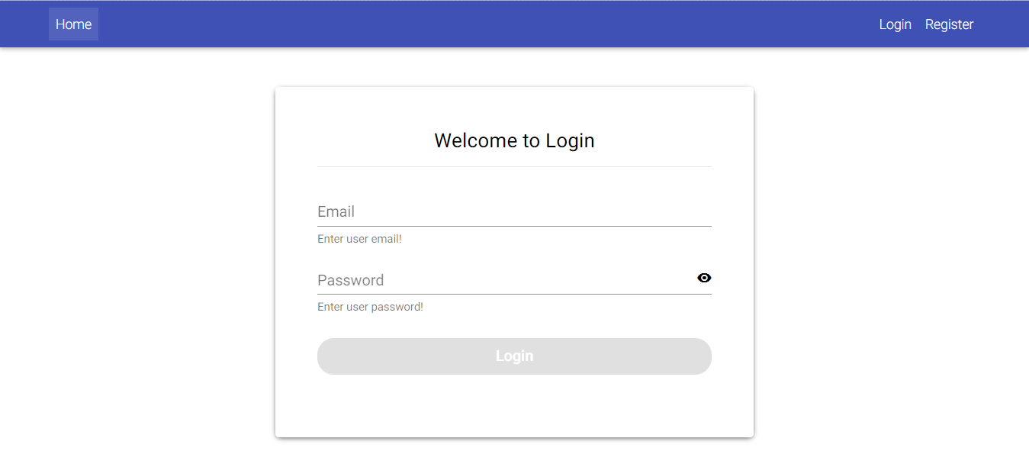
User Interface ( House Owner )

Slide 15
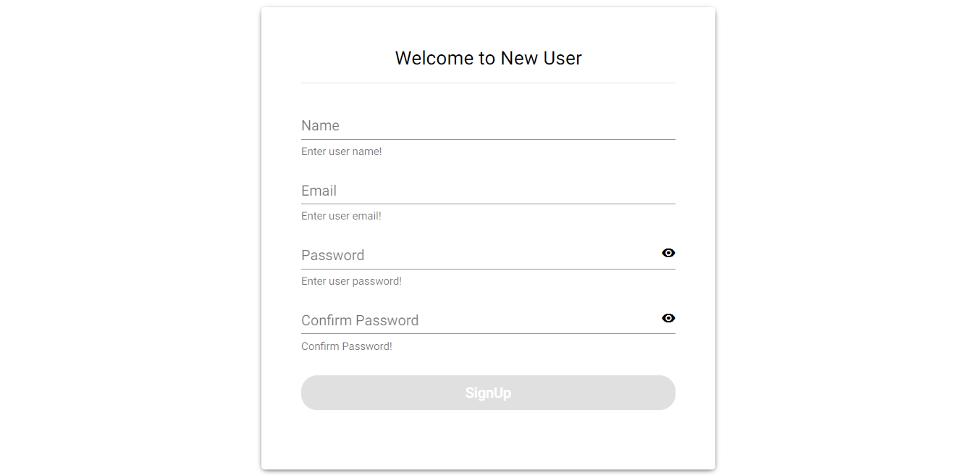
User Interface ( House Owner )

Slide 16
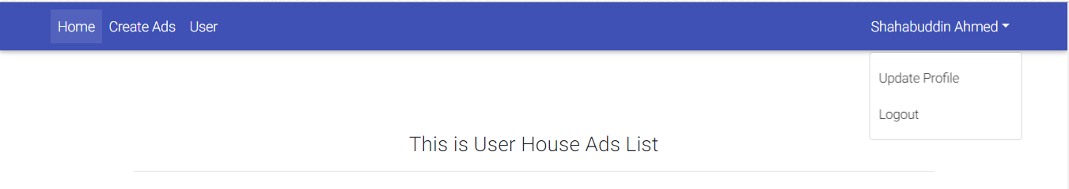
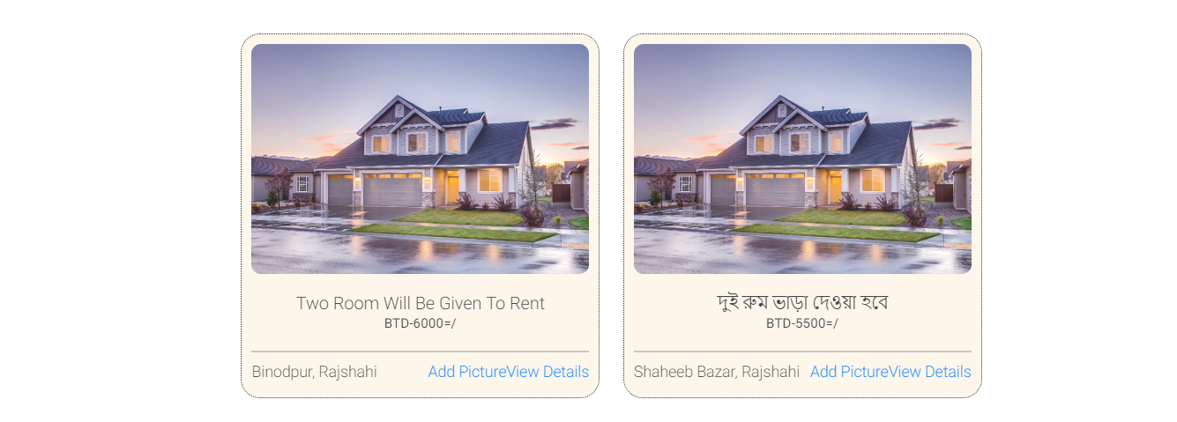
User Interface ( House Owner )

Slide 17
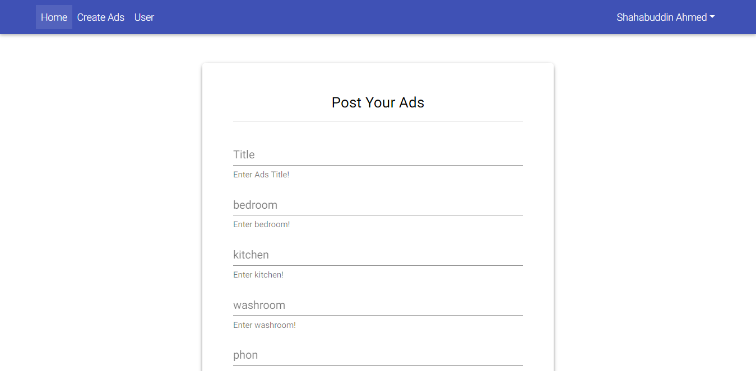
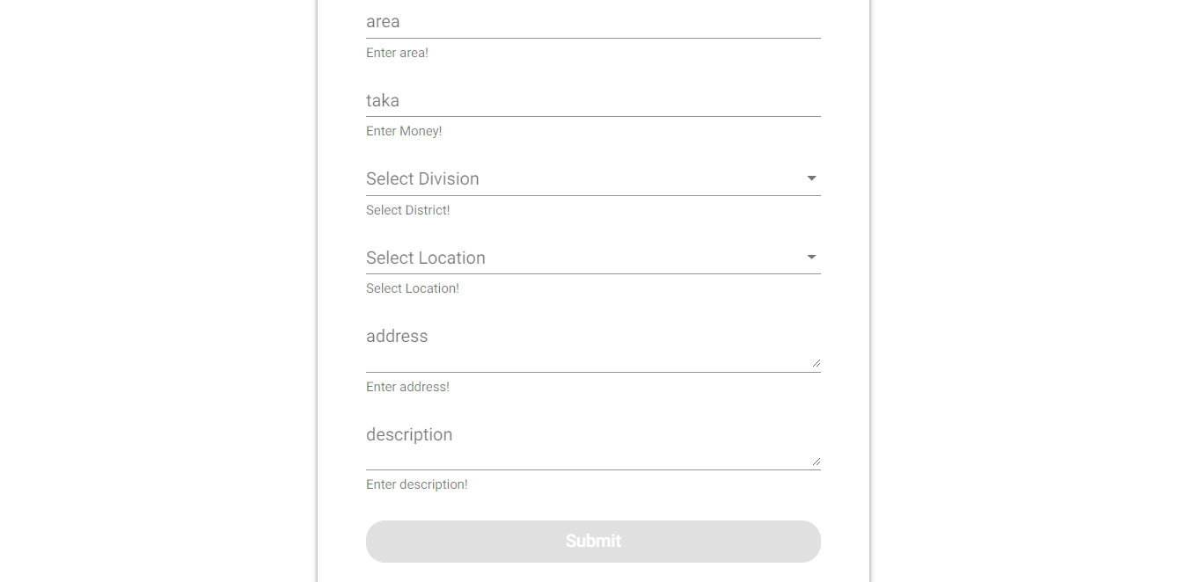
User Interface ( House Owner )

Slide 18
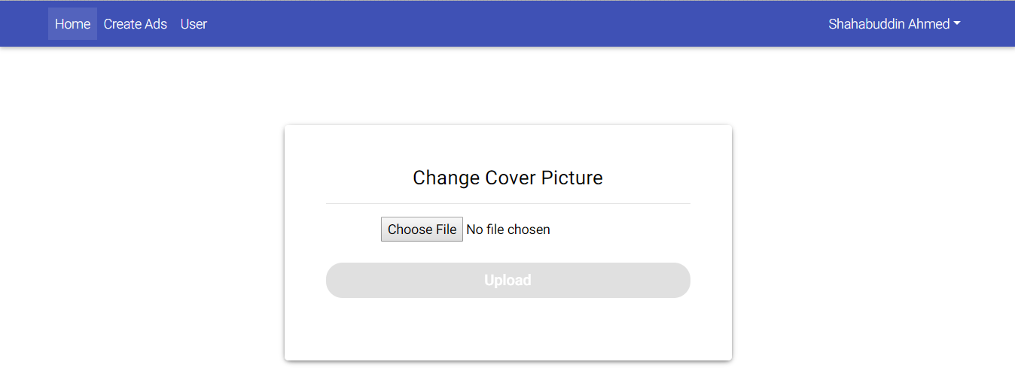

User Interface ( House Owner )

Slide 19
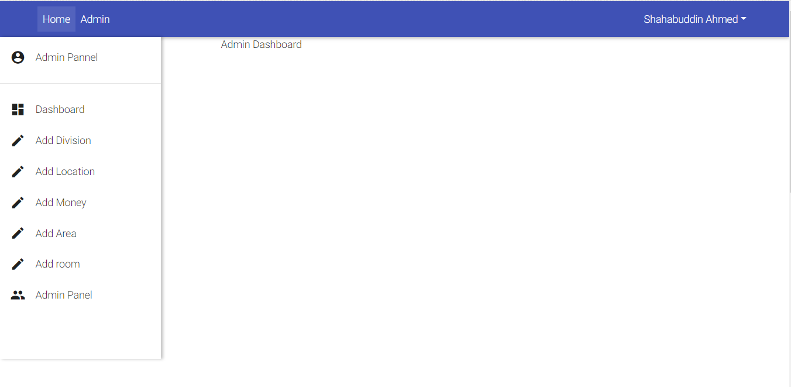
User Interface( Admin )

Slide 20
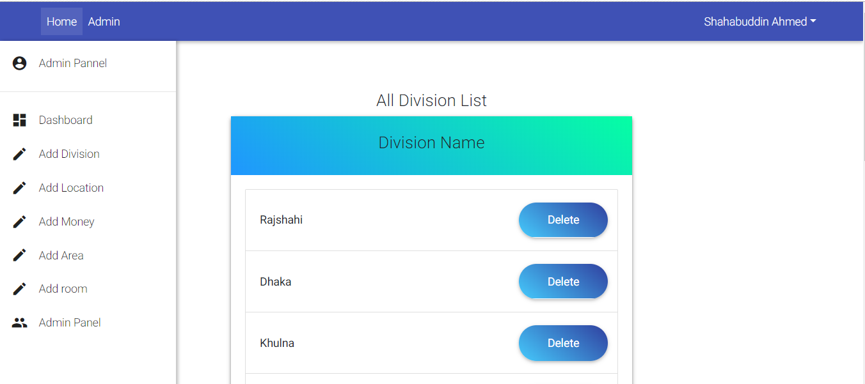
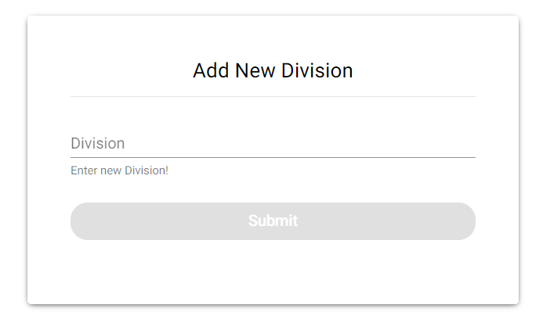
User Interface( Admin )

Slide 21
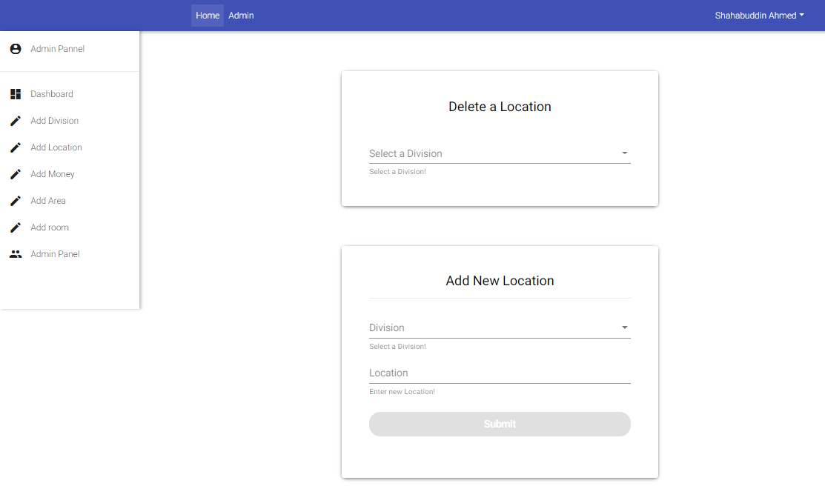
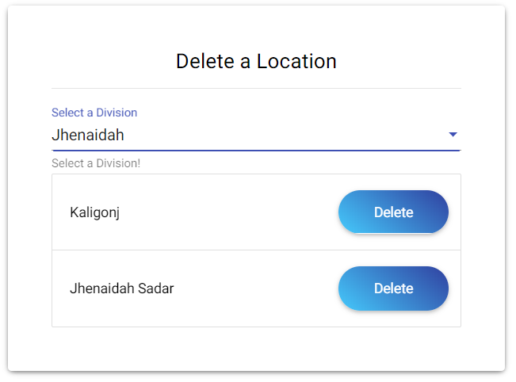
User Interface( Admin )

Slide 22
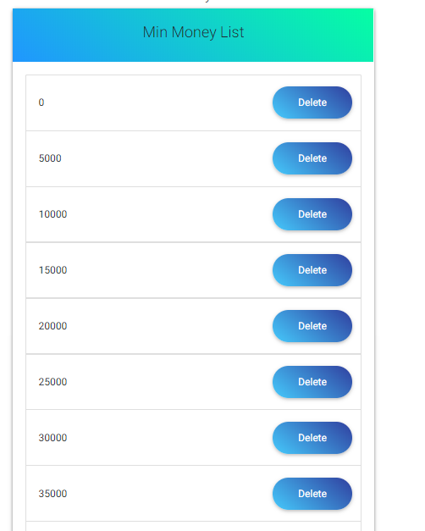
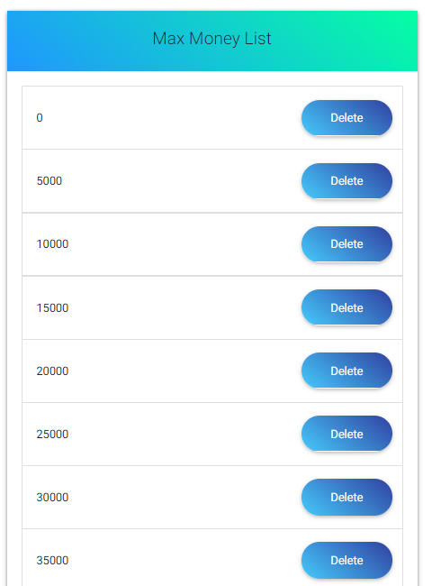
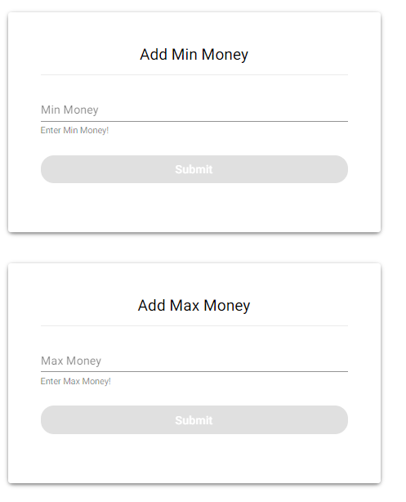
User Interface( Admin )

Slide 23
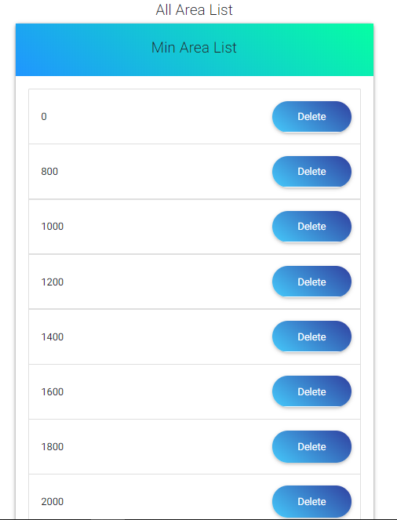
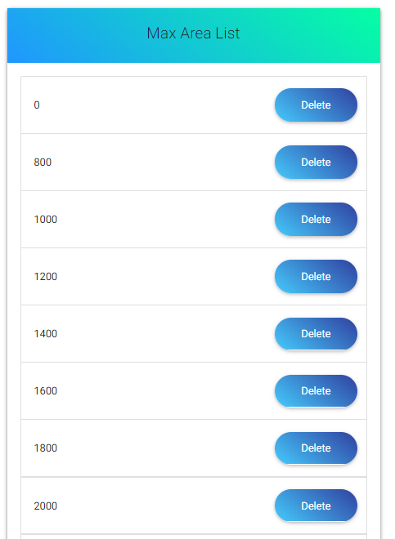
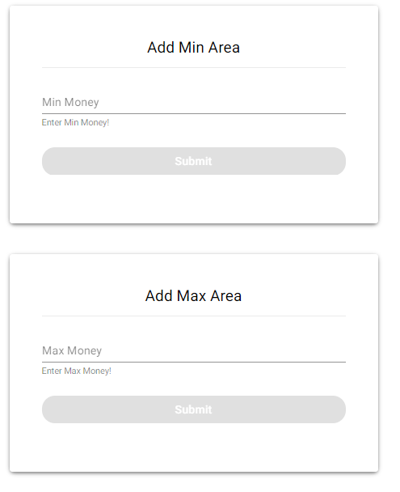
User Interface( Admin )

Slide 24
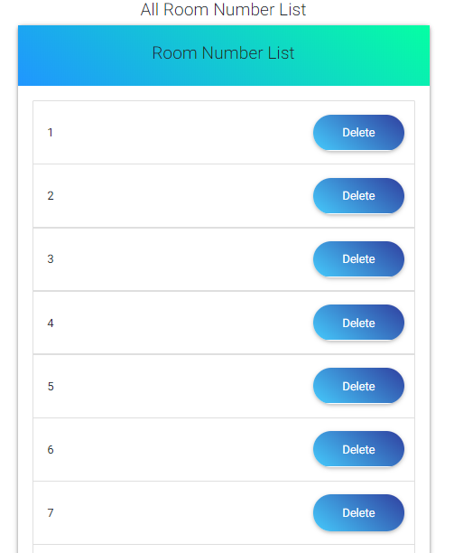
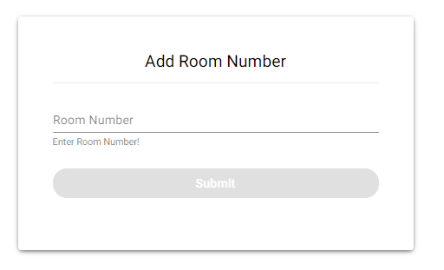
User Interface( Admin )

Slide 25
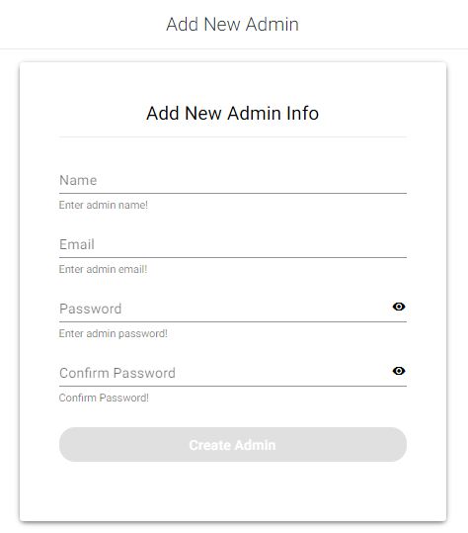
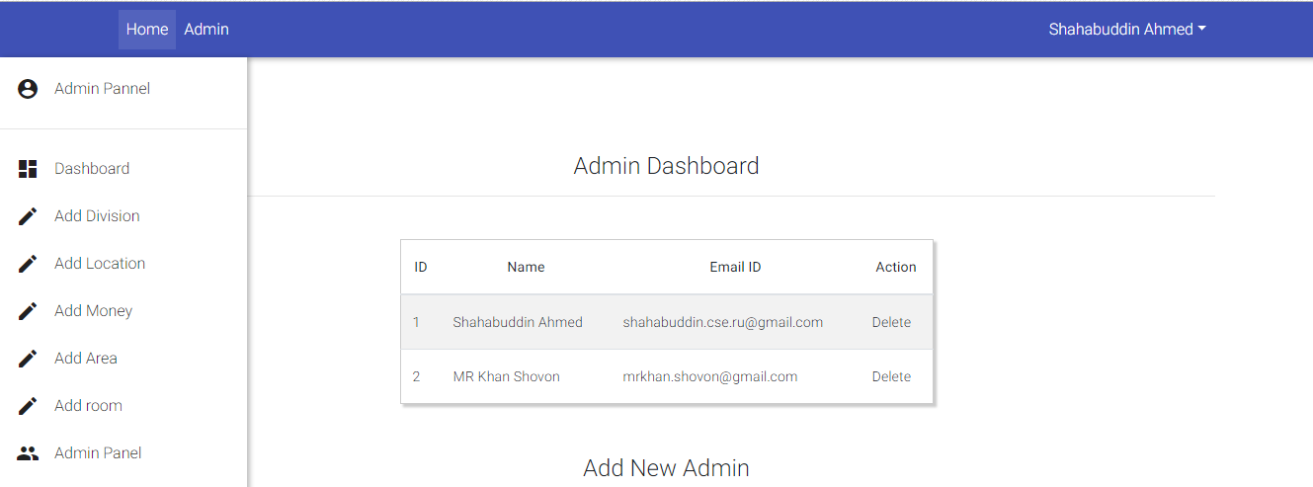
User Interface( Admin )

Slide 26
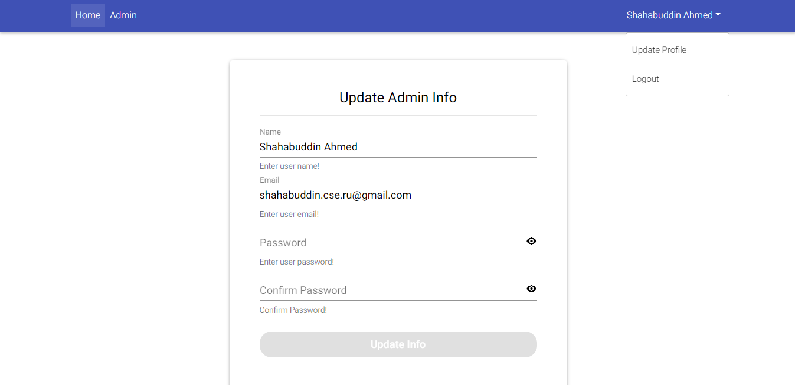
User Interface( Admin )

Slide 27
Expected Outcome
Complete business Platform.
It is reduce time and cost for both renter and advertiser.
It is help to hurry up to find a house for rent.

Slide 28
Thank You

