Slide 1


JAWWY TV · DATA STORY
Jawwy TV Viewership Data Analysis
A million viewing records reveal how users engage — and where the platform can grow
stc Data Analyst Virtual Experience · in partnership with the Misk Foundation

Slide 2
01 · CONTEXT
JAWWY TV · DATA STORY
Three Datasets, One Analysis
Three datasets from the Jawwy TV platform (March 2017 – April 2018), each addressing a distinct analytical objective.
1
2
3
Task 1 — Detailed Interaction Data
Task 2 — Daily Time Series
Task 3 — Ratings Data
1,048,575 viewing records
13 columns including duration, HD quality, and genre
86 business days (Jan – Apr 2018)
Total watch hours per day
1,048,575 records · 11,578 active users
8,013 titles across 16 genres
GOAL
GOAL
GOAL
Understand viewing behavior and playback quality
Forecast future demand
Build a content recommendation engine
All figures presented below are derived directly from these three datasets.
2 / 10

Slide 3
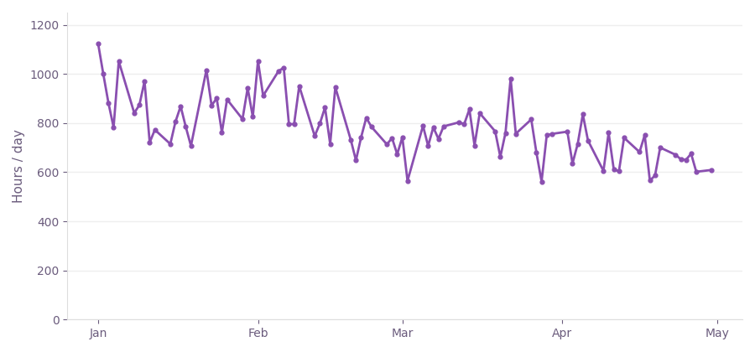
02 · THE PROBLEM
JAWWY TV · DATA STORY
Daily Watch Hours Show a Sustained Decline
A sustained decline in daily watch hours signals broader user disengagement — total daily watch hours across 86 business days, Jan–Apr 2018.
883 hrs/day
January average
first 30 days of the dataset
696 hrs/day
April average
last 30 days of the dataset
− 21%
decline over 4 months
January average vs. April average
Source: daily watch-hours dataset, 86 business days.
3 / 10

Slide 4
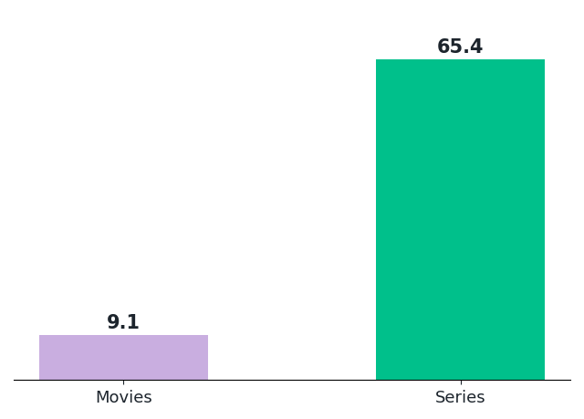
03 · THE FINDINGS — 1 OF 3
JAWWY TV · DATA STORY
Series Drive Far More Engagement Than Movies
Series attract roughly one-third the viewership of movies, yet each series viewer generates substantially higher watch time.
Average Watch Hours per User
3,901
users watched series content
vs. 11,355 users for movies
255,098
total watch hours for series
vs. 103,444 hours for movies
7.2×
more watch time per user
65.4 hrs vs. 9.1 hrs for movies
Episodic content generates substantially higher watch time per user than movies.
4 / 10

Slide 5
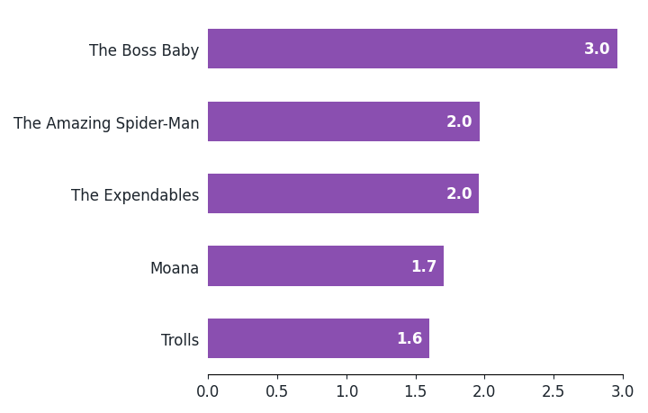
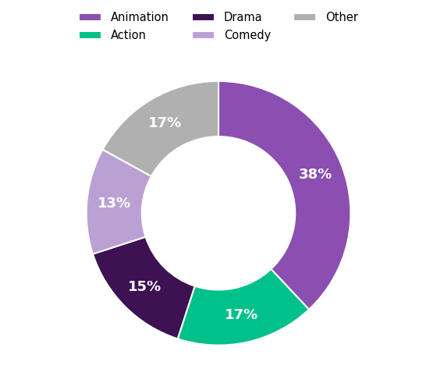
03 · THE FINDINGS — 2 OF 3
JAWWY TV · DATA STORY
Top Movies Skew Toward Family and Animation
Which titles and genres capture the most viewing time.
Top Five Most-Watched Movies (Thousand Hours)
Viewing Records by Genre
The Boss Baby and Moana top the most-watched list; animation accounts for 38% of all viewing records.
5 / 10

Slide 6
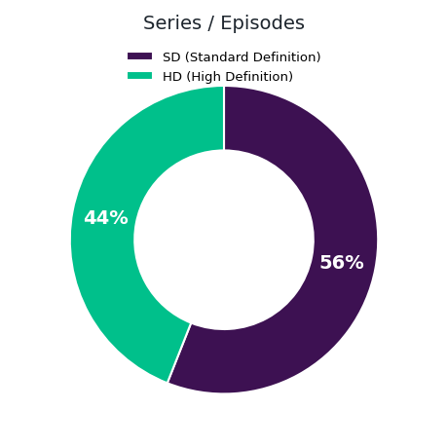
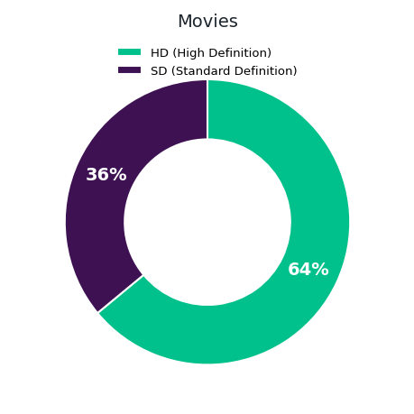
03 · THE FINDINGS — 3 OF 3
JAWWY TV · DATA STORY
The Playback Quality Gap
Share of viewers watching in high definition (HD) versus standard definition (SD), by program type.
Series lean toward standard definition far more than movies — likely a bandwidth-saving pattern during long viewing sessions.
6 / 10

Slide 7
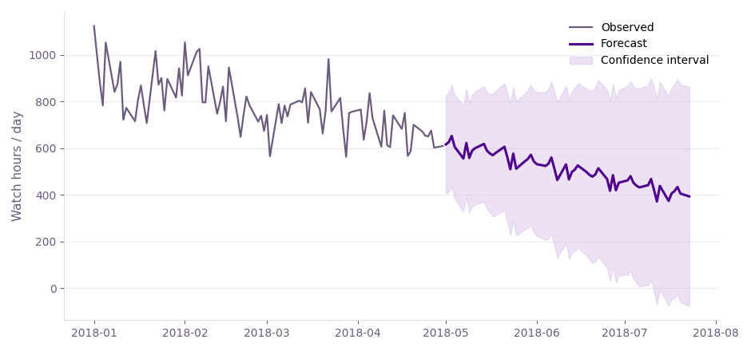
04 · THE SOLUTION — TOOL 1
JAWWY TV · DATA STORY
Forecasting Future Demand
An 86-day time series feeds a seasonal SARIMA model that forecasts demand two months ahead.
Time Series Decomposition
Separates the underlying trend from seasonal variation and random noise
Evaluation of 64 SARIMA Configurations
Grid search across candidate (p,d,q) × (P,D,Q,12) parameters, evaluated using AIC
Selected Model: SARIMA(0,1,1) × (0,1,1,12)
AIC = 909.6, the lowest score in the search
60-Day Forecast Horizon
Provides a confidence interval to support infrastructure and marketing planning
Business value: Enables the team to prepare infrastructure and schedule new releases ahead of anticipated demand peaks.
7 / 10

Slide 8
04 · THE SOLUTION — TOOL 2
JAWWY TV · DATA STORY
A Content Recommendation Engine
Built using collaborative filtering (K-Nearest Neighbors, cosine similarity) on 11,578 users' ratings.
Top 5 Recommendations
EXAMPLE
1
Trolls
A user who watched
Moana
2
Surf's Up: WaveMania
3
The Mermaid Princess
Family / Animation
4
The Boss Baby
The model identifies similar titles automatically, without manually defined rules, by learning directly from the viewing behavior of users with similar preferences.
5
The Jetsons & WWE: Robo-WrestleMania!
Recommendations are ranked by similarity score, reflecting how closely each title aligns with the viewing patterns of Moana's audience.
These results are consistent with genre classifications, confirming the model's readiness for a home-screen "Recommended for You" feature.
8 / 10

Slide 9
04 · THE SOLUTION — ACTION PLAN
JAWWY TV · DATA STORY
Recommended Actions
Five recommended actions that translate these findings into product decisions.
1
Deploy the Recommendation Engine — Launch the validated model as a “Recommended for You” row on the home screen.
2
Operationalize the Forecast Model — Feed SARIMA output into infrastructure and content-release planning.
3
Expand Family & Animation Placement — Animation accounts for 38% of viewing; allocate a dedicated home-screen section to this content category.
4
Investigate the HD Quality Gap in Series — Determine the underlying cause of the higher standard-definition playback rate observed in series content.
5
Prioritize Series in New Content Investment — Series generate 7.2× the per-user watch time of movies.
9 / 10

Slide 10
Thank You
Prepared for the stc Data Analyst Virtual Experience, in partnership with the Misk Foundation.

