Slide 1


Jawwy TV Viewership Data Analysis
A million viewing records reveal how users engage — and where the platform can grow.
stc Data Analyst Virtual Experience — in partnership with the Misk Foundation
Notes:
Set up the brief: one million viewing records from Jawwy TV, three datasets, two deliverables.

Slide 2

01 · CONTEXT
Three Datasets, One Analysis
Three datasets from the Jawwy TV platform, covering March 2017 – April 2018, each addressing a distinct analytical objective.
TASK 1
TASK 2
TASK 3
Detailed Interaction Data
Daily Time Series
Ratings Data
1,048,575 viewing records
86 business days (Jan – Apr 2018)
1,048,575 records · 11,578 active users
13 columns including duration, HD quality, and genre
Total watch hours per day
8,013 titles across 16 genres
GOAL
GOAL
GOAL
Understand viewing behaviour and playback quality
Forecast future demand
Build a content recommendation engine
All figures in this deck are derived directly from these three datasets.
2 / 12
Notes:
Three datasets, three questions: behaviour, demand, and recommendations.

Slide 3
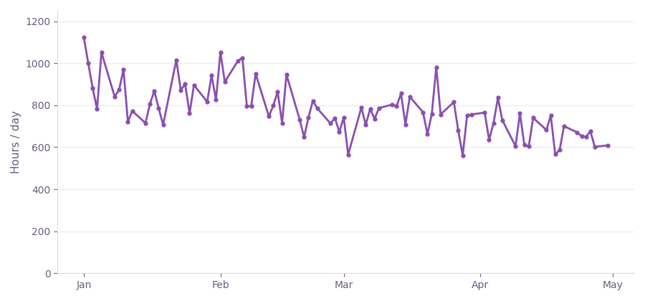
02 · THE PROBLEM
Daily Watch Hours Show a Sustained Decline
Total daily watch hours across 86 business days, January – April 2018.
883 hrs/day
January average
first 30 days of the dataset
696 hrs/day
April average
last 30 days of the dataset
−21%
decline over four months
Source: daily watch-hours dataset, 86 business days.
3 / 12
Notes:
The problem: demand fell 21% across four months of business days.

Slide 4
03 · THE FINDINGS — 1 OF 4
Series Drive Far More Engagement Than Movies
Series attract roughly one-third the viewership of movies, yet each series viewer generates substantially higher watch time.
AVERAGE WATCH HOURS PER USER
3,901
65.4
users watched series content
vs. 11,355 users for movies
255,098
total watch hours for series
vs. 103,444 hours for movies
9.1
7.2×
more watch time per user
Movies
Series
Episodic content generates substantially higher watch time per user than movies.
4 / 12
Notes:
Fewer series viewers, far more watch time each: 7.2x per user.

Slide 5
03 · THE FINDINGS — 2 OF 4
Top Movies Skew Toward Family and Animation
The five most-watched movies, in thousand hours of viewing time.
The Boss Baby
3.0
The Amazing Spider-Man
2.0
The Expendables
2.0
Moana
1.7
Trolls
1.6
The Boss Baby and Moana lead the ranking.
5 / 12
Notes:
Family and animation titles lead the ranking.

Slide 6
03 · THE FINDINGS — 3 OF 4
Animation Drives Most of the Viewing
Share of all viewing records by genre.
Animation
38%
Action
17%
Drama
15%
Comedy
13%
Other genres
17%
Animation accounts for 38% of all viewing records.
6 / 12
Notes:
Animation alone drives 38% of all viewing records.

Slide 7
03 · THE FINDINGS — 4 OF 4
The Playback Quality Gap
Share of viewers watching in high definition (HD) versus standard definition (SD), by program type.
Series / Episodes
Movies
WHAT IT SUGGESTS
Series lean toward standard definition far more than movies — likely a bandwidth-saving pattern during long viewing sessions.
44%
64%
HD
HD
56% standard definition
36% standard definition
Quality mix measured across all viewing records in the interaction dataset.
7 / 12
Notes:
Series skew to SD, movies to HD — likely bandwidth saving on long sessions.

Slide 8
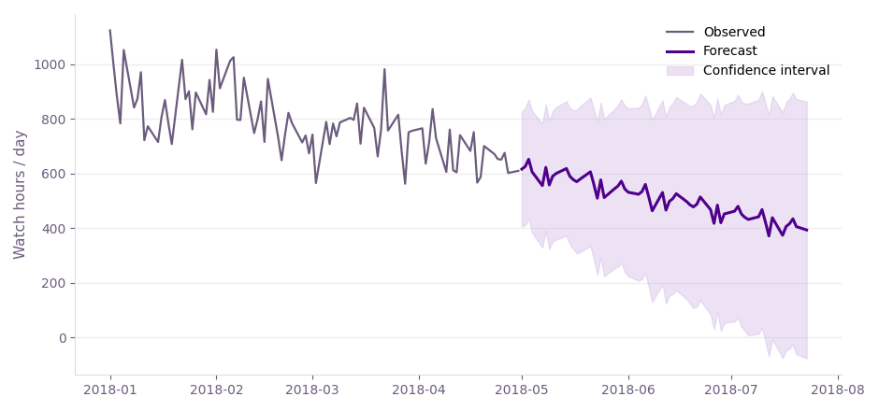
04 · THE SOLUTION — TOOL 1
Forecasting Future Demand
A seasonal SARIMA model projects daily watch hours two months beyond the dataset.
60-day horizon with a confidence interval for planning.
8 / 12
Notes:
SARIMA forecast, 60 days ahead.

Slide 9
04 · THE SOLUTION — TOOL 1
How the Model Was Built
From decomposition to a single AIC-selected configuration.
Time series decomposition
64 SARIMA configurations
Separates trend from seasonal variation and noise
Grid search across (p,d,q) × (P,D,Q,12), evaluated by AIC
Selected: SARIMA(0,1,1) × (0,1,1,12)
60-day forecast horizon
AIC = 909.6, among the lowest scores in the search
Confidence interval supports infrastructure and marketing planning
Business value: plan infrastructure and releases ahead of demand peaks.
9 / 12
Notes:
Grid search over 64 configurations; AIC-selected model.

Slide 10
04 · THE SOLUTION — TOOL 2
A Content Recommendation Engine
Collaborative filtering (K-Nearest Neighbors, cosine similarity) on the ratings of 11,578 users.
TOP 5 RECOMMENDATIONS
EXAMPLE
1
Trolls
A user who watched
Moana
2
Surf's Up: WaveMania
Family / Animation
3
The Mermaid Princess
4
The Boss Baby
The model identifies similar titles without manually defined rules, learning from the behaviour of users with similar preferences.
5
The Jetsons & WWE: Robo-WrestleMania!
Ranked by similarity score — how closely each title aligns with the viewing patterns of Moana's audience.
Results confirm readiness for a “Recommended for You” home-screen feature.
10 / 12
Notes:
KNN collaborative filtering on 11,578 users; walk through the Moana example.

Slide 11
04 · THE SOLUTION — ACTION PLAN
Recommended Actions
Five actions drawn directly from the findings above.
1
Deploy the recommendation engine
Launch the validated model as a “Recommended for You” row on the home screen.
2
Operationalize the forecast model
Feed SARIMA output into infrastructure and content-release planning.
3
Expand family & animation placement
Animation accounts for 38% of viewing; give it a dedicated home-screen section.
4
Investigate the HD gap in series
Determine the cause of the higher standard-definition playback rate in series.
5
Prioritize series in new investment
Series generate 7.2× the per-user watch time of movies.
Ordered by expected impact on engagement.
11 / 12
Notes:
Five actions: two deployments, two content moves, one investigation.

Slide 12
Thank You
Prepared for the stc Data Analyst Virtual Experience, in partnership with the Misk Foundation.
Notes:
Close and invite questions.

