Slide 1



Project senior 2
Project Title: smart learning “Advance Kasit”.
Supervised By Prof: Amjad Hudaib. & Prof. Ammar Alhunaity.
Fall Semester.
2021 - 2022.
# | Student name | Student ID
1- | Shahad Altamimi. | 0181212.
2- | Ammar Arab. | 0178071
3- | Huda Almanaseer. | 0178763
4- | Malak AL Khawaldh. | 0147015

Slide 2
Overview:
We all become superior a certain subject in university to the extent that we feel like we are very creative and intelligent while studying it, therefore, we as students see in ourselves the potentials and abilities to teach this subject to other students who are facing difficulties to understand it, we as information technology students should help those students by developing a web application that connects superior students and students who need additional help besides their instructors help.
We expect a high quality of service and support to the users of our project, and this is the main target we are hardly working to reach.
This documentation is an accurate and specific explanation about how we worked to build a good based platform to sustain user’s requests and replies.
This project is especially made for King Abdullah School of Information Technology, as well as its applicable at any other faculty and educational institutes, which runs on any browser.

Slide 3
Problem Statement
There is no existence for a specific online platform specialized only in sharing superior students’ expertise with other students.

Slide 4
Problem Motivation
We as students and web developers find this a very essential application that is required in our faculty, therefore this motivates us to apply our skills with passion.

Slide 5
Project Aim & Objectives
The aim of this system consider under the following notes:
Facilitating and accelerating the process of finding the qualified student who teaches a certain course.
Participate in the process of making our faculty a (smart faculty).
A chance for students with same interests to build relationships that maybe will lead them to cooperate in useful efforts in future.

Slide 6
Project Expected Output:
We expect from our system to provide a suitable online environment that correlates students, increase the communication among them, and increase the expertise for both volunteered and regular students through a web platform that allows students to sign up and create their profiles and fill them with their personal as well as educational information.

Slide 7
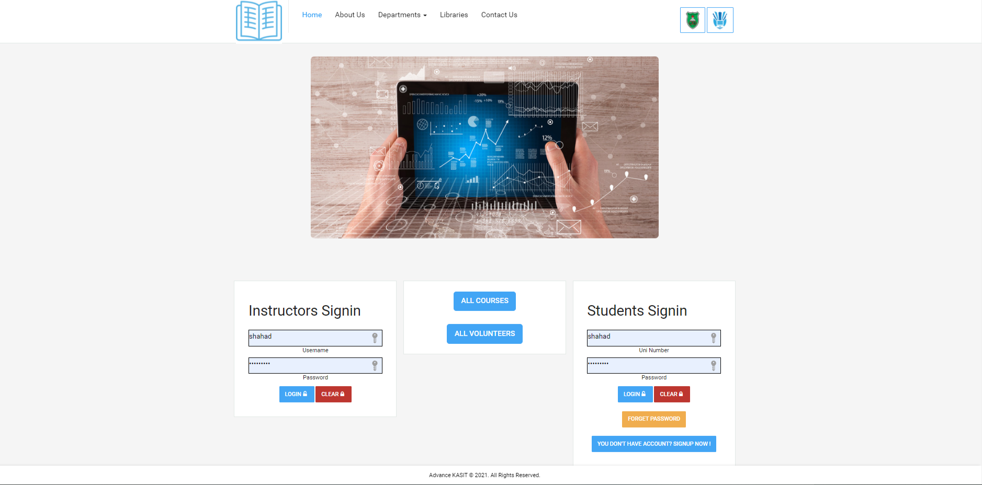
Main interface

Slide 8
Project Conclusion and Future Work
Introduction:
The aim of this system considers under the following notes:
Facilitating and accelerating the process of finding the qualified student who teaches a certain course.
Participate in the process of making our faculty a (smart faculty).
A chance for students with same interests to build relationships that maybe will lead them to cooperate in useful efforts in future.

Slide 9
Project Conclusion and Future Work
Overall Weaknesses:
We can’t be sure that the new volunteered students are qualified enough to teach a certain course due to reviews, as well as we may not find volunteered students for all courses.
Overall Strengths:
We expect from our system to provide a suitable online environment that correlates students, increase the communication among them, and increase the expertise for both volunteered and regular students through a web platform that allows students to sign up and create their profiles and fill them with their personal as well as educational information
Future Work:
As future work, our website portal could be transferred to Android and IOS mobile applications..
Summary:
In this chapter, we wrote weaknesses and strengths in order with the hope to reduce the weaknesses and focus on future work.

Slide 10
The end of the project
&
best regards

