Slide 1
Bank Customers Churn Classification

Slide 2
Background
The goal of this project is to use predictive analysis to classify customers of the bank who are
most likely to churn (close their bank account).
Early and accurate churn prediction empowers customer experience teams to be creative and
proactive in their engagement with the customer. In fact, by simply reaching out to the customer early enough, 11% of the churn can be avoided.

Slide 3
Dataset
The dataset contains the data of 10000 bank customers, some of them have closed their accounts (churned).
Sample size is 10000 customers data of a bank.
The dataset has 10000 rows and 14 columns.

Slide 4
Cleaning the data
Duplicates
NULL values
Incorrect values
Columns format

Slide 5
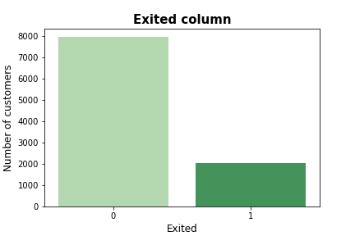
EDA
The bar chart shows class imbalance

Slide 6
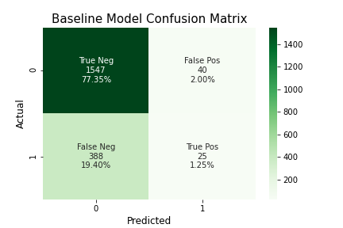
Baseline Model
This is the confusion matrix of the baseline
model, which was created using Logistic
Regression. The accuracy of the baseline
model is: 0.786, which is not bad. But the F1
score is 0.104, which is very low.

Slide 7
Solving class imbalance
Method | F1 Score using Logistic Regression
Oversampling | 0.455
SMOTE | 0.469
Undersampling | 0.453
Combining Undersampling and Oversampling | 0.456
The method that produce the best F1 score is Oversampling SMOTE.

Slide 8
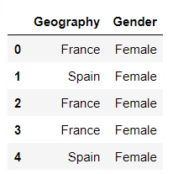
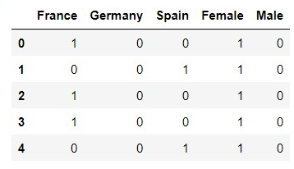
Feature Engineering
Created dummy variables for the categorical features

Slide 9
Experimenting with different Models
Model | F1 Score
Logistic Regression | 0.469
Decision Tree | 0.505
Random Forest | 0.603
XGBoost | 0.599
Stacking models Using Max Voting | 0.574
Stacking models Using Average Voting | 0.574
Stacking models Using Weighted Voting | 0.553
Stacking models Using Stacked Classifiers | 0.583
The best performing model is Random Forest with F1 score equal to 0.603

Slide 10
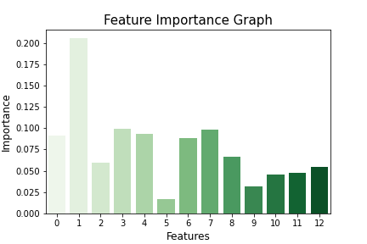
Feature Selection
Dropped the feature where the importance
was very low

Slide 11
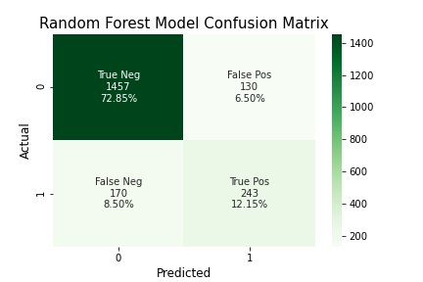
Final Result
After applying feature selection, the F1 score using Random Forest has increased from 0.603 to 0.618

Slide 12
THANK YOU

