Slide 1
Prediction of Airbnb stays prices

Slide 2
Background
Airbnb, Inc. is an American company that operates an online marketplace for lodging, primarily homestays for vacation rentals, and tourism activities. Based in San Francisco, California, the platform is accessible via website and mobile app.

Slide 3
Dataset
Sample size is 6 major cities (New York, Los Angeles, Chicago, San Diego, Houston, and Philadelphia) that are located in the United States.
The dataset has 1080 rows and 10 columns.

Slide 4
Cleaning the data
Duplicates
NULL values
Incorrect values
Changed the format of the columns

Slide 5
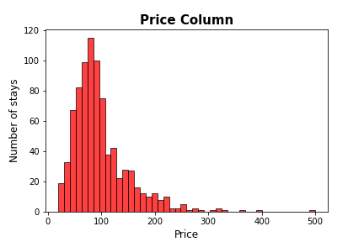
EDA
The data has some outliers, but they were kept as they had meaning.

Slide 6
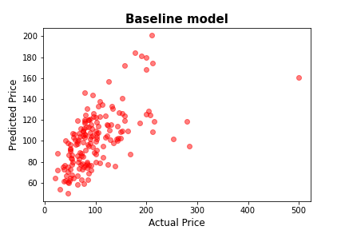
Baseline Model
The R2 score of training data is 0.2280, and for the validation data is 0.3327.
The model is not very accurate. Also, the R2 score of validation data is slightly higher than training data, which means that the model is not robust enough.

Slide 7
Feature Engineering
Created dummy variables
Used flag columns on ‘rating’ and ‘number of reviews’ columns

Slide 8
Models used
Model | Validation R2 Score
Linear Regression | 0.199
Linear Regression with log | 0.244
Polynomial degree 2 | 0.211
Ridge | 0.197

Slide 9
Thank You

