Slide 1

Analysis of Car crashes and Metro traffic in NYC

Slide 2
Background
The goal of this project is to work with New York Police Department to try to reduce the number of car accidents in New York City by finding how can metros impact the number of car accidents.
By finding the relation between the rate of car accidents and the traffic of the metro stations, we could help encourage more people to use the metro rather than using cars. Which will lower the rate of accidents and cut the costs and efforts of NYPD in handling the accidents.

Slide 3
Datasets
Datasets used:
MTA Dataset.
Car Collisions Dataset.
Scope:
The scope is 3 months (from May to July 2019) to find the relation between car accidents and metro traffic without the impact of covid-19.

Slide 4
Cleaning the data
MTA Dataset:
A lot of duplicates were found in the data due to what I assume, a problem with the turnstile that made it take a second reading of the entries as ‘Recover aud’. All the duplicates were removed.
There was no NULL values found in the dataset.
There were incorrect values in ‘ENTRIES’ column. When I found the number of entries per day, a large number of ‘ENTRIES’ values were negative numbers, which does not make sense. Those were corrected using the math function ‘abs’.
A lot of outliers were found in ‘ENTRIES’ column. Since my data did not have holidays other than 4th of July, the value of the outliers did not make sense, so they were removed.

Slide 5
Cleaning the data
Car Collisions Dataset:
No duplicate records were found in the dataset.
There was a lot of NULL values in ‘BOROUGH’ column. I had to either drop or change the value. I decided to change the value to ‘Unknown’, so when I calculate the number of crashes in a period of time regardless of the borough, these records will be included in the calculation.
no outliers were found in the dataset.

Slide 6
Data exploration
Does the number of metro entries affects he number of car crashes?
Does the 4th of July holiday affects the number of metro entries and car crashes?
Does the number of stations in each borough affects the number of car crashes in that borough?

Slide 7
Does the number of metro entries affect the number of car crashes?
To answer this question, I used two plots. One to show the number of entries of 4 stations located in Manhattan. The other is to show the number of car crashes in Manhattan at the same time period.

Slide 8
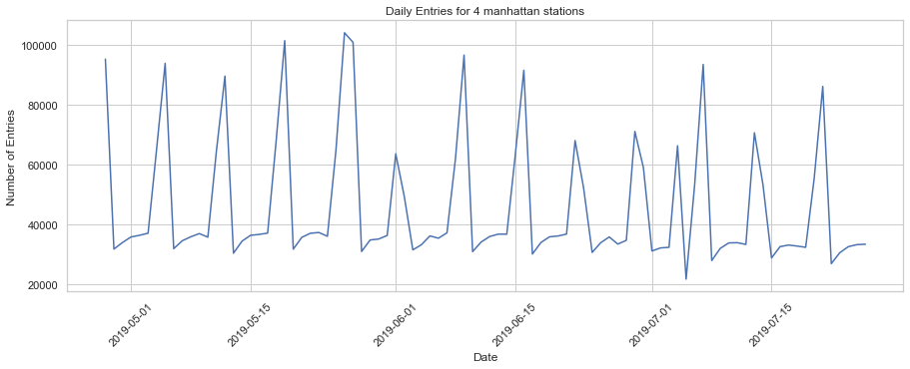
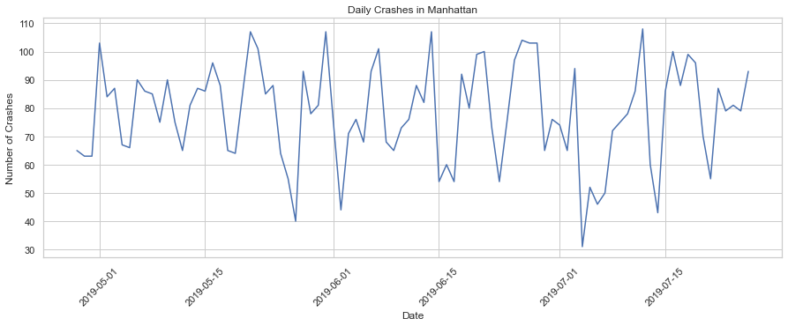
Does the number of metro entries affect the number of car crashes?
I noticed that the days where the number of entries rise, the number of car accidents is low.

Slide 9
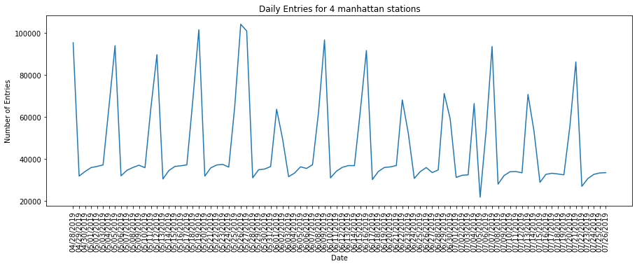
Does the 4th of July holiday affects the number of metro entries and car crashes?
By looking at ‘Daily Entries of 4 stations in Manhattan’ graph, I noticed that there was no major difference between the number of metro entries on fourth of July holiday and the days before and after it.

Slide 10
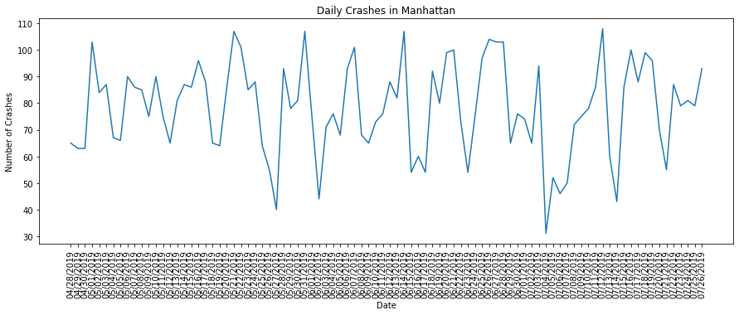
Does the 4th of July holiday affects the number of metro entries and car crashes?
However, by looking at ‘Daily Crashes in Manhattan’ graph, it is noticeable that the number of car crashes dropped that day.
Which leads me to the conclusion that the 4th of July holiday does not affect the traffic in the metro stations, but it does affect the number of car crashes.

Slide 11
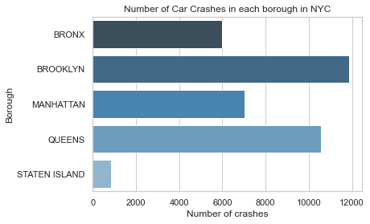
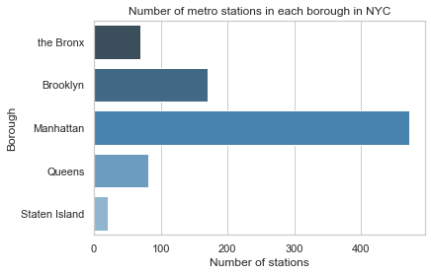
Does the number of stations in each borough affects the number of car crashes in that borough?
By looking at the two graphs, it appears that the number of stations in each borough may have an impact on the number of car crashes in that borough.

Slide 12
Conclusion
The number of metro entries affects he number of car crashes. When the number of metro station entries increase, the number of car accidents decrease.
The 4th of July holiday does not affect the traffic in the metro stations, but it does affect the number of car crashes.
If a borough has more metro stations, the number of car accidents in that borough decreases.

Slide 13
Thank You

