Slide 1
Credit EDA Case Study
By -: Shahad Riyaz Shaikh And
Vijayaragavan Seenivasan

Slide 2
CHECKING FOR OUTLIERS

Slide 3
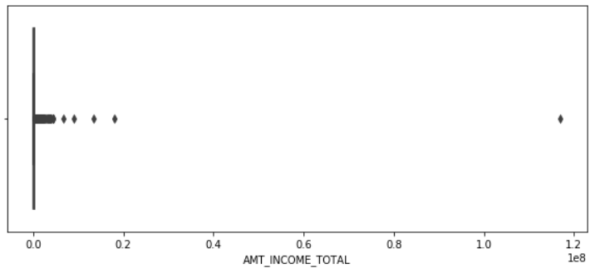
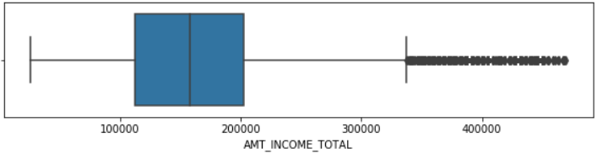
BOXPLOT FOR TOTAL INCOME AMOUNT
Before removing the outliers
Few points can be concluded from the graph -:
Before removing the outliers, we can see that there are few outliers and one of which is extremely far away from the rest.
Few points can be concluded from the graph.
The quartiles are not visible at all.
To remove the outliers, we have excluded values outside 99 percentile.
After removing the outliers, we can see that there the first quartile is smaller than the third quartile.
This means that most of the total income amount for the clients are present in the third quartile.
Few points can be concluded from the graph.
Few points can be concluded from the gr
After removing the outliers

Slide 4
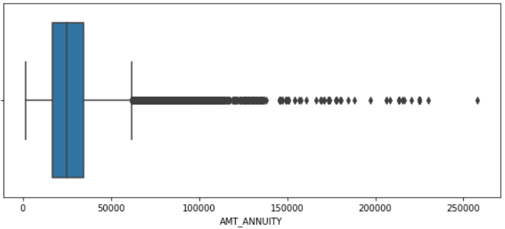
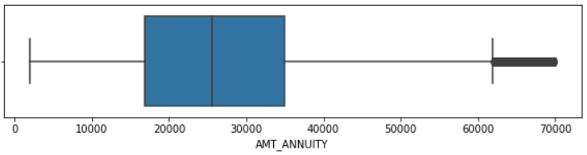
BOXPLOT FOR AMOUNT ANNUITY
Before removing the outliers
Few Points can be concluded from the graph -:
Before removing the outliers, we can see that there are few outliers far away from the quartiles.
To remove the outliers, we have excluded values outside 99 percentile.
After removing the outliers, we can see that the first quartile is smaller that the third quartile.
This means that most of the amount annuity for the clients are present in the third quartile.
After removing the outliers

Slide 5
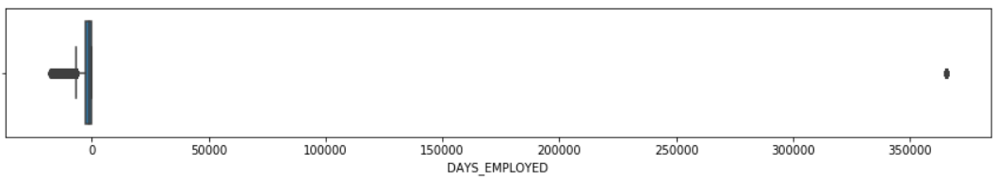
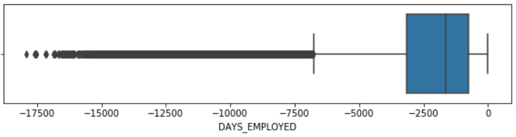
BOXPLOT FOR DAYS EMPLOYEED
Before removing the outliers
Few points can be concluded from the graph -:
Before removing the outliers, we can see that there only a single outlier which is very far away from the rest.
All the three quartiles are barely visible in the graph.
To remove the outliers, we have excluded values outside 99 percentile.
After removing the outliers, we can see that third quartile is smaller than the first quartile.
Which means that maximum number of the clients are present in the first quartile.
After removing the outliers

Slide 6
CHECKING FOR IMBALANCE

Slide 7
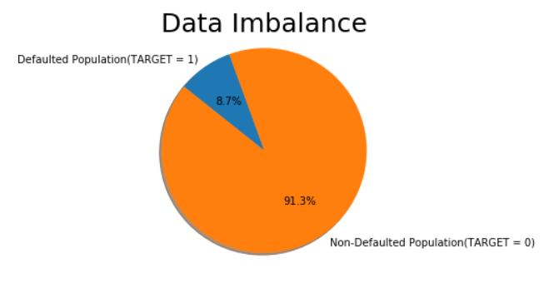
PIE GRAPH FOR DATA IMBALANCE
Few points can be concluded from the graph -:
The non-defaulted holds 91.3% of the total data imbalance in the graph.
The defaulted population holds 8.7% of the total data imbalance in the graph.
Which means that we can see that the Application data has high imbalance with Defaulted population at 8.7% as compared to Non-defaulted population at 91.3% Imbalance ratio is 11.4.

Slide 8
CATEGORICAL UNIVARIATE ANALYSIS FOR TRAGET 0 AND TRAGET 1

Slide 9
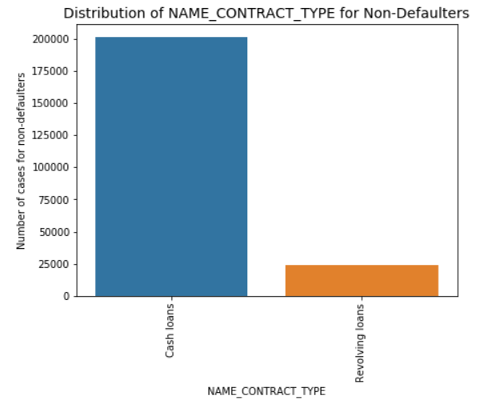
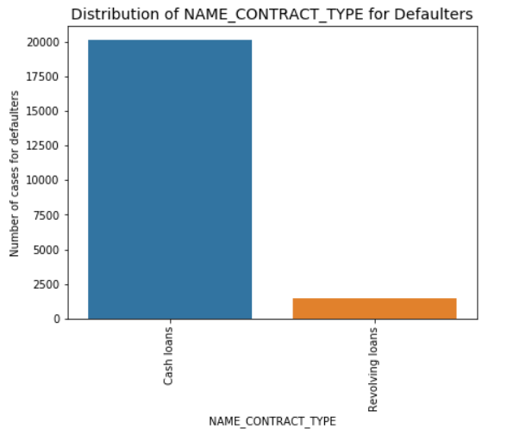
DISTRIBUTION OF CONTRACT TYPE
Few points can be concluded from the graph -:
We can notice from the graph that revolving loans are lesser in the defaulted population.
Hence, we can infer that revolving loans are comparatively safer than cash loans.
This may be attributed to the Nature of revolving loan as it is considered a flexible financing tool due to its repayment and re-borrowing flexibility.

Slide 10
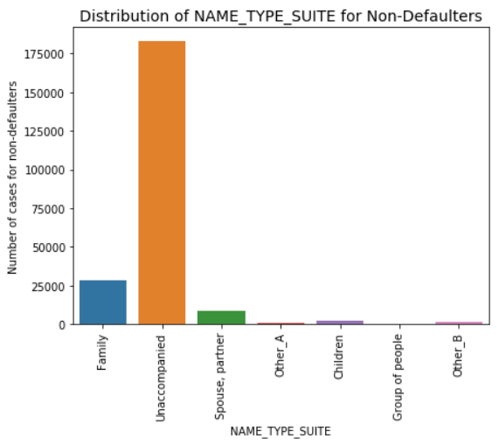
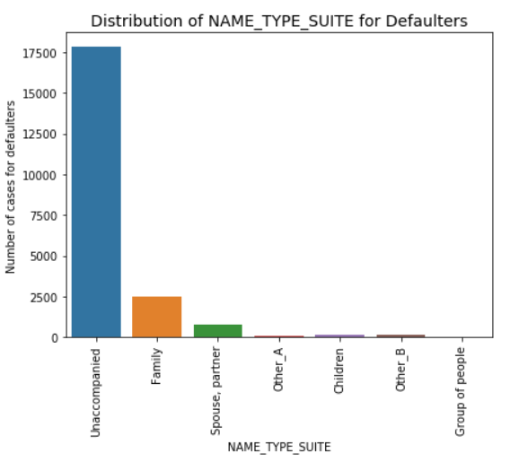
DISTRIBUTION OF SUITE TYPE
Few points can be concluded from the graph -:
We can notice from the graph that who was accompanying client when he was applying for the loan does not have any impact on the default.
We can say that both populations have same proportions.

Slide 11
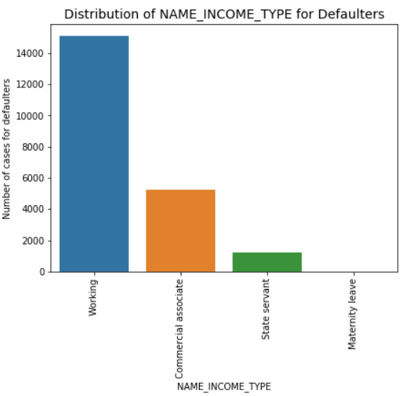
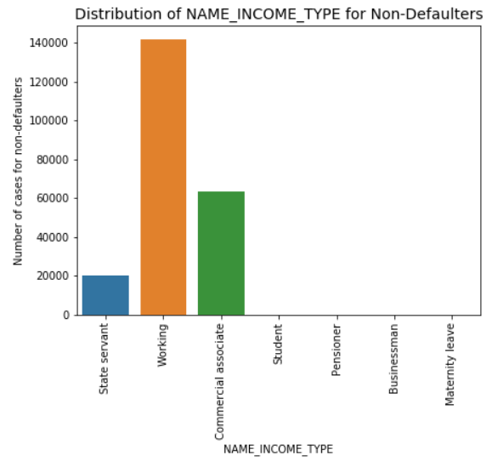
DISTRIBUTION OF INCOME TYPE
Few points can be concluded from the graph -:
We can notice from the graph that most of the defaults are from working population.
And the least of the defaults are from state servant population.

Slide 12
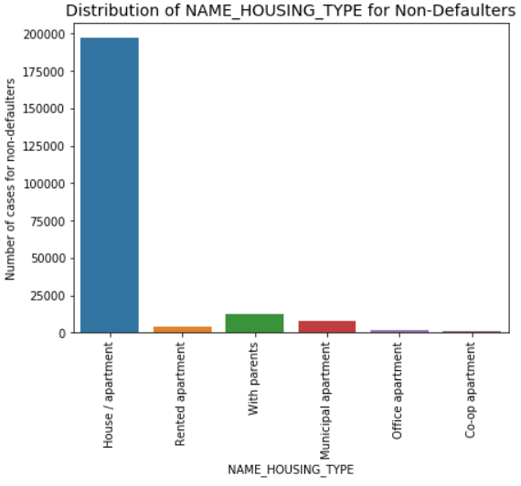
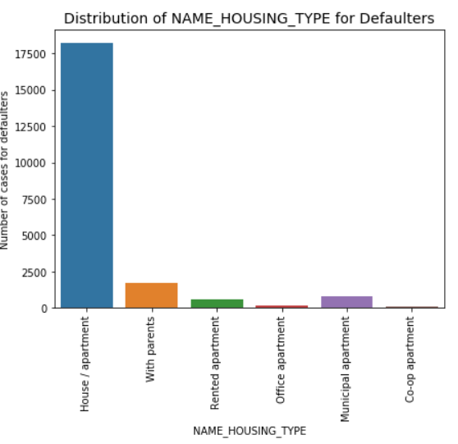
DISTRIBUTION OF HOUSING TYPE
Few points can be concluded from the graph -:
Population living in Rented apartments and those living with parents have higher default rate as they have higher proportion in the Defaulted population as compared to non defaulted population.
Living in rental apartment means a cash outflow towards rent and thus less cash left for repayment of loan.
Living with parents may suggest that the income is not too high and thus difficulty in repayment of loan.

Slide 13
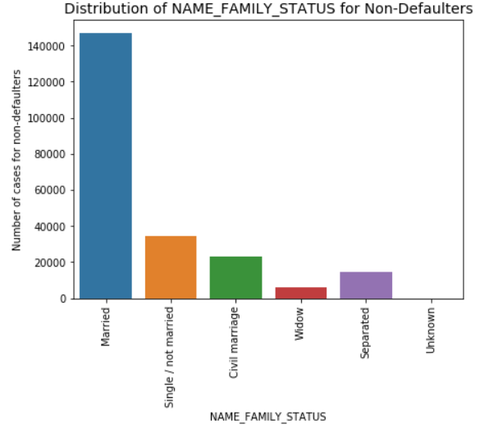
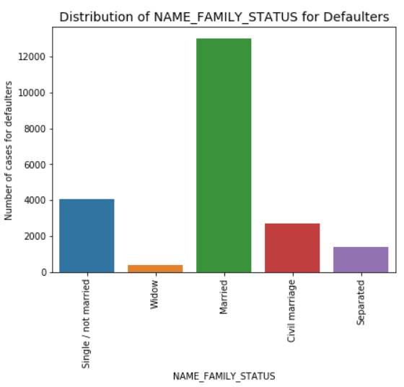
DISTRIBUTION OF FAMILY STATUS TYPE
Few points can be concluded from the graph -:
We can notice from the graph that the married population is higher in both defaulted population and non defaulted population.
We can say that this shows that Married applicants have higher defaults.

Slide 14
CATEGORICAL UNIVARIATE ANALYSIS
FOR TRAGET 0 AND TRAGET 1

Slide 15
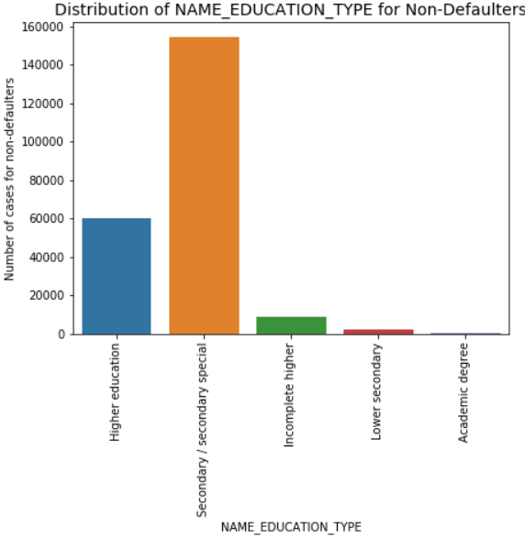
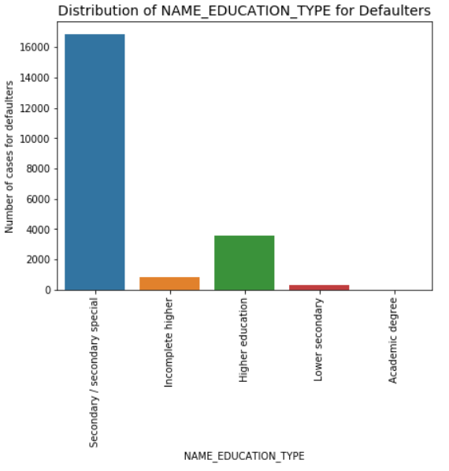
DISTRIBUTION OF EDUCATION TYPE
Few points can be concluded from the graph -:
Higher education count is proportionally lesser in defaulted population as compared to non defaulted population.
Hence, we can say that higher the education level, lower the default rate.
This is logical as higher degree category should be earning more and hence easier to pay off loan installments.

Slide 16
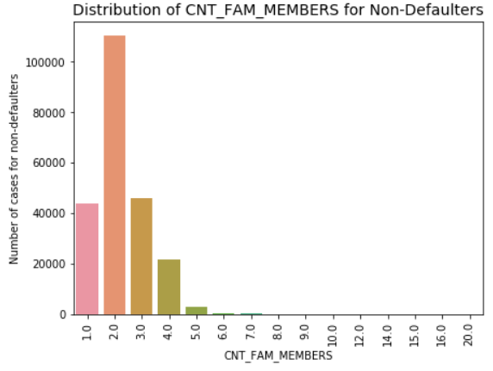
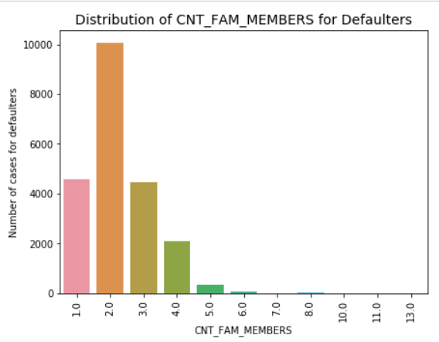
DISTRIBUTION OF FAMILY MEMBERS TYPE
Few points can be concluded from the graph -:
We can notice from the graph that the children count seem to have some impact on default rate.
As the proportion for higher count of children is more in defaulted population as compared to non defaulted.

Slide 17
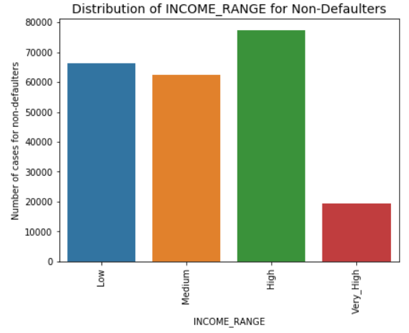
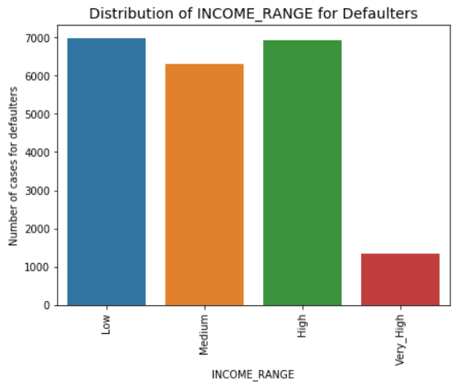
DISTRIBUTION OF INCOME RANGE TYPE
Few points can be concluded from the graph -:
We can notice from the graph that the low-income range has higher defaults as their proportion in defaulted population is higher than in the non defaulted population.
And the high-income range has lowest defaults as compared to others.

Slide 18
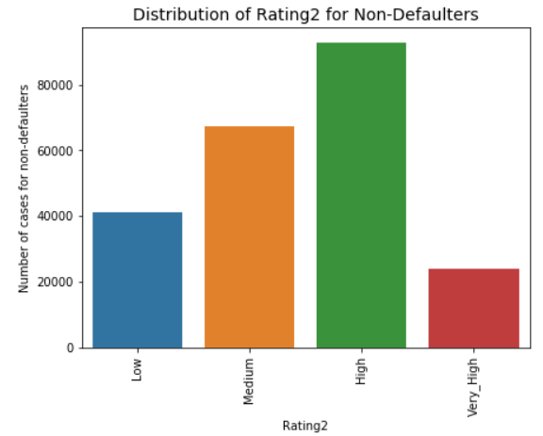
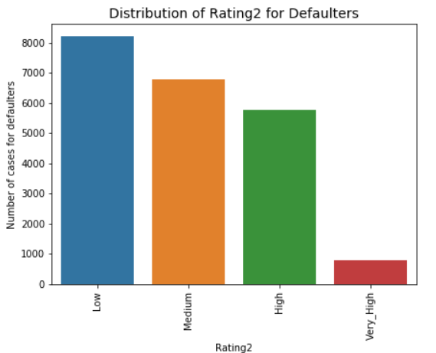
DISTRIBUTION OF RATING TYPE
By looking at the graph we can conclude here that people having low Rating tends to Default more.

Slide 19
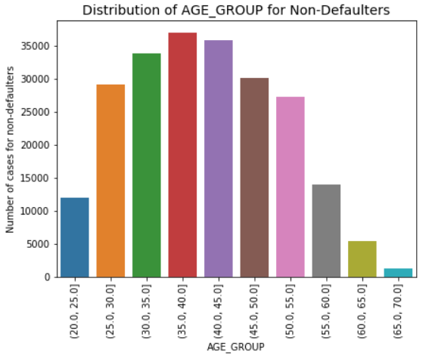
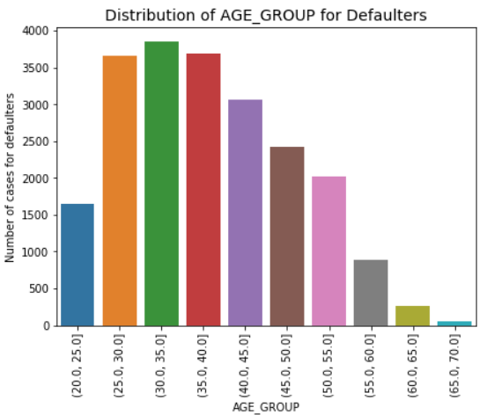
DISTRIBUTION OF AGE GROUP TYPE
Few points can be concluded from the graph -:
We can notice from the graph that people in age group 65 – 70 has comparatively lower number of defaults.
Also, people in the age group 30 - 35 tend to default more in defaulted population as compared to the non defaulted population.

Slide 20
BIVARIATE ANALYSIS FOR TRAGET 0 AND TRAGET 1

Slide 21
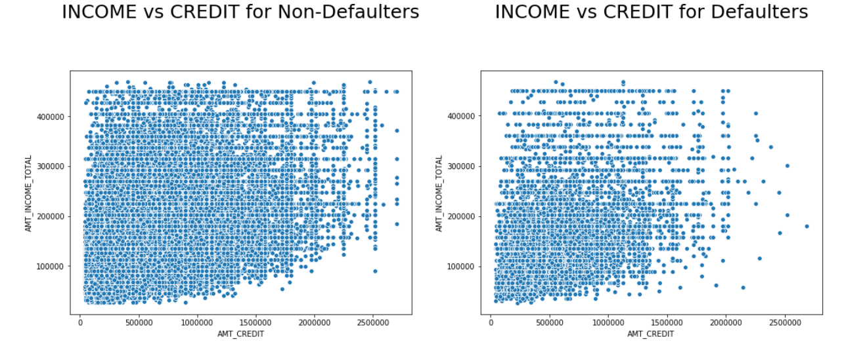
DISTRIBUTION OF INCOME VS CREDIT
Here, we notice in the graph that the lower density of defaults where income is higher than 300k or credit is lower than 200k

Slide 22
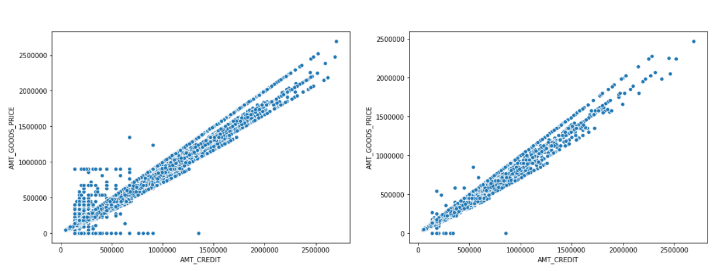
DISTRIBUTION OF CREDIT VS GOODS PRICE
Here, we notice from the graph that the number of defaulters are less if price of good is up to 500k and amount credit is also less than 500k.

Slide 23
ANALYSIS AFTER MERGING PREVIOUS DATA

Slide 24
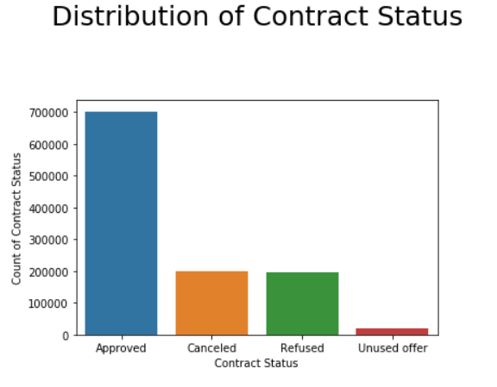
DISTRIBUTION OF CONTRACT STATUS
Few points can be concluded from the graph -:
Here we can see from the graph that the approved category in the contract status has the highest count as compared to the others.
And the lowest category is unused offer. However, both cancelled and refused category are approximately same.

Slide 25
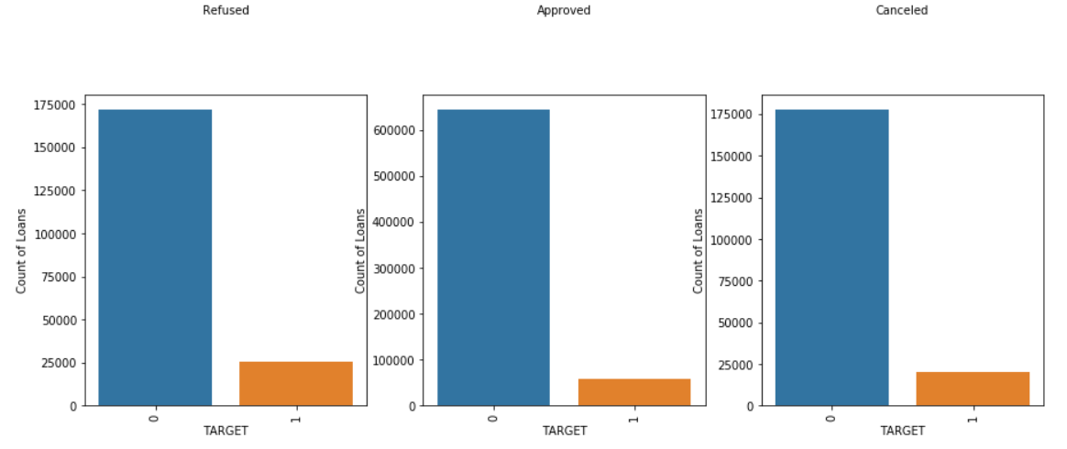
PREVIOUS DATA VS APPLICATION DATA
Here, we notice from the graph that the loans which were previously refused or cancelled have a higher default rate.

Slide 26
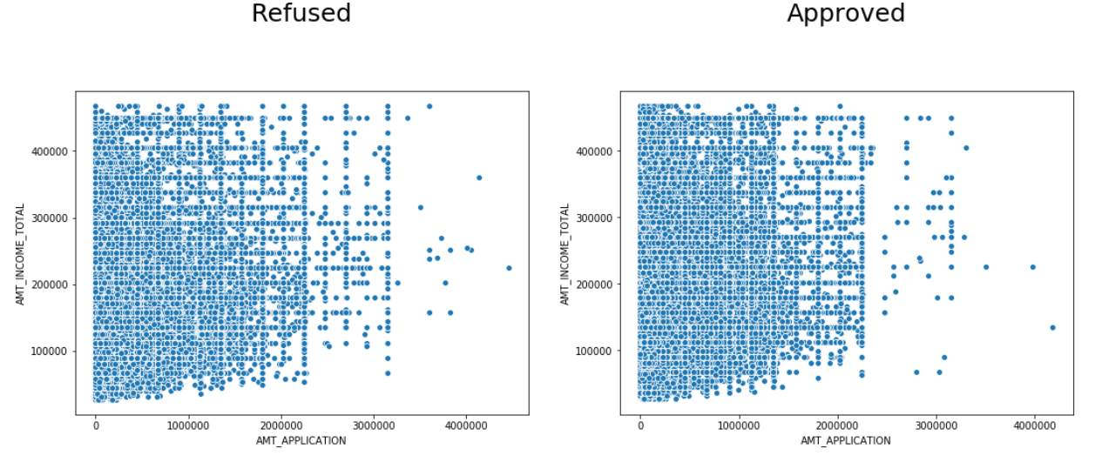
REFUSED VS APPROVED
Here, we can notice from the graph that the loan request higher than 200k had a higher rejection rate. Also, loan rejection rate was much lower if the income was higher than 500k

Slide 27
CONCLUSION
Banks should provide more revolving loans to the clients as they are flexible and comparatively much safer.
Banks should focus less on clients with income type ‘Working’ as they have the greatest number of defaults.
Banks should also focus less on clients from the housing type ‘Rented’ and living with parents as it may suggest that the income is not too high and thus difficulty in repayment of loan.
Banks should focus more on the clients with higher education as higher degree category should be earning more and hence easier to pay off loan installments.
Banks should also focus more on the clients who has family status type ‘Separated’ or ‘Single/Not married’ as they have a smaller number of defaults compared to others.

Slide 28
THANK YOU

