Slide 1

Database Design and Normalization
Software engineering course
Name : Zainab Darwech

Slide 2
Objectives:
What is DB design ?Importance?
Some risks and solutions?
Some keys and concepts
ER-diagram
Relational Schema
SQL
Normalization and its importance
Importance of DB in SE

Slide 3
"A good database design is the foundation of any reliable software system. Normalization brings order to chaos by eliminating redundancy and preserving data integrity."
Data Base design and normalization

Slide 4

What is database design?
Organizing data into structured tables.
Defining relationships between tables.
Ensuring data accuracy and consistency.
Supporting efficient data storage and retrieval.

Slide 5
IMPORTANCE OF DB DESIGN
Ensures data is accurate, consistent, and organized.
Reduces data redundancy and improves efficiency.
Makes data retrieval , querying , and updates faster and easier.
Supports scalability and future system growth.
Enhances data security and integrity.

Slide 6
RISK & SOLUTION IN DB DESIGN
RISK | SOLUTION
Poor normalization | Apply proper normalization rules (1NF to 3NF) during design
Over-normalization | Balance normalization with performance needs ; denormalize when necessary
Lack of scalability | Design with modular, flexible structures and plan for growth.
Weak data integrity rules | Use constraints like NOT NULL, UNIQUE, CHECK, and foreign keys.
Security flaws | Implement role-based access control and encrypt sensitive data.
Bad relationship modeling | Use Entity-Relationship (ER) diagrams to define correct relationships.

Slide 7
Database design
• Conceptual Design (ER-diagram)
– Transforms data requirements to conceptual model
– Conceptual model describes data entities, relationships, constraints,
etc. on high-level
• Does not contain any implementation details
• Independent of used software and hardware
• Logical Design (relational schema)
– Maps the conceptual data model to the logical data model used by the DBMS
• e.g. relational model, hierarchical model, …
• Technology independent conceptual model is adapted to the used DBMS software
• Physical Design (Storage/performance tuning)
– Creates internal structures needed to efficiently store/manage data
• Table spaces, indexes, access paths, …
• Depends on used hardware and DBMS software

Slide 8
MOST COMMON USED KEYS
Primary key: A Primary Key is a column (or set of columns) that uniquely identifies each record in a table. (can’t be null , can’t have same PK to more than 1 person)
example: if we have a patient table __ patient ID is a PK .
Foreign key: Foreign Key is a field in one table that refers to the Primary Key in another table , it creates a link between two tables.
(can’t schedule an appointment for a doctor or patient who doesn’t exist in the doctor or patient table)
Example:
CREATE TABLE Appointment (
AppointmentID INT PRIMARY KEY,
PatientID INT,
DoctorID INT,
Date DATE,
FOREIGN KEY (PatientID) REFERENCES Patient(PatientID),
FOREIGN KEY (DoctorID) REFERENCES Doctor(DoctorID)
);

Slide 9
MOST COMMON USED KEYS
Candidate key: A candidate key is any column (or combination of columns) that can uniquely identify a record in a table.
A table can have multiple candidate keys.
Only one is chosen to be the primary key.
Example: In a Patient table, both PatientID and SSN can uniquely identify a patient — so both are candidate keys, but only one
becomes the primary key.
Composite Key:
Definition: A Primary Key made of two or more columns.
Used when a single column cannot uniquely identify a record, but the combination can.
Example: In a many-to-many relationship table like Doctor_Nurse: CREATE TABLE Doctor_Nurse (
DoctorID INT,
NurseID INT,
PRIMARY KEY (DoctorID, NurseID)
)

Slide 10
Let’s break down some concepts?
Entities are the "things" in your database (e.g., patients, doctors)
Weak entities depend on strong entities (e.g., appointments need patients)
Attributes describe entities (e.g., names, dates)
Key attributes ensure uniqueness (e.g., IDs)
Multivalued attributes allow multiple values (e.g., multiple phone numbers)
A relationship that connects a weak entity to its strong entity (parent)
(e.g., Appointment (weak entity) is linked to Patient (strong entity) via PatientID)
Without the Patient, the Appointment cannot exist.

Slide 11
Types of relationships:
1. One-to-One (1:1):Each Patient has one MedicalRecord, and each MedicalRecord belongs to one Patient.
Patient(
PatientID PRIMARY KEY,
Name,
DOB
)
MedicalRecord(
RecordID PRIMARY KEY,
PatientID UNIQUE FOREIGN KEY → Patient(PatientID),
Diagnosis
)

Slide 12
Types of relationships:
2. One-to-Many (1:N) or many to 1:One Doctor can have many Appointments, but each Appointment is with only one Doctor.
Doctor(
DoctorID PRIMARY KEY,
Name
)
Appointment(
AppointmentID PRIMARY KEY,
DoctorID FOREIGN KEY → Doctor(DoctorID),
Date,
Reason
)

Slide 13
Types of Relationships:
3. Many-to-Many (M:N):
Patient(
PatientID PRIMARY KEY,
Name,
DOB
)
Medication(
MedicationID PRIMARY KEY,
Name,
Dosage
) Patient_Medication(
PatientID FOREIGN KEY → Patient(PatientID),
MedicationID FOREIGN KEY → Medication(MedicationID),
StartDate,
EndDate,
PRIMARY KEY (PatientID, MedicationID)
)

Slide 14
Scenario: Library Book Management System
Books are published by publishers.
Members borrow books from the library.
Each book has attributes like title, author, price, availability, and a unique ID.
A book can only be borrowed by one member at a time (no duplicates).
A member can borrow multiple books.

Slide 15
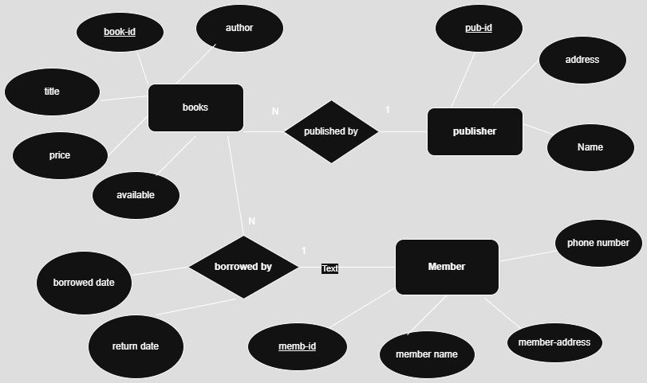
ER-diagram

Slide 16
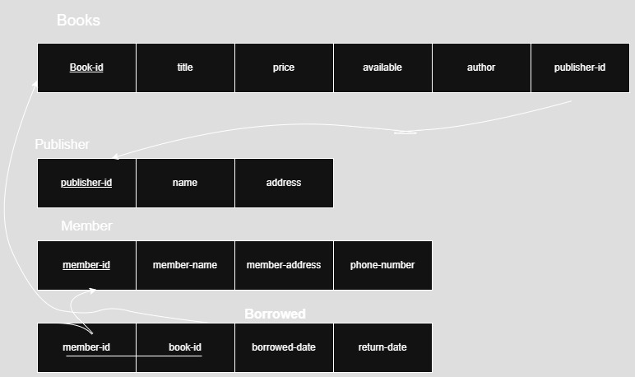
Relational Schema

Slide 17
SQL
CREATE TABLE Publisher (
pub_id INT PRIMARY KEY,
name VARCHAR(100),
address VARCHAR(200)
);
CREATE TABLE Books (
book_id INT PRIMARY KEY,
title VARCHAR(100),
price DECIMAL(10,2),
available BOOLEAN,
author VARCHAR(100),
pub_id INT,
FOREIGN KEY (pub_id) REFERENCES Publisher(pub_id)
);

Slide 18
SQL
CREATE TABLE Member (
memb_id INT PRIMARY KEY,
member_name VARCHAR(100),
member_address VARCHAR(200),
phone_number VARCHAR(15)
);CREATE TABLE Borrowed (
book_id INT,
memb_id INT,
borrowed_date DATE,
return_date DATE,
PRIMARY KEY (book_id, memb_id),
FOREIGN KEY (book_id) REFERENCES Books(book_id),
FOREIGN KEY (memb_id) REFERENCES Member(memb_id)
);

Slide 19
Data Normalization
Benefits:
Eliminates duplicate data
Reduces data anomalies (insert, update, delete)
Improves data consistency
Enhances maintainability

Slide 20
UNF –Unnormalized Form
PatientAppointments
Patient-id | Name | Symptoms | doctor | department
P01 | Sara | Fever, Cough | Dr. Lee | Cardiology
P02 | Omar | Headache | Dr. Kim | Neurology
problem?
_Multiple symptoms in one field

Slide 21
1NF-First Normal Form
Patient-id | Name | Symptoms | doctor | department
P01 | Sara | Fever | Dr. Lee | Cardiology
P01 | Sara | Cough | Dr. Lee | Cardiology
P02 | Omar | Headache | Dr. Kim | Neurology
Removes repeating groups
or nested data
Makes querying and filtering
data simpler and more reliable.

Slide 22
2NF_Second Normal Form
Remove partial dependencies (data depending on part of a composite key)
Separate out repeating Doctor info into a new table:
Patient(PatientID, Name)
Symptom(PatientID, Symptom)
Doctor(Doctor Name, DoctorDept)

Slide 23
3NF-Third Normal Form
Remove transitive dependencies (non-key fields depending on other non-key fields)
Split doctor and department into separate tables
Patient(PatientID, Name)
Symptom(PatientID, Symptom)
Doctor(DoctorName, DeptID)
Department(DeptID, DeptName)

Slide 24

Data Base Supports Software Engineering
Well-normalized databases improve code quality and reduce errors
Support modular development, where teams can work on independent parts (e.g., patients, doctors, appointments)
Critical for building scalable, reliable, and secure systems

