Slide 1
Data Analysis on Covid-19 Dataset
Bangladesh’s Covid-19 situation of last 21 months

Slide 2
Student ID | Student Name
2019-1-60-068 | Md. Shahadat Anik Sheikh
2019-1-60-108 | A. M. Feroz Ehses Shishir
2019-3-60-052 | Abdullah Al Munem
Instructor
Dr. Mohammad Rezwanul Huq Associate Professor Department of Computer Science & Engineering East West University

Slide 3
Contents
Introduction
Data Pre-processing
Dataset Characteristics
Performance Evaluation
Classifications
Regressions
Time Series Analysis
Discussion
Conclusion

Slide 4
Introduction
Here we focuses on developing some supervised machine learning model.
Before implementing regression and classification models we pre-process the dataset.
Compare model with different performance characteristics.
Compare same model with different parameter.

Slide 5
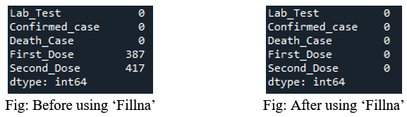
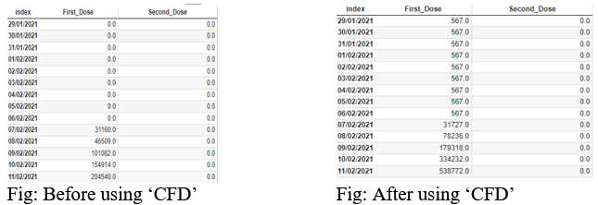
Data Pre-Processing
Filling Null Values
Duplicate Checking
Cumulative Frequency Distribution (CFD)

Slide 6
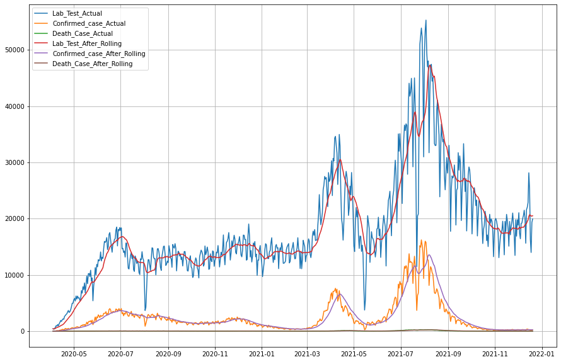
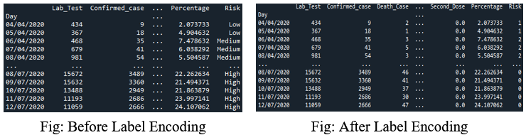
Data Pre-Processing
Moving Average
Level Encoding

Slide 7
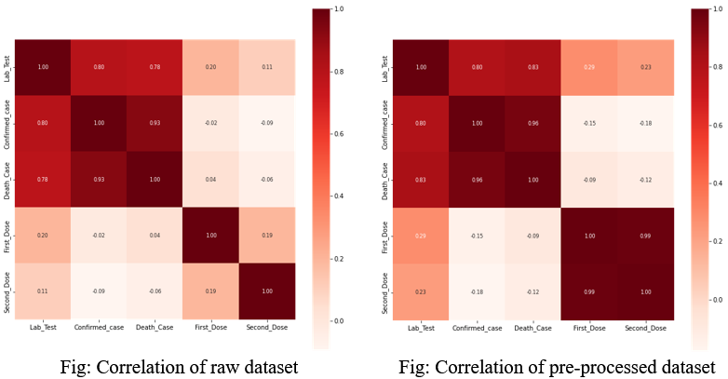
Dataset Characteristics
Merged dataset has 626 rows and 5 columns
"Day" is used as indexing

Slide 8
Performance Evaluation
Classifications
Regressions
Time Series Analysis

Slide 9
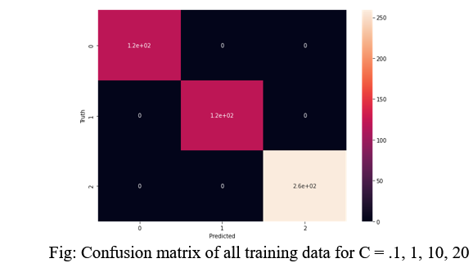
Classifications: Logistic Regression

Slide 10
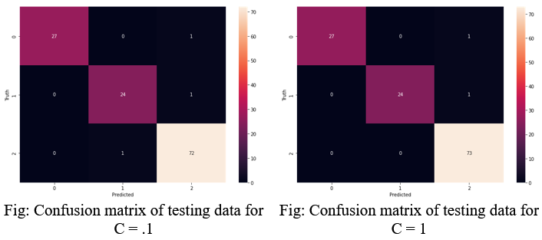
Classifications: Logistic Regression

Slide 11
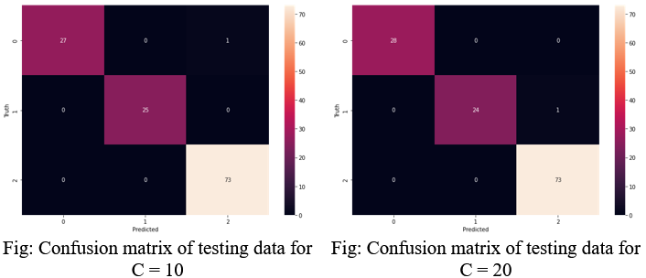
Classifications: Logistic Regression

Slide 12
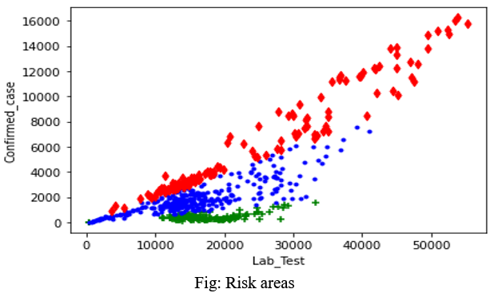
Classifications: Linear Support Vector Classifier

Slide 13
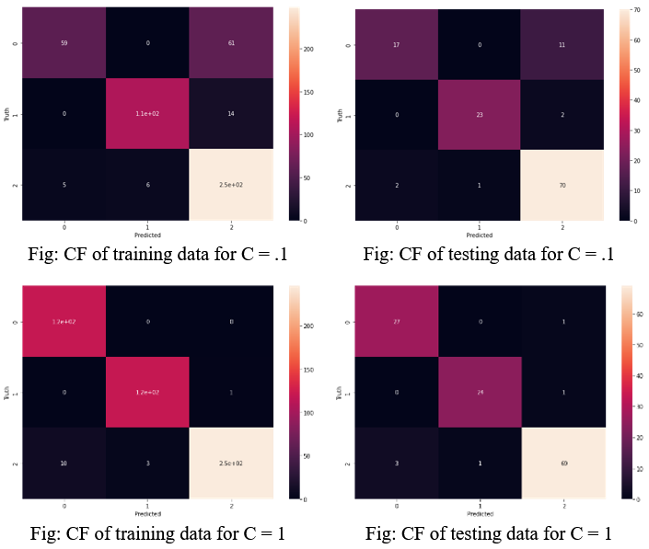
Classifications: Linear Support Vector Classifier

Slide 14
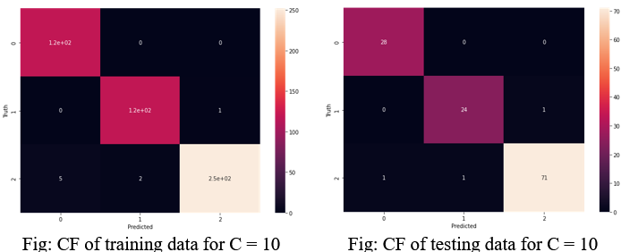
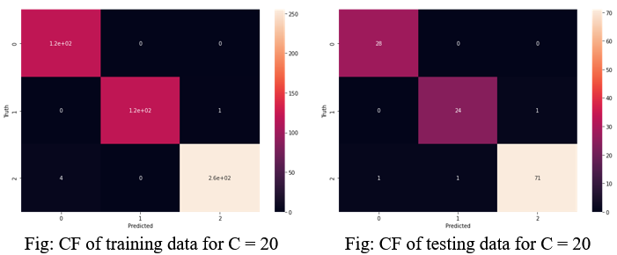
Classifications: Linear Support Vector Classifier

Slide 15
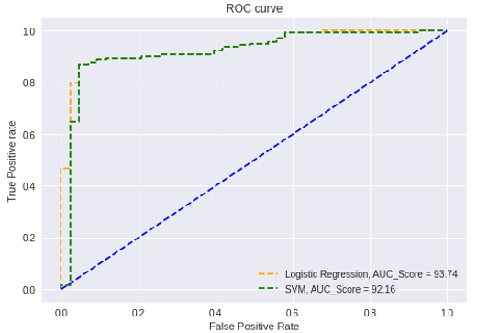
Evaluation of Classifier

Slide 16
Performance Evaluation
Classifications
Regressions
Predict the Death Case
Predict the Confirmed Case
Time Series Analysis

Slide 17
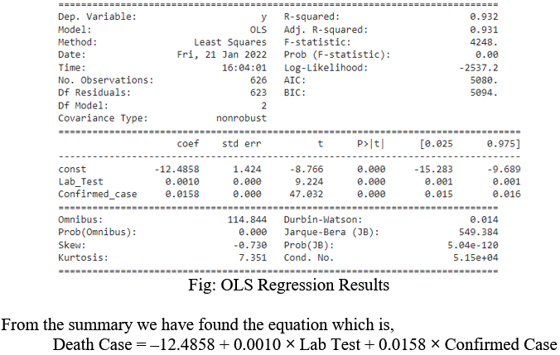
Regressions: Predict The Death Case: OLS

Slide 18
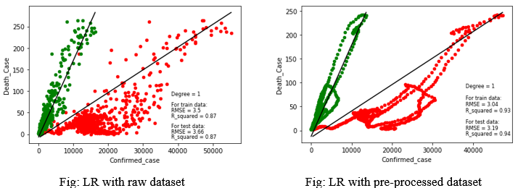
Regressions: Predict The Death Case: Linear Regression

Slide 19
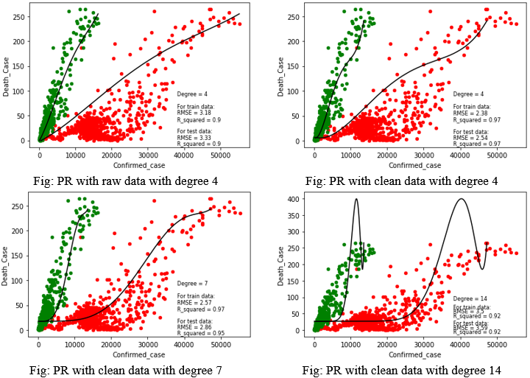
Regressions: Predict The Death Case: Polynomial Regression

Slide 20
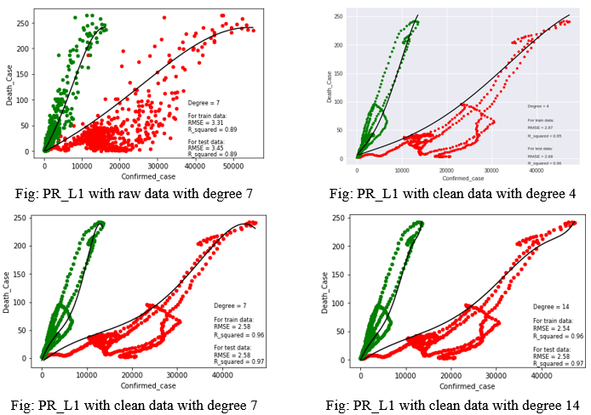
Regressions: Predict The Death Case: Polynomial Regression L1

Slide 21
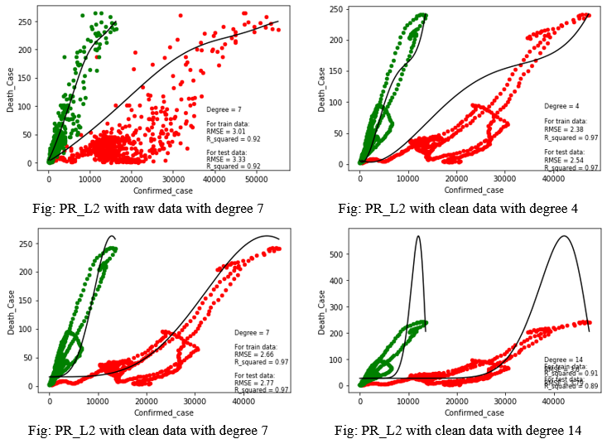
Regressions: Predict The Death Case: Polynomial Regression L2

Slide 22
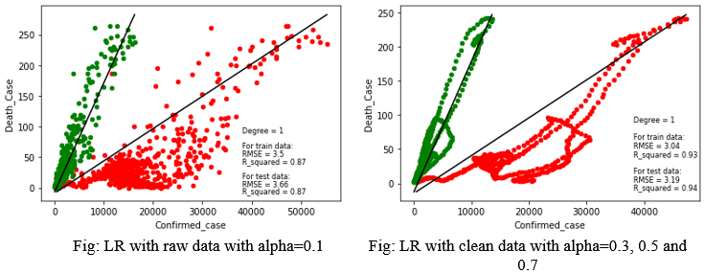
Regressions: Predict The Death Case: Lasso Regression

Slide 23
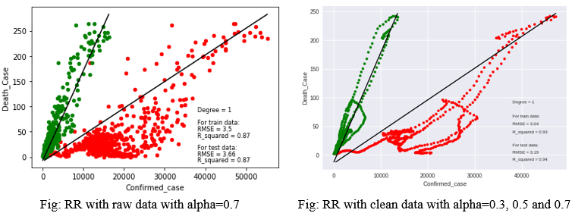
Regressions: Predict The Death Case: Ridge Regression

Slide 24
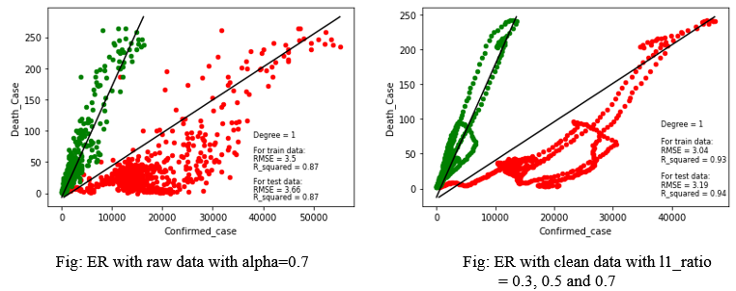
Regressions: Predict The Death Case: ElasticNet Regression

Slide 25
Performance Evaluation
Classifications
Regressions
Predict the Death Case
Predict the Confirmed Case
Time Series Analysis

Slide 26
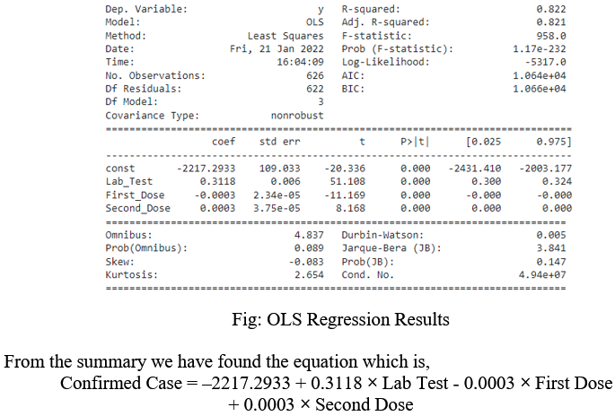
Regressions: Predict The Confirmed Case: OLS

Slide 27
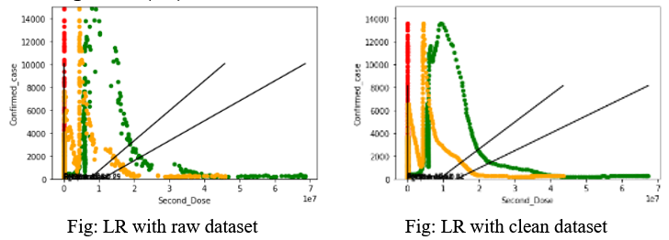
Regressions: Predict The Confirmed Case: Linear Regression

Slide 28
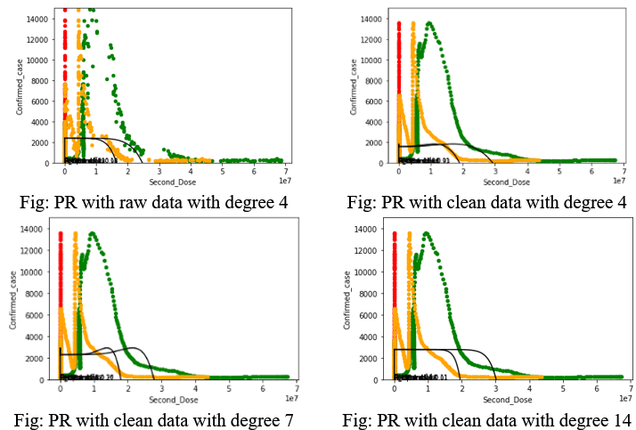
Regressions: Predict The Confirmed Case: Polynomial Regression

Slide 29
Performance Evaluation
Classifications
Regressions
Time Series Analysis

Slide 30
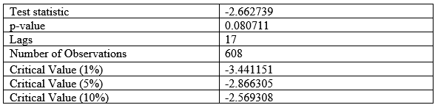
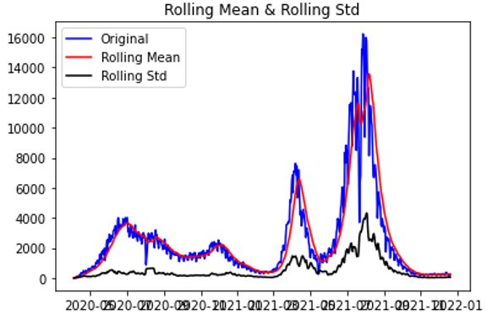
Time Series Analysis: Stationarity

Slide 31
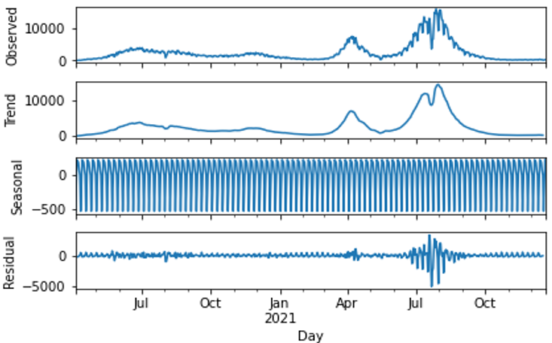
Time Series Analysis: Seasonality

Slide 32
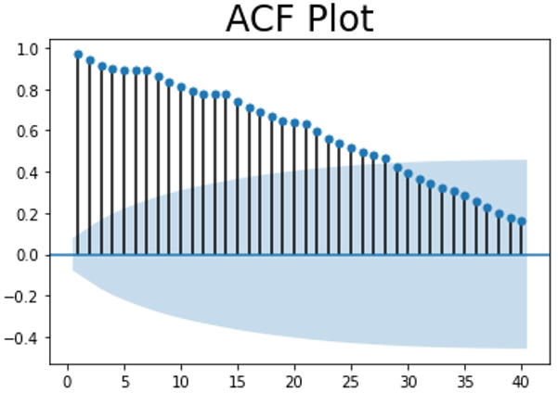
Time Series Analysis: Autocorrelation

Slide 33
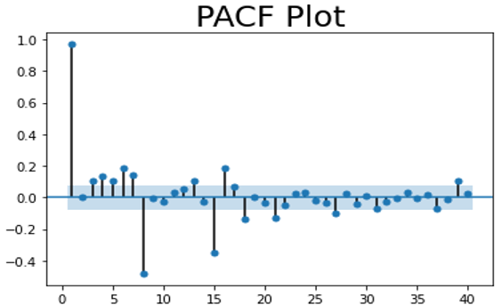
Time Series Analysis: Partial Autocorrelation

Slide 34
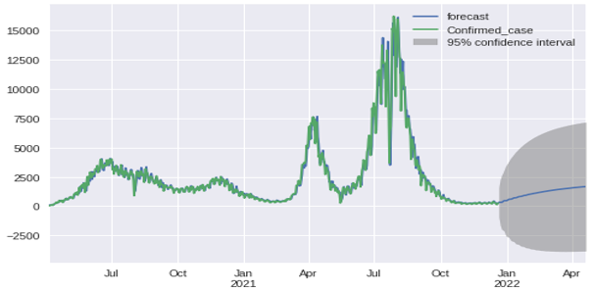
Time Series Analysis: Forecasting the Confirmed case

Slide 35
Conclusion
This project has increased our knowledge on making different type of models & predict the accuracy level in respect with different type of information’s. By applying several models, it gave us a new incite and taste of working in Machine Learning. We are more intrigued and motivated as we are confident enough in our ability to take a further difficult challenge to improve ourselves after completing this project.

Slide 36
Thank You

