Slide 1


Slide 2
Development of Office Management System for Dhaka Solution
Supervised By Arifa Tur Rahman Senior Lecturer,
Department of CSE
Presented By Rafia Islam
ID: 15103272 Program: BCSE

Slide 3

Contents of the Presentation
Organizational Overview
Project overview
Requirement Engineering
Analysis and Design
Risk Engineering
Project Planning and Scheduling
Project Estimation
Testing
Software Demonstration
Future Work
Conclusion

Slide 4
Organizational Overview
Organization Services
Web Design
Web Development
E-Commerce
Software Development
Digital Marketing
Domain & Hosting
Dhaka Solution is a Web Design & Development company in Bangladesh.
This organization has 5 years of experience in web design and development.

Slide 5
Project overview

Slide 6
Objectives
Broad Objectives
To build a fully digital, faster, error-free and easy to manage Office Management System.

Slide 7
Specific Objectives
To make the System more efficient.
Combine all the resources together so that working process can be faster than before.
To do the accurate process and calculation for all the resources.
Employee can do the work faster way.
Reduce time for finding information.
Minimize manual attendance
Security of data.
Identifying the problems to develop the system.
To build up a system with advance technology.

Slide 8
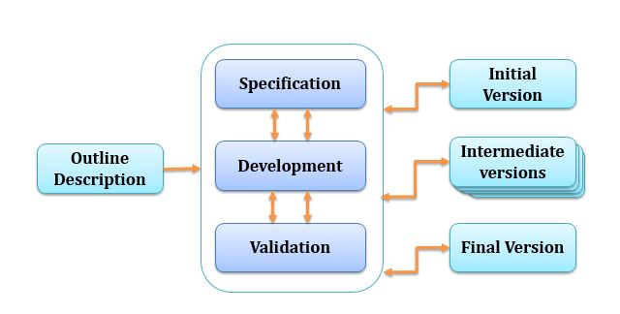
Software Process Model
Fig: Evolutionary Process Model

Slide 9
Feasibility Study
Technical Feasibility
Economic Feasibility
Operational Feasibility

Slide 10
Requirement Engineering
1 User Requirements
2 System Requirements
3 Functional Requirements
4 Non-Functional Requirements

Slide 11
User Requirements
Use security to access the System.
Identify type of user by matching their employee ID and password.
Admin can manage whole system.
Employee can give daily attendance/ apply for leave/ View tasks, quality ranking.

Slide 12

System Requirements
If user wants to access the system then login required.
Admin will add new employee and give ID and password to access system.
With valid ID and password employee can access system.
Invalid user won’t be access to the system.
Use security to access.

Slide 13
System Requirements
Create user role while registering an employee by assigning user type.
Detect user type by employee ID while login.
Provide access to the system according their role.
Identify type of user by matching their employee ID and password, and access them to the system by their role.

Slide 14
System Requirements
Admin can view, edit, update any of the information
Admin can manage whole system.

Slide 15
System Requirements
Identify by login
Create page according to employee information
Create option for giving daily attendance.
View attendance log of his own.
Allow to apply for leave.
View leave application details.
View project monitoring task and submit task.
View employee quality ranking.
Employee can give daily attendance/ apply for leave/ view tasks, payslip and quality ranking.

Slide 16
Functional Requirement
Login management
Employee management
Attendance management
Leave management
Payroll System
Project Monitoring
Employee Quality Ranking
Report generates.

Slide 17
Non-Functional Requirement
Pages are loaded within few second
All user can use simultaneously.

Slide 18
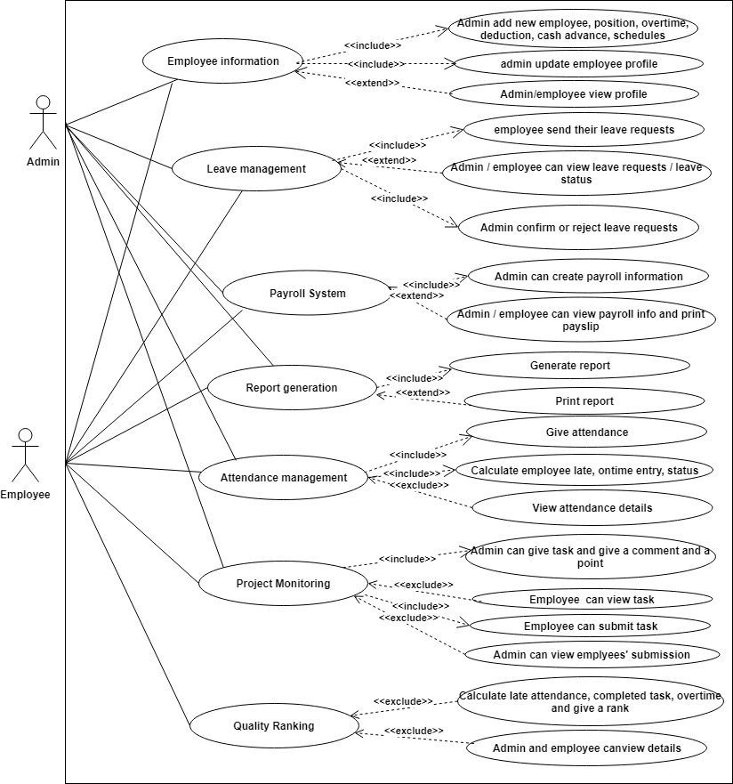
Use Case Diagram
Figure: Use Case Diagram

Slide 19
Function of Proposed System
Login management | [F01]
Employee Management | [F02]
Attendance Management | [F03]
Leave Management | [F04]
Payroll System | [F05]
Project Monitoring | [F06]
Employee Quality Ranking | [F07]
Report Generation | [F08]

Slide 20
Content of the Presentation
Project Planning and Scheduling

Slide 21
Unadjusted function Point Contribution for Transaction Function
Transaction Function | FTR’S | DET’S | Complexity | UFP
Sign in(EI) | 1 | 2 | Low | 3
Insert position information(EI) | 1 | 3 | Low | 3
Add employee information(EI) | 2 | 11 | Average | 4
Update employee information (EI) | 2 | 11 | Average | 4
Add new leave request(EI) | 2 | 6 | Average | 4
Approve leave requests(EI) | 1 | 3 | Low | 3
Add attendance(EI) | 2 | 5 | Average | 4
Insert project monitoring task(EI) | 1 | 7 | Low | 3
View employee quality ranking(EQ) | 1 | 4 | Low | 3
View leave status(EO) | 2 | 3 | Low | 4
Generate attendance Report(EQ) | 3 | 4 | Low | 3
Notification(EQ) | 2 | 4 | Low | 3
Add Advance cash (EI) | 1 | 5 | Low | 3
Generate Payslip (EI) | 2 | 14 | Average | 4
View Payslip for individual (EO) | 2 | 15 | Average | 5
View payroll (EQ) | 2 | 13 | Average | 4
Total |  |  |  | 57

Slide 22
Unadjusted function Point Contribution for Data Function
Data function | RET’S | DET’S | Complexity | UFP
users (ILF) | 2 | 3 | Low | 7
employees(ILF) | 4 | 8 | Low | 7
position(ILF) | 1 | 3 | Low | 7
Employee attendances(ILF) | 2 | 5 | Low | 7
Leaves(ILF) | 2 | 7 | Low | 7
Advanced cash (ILF) | 1 | 10 | Low | 7
Overtime(ILF) | 1 | 2 | Low | 7
Project Monitoring(ILF) | 2 | 7 | Low | 7
Quality Ranking(ILF) | 1 | 5 | Low | 7
Payroll(ILF) | 1 | 3 | Low | 7
Total |  |  |  | 70

Slide 23
Determine the Value Adjustment Factor
GSC | DI
Data Communications | 5
Distributed Data Processing | 0
Performance | 5
Heavily Used Configuration | 0
Transaction Rate | 0
Online Data Entry | 4
End-user Efficiency | 5
Online Update | 4
Complex Processing | 1
Reusability | 4
Installation Ease | 4
Operational Ease | 5
Multiple Site | 0
Facilitate Change | 4
Total Degree of Influence (TDI) | 41

Slide 24
Counting Adjusted Function Point
UFP = UFP (Data Fn) + UFP (Transection Fn)
= 57+ 70
= 127
Value Adjustment Factor (VAF) = (0.65+ (0.01×41))
= 1.06
Adjusted Function Point Count = UFP x VAF
= 127 x 1.06= 134.6
Efforts for PHP = AFP x Productivity
= 134.6 x 15.5
= 2086.5 hours/8 hours
= 260.8 person days/24
= 10.25/3 Person Months
= 3.42 Months

Slide 25
Effort Distribution
Fig : Effort Distribution

Slide 26
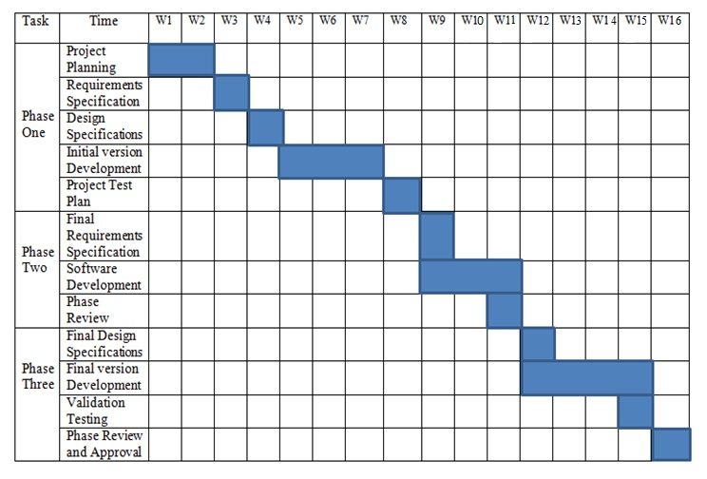
Project Schedule Chart
Fig : Project Schedule Chart

Slide 27
Project Estimation

Slide 28
Cost Estimation System
Particulars | Taka
Personnel cost
System Analyst | 52,710.00
Programmer | 35,141.40
 | 87,851.4
Software Cost
Windows 10 | 1,333.00
Microsoft Office 2007 | 1,066.40
SUBLIME TEXT 2017 | 0.00
MS SQL SERVER | 0.00
 | 2399.40
Hardware Cost
Computer | 12,000.00
Printer | 1,333.50
 | 13,333.50
Other Costs
Furniture | 2,000.00
House Rent | 7,000.00
Electricity bill | 1,000.00
Utilities | 1,000.00
 | 11,000.00
Total: | 1,14,584.3

Slide 29
Analysis and Design

Slide 30
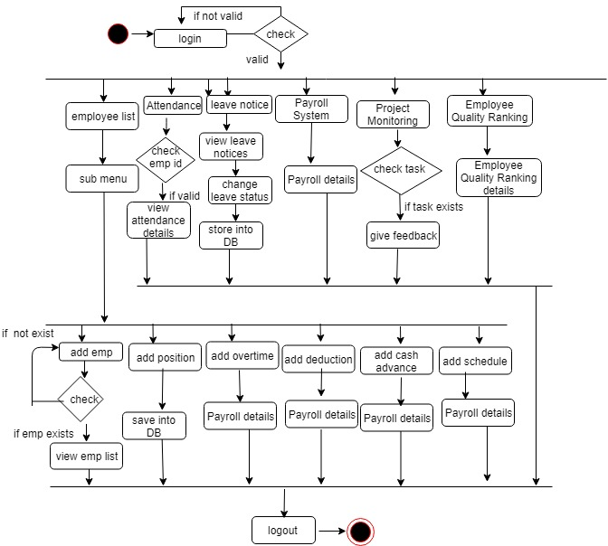
Activity Diagram (Admin)
Figure: Activity Diagram (Admin)

Slide 31
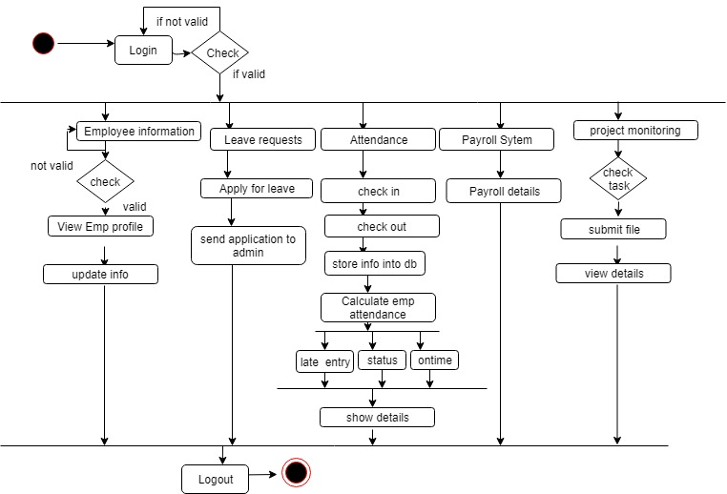
Activity Diagram (Employee)
Figure: Activity Diagram (Employee)

Slide 32
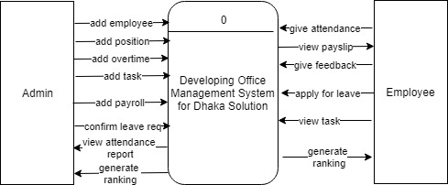
Data Flow Diagram – Context LEVEL
Figure: Context Level Diagram

Slide 33
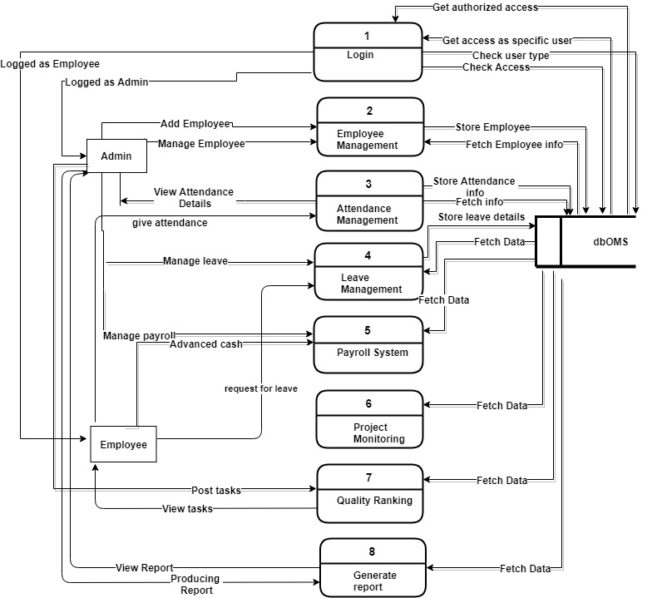
Data Flow Diagram – Level 1
Figure: Level 1 Diagram

Slide 34
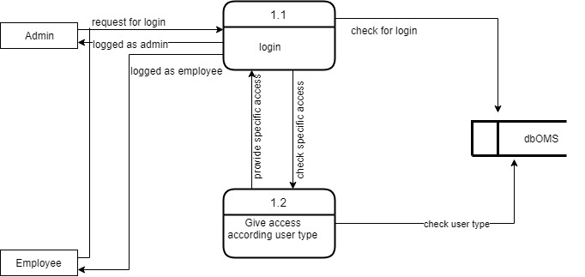
Level 2 Process 1 (login)
Figure: DFD Level 2 Process 1 Diagram

Slide 35
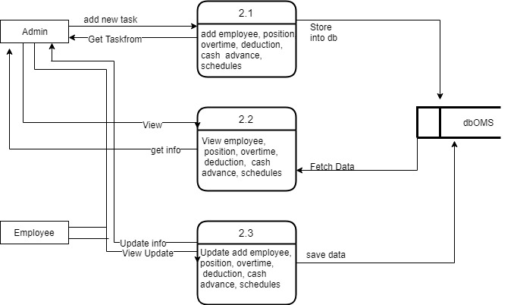
Level 2 Process 2 (Employee management)
Figure: DFD Level 2 Process 2 Diagram

Slide 36
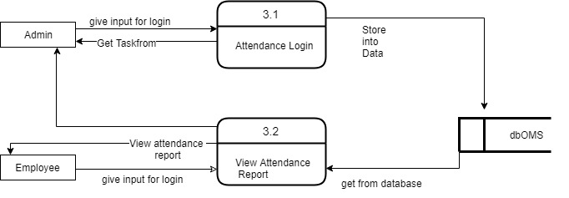
Level 2 Process 3 (Attendance Management)
Figure: DFD Level 2 Process3 Diagram

Slide 37
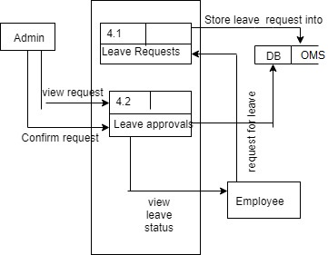
Level 2 Process 4 (Leave Management)
Figure: DFD Level 2 Process 4 Diagram

Slide 38
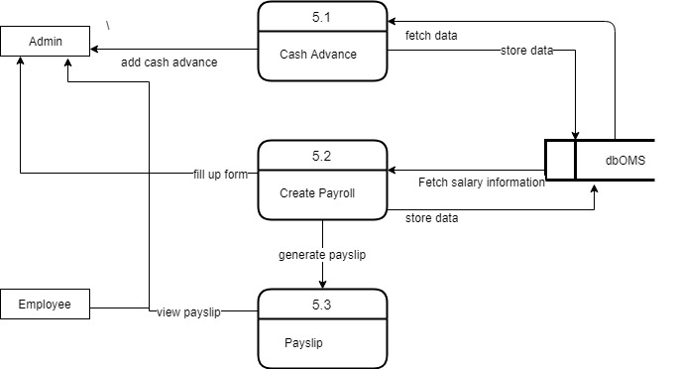
Level 2 Process 5 (Payroll System)
Figure: DFD Level 2 Process 5 Diagram

Slide 39
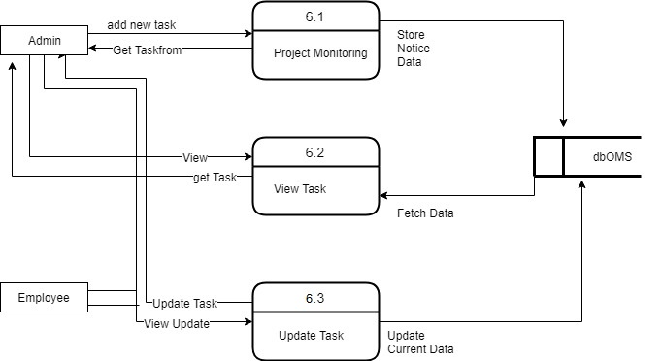
Level 2 Process 6 (Project Monitoring)
Figure: DFD Level 2 Process 6 Diagram

Slide 40
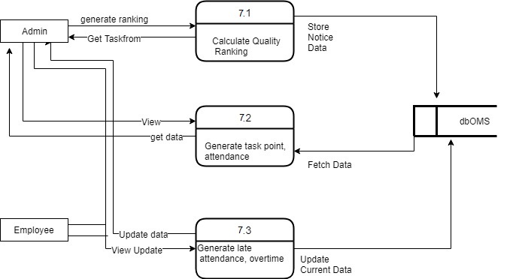
Level 2 Process 7 (Employee Quality Ranking)
Figure: DFD Level 2 Process 7 Diagram

Slide 41
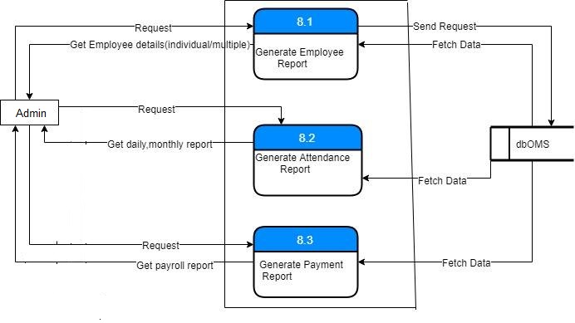
Level 2 Process 8 (Generate Report)
Figure: DFD Level 2 Process 8 Diagram

Slide 42
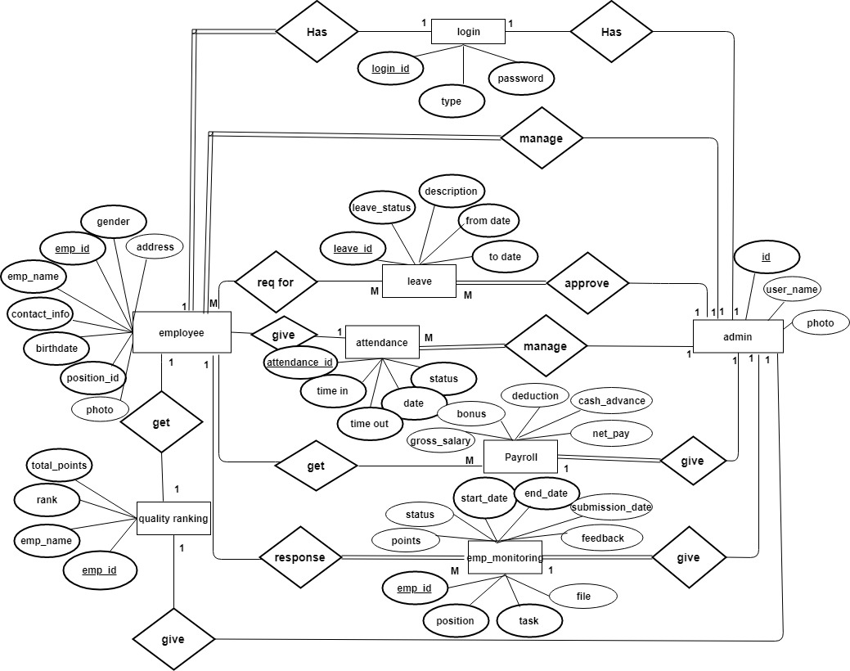
ER Diagram
Figure: Entity Relationship Diagram

Slide 43
Content of the Presentation
Risk Engineering

Slide 44
Risk Analysis & Planning
Technology Risks
People Risks
Organizational Risks
Tools risks
Risk Planning
Risk |  | Strategy
People may fall in sick. | In the time of team up there should be some extra hour or employee so that anyone absence will not affect the project.
Employee is not skilled about this project. | Before starting the project work need to sure that for doing that kind of project employee are available or not and know about their skill.
Before starting the project need to know that the organization will provide the cost. | Organization may have some financial problem they are not ready to give the budget for project
After complete the project some requirement may come that can effect on whole System. | If requirement is change than it become hard to do the project like when employee working for project then some requirement become change then it becomes harder.
Resources may not be enough to complete the project. | Back up will be ready with extra resources.

Slide 45
Risk Monitoring
Assess each identified risks regularly to decide whether or not it is becoming less or more probable.
Also assess whether the effects of the risk have changed.
Each key risk should be discussed at management.
45

Slide 46
Testing

Slide 47
Testing
White Box Testing
Acceptance Testing
System Testing
Black Box Testing
Unit Testing
Integration Testing

Slide 48
Contents of the Presentation
Software Demonstration

Slide 49
Future Work

Slide 50
Future Work
For the future I have plan to work on more modules Such as:
Business Communication and Relationship Management.
Recruit Management.

Slide 51

Questionnaires

Slide 52
Conclusion

Slide 53

Thank You !

