Slide 1


Fluxora
Cash-flow decisions
for small businesses
SKLab
Topic E / SME Finance Copilot
2026 Shenzhen International FinTech Competition
Concept illustration
01
Notes:
00:00 to 00:20 (20 seconds)
We are SKLab, and this is Fluxora, our cash-flow decision workspace for small businesses. It connects deterministic financial calculations with traceable evidence and an agent that prepares work for owner review. We will show one synthetic business case for Topic E, SME Finance Copilot.
Sources
https://github.com/ShahadatTest/fluxora/blob/22d3e6279d06d2e7691f122ed7a4232259739098/README.md
Existing project-generated mark and planning illustration. https://github.com/ShahadatTest/fluxora/blob/22d3e6279d06d2e7691f122ed7a4232259739098/docs/BRAND-ASSETS-0.20.1.md
Official guidance, freshly fetched 20 October 2026, SHA-256 9005e42629435a1e129a8367c8d3d5e3714b6ea0bbab30713cd6be2f2bdd0c5a: https://drive.scmc.cmu.ac.th/s/2jKErkTJpFmcxYF/download. Presentation deck appears in the submission checklist. Final presentation maximum 10 minutes. Demo video maximum 5 minutes. One checklist item calls video optional while the execution-evidence item mentions demo video for non-on-chain topics.
Synthetic data. Financial results depend on recorded assumptions. Concept illustrations and archived UI are labelled. Planned timing requires rehearsal.

Slide 2
The cash timing problem
An invoice can arrive after payroll is due
USD 10,000
EUR 1,000
Recorded USD cash
A separate currency balance
Will the business stay above its cash floor before the next collection?
Synthetic Atlas example, snapshot 16 October 2026. Expected collections remain conditional.
02
Notes:
00:20 to 01:00 (40 seconds)
A business can look profitable and still run short of cash before payroll. Our Atlas example starts with ten thousand US dollars and one thousand euros. Those balances stay separate. The owner needs to know whether the next collection arrives before obligations fall due, and which assumptions support that answer. An unpaid invoice contributes to a conditional projection, but it does not establish an observed receipt. This case uses invented records from the bundled fixture, rather than the finances of a real company.
Sources
https://github.com/ShahadatTest/fluxora/blob/22d3e6279d06d2e7691f122ed7a4232259739098/cashflow_copilot/data/fixture_v1.json
https://github.com/ShahadatTest/fluxora/blob/22d3e6279d06d2e7691f122ed7a4232259739098/cashflow_copilot/forecast.py
Fresh deterministic output in work/slide261/deck-data.json. No ledger mutation.
Synthetic data. Financial results depend on recorded assumptions. Concept illustrations and archived UI are labelled. Planned timing requires rehearsal.

Slide 3
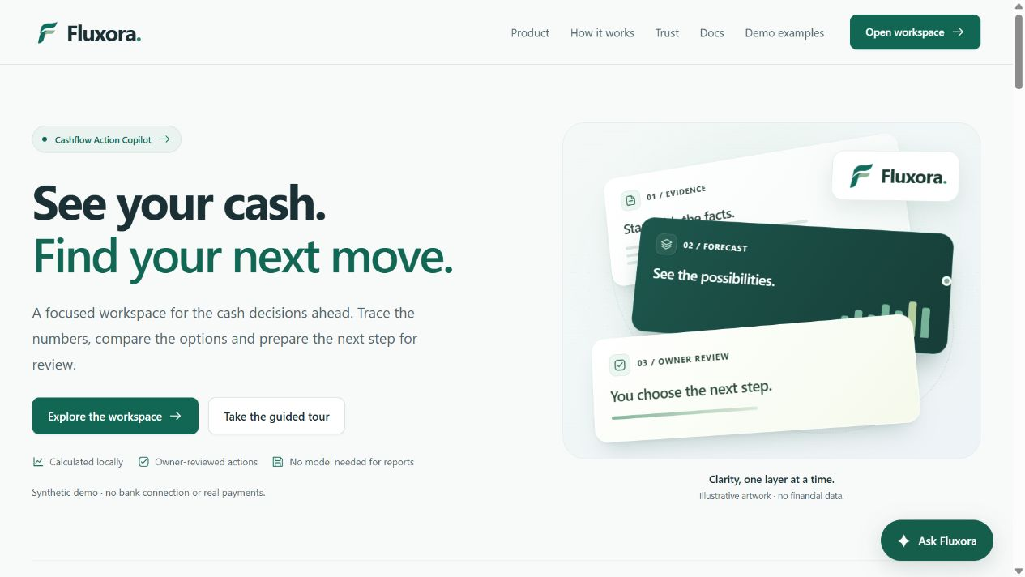
The owner workspace
One place to inspect
the next decision
Evidence, forecasts and reviewed actions have dedicated pages.
Direct reports work without a model key.
Actual local application screenshot. Hero artwork illustrates the concept.
03
Notes:
01:00 to 01:35 (35 seconds)
The workspace groups tasks around the owner’s day. Evidence and Ledger holds source records. Forecast and Scenarios examine cash timing. The approval queue and action history keep preparation separate from a decision. These are dedicated pages, with documentation and a guided start for someone seeing the product for the first time. The public judge demo provides an expiring synthetic workspace for each visitor. A private local installation keeps the selected SQLite database across restarts. The financial reports work without a model key.
Sources
https://github.com/ShahadatTest/fluxora/blob/22d3e6279d06d2e7691f122ed7a4232259739098/docs/media/README.md
https://github.com/ShahadatTest/fluxora/blob/22d3e6279d06d2e7691f122ed7a4232259739098/docs/LOCAL-SETUP.md
https://github.com/ShahadatTest/fluxora/blob/22d3e6279d06d2e7691f122ed7a4232259739098/cashflow_copilot/workspace_ui.py
Synthetic data. Financial results depend on recorded assumptions. Concept illustrations and archived UI are labelled. Planned timing requires rehearsal.

Slide 4
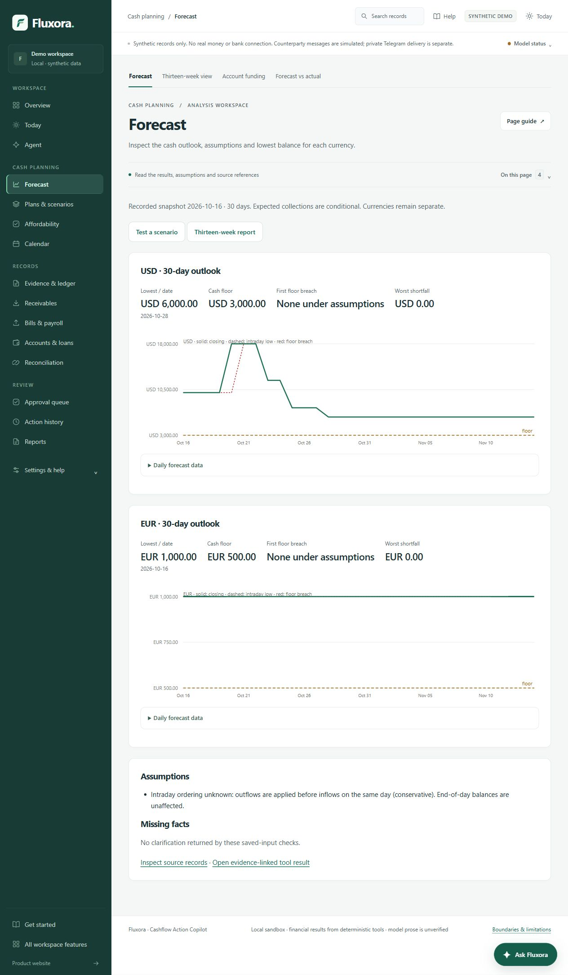
A forecast the owner can inspect
USD 6,000
Baseline minimum
28 October 2026
USD 3,000 cash floor
No projected floor breach under the recorded assumptions
Synthetic 30-day projection as of 16 October 2026. Currencies remain separate.
04
Notes:
01:35 to 02:20 (45 seconds)
This is an actual forecast report from the local application. The baseline reaches a minimum of six thousand US dollars on October twenty-eighth, above the recorded three-thousand-dollar floor. The report exposes assumptions and provides links to source records. Unknown intraday timing uses outflows before inflows on the same day, so a closing balance cannot hide that ordering risk. The euro forecast stays separate. These results come from integer minor-unit calculations in Python. They remain conditional on the dates and amounts supplied to the ledger.
Sources
https://github.com/ShahadatTest/fluxora/blob/22d3e6279d06d2e7691f122ed7a4232259739098/docs/media/forecast.jpg
https://github.com/ShahadatTest/fluxora/blob/22d3e6279d06d2e7691f122ed7a4232259739098/cashflow_copilot/forecast.py
https://github.com/ShahadatTest/fluxora/blob/22d3e6279d06d2e7691f122ed7a4232259739098/cashflow_copilot/data/fixture_v1.json
Fresh baseline data: work/slide261/deck-data.json. Screenshot crops preserve the report values. Assumptions are restated visibly.
Synthetic data. Financial results depend on recorded assumptions. Concept illustrations and archived UI are labelled. Planned timing requires rehearsal.

Slide 5
A seven-day delay creates a cash gap
Delayed minimum
USD -500
USD 3,500
below the cash floor
Synthetic timing scenario for inv-client-001. No receipt, agreement or consent changes.
05
Notes:
02:20 to 03:25 (65 seconds)
The scenario delays invoice inv-client-001 by seven days while preserving the other recorded assumptions. The green line shows the baseline and the red line shows the delayed collection. The dashed line is the owner’s three-thousand-dollar floor. The delayed minimum becomes negative five hundred dollars, leaving a worst shortfall of three thousand five hundred dollars against that floor. This chart is editable and uses values freshly computed by the same deterministic engine. A scenario lets the owner compare timing before changing any record. It does not record a receipt or establish counterparty consent. The application protects payroll, checks feasibility, and can report that no allowed plan meets the constraints. The euro balance cannot fill this dollar gap through a display exchange rate.
Sources
https://github.com/ShahadatTest/fluxora/blob/22d3e6279d06d2e7691f122ed7a4232259739098/cashflow_copilot/planning.py
https://github.com/ShahadatTest/fluxora/blob/22d3e6279d06d2e7691f122ed7a4232259739098/cashflow_copilot/forecast.py
https://github.com/ShahadatTest/fluxora/blob/22d3e6279d06d2e7691f122ed7a4232259739098/cashflow_copilot/data/fixture_v1.json
Fresh data: work/slide261/deck-data.json. Values equal integer USD minor units / 100. Native editable chart with a materialized data workbook. No formulas or observed business outcome are invented.
Synthetic data. Financial results depend on recorded assumptions. Concept illustrations and archived UI are labelled. Planned timing requires rehearsal.

Slide 6
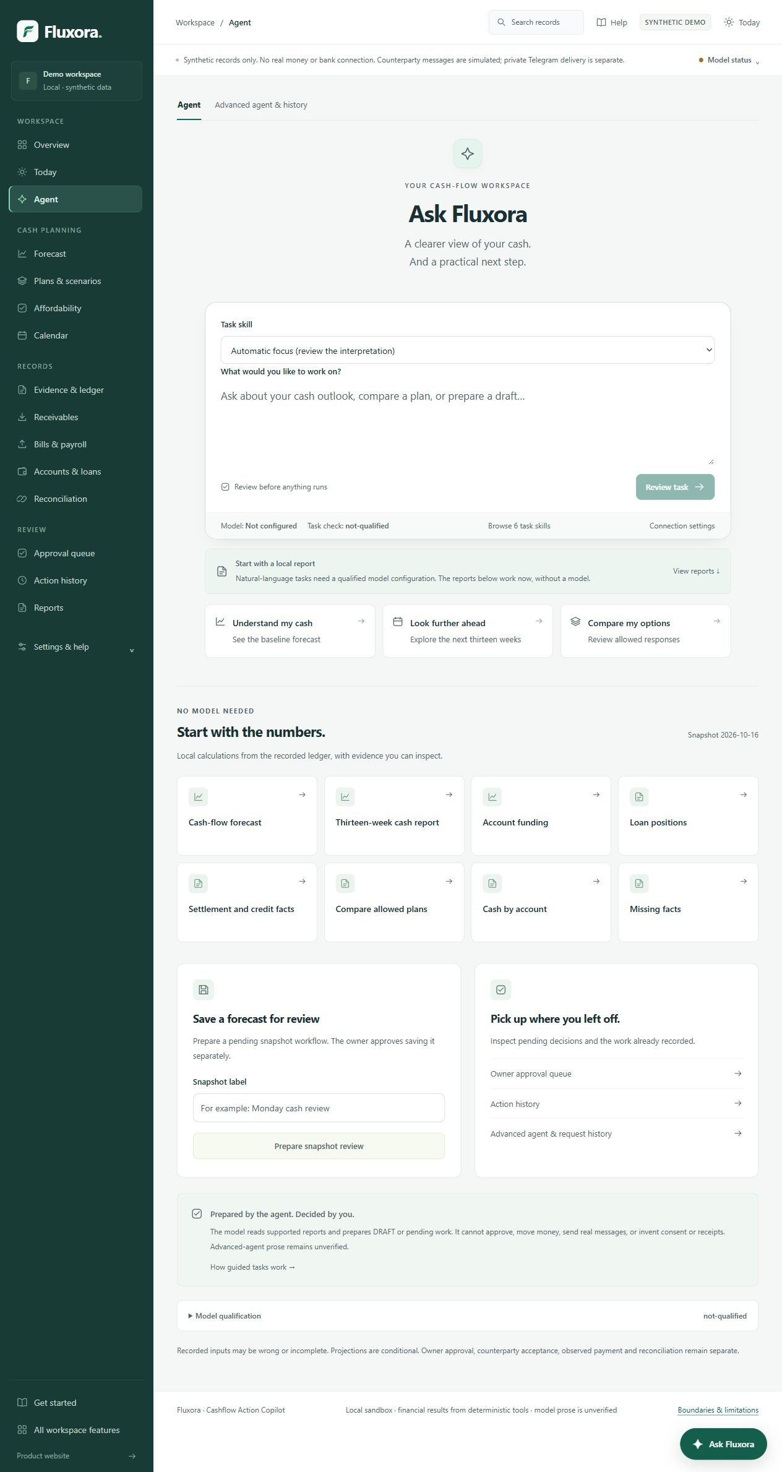
One Send prepares supported work
“Prepare an early-payment request draft for inv-client-001, USD 100 on 2026-10-22.”
Interpret and validate
Compute a report or DRAFT
Show the selected task
Keep final approval separate
Archived local UI, version 0.25.9, AI disconnected. Current UI uses Send with optional preview.
06
Notes:
03:25 to 04:20 (55 seconds)
The optional model interprets an explicit instruction. Here the user supplies an invoice, amount, currency and date. The current interface uses one Send action. Local code validates the selected task and prepares a report, a DRAFT, or pending work. It displays the selected task and exact terms. Preview before sending remains available in Options. Final owner approval stays separate. The archived screenshot shows the earlier disconnected local interface, rather than a new live completion. Separate live qualification passed eight model interpretation cases and five local safety guards. These finite tests do not prove unrestricted language accuracy.
Sources
https://github.com/ShahadatTest/fluxora/blob/main/docs/AUTOPILOT.md
https://github.com/ShahadatTest/fluxora/blob/main/docs/VALIDATION.md
Screenshot: archived local synthetic UI 0.25.9. Current Send flow: https://github.com/ShahadatTest/fluxora/blob/main/cashflow_copilot/agent_web.py
Synthetic data. Financial results depend on recorded assumptions. Concept illustrations and archived UI are labelled. Planned timing requires rehearsal.

Slide 7
The owner retains approval authority
Step | Who can do it | Boundary
Read a report | Direct tools or the agent | Inspect assumptions and evidence
Prepare a DRAFT | The agent or an owner form | Preparation creates no approval
Approve local work | Owner, separately | Apply only the exact reviewed scope
Record consent or payment | Explicit source-backed owner step | The model cannot invent the event
Reconcile records | Separate matching workflow | An observation alone is not a match
No real bank connection, payment rail or counterparty messaging exists in this sandbox.
07
Notes:
04:20 to 05:10 (50 seconds)
Approval is a separate authority boundary. The agent can read supported reports and prepare DRAFT or pending work. It cannot approve itself. The owner decides on the exact reviewed local scope, and a separate executor applies only that scope. Counterparty acceptance still needs its own supported event. Observed receipts or payments need the source and explicit confirmation required by the domain rules. Reconciliation then performs a separate match. This distinction matters because approval cannot prove that a customer agreed or that money arrived. Source documents provide evidence, and never grant an agent authority to act.
Sources
https://github.com/ShahadatTest/fluxora/blob/22d3e6279d06d2e7691f122ed7a4232259739098/cashflow_copilot/authz.py
https://github.com/ShahadatTest/fluxora/blob/22d3e6279d06d2e7691f122ed7a4232259739098/cashflow_copilot/agent_workflows.py
https://github.com/ShahadatTest/fluxora/blob/22d3e6279d06d2e7691f122ed7a4232259739098/cashflow_copilot/actions.py
https://github.com/ShahadatTest/fluxora/blob/22d3e6279d06d2e7691f122ed7a4232259739098/cashflow_copilot/settlement.py
Synthetic data. Financial results depend on recorded assumptions. Concept illustrations and archived UI are labelled. Planned timing requires rehearsal.

Slide 8

Evidence stays attached to the decision
Evidence supports
a recorded fact
Import staging, settlement records and corrections preserve the audit trail.
Traceability cannot prove that every uploaded source is authentic or complete.
Concept illustration. Documents provide evidence, never authorization.
08
Notes:
05:10 to 05:50 (40 seconds)
The evidence workflow connects a forecast assumption or proposed action to its source. Import staging gives the owner a chance to inspect records before accepting them. Settlement observations, corrections and reconciliation keep their own audit history. The illustration represents this review boundary rather than a real document or payment. A useful audit trail helps someone inspect a decision, but it does not authenticate every uploaded source or guarantee that an owner’s attestation is true. That limitation remains part of the product’s threat boundary.
Sources
https://github.com/ShahadatTest/fluxora/blob/22d3e6279d06d2e7691f122ed7a4232259739098/cashflow_copilot/ledger.py
https://github.com/ShahadatTest/fluxora/blob/22d3e6279d06d2e7691f122ed7a4232259739098/cashflow_copilot/settlement.py
https://github.com/ShahadatTest/fluxora/blob/22d3e6279d06d2e7691f122ed7a4232259739098/docs/SECURITY.md
Existing project-generated evidence illustration: https://github.com/ShahadatTest/fluxora/blob/22d3e6279d06d2e7691f122ed7a4232259739098/docs/BRAND-ASSETS-0.20.1.md
Synthetic data. Financial results depend on recorded assumptions. Concept illustrations and archived UI are labelled. Planned timing requires rehearsal.

Slide 9
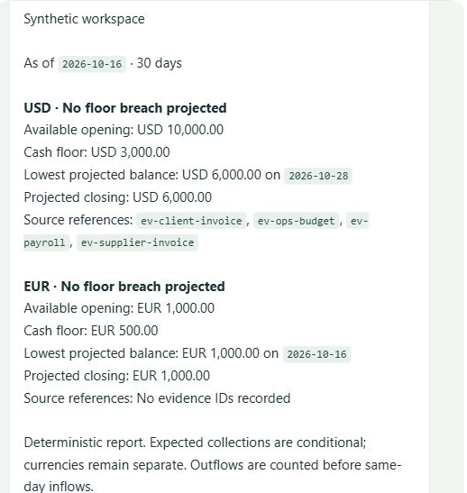
Telegram updates and owner decisions
Browser practice
No Telegram account or token
Deterministic commands on a separate disposable lesson
Simulated delivery and explicit human review
Private Autopilot sends updates and exact DRAFT decision buttons to a paired owner.
Captured /forecast response. No real delivery.
09
Notes:
05:50 to 06:35 (45 seconds)
Judges can inspect Telegram behavior in the browser without joining our private bot. The lesson uses separate synthetic data and clearly labels simulated transport. It supports forecast, a sample DRAFT and a separately reviewed snapshot. In a private deployment, Autopilot can queue updates and exact Approve DRAFT or Reject buttons for the paired owner. Real Telegram API acknowledgments confirm delivery requests succeeded. Callback approval and rejection passed against a simulated transport, including restart and stale-button checks. These are different types of evidence. Approving a DRAFT does not send a counterparty message or record a payment.
Sources
https://github.com/ShahadatTest/fluxora/blob/main/docs/TELEGRAM-INTERACTIVE-DEMO.md
https://github.com/ShahadatTest/fluxora/blob/main/docs/AUTOPILOT.md
https://github.com/ShahadatTest/fluxora/blob/main/docs/VALIDATION.md
Screenshot: archived simulated browser lesson, deterministic /forecast, zero real delivery.
Synthetic data. Financial results depend on recorded assumptions. Concept illustrations and archived UI are labelled. Planned timing requires rehearsal.

Slide 10
Scheduled checks use local code
Local Autopilot
AI for explicit instructions
Five-minute checks when enabled
Changed data triggers analysis
Owner limits bound DRAFT preparation
Unchanged data uses a timed digest
The model selects a supported task
Local tools calculate financial results
Scheduled checks make zero AI calls
Exact approval remains with the owner
Restart preserves policy and accepted effects. Hosted checks run on the VPS. Private notifications use Telegram.
10
Notes:
06:35 to 07:15 (40 seconds)
Autopilot runs on Python and SQLite. The enabled private workspace checks every five minutes. Changed recorded financial inputs trigger deterministic analysis. The selected strategy can prepare only an eligible DRAFT batch within the owner limits and a separately approved pending snapshot. Unchanged data produces a timed digest. Scheduled checks make zero AI calls. The model interprets explicitly submitted language tasks. It does not independently reason about new situations in the background. Hosted execution runs on the VPS. Local installation runs on the owner’s machine, and Telegram needs internet access. Persisted policies and effect identities survive restart.
Sources
https://github.com/ShahadatTest/fluxora/blob/main/docs/AUTOPILOT.md
https://github.com/ShahadatTest/fluxora/blob/main/cashflow_copilot/autopilot.py
https://github.com/ShahadatTest/fluxora/blob/main/cashflow_copilot/telegram_bridge.py
Synthetic data. Financial results depend on recorded assumptions. Concept illustrations and archived UI are labelled. Planned timing requires rehearsal.

Slide 11
Verification and the remaining limits
Check | Measured result | Scope
Complete local suite | 2,211 passed | Synthetic tests, HTTP stubs and mocks
Worker and restart | Passed | 2 DRAFTs, separate decisions, no duplicates
Earlier live qualification | 13 cases passed | 8 model cases and 5 local guards
Rendered mobile review | Blocked | Browser disabled. 360 / 390px pending
Fresh-user walkthrough | No issues reported | User report. Detailed study log absent
Source 0.26.1. Finite tests and user feedback do not certify universal accuracy or production readiness.
11
Notes:
07:15 to 08:00 (45 seconds)
The fresh complete local suite passed two thousand two hundred eleven tests. It uses synthetic records, local HTTP stubs and mocked providers. The disposable VPS canary ran the actual scheduler, prepared two DRAFTs, saved a separately approved snapshot and handled exact synthetic approval and rejection. An actual container restart preserved the results without duplicate DRAFTs. Earlier live qualification passed eight real model cases and five local guards. A fresh public forecast and replay also passed. The user reports that a fresh person completed the walkthrough without finding problems. We have no detailed study log. New rendered mobile checks remain blocked because the browser tool is disabled. Broad language accuracy and real-business security review remain open.
Sources
https://github.com/ShahadatTest/fluxora/blob/main/docs/FINAL-REVIEW-2026-10-20.md
https://github.com/ShahadatTest/fluxora/blob/main/docs/VALIDATION.md
User-reported fresh-user result from this conversation. No participant identities, measured timings or device coverage supplied.
Earlier actual qualification belongs to source 0.26.0. This review made one new public model task call. Scheduler and replay made zero extra calls.
Synthetic data. Financial results depend on recorded assumptions. Concept illustrations and archived UI are labelled. Planned timing requires rehearsal.

Slide 12
Fluxora by SKLab
Cash timing, traceable evidence
and work prepared for owner review
fluxora.sklab.cc/start
github.com/ShahadatTest/fluxora
Synthetic demonstration. No real bank connection or payment execution.
12
Notes:
08:00 to 08:30 (30 seconds)
Fluxora connects cash timing with inspectable evidence and constrained preparation of the next action. Deterministic tools supply financial results. Autopilot handles scheduled checks and prepares work within recorded limits. The owner retains approval authority. Judges can start with the guided demo and the simulated Telegram lesson, or run the complete source locally. Broader language evaluation and a real-business security review will guide further work. Thank you.
Sources
https://github.com/ShahadatTest/fluxora/blob/22d3e6279d06d2e7691f122ed7a4232259739098/README.md
https://fluxora.sklab.cc/start
Team name SKLab is user-confirmed. Two team members are planned, but their names and affiliations have not been supplied. No personal identities or eligibility claims are invented.
Synthetic data. Financial results depend on recorded assumptions. Concept illustrations and archived UI are labelled. Planned timing requires rehearsal.

Slide 13
Feature coverage
Workspace | Available work
Overview and daily review | Cash position, priorities and upcoming obligations
Forecast and account funding | Daily outlooks, cash availability and payroll protection
Plans and scenarios | Timing changes, affordability and bounded alternatives
Evidence and ledger | Staged imports, source references and record review
Actions and approvals | DRAFT preparation and exact owner decisions
Settlement and recovery | Observed records, reconciliation, corrections and backups
Agent and Autopilot | Supported tasks, 6 skills, scheduled checks and bounded DRAFTs
Telegram companion | Browser simulation and paired private updates and decisions
A1
Notes:
Q&A appendix, outside planned pitch
The application groups supported work into owner workflows. Autopilot adds persisted monitoring and bounded preparation. Model interpretation applies only to explicit supported tasks. A feature count does not prove a model understands every instruction.
Sources
https://github.com/ShahadatTest/fluxora/blob/main/docs/AUTOPILOT.md
https://github.com/ShahadatTest/fluxora/blob/main/README.md
Synthetic data. Financial results depend on recorded assumptions. Concept illustrations and archived UI are labelled. Planned timing requires rehearsal.

Slide 14
Threat boundaries and known limitations
Risk | Implemented control | Remaining limit
Untrusted model output | Typed tasks, scope checks and exact review | A model can still misread intent
Provider failure or leaked error body | Deadlines, response bounds and sanitization | Availability and remote handling remain external
Replay or stale approval | Durable request identity and revision binding | Local storage and host security still matter
Misleading documents or attestations | Source references and explicit owner steps | Source authenticity is not independently proven
Public demo or private integrations | Isolated synthetic visitors, locked settings | No production identity system or bank integration
Windows SQLite backup paths have a documented length limitation. Use a short writable directory.
A2
Notes:
Q&A appendix, outside planned pitch
The model cannot approve, send counterparty messages or move money. Autopilot uses explicit limits and rejects stale or late work before committing. Owner approval, counterparty acceptance and observed payment stay distinct. Real private Telegram notifications need an existing paired owner. Public demo visitors have isolated, expiring synthetic workspaces. Local storage and operating-system administrators remain trusted. Automated checks and user feedback do not constitute a production security certification.
Sources
https://github.com/ShahadatTest/fluxora/blob/main/docs/SECURITY.md
https://github.com/ShahadatTest/fluxora/blob/main/docs/AUTOPILOT.md
Synthetic data. Financial results depend on recorded assumptions. Concept illustrations and archived UI are labelled. Planned timing requires rehearsal.

Slide 15
Demo access and reproducibility
Judge tour
https://fluxora.sklab.cc/start
Telegram practice
https://fluxora.sklab.cc/telegram/demo
Source and setup
https://github.com/ShahadatTest/fluxora
Local readiness check
python -m tools.local_setup --check
Direct reports and Telegram practice need no key. Public AI depends on provider availability and shared limits.
A3
Notes:
Q&A appendix, outside planned pitch
These are the judge-facing entry points. Direct financial reports and the simulated Telegram lesson need no provider key or Telegram account. For local setup, use the short writable folder described in the repository. The repository includes the full test commands, documentation and known limitations. The linked official guidance distinguishes a maximum ten-minute final presentation from a maximum five-minute demo video. Do not concatenate a separate demo video with the complete spoken deck inside a ten-minute presentation slot.
Sources
https://github.com/ShahadatTest/fluxora/blob/22d3e6279d06d2e7691f122ed7a4232259739098/docs/JUDGE-QUICKSTART.md
https://github.com/ShahadatTest/fluxora/blob/22d3e6279d06d2e7691f122ed7a4232259739098/docs/LOCAL-SETUP.md
Official guidance, freshly fetched 20 October 2026, SHA-256 9005e42629435a1e129a8367c8d3d5e3714b6ea0bbab30713cd6be2f2bdd0c5a: https://drive.scmc.cmu.ac.th/s/2jKErkTJpFmcxYF/download. Presentation deck appears in the submission checklist. Final presentation maximum 10 minutes. Demo video maximum 5 minutes. One checklist item calls video optional while the execution-evidence item mentions demo video for non-on-chain topics.
Synthetic data. Financial results depend on recorded assumptions. Concept illustrations and archived UI are labelled. Planned timing requires rehearsal.

