Slide 1
Restaurants Reviews
Sahar Alharthi – Shahad Almutiri -Ghaida Alaqeel
Dr. Mejdal Alqahtani

Slide 2
HAMBURGER....
CONTENTS
Introduction...
DataSet....
$9
Data Collect....
$5
$7
Data modeling....
Pre-process....
$5
$2
Topic Model....
$8

Slide 3
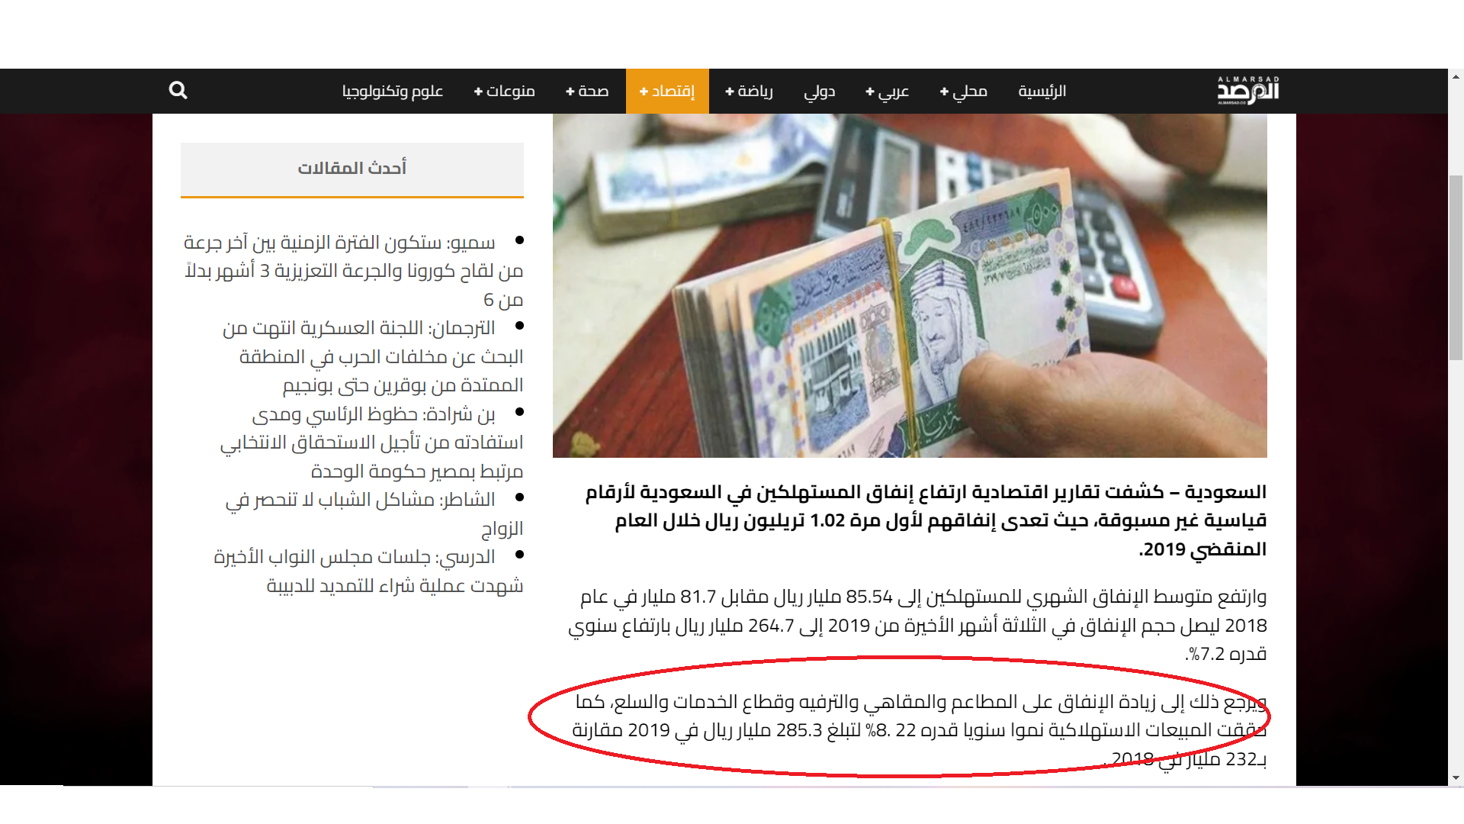
Introduction

Slide 4
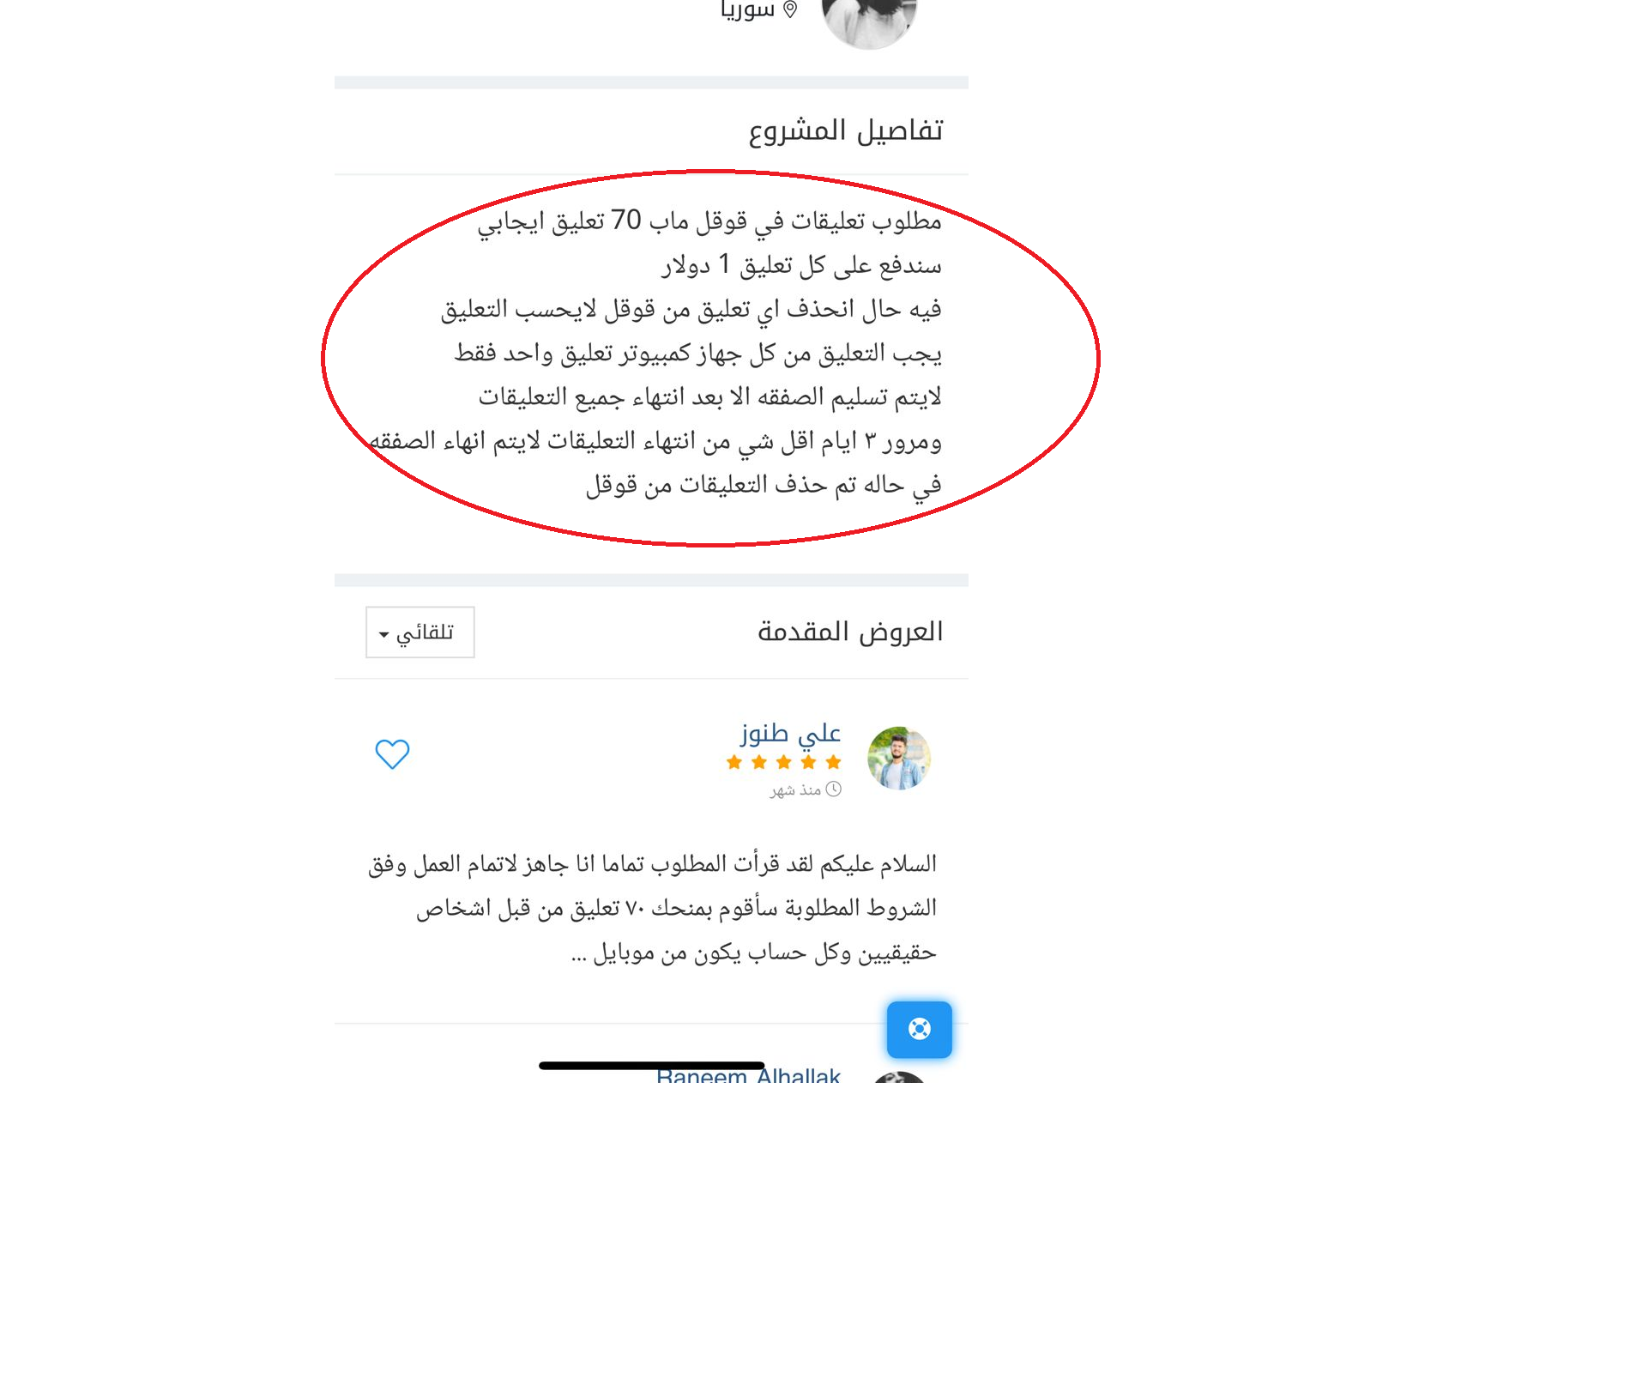

Slide 5
Data Collect
1
Google maps API’s
Extract and scraping data
2
Sorting data set
Merges 11 dataframes

Slide 6
Data Set
Before
After
Review Text
Review Text
Rating
Size => 16500 × 2
Size => 14963 × 1

Slide 7
Pre-Processing
Remove
Convert
Remove
Remove non english words
Convert text to lowercase
Remove all punctuation
Remove
Use
Remove all stop Words
Using Lemmatizer

Slide 8
Vectorizer
Count Vectorization
TF-IDF

Slide 9
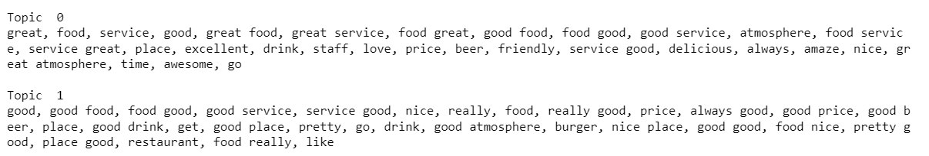
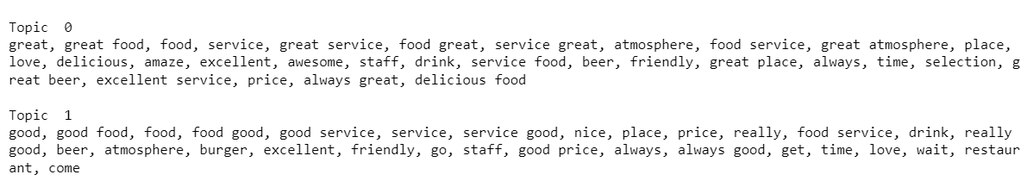
Topic Modeling
LSA
Jupiter is the biggest one
The Earth is our planet
$12
$5
NMF
Saturn is a ringed planet
Mercury is a hot planet
$10
$15

Slide 10
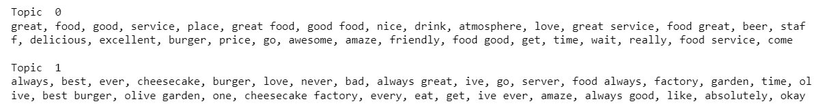
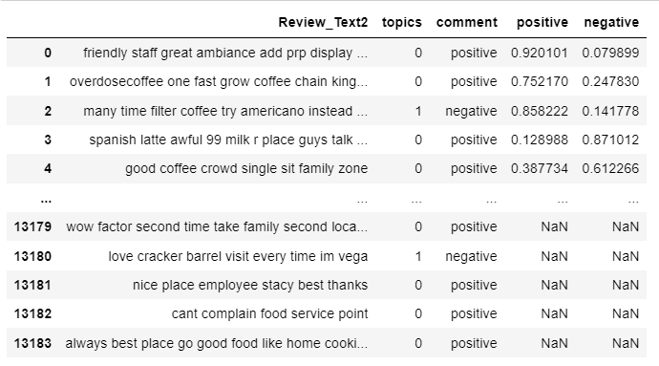
Topic Modeling
LDA

Slide 11
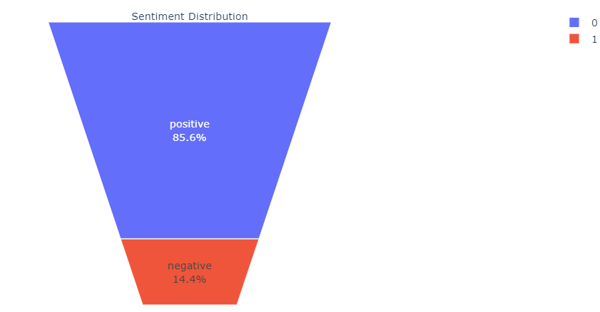
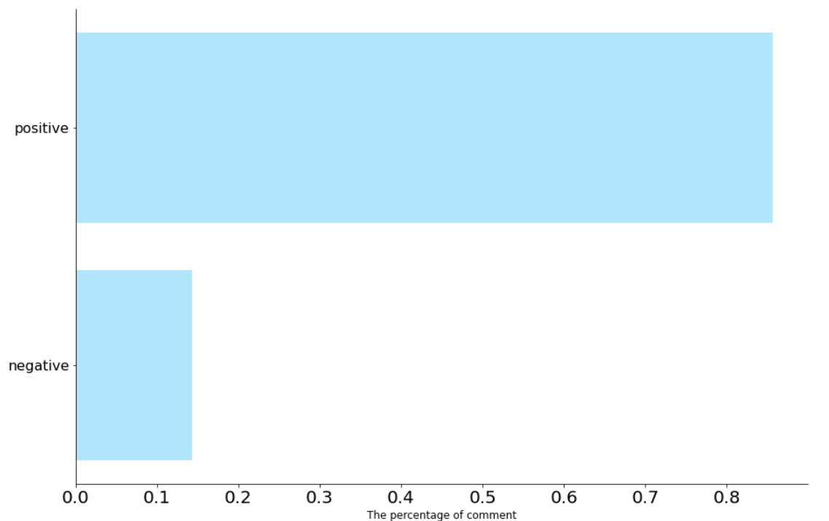
Positive , Negative Reviews
positive
negative

Slide 12
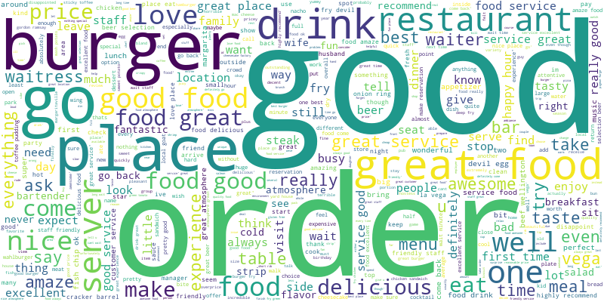
More common words ?
Words
1- Good
2- Order
3- Burger
4- Place
5- Drink
The Top 5 !

Slide 13
Clustering
Kmean
# of clustering = 2
Positive 1
Negative 0

Slide 14
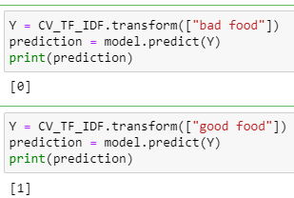
Negative 0
Positive 1

Slide 15
Classification Model
Logistic Regression
SVM
Accuracy
88%
Accuracy
89%
Naïve Bayes
Accuracy
86%

Slide 16
Future Work
Finally!
We will work with the Arabic data set , we’re readily scrapped and exporting to the competent authorities to a good choice restaurant in public events

Slide 17
THANKS!

