Slide 1
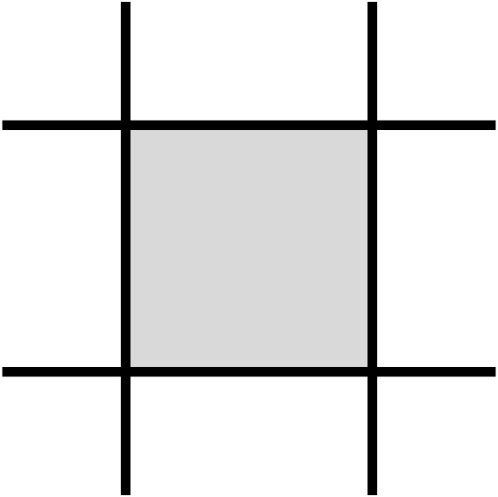
Area (K)
Width (q)
Length (p)
Perimeter (p)

Slide 2
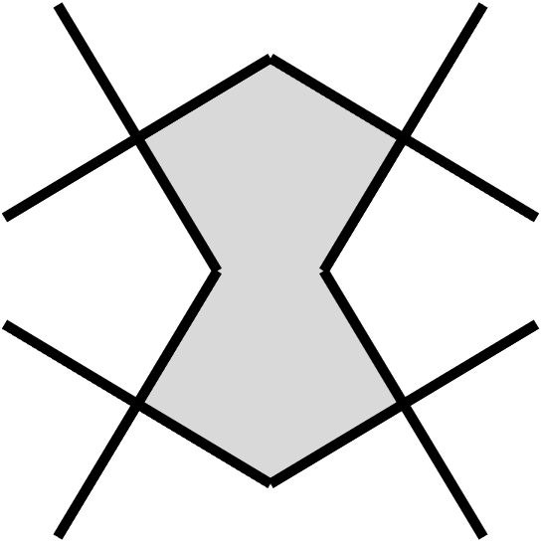
Major Angle (A)
Width (q)
Minor Angle (B)
Length (p)
Area (K)
Perimeter (p)

Slide 3
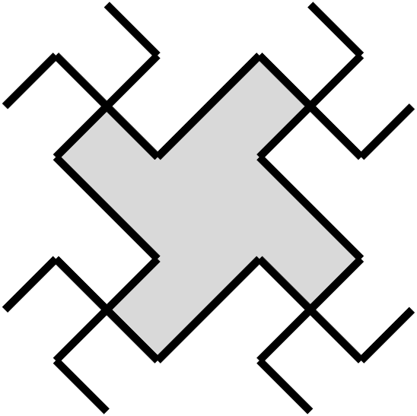
Major Angle (A)
Width (q)
Area (K)
Minor Angle (B)
Length (p)
Perimeter (p)

Slide 4
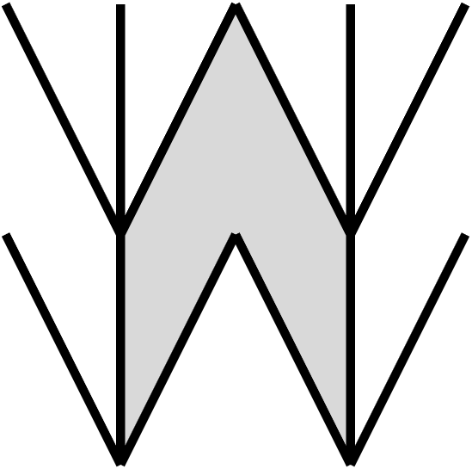
Width (q)
Area (K)
Length (p)
Major Angle (A)
Perimeter (p)

Slide 5
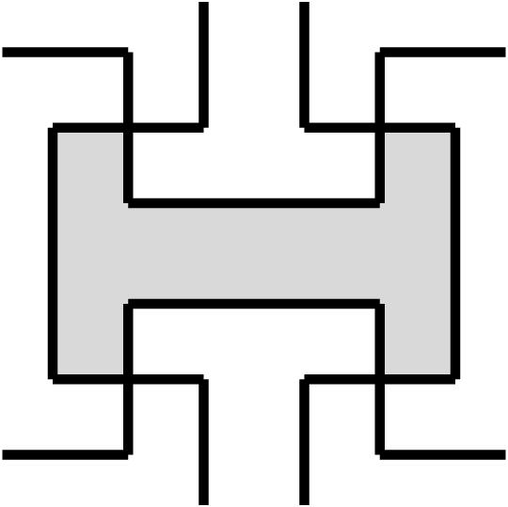
Length (p)
Width (q)
Area (K)
Perimeter (p)

Slide 6
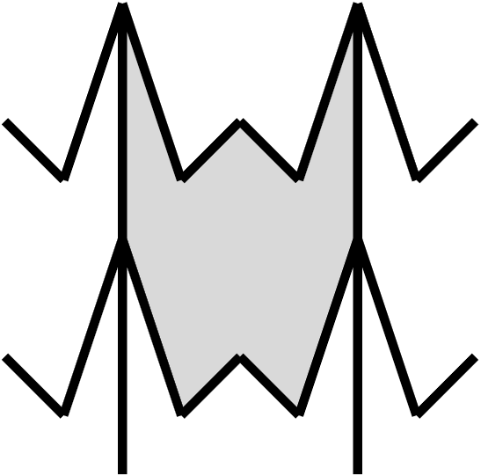
Perimeter (p)
Width (q)
Area (K)
Length (p)
Major Angle (A)

Slide 7
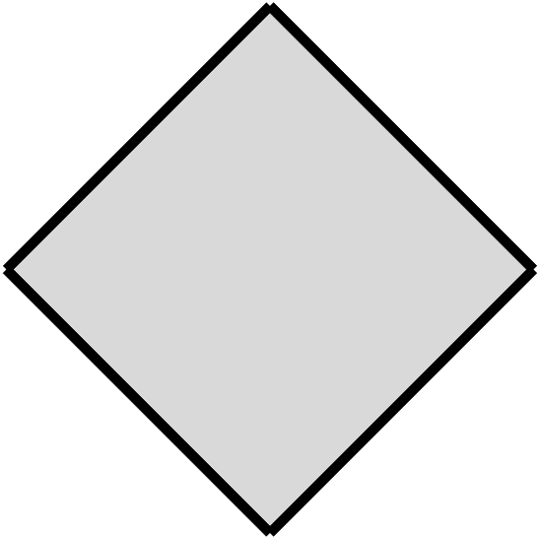
Area (K)
Width (q)
Length (p)
Perimeter (p)

Slide 8
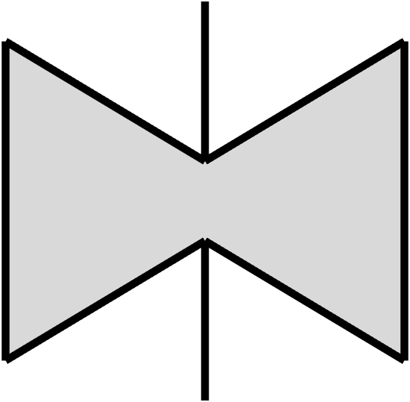
Major Angle (A)
Length (p)
Width (q)
Area (K)
Perimeter (p)

Slide 9
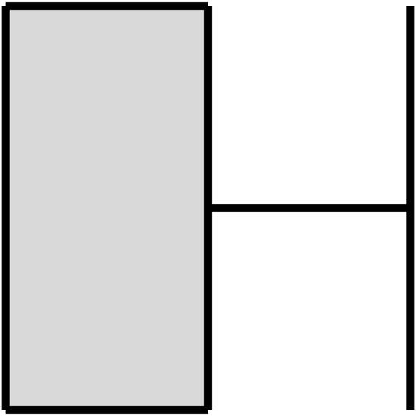
Perimeter (p)
Area (K)
Length (p)
Width (q)

Slide 10
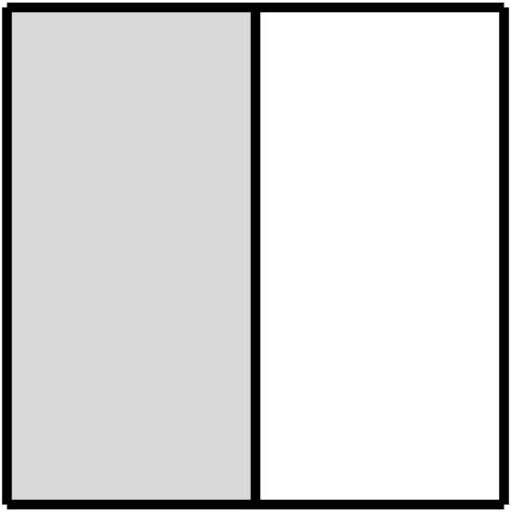
Perimeter (p)
Area (K)
Length (p)
Width (q)

Slide 11

Perimeter (p)
Major Angle (A)
Area (K)
Length (p)
Width (q)

Slide 12

Perimeter (p)
Area (K)
Major Angle (A)
Length (p)
Width (q)

Slide 13
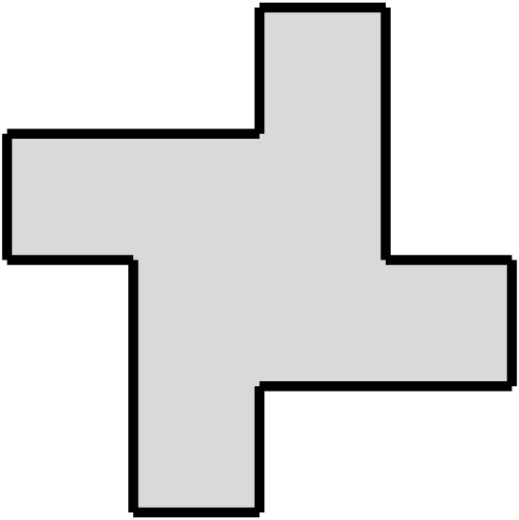
Area (K)
Length (p)
Width (q)
Perimeter (p)

Slide 14
Preserve cell design or scaffold dimensions

Slide 15
Layer 1
Layer 2
X offset
Y offset

Slide 16
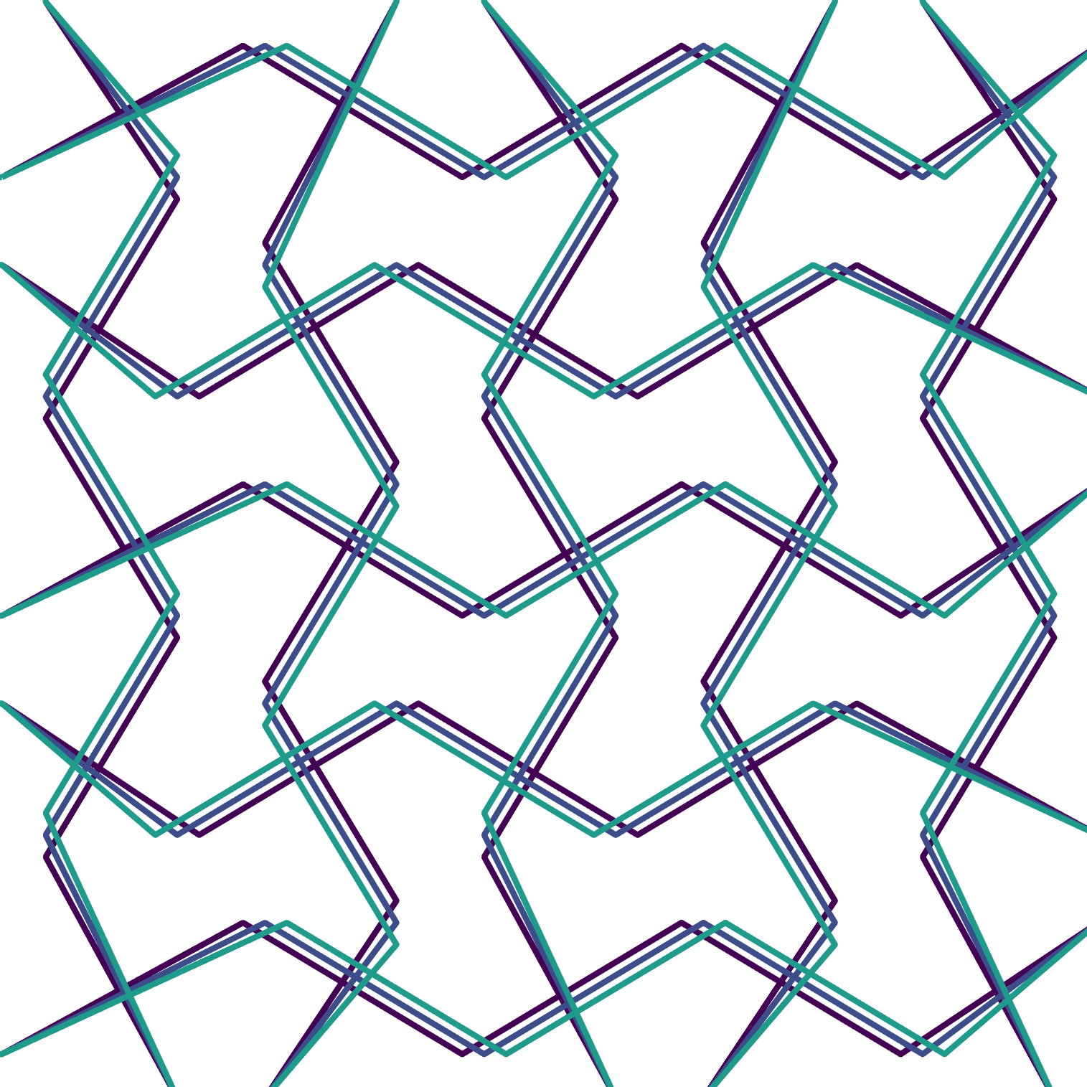
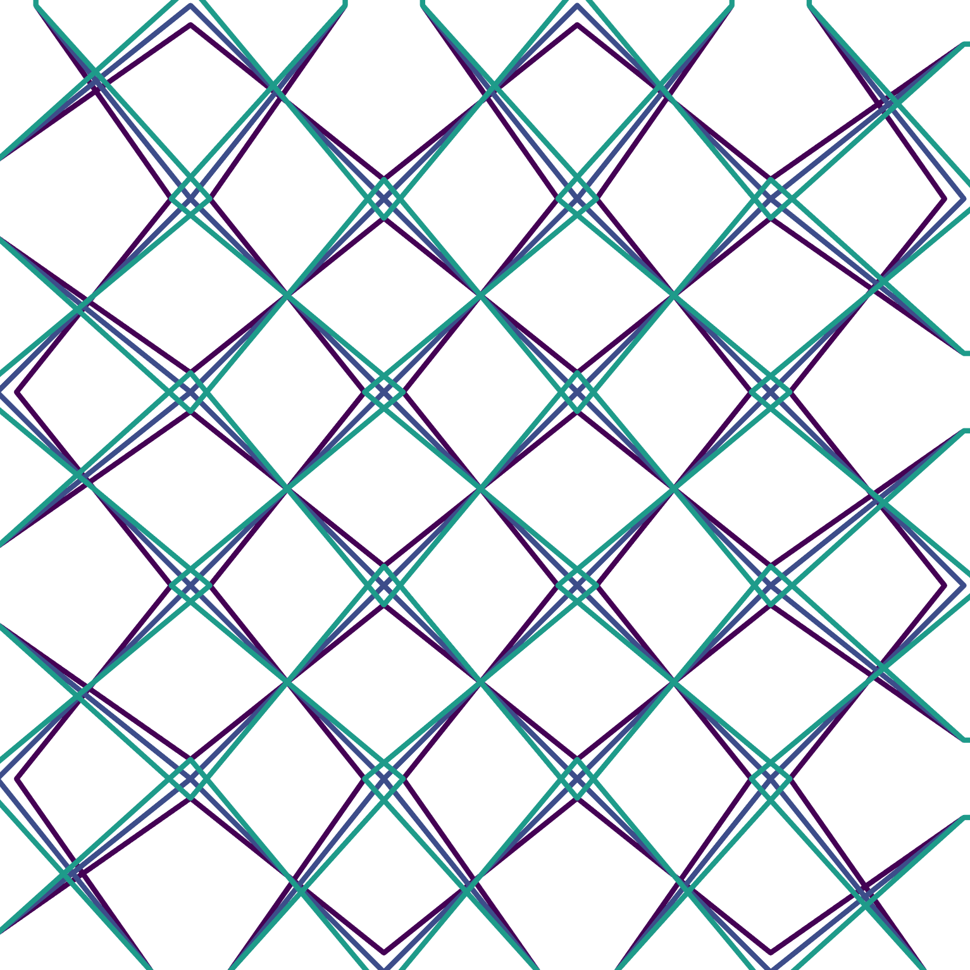
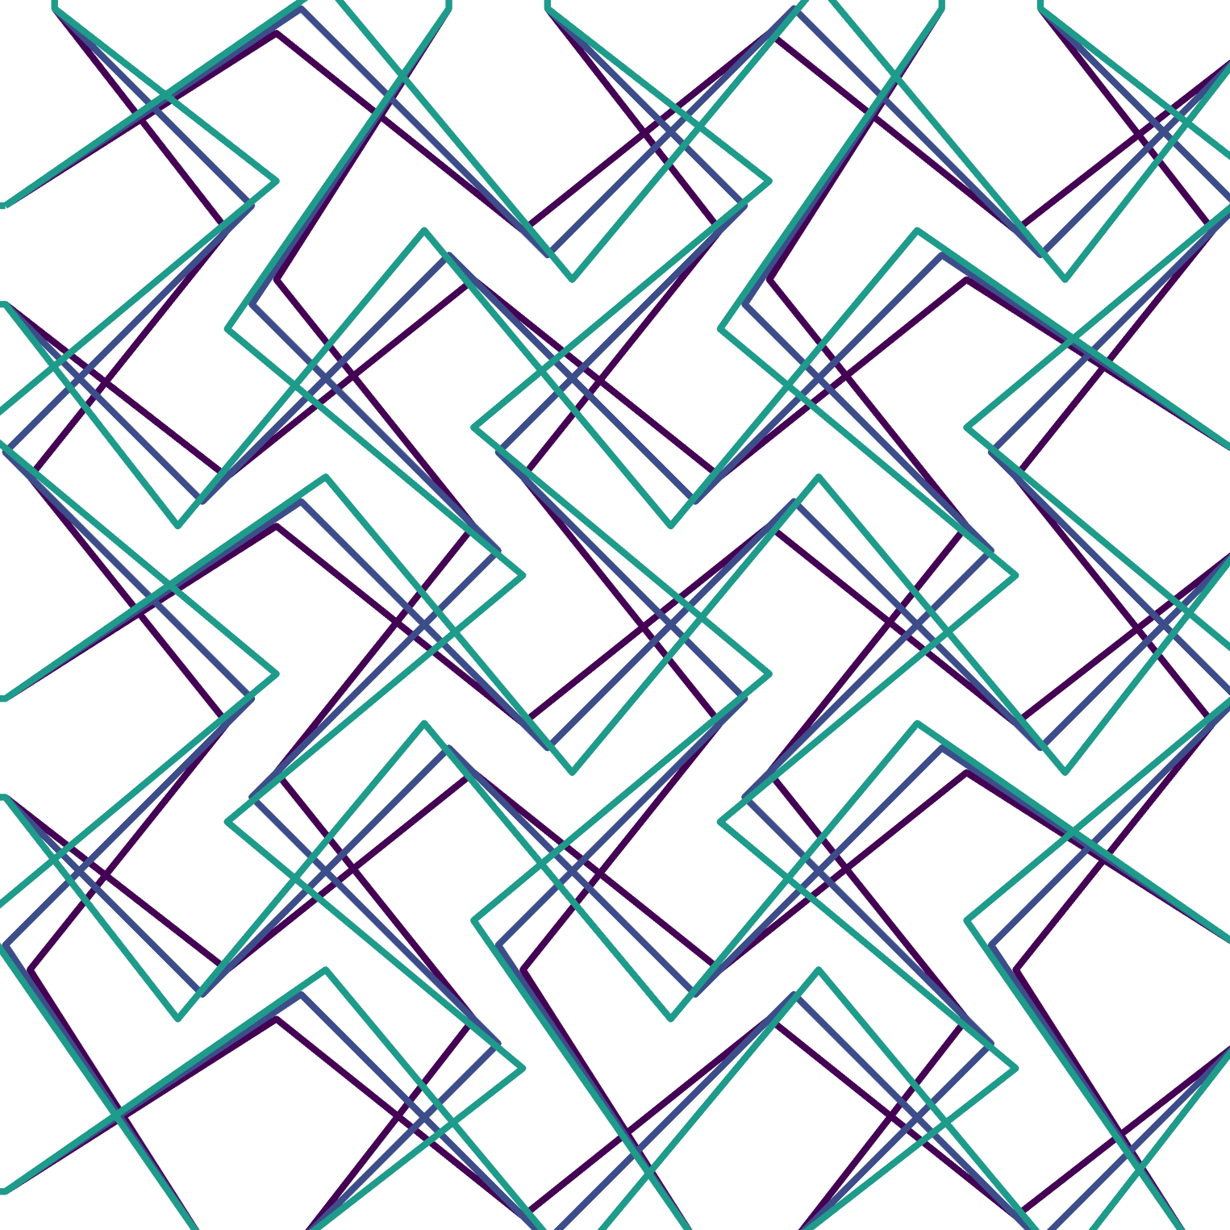
Phase: offsets node in the direction of print
Amplitude: offsets node perpendicular to print
New node
Previous
node
Print direction
Example combinations
Phase only
Amp only
Both
Layer 1
Layer 2
Layer 3

