Slide 1
EFFICIENT AUCTION PRICE PREDICTION USING MACHINE LEARNING FOR IPL TOURNAMENT
SHAHAL AHAMMED K DR.ASWATHY A L
MSC AI PROJECT SUPERVISOR
DEPARTMENT OF COMPUTER SCIENCE
UNIVERSITY OF KERALA
THIRUVANANTHAPURAM
07-08-2023

Slide 2

AGENDA
Introduction
Objective
Problem Statement
Literature Review
Methodology
Result and Analysis
Conclusion
Future Enhancement
Reference

Slide 3
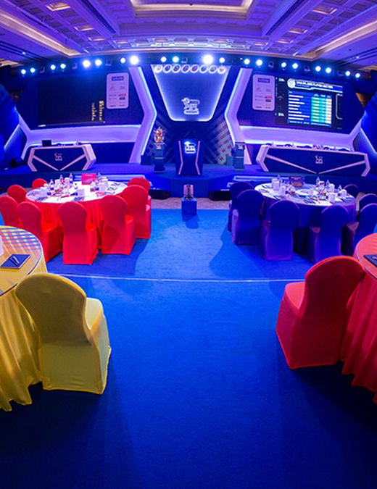
INTRODUCTION
Indian Premier League(IPL) one of the most successful T20 format tournaments in the world.
IPL was conducted by Board of Control for Cricket in India (BCCI) for past 15 year. Last time 10 teams were participated and 74 matches played. Each match cost a revenue of around 140 crore.
The IPL teams select players through Auction in each edition of IPL.

Slide 4
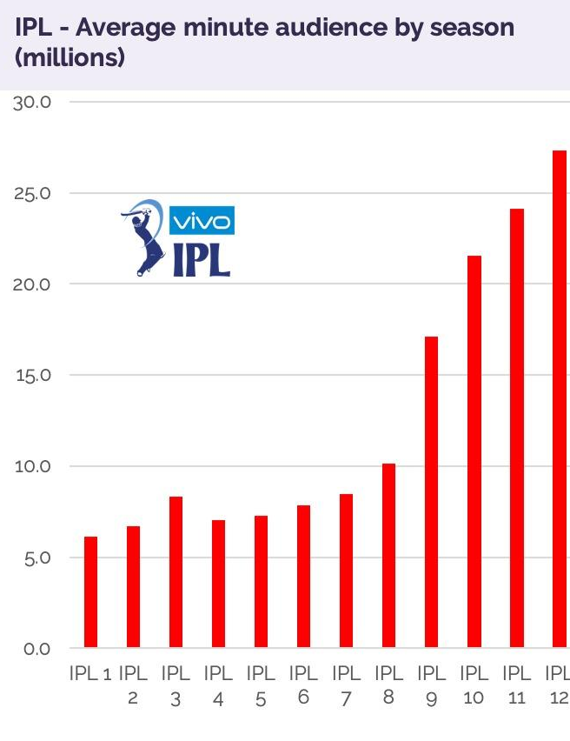
In each edition of IPL franchise selects players through auction were each team have squad depth of 18 - 25 players.
Franchise need to select players without exceeding their budget . Auction is one major part of the IPL that decide the result of the season
In this work aims to evaluate and predict auction price for each player and selecting the best players at a particular position with expected budget.

Slide 5
OBJECTIVE
To propose a better Machine Learning model that can predict optimal price for each players. The model helps IPL teams to select best players within budget that is beneficial for franchise.

Slide 6
PROBLEM STATEMENT
In an auction, franchises lack proper evaluation of player prices, which affects the season's results.
Traditional models have been inaccurate in the evaluation and price prediction of players.
Existing models lack certain features, which leads to inaccuracies in analysis.

Slide 7
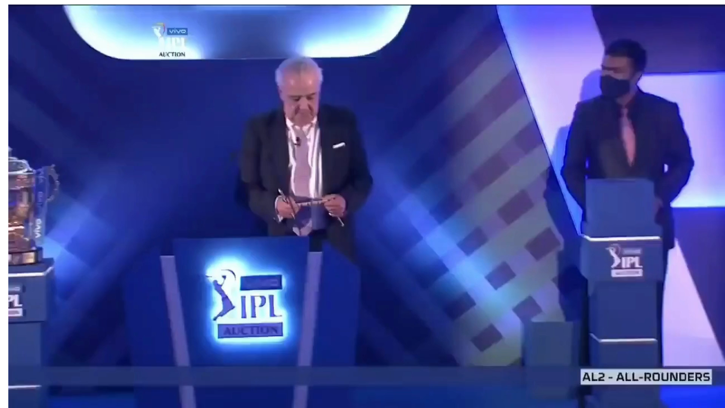
WHY OPTIMAL?

Slide 8
LITERATURE REVIEW
Author | Paper | Method | Year
Gaurav Malhotra et. al. | A Comprehensive Approach To Predict Auction Prices And Economic Value Creation Of Cricketers In The Indian Premier League | Linear Regression used for Creating Hedonic Model | 2022
Jhansi Rani et.al. | Prediction Of Player Price In IPL Auction Using Machine Learning Regression Algorithms | KNN, SVR, Decision Tree Regressor, Linear Regression, Stochastic Logistic Regression, Random Forest Regressor for Models comparison | 2020
Pabitra Kr. Dey et.al. | AHP-Neural Network Based Player Price Estimation | Create model based on Analytical hierarchy Process (AHP) and Artificial Neural Network (ANN) | 2014

Slide 9
A Comprehensive Approach To Predict Auction Prices And Economic Value Creation Of Cricketers In The Indian Premier League(IPL)
The aim of the study was to create a model by linear regression using several statistics to estimate auction price.
The goal of the project was to find the difference between the price predicted by the model and actual price they got in the auction.
Linear regression, Bayesian ridge regression, and Random Forest were attempted, and Linear regression was selected as the best model.
The model was inaccurate in prediction as they lack in dataset.

Slide 10
Prediction Of Player Price In IPL Auction Using Machine Learning Regression Algorithms
In the study, a comparison of machine learning models was conducted, including the Decision Tree Regressor, K-Nearest Neighbors (KNN), Linear Regression, Stochastic Logistic Regression, Random Forest Regressor, and Support Vector Regression (SVR)..
Concluded that SVR is the best model for batsmen and Linear regression is the best model for bowlers.
Work estimated the players’ selling price using their past performance parameters like runs, balls, innings, wickets and matches played.
Many features are not considered as important for prediction, such as experience, popularity, etc.

Slide 11
AHP-Neural Network Based Player Price Estimation in IPL
This study has developed an intelligent model for estimating player prices by using a combination of the Analytic Hierarchy Process (AHP) and Artificial Neural Network (ANN).
In the study, the relative importance of the attributes was calculated to train the system, and finally, the player price was generated as an output.
Player’s estimation done basic features, player’s Performance Appraisal, Player’s Experience Contribution, player’s recent form.
The prediction may not be accurate due to the lack of features such as international match experience, popularity, and other factors.

Slide 12
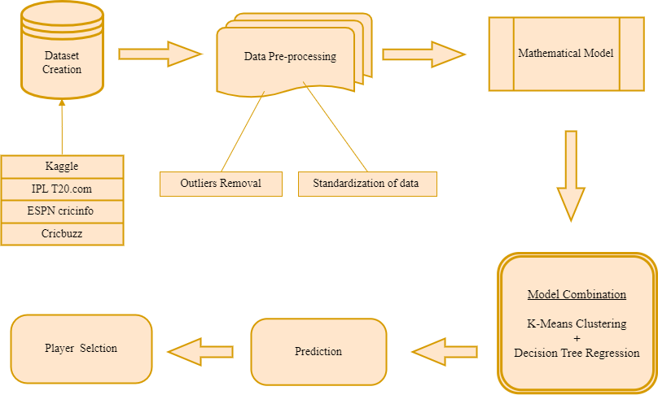
METHODOLOGY

Slide 13
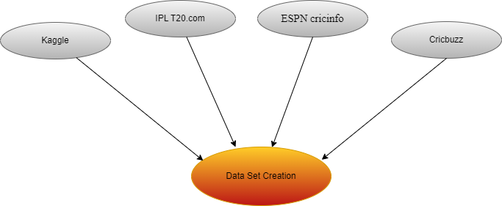
DATASET
Auction Dataset
Two datasets were used for prediction.
An auction dataset is created to include data for all players in the auction, which is used to evaluate player performance and predict prices based on their performance.
The auction dataset contains 590 data points with more than 40 features used for evaluating and predicting player prices based on their performance.

Slide 14
Auction Dataset | Name , Age, SLOT , ROLE, Batting ,Bowling ,U/C/A ,Test caps ,ODI caps ,T20 caps ,IPL ,T20I Runs ,T20I HS,T20I Bat avg,T20I Bat strike rate,T20I Wickets ,T20I Bowl avg,T20I Bowl strike rate,T20I Bowl Economy ,IPL Runs ,IPL HS ,IPL Bat avg ,IPL Bat strike rate ,IPL Wickets ,IPL Bowl avg ,IPL Bowl strike rate ,IPL Bowl Economy ,Last IPL Runs ,Last IPL HS ,Last IPL Bat avg ,Last IPL Bat strike rate,Last IPL Wickets ,Last IPL Bowl avg ,Last IPL Bowl strike rate ,Last IPL Bowl Economy ,T20 Runs ,T20 HS ,T20 Bat avg,T20 Bat strike rate ,T20 Wickets ,T20 Bowl avg ,T20 Bowl strike rate,T20 Bowl Economy ,Current Form ,Popularity ,Captain ,Base Price
Stats Dataset
Stats contain the players who were sold at that auction, and they are used to compare the actual price at which players were sold with the predicted price for each individual player. This evaluation is performed by the model.
The dataset consists of 135 data points, each containing over 20 features, aimed at evaluating a player's performance during the season. The goal is to compare the actual and predicted prices.
The data sets were created from www.IPLT20.com,www.espncricinfo.com,www.icccricket.com,www.kaggle.com, and www.cricbuzz.com. The study included data sets specifically for the 2022 IPL season.
Stats Dataset | Name, Age ,SLOT ,ROLE ,Matches ,Batting innings ,Not out, Runs scored ,High score ,Batting avg ,Balls Faced ,Batting strike rate ,100 scored ,50 scored ,4s ,6s ,Bowling innings ,Overs bowled ,Runs conceded ,Wickets taken ,Bowling average ,Bowling economy ,Bowling strike rate ,Sold Price

Slide 15
DATA PRE-PROCESSING
Select the essential features for prediction while excluding player personal characteristic features such as name, age, and slot.
The null values in the set in the datasets were replaced by ‘0’.
The labeled data were converted into categorical data.
The dataset was normalized and splits into four in base of roles.

Slide 16
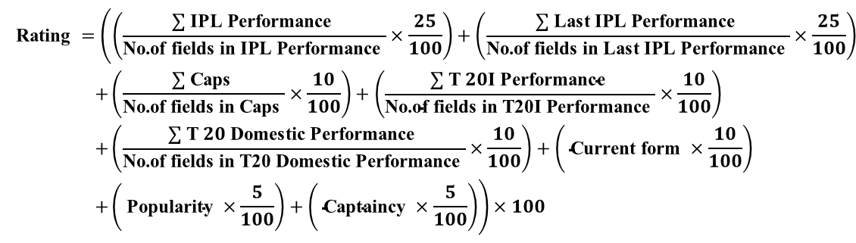

MATHEMATICAL MODEL
The mathematical model was created by our own mathematical equation were evaluated by the ability of the player according to their roles.
The model was used as feature (Rating) in the dataset to standardize the cluster.
The model is assessed by the ability of the player according to their roles.
Two abilities are Bowling ability and Batting ability
Bowler-Bowling ability Batter, Wicket-keeper-Batting ability All-rounder-Batting and Bowling ability
(Rating Equation for Auction Dataset)
(Rating Equation for Stats Dataset)

Slide 17
MODEL COMBINATION
In the study, we utilize a combination model to cluster players based on their performance. We apply clustering models for the initial clustering process and then validate the resulting clusters using a regression model. This approach aims to determine the accurate clusters in effectively grouping players according to their performance.
After attempting various machine learning models, found that K-means and Decision Tree regression as the best combination.

Slide 18
Model Combinations
Clustering Model | Regression Model | Accuracy
K-Means Clustering | KNN | 55%
 | Decision Tree Regression | 95%
 | Linear Regression | 85%
Fuzzy-C-Means | KNN | 19%
 | Decision Tree Regression | 17%
 | Linear Regression | 8%
Agglomerative Clustering | KNN | 63%
 | Decision Tree Regression | 84%
 | Linear Regression | 79%
Spectral Clustering | KNN | 11%
 | Decision Tree Regression | 7%
 | Linear Regression | 8%

Slide 19
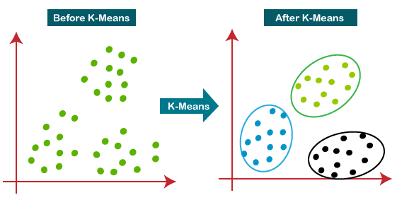
K-MEANS CLUSTERING
K-means is an unsupervised machine learning algorithm that takes an unlabeled dataset as input and divides it into a predetermined number of clusters.
In this context, clustering refers to the process of grouping similar data points together based on their similarities for price setting for each player.
In this study we attempted K-Means ,Fuzzy-C-Means, Spectral and Agglomerative clusters for clustering and eventually got K-means as best cluster.

Slide 20
DECISION TREE REGRESSION
Decision tree regression is a supervised machine learning algorithm which is used for prediction and classification.
The prediction is used for the validation of the clusters.
In this study attempted Linear Regression, KNN and Decision Tree Regression used for prediction and eventually got Decision Tree as best prediction.

Slide 21
RESULT AND ANALYSIS
Cluster Validation
Model Accuracy
Cluster standardization evaluated and price mapped.
Season Performance VS Performance Standard by the model
The model was compared with Previous study and found to be the model more accurate than previous study.
Player Selection

Slide 22
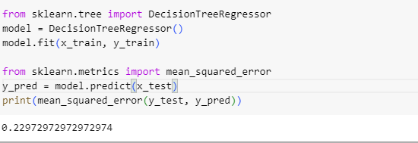
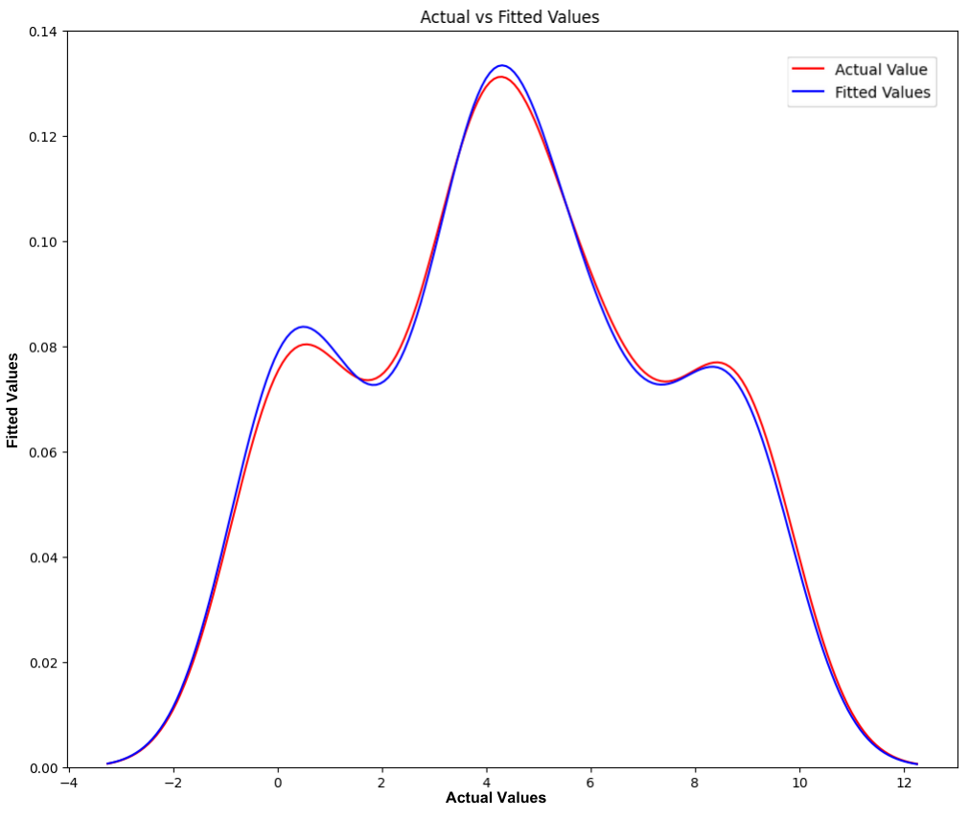
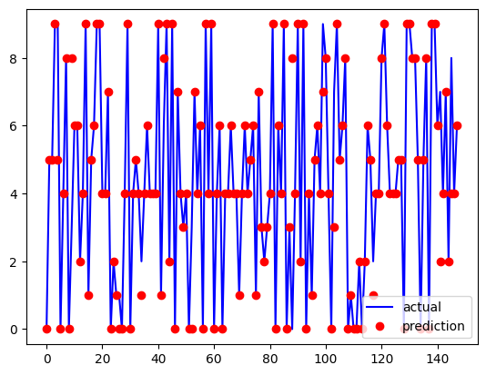
CLUSTER VALIDATION
(Mean squared error for Auction dataset)
(1)
(2)
(Auction dataset: Actual VS Predicted Plotting (1)&(2))

Slide 23
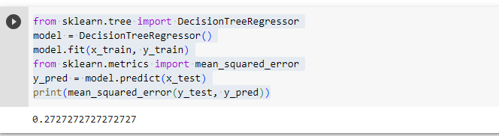
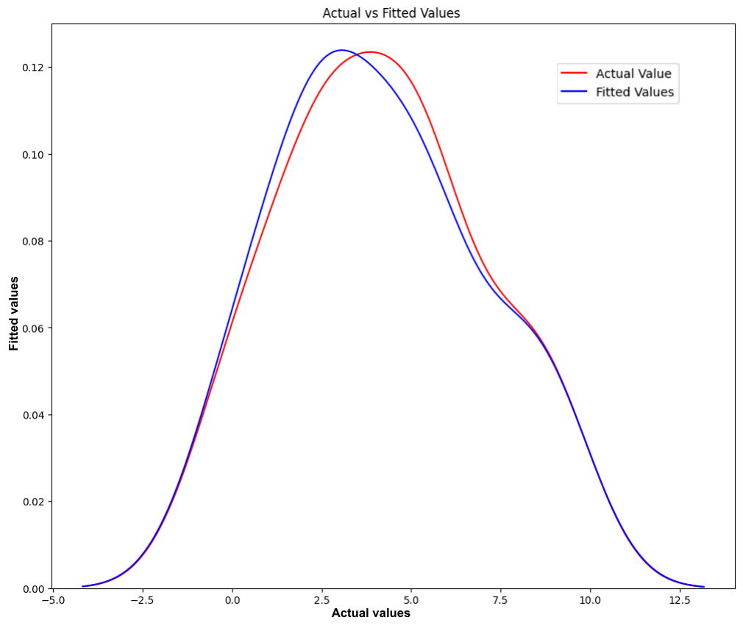
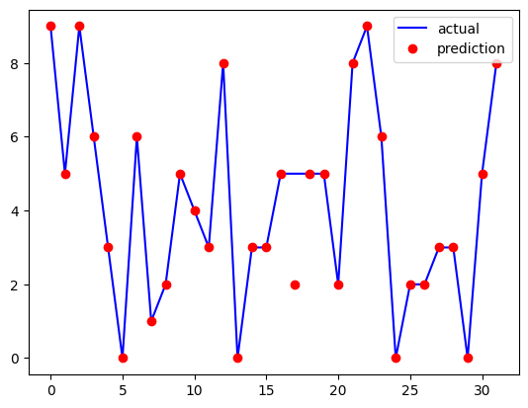
CLUSTER VALIDATION
(Mean squared error for Stats dataset)
(1)
(2)
(Stats dataset: Actual VS Predicted Plotting (1)&(2))

Slide 24
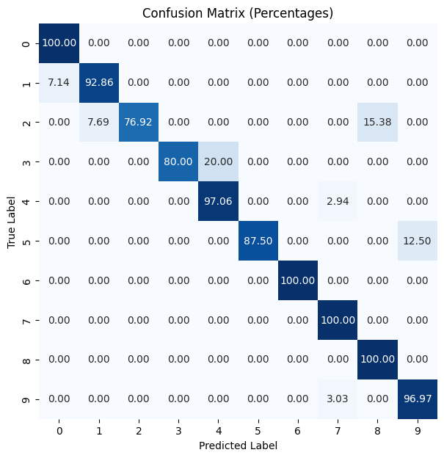
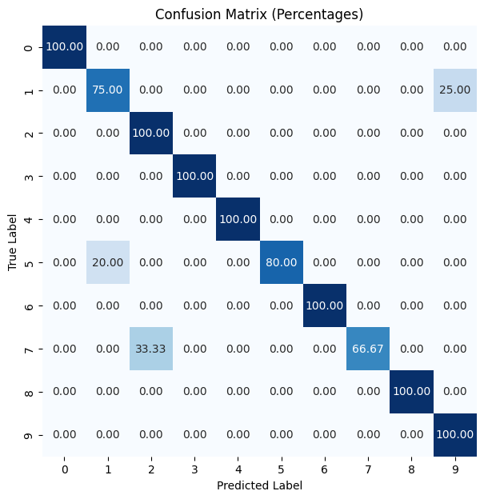
CONFUSION MATRIX
(Confusion Matrix for Auction dataset)
(Confusion Matrix for Stats dataset)

Slide 25
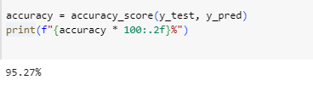
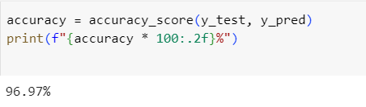
MODEL ACCURACY
(Accuracy for Auction dataset)
(Accuracy for Stats Dataset)
The model obtained 95% accuracy for the auction-based dataset and obtained 96% accuracy for Season stats-based dataset.

Slide 26
STANDARDIZATION OF CLUSTERS
The standardization of clusters was evaluated on the basis of Rating
The 10 clusters were standardized into 10 standards.
Mean of Rating is taken as primary consideration and Mean of Base price is considered as secondary.
On the basis of standard set price for each player are done by mapping in Auction dataset.
Cluster Standardization for Auction Dataset
Cluster | Mean Rating | Mean Base Price
0 | 14.608712 | 28.421053
1 | 22.963482 | 74.907407
2 | 37.202775 | 88.617021
3 | 28.795325 | 72.222222
4 | 14.604351 | 21.176471
5 | 10.779360 | 20.000000
6 | 51.168042 | 142.209302
7 | 58.330401 | 155.833333
8 | 31.687965 | 32.692308
9 | 17.185609 | 21.264368

Slide 27
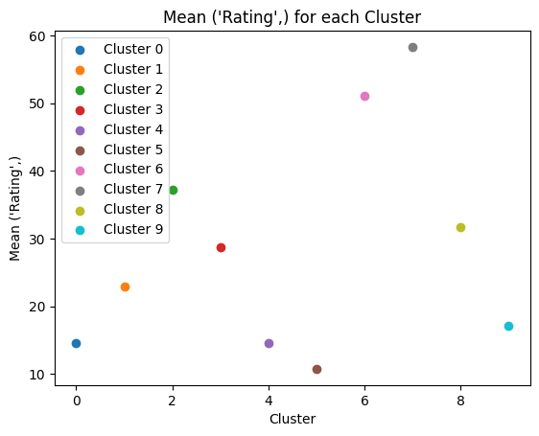
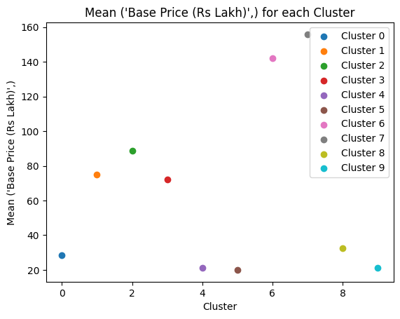
STANDARDIZATION OF CLUSTERS
(1)
(2)
(Auction dataset Standardization in case of Mean Rating(1) and Mean Base Price(2))

Slide 28
STANDARDIZATION OF CLUSTERS
Cluster Standardization for Stats Dataset
Cluster | Mean Rating | Mean Base Price
0 | 7.283501 | 46.333333
1 | 39.237750 | 77.105263
2 | 67.331450 | 141.666667
3 | 37.039387 | 41.250000
4 | 48.235682 | 65.000000
5 | 62.075786 | 144.333333
6 | 25.388785 | 85.714286
7 | 52.585088 | 111.071429
8 | 62.101384 | 150.000000
9 | 24.486389 | 70.833333

Slide 29
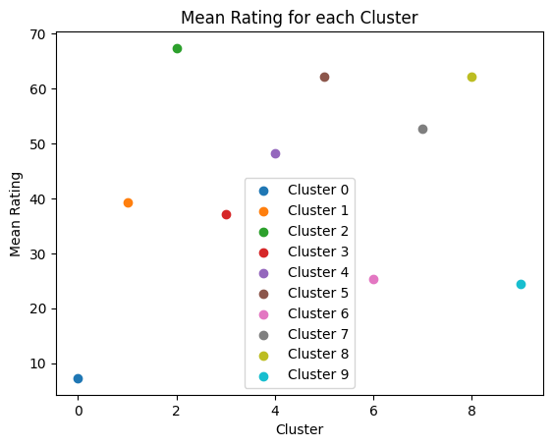
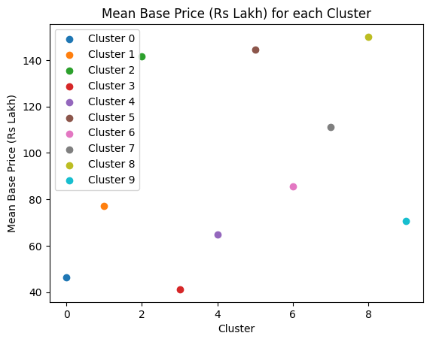
STANDARDIZATION OF CLUSTERS
(1)
(2)
(Stats dataset Standardization in case of Mean Rating(1) and Mean Base Price(2))

Slide 30
AUCTION PRICE MAPPING
Price Mapping According to standard
Standard | Starting Price | Maximum Price
A | 1200 | 1500
B | 1000 | 1200
C | 800 | 1000
D | 650 | 800
E | 500 | 650
F | 350 | 500
G | 200 | 350
H | 100 | 200
I | 50 | 100
J | 20 | 50

Slide 31
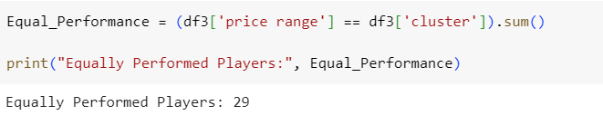
SEASON PERFORMANCE VS PERFORMANCE STANDARD BY THE MODEL
The comparison of player Season performance and Actual performance by our model is calculated by equality performed.
In the result, 29 players from the list performed up to their standard of performance. The performance of each player depends on many factors, including player selection in the playing eleven, the player's price, match pitch variation, and team mentalities.

Slide 32
COMPARISON OF CURRENT MODEL AND PREVIOUS MODEL
Mean Difference in Actual price and Predicted price Previous study
 | Batters | Bowlers | All-rounders
Average | 14.4% | 21.3% | 38.4%
Mean Difference in Actual price and Predicted price Current study
 | Total Sold Price (Lakh) | Difference From Sold Price | Mean Difference (%)
All-rounders | 15675 | 2130 | 13.588517%
Batters | 8205 | 80 | 0.975015%
Bowlers | 10385 | 420 | 4.044295%
Wicket-Keepers | 5680 | 25 | 0.440141%
As the result got that our model more accurate than traditional model.

Slide 33
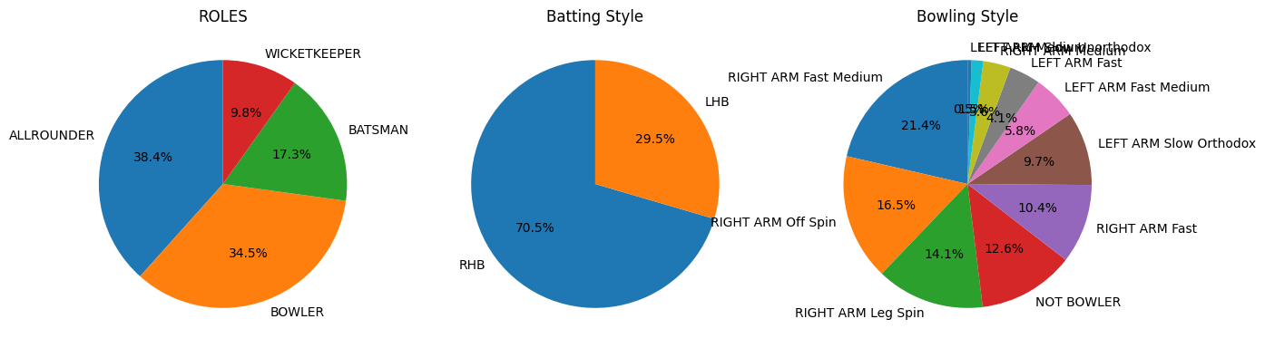
PLAYERS SELECTION
The model assists franchises to select the best player for their squad by their role to select players within their budget. The player selected by budget allotted to the player, role of the player, batting style and bowling style. The model selects best 5 players for the requirement of franchises.
(Players Selection Criteria)

Slide 34
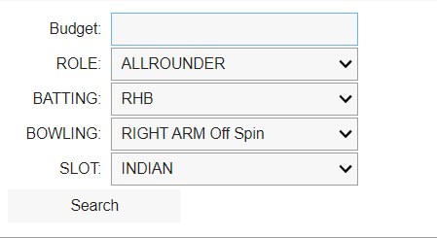
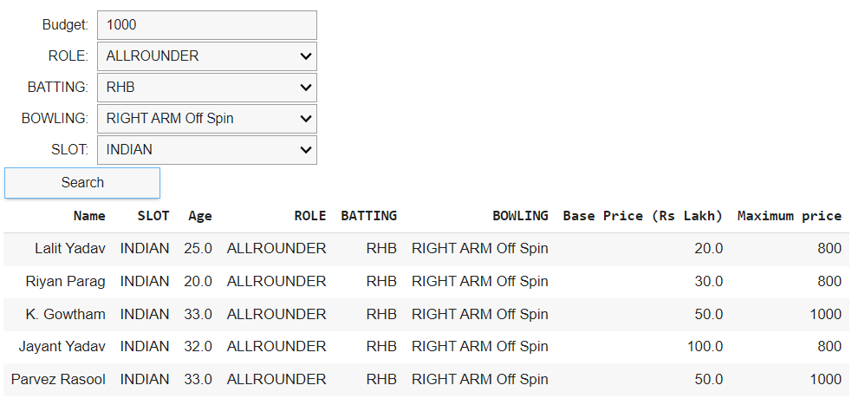
PLAYERS SELECTION
(Players Selection Widget)
(Players Selected for certain selections)

Slide 35
CONCLUSION
The IPL auction price prediction can be used for several T20 franchise-based tournaments. This study used K-means clustering and Decision tree regression for price prediction from created datasets. As result, the proposed model predicted the price for the player more accurately than traditional models.

Slide 36
FUTURE ENHANCEMENT
The model can be used to predict the price of the players in other franchise based tournaments. Nowadays franchise-based tournaments grow around the world. The players selection can be connected to websites which is more precise for the selection.

Slide 37
REFERENCE
Gaurav Malhotra,15 September 2022, A comprehensive approach to predict auction prices and economic value creation of cricketers in the Indian Premier League (IPL), Journal of Sports Analytics 8 (2022) 149– 170.
Dr. Jhansi Rani Apurva Kulkarni, Aditya Vidyadhar Kamath, November 04,2020, Prediction Of Player Price In IPL Auction Using Machine Learning Regression Algorithms
Pabitra Kr. Dey, Abhijit Banerjee, Dipendra Nath Ghosh, Abhoy Chand Mondal,2014, AHP-Neural Network Based Player Price Estimation in IPL, International Journal of Hybrid Information Technology, Vol.7, No.3 (2014), pp.15-24
Kristina P. Sinaga and Miin-Shen Yang, May 13 2020, Unsupervised K-Means Clustering Algorithm, IEEE Access, Ministry of Science and Technology, Taiwan, under Grant MOST 107-2118-M-033-002-MY2.
Harsh H. Patel , Purvi Prajapati, October 31 2018, Study and Analysis of Decision Tree Based Classification Algorithms, International Journal of Computer Sciences and Engineering, Vol.-6, Issue-10, Oct. 2018.

Slide 38
THANK YOU

