Slide 1
DRIVER VIGILANCE SYSTEM
Sayona P - IT23PSCSD16
Shahala K O P - IT23PSCSD17
Sreya C - IT23PSCSD19

Slide 2
Contents
Introduction
Objective
System Components and Functions
Existing System
Proposed System
Flow Chart
Circuit Diagram
Advantages and Features
Challenges
Future Enhancements
Conclusion
Output Image
Reference

Slide 3
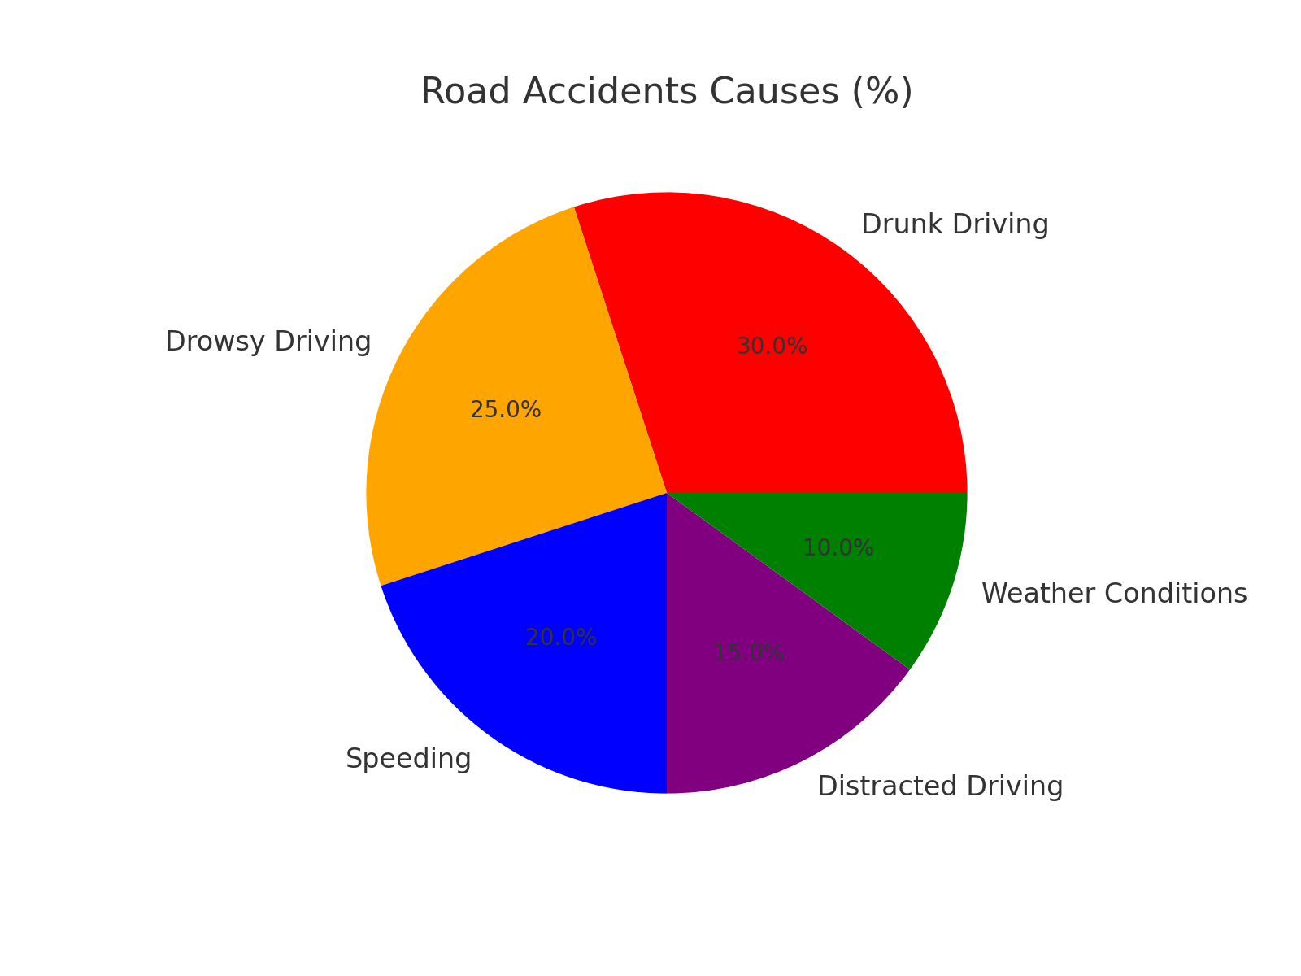
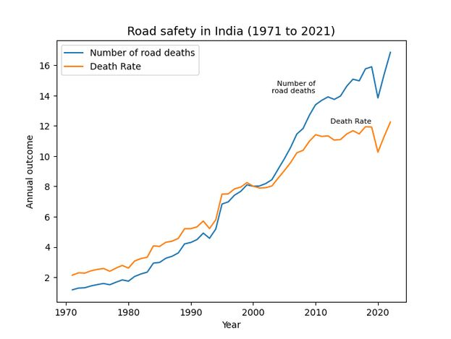
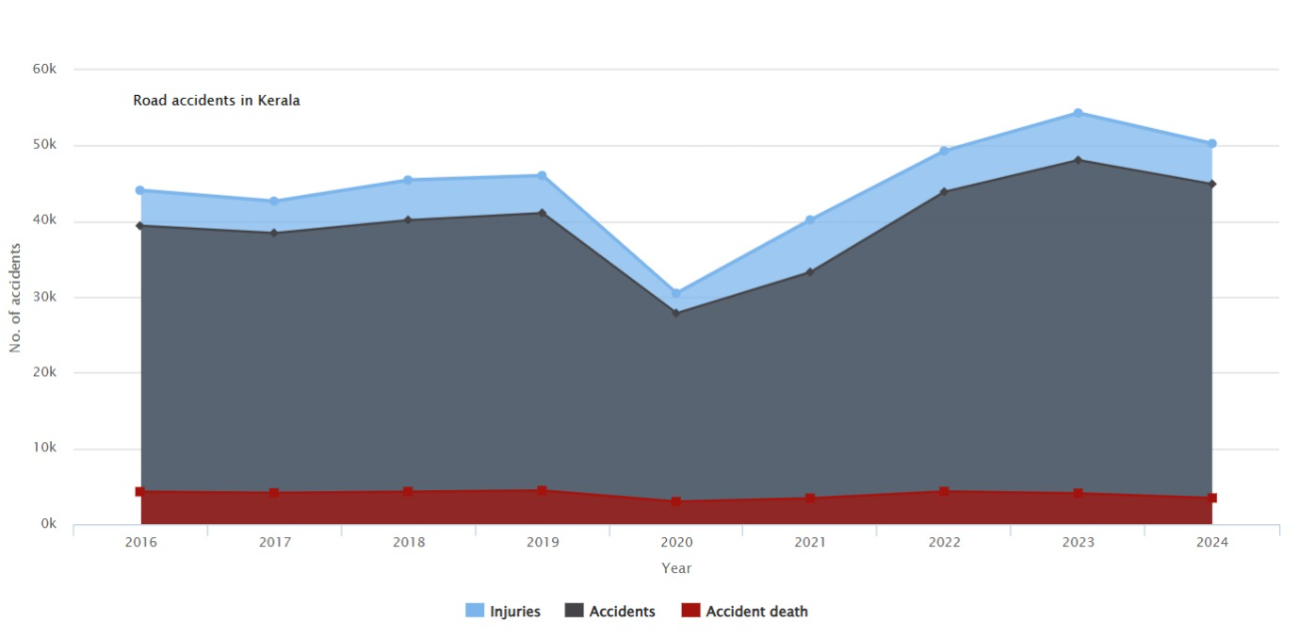
Introduction

Slide 4
Introduction cntd…
Road accidents are a major cause of injuries and fatalities.
Main causes of accidents:
• Drunk driving
• Drowsiness & fatigue
• Obstacle collisions
Our solution: An automated system to detect driver impairment and prevent accidents.

Slide 5
Introduction cntd…
To address these critical issues, our project introduces a Driver Vigilance Monitoring System, which focuses on enhancing road safety through:
Alcohol Detection: Using an MQ-3 alcohol sensor to monitor the driver’s breath and halt the vehicle if alcohol is detected above a safe threshold.
Drowsiness Monitoring: Employing an eye-blink sensor to detect prolonged eye closure or irregular blinking, indicating fatigue or inattention, and taking necessary preventive actions.
Obstacle Avoidance: Incorporating an ultrasonic sensor to detect obstacles in the vehicle's path and stopping the vehicle to avoid collisions.

Slide 6
Objectives
Ensure driver safety by monitoring alertness.
Prevent impaired driving using alcohol detection.
Avoid collisions using an obstacle detection system.
Automate vehicle control to stop the vehicle in unsafe conditions.

Slide 7
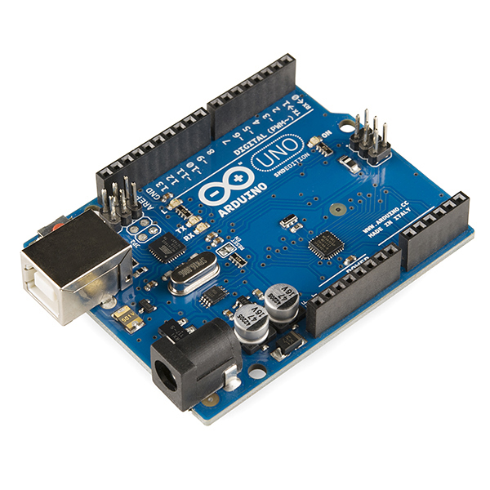
System Components and Functions
1. Arduino-Uno
The Arduino Uno is a popular microcontroller board based on the ATmega328P. It is widely used in embedded systems, robotics, and IoT projects due to its ease of use, open-source ecosystem, and vast community support..

Slide 8
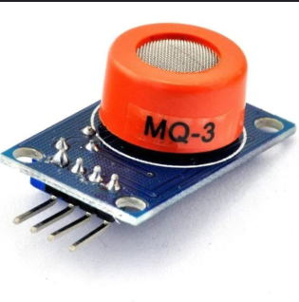
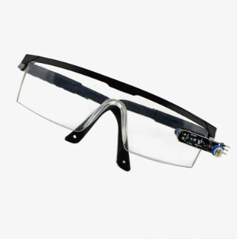
2. MQ-3 Alcohol Sensor
The MQ-3 Alcohol Sensor is a gas sensor designed to detect alcohol concentration in the air. It is widely used in breathalyzers, vehicle safety systems, and IoT-based alcohol detection applications..
3. Eye Blink Sensor
The Eyeblink Sensor is used to detect eye blinks by measuring the variation in infrared (IR) reflection caused by eyelid movement. It is commonly used in assistive technology, drowsiness detection systems, and human-computer interaction.

Slide 9
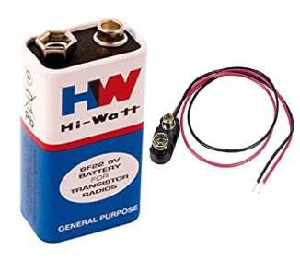
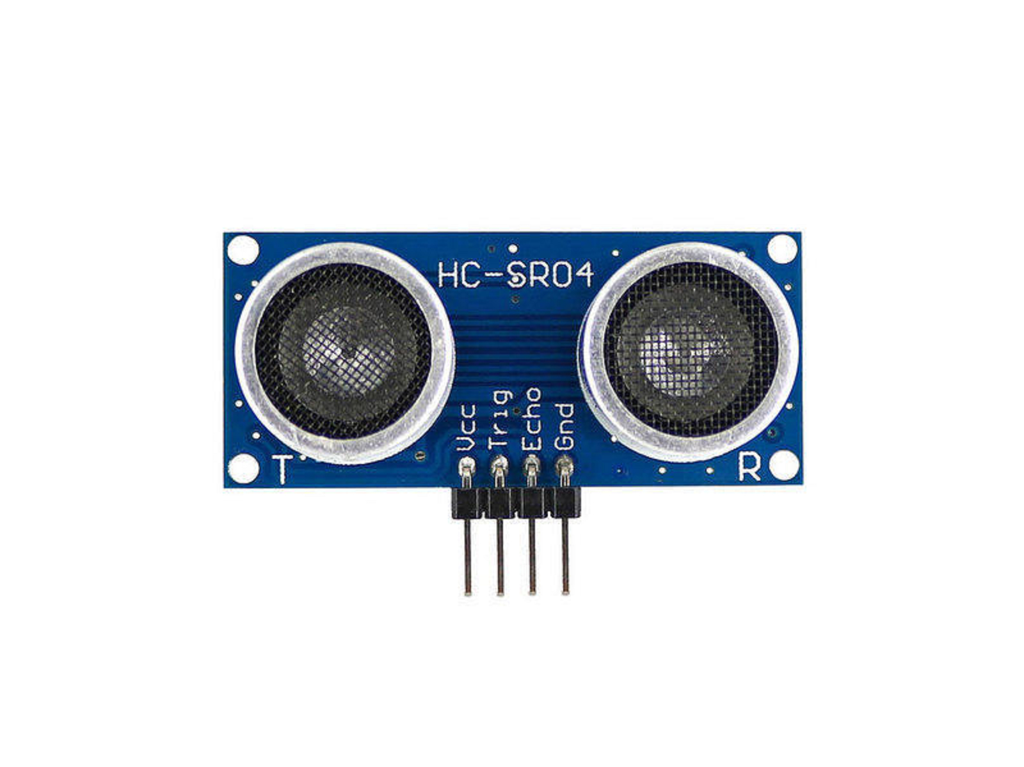
4. Battery
A battery is a device that stores chemical energy and converts it into electrical energy. It is widely used in electronics, IoT devices, robotics, and portable systems.
5. Ultrasonic sensor
An ultrasonic sensor is used for distance measurement by emitting ultrasonic waves and measuring the time it takes for the echo to return. It is widely used in robotics, obstacle detection, IoT, and automation.

Slide 10
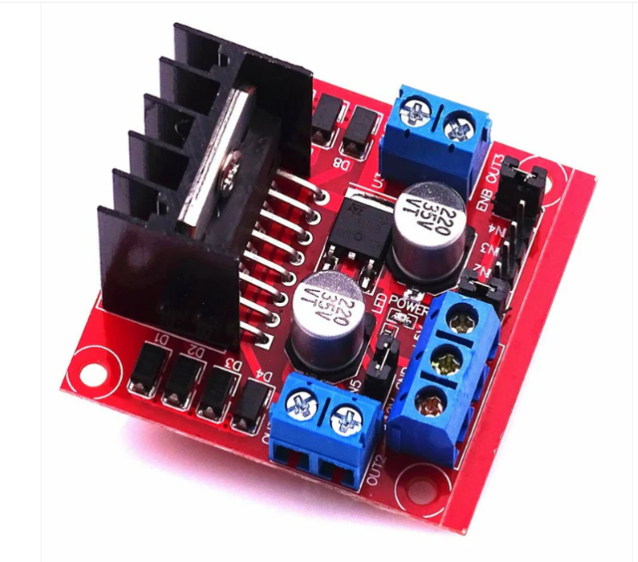
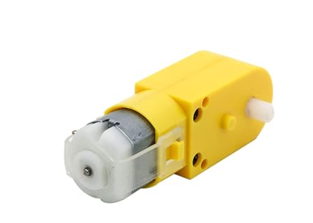
6. Motor Driver
A motor driver is an electronic circuit that controls the speed and direction of motors using low-power control signals from microcontrollers like Arduino, Raspberry Pi, or ESP32. It is essential for robotics, automation, and IoT-based motion control applications.
7. Motor
A motor is an electromechanical device that converts electrical energy into mechanical motion. Motors are widely used in robotics, automation, IoT, industrial machinery, and consumer electronics..

Slide 11
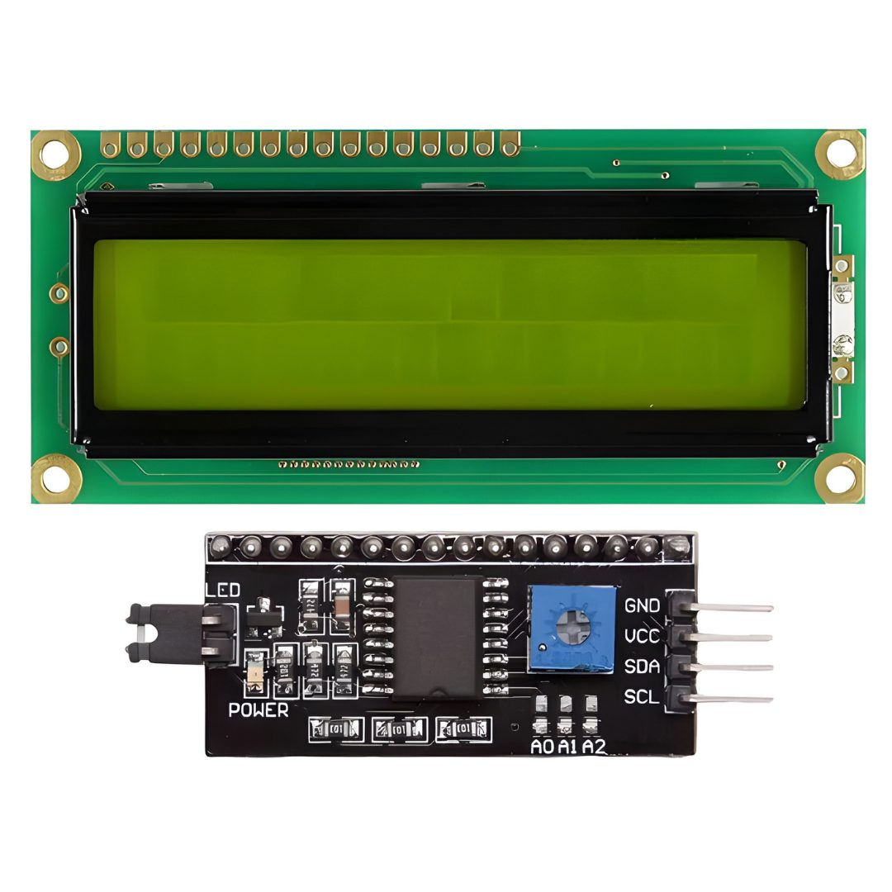
8. LCD Display
An LCD (Liquid Crystal Display) is commonly used in embedded systems and IoT projects for displaying data such as sensor readings, messages, and real-time information. The 16x2 LCD is one of the most widely used displays in Arduino and microcontroller-based projects..

Slide 12
Existing System
Alcohol Detection:
Ignition Interlock Devices (IIDs): Block vehicle start if alcohol is detected.
Integrated Sensors: Built into steering wheels or seats (e.g., Nissan, Volvo).
Drowsiness Detection:
Camera Monitoring: Tracks blinking and head movements (e.g., Tesla, BMW).
Steering Monitoring: Detects erratic steering behavior.
Challenges:
Expensive and complex systems.
Limited to specific safety features.

Slide 13
Proposed System
Eye-Blink Sensor: Monitors eye movements to identify drowsiness or inattention, halting the vehicle if irregular blinking patterns are detected.
Ultrasonic Sensor: Detects obstacles in the vehicle's path and stops the vehicle to prevent collisions.
The proposed system enhances driver safety by monitoring critical parameters related to the driver's condition and vehicle surroundings.
Alcohol Sensor: Detects alcohol in the driver's breath and stops the vehicle if the level exceeds a predefined threshold
Proposed System

Slide 14
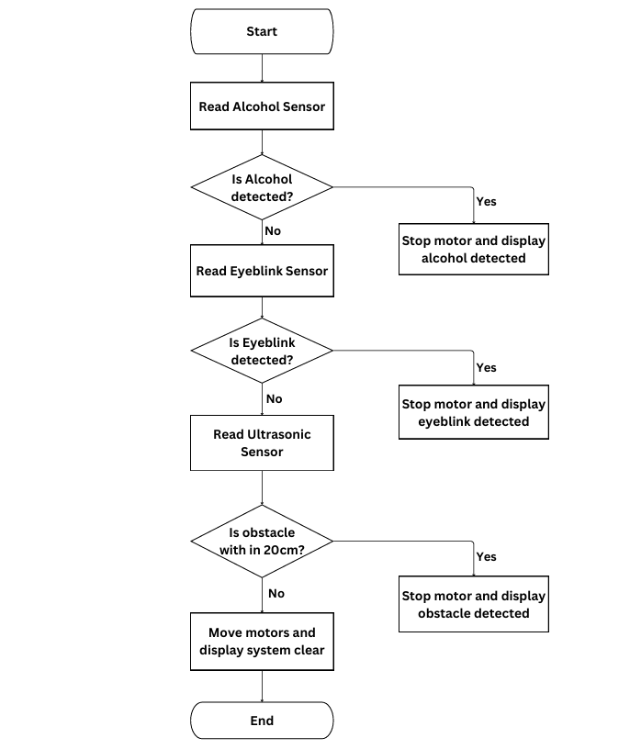
Flow Chart

Slide 15
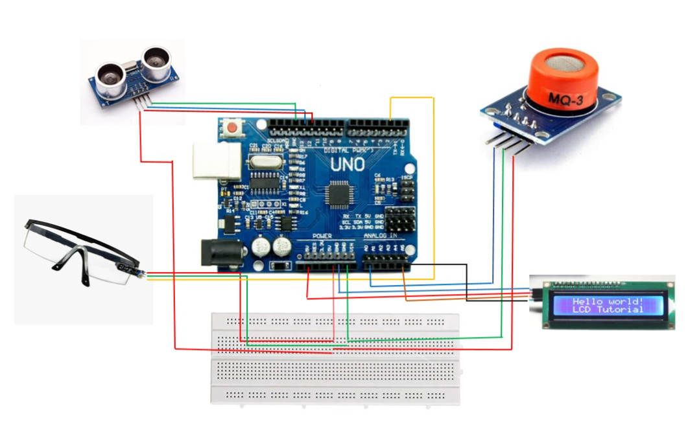
Circuit Diagram

Slide 16
Advantages & Features
✅ Real-time driver monitoring
✅ Automatic vehicle stopping mechanism
✅ Cost-effective and easy to implement
✅ Enhances road safety by preventing accidents
✅ Can be expanded with AI, GPS, and emergency alerts

Slide 17
Challenges
🔴 Environmental interference: External factors may affect sensor accuracy.
🔴 False alarms: Sensors may misinterpret driver actions.
🔴 Power consumption: Multiple sensors may drain battery.
🔴 IR-based eye blink detection can be affected by ambient light or reflections,
leading to incorrect reading

Slide 18
Future Enhancements
🚀 Integration with GPS & GSM for emergency alerts.
🚀 AI-based driver behavior analysis.
🚀 Advanced automatic braking system.
🚀 Voice alerts for real-time driver assistance.

Slide 19
Conclusion
The Driver Vigilance Monitoring System helps reduce accidents by monitoring:
• Alcohol levels
• Drowsiness
• Obstacles
Real-time detection and automatic intervention ensure safety.
This project can be enhanced further for better accuracy and integration.

Slide 20
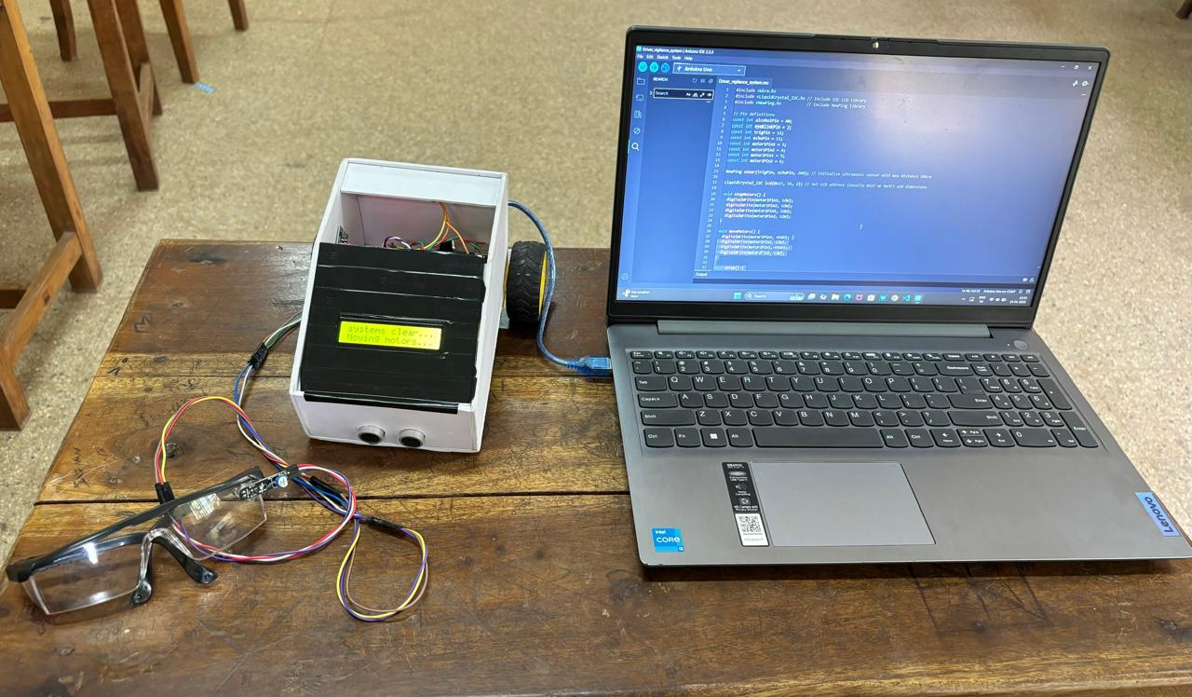
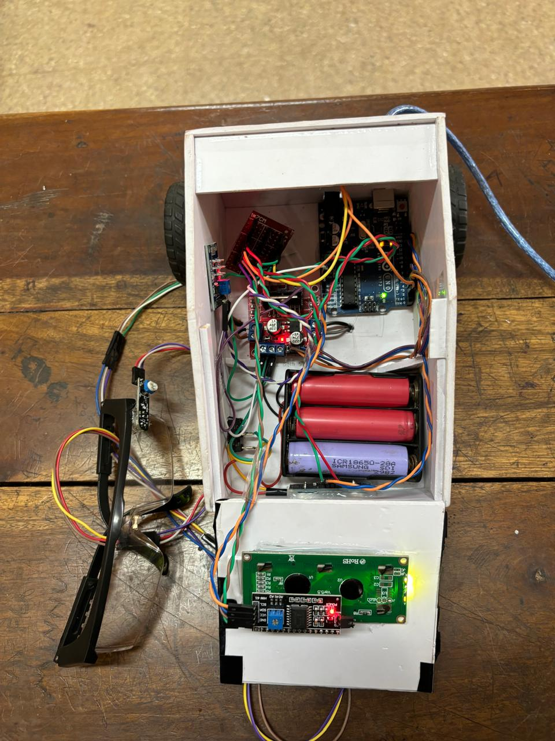
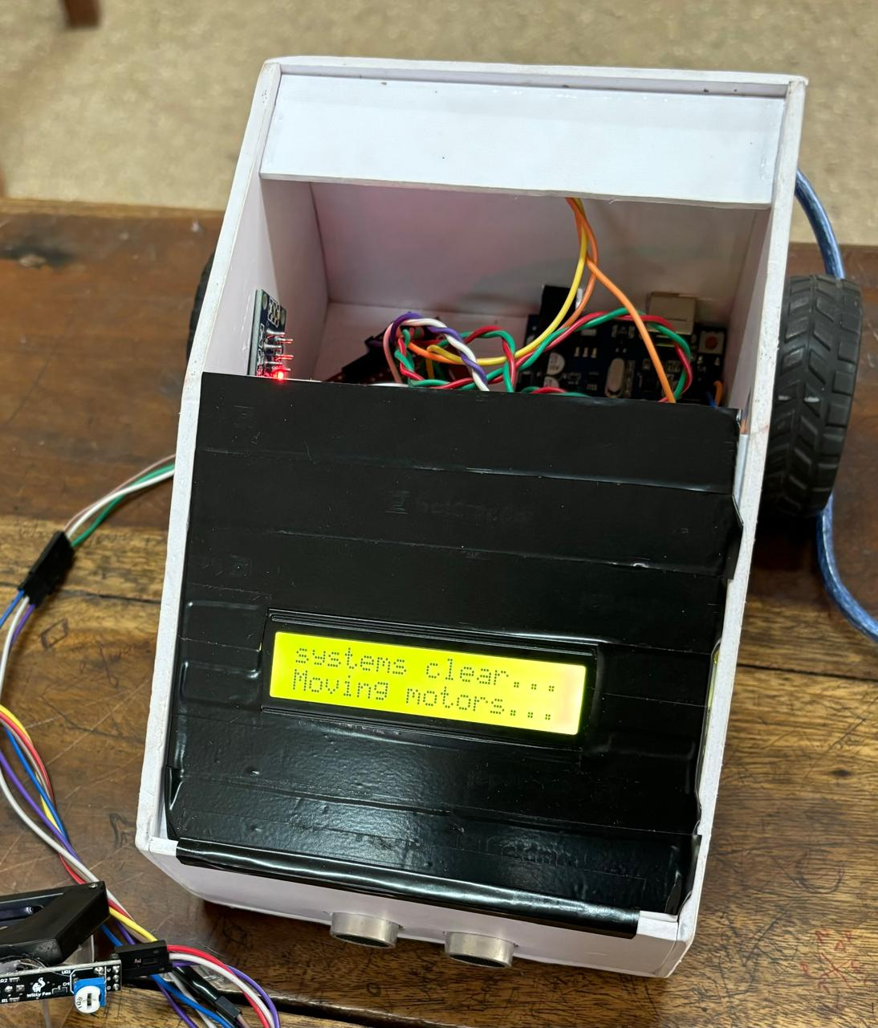
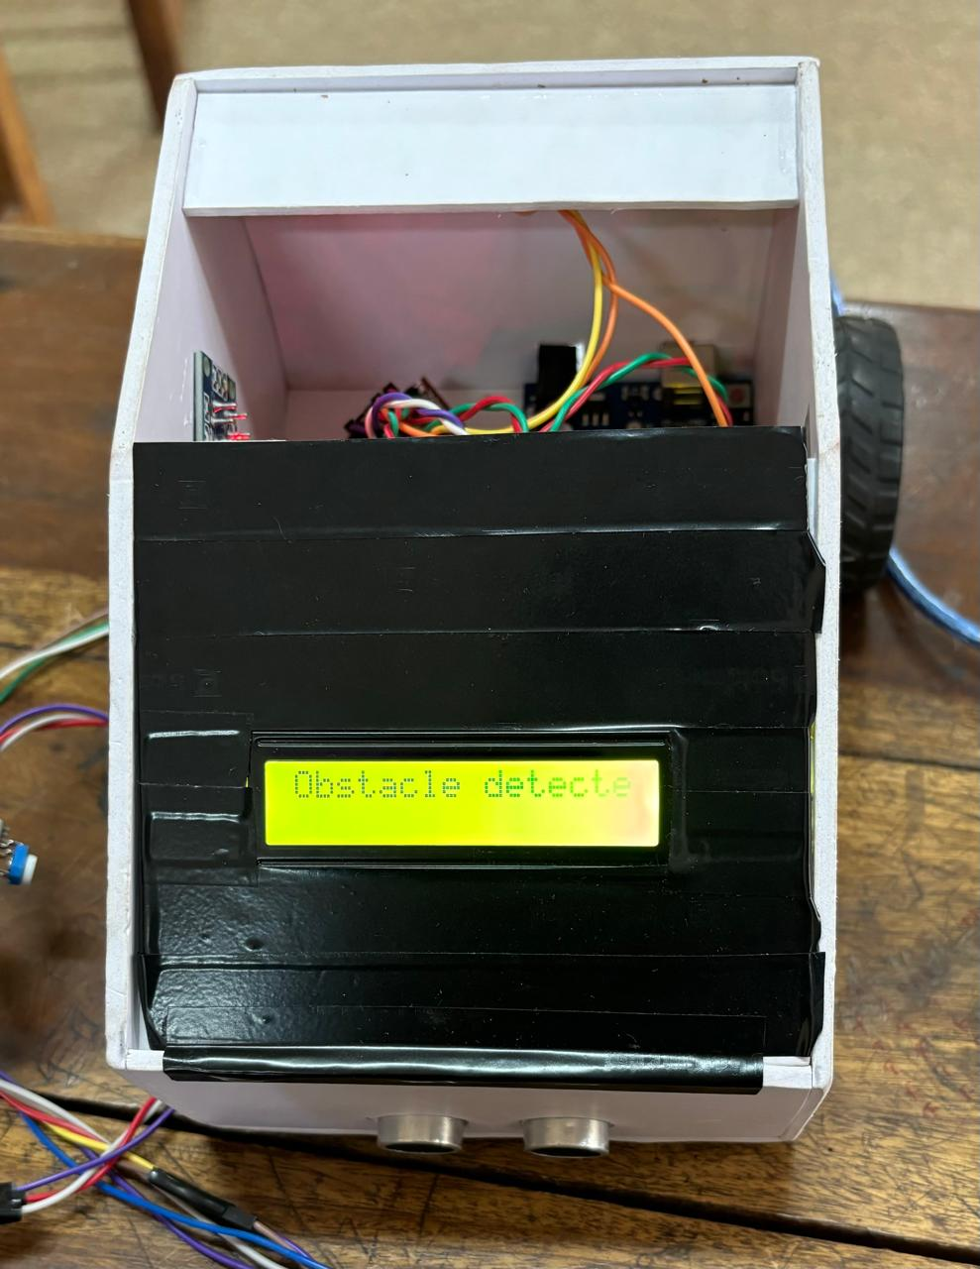
Output Image

Slide 21
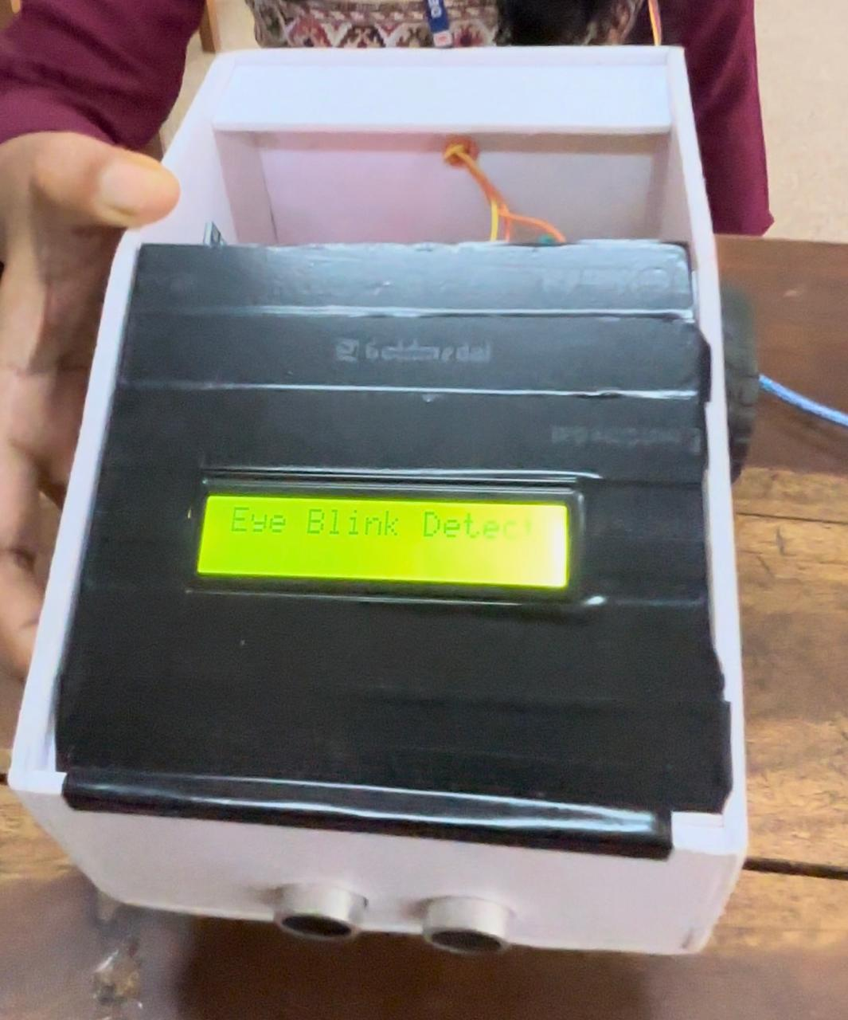
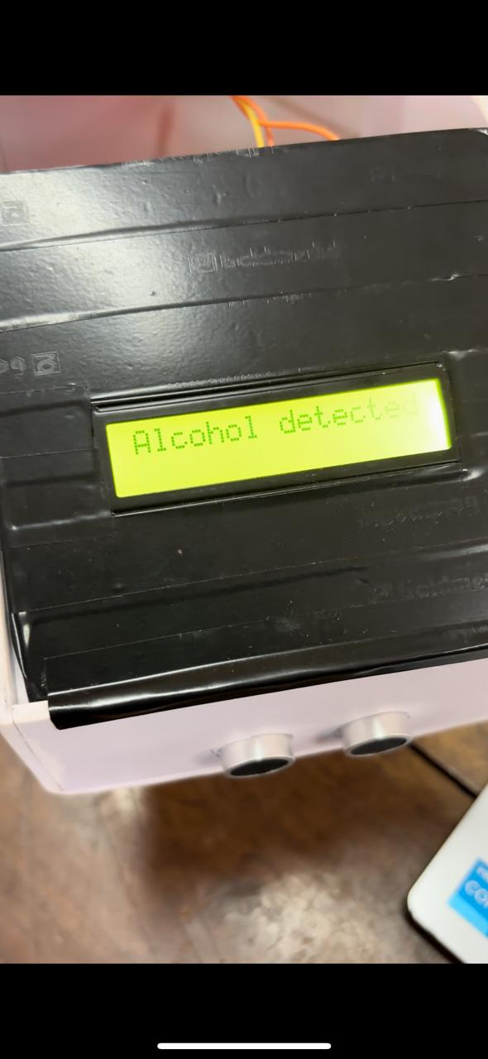

Slide 22
Reference
1. IOT BASED SMART EMBEDDED SYSTEM FOR VEHICLE SAFETY AND DRIVER SECURITY - [M. Rama Krishna , M. Sasi Kala , S. Devi Venkata Prasad , D. Uma Venkata Sujitha, K.Gowtham Sai, Y. LokanadhaManikanta] https://jespublication.mlsoft.in/upload/2023-V14I4011.pdf
2. IOT-BASED DRIVER DISTRACTION PREVENTION SYSTEM - [Liang-Sian Lin, Li-Wei Jiang, Yu Wang, Zhi-Yu Chen] https://www.researchgate.net/publication/365736418_IoT- Based_Driver_Distraction_Prevention_SystemBased_Driver_Distraction_Prevention_System
3. DRIVER DROWSINESS DETECTION SYSTEM FOR ACCIDENT PREVENTION https://nevonprojects.com/driver-drowsiness-detection-system-for-accident-prevention/
4. ALCOHOL DETECTOR USING ARDUINO AND MQ3 SENSOR – [ Mohd Shahid ] https://techatronic.com/alcohol-detector-using-arduino-and-mq3-sensor/

Slide 23
5. IMPLEMENTATION OF DISTANCE MEASUREMENT USING ARDUINO UNO, HC-SR04 ULTRASONIC SENSOR AND LCD DISPLAY – [ Likith M, Dr.Sudha M S, Kumuda K V, Harshitha N, Manoj N, Chandu Yadav D N ] https://www.jetir.org/papers/JETIR2402392.pdf
6. ARDUINO UNO, ULTRASONIC SENSOR HC-SR04 MOTION DETECTOR WITH DISPLAY OF DISTANCE IN THE LCD – [ Mutava Mutinda, Paul Kamweru ] https://www.researchgate.net/publication/341871272_Arduino_Uno_Ultrasonic_Sensor_HC-SR04_Motion_Detector_with_Display_of_Distance_in_the_LCD
7. ARDUINO BASED ACCIDENT PREVENTION SYSTEM USING EYE BLINK SENSOR – [ Prof. V. M. Joshi , Mr. Mahesh Kavade , Mr. Sagar Vyavhare , Mr. Ashish Gawade , Mr. Ganesh Kharat ] https://ijarsct.co.in/Paper15792.pdf
8. HOW TO CONNECT I2C LCD DISPLAY TO ARDUINO UNO – [ JunezRiyaz ]
https://www.instructables.com/How-to-Connect-I2C-Lcd-Display-to-Arduino-Uno/

Slide 24
Thank You…

