Slide 1
Database Banking System
Course no: CSE 3104
Course title: Database Lab

Slide 2
Database Lab CSE 3104
Submitted to
Mr.Nazmus Sakib
Mr. Mir Tafseer Nayeem
Submitted by
Nusrat Jahan(16.01.04.047)
Md Rayhan Jonny(16.01.04.028)
Shahana Alam Antora(16.01.04.032)

Slide 3
Aim :
To create sql for solving financial applications of a customer in banking environment in order to nurture the needs of an end banking user by providing various ways to perform banking tasks. Also to enable the user’s workspace to have additional functionalities which are not provided under a conventional banking software.

Slide 4

Problem Description:
The database Bank System is an application for maintaining a person’s account in a bank . The system provides the access to the customer to create an account, deposit/withdraw the cash from his account, also to view reports of all accounts present • The following presentation provides the specification for the system.

Slide 5

System Requirements:
Software-
Hardware-
Component | Requirement
.NET Framework | SQL Server 2016 (13.x) RC1 and later require
Network Software | TCP/IP and VIA.
Hard Disk | a minimum of 6 GB of available hard-disk space.
Drive | A DVD drive, as appropriate
Monitor | Super-VGA (800x600) or higher resolution monitor.
Internet | requires Internet access
Memory | 1 GB
Processor Speed | 1.4 GHz
Processor Type | x64 Processor

Slide 6
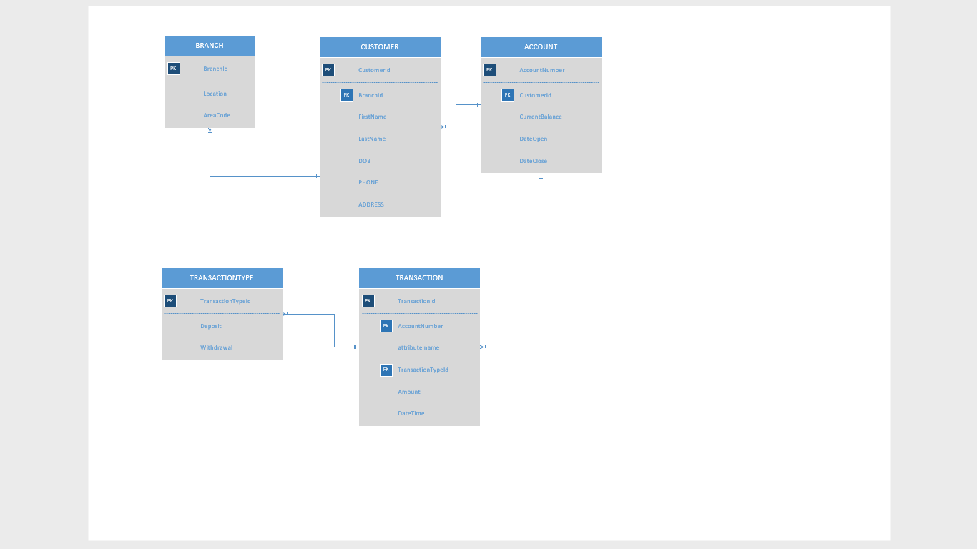
ER Diagram:

Slide 7
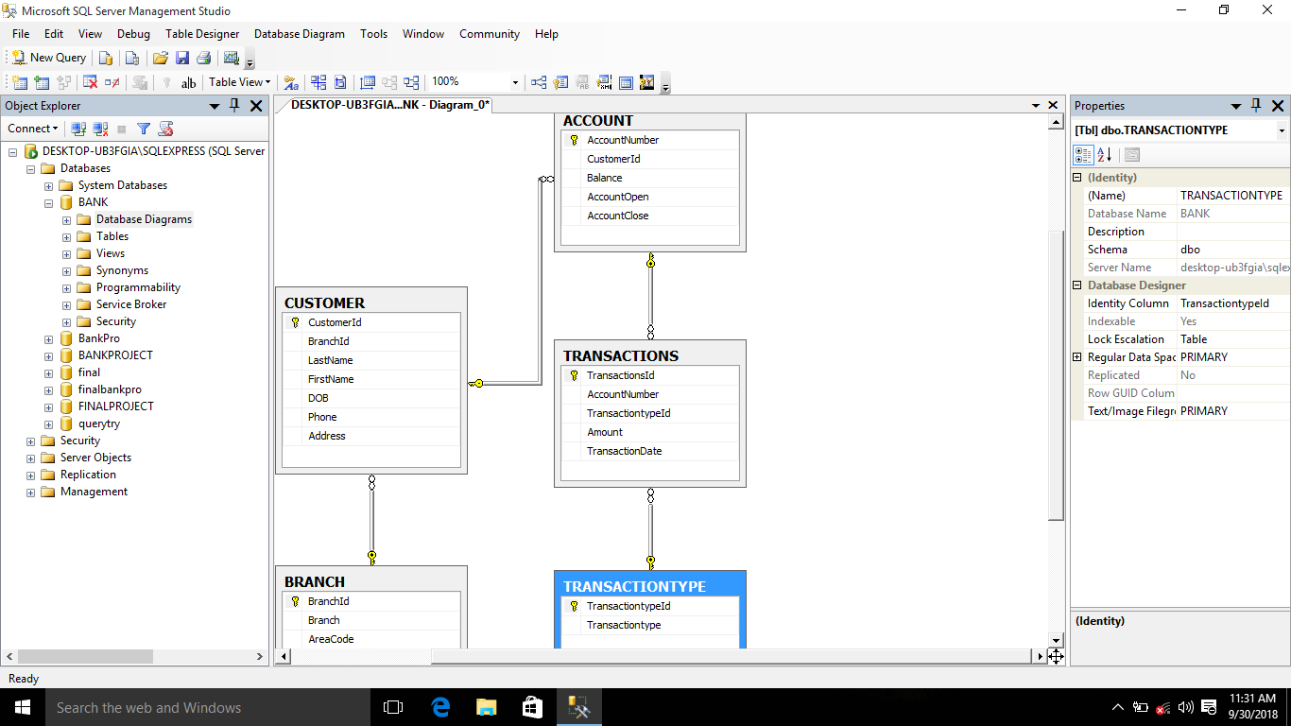
Database Diagram

Slide 8
Conclution:
This project is developed to nurture the needs of a user in a banking sector by embedding all the tasks of transactions taking place in a bank.
This system has been made focusing on easy data retrieving,modify data without waste of time and paper and also transaction record in short time.The data are stored in manual process.It can also be of great help for such banks who have many branches,therefore they can access information of customers from any where which will ease the customer to transacts from any of the branch of same bank.

Slide 9
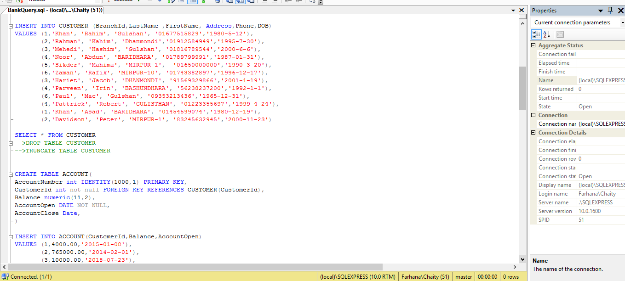
Screen shots:

Slide 10
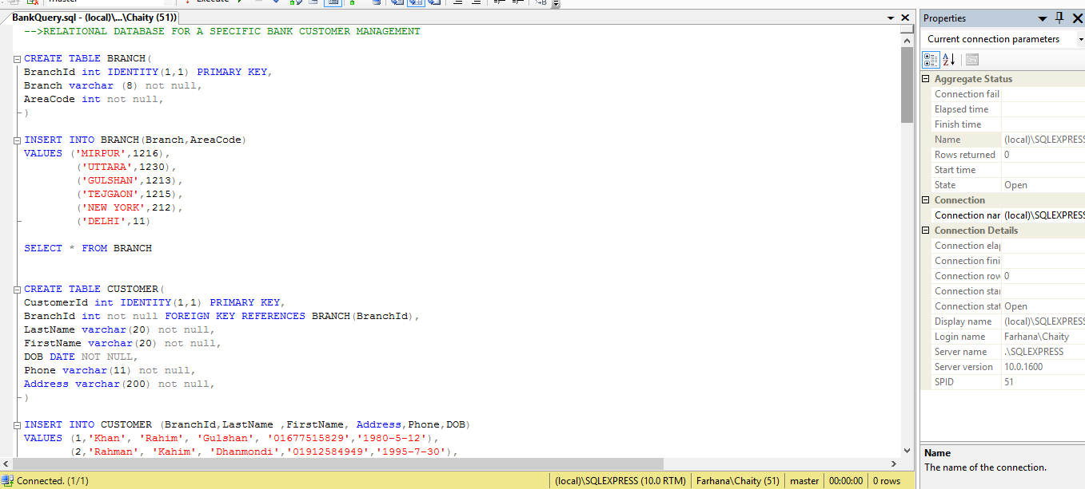
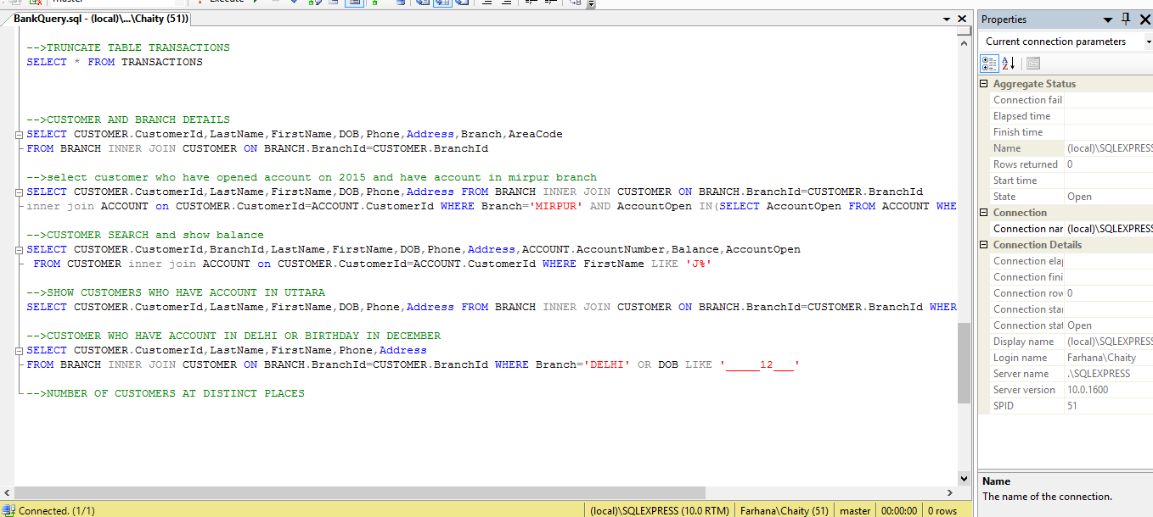

Slide 11
