Slide 1

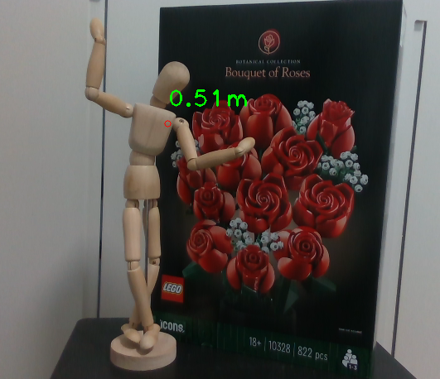
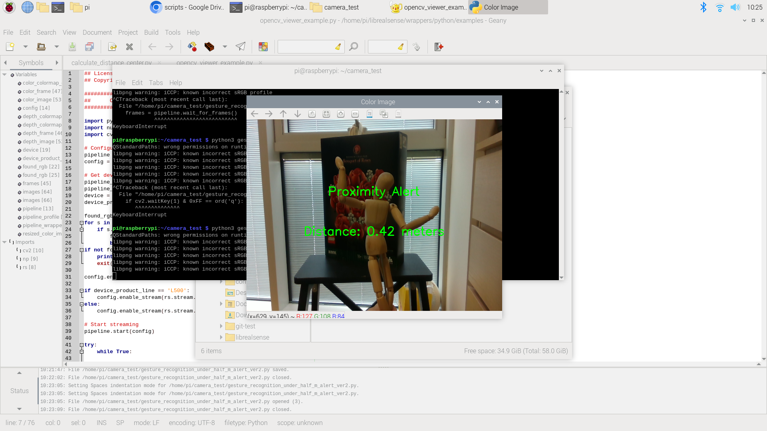
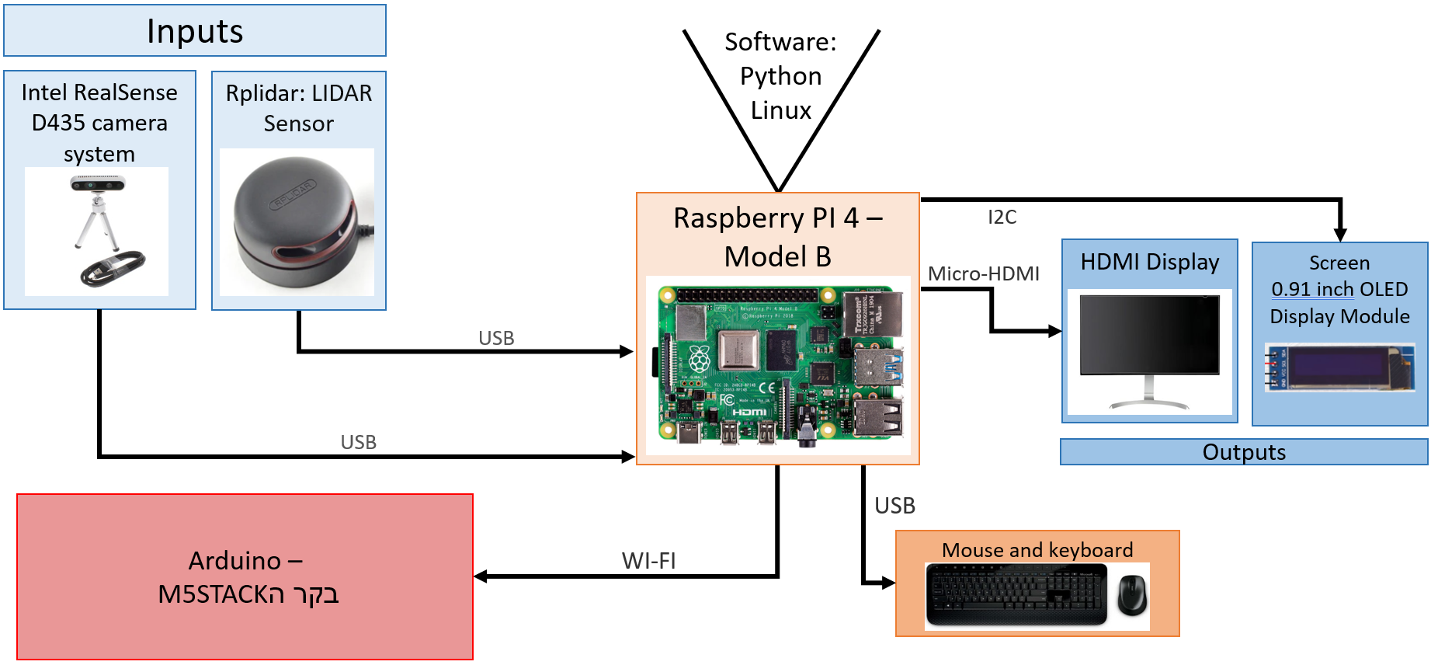
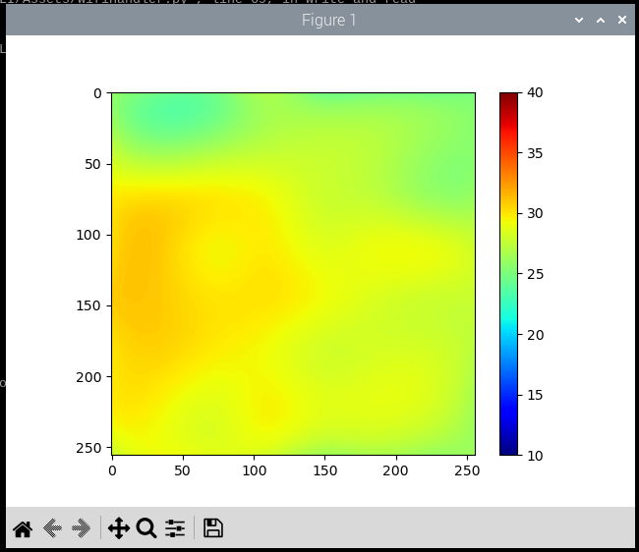
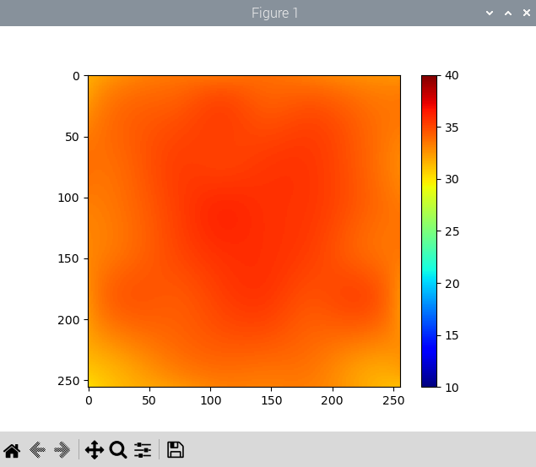
Sensing System for Advanced Algorithms
Project Number: 22-1-1-2667
Names: Shahar Hannover and Tal Ariely
Advisor: Simcha Leibovitz
Introduction This final project endeavors to construct a versatile infrastructure based on Raspberry Pi, fit specifically for future endeavors in the field of physiotherapy. The infrastructure primarily comprises a Raspberry Pi directly connected to sensors, alongside an Arduino infrastructure integrated with complementary sensors. This configuration allows the infrastructure to operate independently, making it readily usable. The project encompasses comprehensive instructional documents, detailing the sensor options considered, along with an installation guide covering all sensors, and a compilation of tests conducted for each sensor variant. Motivation/Objectives Enhanced User Experience: Utilizing Raspberry Pi, creation of an intuitive environment that translates sensor inputs into tailored outputs, aligning seamlessly with user preferences. Documentation: Detailed guides enhance accessibility, supporting future infrastructure enhancements. Research & Optimization: Extensive analysis ensured the selection of compatible sensor types, optimizing functionality. Collaborative Synergy: Partnership with an Arduino M5Stack team enriches project scope and capabilities. Methods/Implementation | Results Identifying distances from the center of the frame: Samples every second and prints the results on the screen. LIDAR: Alerting when the presence of an object is close to the sensor from a certain distance (360-degree scan). Sample only when object is closer then 150 mm | Connection of Raspberry PI and Arduino : a scan of the device is performed, and a connection is made in WIFI configuration. Conclusions We selected and integrated sensors compatible with the Raspberry Pi, including camera, LIDAR, and OLED screen. Testing showcased functionalities such as Real-sense software for the camera and scanning configuration for the LIDAR sensor. Integration with Arduino via WIFI was successful. Future recommendations include exploring sensor integration, advanced testing, and enhancing physical configuration for seamless use in upcoming projects. Documentation Component definition document - shows all the alternative components that we could use in this project and information about them. Sensor installation document - a document that includes detailed installation guides for all the sensors in the project Git: https://github.com/ShaharHanno/TAU-RP-Sensing/
Object
Camera:
Displaying the distance marked on the screen using the mouse.
LIDAR
screen
Required point and its distance
Alert-
100 mm,300 deg
Object
LIDAR
screen
Alert on the screen when a close object is detected from a predefined distance.
The system warns about the presence of the object since it is less than 0.75 meters away.
Temperature sensor results: On the right - placing a high temperature object on the sensor, on the left - lifting the object.
1m
2m
Camera
screen
Object
Camera
screen
Object
The system components are:
Raspberry PI 4 Model B
Intel RealSense D435 camera
Rplidar: LIDAR Sensor
M5STACK (Arduino)
USB Mouse
USB keyboard
HDMI type Display
0.91 inch OLED Display

