Slide 1

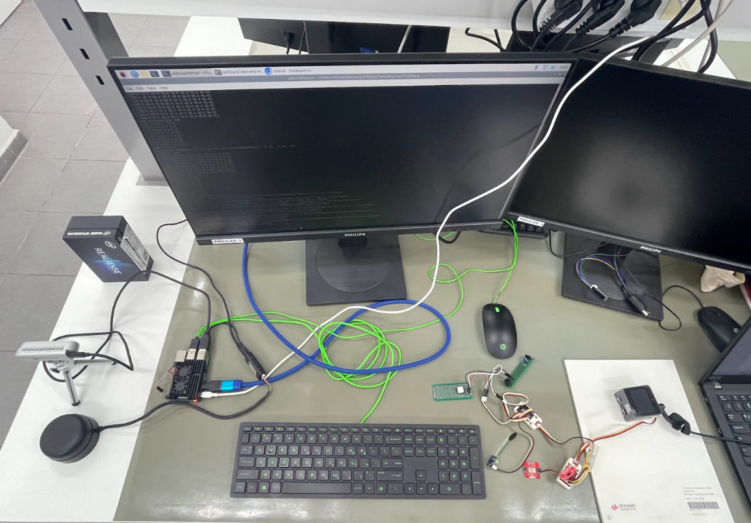
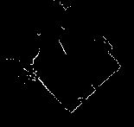
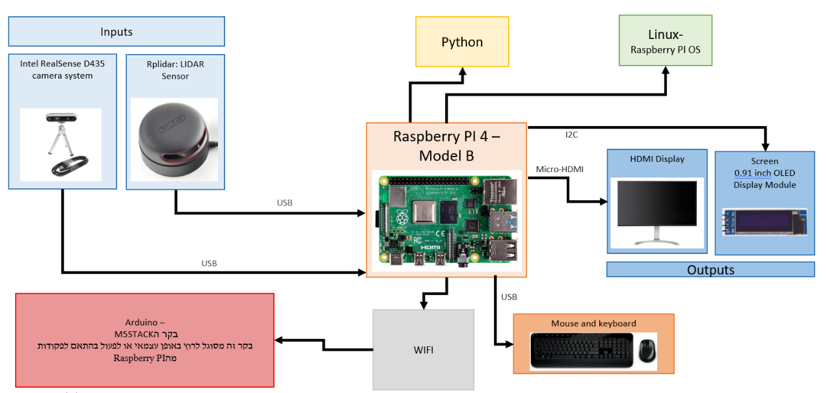
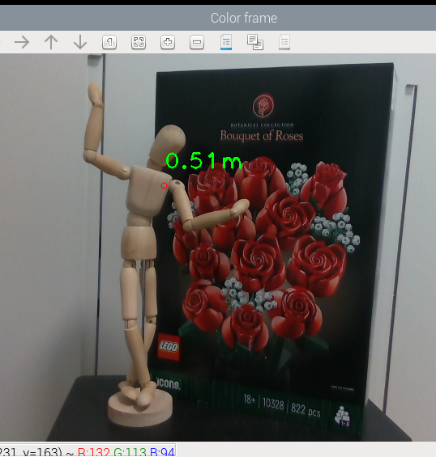
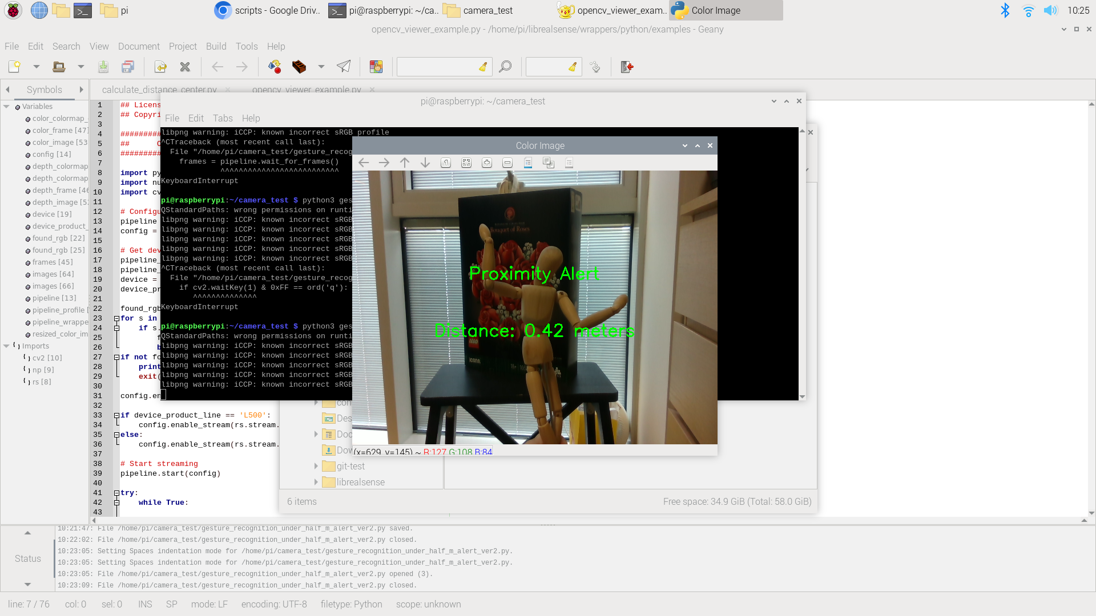
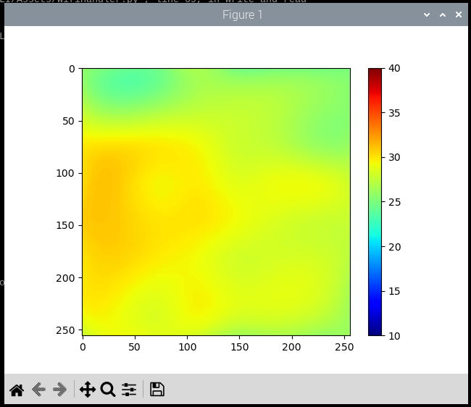
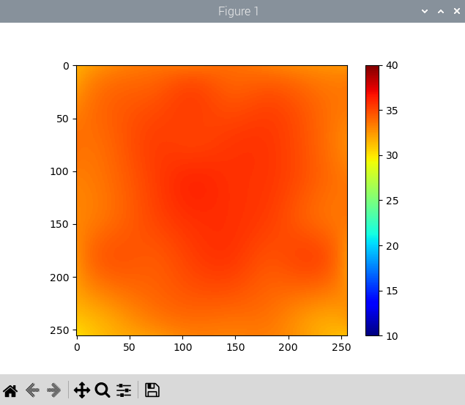
Insert The Project Name Here
Project Number: 22-1-1-2667
Names: Shahar Hannover and Tal Ariely
Advisor: Simcha Leibovitz
Introduction In the realm of electrical engineering, innovation often stems from the integration of cutting-edge technology into practical applications. This final project endeavors to construct a versatile infrastructure based on Raspberry Pi, tailored specifically for future endeavors in the field of physiotherapy. The infrastructure we have constructed primarily comprises a Raspberry Pi directly connected to sensors, alongside an Arduino M5Stack infrastructure integrated with complementary sensors. This configuration allows the infrastructure to operate independently, making it readily usable. The project encompasses comprehensive instructional documents, detailing the array of sensor options considered, along with an installation guide covering all sensors, and a compilation of tests conducted for each sensor variant. Motivation/Objectives Enhanced User Experience: Utilizing Raspberry Pi, we create an intuitive environment that translates sensor inputs into tailored outputs, aligning seamlessly with user preferences. Documentation: Detailed guides enhance accessibility, supporting future infrastructure enhancements. Research & Optimization: Extensive analysis ensured the selection of compatible sensor types, optimizing functionality. Collaborative Synergy: Partnership with an Arduino M5Stack team enriches project scope and capabilities. Empowering Users: Deliverables empower users to integrate and utilize sensors within physiotherapy infrastructure. | Methods/Implementation The system components are: Raspberry PI 4 Model B Intel RealSense D435 camera system Rplidar: LIDAR Sensor M5STACK (Arduino) USB Mouse USB keyboard HDMI type Display 0.91 inch OLED Display Results Camera: Displaying the distance marked on the screen using the mouse. Alert on the screen when a close object is detected from a predefined distance. Identifying distances from the center of the frame: | LIDAR: Build a real-time visualization of the room where the sensor is in an overhead view. Warning about the presence of an object that is close to the sensor from a certain distance (360-degree scan). For the connection of the Raspberry PI with the M5stack: a scan of the device is performed, and a connection is made in the WIFI configuration. On the Raspberry PI display you can see the outputs of the sensors of the M5stack Conclusions This project aimed to build a hardware and software infrastructure around a Raspberry Pi, tailored for electrical engineering and physiotherapy projects. We selected and integrated sensors compatible with the Raspberry Pi, including camera, LIDAR, and OLED screens. Testing showcased functionalities such as Real-sense software for the camera and scanning configuration for the LIDAR sensor. Integration with M5stack via WIFI was successful. Future recommendations include exploring sensor integration, advanced testing, and enhancing physical configuration for seamless use in upcoming projects.

