Slide 1

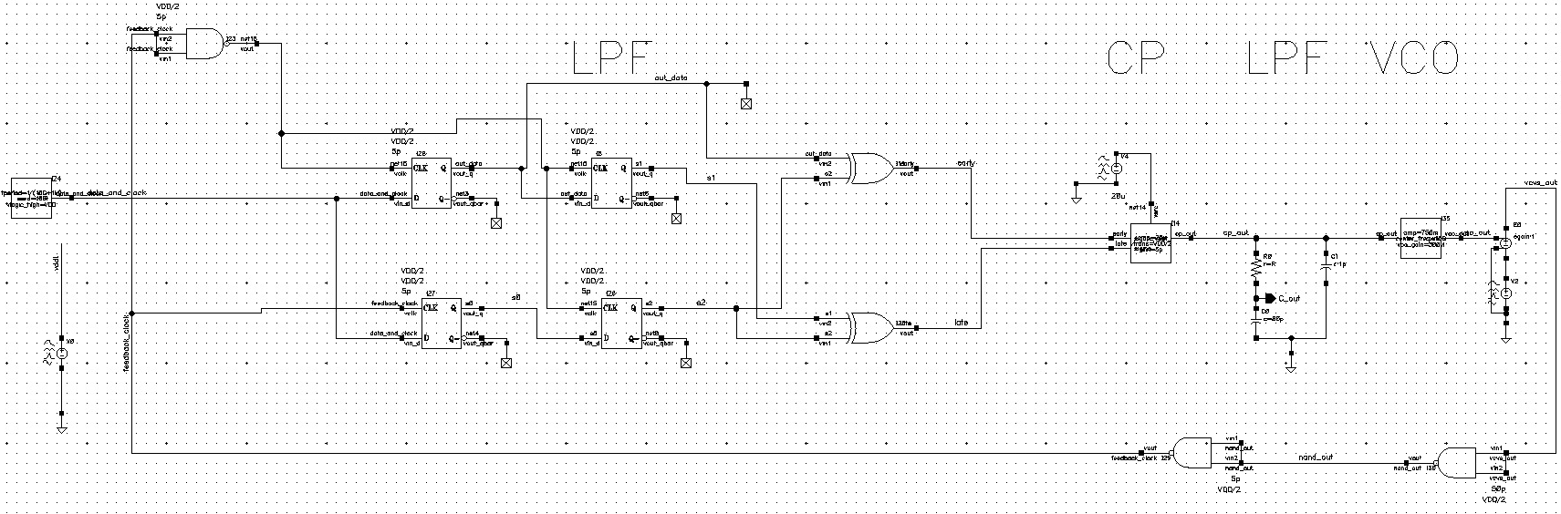
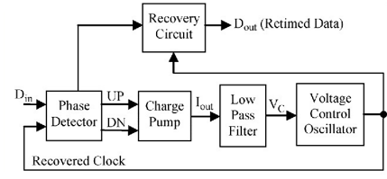
Clock And Data Recovery
Project Number: 22-1-1-2576
Names: Shahar Zarkovsky, Tal Kahlon
Advisor: Dr. Miki Moyal
Introduction This Project is focused on implementing a digital CDR ,A closed loop control system which provide clock extracted from the received signal of clock and information combined. From the extracted clock we sample the data of the received signal. In general CDR system is built from 3 main components as shown below: Phase Detector – The function of the phase detector is to identify a phase difference between two incoming signals. Charge Pump (CP) and Low Pass Filter (LPF) - The function of the charge pump is to convert the output voltage of the phase detector to current and the function of the low pass filter (LPF) is to convert the charge pump current into control voltage. VCO - The function of the voltage control oscillator is to generate the clock signal at its output. Motivation/Objectives Clock and Data Recovery (CDR) is a fundamental process in digital communication systems that extracts the clock signal from a transmitted data stream. In this process, timing information that may be lost due to noise, interference, or other factors is recovered to synchronize the received data. CDR utilizes techniques such as phase-locked loops (PLLs), | , and other signal processing algorithms to recover the original timing information. The recovered clock signal is then used to correctly interpret the received data, making CDR an essential component of many high-speed communication systems such as Ethernet, Fiber Channel, and other data center and telecommunications applications Methods/Implementation For the implementation we used 4 main components from ahdlib,analoglib,gpdk45 librarues: 1.phase detector – built from 4 dff , not gate , 2 xor gate.block . 2.charge pump – from ahdlib. 3.LPF – second order lpf that built from 2 capacitor and one resistors 4.VCO – from ahdlib. 5. להוסיף עוד משהו לתת בשר In addition we built a vco at the transistor level instead of a library component. Add picture Results | Results The following graphs show the information sample when the clock was taken out of the control system from the input signal of the clock and the data combined We can see that the capacitor stabilizes at a constant value when the system stabilizes and reaches a constant clock frequency that matches the frequency of the input signal We can see that the information is well sampled with 0 bit errors We can see that when the frequency changes by +- 1 Mega Hz the CDR adapts itself to the new frequency and stabilizes properly Conclusions Bibliography need to add

