Slide 1
CSE 431
Paper Presentation
A Self-Atention-Based Approach for Named Entity Recognition in Cybersecurity

Slide 2
Personal Information
Shaharear Hossain Emon
ID:18201109

Slide 3
Introduction
Data-driven security is essential as cybersecurity becomes increasingly complicated.
Security analysts and machines struggle to analyze textual cybersecurity data. We extract cybersecurity-related entities and present a self-attention-based neural network model for cybersecurity named entity recognition to transform textual input into structured data for autonomous analysis.
Used CNN to extract character features and concatenate them with word features to identify the object. Based on the BiLSTM-CRF model, we incorporate self-attention. The suggested approach outperforms the existing entity extraction model on the labelled dataset.

Slide 4
Introduction
Focusing on developing vulnerabilities, exploitation, and cyber-attack methodologies helps enhance cybersecurity. Manually analyzing threat-related textual sources is inefficient and time-consuming. At this phase, Maximum Entropy Models (MEM) [4], Support Vector Machines (SVM), Hidden Markov Models (HMM), and Conditional Random Fields (CRF) [7] were suggested and performed well. Scholars utilize machine learning to recognize named items after its success in image and audio recognition. Early NER systems relied on pattern recognition, which requires specialists to build identifying rules and is not portable.
Image, audio, and natural language processing have improved with machine learning. Yet, manual domain feature extraction may reduce model robustness and generalization. Self-attention-based cybersecurity entity identification is proposed. Section 2 describes the concept and procedure, and Section 3 compares our model to some common past models.

Slide 5
Methodology
Using a large amount of unlabeled cybersecurity data, we first derive the word embedding for the proposed model using Word2Vec . We also provide the CNN model, which extracts character features from each word. The suggested model is then fed the concatenation of the word embedding and the character embedding. It is noteworthy that we include the self-attention mechanism between the BiLSTM layer and the CRF layer so that we can gain a better context representation of the current word and more details about it.

Slide 6
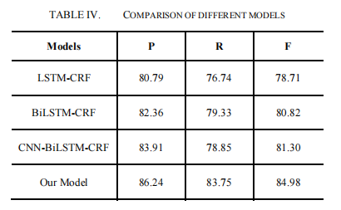
Result

Slide 7
CONCLUSION
The research suggested a Self-Attention-based entity identification paradigm for cybersecurity structured data production. Self-attention was introduced to gather extra sentence-related feature information for the current word. The self-attention mechanism improved performance on the labelled dataset we created using sequence labeling criteria.

