Slide 1
CSE 449
Paper Presentation
Tomato Leaf Disease Detection Using Convolution
Neural Network

Slide 2
Personal Information
Shaharear Hossain Emon
ID:18201109

Slide 3
Abstract
Numerous plant diseases have a substantial impact on the crop's quality and yield.
One of the significant crops that is produced in great amounts and has a high commercial value is the tomato.
In this study, we implemented two convolution neural network (CNN)-based models, GoogLeNet and VGG16, for the classification of tomato leaf diseases.
With the help of deep learning, the proposed effort seeks to identify the most effective method to the problem of tomato leaf disease detection.
On the Plant Village dataset, which contained 10735 leafimages, VGG16 achieved 98% accuracy while GoogLeNet achieved 99.23%.

Slide 4
Introduction
Plant diseases are a major cause of crop loss, which is bad for the economy.
Since the majority of the population in agricultural nations depends on the agriculture sector, plant disease detection is essential for enhancing the economy through increasing crop yield.
Early illness diagnosis is crucial to reduce economic loss because the infections can also damage plants and destroy crops.
To identify plant diseases such bacterial speck, target spot, late blight, early blight, mosaic virus, and Septoria leaf spot, the authors of [5] created a neural network-based approach.
In [7], the authors suggested a CNN-based method to identify maize illnesses using DL models like Google Neural Network and Cifarlo, which had an overall accuracy of 98.90%.
For the purpose of identifying fungal rust on pea plants, the authors of [8] introduced a plant disease detection method.

Slide 5
Methodology
An input layer, a number of hidden layers, and a classification layer make up a conventional CNN.
Convolution, pooling, fully linked, and other hidden layers are included in CNNs.
Fig. 1 displays the deep neural network's organizational structure.
Using the Plant-Village dataset, the proposed method uses CNN models like GoogLeNet and VGG16 to identify plant illnesses.

Slide 6
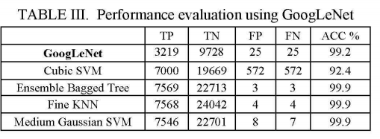
Results

Slide 7
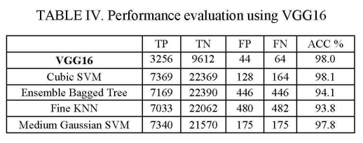
Results

Slide 8
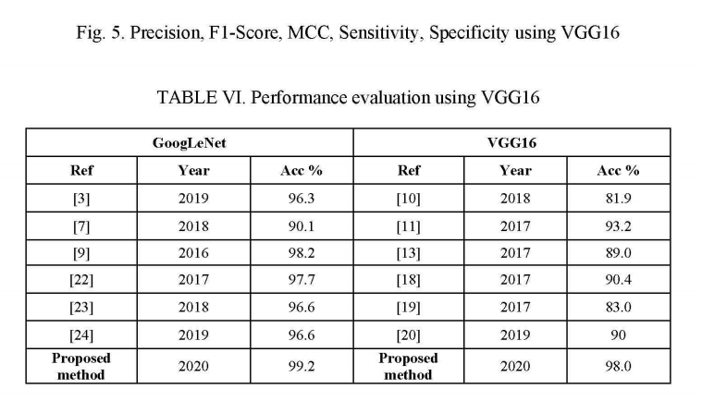
Results

Slide 9
CONCLUSION
Systems based on computer vision are frequently used in several agricultural fields.
These systems can assist in automating time-consuming operations to generate sufficient data for subsequent analysis.
Two deep learning models, VGG16 and GoogLeNet, are used in our suggested approach to categorize illnesses in tomato leaf images.
The success percentage for VGG-16 was 98.00%.
The findings make it clear that the CNN is ideally suited for plant disease identification that is automated.

