Slide 1

Capstone Project (January-May 2022)
Human Pose Estimation and Activity Recognition Using Deep Learning for Smart Cities
Project Group Number: CSERGC0451
Course Code: CSE 445
Submitted By
Shahbaz Ahmad 11809952
Adnan Raghib 11807062

Slide 2
Introduction
To perform human activity recognition, we have to deal with videos which is a bit tricky than our usual image recognition. Videos are nothing but sequences and frames of different images. But if we think of activity recognition(video) same as image recognition then we will get different results for the different frames of the images. In this paper we will be using different architectures and approaches to train our model so that it can predict best results on our unseen video data. Lastily we will pick the best performing model and deploy it in our web app
We have also used Media Pipe and OpenCV to implement a pose estimation model which can multiply use cases in health and sports
We have analysed results of our different approaches deeply and plotted the accuracy table to evaluate the best performing model for our purpose. The paper mainly discusses deep learning approach to experiment with our dataset which includes different videos of different classes to recognise the human activity in the video. We tried to implement CNN first and found good results but when we merge it with LSTM the result was much more accurate.

Slide 3
How it works
In We In this method we will implement LRCN along with something else called LSTM layers in a single model. Other similar approaches might be using a CNN model and LSTM model trained separately. By using both we can take advantage of both of these methods like CNN can be used to extract features from different frames of the video while LSTM can then use these features extracted by CNN to predict actions performed in the video by taking account of the previous inputs as well. But in this approach we will implement something different known as the Long-term Recurrent Convolutional Network (LRCN), which combines CNN and LSTM layers in a single model. To extract spatial features from the frames convolutional layers are used, LSTM is then fed with these extracted spatial features at each time steps for temporal sequence modeling. This results in a robust model which is learned by spatiotemporal features directly in an end to end training.
Using 3 steps to completing this work:
Step 1: Construct the model

Slide 4
USER MANUAL
Step 2: Check model’s structure
Step 3: Evaluating Trained Model
This section will familiarize you with the overall interface of the website including the main menu and the other options. The first page a user will se after opening our application is our home page. Here the first thing that you will see is the beautiful user interface where on top of page is a card view where the title of our app is shown along with the classes which our model can predict. The below card contains a element where the selected video is played, also an tag for the file upload to upload our videos. The right side of video element have the result and accuracy span where the predicted class and accuracy will be shown.

Slide 5
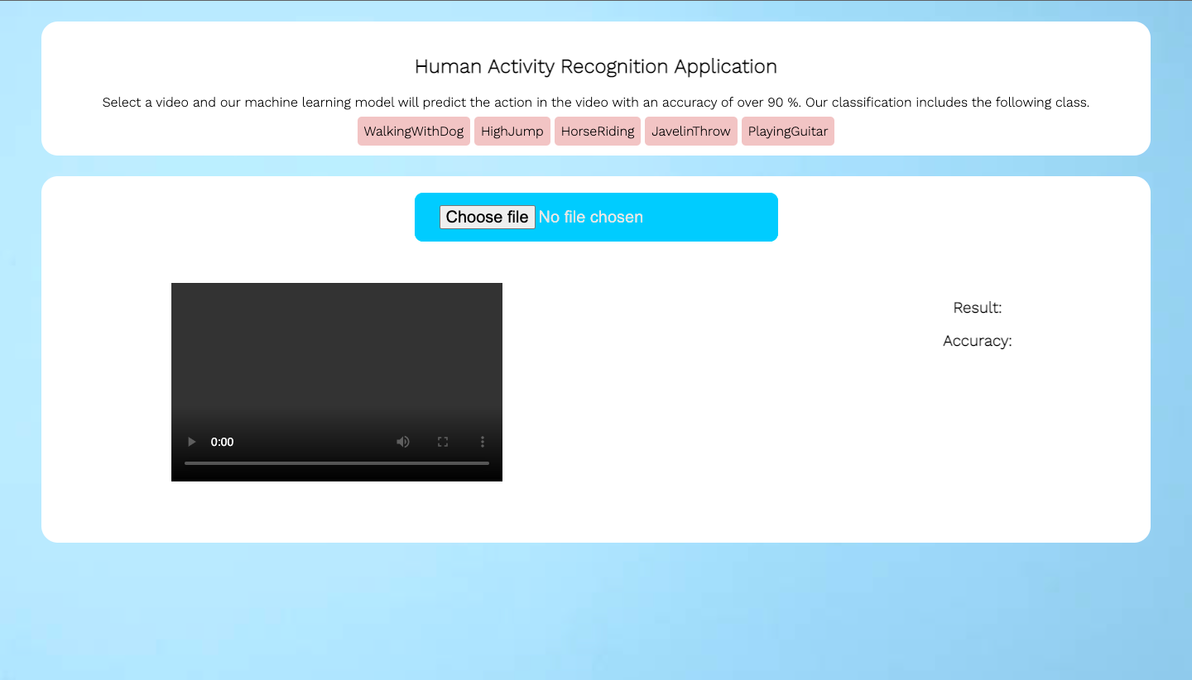
Landing Page

Slide 6
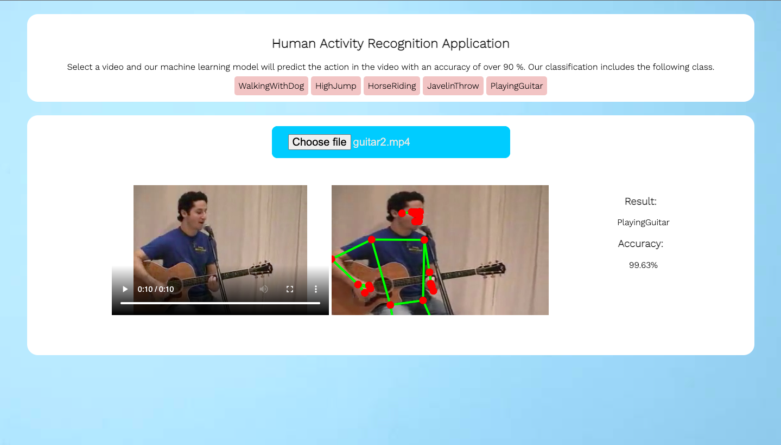
Activity recognition on guitar playing video (external dataset)

Slide 7
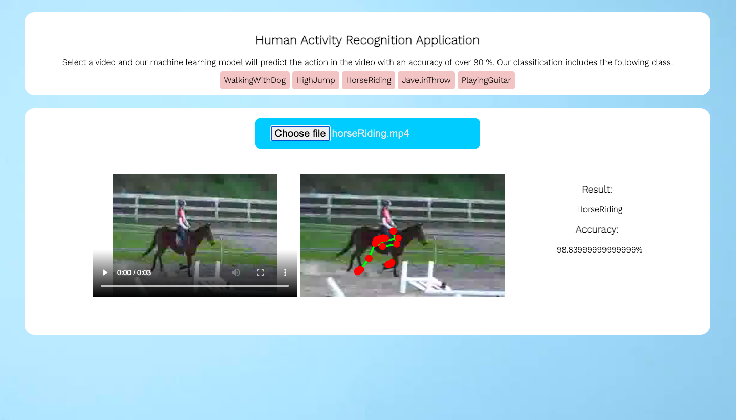
Activity recognition on horse riding video (external dataset)

Slide 8
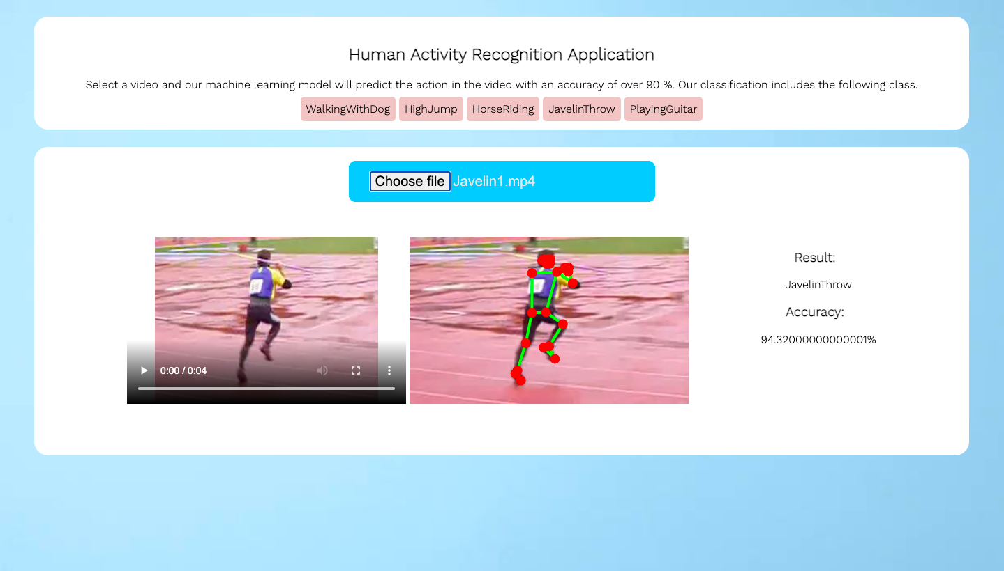
Activity recognition on javelin throw video (external dataset)

Slide 9
Specific Requirements:
S/w and H/w requirement:
Environment:
Operating System: - Microsoft Windows10
Clients : Microsoft Internet Explorer, Google chrome
Tools&Tech: OpenCv, MediaPipe, CNN,LSTM, Flask, VsCode, Google Colab
User Interface: html, CSS,JavaScript
Hardware requirements:
Number | Description
1 | Windows XP or Higher
2 | OpenCv
3 | MediaPipe
4 | CNN&LSTM
5 | Flask

Slide 10
Future Improvements
The future direction of research is obviously encouraged to unite various datasets as a large, complex, and complete one. Though every dataset may act as benchmark in its specific domain, uniting all of them triggers more effective and general algorithms which are more close to real-world occasions.
For example : The system should be able to tell the behavior “having a meeting” rather than lots of people sitting and talking, or even more difficult, concluding that a person hurried to catch a bus rather than just recognizing “running.”

Slide 11

THANK YOU

