Slide 1
ME-446 | COMPLEX ENGINEERING PROBLEM
AI-Based Building Energy Consumption
Prediction and Analysis for HVAC and
Energy Efficiency Applications
NED University of Engineering and Technology | Department of Mechanical Engineering
Group: [Group No.] Students: [Name — Roll No.] Instructor: [Instructor Name]
Fall Semester 2026 | Submission: 4 November 2026
Core finding: accurate for buildings with history; not validated for unseen buildings.
Dataset approval pending | Tableau workbook pending | Full-data run pending
Notes:
Introduce the team. State the one-sentence takeaway: the model is accurate for known buildings but not for new ones. Mention that the local results are subset results and that approval, the Tableau workbook, and full-data metrics are pending.

Slide 2
MOTIVATION
The engineering problem is conditional accuracy
• Buildings and HVAC systems account for a major share of electricity use.
• A normal-demand model can support monitoring, demand planning, and anomaly screening.
• Target: hourly electricity meter reading (meter 0) from building, calendar, and weather data.
• The real question: accurate for which buildings, and under what conditions?
Why it matters
• Peak demand drives capacity and cost.
• HVAC scheduling and setback decisions need a baseline.
• False anomaly alarms erode trust.
• Predictions are not measured savings or efficiency.
High aggregate R² can hide poor transfer to new buildings.
ME-446 CEP | Fall 2026
2
Notes:
Explain why a mechanical engineer cares: peak demand, HVAC scheduling, avoiding false alarms. Do not claim savings. The key tension is that a high aggregate score can hide failure on new buildings.

Slide 3
DATA
Dataset and local scope
12.06 M
1,413
120
1.03 M
electricity rows
electricity buildings
buildings in local subset
local hourly rows
• ASHRAE Great Energy Predictor III, accessed 20 October 2026 via KaggleHub.
• Full train: 20,216,100 rows, 1,449 buildings, 16 sites, four meter types.
• Electricity only (meter 0); 4.40% zero readings retained.
• Chronological split: Jan–Sep train / Oct–Nov validation / Dec test.
• Units: dataset energy units (documented as kWh), not independently verified.
All local metrics are subset metrics — not full-dataset results.
Teacher approval pending. Dataset uniqueness is not claimed.
Split: 769,122 train | 174,537 validation | 87,308 test
ME-446 CEP | Fall 2026
3
Notes:
Be explicit that all local results are subset results. The subset preserves all 16 sites and all 16 primary uses but not the full building mix. Approval and uniqueness are pending.

Slide 4
METHOD
Preprocessing is traceable and leakage-safe
Data handling
Model features (24)
• Raw CSVs retained unchanged; typed Parquet intermediates.
• Missing metadata retained: year_built 51.76%, floor_count 70.90%.
• Weather: past-only forward fill, 3-hour limit.
• Negative precipitation and invalid pressure treated as missing.
• Explicit missing flags for cloud, precipitation, pressure.
• Identity: building_id, site_id, primary_use.
• Size and vintage: square_feet, floors, year_built, age.
• Calendar: hour, day, month, weekend, cyclical encodings.
• Weather: air/dew temperature, wind, cloud, precipitation, pressure.
• No target lags, no future fill, no test-driven selection.
Leakage controls: chronological split + pipeline-fitted preprocessing + past-only weather fill.
ME-446 CEP | Fall 2026
4
Notes:
Emphasize that weather fill uses only the past, and the test month is never used to choose the model. Missing values are not replaced by invented building ages.

Slide 5
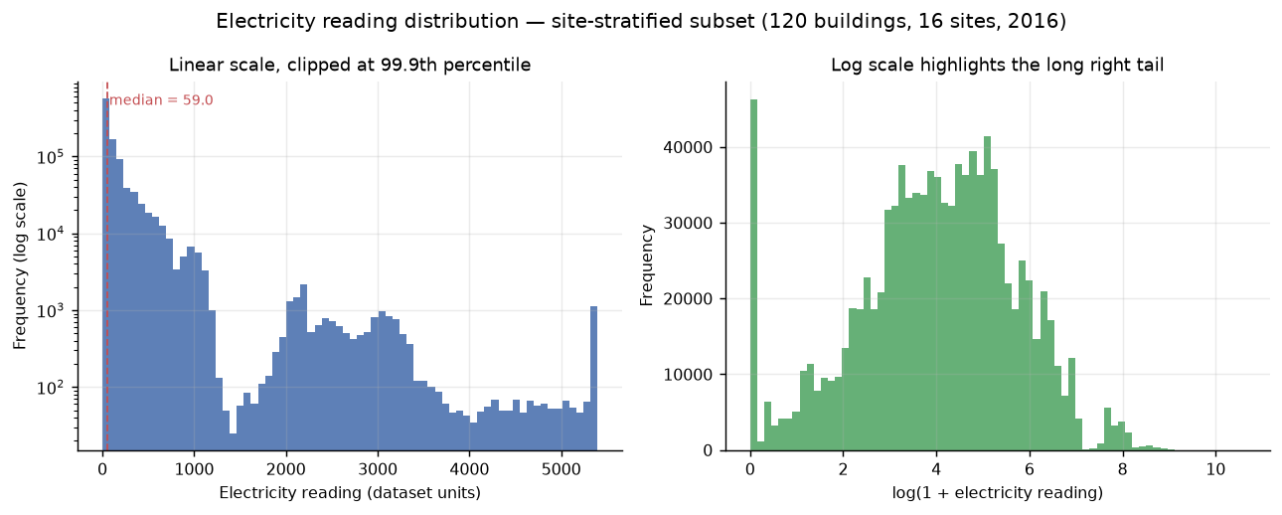
INSIGHT 1
Demand is right-skewed and building-dominated
• Median 59.05 vs mean 188.78.
• 99th percentile 2,454; maximum 41,552.
• Floor-area log correlation 0.750.
• square_feet is the top permutation feature.
Benchmark within building/use groups; normalize by floor area.
Local subset: 1,030,967 hourly electricity readings.
ME-446 CEP | Fall 2026
5
Notes:
The mean is not the typical building. A single global average is a poor benchmark. This motivates size- and use-normalized comparisons.

Slide 6
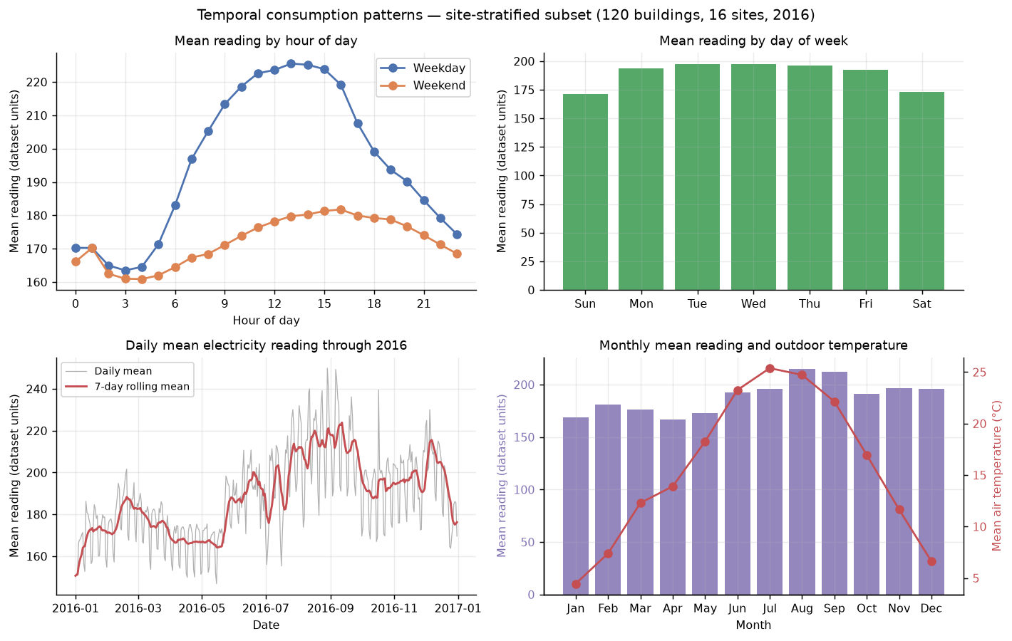
INSIGHT 2
Occupancy schedules create a weekday and midday cycle
• Weekday mean 195.44 vs weekend 172.24.
• Weekday/weekend ratio 1.135.
• Peak at 13:00; trough at 03:00.
• August highest monthly mean: 215.14.
Target setback and scheduling studies at low-occupancy hours.
Local subset: hourly, daily, and monthly demand patterns.
ME-446 CEP | Fall 2026
6
Notes:
The cycle is consistent with occupancy and cooling, but the data have no occupancy labels. Do not claim that a schedule change will save energy without measurement.

Slide 7
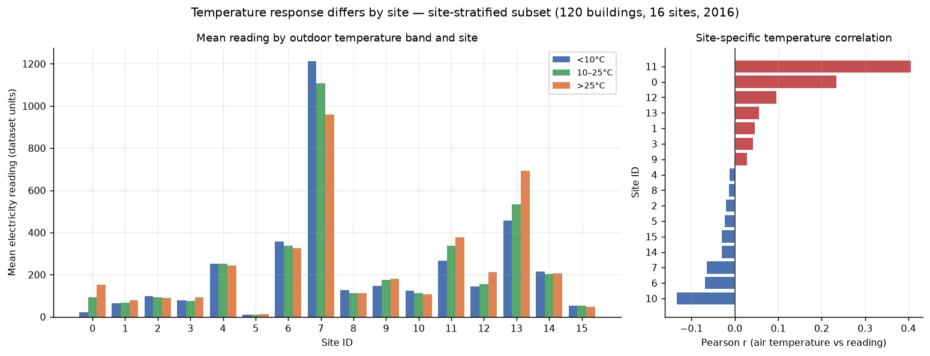
INSIGHT 3
Temperature response is site-specific
• Pooled r = −0.074 looks weak.
• Site r ranges −0.134 to +0.406.
• Site 11 rises from 265.74 to 377.17.
• Sites 6, 7, 10 are negative.
Use site interactions or degree hours, not one global coefficient.
Per-site temperature response; pooled correlation masks opposite regimes.
ME-446 CEP | Fall 2026
7
Notes:
This is a pooled-correlation trap. Opposite heating and cooling responses cancel. A single global temperature coefficient is inadequate.

Slide 8
METHOD
Three regressors, one pre-declared selection rule
Linear Regression
Random Forest
HistGradientBoosting
Interpretable baseline
Nonlinear interactions
Efficient boosting
One-hot; median imputation; scaling; sparse design matrix
80 trees; depth 16; min leaf 20; 250,000-row sample
200 iterations; lr 0.08; 31 leaves; all 769,122 rows
Selection rule: lowest validation RMSE. Test evaluated once after selection.
Metrics: MAE, RMSE, R², RMSLE | Seed 42 | Identical held-out rows
ME-446 CEP | Fall 2026
8
Notes:
Explain why RMSE: large peak errors are costly for demand planning. The mean baseline is a reference, not a candidate. All models use the same split.

Slide 9
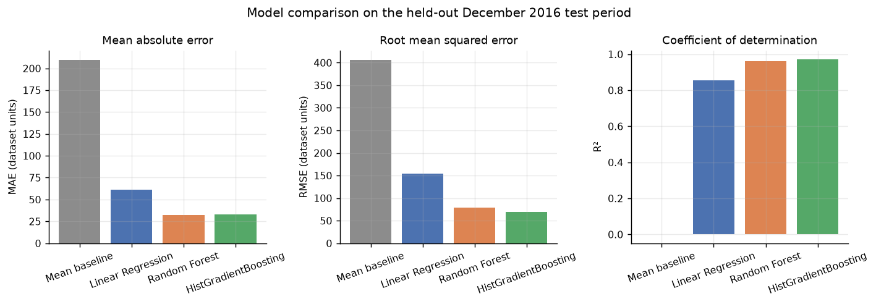
RESULTS
HGB wins validation RMSE; RF wins MAE and RMSLE
Model | Val RMSE | Test MAE | Test RMSE | Test R² | Test RMSLE
Mean baseline | 411.67 | 209.57 | 406.05 | −0.001 | 1.920
Linear Regression | 223.03 | 61.39 | 154.51 | 0.855 | 0.942
Random Forest | 166.92 | 32.05 | 78.90 | 0.962 | 0.448
HistGradientBoosting | 165.74 | 33.20 | 69.78 | 0.970 | 0.591
• HGB: best validation RMSE, test RMSE, and test R².
• Random Forest: slightly lower MAE and better RMSLE.
• HGB fit about 4.3× faster than RF (53.9 s vs 232.4 s).
• Trade-off is reported; RMSE prioritizes large peak errors.
ME-446 CEP | Fall 2026
9
Notes:
Do not say HGB dominates every metric. The choice depends on whether peak RMSE or typical MAE is the operational priority. The selection rule was fixed before test evaluation.

Slide 10
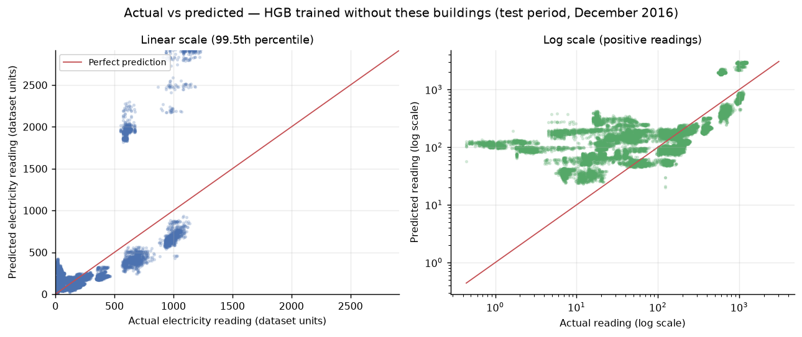
CRITICAL FINDING
The high R² does not transfer to unseen buildings
Group | MAE | RMSE | R² | RMSLE
Seen buildings, test | 33.86 | 74.15 | 0.971 | 0.595
Unseen buildings, test | 150.51 | 321.33 | −0.555 | 1.525
• 20% of buildings held out entirely, stratified by site.
• Unseen predicted mean 242.49 vs actual 176.99.
• building_id is a top-three feature.
• December: 126 zeros vs 44,796 in training.
This is building-specific interpolation, not a universal physical model.
HGB trained without the held-out buildings.
ME-446 CEP | Fall 2026
10
Notes:
This is the most important slide. The main model relies on building identity. Do not deploy to new buildings without calibration or richer descriptors. The test month also has a different zero-reading distribution.

Slide 11
DEMONSTRATION
Two held-out rows, two very different stories
Case | Building | Time | Actual | Predicted | Error
High demand | 1088 | 19 Dec 15:00 | 3,427.60 | 3,417.33 | 0.30%
Typical | 386 | 9 Dec 06:00 | 41.16 | 41.16036 | 0.0009%
• Building 1088: 287,594 ft² education building at −10.6 °C; high winter load is plausible.
• The near-exact typical case is not proof of generalization; trees can match a leaf closely.
• The feature-consistency check between training SQL and Python inference passed.
• The building-holdout experiment is the real generalization test.
These are unseen rows, but the buildings are still known to the main model.
ME-446 CEP | Fall 2026
11
Notes:
Be precise: the rows are unseen, but the buildings are in the training data. The near-exact second case should not be oversold. The holdout experiment shows the real transfer performance.

Slide 12
DELIVERABLES
Dashboard: data and guide complete, workbook pending
Energy Overview
Weather & Building
Model Performance
Totals, averages, building/site counts, trend
Temperature, schedules, use, size
Comparison, residuals, error groups
• Tableau-ready CSVs: 1,030,967 electricity rows; 349,232 prediction rows.
• Detailed dashboard specification and step-by-step Tableau build guide.
• Supplementary Streamlit app with four pages; smoke-tested with AppTest.
• Reproducible notebook, 22 passing tests, audit, report, and five insights.
No Tableau workbook has been authored, published, or tested.
Streamlit is supplementary; it does not replace Tableau.
ME-446 CEP | Fall 2026
12
Notes:
Be explicit about the dashboard status. Data and instructions are complete; authoring and validation remain. Do not show a fabricated Tableau screenshot.

Slide 13
ENGINEERING INTERPRETATION
Five insights translate into concrete actions
1
Demand is right-skewed and building-dominated
Benchmark within peer groups; normalize by size.
2
Weekday/midday cycle
Target setback and scheduling studies.
3
Temperature response is site-specific
Add degree hours or site interactions.
4
Primary use and site dominate
Segment models and dashboards.
5
Seen-building accuracy does not transfer
Calibrate before new-building use.
Add past-only history features, model zero/non-zero separately, calibrate residuals, validate on a future year.
ME-446 CEP | Fall 2026
13
Notes:
Connect each insight to a concrete action. Avoid claiming causal savings. The fifth insight is the main deployment caution.

Slide 14
CONCLUSION
Conclusion: a useful monitoring tool, not a universal predictor
• HGB test R² 0.970 on seen buildings; MAE 33.20, RMSE 69.78.
• Unseen-building R² −0.555; MAE 150.51 — a critical limitation.
• Results are 120-building subset results from one year.
• Winter-only test, zero-reading shift, site-level weather, missing metadata.
• Tableau workbook, full-data run, and teacher approval remain pending.
Next: full-data Colab run, history features, degree hours, two-stage zero model, Tableau workbook.
Do not use the model for a new building without calibration.
Questions?
ME-446 CEP | Fall 2026
14
Notes:
End with the conditional conclusion. Invite questions about generalization and operational use. Keep the caveats visible.

Slide 15
REFERENCES
References and project evidence
• ASHRAE. (2019). Great Energy Predictor III. Kaggle.
• Miller, C., et al. (2020). The ASHRAE Great Energy Predictor III competition: Overview and results. Science and Technology for the Built Environment, 26(10), 1427–1447.
• Amasyali, K., & El-Gohary, N. M. (2018). A review of data-driven building energy consumption prediction studies. Renewable and Sustainable Energy Reviews, 81, 1192–1205.
• scikit-learn, pandas, Tableau, and Streamlit documentation.
Evidence: README.md | reports/technical_report.md | reports/engineering_insights.md | reports/tables/ | reports/figures/
Thank you.
ME-446 CEP | Fall 2026
15
Notes:
Thank the audience and invite questions. Keep this slide visible during Q&A.

