Slide 1
ME-446 · AI & INTERNET OF THINGS · COMPLEX ENGINEERING PROBLEM
Detecting Dangerous
Milling Conditions
from vibration and spindle/drive-current statistics
Random forest · 96.2 % recall · MCC 0.762 · grouped validation
Group ______ · NED University of Engineering & Technology
Data: Piecuch & Żabiński, Scientific Data 12, 650 (2025) · CC BY 4.0

Slide 2
01 · ENGINEERING PROBLEM
A safety monitor for an aggressive cut
The machine does not know which radial depth of cut it is running. The sensor signature does.
The condition
The risk
The task
RDOC 8 mm is 80 % of the cutter diameter. Chip load, cutting force and spindle torque rise; chatter and overload become likely.
A missed dangerous cut means faster wear, scrap or a broken tool. A false alarm costs an inspection, not a spindle.
Binary classification: optimal (4.5 mm) vs non-optimal (8 mm). 120 vibration/current statistics per cycle; no process settings as inputs.
Why it is a genuine CEP problem: RDOC is constant within every tool and experiment. A random row split lets the model memorise tool identity, so the validation design — not just the algorithm — decides whether the result is believable.
Piecuch & Żabiński, Scientific Data 12, 650 (2025) · CC BY 4.0 · ME-446 CEP
02

Slide 3
02 · DATASET
968 cycles from a public milling campaign
Piecuch & Żabiński (2025), Scientific Data — processed 120-statistic feature matrix, CC BY 4.0.
968
24
14
milling cycles
experiments
cutting tools
120
212
2
sensor statistics
dangerous cycles · 21.9 %
RDOC levels: 4.5 / 8 mm
▪ Two independent sources feature CSV and metadata workbook cross-checked row for row.
▪ Zero missing values no duplicate rows, no duplicate sensor vectors, no zero-variance features.
▪ Difficult records kept 14 censored cycles and one single-cycle failure retained, not deleted.
Features the model sees
8 accelerometer channels + 12 current channels, each with min, max, mean, std, skew and kurtosis. Metadata, hardness, wear counters and IDs are excluded.
Piecuch & Żabiński, Scientific Data 12, 650 (2025) · CC BY 4.0 · ME-446 CEP
03

Slide 4
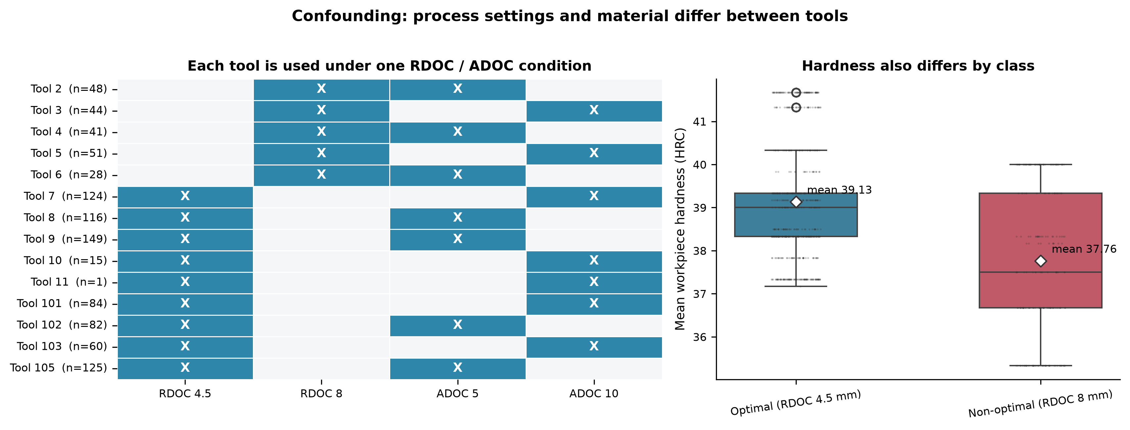
03 · THE TRAP
RDOC is perfectly confounded with tool identity
0 experiments and 0 tools contain both classes — so the split strategy is the result.
▪ One condition per tool Every tool runs at exactly one RDOC/ADOC combination.
▪ One condition per experiment So do all 24 experiments; the class is a property of the setup.
▪ Tool type 2 never appears at 8 mm Material and tool type are entangled with the target.
▪ Random split leaks The same tool appears in train and test; scores become memorisation.
Tool 11 has one cycle; tool type 2 is only ever optimal.
Piecuch & Żabiński, Scientific Data 12, 650 (2025) · CC BY 4.0 · ME-446 CEP
04

Slide 5
04 · METHOD
Cleaning → grouped validation → four models
Every model sees the same 120 features and the same folds. Nothing is tuned on the held-out tool.
1
2
3
4
5
Audit & clean
Features
Grouped CV
Compare
Select
Parse export quirks; cross-check sources; keep all 968 cycles.
signed-log1p on 120 sensor statistics; balanced class weights.
5 tool folds; tuning nested inside each outer fold.
Dummy · logistic · random forest · histogram gradient boosting.
Tune threshold on out-of-fold probabilities; stress-test by tool.
Primary estimate
Leakage control: never the headline
5-fold tool-group CV, pooled out-of-fold predictions. Leave-one-tool-out and leave-one-experiment-out are sensitivity tests.
Random 5-fold: RF ROC-AUC 0.998. Tool-grouped: 0.942. The gap is the leakage. All reported numbers are grouped.
Piecuch & Żabiński, Scientific Data 12, 650 (2025) · CC BY 4.0 · ME-446 CEP
05

Slide 6
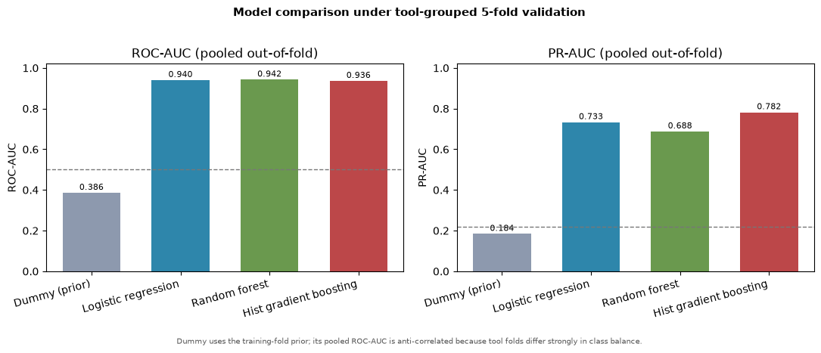
05 · MODEL COMPARISON
Four models, one honest comparison
5-fold tool-group CV, threshold 0.5. ROC-AUC and PR-AUC are threshold-independent; the rest are operating-point metrics.
Model | ROC-AUC | PR-AUC | Recall | Precision | F1 | MCC | Brier
Dummy (prior) | 0.386 | 0.184 | 0.000 | 0.000 | 0.000 | 0.000 | 0.173
Logistic regression | 0.940 | 0.733 | 0.948 | 0.663 | 0.781 | 0.725 | 0.093
Random forest | 0.942 | 0.688 | 0.892 | 0.724 | 0.799 | 0.742 | 0.082
Hist gradient boosting | 0.936 | 0.782 | 0.877 | 0.620 | 0.727 | 0.650 | 0.107
Random forest wins the operating point (F1 0.799, MCC 0.742, Brier 0.082). Gradient boosting wins threshold-independent PR-AUC (0.782) but is weaker at 0.5 — reported honestly, not hidden.
Piecuch & Żabiński, Scientific Data 12, 650 (2025) · CC BY 4.0 · ME-446 CEP
06

Slide 7
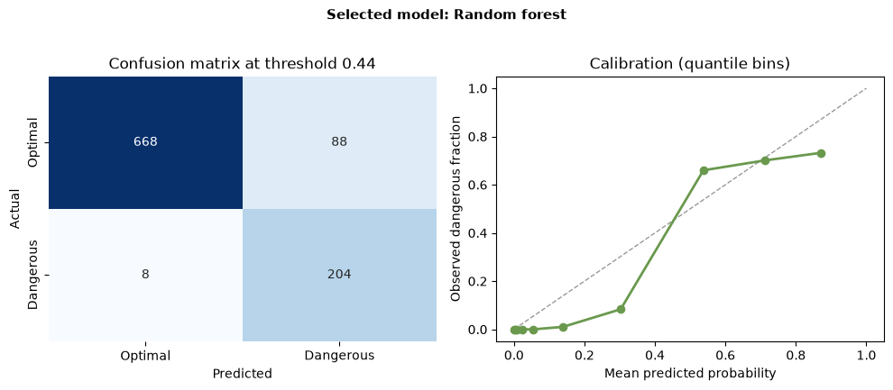
06 · SELECTED MODEL
At the tuned operating point, missing a cut is rare
Threshold 0.444 maximises F1 on pooled out-of-fold probabilities; it sits below 0.5 on purpose.
96.2 %
69.9 %
0.762
recall (dangerous)
precision
MCC
0.923
0.810
0.082
balanced accuracy
F1
Brier score
8 missed dangerous cycles out of 212 (3.8 %), 88 false alarms out of 756 (11.6 %). Leave-one-tool-out agrees: recall 0.962, MCC 0.778. The model is not relying on one grouping of tools.
Threshold is a policy: 0.444 favours recall; the dashboard exposes the trade-off.
Piecuch & Żabiński, Scientific Data 12, 650 (2025) · CC BY 4.0 · ME-446 CEP
07

Slide 8
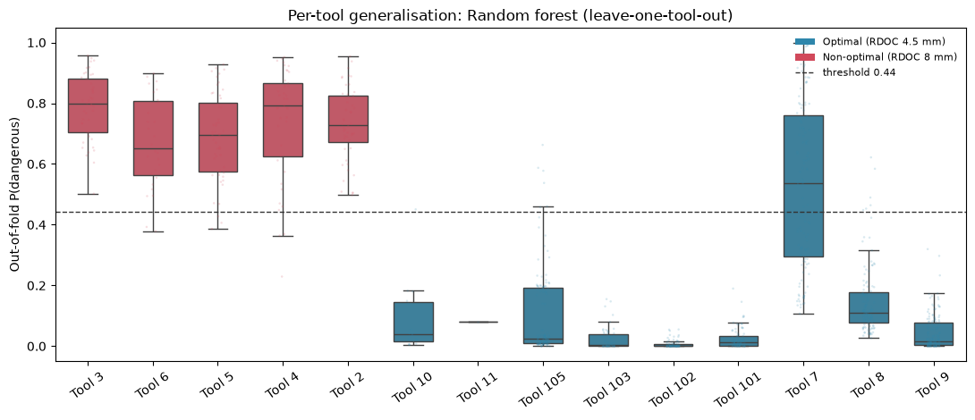
07 · ERROR ANALYSIS
One optimal tool drives most false alarms
Tool 7 accounts for 75 of the 88 false alarms; the 8 misses are spread across tools 4–6.
Tool | Actual | Cycles | Mean P | Flagged
4 | Dangerous | 41 | 0.712 | 92.7 %
5 | Dangerous | 51 | 0.623 | 94.1 %
6 | Dangerous | 28 | 0.676 | 92.9 %
7 | Optimal | 124 | 0.563 | 60.5 %
8 | Optimal | 116 | 0.149 | 5.2 %
105 | Optimal | 125 | 0.104 | 5.6 %
Tool 7 false alarms cluster late in tool life (mean normalised life 0.33). Wear pushes an optimal tool into a dangerous-looking signature — the central confound.
Piecuch & Żabiński, Scientific Data 12, 650 (2025) · CC BY 4.0 · ME-446 CEP
08

Slide 9
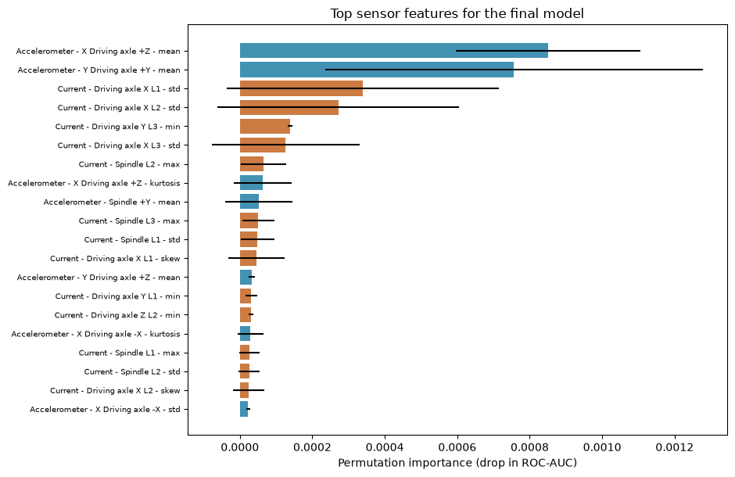
08 · INTERPRETATION
It reads force, not the answer key
Permutation importance on the fitted forest. Correlated channels share importance; the ranking is the message.
▪ Drive-axis mean acceleration the top signal — a static force offset grows with radial engagement.
▪ Current variability drive and spindle current std follow the heavier, more interrupted cut.
▪ No wear counter or ID metadata is excluded, so the model cannot read the target.
▪ Physically plausible the ranking matches cutting mechanics, not a dataset artefact.
Piecuch & Żabiński, Scientific Data 12, 650 (2025) · CC BY 4.0 · ME-446 CEP
09

Slide 10
09 · UNSEEN CASES
Held-out experiments behave as they should
A fresh forest is trained without P002 and P108, then applied to all 127 of their cycles.
Experiment | Actual | Cycles | Mean P | Flagged
P002 | Dangerous | 46 | 0.746 | 97.8%
P108 | Optimal | 81 | 0.006 | 0.0%
Single-cycle scoring with the final model
Cycle | Actual | P(dangerous) | Decision
P002_F12_C4 | Dangerous | 0.967 | Flag
P108_F12_C7 | Optimal | 0.000 | Clear
The one miss is a real engineering finding
Same 120-feature interface a deployment would use: one row of sensor statistics, no metadata. P108 is cleared on every cycle; P002 is flagged on 45 of 46.
P002's first cycle scores 0.439 — just under the 0.444 threshold. A fresh tool has not yet developed the wear-driven rise in vibration and current. Use a rolling window, not a verdict on one cycle.
Piecuch & Żabiński, Scientific Data 12, 650 (2025) · CC BY 4.0 · ME-446 CEP
10

Slide 11
10 · ENGINEERING INTERPRETATION
A data-driven cutting-force monitor
The model's signal and its errors both make physical sense.
SIGNAL
MODEL
ERROR
Larger RDOC → higher chip load → higher drive-axis mean acceleration and more variable spindle/drive current.
The forest combines correlated channels and shifts its decision boundary at 0.444 to favour recall.
Wear, hardness and tool geometry move the signature in the same direction as RDOC, so tool 7 overlaps.
CONSEQUENCE OF AN ERROR
A false negative continues a dangerous cut — faster wear, chatter, scrap or a broken tool. A false positive costs an inspection. The threshold and the human-in-the-loop workflow are chosen around that asymmetry.
Piecuch & Żabiński, Scientific Data 12, 650 (2025) · CC BY 4.0 · ME-446 CEP
11

Slide 12
11 · CAVEATS & NEXT STEPS
Strong screening alarm, not a causal instrument
The confound is a property of the experiment, not something a better model can remove.
LIMITATIONS
RECOMMENDATIONS
▪ Confounded design RDOC constant within each tool and experiment.
▪ Wear confound Dangerous tools fail sooner; signal drifts with life.
▪ Small tool count 14 tools, 5 dangerous; tool 7 dominates errors.
▪ Pre-computed features No raw waveforms; no re-optimised windows.
▪ Uncalibrated units ADC counts, single machine, one campaign.
▪ Two-cycle confirmation Do not retract on one marginal cycle.
▪ Tool-specific baseline Compare with the tool's own early-life signature.
▪ Balanced experiment Cut the same tool at both RDOC levels.
▪ Calibrate channels Convert ADC to g and A before transfer.
▪ Tune to cost ratio Inspection cost vs missed-cut risk.
Piecuch & Żabiński, Scientific Data 12, 650 (2025) · CC BY 4.0 · ME-446 CEP
12

Slide 13
ME-446 · COMPLEX ENGINEERING PROBLEM
Delivered and reproducible
11 figures
EDA, model comparison, calibration, per-tool evidence
Executed notebook
cleaning → models → threshold → unseen cases
Streamlit dashboard
6 tabs, threshold slider, live scoring, CSV upload
Tableau extracts
8 tables + calculated-field build guide
Technical report
17 pages, 5 400 words, 11 figures
Live dashboard: milling-cep-iguwxgwerngzavkpz2aguj.streamlit.app
github.com/Shahbaz2104/milling-cep · Questions

