Slide 1



ICP Prediction Model — Project Report
Identify high-intent student leads so sales teams prioritize outreach and convert more course enrollments.
AUGUST 2026
MO SHAHBAZ LUKMAN

Slide 2

Business Problem & Objective
Problem
Large volumes of student leads with varying intent waste human follow-up time and delay high-intent prospects.
Objective
Predict whether a lead will purchase within 30 days and rank prospects so sales focus on those most likely to convert.

Slide 3

Target & What ICP Represents
Target
Profile
purchased_within_30_days — binary: 1 if purchased within 30 days, else 0.
Age, education, occupation, city.
Intent & Behavior
Engagement & Recency
Course enquiry, lead source, page views, brochure downloads, email/WhatsApp responses.
Follow-ups, webinar/demo attendance, video watches, days since last activity.
Leakage control: post-purchase features like purchased_course were excluded — only pre-purchase signals used.

Slide 4
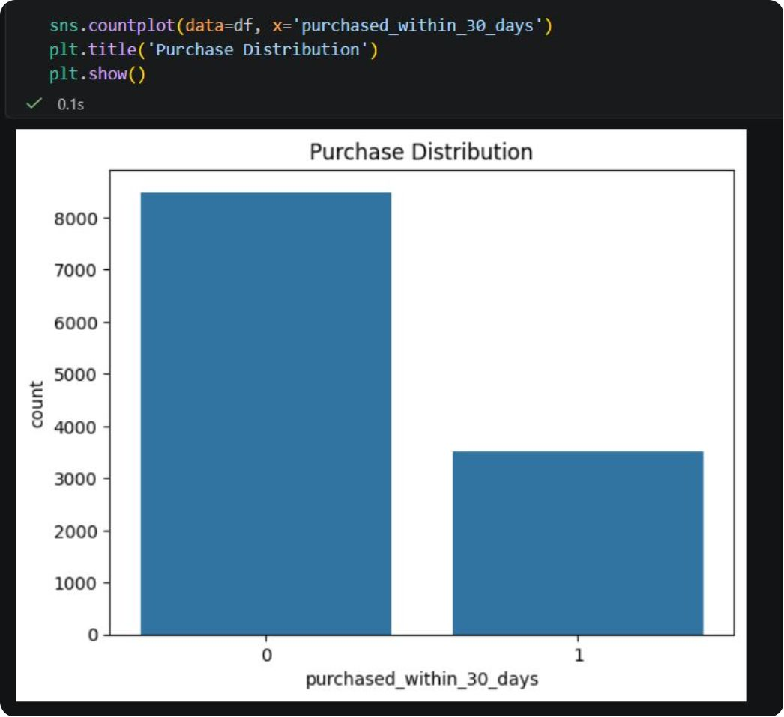
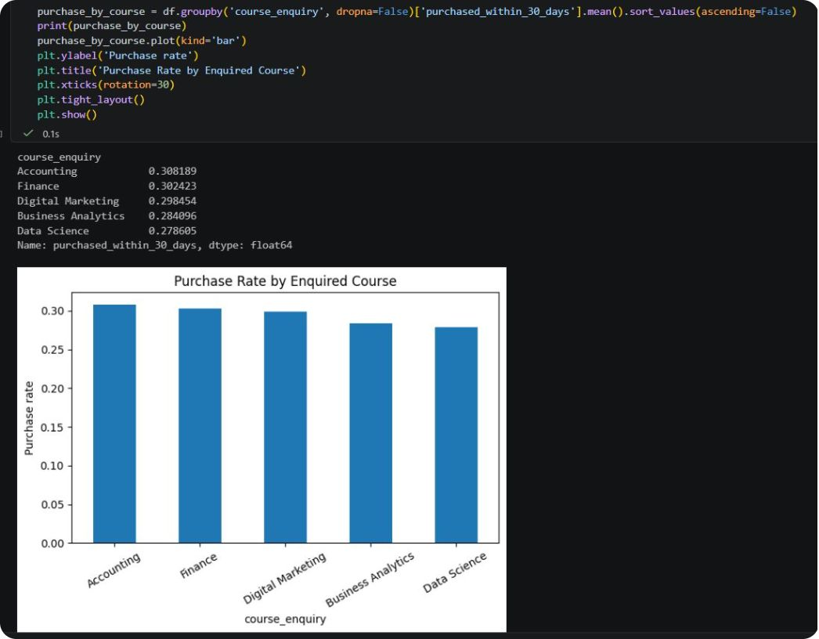
Data Overview & EDA Highlights
Dataset: 12,000 leads. Clear class imbalance: ~8,500 non-purchasers vs ~3,500 purchasers.
Observed course purchase rates (approx.): Accounting 30.82%, Finance 30.24%, Digital Marketing 29.85%, Business Analytics 28.41%, Data Science 27.81% — modest spread, so course alone is insufficient for ICP.
EDA takeaway: combine profile + engagement signals for better prediction.

Slide 5





Feature Groups & Preprocessing
Profile
Intent
Web Behavior
Age, education, occupation, city
Course enquiry, lead source
Website/course/pricing views
Communication
Recency
Days since last activity
Email opens, WhatsApp, calls
Preprocessing: numeric median imputation + standardization; categorical most-frequent imputation + one-hot encoding; all embedded in a single pipeline to avoid train/serve mismatch.

Slide 6
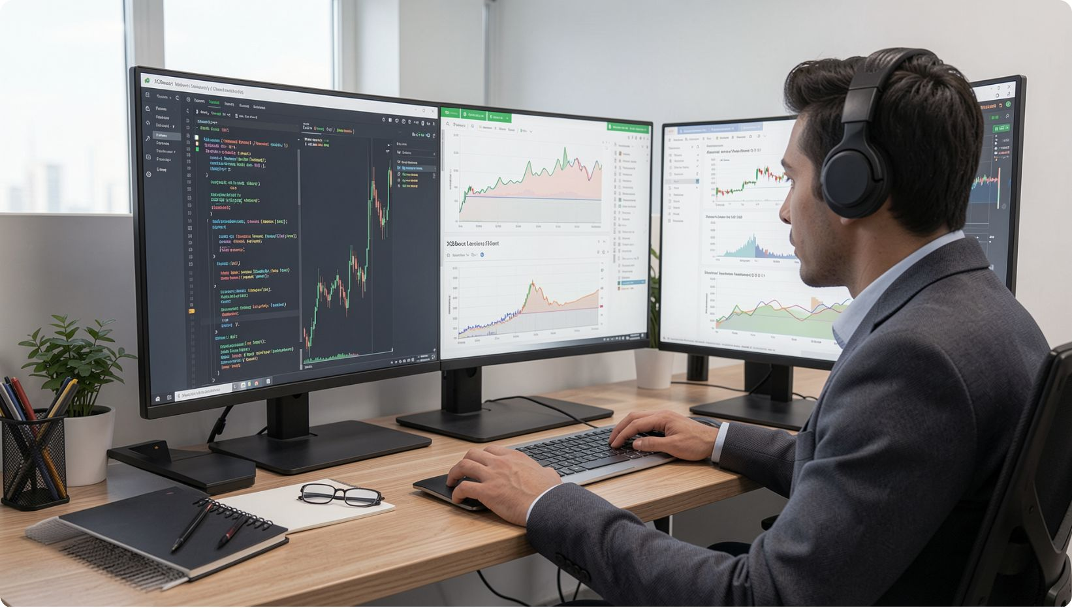
Model Comparison & Selection
Tuning: RandomizedSearchCV over 25 parameter combos with 5-fold stratified CV, optimizing average precision. Final evaluation uses the tuned XGBoost model.
Logistic Regression
Random Forest
CV ROC-AUC 0.834 • PR-AUC 0.695 • High recall (0.759)
CV ROC-AUC 0.825 • Balanced precision/recall
XGBoost
CV ROC-AUC 0.823 • Chosen for tuning (PR-AUC objective)

Slide 7
Final Test Performance (Tuned XGBoost)
Accuracy
Precision
0.7954
0.7089
Recall
ROC-AUC
0.5100
0.8362
PR-AUC
Brier Score
0.6951
0.1426
Interpretation: 0.836 ROC-AUC indicates useful ranking; at 0.50 threshold ~71% of predicted purchasers were correct while capturing ~51% of actual purchasers.

Slide 8
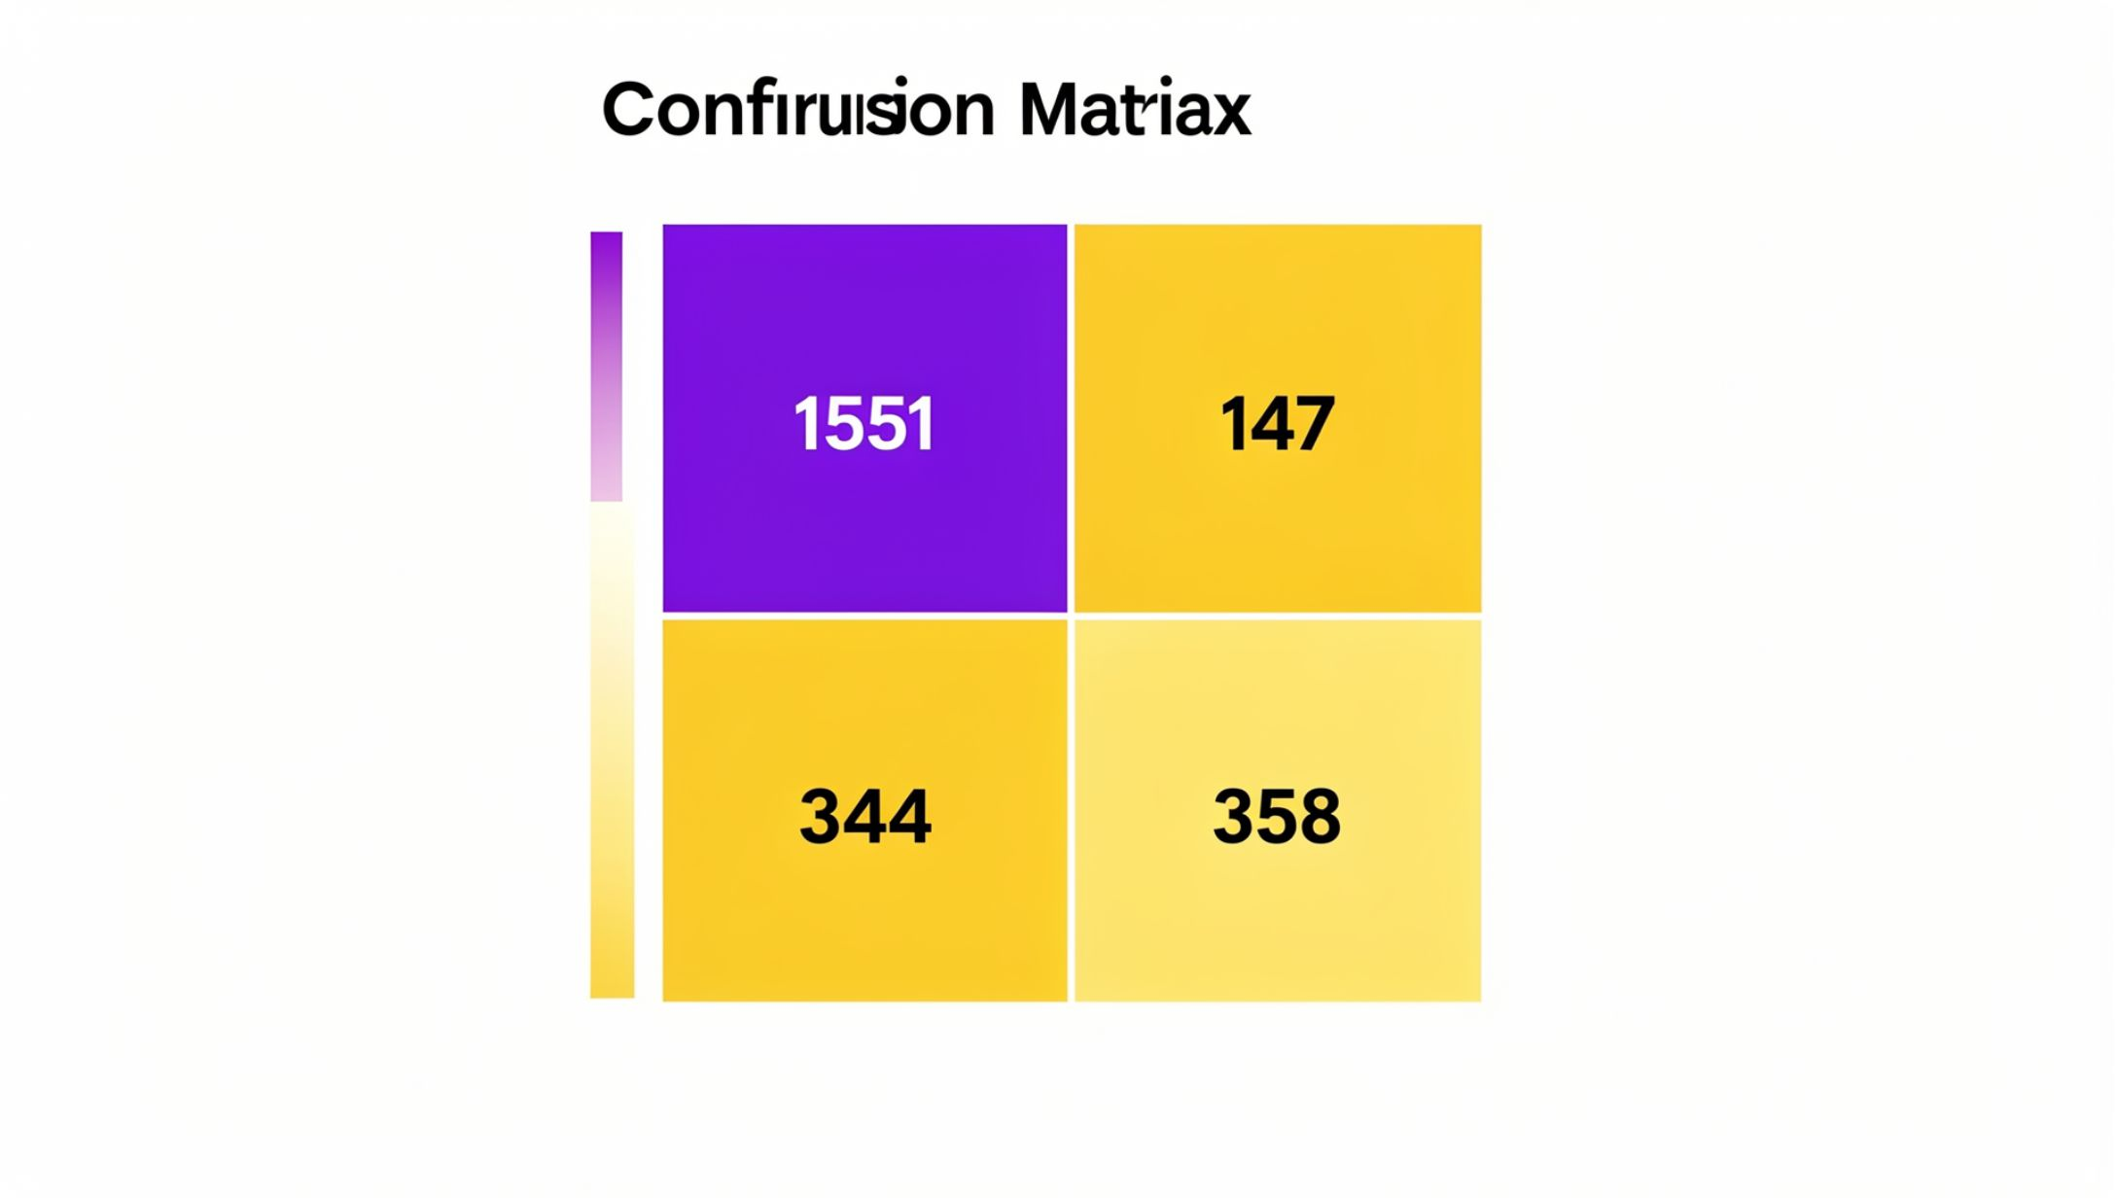
Confusion Matrix & Trade-offs
Counts at 0.50 threshold: TN=1,551 • FP=147 • FN=344 • TP=358.
Business implication: 344 false negatives are the largest opportunity — lower threshold to capture more purchasers if missing buyers is costly; raise threshold to conserve counselor capacity.

Slide 9
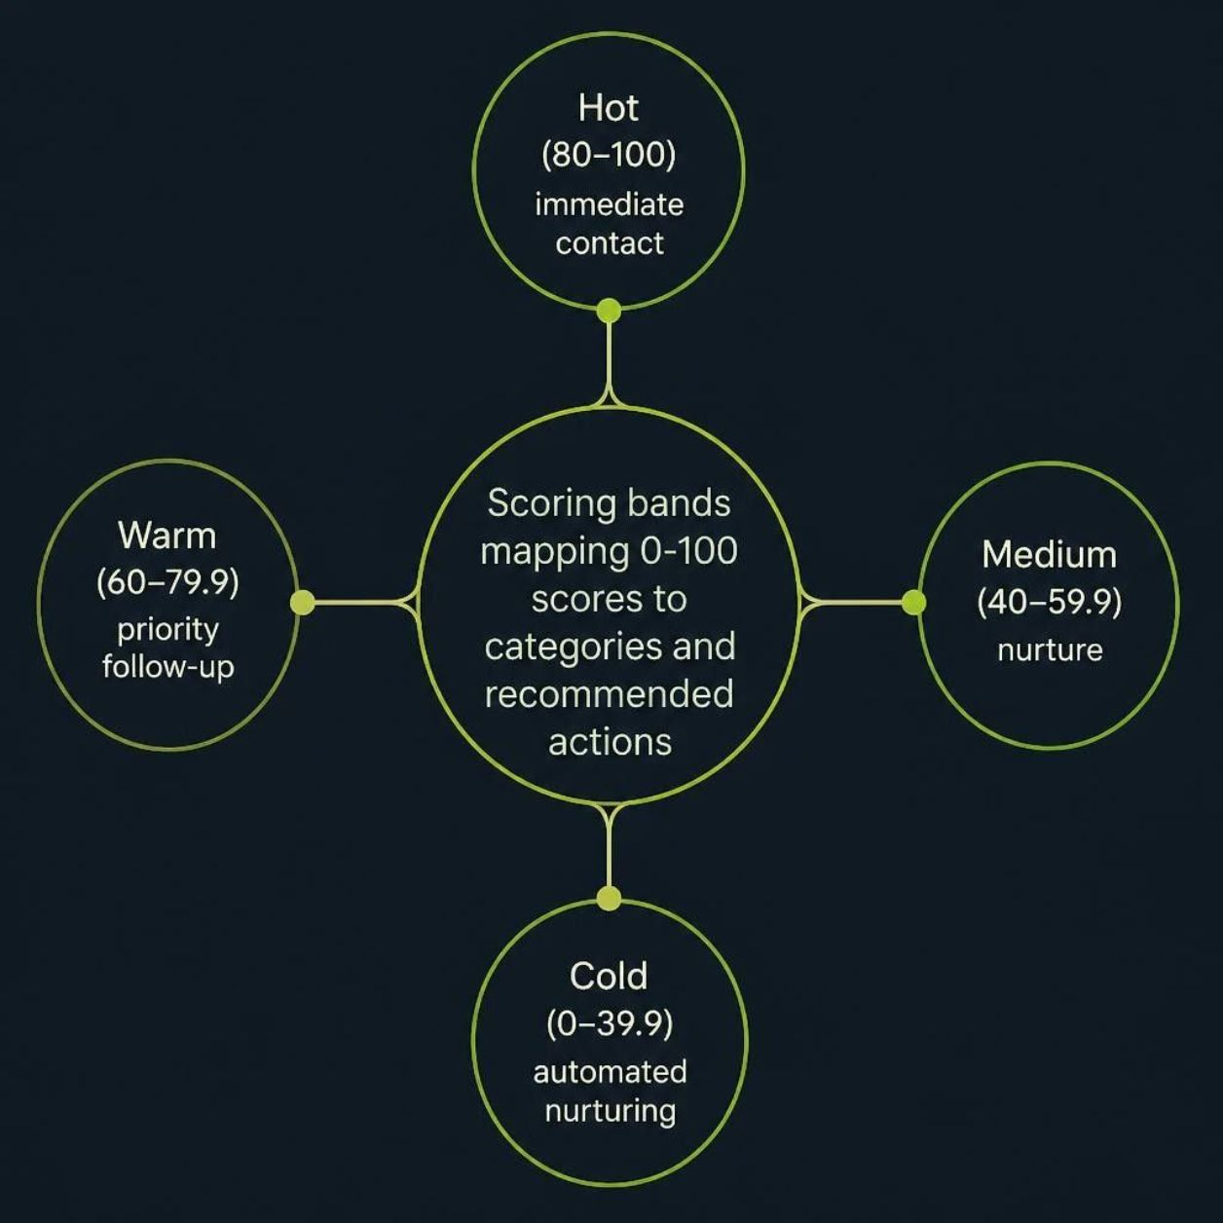

Lead Scoring, Threshold Strategy & Workflow
Threshold examples from analysis:
0.40 → Precision 63.8%, Recall 64.2% (~29.5% leads)
0.50 → Precision 70.9%, Recall 51.0% (~21.0% leads) [current default]
0.70 → Precision 82.1%, Recall 26.8% (~9.5% leads) — useful when capacity is very limited
Recommendation: use capacity-based cutoffs and re-evaluate periodically.

Slide 10






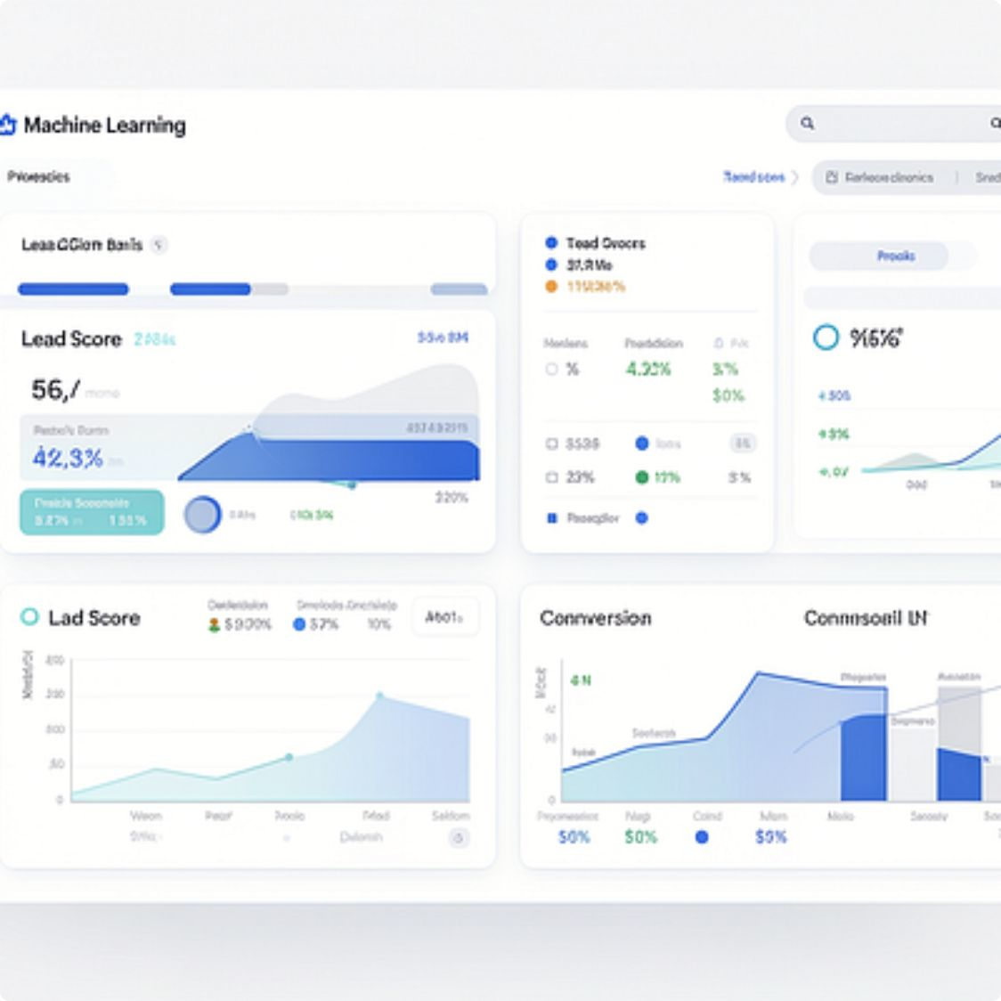
Recommendations, Deployment & Conclusion
Rank then Contact
Capacity-Based Thresholds
Sort leads by score and allocate human effort top-down.
Adjust cutoff by counselor capacity, contact cost and lead value.
Re-score Dynamically
Monitor Outcomes
Update scores as new website/email/call/webinar activity arrives.
Track precision, recall, PR-AUC and revenue by score band after deployment.
Conclusion: The tuned XGBoost model (ROC-AUC 0.836; precision 70.9%; recall 51.0% at 0.50) is a practical prioritization engine — use it to find the best customer, prioritize the right conversations, and iteratively improve the ICP using measured outcomes.

