Slide 1
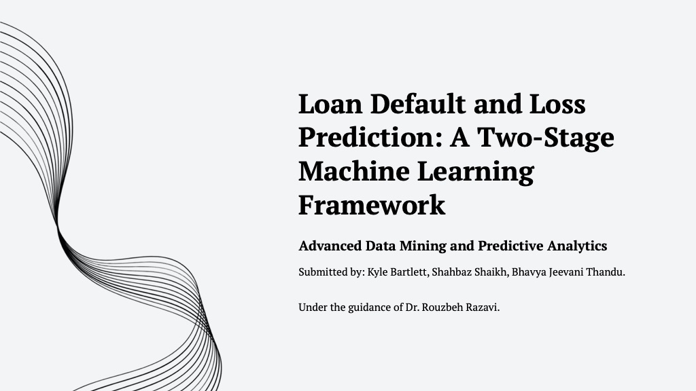

Slide 2
Project Goal & Business Context
Project Goal
Financial Relevance
Build a machine learning framework to predict loan loss.
Forecast both the probability of default and the expected loss amount.
Provide a submission file with predicted loss for each test case.
Move beyond simple yes/no bad-credit classification.
Enable more advanced, quantitative decisions for underwriting and portfolio management.
Calculate risk using both default probability and loss severity.

Slide 3
Data Overview
The dataset is derived from historical loan applications. The goal is to predict the loss value for the test set, which is not provided.
Metric | Value
Training Rows | 80,000
Test Rows | 25,471
Usable Predictor Features | 760
Raw Train Columns | 763
Raw Test Columns | 762
Default Rate | 9.22%
Zero Loss Rate | 90.78%

Slide 4
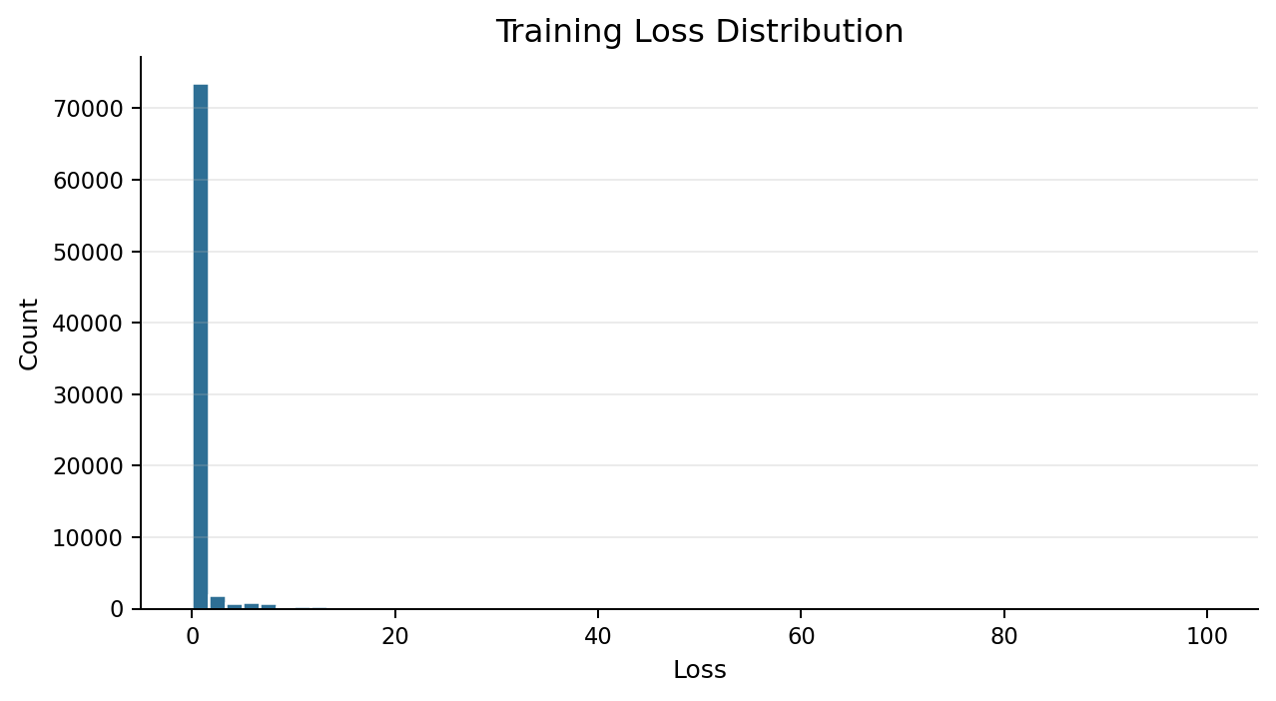
The Core Challenge: Zero-Inflation
A Highly Imbalanced Dataset
90.78% of loans have zero loss.
Only 9.22% of loans default and incur a positive loss.
A single regression model would be heavily biased toward predicting zero.
This structure motivates splitting the task into a classification problem and a regression problem.

Slide 5
Data Preprocessing
A multi-step pipeline was used to prepare the data for modeling, prevent data leakage, and ensure compatibility with all algorithms.
Removed V1 / index-style column because it is not loan information.
Stored id separately for the final submission file.
Created a binary default variable for classification: default = 1 if loss > 0.
Encoded categorical features into numeric representations.
Imputed missing values using the median to handle outliers.
Scaled features using centering and standardization.
Cleaned data to handle NA/NaN/Inf values for XGBoost.

Slide 6
Solution: A Two-Stage Framework
To address zero-inflation, the problem was split into two modeling stages, which aligns with standard credit risk assessment practices.
1
2
Stage 1: Classification
Stage 2: Regression
Predict the Probability of Default (P(Default)). This model answers: will this loan default?
For loans predicted to default, predict the Loss Severity. This model answers: if it defaults, how much will be lost?
Final Calculation
Expected Loss = P(Default) x Predicted Loss Severity

Slide 7
Stage 1: Classification Model Comparison
Performance (AUC)
Models were compared using Area Under the Curve (AUC) to measure their ability to discriminate between defaulting and non-defaulting loans.
Model | AUC
XGBoost | 0.712861
Logistic Regression | 0.702779
Random Forest | 0.621714
Elastic Net Logistic | 0.705165
Why XGBoost?
Achieved the highest AUC score.
Effectively captures non-linear relationships and feature interactions.

Slide 8
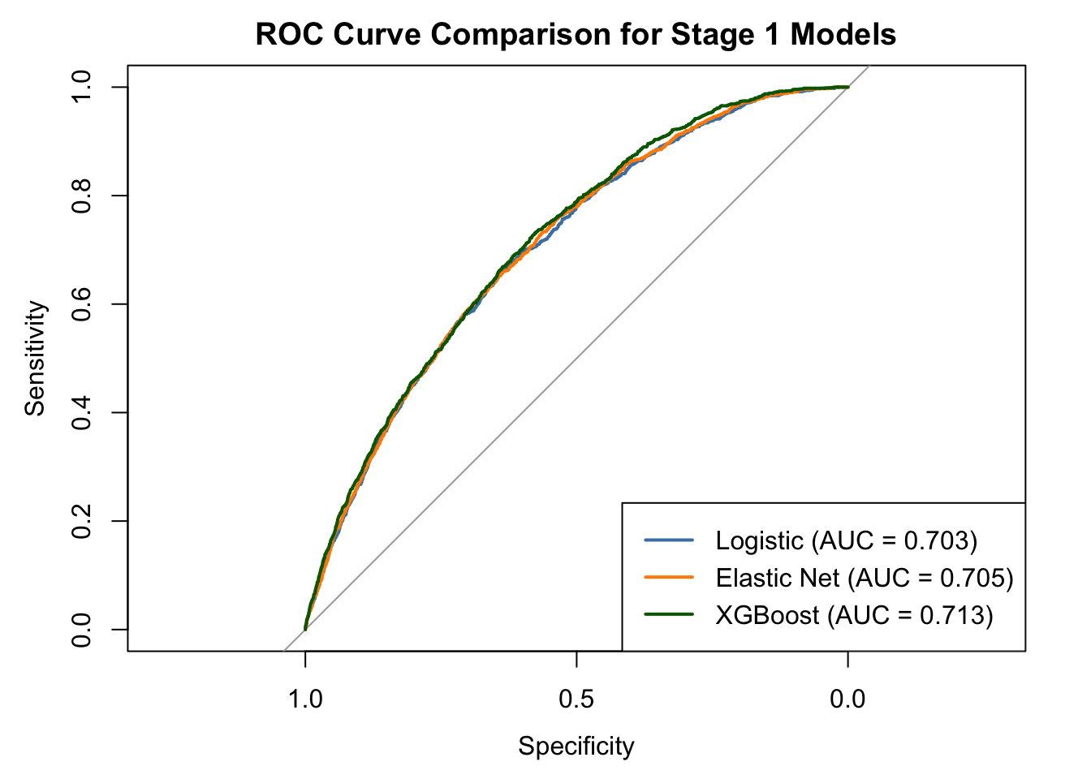
Stage 1: XGBoost ROC Curve
Interpreting the Curve
The ROC curve illustrates the trade-off between true positives and false positives across classification thresholds.
An AUC of 0.712861 indicates a fair to good discriminative ability.
The model performs significantly better than random chance.
This confirms XGBoost's capacity to rank defaulted loans higher than non-defaulted ones.

Slide 9
Stage 2: Regression Model Comparison
Performance (MAE)
For defaulted loans, models were evaluated by Mean Absolute Error (MAE). A lower MAE indicates better prediction accuracy.
Model | MAE
XGBoost Regression | 5.033003
Ridge Regression | 5.934699
PLS Regression | 6.432512
Why XGBoost?
Achieved the lowest MAE, minimizing prediction error.
Better captures the complex structure of loss severity.

Slide 10
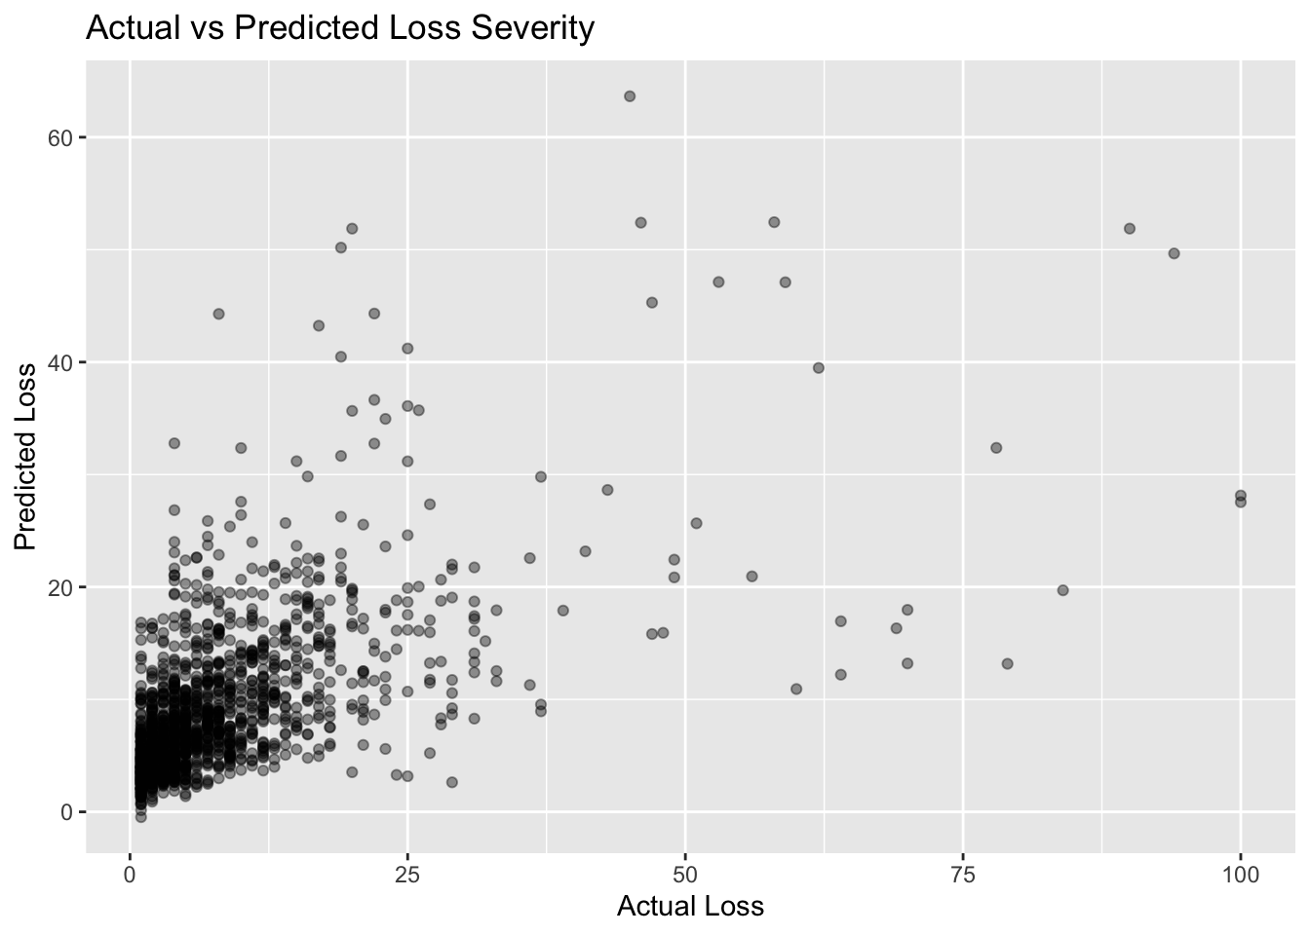
Stage 2: Actual vs. Predicted Loss
Model Accuracy
This scatter plot compares the model's predicted loss against the actual loss for the validation set.
The model captures the overall shape of the loss severity.
An ideal model would place all points on a 45-degree diagonal.
Prediction error is larger for high-loss events, which are rare and difficult to predict.

Slide 11
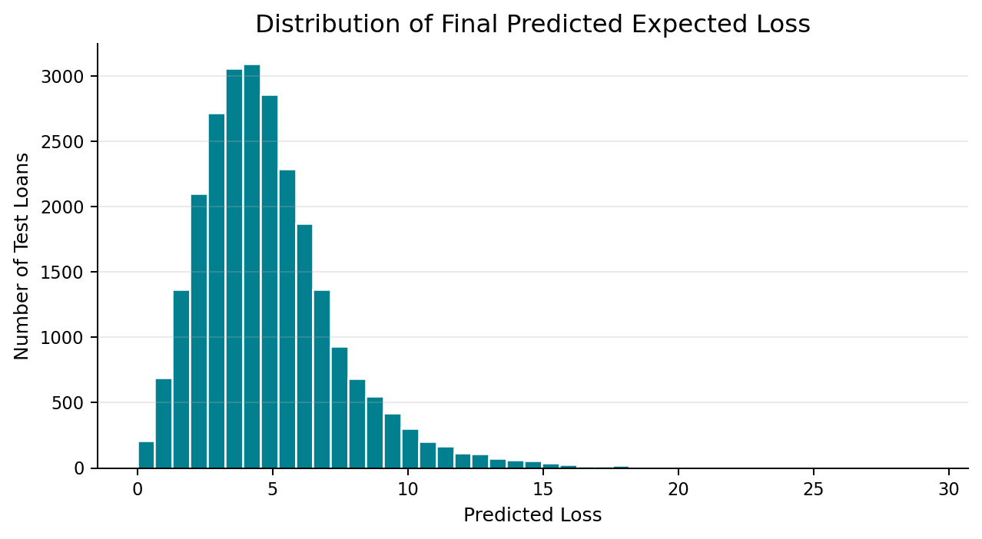
Final Prediction: Expected Loss Distribution
Combining the Stages
The final expected loss for the test set is calculated by multiplying the estimate of default risk with the predicted loss value for each loan.
The resulting predictions form a right-skewed distribution, consistent with the nature of financial loss data.
Submission Format | Meaning
id, loss | Predicted expected loss for every test record

Slide 12
Key Insights & Conclusion
Primary Finding
A two-stage machine learning framework using XGBoost provides a robust and financially interpretable solution for predicting loan loss in a zero-inflated dataset.
The two-stage approach successfully manages the zero-inflation problem.
XGBoost was the superior algorithm for both classification (AUC: 0.712861) and regression (MAE: 5.033003).
This framework separates the prediction of default probability from the prediction of loss severity, which is a more appropriate and actionable approach for credit risk analysis.

Slide 13
Limitations & Future Work
Limitations
Future Work
Anonymized Features: Prevents domain-specific feature engineering.
Imbalanced Data: While it can be managed, it remains an inherent challenge.
Hyper-parameter Tuning: This project used a baseline; further tuning could improve performance.
Model Explainability: Use SHAP or LIME to understand key drivers of default and loss.
Threshold Optimization: Optimize classification threshold based on a business-specific financial cost matrix.
Alternative Models: Compare against other methods like LightGBM, CatBoost, and Tweedie regression.

Slide 14
Thank You
Questions?
?

