Slide 1
AI Medical Chatbot using RAG (MediBot)

Slide 2
PROJECT LAYOUT
Phase 1–Setup Memory for LLM (Vector Database)
Load raw PDF(s)
Create Chunks
Create Vector Embeddings
Store embeddings in FAISS
Phase 2–Connect Memory with LLM
Setup LLM (Mistral with HuggingFace)
Connect LLM with FAISS
Create chain
Phase 3–Setup UI for the Chatbot
Chatbot with Streamlit
Load Vector store (FAISS) in cache
Retrieval Augmented Generation–RAG

Slide 3
Tools & Technologies
Langchain (AI Framework for LLM applications)
HuggingFace (ML/AI Hub)
Mistral (LLM Model)
FAISS (Vector Database)
Steamlit (For Chatbot UI)
Python (Programming Language)
VS Code (IDE)

Slide 4
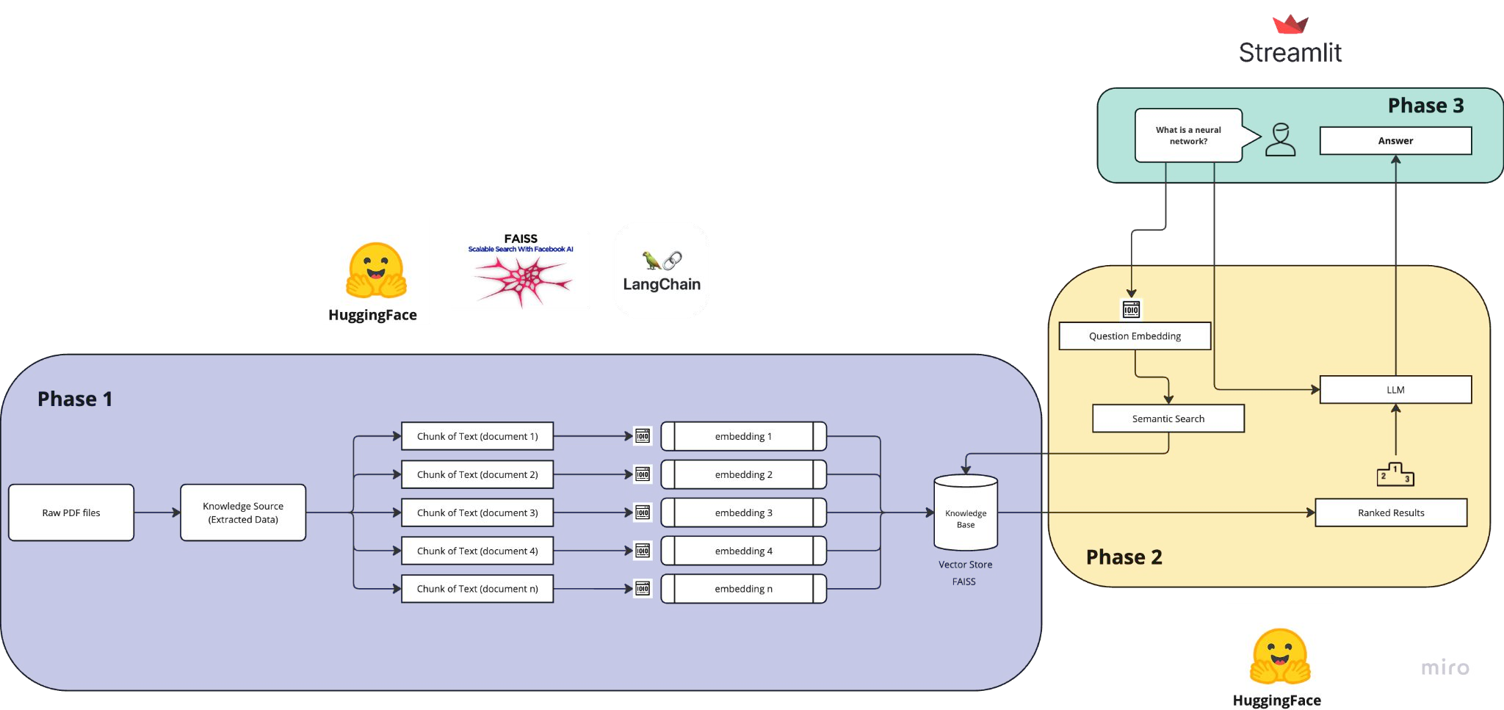
Technical Architecture

Slide 5
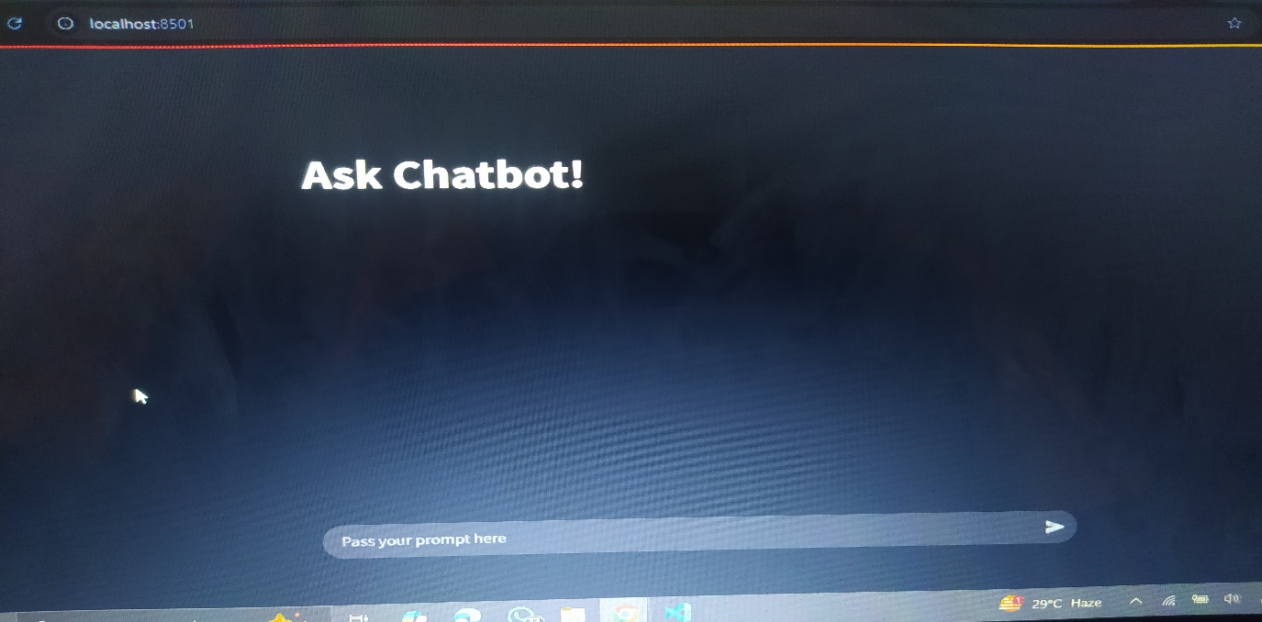
UI through Streamlit

Slide 6
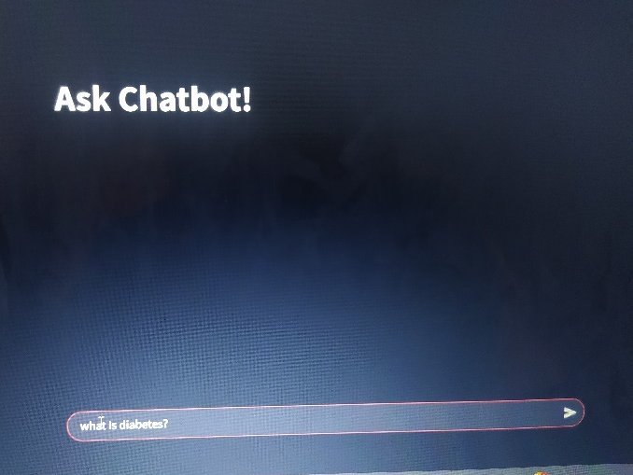
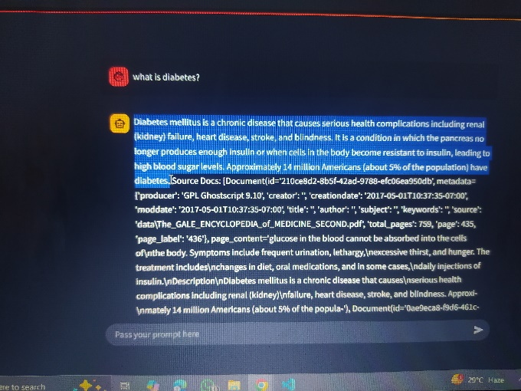
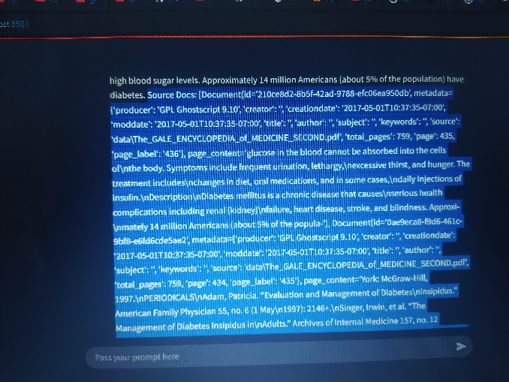
Prompting

Slide 7
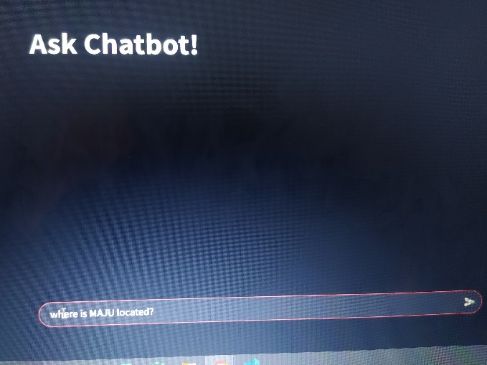
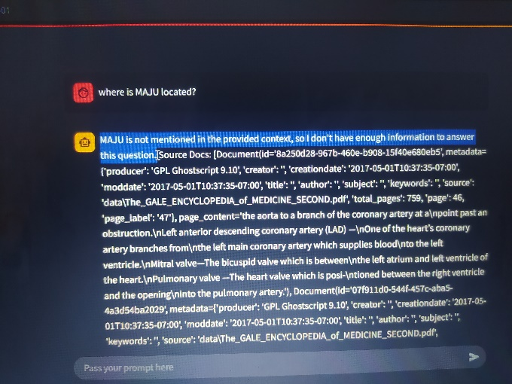
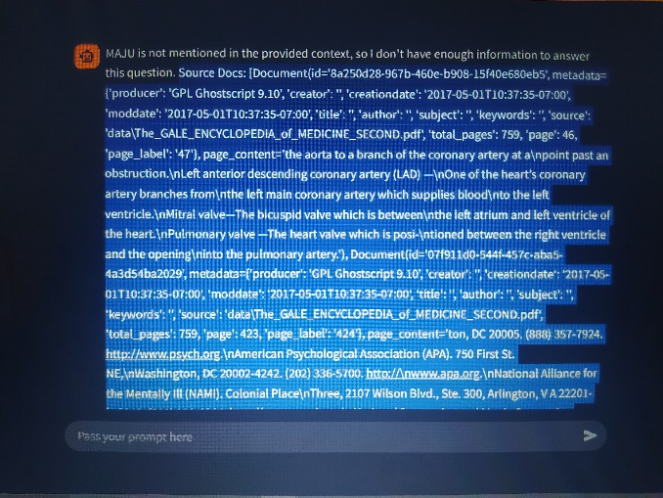
Prompting

Slide 8
Results
We give two prompts to the medical chatbot to test the credibility of the information.
Firstly, we asked about a disease, and the chatbot easily answered to that along with source documents.
Secondly, we asked a random question to check the credibility of the information, we expect it to not answer if the related document is not present in it database.
The chatbot didn’t give any false information or hallucinations of the information it doesn’t have.

Slide 9
Improvement Potential/Next Steps
Add authentication in the UI
Make use of self-upload document functionality
Add multiple documents and embed them together
Add Unit testing of RAG applications

Slide 10
Summary
Modern AI Chatbot for Documents
Modular 3 phased Chatbot project
Used Technologies
  Streamlit | Langchain | HuggingFace
  RAG
  Vector Embeddings
  End to End RAG pipeline
Future Possibilities
Any sort of Feedback will be highly appreciated

