Slide 1
Telecom Customer Churn & Retention Analysis
NTI Data Analytics Capstone
Ahmed Baligh | Karim Sobhy | Shahd Waleed | Ahmed Yehia
Ahmed Mohamed — Documentation & Presentation

Slide 2
Telecom Customer Churn & Retention Analysis
Data-Driven Insights for Customer Retention & Revenue Stabilization
7,043
1,869
Total Customer Base
Total Churned Clients
26.54%
14
Baseline Churn Rate
Relational Tables Modelled
1 in every 4 customers churns. This analysis identifies the root causes, quantifies the risk, and prescribes high-ROI retention interventions.

Slide 3
Executive Summary & Core KPIs
Core Problem
26.54% — Baseline Churn Rate
At a 26.54% baseline churn rate, the business is losing 1 in every 4 customers — a structural revenue leak requiring immediate executive intervention.
Across 7,043 customers, 1,869 have churned. This rate exceeds industry benchmarks and signals systemic retention failure rather than isolated attrition.
Primary Drivers
Short-term contract exposure, manual payment friction, and aggressive competitor offers across fiber optic markets.
Contract Structure — Root Cause #1
Month-to-Month contracts account for 88.5% of all churn. Two-Year subscribers churn at only 2.83% — a 15x improvement in retention.
Key Opportunity
High retention leverage exists in contract conversion programs and automated billing incentives — two levers with quantifiable, near-term ROI.
45.29% — Electronic Check Churn Rate
Manual payment methods create monthly friction. Auto-pay customers churn at 15–17%, nearly 3x lower than Electronic Check users.
Value-Added Services — Retention Anchor
Tech Support and Online Security adoption collapse churn from 41%+ down to 14–15%, demonstrating strong product stickiness potential.

Slide 4
The Technical Foundation: ETL & Relational Modeling
Data Cleaning & Transformations
Relational Star Schema — 14 Tables
01
Category
Dimension / Fact Tables
Deduplication
Customer & Geo
Dim_Customers, Dim_Locations
Applied 1:1 primary key uniqueness on CustomerID across all dimension tables to eliminate duplicate records.
Contract & Billing
Dim_Contracts, Dim_PaymentMethods
02
Phone & Internet
Dim_PhoneServices, Dim_InternetServices
Whitespace & Null Imputation
Security & Support
Dim_OnlineSecurity, Dim_TechSupport
Trimmed text fields and imputed missing Total Charges for new accounts (Tenure = 0) with a zero value.
Backup & Protection
Dim_OnlineBackup, Dim_DeviceProtection
Streaming
Dim_StreamingTV, Dim_StreamingMovies
03
Fact Entities
Fact_MonthlyBilling, Fact_CustomerChurn
Type Casting
Converted Total Charges to Decimal Numeric Float for accurate financial aggregation and analysis.
04
Feature Engineering
Built Tenure_Group cohorts: 0–1 Year, 1–2 Years, 2–4 Years, 4+ Years for longitudinal churn analysis.

Slide 5

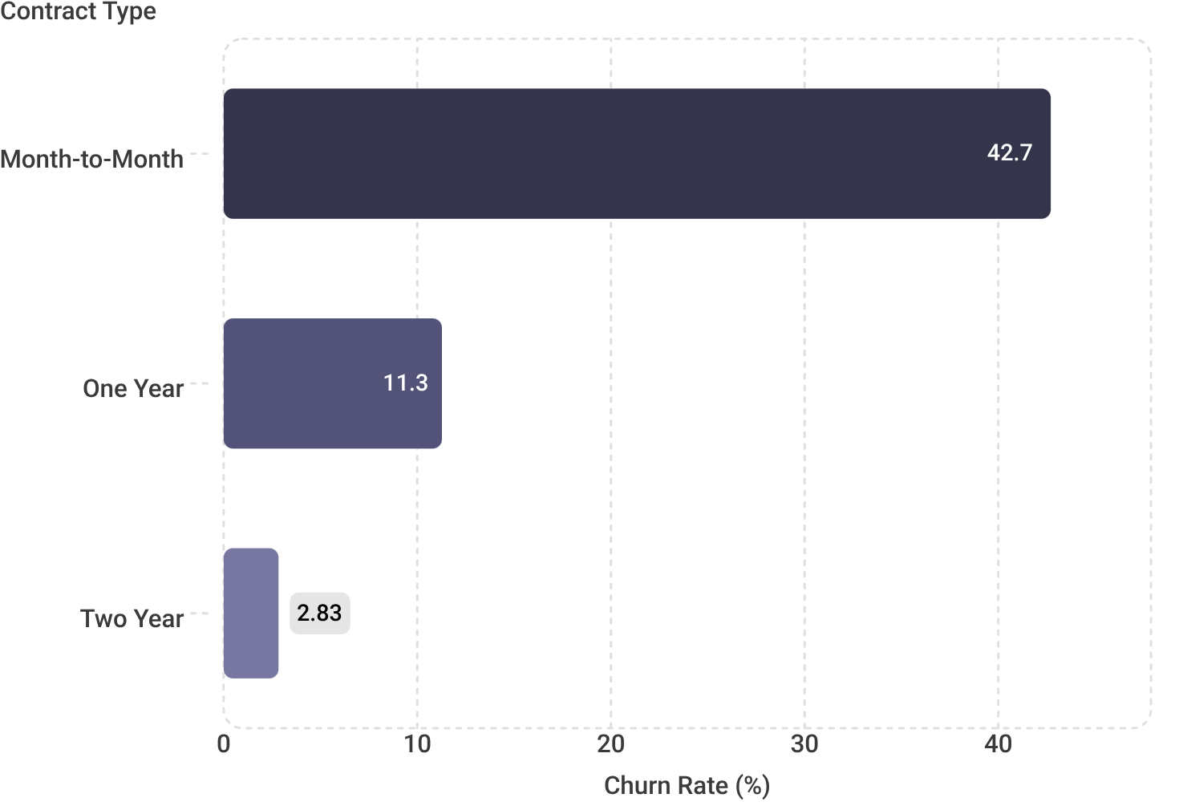
Root Cause #1: Contract Structure Dynamics
88.5% of all churn originates from Month-to-Month contracts. Long-term contract adoption is the single highest-leverage retention mechanism available.
Month-to-Month
One Year
1,655 churned of 3,875 total
42.71% churn rate
166 churned of 1,473 total
11.27% churn rate
Two Year
48 churned of 1,695 total
2.83% churn rate
Two-year subscribers churn at 2.83% — a 15x improvement over month-to-month attrition. Contract conversion is the fastest path to structural churn reduction.

Slide 6

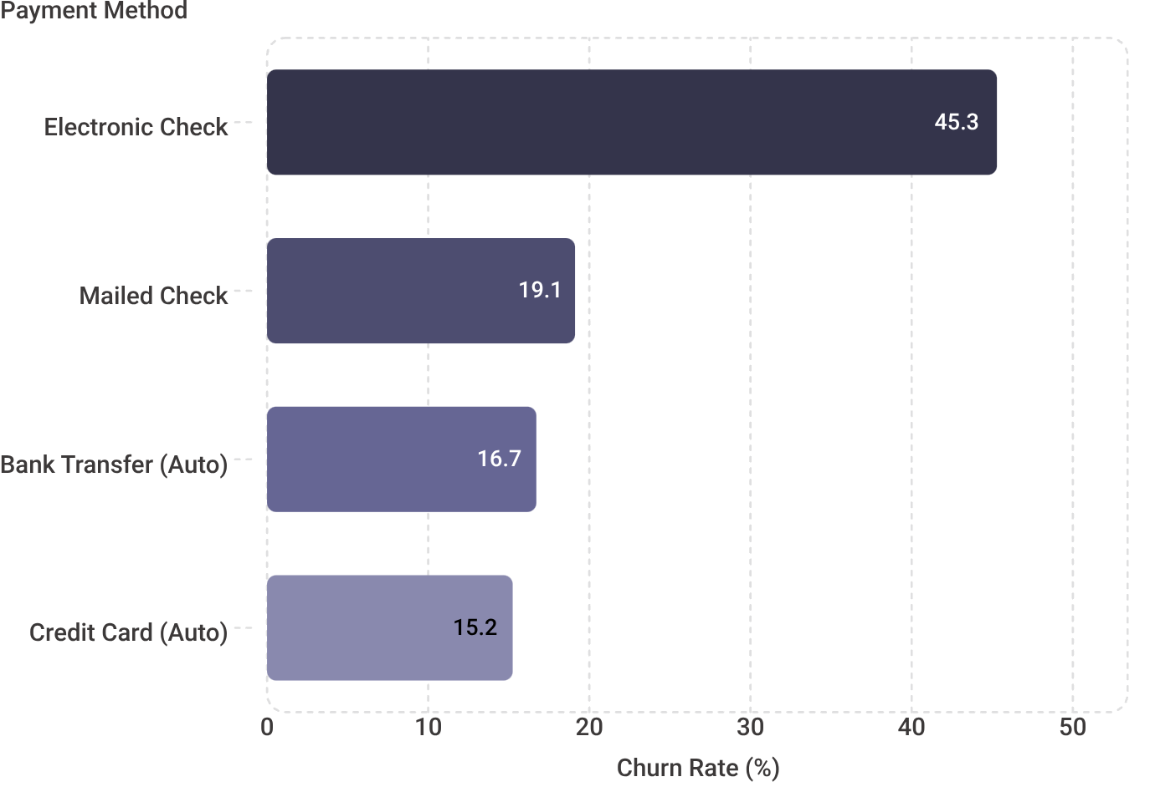
Root Cause #2: Payment Method Friction
Electronic Check users churn at 45.29% — nearly triple the rate of auto-pay users. Manual payment execution creates monthly friction that accelerates customer exit decisions.
Critical Risk — Electronic Check
1,071 churned · 45.29% churn rate. Monthly manual login and payment execution generates recurring friction at the billing moment of truth.
Moderate Risk — Mailed Check
308 churned · 19.11% churn rate. Physical check writing creates effort barriers but at lower frequency than digital friction.
Low Risk — Auto-Pay Methods
Bank Transfer: 258 churned · 16.71% | Credit Card: 232 churned · 15.24%. Automation removes the monthly decision point entirely.

Slide 7
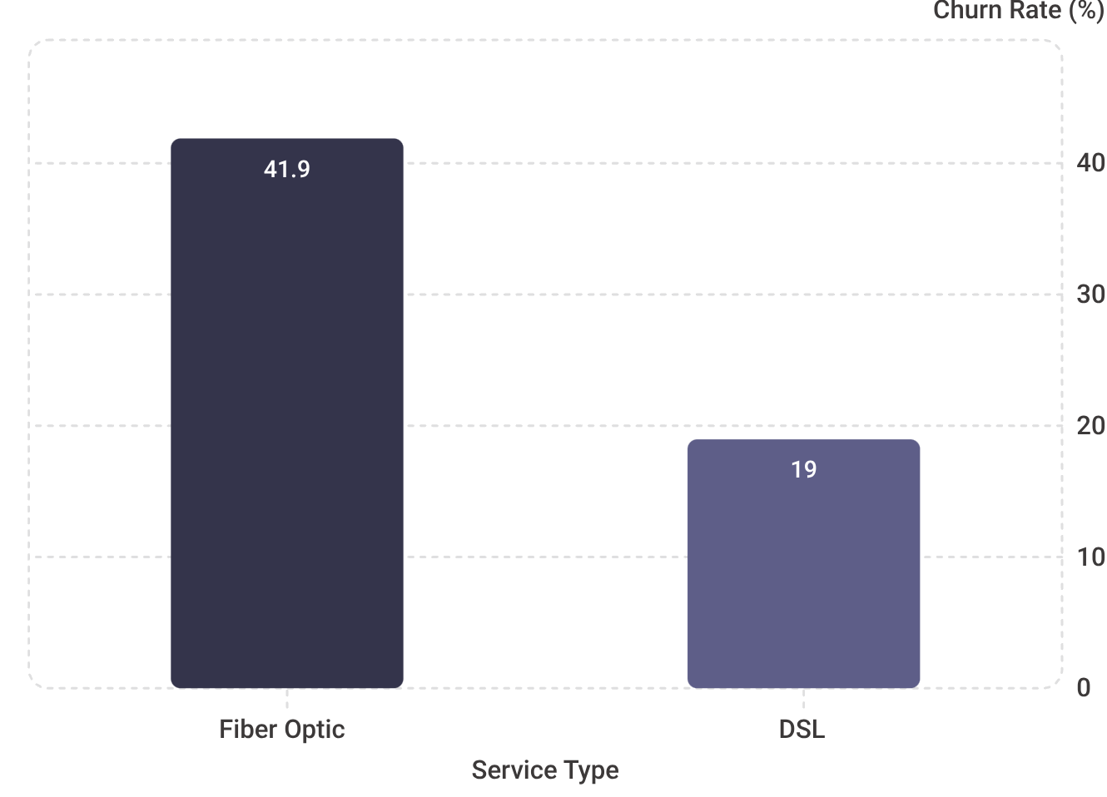

Root Cause #3: Product Attach Rates & Fiber Optic Risk
Internet Service Type vs. Churn Rate
Value-Added Services: Churn Collapse Effect
Service Feature
Churn WITH
Churn WITHOUT
Impact
Tech Support
15.17%
41.64%
−63.6% drop
Online Security
14.61%
41.77%
−65.0% drop
Key Insight: Attaching Tech Support or Online Security collapses churn from 41%+ down to 14–15%. Bundling these features into Fiber Optic plans is the highest-impact product lever available.
Fiber Optic customers churn at 41.89% — a +22.9 percentage point premium over DSL — driven by aggressive competitor pricing and speed comparisons in the market.

Slide 8
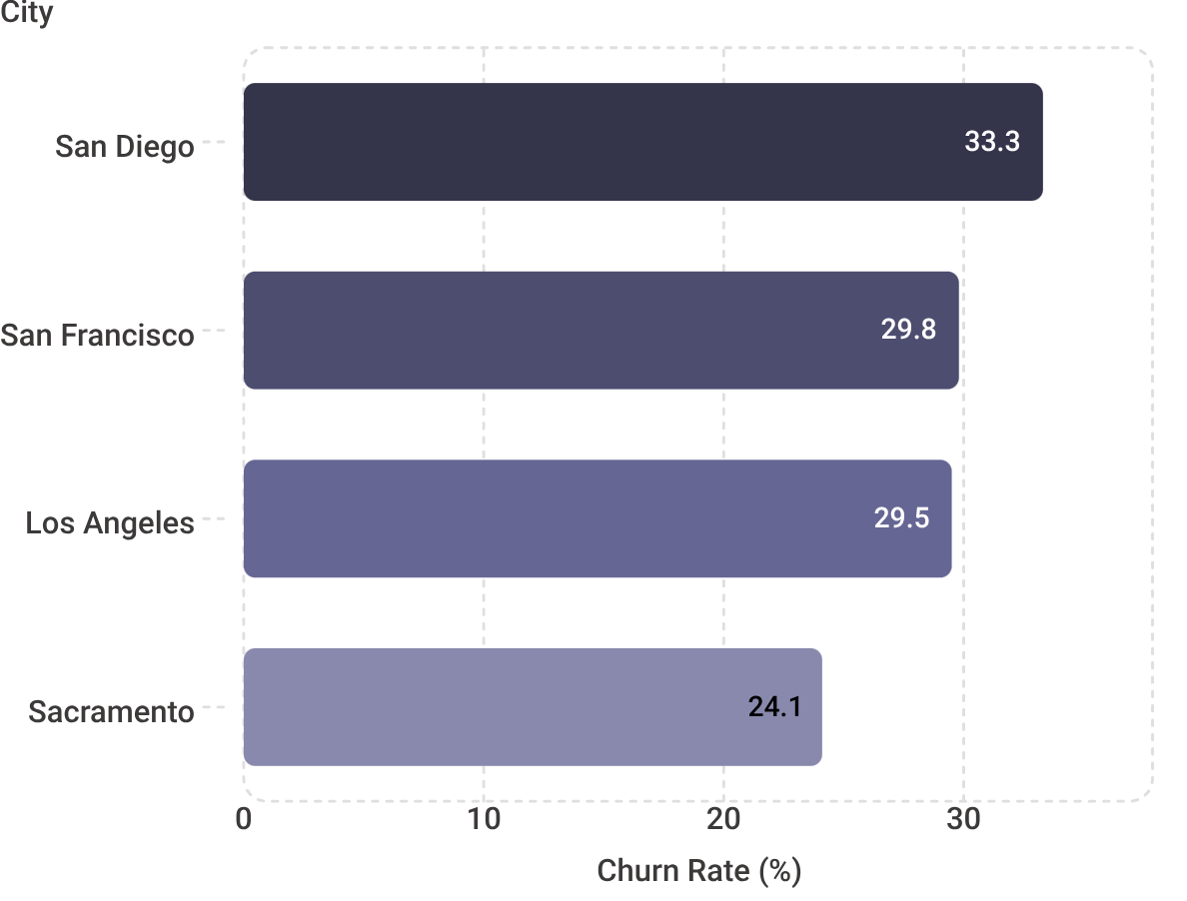

Geographic Risk & Primary Churn Drivers
Top Churn Cities — California
Primary Attrition Reasons — Client Count
Competitor Pressure
Customer Support Issues
Better download speeds: 189 clients lost
Better competitor offers: 140 clients lost
Total: 329 clients lost to competitive speed and price positioning.
Attitude of support staff: 192 clients lost
Attitude of service provider: 135 clients lost
Total: 327 clients lost to preventable service experience failures.
Combined, competitor pressure and support attitude failures account for 656 churned clients — 35% of total churn — and are directly addressable through targeted interventions.
City
Churned
Total
Los Angeles
90
305
San Diego
50
150
San Francisco
31
104
Sacramento
26
108

Slide 9

Interactive Dashboard Architecture
Power BI Dashboard — Component Overview
Top KPI Summary Cards
Contract & Payment Analysis
Total Base: 7,043
Churned: 1,869
Churn Rate: 26.54%
Bar charts decomposing churn rate by contract type and payment method with absolute volume overlays.
Service & Geographic Drill
Cross-Filtering Slicers
Fiber Optic vs. DSL risk comparison, top city churn losses, and primary attrition reason breakdowns.
Dynamic filters: Contract Type, Senior Citizen, Partner, City — enabling real-time risk profile isolation.
Core Dashboard Value: Enables dynamic cross-filtering to isolate specific risk profiles in real time — for example, filtering married users on monthly contracts to evaluate price sensitivities and model targeted intervention impact.

Slide 10
Actionable Strategic Recommendations
1
2
Contract Migration Program
Auto-Pay Discount ($5 Credit)
Offer a 20% discount for 2 months or free speed upgrades to Month-to-Month subscribers converting to 1- or 2-year plans.
Target: Transitioning 20% of monthly users saves hundreds of clients quarterly and structurally compresses the 42.71% churn rate.
Provide a $5/month billing credit for users switching from Electronic Check to Direct Debit or Credit Card Auto-Pay.
Target: Directly tackles the 45.29% Electronic Check churn rate — the single highest-risk payment segment.
3
4
Support & Security Value Bundles
Regional Support Audits
Package Tech Support and Online Security directly into standard Fiber Optic plans at no additional friction cost.
Target: Caps Fiber Optic churn below 15%, down from the current 41.89% — a potential 63–65% attrition reduction.
Conduct staff retrainings and network audits in Los Angeles, San Diego, and San Francisco — the top three churn cities.
Target: Addresses service attitude complaints from 327 total clients, the second-largest driver of attrition after competitor pressure.

Slide 11
Expected Strategic ROI & Next Steps
Projected Impact — Retention Uplift
Immediate Next Steps
<18%
1
Executive Budget Presentation
Present the retention campaign budget and projected ROI to executive leadership for approval and resource allocation.
Projected Churn Rate
Down from 26.54% baseline through contract conversion + auto-pay adoption
2
Auto-Pay Credit Deployment
400+
Deploy the $5/month auto-pay credit incentive directly in the customer billing portal with in-app prompts targeting Electronic Check users.
Accounts Retained Annually
3
Regional Retention Launch
Protecting significant recurring revenue from preventable attrition
Launch targeted contract migration and service bundle offers in Los Angeles, San Diego, San Francisco, and Sacramento — the top 4 churn cities.
Intervention
Current Rate
Target Rate
Contract Conversion (20% of M2M)
42.71%
~30%
Auto-Pay Migration
45.29%
~15–17%
Fiber Optic Bundle (Tech + Security)
41.89%
<15%
Regional Support Audit (3 cities)
29–33%
Below Avg.

Slide 12
9. Team Roles & Contributions
Ahmed Baligh — Data Cleaning & Relational Modeling
Power Query cleaning, normalization, and the 14-table model.
Karim Sobhy — Transformation, Modeling & Pivot Analysis
Data transformation, Power Pivot relationships, and Pivot Table analysis.
Shahd Waleed — Dashboard Design
KPI cards, charts, slicers, and interactive dashboard structure.
Ahmed Yehia — Insights & Business Analysis
Interpreting churn patterns and translating findings into business insights.
Ahmed Mohamed — Documentation & Presentation
Final documentation, presentation structure, slide preparation, and project presentation.

Slide 13
10. Conclusion
The project transformed raw customer data into a structured analytical model.
The analysis identified the main factors associated with churn.
The findings were converted into practical retention recommendations.
Thank you — Questions?

