Slide 1


Vodafone Telecommunications Analytics Dashboard
Business intelligence project — analyzing telecommunications data using Power BI
made by · Shahd Abdelghany & LeQaa Bakhit

Slide 2

PROJECT OVERVIEW
Project Goal
Analyze Vodafone telecom data and provide accurate business insights using Power BI to help decision-makers improve services, increase revenue, and raise customer satisfaction.
Customer Service
Analyze complaints and reduce response time
Sales Performance
Compare store branches and identify patterns
Recharge Analysis
Track revenue and payment patterns
Subscriptions
Monitor subscription trends and line distribution

Slide 3
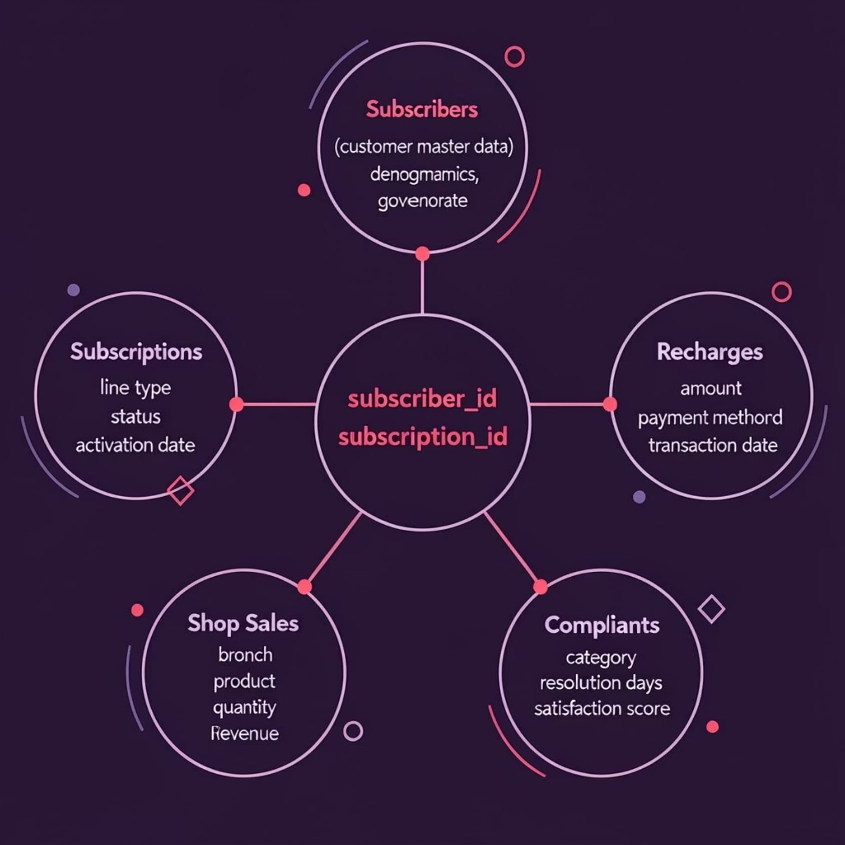
DATASETS
Description of the Datasets
The project relies on five interconnected datasets that cover all aspects of Vodafone's business.
Linking Variables
All tables are connected through the subscriber_id and subscription_id keys, enabling integrated and comprehensive analysis.
Subcribers: demographic data and governorate
Subscriptions: line type and subscription status
Recharges: amount and payment method
Shop Sales: branch, product, and revenue
Complaints: category, resolution time, and satisfaction

Slide 4

DATA PROCESSING
Data Cleaning
01
Standardize text values
Handle variation in spelling and standardize governorate and region names
02
Convert data types
Convert dates and financial values to the correct numeric formats
03
Handle missing values
Remove duplicates and deal with empty or invalid values
04
Split compound fields
Separate the region and postal code field into two independent columns

Slide 5
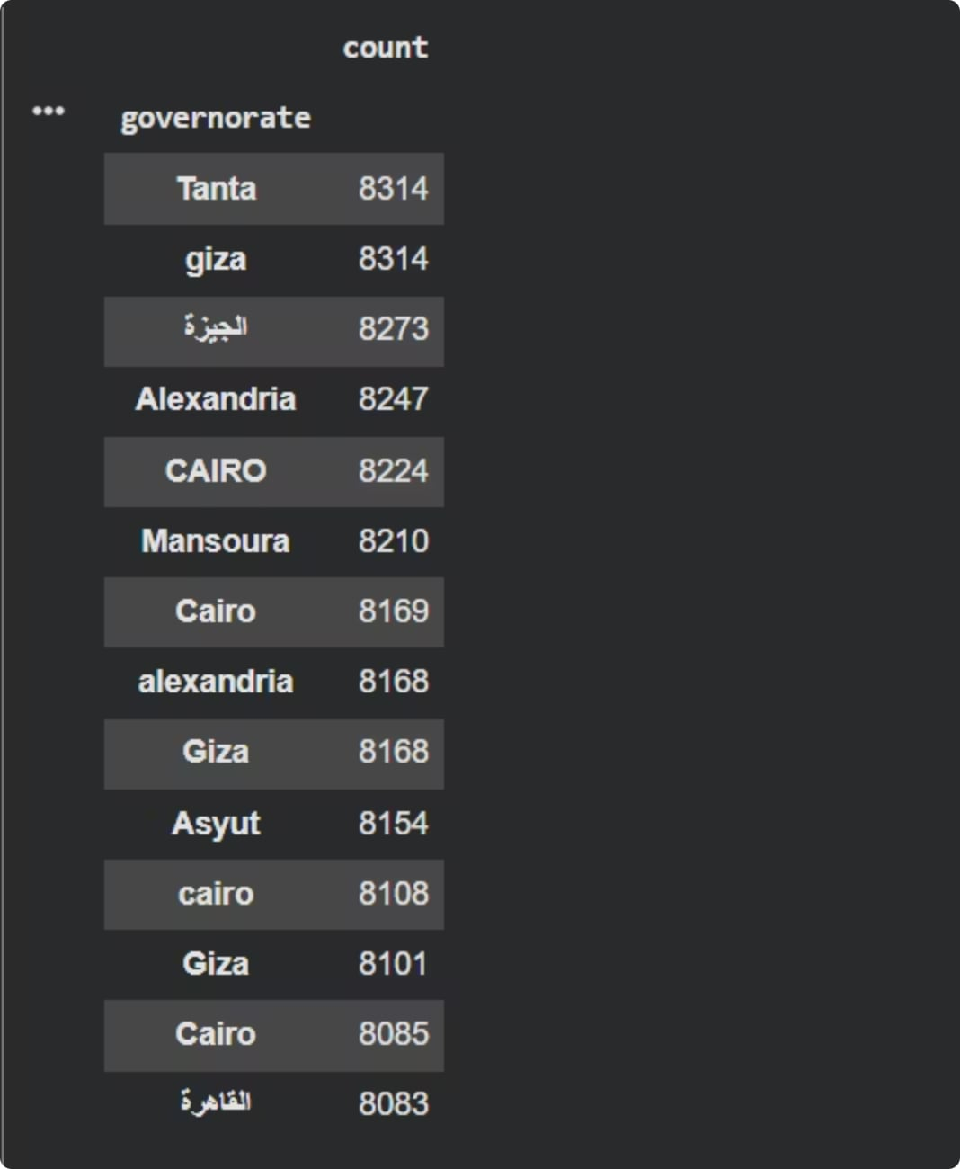
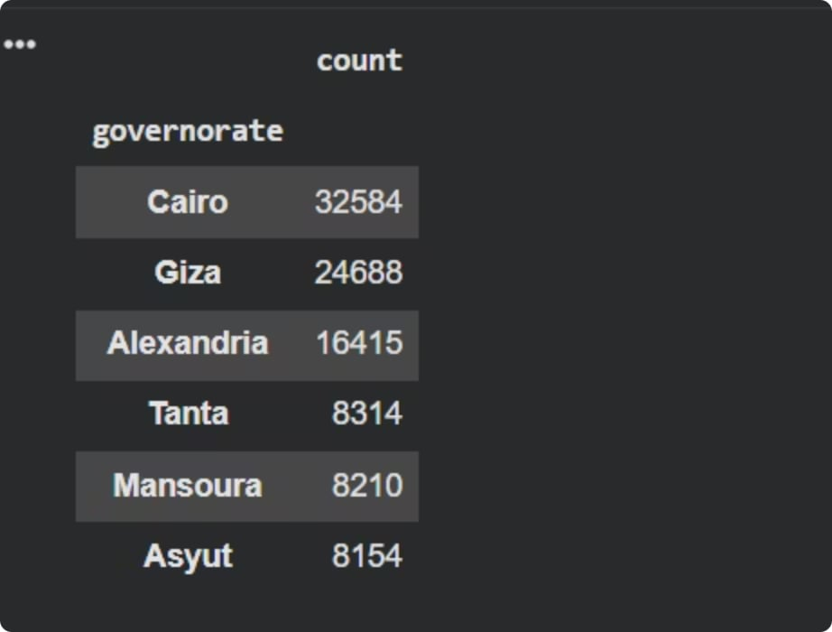
Data Cleaning Result
Before Cleaning
After Cleaning
Standardized governorate names
Removed duplicates
Split into separate region and zip_code columns
Clean, consistent data
Inconsistent governorate names (CAIRO, Cairo, cairo)
Duplicate entries with different spellings
Combined region_and_zip field
Data quality issues

Slide 6
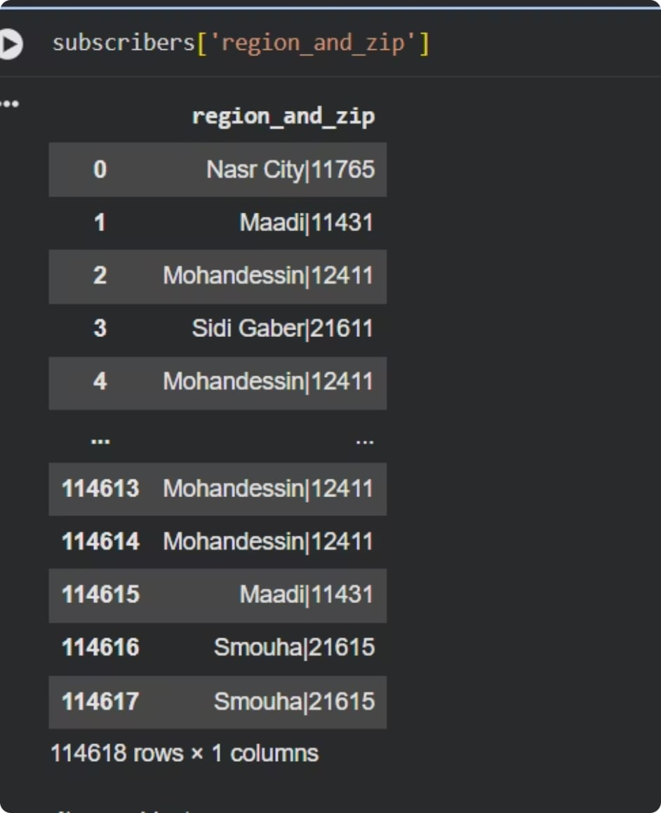
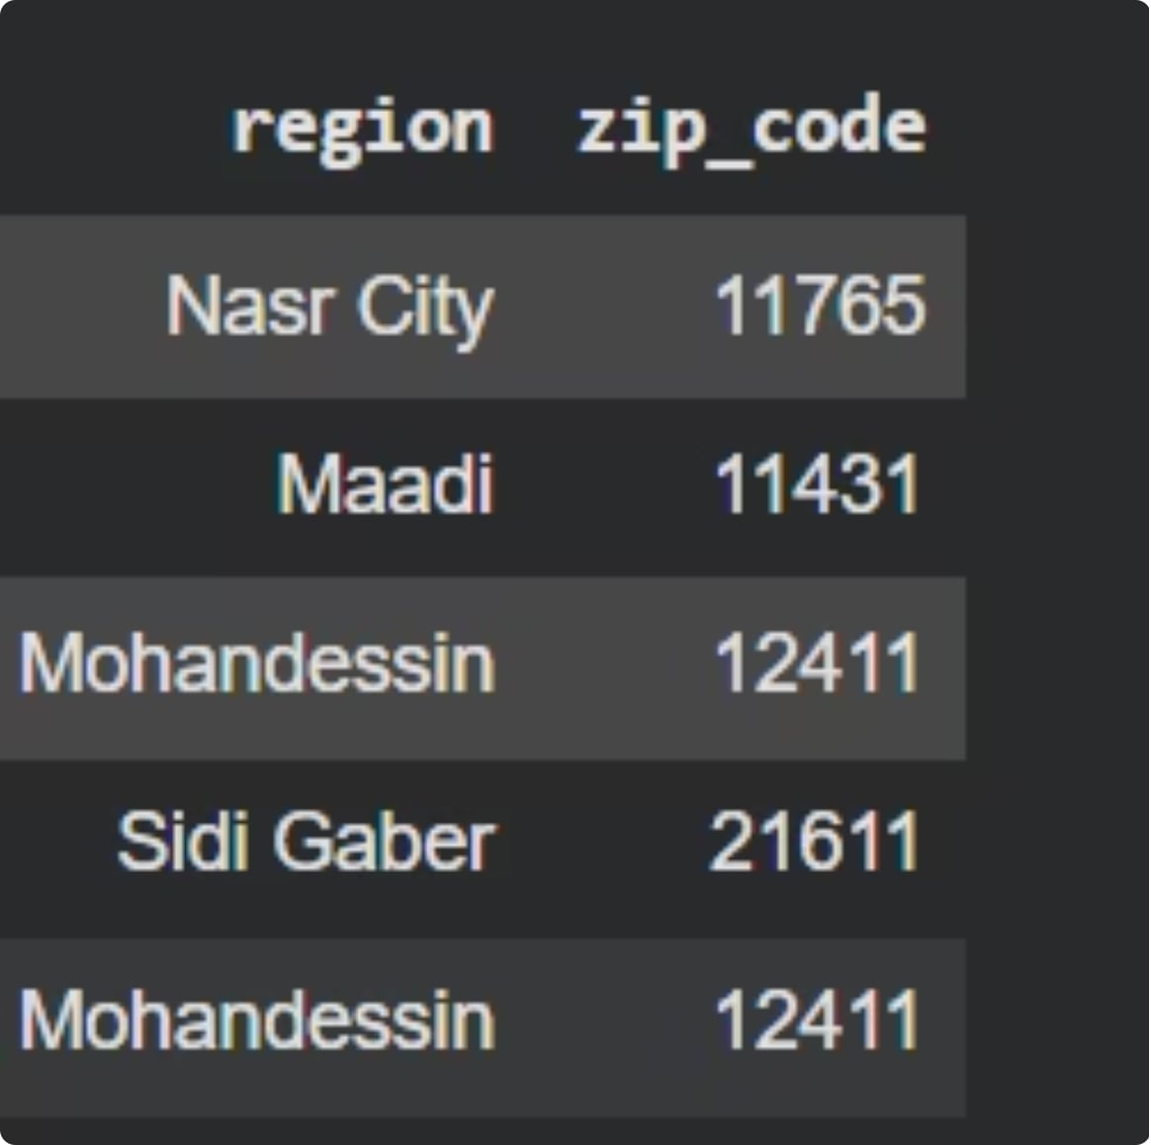
Splitting Compound Fields
Before: Combined region_and_zip
After: Separate region and zip_code
Single column with mixed data
Region and zip code combined
Difficult to analyze separately
Data extraction required
Two separate columns
Region in one column
Zip code in another column
Easy to filter and analyze

Slide 7
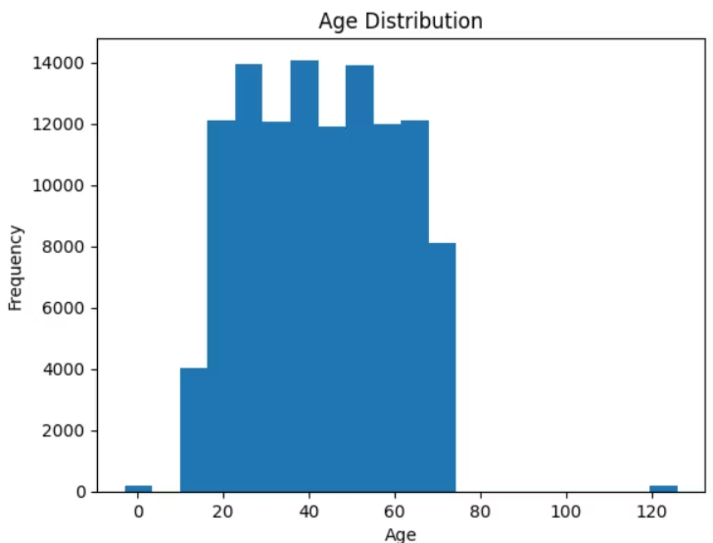
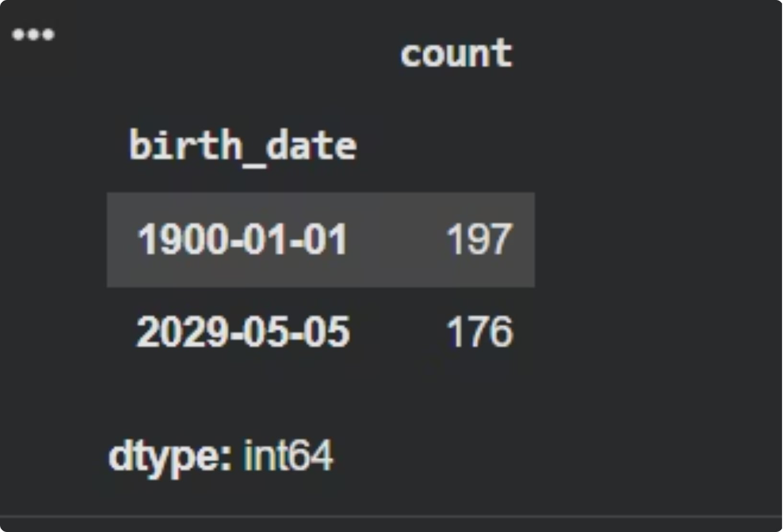
Handling Unnatural Age and Birth Date Values
Data Quality Issues
Data Cleaning Solution
Age values ranging from 0 to 120+ years
Unrealistic birth dates (1900-01-01)
Future dates (2029-05-05)
Data entry errors and invalid records
Remove records with age < 18 or > 100
Filter out birth dates before 1924 or after current year
Validate date formats
Keep only realistic customer age ranges
Result: Clean, valid demographic data

Slide 8
MODELING AND DESIGN
Data Modeling and Dashboard
Data model in Power BI
All tables were linked through the subscriber_id and subscription_id keys, with a Calendar table added to support time-based analysis.
Dashboard pages
Home: comprehensive executive summary
Subscribers: demographic distribution
Subscriptions: line types and trends
Recharges: revenue and transactions
Shop Sales: branch and product performance
Complaints: categories and satisfaction level

Slide 9
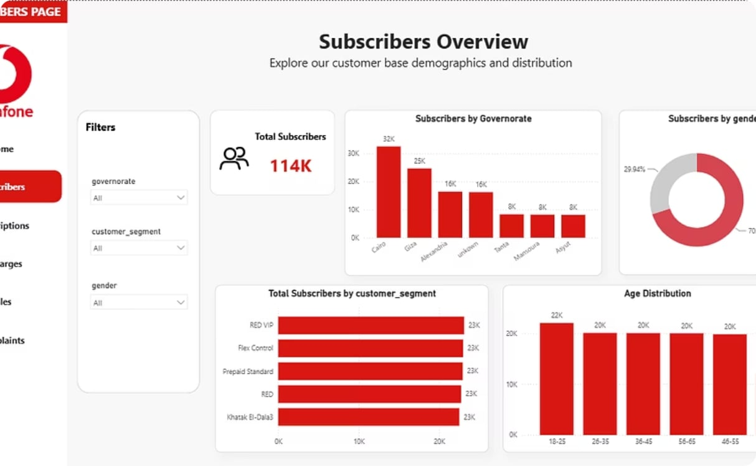
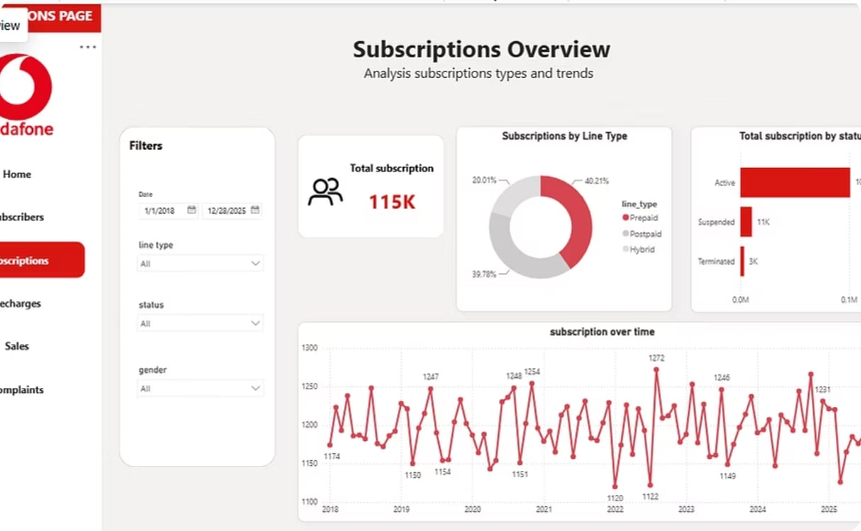
VISUAL ANALYSIS
Subscribers and Subscriptions Dashboard
Subscribers Dashboard
Subscriptions Dashboard
Total subscribers and geographic distribution
Gender and age group distribution
Distribution of line types (Prepaid / Postpaid)
Percentage of active subscriptions
Subscription trend over time

Slide 10
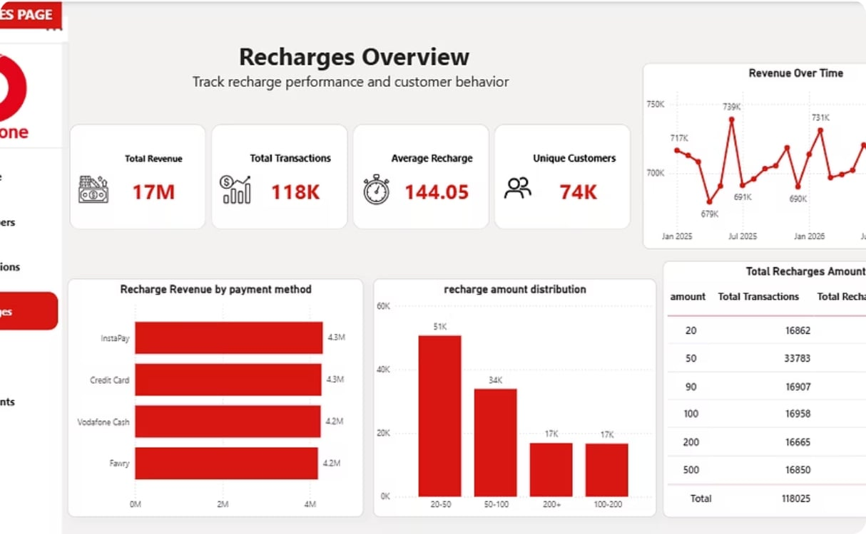
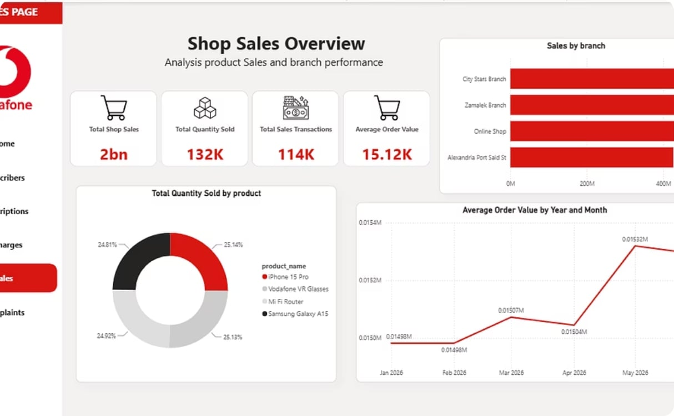
VISUAL ANALYSIS
Recharge and Store Sales Dashboard
Recharge Dashboard
Store Sales Dashboard
Total revenue and number of transactions
Average recharge amount
Revenue by payment method
Total sales and quantities sold
Average order value
Sales by branch and product

Slide 11
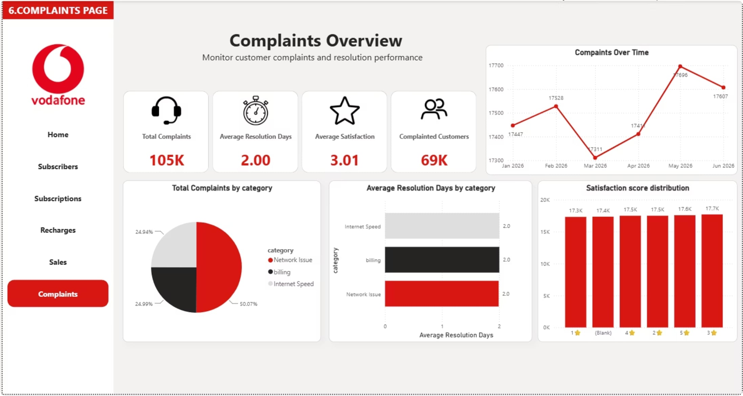

VISUAL ANALYSIS
Complaints Dashboard
Key Performance Indicators
Total complaints and average resolution days
Average customer satisfaction score
Complaint distribution by category
Complaints trend over time
Relationship between resolution time and satisfaction
Key insight: The longer a complaint takes to resolve, the lower the customer satisfaction score — underscoring the importance of reducing response time.

Slide 12
INSIGHTS AND RECOMMENDATIONS
Business Insights and Recommendations
Key Insights
Recommendations
Cairo has the largest subscriber base
Prepaid customers make up the majority
Network issues lead the complaints
Resolution time affects customer satisfaction
Improve network quality and reduce outages
Reduce complaint resolution time
Marketing campaigns for high-value customers
Improve recharge offers
Increase the efficiency of lower-performing branches
Enhance the overall customer experience

Slide 13
CONCLUSION
Tools, Challenges, and Conclusion
Tools and Technologies
Project Summary
Python · Pandas · NumPy . Matplotlib
Power BI · DAX
The project delivered an interactive dashboard that transforms Vodafone data into actionable insights, supports decision-making, and improves business performance.
Key Challenges
Missing values and inconsistent formatting
Data cleaning and model building
Creating relationships between tables
Thank you for attending
We welcome your questions and kind feedback

