Slide 1
PM
Industrial Predictive
Maintenance & Failure Prevention
Predicting machine failure from sensor data — and knowing what the number is worth
Graduation Project · Advanced Data Science & AI · AI4I 2020 Dataset
Notes:
Good morning. This project builds a predictive maintenance system on the AI4I 2020 dataset. The headline result is a model that catches 94% of machine failures — but the more interesting part of this talk is the two bugs I found along the way, because they changed the result more than any model choice did.

Slide 2
THE PROBLEM
Rare, expensive, and invisible until it happens
A machine fails. Production stops, tooling is damaged, and scheduled maintenance becomes emergency repair.
Every machine already reports five cheap measurements: air temperature, process temperature, rotational speed, torque, and tool wear.
The question: given those readings right now, how likely is this machine to fail — and should someone look at it?
3.4%
of records are failures
A model that always says "no failure"
scores 96.6% accuracy — and is useless.
The two mistakes are not equal
Missed failure
False alarm
Unplanned downtime, machine damage, emergency repair costs.
A technician inspects a healthy machine. Inconvenient — and comparatively cheap.
Notes:
Two things frame every decision in this project. First, failures are only 3.4% of the data — so accuracy is a useless metric; predicting "never fails" gets you 96.6%. Second, the two kinds of mistake cost wildly different amounts. Missing a failure is expensive. A false alarm just wastes an inspection. That asymmetry justifies a design choice I will come back to at the end.

Slide 3
DATA & LEAKAGE
The most important decision was not a model choice
The dataset ships with five failure-mode flags: TWF, HDF, PWF, OSF, RNF.
Used as model inputs
Excluded — enforced in code
97%
9 features
recall — and completely meaningless.
"Machine failure" is the union of those
five flags. The model was handed the answer.
One function defines the feature list.
Both the ML and DL tracks call it, and a
test asserts the flags never appear.
Cross-validation would never have caught this — the leakage was in every fold. It took reading what the columns meant, not what they correlated with.
Notes:
This is the finding I would lead with. The five failure-mode flags are components of the target, not independent predictors — machine failure is essentially their union. An early version of the deep learning notebook used them as inputs and reported 97% recall. That number was leakage, not skill. No amount of cross-validation would have exposed it, because the leak is present in every fold. It required understanding what the columns represented. The fix is structural: one function defines the feature list, both tracks call it, and a test asserts the flags never appear.

Slide 4
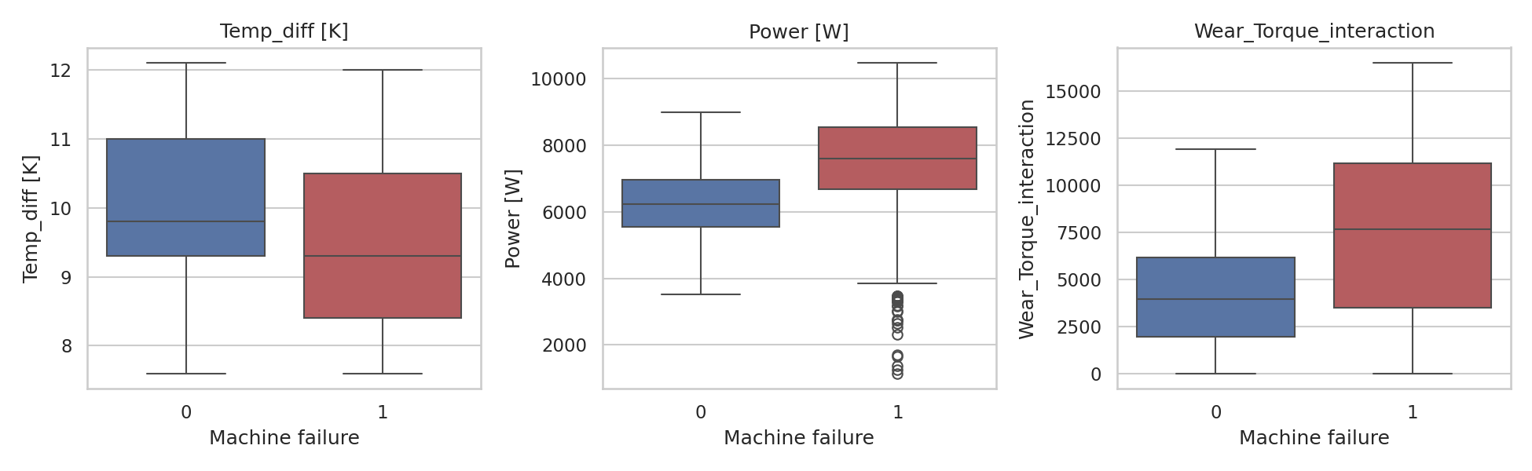
FEATURE ENGINEERING
Four features, each for a physical reason
Temp difference
Running hot vs ambient = poor heat dissipation
Process temp − Air temp
Mechanical power
The quantity that actually drives wear and heat
Torque × (rpm × 2π / 60)
Wear × Torque
A worn tool under load is riskier than either alone
Engineered features separate failures (red) from normal operation (blue) far better than any single raw sensor reading.
Tool wear × Torque
Quality grade
Ordinal encoding preserving real ordering
No single raw reading correlates strongly with failure — the signal lives in the interactions.
L→0, M→1, H→2
Notes:
Four engineered features, each chosen for a physical reason rather than found by searching over transformations. Temperature difference catches poor heat dissipation. Mechanical power combines torque and speed into the quantity that actually causes wear. The wear-times-torque interaction captures that a worn tool under load is the dangerous combination. The boxplots on the right show these separate failures from normal operation much better than any single raw sensor does — which matches the weak individual correlations we saw in EDA.

Slide 5
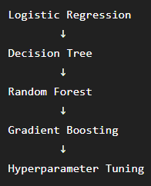
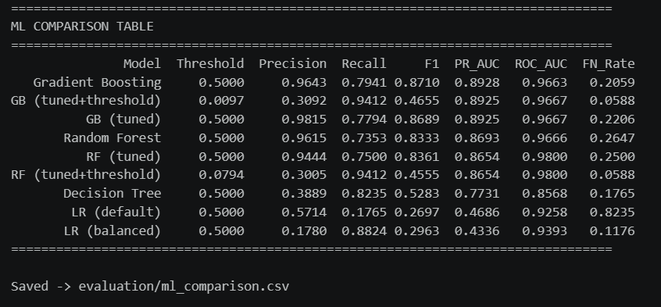
ML models & Evaluation
Model comparison
Evaluation Metrics
Precision
Recall
F1-score
PR-AUC
ROC-AUC
False Negative Rate
Key takeaway
Tree-based ensemble models substantially outperformed the linear and single-tree baselines.
Recall and PR-AUC were emphasized because machine failures are the minority class and missed failures are particularly important in predictive maintenance.

Slide 6
RESULTS
Seven models, one held-out test set
What the chart says
Tree ensembles dominate. Gradient Boosting reaches PR-AUC 0.894 and ROC-AUC 0.968.
Logistic regression collapses (PR-AUC 0.469) — the problem is not linearly separable.
Class weighting moved recall from 0.18 to 0.88 but dropped PR-AUC: it shifts where you sit on the curve, it does not improve the curve.
80/20 stratified split. 5-fold CV for tuning. Every model — classical, neural, unsupervised — scored on the same test set.
Notes:
Seven models, all evaluated on the same held-out test set with the same metric function — that is what makes this comparison meaningful rather than seven separate reports. Gradient boosting wins at PR-AUC 0.894. Logistic regression collapses, which tells us the problem is not linearly separable. The class weighting experiment is worth a note: it moved recall from 0.18 to 0.88, but PR-AUC actually fell slightly. Class weighting expresses a cost preference; it does not make a weak model strong.

Slide 7
Final ML outcome
Overall best Model :
Gradient Boosting (Tuned)
Selected based on cross-validation/model-selection procedure:
CV PR-AUC = 0.9133
Test performance:
Precision 98.15%
Recall 77.94%
F1 86.89%
PR-AUC 89.25%
ROC-AUC 96.67%
Failure-Sensitive Configuration
RF + optimized threshold
Recall 94.12%
FN Rate 5.88%
Precision 30.05%

Slide 8
DEEP LEARNING
Deep learning lost. That is the correct result.
MLP classifier
Autoencoder — unsupervised
64 → 48 → 32 → 1, LeakyReLU, class-weighted loss, early stopping with best-epoch restore, LR scheduling. Validation split taken from inside the training set, so the test set stays untouched.
Trained only on healthy records through a 6-unit bottleneck. Reconstruction error becomes an anomaly score. No failure labels used in training — only to pick a threshold and evaluate.
Why reporting the loss is better practice than engineering a win
Gradient-boosted trees are consistently strong on small, well-engineered tabular data. With 10,000 rows and 9 features there is neither the volume nor the structural complexity for a neural network's extra flexibility to pay for itself.
The autoencoder still earns its place: it flags anomalies no supervised model can, including failure modes that were rare or absent in training.
Notes:
Two neural models, both scored on the same test set. And both lose to gradient boosting. I want to be direct about that rather than tune until the sophisticated method happens to edge ahead. Gradient-boosted trees are simply strong on small tabular data — ten thousand rows and nine features is not where a neural network earns its keep. The autoencoder still matters though, for a different reason: it is unsupervised, so it can flag anomalies that look nothing like anything in the training labels. The two approaches are complementary, not competing.

Slide 9
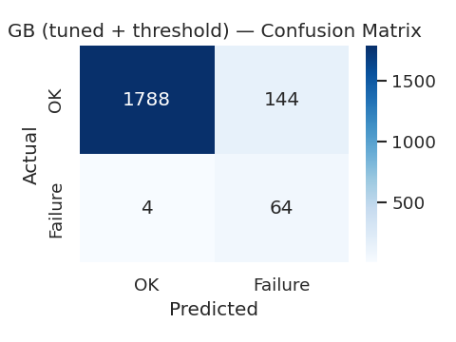
THE SECOND BUG
The threshold is part of the model
0.5 is a convention, not a business decision. Given the cost asymmetry, we maximise recall subject to precision staying above 30%.
0.779
0.941
22.1%
5.9%
Recall at default 0.5
Recall at tuned 0.0092
Missed failures — before
Missed failures — after
What almost shipped
The champion model was saved to disk paired with its default-threshold metrics. The app would have loaded that metadata and run at 0.5 — quietly discarding every bit of the tuning above, at 78% recall instead of 94%.
Fix: save the tuned threshold with the model, and assert in a test that the deployed threshold is never exactly 0.5.
A model artifact is not just weights. Lose the threshold in the handoff to production and you silently undo the tuning.
Notes:
Second finding. The default 0.5 threshold is an arbitrary convention. Given that missing a failure costs far more than an inspection, we pick the threshold that maximises recall while keeping precision above 30% — a floor representing how many false alarms the team can absorb. That moves recall from 78% to 94%, and cuts missed failures from 22% to under 6%. The bug: the model was originally saved with its default-threshold metrics, so the app would have run at 0.5 and thrown all that away. The lesson is that the decision threshold is part of the model, and it has to survive the handoff to production.

Slide 10
DEPLOYMENT
From notebook to something a technician can use
1
2
3
Single check
Batch scoring
Monitoring
Enter readings, get a probability, a risk tier, and a recommended action. Warns when an input falls outside the range the model was trained on.
Upload a CSV of machines, score them in one pass, download results — the realistic workflow for a shift's worth of readings.
Every prediction is logged with timestamp, model version, and tier. Alert-rate charts are the simplest available drift signal.
The whole pipeline closes a loop
SQL data layer → feature pipeline → trained models → Streamlit app → prediction log → back into SQL
The app's log uses the same column names as the PredictionHistory table — it loads straight back in with no reshaping.
Notes:
The model ships as a Streamlit dashboard with three tabs: single machine check, batch scoring, and monitoring. Two details worth noting. First, the app checks each input against the percentile range seen in training and warns when something falls outside it — a guard against being asked to extrapolate. Second, the prediction log uses the same column names as the SQL PredictionHistory table, so predictions flow back into the same database the training data came from. That closes the loop.

Slide 11
ENGINEERING PRACTICE
Both bugs are now tests
23 tests, all passing
One source of truth
Feature formulas checked against hand-computed physics values
An assertion that the failure-mode flags never enter the feature list
An assertion that the deployed threshold is never exactly 0.5
Metric correctness on constructed edge cases
A headless UI test driving a full prediction through the app
Feature engineering lives in one module. The notebook, the app, and the tests all import it.
Reimplementing it in the app is the standard route to training/serving skew — where the model quietly gets differently-computed features at inference time. One function makes that impossible.
Also shipped: SQL schema with 12 analytical queries (JOINs, CTEs, window functions) · Dockerfile with layer-cached dependencies and a healthcheck · versioned model artifacts carrying their own feature list and threshold
Notes:
Both bugs I described are now encoded as tests — which is generally how the tests worth keeping get written. Twenty-three tests covering feature formulas, metric correctness, model artifacts, and a headless UI test that drives a real prediction through the app. The other structural decision is that feature engineering lives in exactly one module that the notebook, the app, and the tests all import. Reimplementing it in the app is the classic route to training-serving skew.

Slide 12
LIMITATIONS
What these numbers do not prove
The dataset is synthetic
Strong metrics validate the pipeline and methodology — not real-world industrial reliability. This is not a certified safety system.
No real temporal structure
Records are independent snapshots, not per-machine time series. Genuine predictive maintenance tracks degradation over time; this data cannot support that.
Random failures are unpredictable
RNF events have no relationship to the sensor readings by construction — a hard ceiling on achievable recall that no model can lift.
The precision floor was chosen, not measured
30% is a reasonable default. Real deployment should derive it from actual inspection and downtime costs.
Next: failure-mode classification · cost-based alerting from measured costs · statistical drift detection · sequence models if per-machine time series become available
Notes:
Being clear about what this does not show. The dataset is synthetic, so good metrics validate the methodology, not real-world reliability. There is no real time structure — these are independent snapshots, and real predictive maintenance tracks degradation over time. Random failures are unpredictable by construction, which caps achievable recall. And the 30% precision floor was a reasonable default, not something derived from measured costs — a real deployment should set it from actual inspection and downtime numbers.

Slide 13
Three lessons — none of them a modelling technique
Understand your columns
01
The leakage produced impressive, meaningless results. Catching it required knowing what the data represented — not what it correlated with.
The threshold ships with the model
02
All the tuning would have been wasted had it deployed at 0.5. A model artifact is not just weights.
Report the honest comparison
03
Deep learning lost to gradient boosting. Saying so, and explaining why it is expected, beats manufacturing a win.
PR-AUC 0.894 · 94% of failures caught · 5.9% missed
Notes:
To close. The best model reaches PR-AUC 0.894 and catches 94% of failures. But the three things I would actually take from this project are not modelling techniques. Understand what your columns mean — the leakage was invisible to cross-validation. The threshold is part of the model and has to survive the handoff to production. And report the honest comparison: deep learning lost here, that is the expected result for small tabular data, and saying so plainly is better practice than tuning until the fancy method wins. Happy to take questions.

