Slide 1
Sensor Network and Internet of Things
Lecture (7)
Machine to Machine Communication
Dr. SAMAR A. Said

Slide 2
Machine to Machine Communication
M2M Communication
M2M Service Platform (M2SP)
Interoperability in Internet of Things

Slide 3
M2M Communication
Machine-to-Machine (M2M)
  communication refers to the exchange of information between devices or machines equipped with computing and communication capabilities, without requiring human intervention.

Slide 4
Features of M2M Communication
Features of M2M Communication
  Large Number of Nodes or Devices: Supports extensive device connectivity within the network.
  Low Cost: Designed to be cost-effective, making it suitable for large-scale implementations.
  Energy Efficiency: Devices consume minimal power, ensuring long operational life.
  Small Traffic Per Device: Each device transmits a relatively small amount of data.
  Large Quantity of Collective Data: The aggregated data from all devices is significant and requires robust handling.
  No Human Intervention: Machines communicate directly without the need for human input.

Slide 5
M2M Ecosystem
M2M Ecosystem
The M2M ecosystem includes several key components working together to enable seamless communication and data exchange:
  Device Providers:
    Responsible for the creation and deployment of devices involved in the M2M network.
    These devices collect and transmit data.
  M2M Area Network:
    Transfers data from M2M devices through a gateway to the Internet.
    Operated by Internet Service Providers (ISPs).
  RESTful Architecture:
    Acts as an interface between device providers and ISPs.
    Particularly suited for low-resource environments.

Slide 6
M2M Ecosystem
  Internet Service Providers (ISPs):
    Handle the transmission of data across the Internet.
  Platform Providers:
    Perform key functions such as:
      Device Management: Monitoring and maintenance of devices.
      User Management: Managing access control for users.
      Data Analytics: Processing and analyzing the collected data.
      User Access: Providing access to data for service users.
  Service Providers and Users:
    Receive and utilize the processed data for business and operational needs.
    RESTful architecture facilitates the interface between the platform and service providers.

Slide 7
M2M Platforms
M2M platforms form the backbone of machine-to-machine communication, offering infrastructure for managing devices, users, applications, and access.
They streamline the operations and integration of M2M systems, ensuring efficient data exchange and control.
The platforms can be classified into the Device Platform, User Platform, Application Platform, and Access Platform.

Slide 8
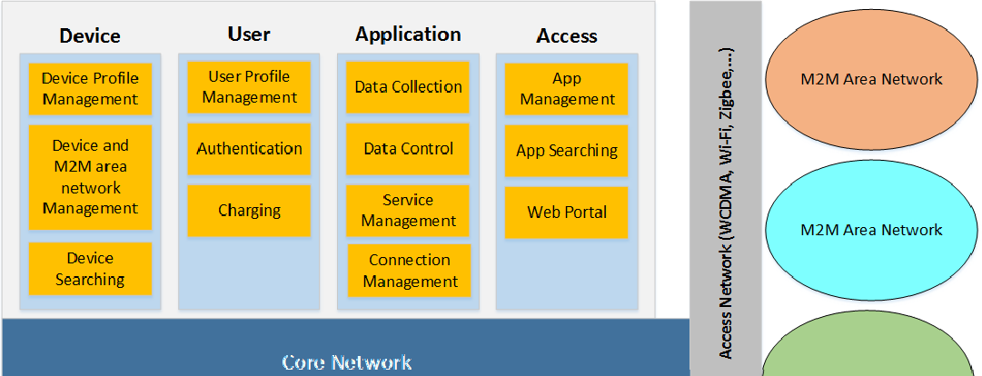
M2M Service Platform (M2SP)

Slide 9
M2M Device Platform
The M2M Device Platform focuses on managing connected devices and ensuring seamless communication.
Key features include:
  Universal Access:
    Allows devices to be accessed anytime and anywhere via the Internet.
  Device Registration:
    Creates a comprehensive database of registered devices, enabling managers, users, and services to retrieve device information effortlessly.

Slide 10
M2M Device Platform
  Profile Management:
    Maintains device profiles, including:
      Location
      Device type
      Address
      Description
  Authentication & Authorization:
    Manages secure access through key authentication and authorization mechanisms.
  Monitoring & Control:
    Tracks the status of devices and M2M area networks.
    Provides control capabilities based on real-time status updates.

Slide 11
M2M User Platform
The M2M User Platform is designed to manage users and their interactions with devices and services. Features include:
User Profile Management:
  Handles tasks such as:
    User registration
    Profile modification
    Billing/charging
    Inquiries

Slide 12
M2M User Platform
Integration with Device Platform:
  Ensures interoperability by managing user access to devices, networks, and services.
Administrative Privileges:
  Grants service providers and device managers administrative control over their respective devices or networks.
Device Management:
  Enables administrators to monitor and control devices effectively.

Slide 13
M2M Application Platform
This platform integrates data collected by devices and transforms it into actionable services. Key features include:
Integrated Services:
  Combines heterogeneous datasets from various devices to create new, innovative services.
Log Data Collection:
  Gathers logs of control processing for device management by interacting with the Device Platform.
Seamless Connection Management:
  Manages network connections to ensure uninterrupted services.

Slide 14
M2M Access Platform
The M2M Access Platform provides an interface for users to interact with M2M services via apps or web portals. Features include:
  Access Environment:
    Offers user-friendly app or web environments for accessing M2M devices and services.
  Service Redirection:
    Apps and links redirect users to the appropriate service providers.
  Service Delivery:
    Acts as the intermediary for delivering services to M2M devices.
  App Management:
    Manages app registrations by developers.
    Provides a mapping relationship between apps and devices.
  Device-to-App Mapping:
    Lists appropriate apps for specific devices, ensuring seamless functionality.

Slide 15
Interoperability in Internet of Things
Interoperability in Internet of Things (IoT)
  Interoperability is the ability of a product or system, with clearly defined interfaces, to function effectively with other products or systems—whether existing or future—without limitations in implementation or access.
  It is a cornerstone of IoT's functionality and integration.

Slide 16
Need for Interoperability in IoT
Need for Interoperability in IoT
  Interoperability is essential to achieve IoT objectives and address heterogeneity within the ecosystem.
To Fulfill IoT Interoperability
  Interaction and Information Sharing: Physical objects can interact with one another and share information seamlessly.
  Universal Communication: Devices can communicate anytime and anywhere.
  Communication Types:
    Machine-to-Machine (M2M)
    Device-to-Device (D2D)
    Device-to-Machine (D2M)
  Seamless Integration: Devices integrate smoothly with IoT networks.

Slide 17
To Address Heterogeneity
IoT involves diverse technologies, protocols, and platforms, such as:
Wireless Communication Protocols: ZigBee (IEEE 802.15.4), Bluetooth (IEEE 802.15.1), GPRS, 6LoWPAN, and Wi-Fi (IEEE 802.11).
Wired Communication Protocols: Ethernet (IEEE 802.3) and Higher Layer LAN Protocols (IEEE 802.1).
Programming Languages: JavaScript, Java, C, C++, Visual Basic, PHP, Python.
Hardware Platforms: Crossbow, NI, etc.
Operating Systems:
  For sensor nodes: TinyOS, SOS, Mantis OS, RETOS, and vendor-specific OS.
  For personal computers: Windows, Mac, Unix, Ubuntu.

Slide 18
Databases: DB2, MySQL, Oracle, PostgreSQL, SQLite, SQL Server, and Sybase.
Data Representations: Variations in formats and structures.
Control Models: Variations in management and governance frameworks.
Syntactic/Semantic Interpretations: Ensuring messages are understandable in both structure and meaning.

Slide 19
Types of Interoperability
1. User Interoperability
Addresses the interaction challenges between users and devices. Key challenges include:
Device Identification and Categorization for Discovery:
Unique addresses like Electronic Product Codes (EPC), Universal Product Code (UPC), Uniform Resource Identifier (URI), and IPv6 ensure precise device identification.
Syntactic Interoperability for Device Interaction:
  Ensures the message formats from devices to users are understandable by user systems.
  Ensures the message formats from users to devices are executable by devices.
Semantic Interoperability for Device Interaction:
  Ensures the meaning of messages is mutually understandable.
  Devices comprehend user instructions and users interpret device responses correctly.

Slide 20
Types of Interoperability
2. Device Interoperability
Focuses on communication challenges between different devices.
Solution: Universal Middleware Bridge (UMB)
UMB overcomes the seamless interoperability challenges caused by middleware heterogeneity.
How UMB Works:
  Creates virtual maps among physical devices across middleware home networks, such as HAVI, Jini, LonWorks, and UPnP.
  Ensures compatibility among these middleware networks.

Slide 21
Types of Interoperability
Components of Universal Middleware Bridge :
  UMB Core (UMB-C):
    Routes universal metadata messages using the Middleware Routing Table (MRT).
  UMB Adaptor (UMB-A):
    Converts physical devices into virtually abstracted devices using the Universal Device Template (UDT).
Universal Device Template (UDT):
UDT provides global identifiers for device functionalities:
  Global Device ID
  Global Function ID
  Global Action ID
  Global Event ID
  Global Parameters
Message Translation:
UMB Adaptors translate local middleware messages into global metadata messages, ensuring seamless communication.

Slide 22
Any Question

