Slide 1

DEPI · DATA ENGINEERING TRACK
DEPI · DATA ENGINEERING TRACK
CAPSTONE PROJECT · 2026
CAPSTONE PROJECT · 2026
Cairo Smart Traffic
Cairo Smart Traffic
Real-Time AI Monitoring System
Real-Time AI Monitoring System
End-to-end data engineering for urban mobility intelligence
End-to-end data engineering for urban mobility intelligence
PRESENTED BY
PRESENTED BY
PRESENTATION DATE
Shahd · Omnya · Abdelrahman · Ebtihal · Aya
Shahd · Omnya · Abdelrahman · Ebtihal · Aya
22 May 2026
Notes:
OPENING (60 seconds): Good morning. We're here to present Cairo Smart Traffic — a real-time AI monitoring system for Cairo's roads. Over the past several weeks, our team of five built an end-to-end data engineering platform that watches 25 critical locations across Cairo in real time, predicts congestion 60 minutes ahead, and explains everything in plain language using AI. In the next 10 minutes, we'll walk you through the problem we solved, how we solved it, the architecture, and a brief live demo. Let's dive in. TIPS: - Smile. First impressions matter. - Don't rush. This slide sets the tone. - State 'Cairo Smart Traffic' clearly. - Whoever opens can briefly introduce the team or just say 'I'm joined by my four teammates'.

Slide 2



Project Idea
The problem, our solution, and what makes it unique
THE PROBLEM
OUR SOLUTION
UNIQUE VALUE
Cairo's traffic crisis
End-to-end platform
What sets us apart
Cairo's road network operates beyond capacity for most of the day. Traffic operators react after problems happen. Planners describe the past instead of predicting the future.
An integrated platform that ingests TomTom and OpenWeather data in real time, applies machine learning for classification and forecasting, generates AI insights via Gemini, and presents results in both an operations dashboard and Power BI analytics.
Three things together :
01
Real-time streaming ML
Sub-second latency
02
Predictive forecasting
89.4%
60 minutes ahead
Streaming
ML
Forecasts
Avg congestion ratio at peak hour
03
AI natural-language insights
9 km/h inner-city · 78 km/h highways
AI Insights
Quality
Gemini summaries
Cairo Smart Traffic
2 / 12
Notes:
SLIDE 2 — PROJECT IDEA : Let's start with the problem. Cairo's road network operates beyond capacity for most of the day. According to our analysis, average congestion ratio at peak hour is 89.4%. Inner-city streets drop to 9 km/h while highways flow at 78. Traffic operators lack a unified system to see all of this at once, predict what's coming, and act before situations get worse. Our solution is an end-to-end real-time platform. We ingest data from TomTom and OpenWeather APIs, process it through machine learning models, generate natural-language insights using Google Gemini, and present results in two interfaces — a real-time React dashboard for operators, and a Power BI analytical view for planners. What makes this project different is that we did three things simultaneously: real-time streaming machine learning, predictive forecasting 60 minutes ahead, and AI-generated natural language summaries. Each one is impressive alone. The combination is rare.

Slide 3
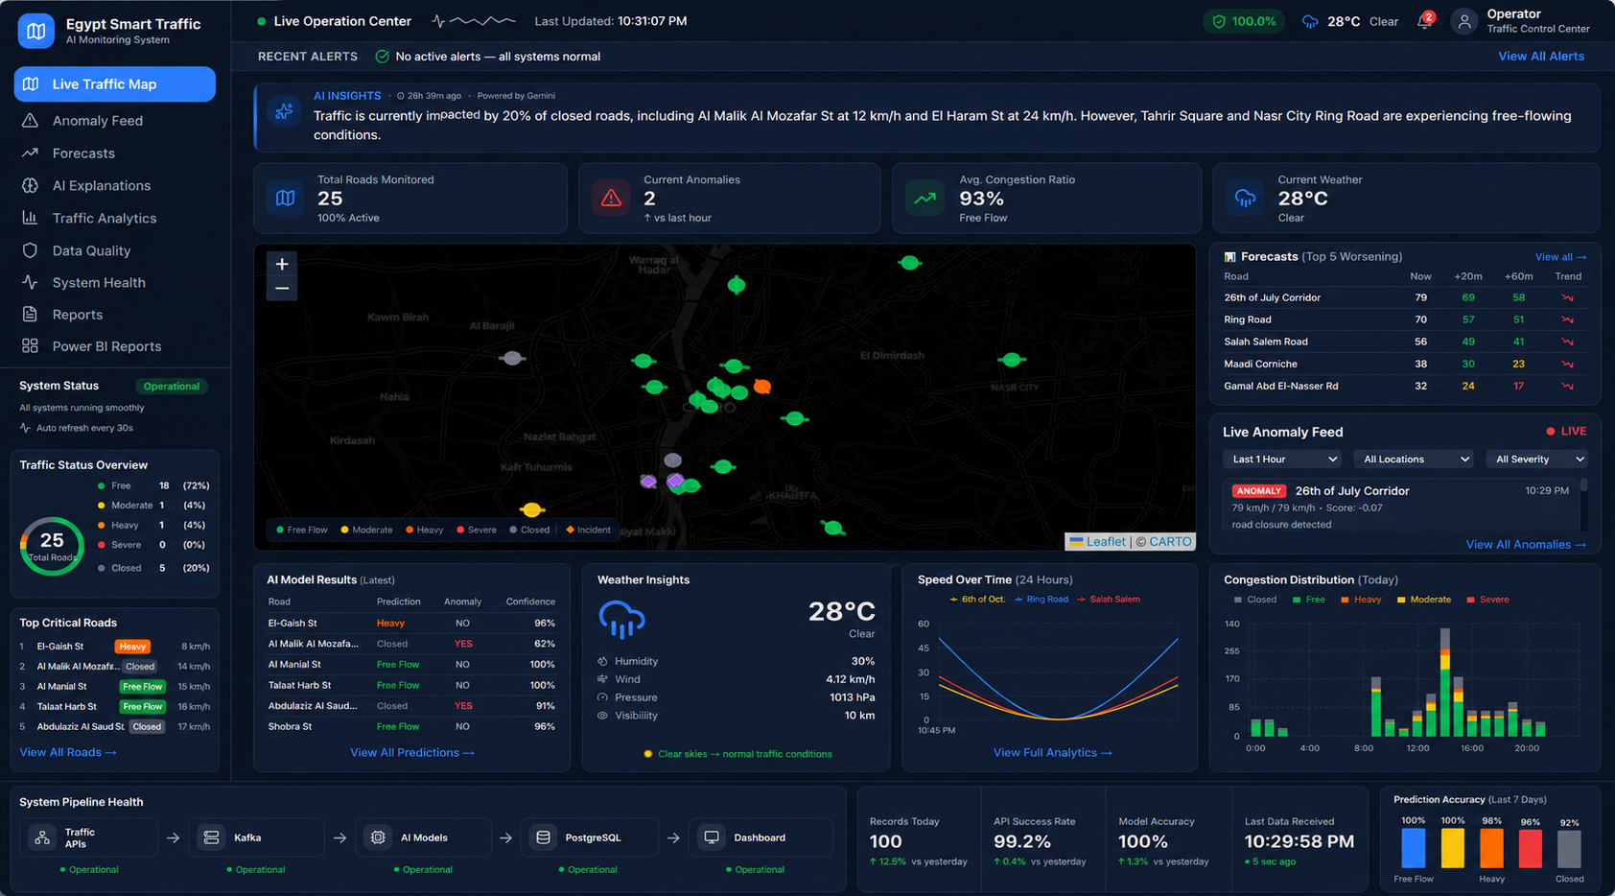
Operations Dashboard
One pane of glass for Cairo traffic intelligence
WHAT THE OPERATOR SEES
1
AI Summary Banner
Gemini insights every 5 min
2
Live Traffic Map
25 locations, 8 districts
3
Forecast Preview
Top 5 worsening roads
4
Anomaly Feed
Real-time alerts
5
DQ Trust Badge
Data quality score
User Journey: Open dashboard → See current state instantly → Review predictions → Read AI explanation → Act
Cairo Smart Traffic
3 / 12
Notes:
SLIDE 3 — DASHBOARD : This is what an operator sees when they log in. At the top, you'll notice the AI Summary — Google Gemini reads the entire current state of all 25 locations and writes a natural-language paragraph explaining what's happening. It refreshes every 5 minutes. In the center is the live traffic map — 25 locations across 8 Cairo districts, color-coded by congestion level. On the right, the Forecast Preview shows the top 5 roads where congestion is predicted to worsen most in the next hour. Below that, the Anomaly Feed streams real-time alerts from our machine learning models. And at the top-right, you'll see a Data Quality badge — every message that reaches this dashboard passed 7 quality checks. The point is: an operator opens this once and immediately sees current state, predicted problems, and AI explanation — without clicking anywhere.

Slide 4
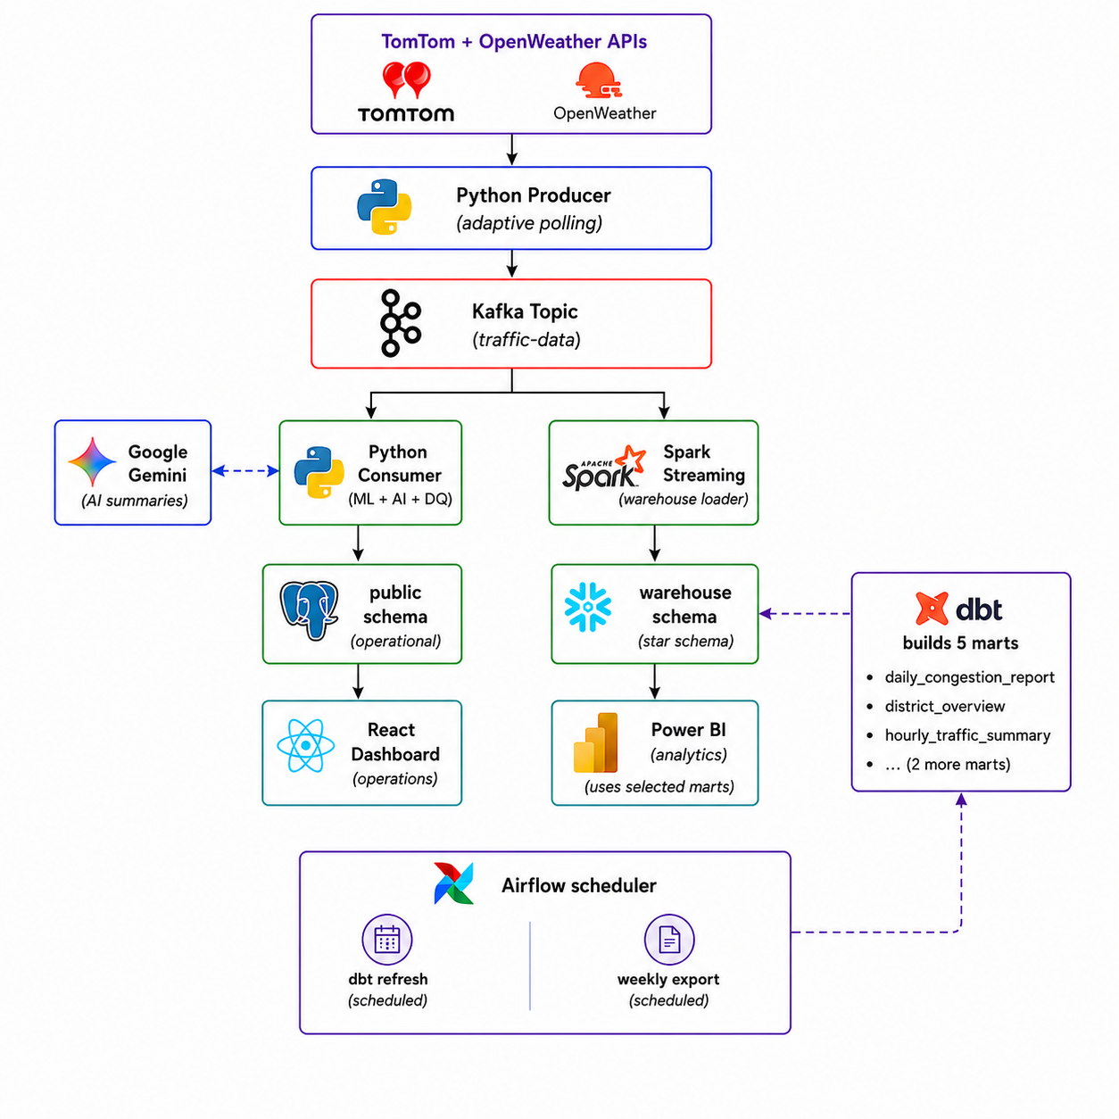
Architecture
Cairo Smart Traffic
4 / 12

Slide 5




End Users & Key Features
Three personas, three sets of features
Traffic Operator
Data Analyst
Platform Engineer
Real-time visibility and response
Historical patterns and KPIs
System health and operations
KEY FEATURES
KEY FEATURES
KEY FEATURES
Live map with 25 locations
Power BI dashboard (13 visuals)
Data Quality dashboard
Anomaly feed (Isolation Forest)
5 dbt mart tables
System Health page
60-min forecast preview
Time-pattern analysis
Airflow DAGs (auto-retry)
AI summary every 5 min
Weekly stakeholder exports
One-click start_all.ps1
Cairo Smart Traffic
5 / 12
Notes:
SLIDE 4 USERS & FEATURES : Our platform serves three different users, each with different needs. The Traffic Operator is our primary user. They need to see what's happening right now and respond. So we built the live map, the anomaly feed, the forecast preview, and the AI summary. The Data Analyst or urban planner needs different things — historical patterns, district-level KPIs, and reports they can share with stakeholders. So we built the Power BI dashboard with 13 visuals on top of our 5 dbt mart tables. The Platform Engineer keeps everything running. They need a Data Quality dashboard, a system health page, Airflow for orchestrating background jobs, and a one-click startup script. We built all of these. The same platform serves three audiences without compromising any of them.

Slide 6


Data Architecture
Two schemas serving different use cases
OPERATIONAL · public schema
ANALYTICAL · warehouse schema
TimescaleDB (PostgreSQL)
Star schema · 5 dbt marts
Real-time tables, hypertable optimization, used by the React dashboard.
Loaded by Spark Streaming. Transformed by dbt. Used by Power BI.
raw_events
Incoming readings (TimescaleDB)
dim_location
dim_time
25 rows
168 rows
predictions
RF classifications, per-message
fact_traffic
anomalies
IF detections with rule filter
loaded by Spark
forecasts
20/30/60-min predictions
dim_weather
ai_summaries
Gemini outputs every 5 min
weather keys
data_quality_events
Per-message DQ scoring
5 dbt MARTS ▸ daily_congestion_report · district_overview · hourly_traffic_summary · rush_hour_analysis · weather_impact_analysis
DATA FLOW: TomTom + OpenWeather → Kafka → Python Consumer (public) + Spark Streaming (warehouse)
Cairo Smart Traffic
6 / 12
Notes:
SLIDE 5 — DATA ARCHITECTURE : We have two database schemas, intentionally separate. On the left, the operational schema uses TimescaleDB — a PostgreSQL extension optimized for time-series data. It holds tables like raw_events, predictions, anomalies, forecasts, ai_summaries, and data_quality_events. This is what feeds our React dashboard. On the right, we have a star schema warehouse. The fact table fact_traffic is loaded by Spark Streaming, connected to three dimension tables — dim_location for the 25 places, dim_time for the 168 hour-day combinations, and dim_weather for weather pattern keys. On top of this warehouse, we built a complete dbt project with 6 models — one staging view and 5 mart tables. The marts include daily_congestion_report, district_overview, hourly_traffic_summary, rush_hour_analysis, and weather_impact_analysis. Power BI consumes these directly. Why two schemas? Because operational and analytical queries have completely different needs. Mixing them slows both down.

Slide 7





Tech Stack
Production-grade tools across every layer
LANGUAGES
STREAMING & PROCESSING
STORAGE & TRANSFORMATION
Python 3.11
Apache Kafka 7.4
PostgreSQL + TimescaleDB
TypeScript
Apache Spark 3.5
dbt (6 models)
JavaScript
Zookeeper
SQL
MACHINE LEARNING & AI
ORCHESTRATION & INFRA
FRONTEND & API
scikit-learn (RF + IF)
Apache Airflow 2.10 (3 DAGs)
React 18 + Vite + Tailwind
LightGBM (6 models)
Docker Compose (9 services)
Recharts
SHAP explainers
Kafdrop, Spark UI
Express + node-postgres
Google Gemini 2.5 Flash
Cairo Smart Traffic
7 / 12
Notes:
SLIDE 6 — TECH STACK : We chose production-grade tools across every layer. Languages: Python for the streaming pipeline and ML, TypeScript for the frontend, JavaScript for the API, and SQL for the warehouse. For streaming, Apache Kafka is our message bus, and Apache Spark Streaming does our analytical warehouse loading. Storage is PostgreSQL with TimescaleDB. Transformation happens in dbt with 6 models. For machine learning, we used scikit-learn for Random Forest and Isolation Forest, LightGBM for our 6 forecast models, SHAP for model explainability, and Google Gemini 2.5 Flash for natural-language insights. Orchestration uses Apache Airflow with Docker Compose running 9 services. Our frontend is React 18 with Vite and Tailwind, served by an Express backend.

Slide 8



Live Application & Testing
Status: fully operational, validated end-to-end
● OPERATIONAL · All systems running
Unit Testing
Integration
Operational
100% pass
Verified
Zero crashes
ML inference, DQ checks, lag calculations
Producer → Kafka → Consumer → DB end-to-end
6+ hours continuous run with monitoring
VERIFIED METRICS
98.3%
RF classification accuracy
0.91
Forecast R² at +60 min
4%
Anomaly false positives (from 56%)
100%
DQ pass rate
22/25
Locations producing live forecasts
<30s
Dashboard refresh latency
Cairo Smart Traffic
8 / 12
Notes:
SLIDE 7 — LIVE APP & TEST : Our system is fully operational right now — running continuously on our development infrastructure. We tested in three phases. Unit testing for ML inference and data quality checks — all passing. Integration testing for the end-to-end pipeline from API through Kafka, through the consumer, into the database — verified working. Operational testing with 6+ hours continuous running — zero crashes. Here are the numbers that matter: - Random Forest classification: 98.3% accuracy - Forecast accuracy at 60 minutes: R² of 0.91 — explaining 91% of speed variation - Anomaly false-positive rate: 4%, down from 56% in the raw model — that's a 92% reduction in false alarms thanks to rule-based post-filtering - Data quality: 100% pass rate in production - 22 out of 25 locations producing live forecasts right now - Dashboard refresh latency: under 30 seconds end-to-end These are real numbers from our running system, not projections.

Slide 9
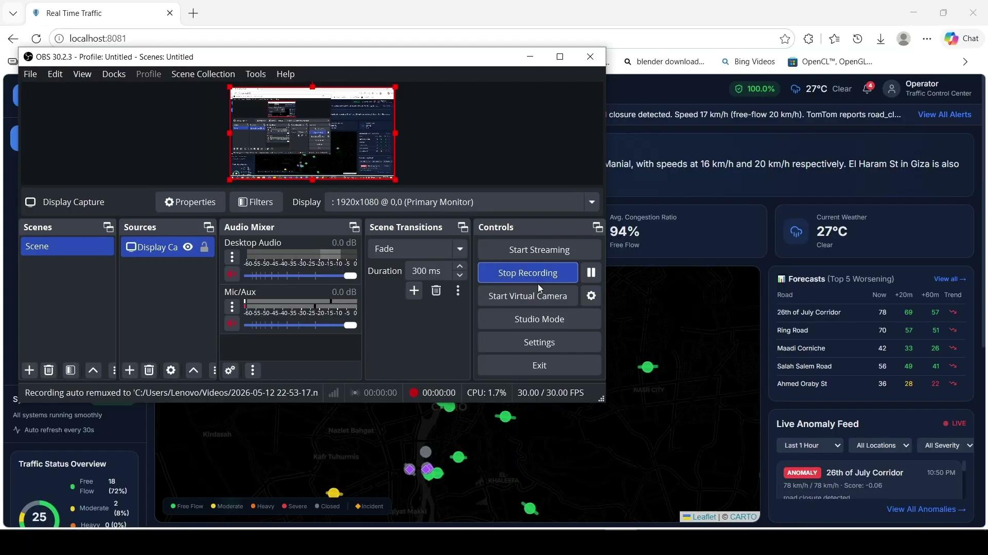
Demo
Cairo Smart Traffic
9 / 12

Slide 10




Project Deliverables
Everything submitted for evaluation
Documentation
Source Code
Project Description (1 page)
GitHub repository (public)
Full Technical Documentation
Complete .zip archive
Traffic Recommendations Report
Setup scripts (start_all.ps1)
Architecture diagrams
Docker Compose configuration
Working System
Visualizations
9 Docker services orchestrated
React dashboard (8 pages)
Producer + Consumer + Spark
Power BI dashboard (13 visuals)
React + Express dashboard
AI-generated summaries (live)
3 Airflow DAGs configured
Forecast tables (3 horizons)
Cairo Smart Traffic
10 / 12
Notes:
SLIDE 8 — DELIVERABLES : What did we deliver? Documentation: Project Description, full technical Documentation, a Traffic Recommendations Report that came from our analysis, and architecture diagrams. Source Code: complete GitHub repository, public access. Also as a downloadable ZIP. Includes setup automation scripts. The Working System itself: 9 Docker services orchestrated, the producer-consumer-spark pipeline running, the React and Express dashboard, and 3 configured Airflow DAGs. Visualizations: 8 pages in the React dashboard, 13 visuals in Power BI, live AI summaries, and full forecast tables.

Slide 11

The Team
Five engineers, one platform
Shahd
Omnya
Abdelrahman
Ebtihal
Aya
Consumer & AI · Dashboard
Business Intelligence
Spark & dbt
Airflow Orchestration
Data Warehouse
Python consumer (ML + DQ)
Power BI dashboard
Spark Streaming consumer
Airflow setup
Star schema design
Gemini AI integration
4 visualizations
dbt project (5 models)
2 scheduled DAGs
Fact + 3 dimensions
React dashboard
Executive analytics
Warehouse loading
Workflow automation
Warehouse modeling
COLLABORATION
GitHub for code · Jira for daily sync · Google Drive for shared docs · Pull requests for code review · Weekly milestones
Cairo Smart Traffic
11 / 12
Notes:
SLIDE 9 — TEAM: Quick word about our team of five. Shahd built the Python consumer, the ML pipeline, integrated Gemini for AI summaries, and built the React dashboard. Omnya owned the business intelligence — the Power BI dashboard with 13 visualizations that powers our executive view. Abdelrahman built the Spark Streaming consumer that loads our warehouse, and the dbt project with 6 models that transforms our raw data into analytical marts. Ebtihal set up Airflow and built our 3 DAGs that orchestrate the scheduled jobs across the platform. And Aya designed the data warehouse — the star schema with fact_traffic and our three dimension tables that everything analytical sits on top of. We coordinated through GitHub for code, daily messaging for syncs, and shared documentation workspaces. Code reviews ran through pull requests, and we worked in weekly milestones.

Slide 12



Thank You
Questions?
GitHub Repository
https://github.com/ShahdAshraf11/azure-traffic-analytics-stream.git
Live Demo
Available now
DEPI · DATA ENGINEERING TRACK CAPSTONE · 22 MAY 2026

