Slide 1

Security

Slide 2
Team members:-
شهد محمد مصطفي عبد المجيد
رانيا محمد عبد العال سيد
سما اسامه فؤاد محمد سيد
جهاد عمر عبد العال عبد الكريم
إيناس رجب عبداللطيف

Slide 3

Introduction :
Cybersecurity is the protection of computers, servers, mobile devices, electronic systems, networks, and data from malicious attacks It is also known as information technology security or electronic information security. The term is used in various contexts from business to mobile computing,
and can be divided into several common categories:

Slide 4
Network security : is the practice of protecting a computer network from hackers, whether attackers targeting the network, or from malware looking for vulnerabilities.
Application security : focuses on keeping software and hardware free from threats, and the intrusion of any application that may cause access to the data the application is designed to protect.
Information security : protects the integrity and privacy of data both when it is stored and when it is transmitted.
Process security : includes processes and decisions related to the processing and protection of data assets. This category includes the permissions that users have when accessing a particular network and the processes that determine how and where data is stored or shared.

Slide 5

Electronic threat size :
Global cyber threats are evolving at a rapid pace, with an
increase in the number of data violations each year.
A shocking report by RiskBased Security showed that as many
as 7.9 billion records experienced data breaches during the first
nine months of 2019 alone.This number is more than double
(112%) the number of records broken during the same period in 2018
With the cyberthreat expected to increase, International Data Corporation predicts that global spending on cybersecurity solutions will reach US $133.7 billion by 2022 . Governments around the world have responded to the growing cyber threat by providing guidance to help organizations implement effective cyber security practices.

Slide 6
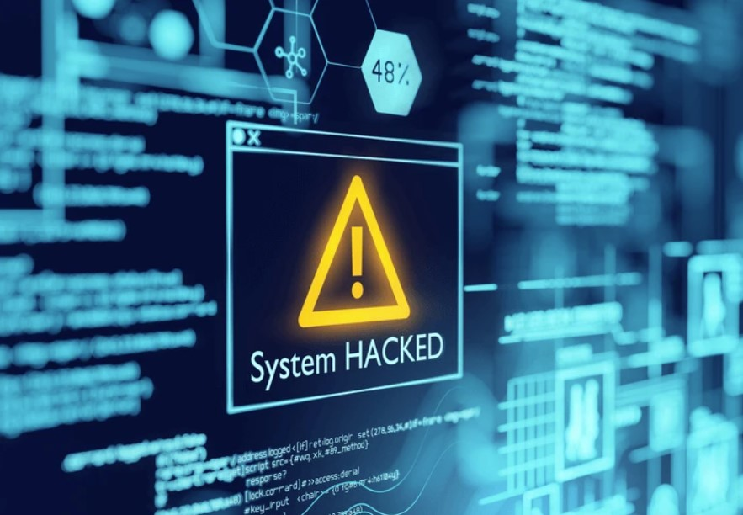
Types of cyber threats :
Cybercrime : involving individual actors or groups targeting
systems for financial gain or to cause malfunctions.
Cyber attacks : often involve politically motivated gathering of information
Cyberterrorism and Cyberwarfare :
Cyberterrorism and cyberwarfare refer to malicious acts in which attackers
use a target’s computer systems, particularly via the Internet, to cause physical,
real-world harm or severe disruption, usually to carry out a political agenda. These
actions range from gathering data to attacking critical infrastructure (e.g., via SCADA
systems).
Malware : stands for malicious software, and one of the most common electronic threats .
Malware often spread through an anonymous email attachment or an apparently legitimate download ,and this
software constitutes one of the most common cyber threats like:
viruses, Trojan horses(A type of malware that masquerades as legit),Spyware, Ransom program, Supported ads and

Slide 7

Phishing (is the process by which cybercriminals target victims by sending emails that appear to have been sent by a legitimate company to obtain sensitive information).
Bitnet networks : are networks of computers infected with malware used by cybercriminals to perform tasks on the internet without the user’s permission.
A middleman attack : A middle man attack is a type of cyber threat in which a cyber criminal interrupts communications between two people in order to steal data . For example, an attacker may interrupt data that is passed on an insecure Wi-Fi network from the victim’s device to the network.

Slide 8
Software Attacks :
(1) Remote Attacks Requiring User Action
Virus: Segment of computer code that performs malicious actions by attaching to another computer program.
Worm: Segment of computer code that performs malicious actions and will replicate, or spread, by itself (without requiring another computer program).
Phishing Attack: Phishing attacks use deception to acquire sensitive personal information by masquerading as official looking e-mails or instant messages.
Spear Phishing Attack: Phishing attacks target large groups of people. In spear phishing attacks, the perpetrators find out as much information about an individual as possible to improve their chances that phishing techniques will be able to obtain sensitive, personal information.

Slide 9
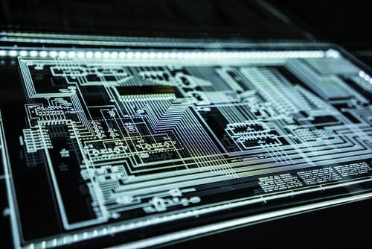
Alien software (or Pest ware) Programs installed on a computer without user's consent or knowledge–Uses valuable system resources and may report user activities back to the creator and it can enable other parties to track your web surfing habits. . Adware: is a vast majority of Pest ware that displays pop-up advertisements on computer screens. . Spyware: Collects personal information about users without their consent, common type is: (keystroke loggers, screen scrapers)..
Spam ware (spam): is pest ware that uses your computer as a launchpad for spammers. Spam is unsolicited email, usually advertising for products and services..

Slide 10
(2) Remote Attacks Needing No User Action
Denial-of-Service Attack :
With a denial-of-service attack, cybercriminals prevent a computer system from fulfilling legitimate requests by excessively increasing traffic on networks and servers. The system becomes enable, preventing the organization from carrying out important functions.
(3) Attacks by a Programmer Developing a System
Trojan Horse: Software programs that hide in other computer programs and reveal their designed behavior only when they are activated.
Back Door: Typically a password, known only to the attacker, that allows him or her to access a computer system at will, without having to go through any security procedures (also called a trap door).
Logic Bomb: Segment of computer code that is embedded within an organization’s existing computer programs and is designed to activate and perform a destructive action at a certain time or date.

Slide 11

Supervisory Control and Data Acquisition (SCADA) Attacks : SCADA refers to a large-scale, distributed measurement and control system. SCADA is responsible for acquiring real-time data from a physical system and managing the physical system or presenting the data to humans, who monitor and manage the system and provide a link between the physical world and the electronic world.If attackers gain access to the network, they can cause considerable damage, such as disrupting the power grid over a large area or upsetting the operations of a large chemical or nuclear plant.

Slide 12
Cookies (tracking cookies): Cookies are text files with small pieces of data — like a username and password — that are used to identify your computer as you use a computer network. Specific cookies known as HTTP cookies are used to identify specific users and improve your web browsing experience. Data stored in a cookie is created by the server upon your connection. This data is labeled with an ID unique to you and your computer. When the cookie is exchanged between your computer and the network server, the server reads the ID and knows what information to specifically serve to you. _Tracking cookies are a sample of text dropped onto a browser while viewing a website. This text collects data from a user such as their activity on a website, browsing history, geographic location, purchase trends, and more. Tracking cookies are unique which they can follow a user across multiple sites or services and continue to stack data. The information gathered is often used for direct marketing purposes such as targeted ads, but tracking cookies do carry criticism as some fear the amount of data collected can be intrusive.

Slide 13

How to protect yourself from cyber attacks :
Cybersecurity relies on encrypted protocols to encrypt emails,files,and other important data.This not only protects the information as it is transmitted, but also protects it from being lost or stolen.
In addition, end-user security software scans computers for malicious software, isolates them, and then removes them from the device.

Slide 14

So here are some of the most important tips that can protect you from a cyber threat:-
Update the applications and operating system: This means taking advantage of the latest security patches
Use of antivirus software: Security solutions such as Kaspersky Total Security will detect and remove threats. Keep your software up to date for maximum protection
Use strong passwords: Make sure your passwords are not easy to guess
Do not open email attachments from senders you do not know: They may be infected with malware
Don't open any links in emails sent by senders you don't know or on unknown websites: this is a common method of spreading malware.
Avoid insecure WiFi networks in public: insecure networks expose
you to the risk of intermediate attacks

Slide 15
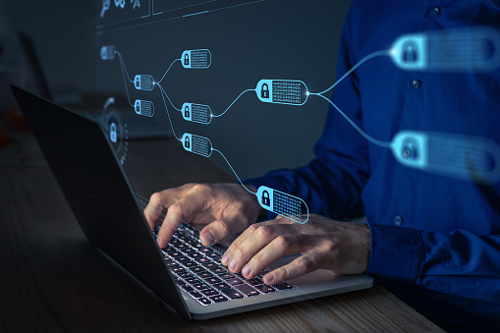
Verifying removable media use: removable media(such as USP sticks) used by employees to transmit or store information is one of the biggest threats to network security . These media can contain malware that helps hack into a company’s systems.
Shopping only on safe sites, even with protections against cyberattacks, its best to use reliable online shopping platforms, especially those that offer, and discounts that may seem very generous.
To make accessibilty varied, each user or employee should be able to access only information and systems within their purview.

