Slide 1
THURSDAY, 21 OCTOBER - 2021
Cardiovascular Disease Prediction
Presentation by Shahd Aljabarti
01

Slide 2





CARDIOVASCULAR DISEASE PREDICTION
Problem Statement
Presentation Outline
Data
Model
Results
Conclusion
02

Slide 3

CARDIOVASCULAR DISEASE PREDICTION
Problem Statement
The cardiovascular diseases lead the cause of death across the world as the statement of World Health Organization. In 2019, 32% of the global death were due to the heart attacks and strokes.
This project aims to explore the features that affect in cardiovascular disease occurrence and build a model to predict whether a person has a heart disease or not.
03

Slide 4

CARDIOVASCULAR DISEASE PREDICTION
Data Understanding
Source of the dataset is Kaggle website where the dataset was extracted in excel format then converted to csv format. It has 70,000 records and 12 features.
Predictors
Target
Age in days
Height
Weight
Gender
Systolic blood pressure
Diastolic blood pressure
Cholesterol
Glucose
Smoking
Alcohol intake
Physical activity
Cardiovascular
disease
presence
04

Slide 5
CARDIOVASCULAR DISEASE PREDICTION
Data Understanding
Source of the dataset is Kaggle website where the dataset was extracted in excel format then converted to csv format. It has 70,000 records and 12 features.
Predictors
Target
Age in years
BMI
Gender
blood pressure
Cholesterol
Glucose
Smoking
Alcohol intake
Physical activity
Cardiovascular
disease
presence
05

Slide 6
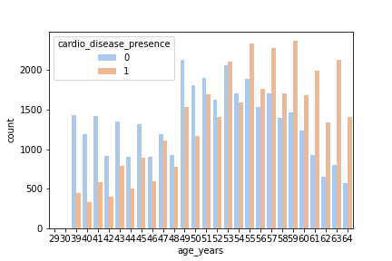
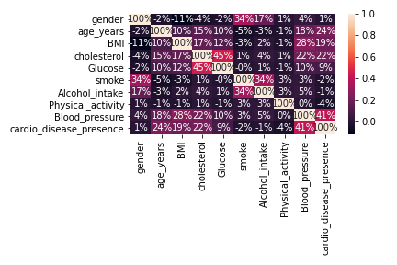
CARDIOVASCULAR DISEASE PREDICTION
Data Understanding
Interesting plots!
Count Plot
Pairwise Correlation
06

Slide 7
CARDIOVASCULAR DISEASE PREDICTION
Models
The following algorithms both were used before choosing logistic regression as the model with better performance.
Logistic Regression
Random Forest
The model was trained with scaled data.
100 trees were built before taking the maximum voting.
07

Slide 8

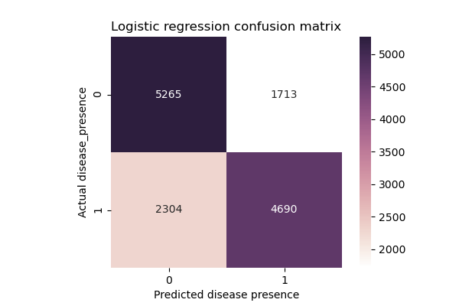
CARDIOVASCULAR DISEASE PREDICTION
Results
- Logistic Regression
Recall 67.06%
Precision 73.25%
Cross Validation 71.72%
ROC AUC 77.91%
08

Slide 9
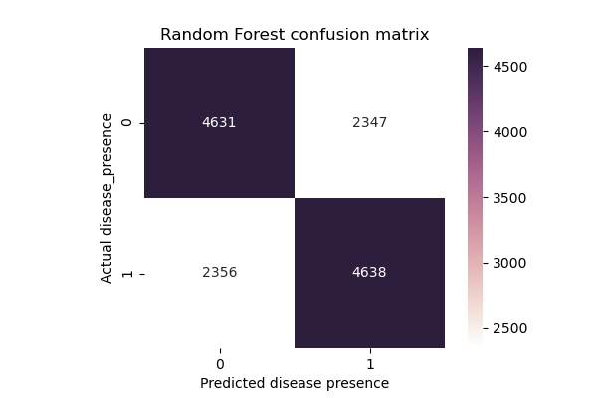
CARDIOVASCULAR DISEASE PREDICTION
Results
- Random Forest
Recall 66.51%
Precision 66.6%
Cross Validation 66.08%
ROC AUC 59.24%
09

Slide 10
CARDIOVASCULAR DISEASE PREDICTION
Conclusion
In this case, the logistic regression has better performance than random forest classifier.
The more the blood pressure, BMI, age & cholesterol level increase the greater your risk for developing heart disease or having a heart attack
After I studied this topic I should advise others to pay attention to their weights, their life styles since the most of bad habits has high impact on the blood pressure so that will directly affects their hearts health.
please live healthier lifestyle
10

Slide 11
CARDIOVASCULAR DISEASE PREDICTION
Thank you!
Any question?
Have a great day ahead.
11

