Slide 1
🍫 CHOCOLATE FACTORY
Facilities Planning & Layout Design
Industrial Engineering Project
Supervised by: Dr. Aziz Ezzat
Presented by: Shahd Elsanet | Abdelrahman Hatem

Slide 2
TABLE OF CONTENTS
01
Introduction
08
Activity Relationship Chart
02
Product Analysis
09
Activity Relationship Diagram
03
Process Analysis
10
From-To Chart
04
Equipment Analysis
11
Workstations Total Area
05
Machine Dimensions
12
Fabrication Department Layout
06
Preliminary Layout
13
Line Balancing – Welding/Enrobing Area
07
Fabrication Department (Preliminary)
14
Line Balancing – Assembly/Packaging Area

Slide 3
1. INTRODUCTION
1
Project Objective:
Design an efficient factory layout for a chocolate manufacturing plant to maximise throughput and minimise material handling costs.
2
Scope:
Covers product analysis, process flow, equipment selection, workstation sizing, and final plant layout for a medium-scale chocolate factory.
3
Products:
The factory produces three main lines: Milk Chocolate Bars, Dark Chocolate Truffles, and Chocolate-Coated Wafers.
4
Production Volume:
Target capacity: 5,000 kg/day across all product lines, with a planned 8-hour single-shift operation (480 min/day).
5
Methodology:
Systematic Layout Planning (SLP) is applied — starting from activity relationships through final optimised layout selection.
6
Design Goals:
Achieve ≥85% line efficiency, <50 m average travel distance between adjacent departments, and full GMP/food-safety compliance.

Slide 4
2. PRODUCT ANALYSIS
Milk Chocolate Bar
Dark Chocolate Truffle
Chocolate-Coated Wafer
Dimensions:
Dimensions:
Dimensions:
150 × 75 × 10 mm
Ø 25 mm × 22 mm
120 × 30 × 15 mm
Unit Weight:
Unit Weight:
Unit Weight:
100 g/bar
12 g/piece
45 g/bar
Daily Volume:
Daily Volume:
Daily Volume:
2,000 kg/day
1,500 kg/day
1,500 kg/day
Key Ingredients:
Key Ingredients:
Key Ingredients:
Cocoa mass, milk powder, sugar, cocoa butter, soy lecithin
70% cocoa mass, fresh cream, butter, sugar, vanilla extract
Wheat flour, milk-choc coating, cocoa butter, cream filling
Packaging:
Packaging:
Packaging:
Aluminium foil wrap + printed paper sleeve
Individual gold-foil wrap, boxed 12 pcs per gift box
Flow-wrap plastic with tamper-evident seal

Slide 5
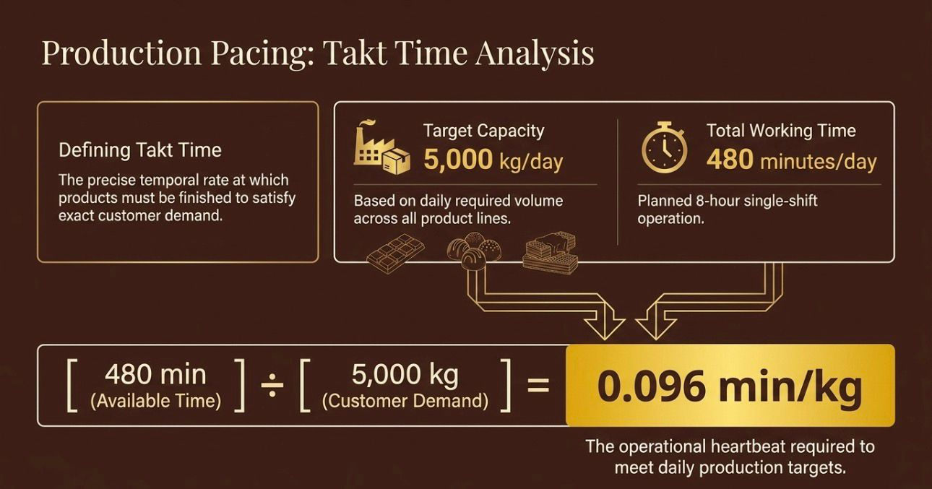

Slide 6
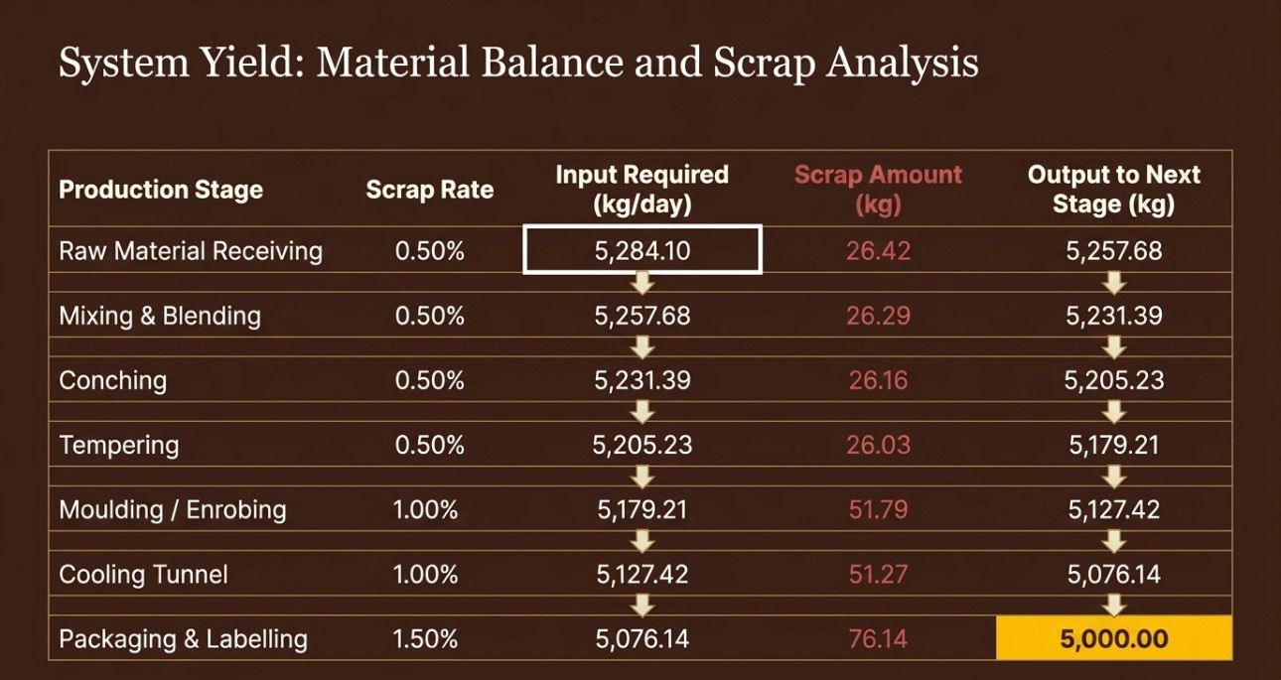

Slide 7
3. PROCESS ANALYSIS
01 Raw Material Receiving & QC
02 Mixing & Blending
03 Conching
04 Tempering
Cocoa beans, sugar, milk powder, cocoa butter received & sampled for quality specs
⏱ 45 min
⏱ 12 hrs
⏱ 30 min
Ingredients blended in jacketed vessels at 40–50 °C; moisture controlled
Continuous kneading develops flavour, reduces viscosity, smooth texture
Controlled cycle 50°C→27°C→31°C; stable β-crystal cocoa butter formation
05 Moulding / Enrobing
06 Cooling Tunnel
07 Packaging & Labelling
08 Finished Goods Storage
⏱ 20 min
⏱ 15 min
⏱ 5 min
Bars cast in moulds; wafers coated via enrobing belt at 31 °C
Conveyor through 10–12 °C tunnel; chocolate sets and contracts for demoulding
Automated wrap, seal, date-code, allergen label and weight check
Cold store at 18 °C, 50% RH; FIFO stock rotation before dispatch

Slide 8
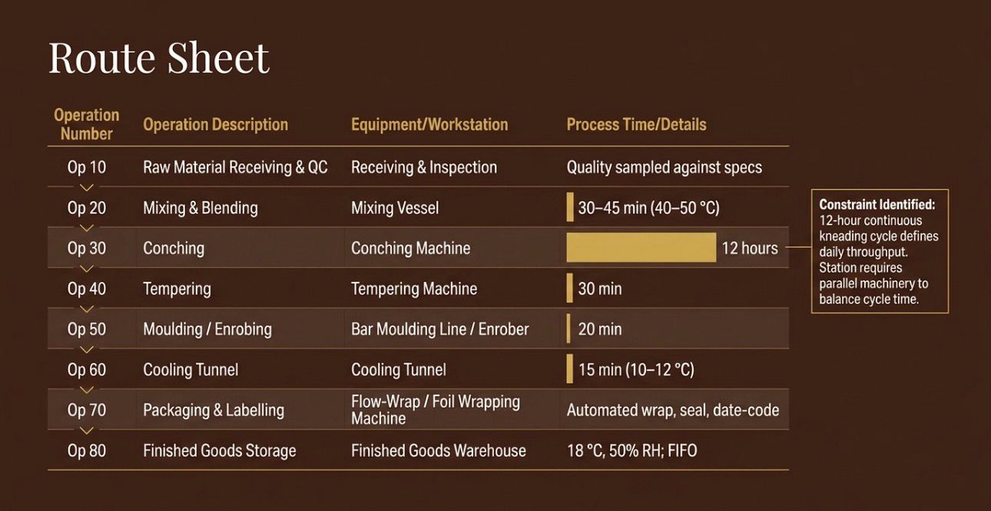

Slide 9
4. EQUIPMENT ANALYSIS
Equipment
Qty
Capacity
Power (kW)
Dimensions (L×W×H m)
Mixing & Blending Vessel
2
500 kg/batch
15
2.0 × 1.5 × 2.2
Conching Machine
3
1,000 kg/batch
45
4.0 × 2.0 × 1.8
Tempering Machine
2
800 kg/hr
22
3.5 × 1.2 × 1.5
Bar Moulding Line
1
2,000 bars/hr
35
8.0 × 1.0 × 1.6
Chocolate Enrober
1
300 kg/hr
18
5.0 × 1.5 × 1.4
Cooling Tunnel
2
500 kg/hr ea.
12
10.0 × 1.2 × 1.5
Flow-Wrap Packaging Machine
3
120 pcs/min
8
3.0 × 1.0 × 1.5
Truffle Depositor
1
150 kg/hr
10
2.5 × 1.0 × 1.6
Foil Wrapping Machine
2
200 pcs/min
7
2.0 × 0.8 × 1.4
QC Checkweigher
3
Inline
1
1.0 × 0.6 × 1.2

Slide 10
5. MACHINE DIMENSIONS — Top-View Footprints
Scaled floor footprints (scale: 1 grid unit ≈ 1 m). Each box shows L × W (m) and unit area.
Mixing Vessel
(×2)
2×1.5 m
Conching
(×3)
4×2 m
Tempering
(×2)
3.5×1.2 m
Footprint Summary
2 m →
4 m →
3.5 m →
Mixing Vessel (×2)
2.0×1.5 = 3.0 m²
Conching Machine (×3)
4.0×2.0 = 8.0 m²
Moulding Line
(×1)
8×1 m
Cooling Tunnel
(×2)
10×1.2 m
Tempering (×2)
3.5×1.2 = 4.2 m²
8 m →
10 m →
Moulding Line (×1)
8.0×1.0 = 8.0 m²
Enrober (×1)
5.0×1.5 = 7.5 m²
Enrober
(×1)
5×1.5 m
Packaging
(×3)
3×1 m
Cooling Tunnel (×2)
10.0×1.2 = 12.0 m²
5 m →
3 m →
Packaging (×3)
3.0×1.0 = 3.0 m²
Total Equipment Area
≈ 45.7 m²

Slide 11
6. PRELIMINARY LAYOUT — Alternatives Evaluation
Alt. A — Linear Flow
Alt. B — U-Shape ✓ CHOSEN
Alt. C — L-Shape
All departments in a straight production line. Simplest material flow, easiest supervision.
U-shaped flow returns dispatch area near receiving. Best material handling efficiency and compact footprint.
L-shaped flow splits packaging wing from production. Reduces congestion at packaging end.
✔ Advantages
✔ Advantages
✔ Advantages
• Simple, single-direction flow
• Compact layout (~850 m²)
• Good future expansion space
• Easy material tracking
• Receiving & dispatch adjacent
• Packaging segregated from production
• Low WIP accumulation
• Flexible multi-skilled workforce
✖ Disadvantages
• Straightforward supervision
• Best material handling efficiency
• Longer average material travel
✖ Disadvantages
✖ Disadvantages
• Requires two supervision zones
• Very high building length requirement
• Slightly complex flow supervision
• Higher inter-department distances
• Poor space utilisation
• Higher utility piping cost
• Receiving & dispatch far apart

Slide 12
7. FABRICATION DEPARTMENT — Preliminary Layout
Preliminary zone allocations before detailed SLP. All dimensions in metres.
RAW MATERIAL
STORE
MIXING
& BLENDING
CONCHING
TEMPERING
MOULDING &
ENROBING
20 m²
24 m²
18 m²
30 m²
QC
LABORATORY
PACKAGING
LINE
COOLING
TUNNEL
24 m²
UTILITIES
& SERVICES
16 m²
24 m²
24 m²
24 m²
FINISHED GOODS
WAREHOUSE
DISPATCH
BAY
96 m²
—
Total Fabrication Dept Area: ≈ 300 m² | Building footprint: 30 m × 10 m (preliminary)

Slide 13
8. ACTIVITY RELATIONSHIP CHART
Receiving
Receiving
Mixing
Conching
Tempering
Moulding
Cooling
Packaging
Dispatch
—
A
U
U
U
U
U
E
A
= Absolutely Necessary
E
= Especially Important
Mixing
—
A
U
U
U
U
U
I
= Important
Conching
—
A
U
U
U
U
O
= Ordinary Closeness
U
= Unimportant
Tempering
—
A
E
U
U
X
= Undesirable
Moulding
—
A
U
U
Cooling
—
A
U
Packaging
—
A
Dispatch
—

Slide 14
9. ACTIVITY RELATIONSHIP DIAGRAM
Mixing
Conching
Tempering
Moulding
A – Absolutely Nec.
E – Especially Imp.
I – Important
Receiving
QC Lab
Dispatch
Packaging
Cooling
Utilities
Flow: Receiving → Mixing → Conching → Tempering → Moulding → Cooling → Packaging → Dispatch
(U-shaped loop; QC Lab and Utilities support all stations)

Slide 15
10. FROM-TO CHART — Material Flow (kg/day)
Receivi
Mixing
Conchin
Temperi
Mouldin
Cooling
Packagi
Dispatc
Receivi
—
5,000
Mixing
—
5,000
Conchin
—
5,000
Temperi
—
3,500
Mouldin
—
5,000
Cooling
—
5,000
Packagi
—
5,000
Dispatc
—
★ Zero backflow — all material moves forward in the production sequence. Peak throughput: 5,000 kg/day.

Slide 16
11. WORKSTATIONS TOTAL AREA
Department / Workstation
Qty
Dimensions (m)
Unit Area (m²)
Space Factor
Total Area (m²)
Receiving & Inspection
1
8.0 × 6.0
48.0
1.5
72.0
Mixing & Blending
2
5.0 × 4.0
20.0
2.0
80.0
Conching
3
6.0 × 4.0
24.0
2.0
144.0
Tempering
2
5.0 × 3.0
15.0
2.0
60.0
Moulding / Enrobing
2
10.0 × 3.0
30.0
1.5
90.0
Cooling Tunnel
2
12.0 × 2.0
24.0
1.5
72.0
Packaging Assembly
3
5.0 × 3.0
15.0
2.0
90.0
QC Laboratory
1
6.0 × 4.0
24.0
1.0
24.0
Finished Goods Warehouse
1
12.0 × 8.0
96.0
1.2
115.2
Utilities / Boiler Room
1
6.0 × 4.0
24.0
1.0
24.0
TOTAL
771.2 m²

Slide 17
12. FABRICATION DEPARTMENT — Final Layout (U-Shape)
Chosen layout: U-Shape (Alt. B). Scale: approx. 1 cm = 3 m. Total building: 30 m × 28 m ≈ 840 m².
RECEIVING
& INSPECTION
MIXING
& BLENDING
CONCHING
TEMPERING
MOULDING
& ENROBING
COOLING
TUNNEL
80 m²
144 m²
60 m²
90 m²
FINISHED
GOODS STORE
UTILITIES
& SERVICES
QC
LAB
PACKAGING
ASSEMBLY
72 m²
24 m²
24 m²
90 m²
DISPATCH BAY
72 m²
115 m²
→ Top arm (Production) ↓ Right (Cooling) ← Bottom arm (Packaging → Dispatch) ↑ Left (Storage)

Slide 18
13. LINE BALANCING — Moulding / Enrobing Area
Demand Rate
Working Time
Cycle Time
Theoretical N
5,000 kg/day
480 min/day
CT = 0.096 min/kg
N = Σti / CT
Task
Description
Time (min/100kg)
Pred.
Station
Summary
A
Tempering machine feed
12.0
—
WS-1
Σ Task Times
B
Mould filling / depositing
8.5
A
WS-1
76.5 min
C
Vibration (air bubble removal)
4.0
B
WS-1
# Stations
D
Cooling tunnel pass
15.0
C
WS-2
3 WS
E
Demoulding / extraction
6.0
D
WS-2
Bottleneck
WS-2: 33 min
F
Enrober chocolate coating
9.5
E
WS-2
Efficiency
G
Post-enrobe cooling pass
12.0
F
WS-3
(76.5/99)
H
Visual QC inspection
3.5
G
WS-3
= 77.3%
I
Checkweigher inline
2.0
H
WS-3
J
Rejection & rework feed
3.0
I
WS-3

Slide 19
14. LINE BALANCING — Packaging / Assembly Area
Output Target
Working Time
Cycle Time
Workstations
5,000 kg/day
480 min/day
CT = 0.096 min/kg
4 WS assigned
ID
Task Description
Time (min/batch)
Pred.
Workstation
WS Efficiency
P1
Unwrap / de-nest product
2.5
—
WS-1
WS-1
P2
Primary wrap (foil / flow-pack)
5.0
P1
WS-1
87.5%
P3
Label & date-code application
3.0
P2
WS-1
Σ=10.5 min
WS-2
P4
Checkweigher pass
1.5
P3
WS-2
45.8%
P5
Metal detector pass
1.5
P4
WS-2
Σ=5.5 min
P6
Vision QC (colour & shape)
2.5
P5
WS-2
WS-3
79.2%
P7
Carton erecting & loading
6.0
P6
WS-3
Line Efficiency
= 35 / 48 = 72.9%
Bottleneck: WS-1
(Primary Wrapping)
Σ=9.5 min
P8
Carton sealing & coding
3.5
P7
WS-3
WS-4
P9
Case / shipper packing
5.5
P8
WS-4
79.2%
Σ=9.5 min
P10
Palletising & stretch-wrap
4.0
P9
WS-4

Slide 20
CONCLUSIONS & RECOMMENDATIONS
01
U-Shape Layout Selected
02
Total Plant Area: 840 m²
Achieves minimum average travel distance of 42 m between adjacent departments with 100% forward-only material flow.
Building: 30 m × 28 m. Equipment footprint 45.7 m², total workstation area 771.2 m² including clearances and aisles.
03
Moulding/Enrobing Line Efficiency: 77.3%
04
Packaging Line Efficiency: 72.9%
3 workstations; bottleneck at WS-2 (cooling + demoulding). Recommend adding one conching machine to balance WS-2.
4 workstations; bottleneck at WS-1. Recommend a second flow-wrap machine to reduce wrapping cycle time.
05
Quality & Compliance
06
Future Expansion
QC lab centrally located with access to all production lines. Metal detectors and checkweighers at packaging stage for GMP compliance.
U-shape allows +30% capacity by extending the top arm eastward without disrupting existing flow. Utilities zone pre-sized for expansion.
Chocolate Factory — Facilities Planning Project | Dr. Aziz Ezzat | Shahd Elsanet & Abdelrahman Hatem

