Slide 1
PROJECT PROGRESS REPORT
PQC Handshake Resilience
in Lossy IoT Networks
ECC-TLS vs. Kyber-TLS · MQTT · NetEm · 1,260 Trials
Maisam Raza
Abdullah Ahtasham
Muhammad Shaheem
CY315 — Wireless and Mobile Security · Spring 2026 · Dr. Muhammad Fawad Khan
Framework ✔
ECC-TLS ✔
Kyber-TLS ✔
Analysis ✔

Slide 2
Presentation Agenda
01
Project Background & Motivation
02
Project Proposal
Research gaps, threat model, IoT context
Objectives, methodology plan, scope
03
Framework Setup & Implementation
04
Key Challenges Resolved
MQTT/TLS stack, ECC & Kyber integration
Technical issues encountered and fixed
05
Experimental Results
06
Key Findings & Conclusions
1,260 trials — mean, variance, P95, JSI
What the data tells us

Slide 3
01 Background & Motivation
Why PQC? Why IoT? Why now?

Slide 4
The Problem: Quantum Threat Meets IoT Reality
🔓 Shor's Algorithm Threat
📡 IoT Network Reality
Breaks ECC & RSA. A sufficiently large quantum computer renders today's TLS handshakes trivially decryptable.
29 billion devices by 2030. Operate over 5G, LoRaWAN, satellite — links with 1–10% packet loss and high jitter.
🔬 Research Gap
🎯 Our Goal
PQC-IoTNet [Almutairi & Sheldon, 2026] only tested 0% & 5% loss, 20 trials, no jitter — insufficient for deployment decisions.
Determine the precise operational boundaries of Kyber handshakes under realistic adverse conditions and compare to ECC.

Slide 5
02 Project Proposal
Track 2: Implementation & Optimization — CY315 Spring 2026

Slide 6
Proposed Methodology & Deliverables
Experimental Design
Proposed Deliverables
• Packet Loss: 0%, 1%, 2%, 3%, 5%, 7%, 10%
Failure Cliff Graph
Precise mapping of where Kyber success drops below 90%
• Jitter: 0, 20, 50 ms random latency variance
Jitter Sensitivity Index
• Base Delay: 50 ms (WAN emulation)
Comparison of jitter impact: PQC vs. ECC
• Trials: 30 per scenario (vs. 20 in baseline)
Full CSV Dataset
1,260+ trials for future PQC benchmarking
• Platform: Ubuntu/WSL2 + Linux NetEm
Technical Report
IEEE-format LaTeX report with comparative results

Slide 7
03 Framework Setup & Implementation
Building the full MQTT/TLS benchmarking pipeline

Slide 8
Protocol Stack & System Architecture
MQTT v3.1.1
Broker
Mosquitto 2.0, port 8883, TLS enabled
Application Layer — Eclipse Paho Python client
ECC Certs
▼
CA + server cert, P-256, CN=localhost + SAN
TLS 1.3
Security Layer — ECC-P256 → Kyber-512 (OQS-provider)
Kyber Config
p256_kyber512 hybrid group, OQS-provider plugin
▼
TCP
Timing
Transport Layer — Reliable delivery over loopback (lo)
time.perf_counter() — sub-ms resolution
▼
Data Output
Linux NetEm
CSV: timestamp, algorithm, loss%, jitter, trial, success, ms
Emulation Layer — packet loss · jitter · base delay (tc qdisc)
Automation
Full orchestration script — 42 conditions × 30 trials each

Slide 9
Work Completed — Full Pipeline
01
Framework Setup
02
Network Emulation
03
Automation Layer
Mosquitto MQTT broker · Paho Python client · Handshake timing
Linux NetEm configured · Loss/jitter/delay validated
Orchestration script · Multi-trial runner · CSV logging
04
ECC-TLS Baseline
05
Kyber-TLS Setup
06
Full Analysis
CA + server certs · Port 8883 · Python TLS integration
liboqs + OQS-provider · Kyber-512 cipher suite · Parallel runner
1,260 trials collected · Statistical processing · 6 figures generated

Slide 10
04 Key Challenges Resolved
Technical issues encountered and fixed during development

Slide 11
Issues Encountered & How We Fixed Them
⚠ Packet Loss Had No Effect
✔ Fixed:
Too few MQTT packets — low probability of any being dropped under NetEm.
Added multiple MQTT message exchanges per trial to increase traffic volume.
→ Observed realistic retransmission-induced latency spikes.
⚠ Mosquitto Service Failure
✔ Fixed:
Certificate files in /home/... were inaccessible by the Mosquitto service user.
Moved certs to /etc/mosquitto/certs/ with correct ownership and permissions.
→ Broker started successfully with TLS on port 8883.
⚠ TLS Handshake Errors
✔ Fixed:
Server certificate CN didn't match 'localhost'; missing SubjectAltName field.
Regenerated certificate with CN=localhost and SAN entries for localhost + 127.0.0.1.
→ Verified via openssl s_client — valid chain, correct server identity.
⚠ Kyber OQS Integration
✔ Fixed:
OQS-provider required specific OpenSSL build flags and environment configuration.
Compiled liboqs and oqs-provider from source; configured OPENSSL_CONF to load provider.
→ Kyber-512 cipher suite active and verified.

Slide 12
05 Experimental Results
1,260 trials · 7 loss levels · 3 jitter conditions · full statistical analysis

Slide 13
Baseline Performance — 0% Loss, 0 ms Jitter
Metric
ECC-TLS
Kyber-TLS
Δ
Mean
588.8 ms
397.9 ms
−32.4%
Median
589.9 ms
397.3 ms
−32.7%
Std Dev
48.4 ms
62.3 ms
+28.7%
Min
522.3 ms
319.4 ms
−38.8%
Max
727.1 ms
547.2 ms
−24.7%
P95
678.4 ms
497.6 ms
−26.7%
Statistically significant: two-sample t-test t = 13.26, p < 0.001 (n=30 per algorithm)

Slide 14
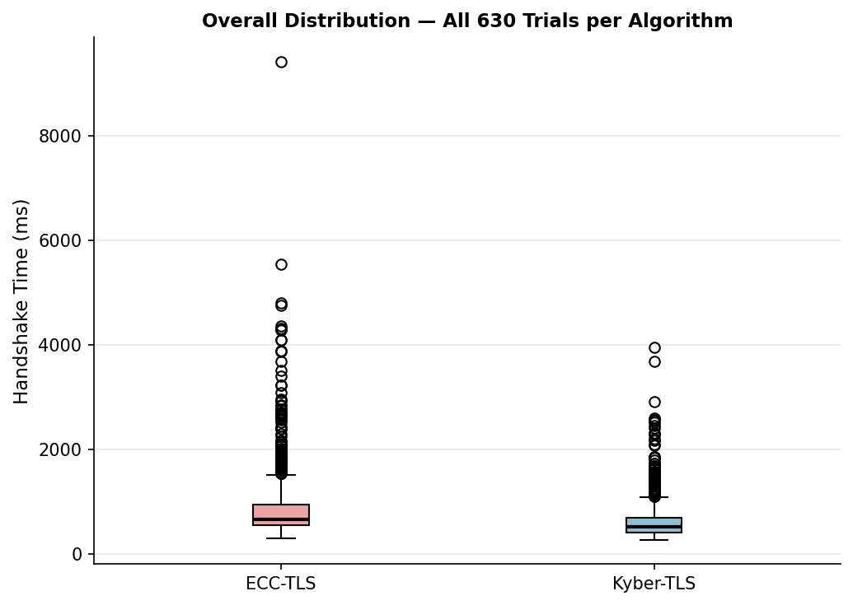
Overall Distribution — All 630 Trials per Algorithm
Kyber-TLS shows lower median, smaller IQR, and fewer extreme outliers than ECC-TLS across all conditions combined.

Slide 15
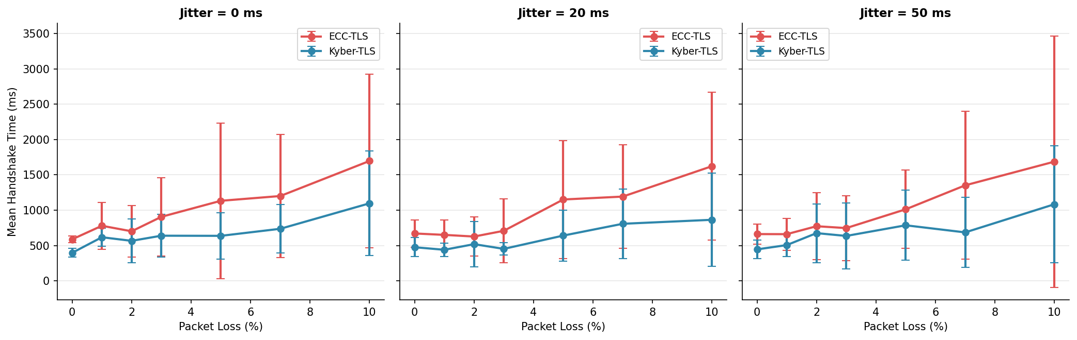
Mean Handshake Time vs. Packet Loss (%)
ECC-TLS mean latency rises more steeply under loss. Both algorithms degrade non-linearly — consistent with TCP exponential backoff.

Slide 16
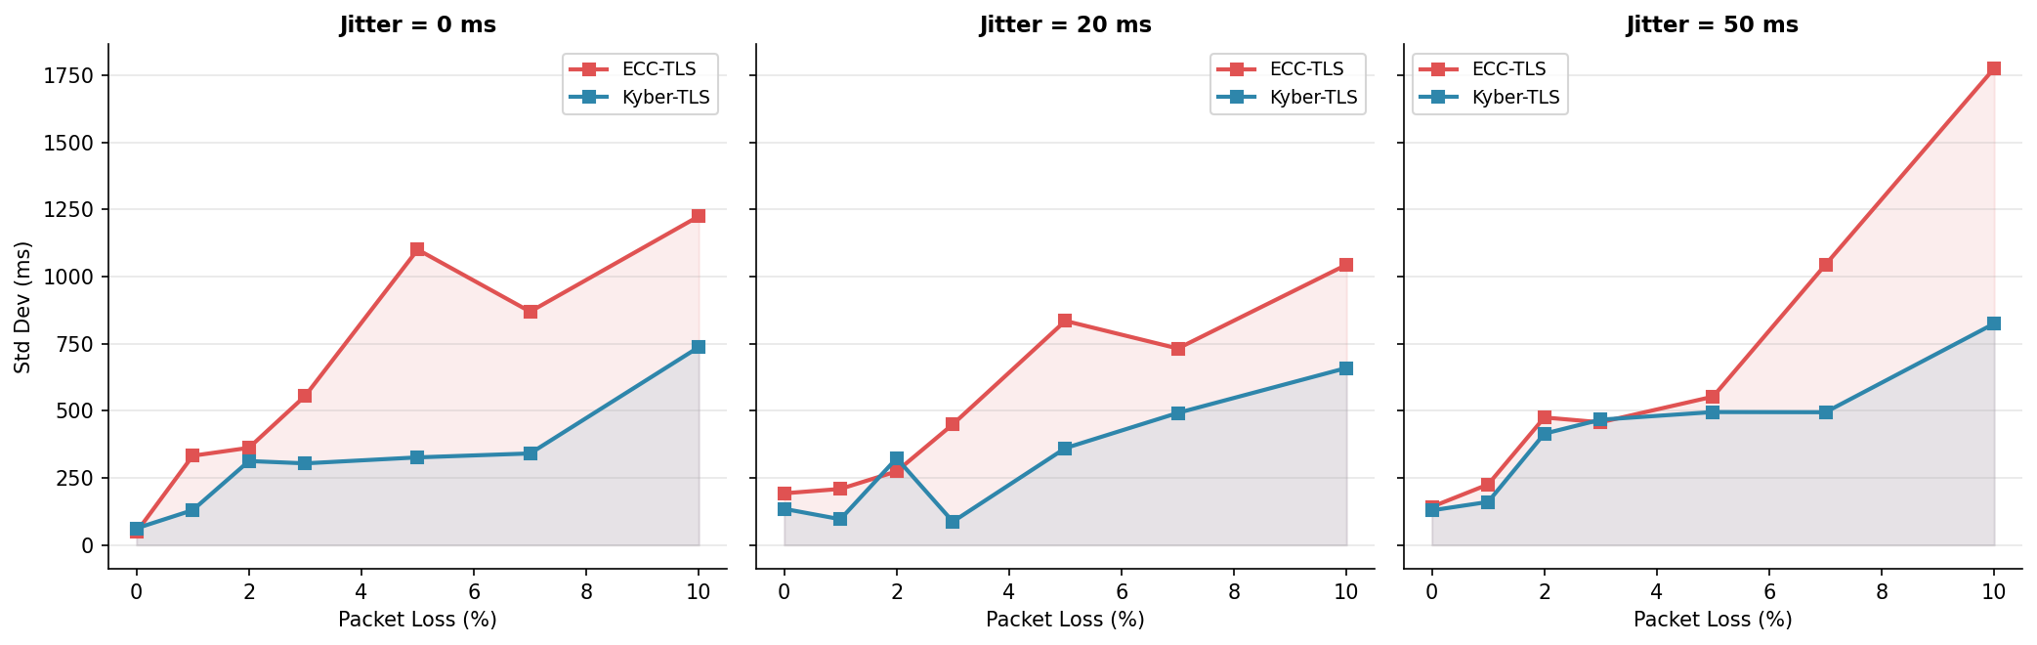
Variance (Std Dev) vs. Packet Loss — Predictability
ECC-TLS σ at 10% loss with 50ms jitter = 1,776 ms vs. Kyber-TLS 825 ms — 2.15× more unpredictable.

Slide 17
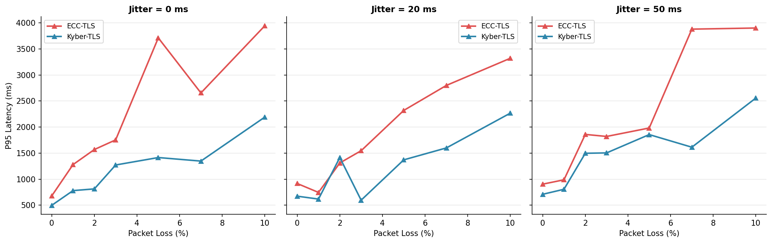
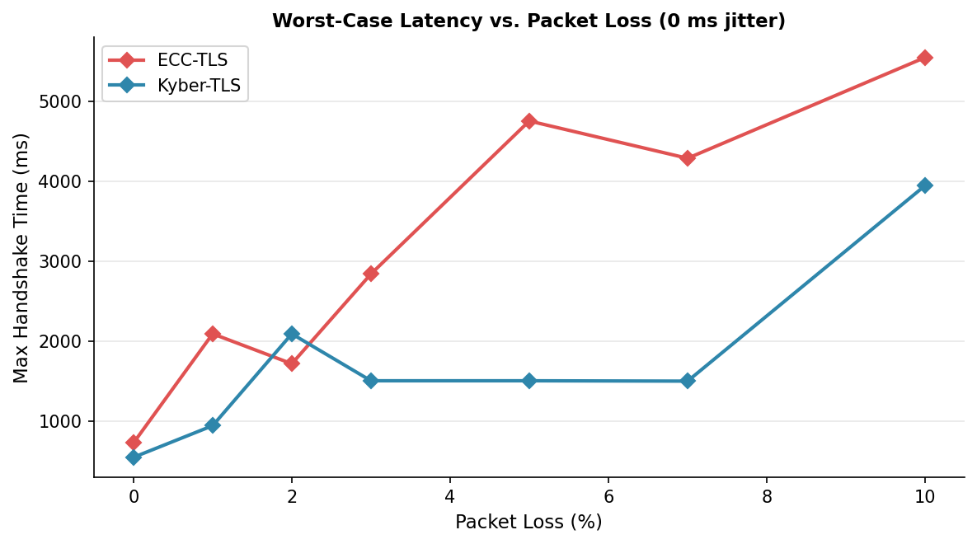
P95 Latency & Worst-Case Latency vs. Packet Loss
95th Percentile Latency
Worst-Case (Max) Latency

Slide 18
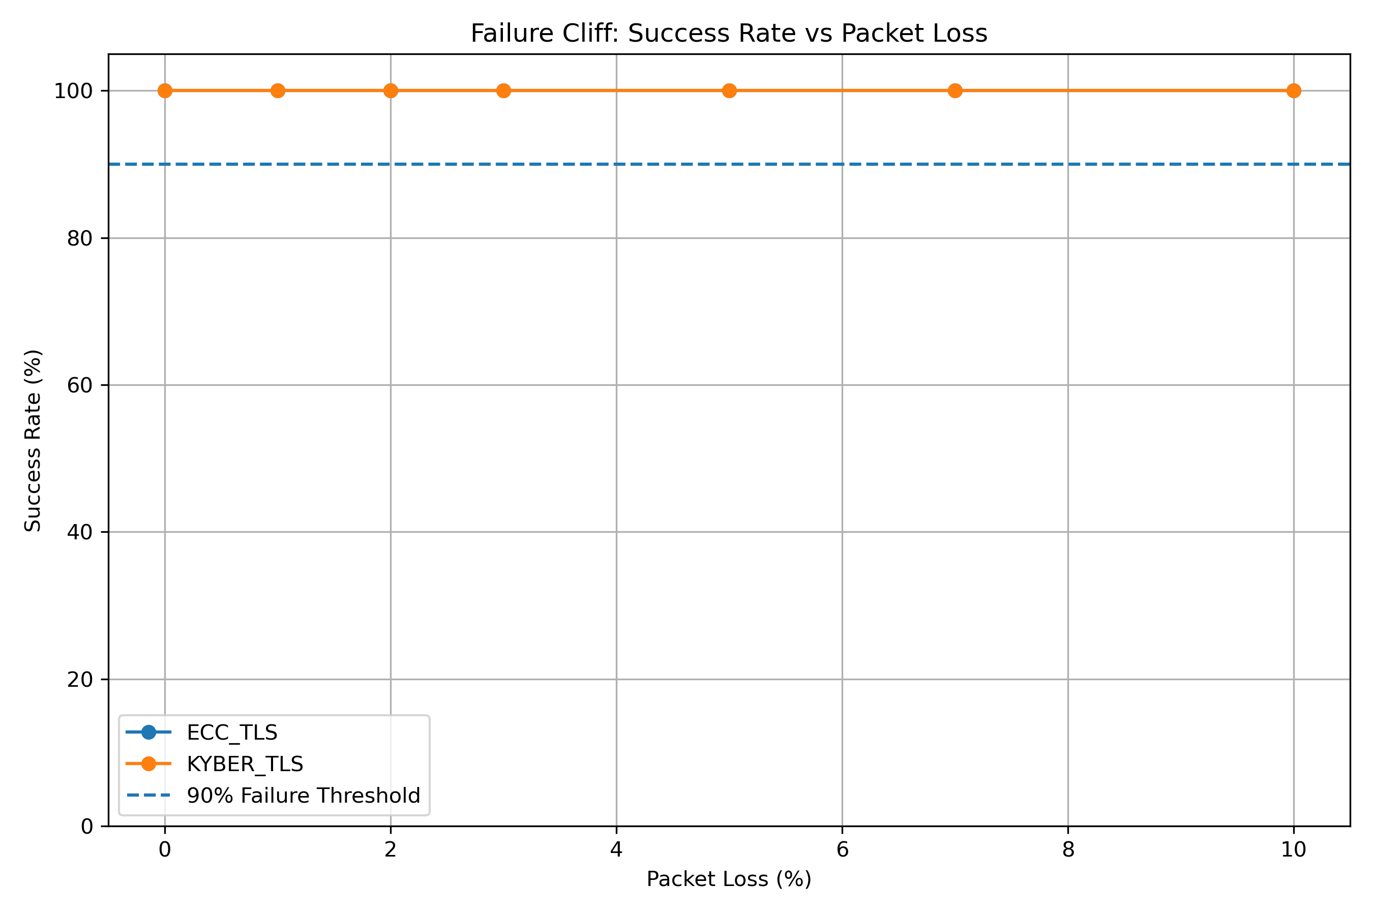
Connection Success Rate — Both Algorithms
100% success rate maintained by BOTH algorithms across all packet loss levels (0–10%). No failure cliff observed.

Slide 19
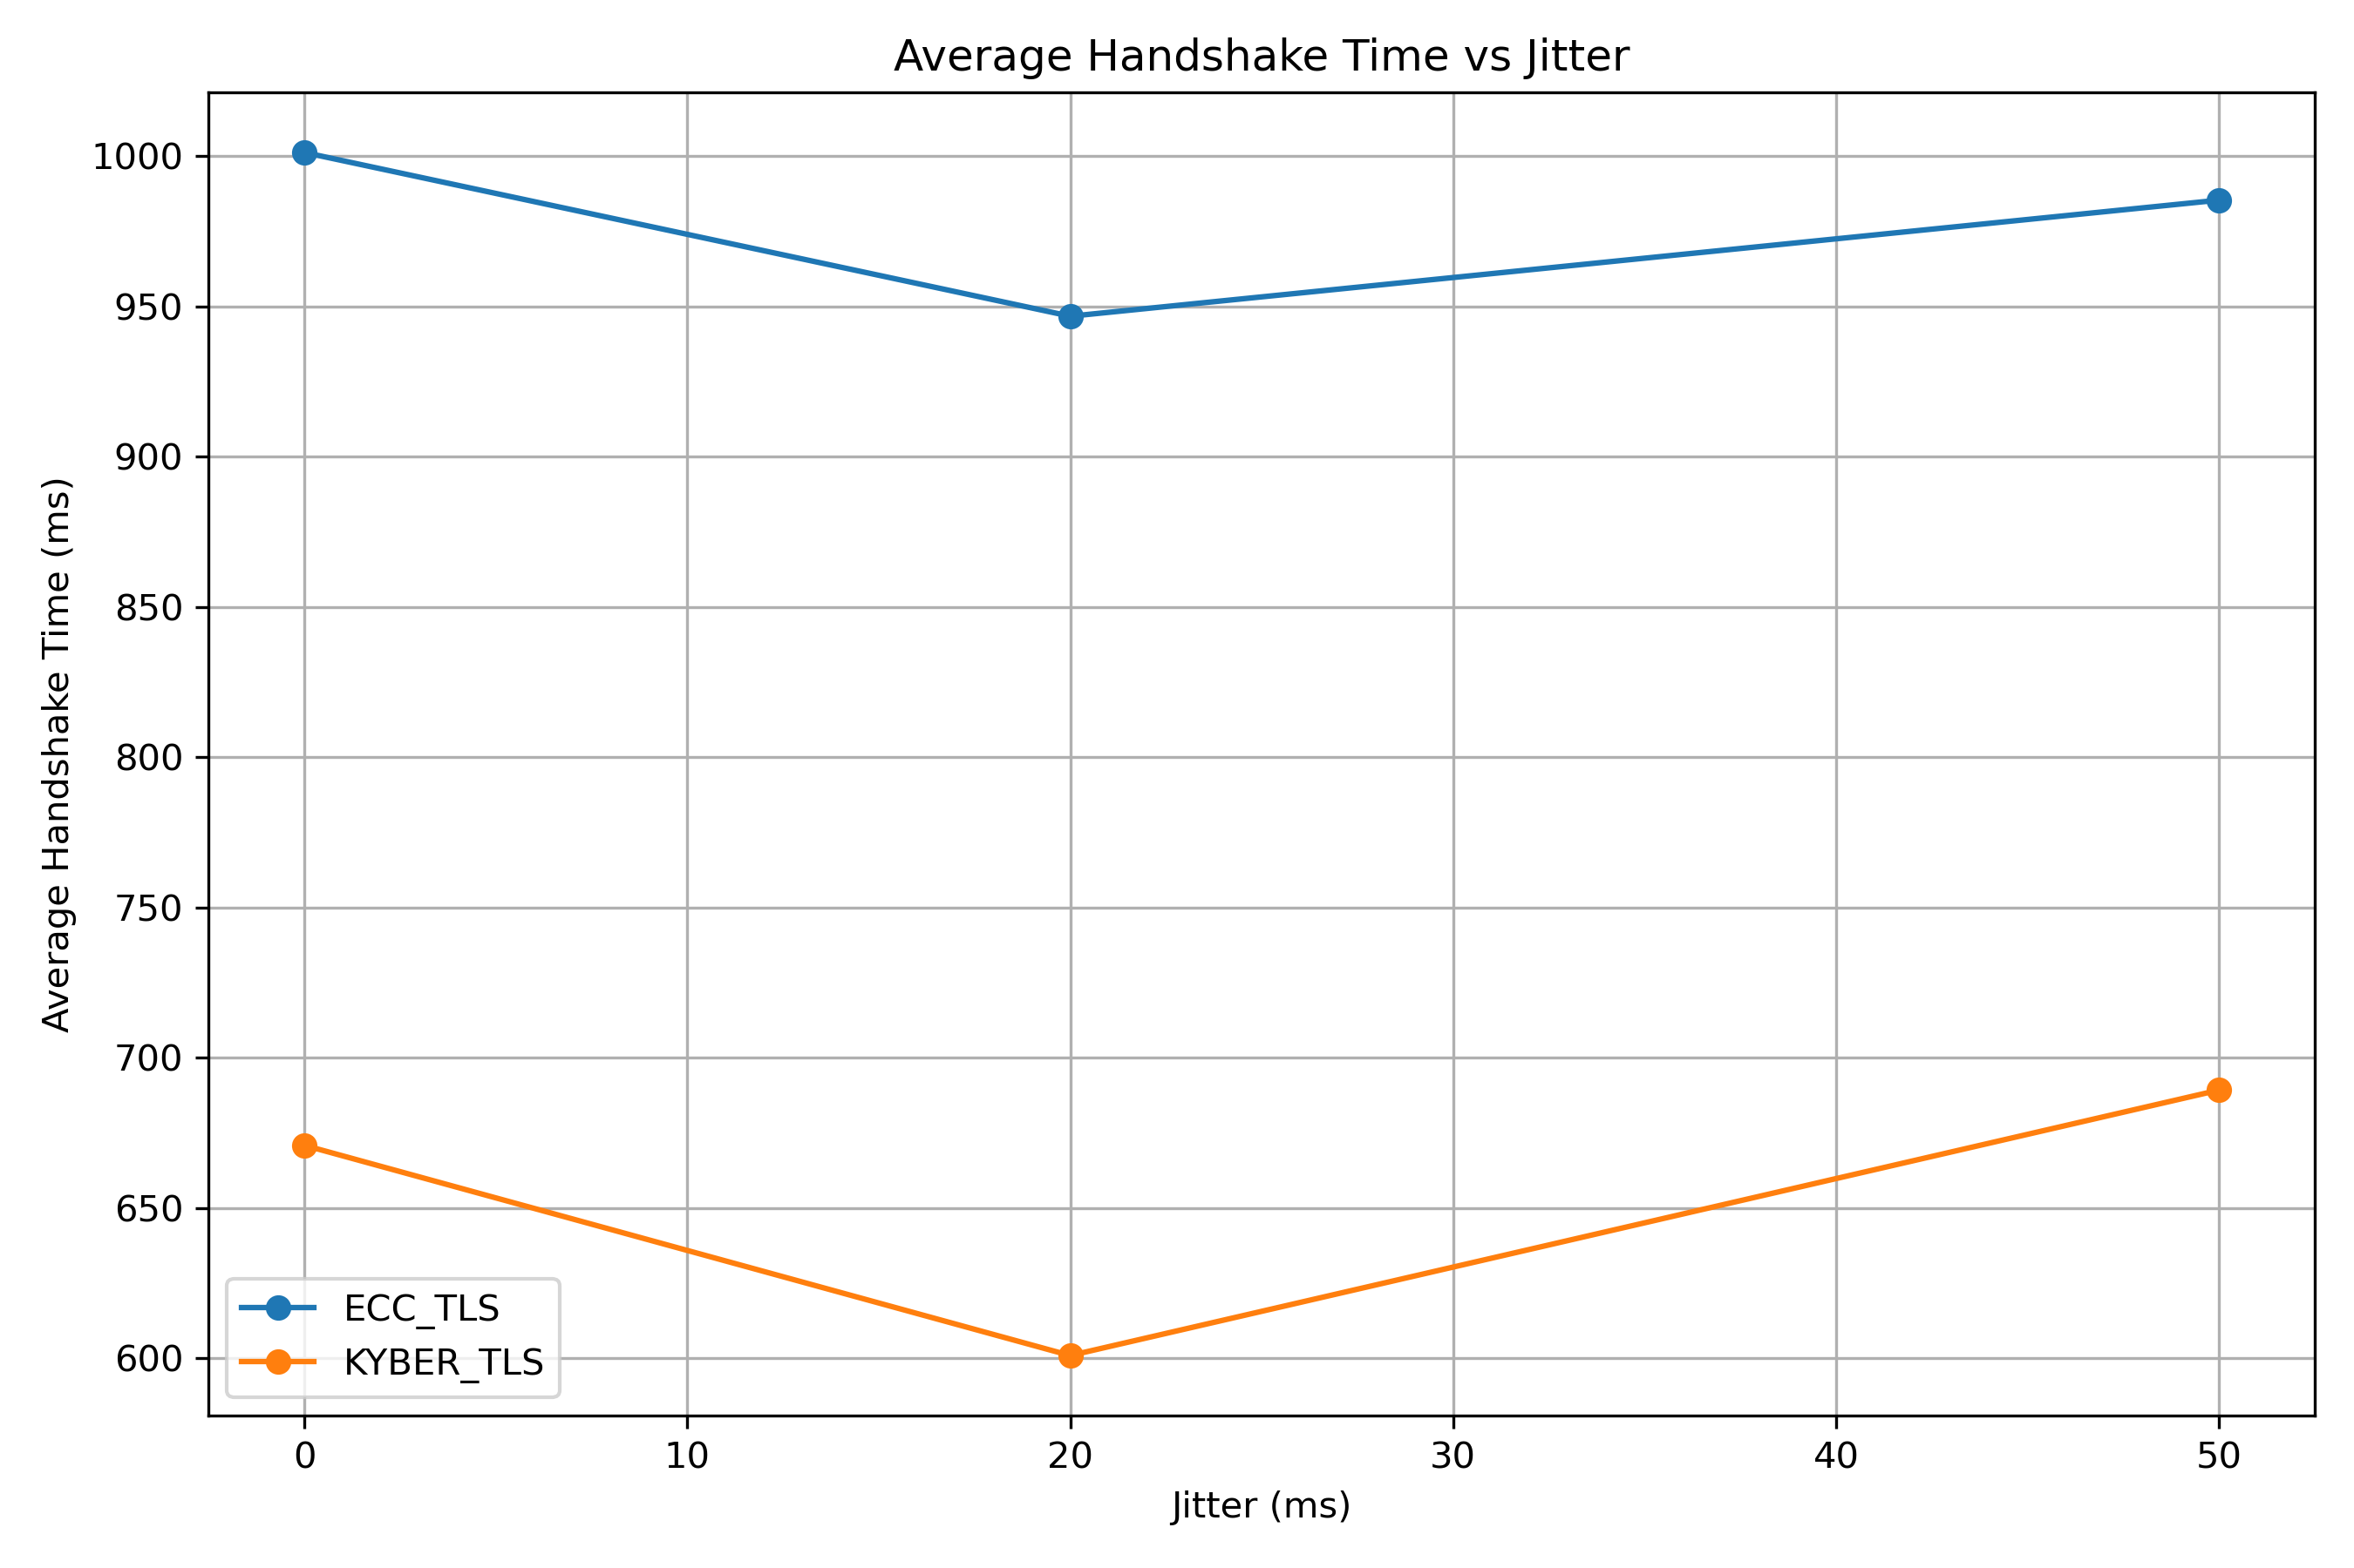
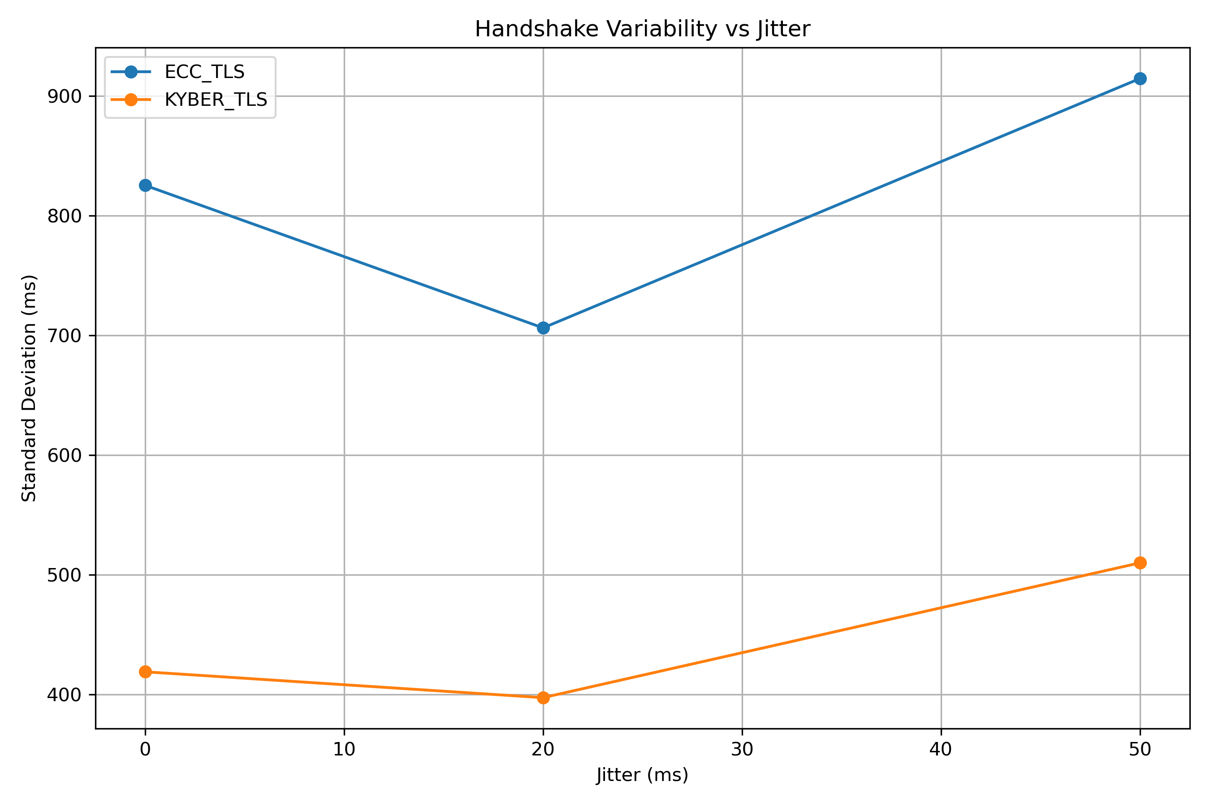
Jitter Impact — Mean & Std Dev vs. Jitter (ms)
Avg Handshake Time vs. Jitter
Std Dev vs. Jitter

Slide 20
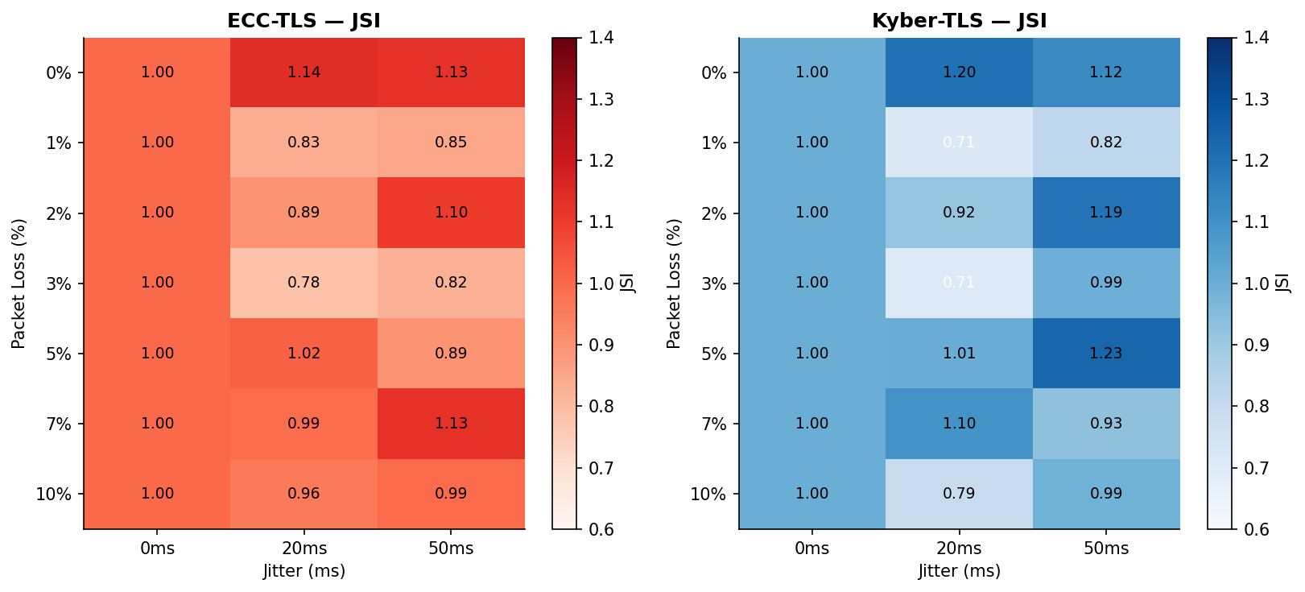
Jitter Sensitivity Index (JSI) — ECC vs. Kyber
JSI = mean(loss, jitter) / mean(loss, jitter=0). Values near 1.0 indicate jitter resilience. Both algorithms broadly JSI ≈ 0.85–1.15.

Slide 21
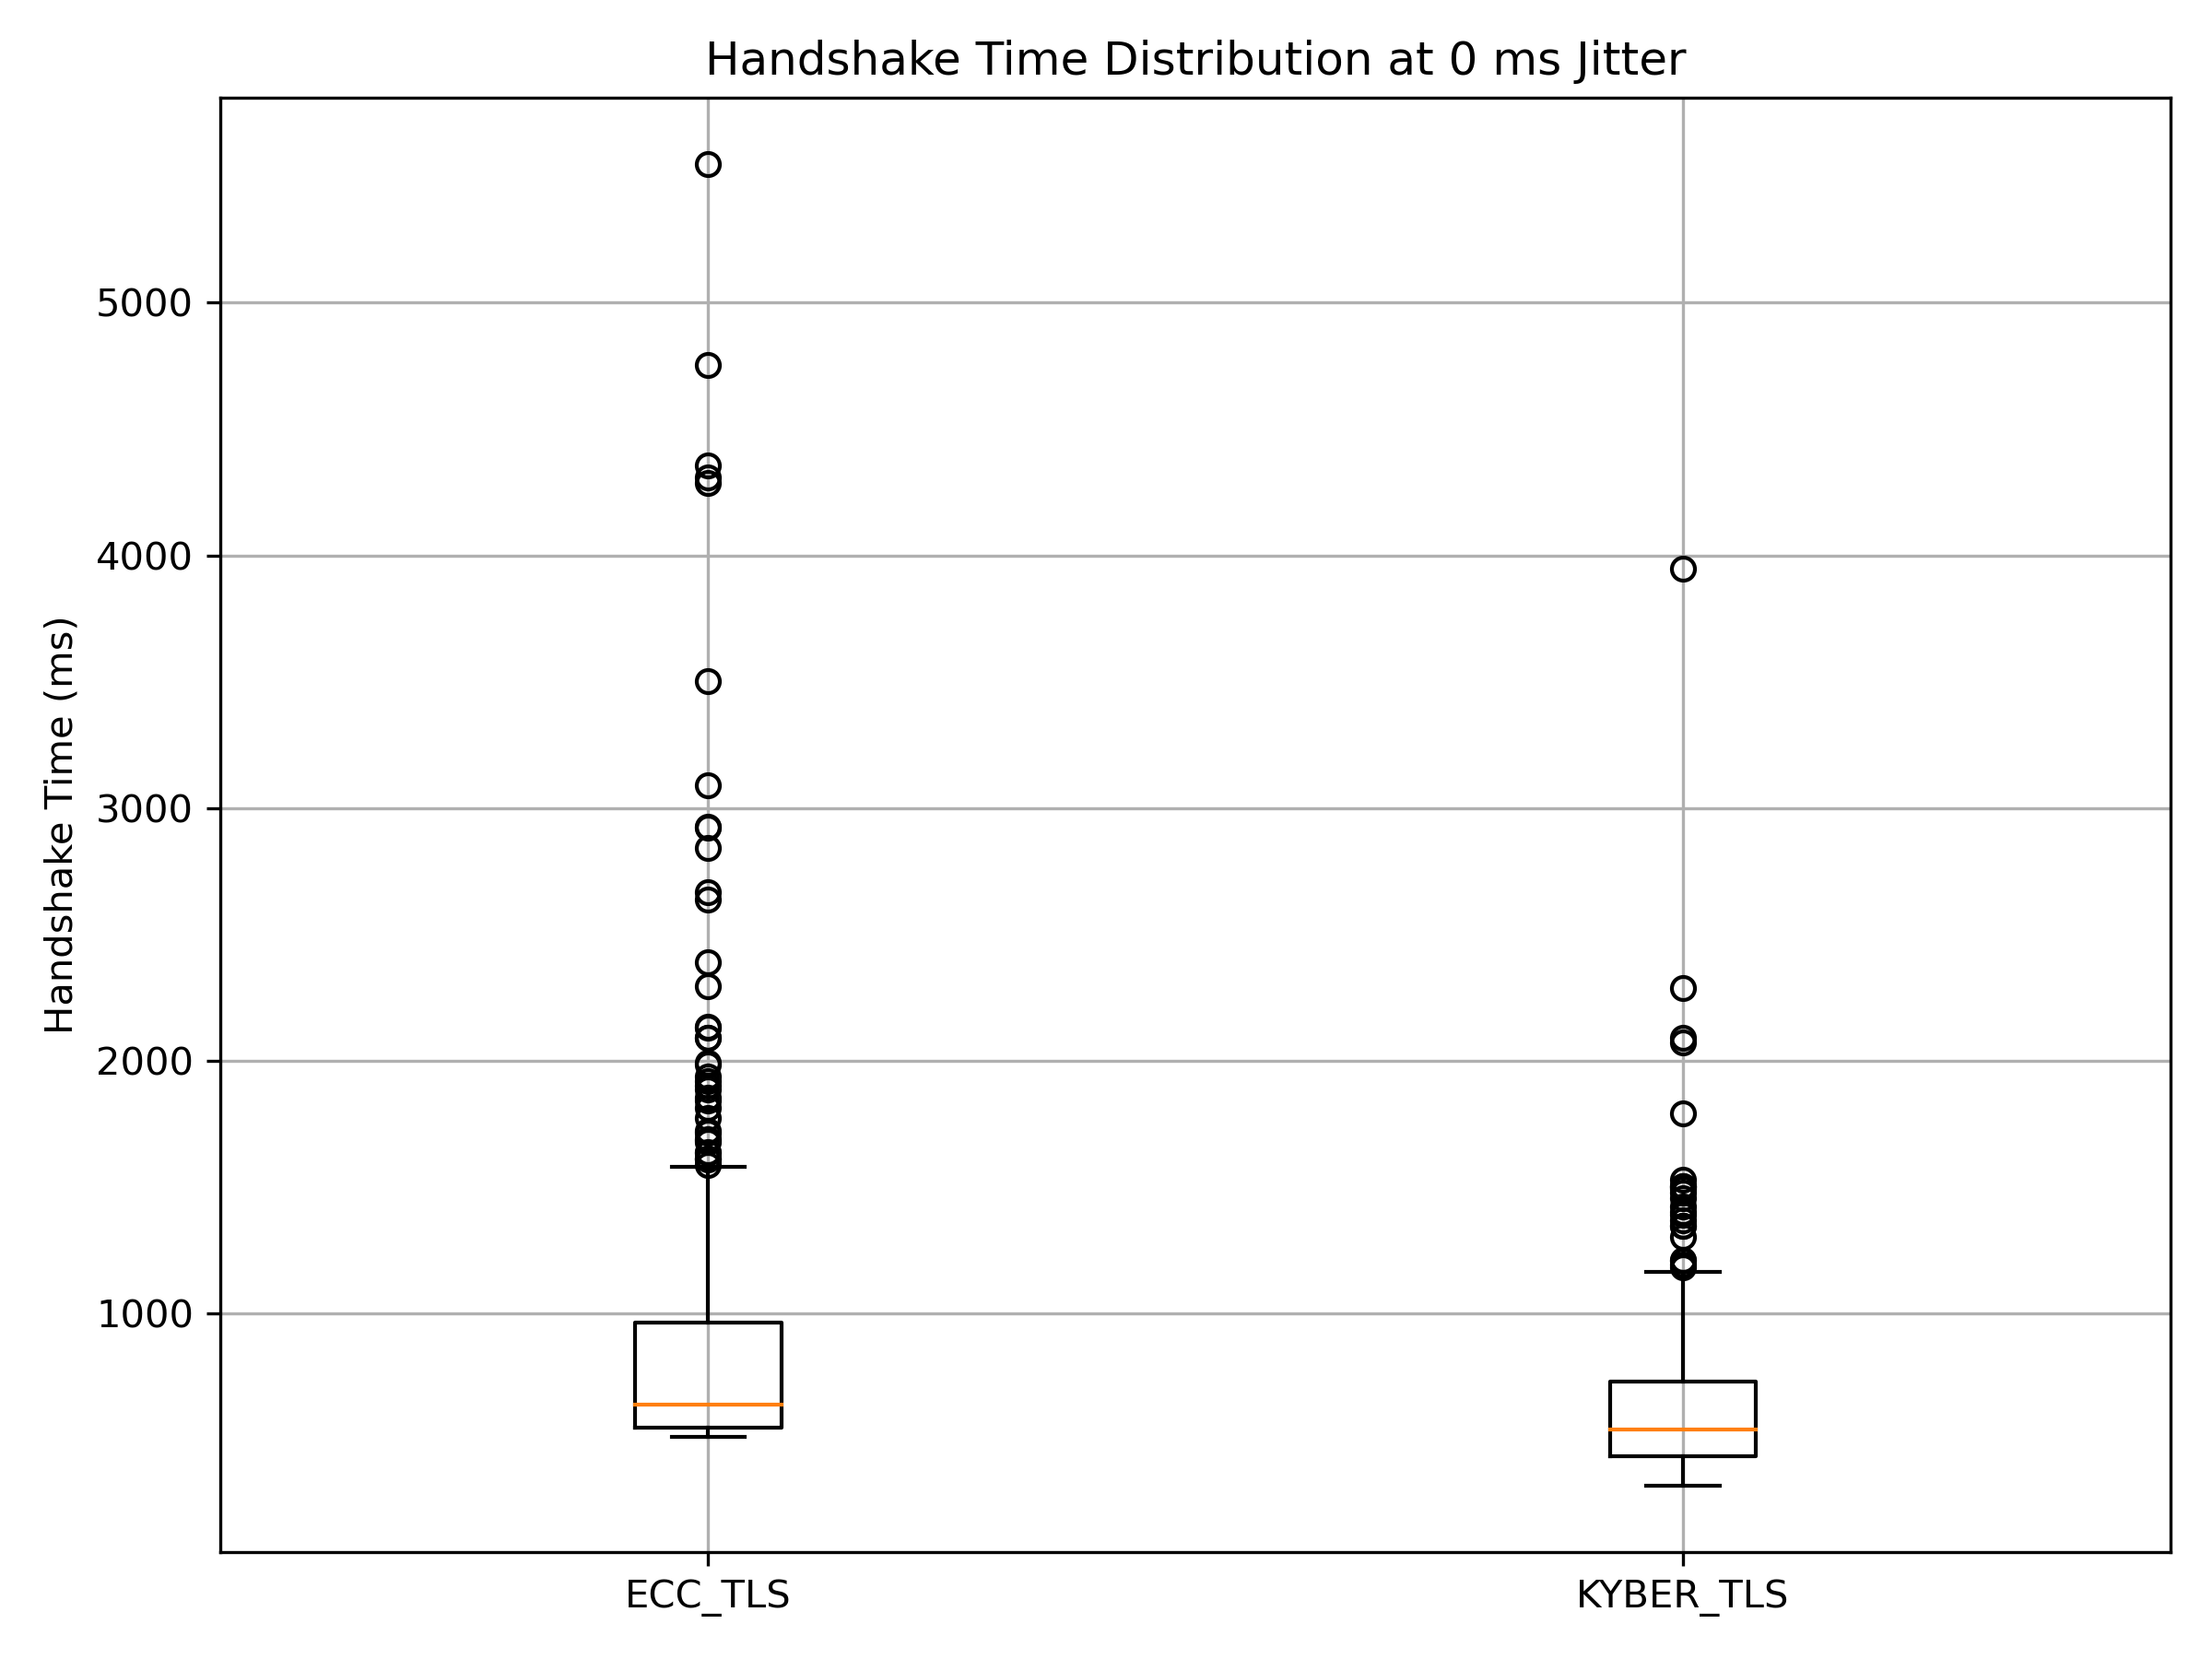
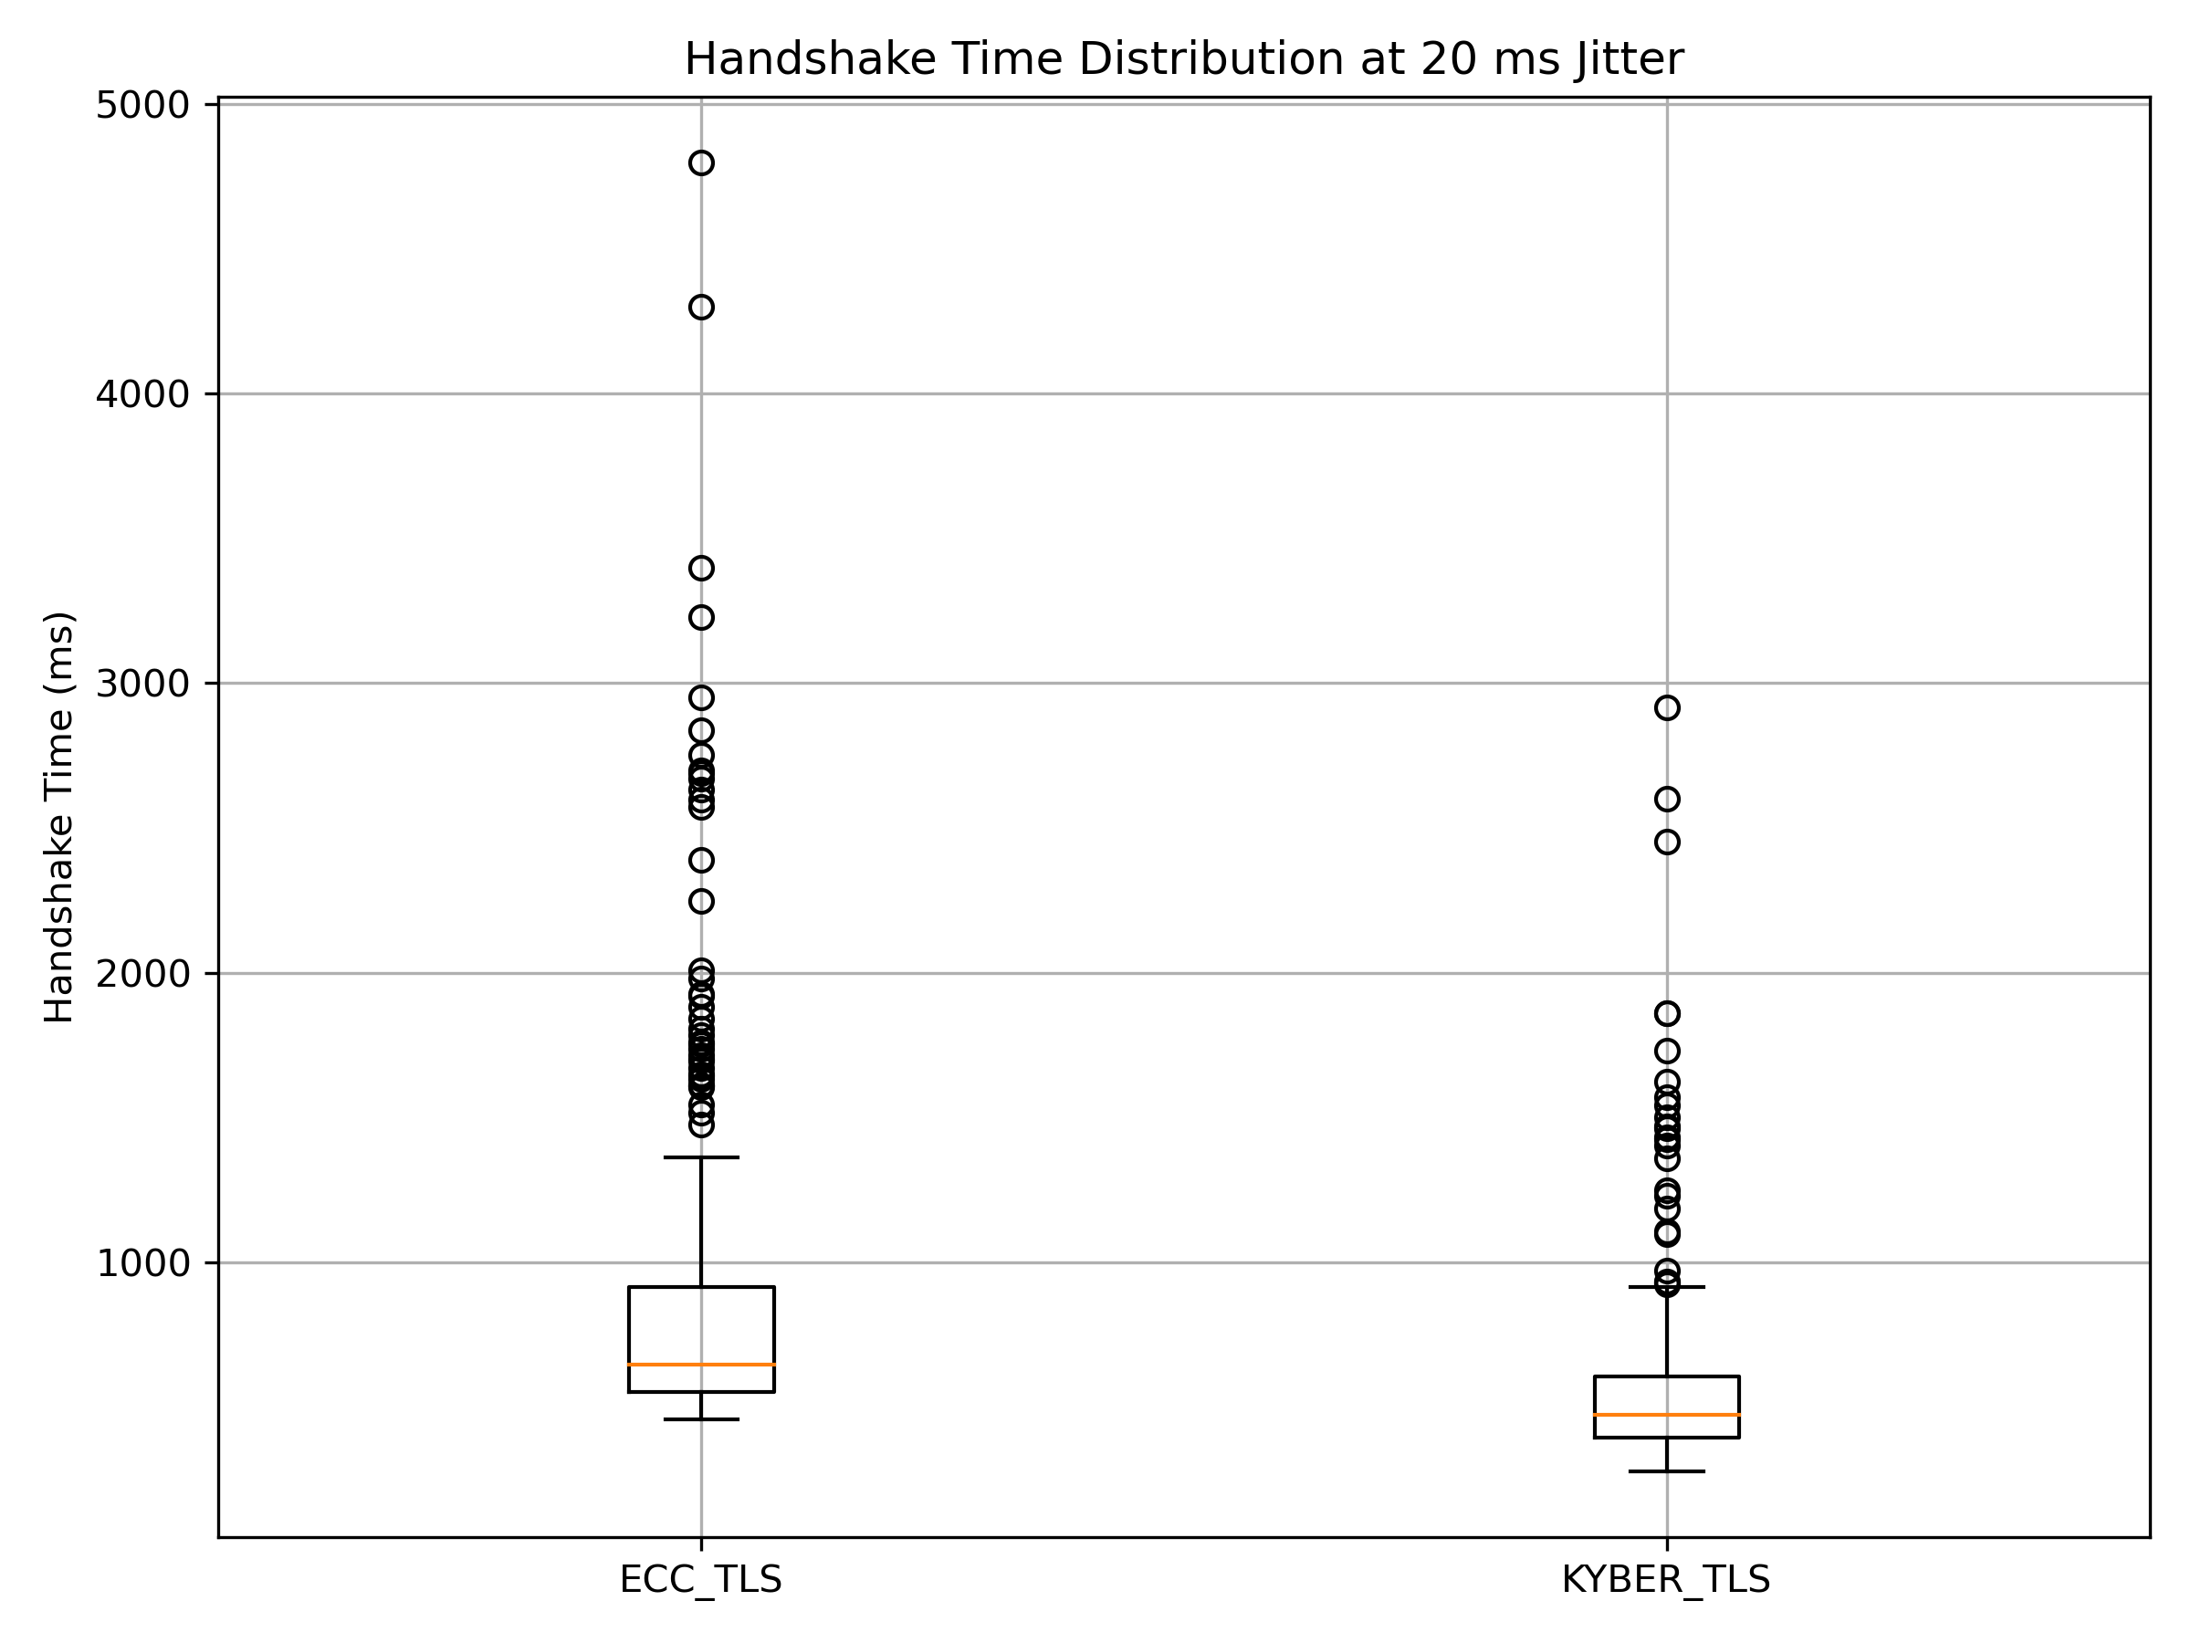
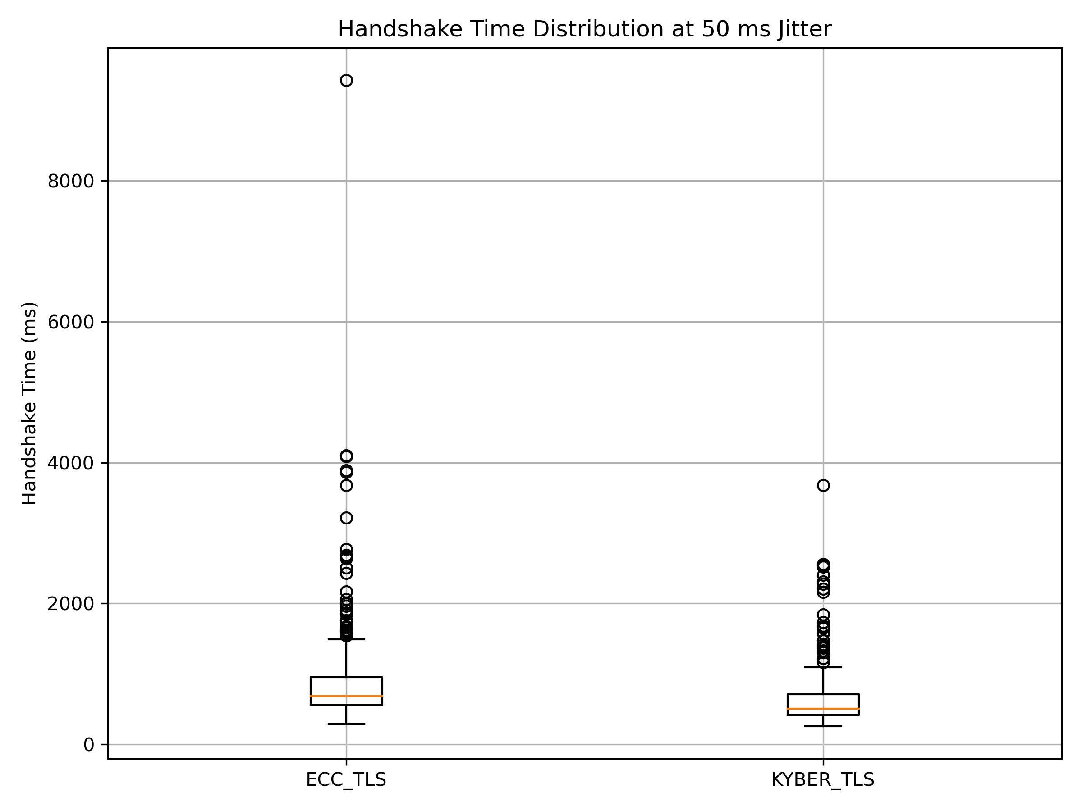
Per-Condition Boxplots — Jitter Level Comparison
0 ms Jitter
20 ms Jitter
50 ms Jitter

Slide 22
06 Key Findings & Conclusions
What the data tells us about PQC deployment readiness

Slide 23
Our Contribution vs. PQC-IoTNet Baseline [3]
Aspect
PQC-IoTNet [3]
This Work
Packet loss levels
2 (0%, 5%)
7 (0–10%)
Jitter testing
None
0, 20, 50 ms
Trials/scenario
20
30
Total trials
~80
1,260
Statistical metrics
Mean only
Mean, Median, σ, P95, Max, JSI
Success rate
Implicit
Explicit — all conditions
Failure cliff
Not identified
Not reached ≤ 10% loss

Slide 24
Key Findings
🏆 Kyber 32.4% Faster at Baseline
📈 ECC More Sensitive to Packet Loss
397.9 ms vs. 588.8 ms mean — statistically significant (p < 0.001, t = 13.26)
ECC at 10% loss: 1,696 ms mean (2.88× baseline). Kyber: 1,097 ms (2.76× baseline).
✅ 100% Success Rate — Both Algorithms
🌊 Jitter Has Minimal Independent Effect
No failure cliff observed up to 10% packet loss. Connection reliability is not the constraint.
JSI ≈ 0.85–1.15 for both. Packet loss — not jitter — drives latency degradation.
📦 Variance is the Key Differentiator
🔒 PQC Ready for IoT Deployment
ECC σ at worst condition = 1,776 ms vs. Kyber 825 ms. Kyber 2.15× more predictable.
Kyber-TLS is faster, lower-variance, and equally reliable — a clear winner for post-quantum migration.

Slide 25
Summary
Kyber-TLS Outperforms ECC-TLS
Under All Tested Conditions
32.4%
Faster
100%
Success
2.15×
More Stable
JSI ≈ 1.0
Kyber baseline
Both algorithms
up to 10% loss
Kyber variance
vs. ECC at 10%
Both algorithms
jitter-resilient
Empirical Analysis of PQC Handshake Resilience in Lossy IoT Networks
CY315 — Wireless and Mobile Security | Spring 2026 | Maisam Raza · Abdullah Ahtasham · Muhammad Shaheem

