Slide 1
Computer Science 101
Introduction to Programming with Sounds

Slide 2
Binary Representation of Signed Integers : Two’s complement system
Must have some specific number of bits.
The leftmost bit will serve as a “sign” bit.
Positives will have 0 as leftmost bit.
Negatives will have 1 as leftmost bit.
Positives will have the same representation as with unsigned except there will be 0 in leftmost bit position.

Slide 3
Two’s Complement (cont.)
Suppose we want to represent 25 as an 8-bit two’s
We have seen that the binary representation of 25 is 11001 (16 + 8 +1).
In 8-bit two’s complement we would have 00011001

Slide 4
Two’s Complement (cont.)
With N bit numbers, to compute negative (of either a positive or negative)
Invert all the bits
Add 1
Example: -25 in 8-bit two’s complement
25 ↔ 00011001
Invert bits: 11100110
Add 1: 1 11100111

Slide 5
2’s Complement: Pros and Cons
Con:
Not so easy to comprehend
Human must convert negative to identify
Pro:
Addition is exactly same as for positives No additional hardware for negatives, and subtraction.
One representation of 0

Slide 6
2’s Complement: Examples
Compute negative of -25 (8-bits)
We found -25 to be 11100111
Invert bits: 00011000
Add 1: 00011001
Recognize this as 25 in binary
Add -25 and 37 (8-bits)
11100111 (-25) + 00100101 ( 37) (1)00001100
Recognize as 12

Slide 7
2’s complement to decimal (examples)
Assume we’re using 8-bit 2’s complement:
X = 11011001 -X = 00100110 + 1 = 00100111 = 32+4+2+1 = 39 (decimal) So, X = -39
X = 01011001 Since X is positive, we have X = 64+16+8+1 = 89

Slide 8
Ranges for N-bit numbers
Unsigned (positive)
0000…00 or 0
1111…11 which is 2^{N}-1
For N=8, 0 – 255
2’s Complement
1000…00 which is -2^{N-1}
0111…11 which is 2^{N-1} - 1
For N=8, -128 to 127

Slide 9
Logarithms (Base 2)
Definition. The logarithm to base 2 of n is that number k such that 2^{k}=n.
Example: 2⁵=32 so Lg(32)=5.
Another way to think of this is that Lg(n) is the number of times we must divide n by 2 until we get 1.
Note: Lg(n) is usually a fraction, but the closest integer will work for us.

Slide 10
Base 2 Logarithms - Table
n Lg(n) n Lg(n) 1 0 1024 10 2 1 2048 11 4 2 4096 12 8 3 8192 13 16 4 1,048,576 20 32 5 64 6 128 7 256 8 512 9

Slide 11
Logarithms (Base 10)
Definition. The logarithm to base 10 of n is that number k such that 10^{k}=n. Logarithms to base 10 are often called common logarithms and are denoted by log.
Example: 10³=1000 so Log(1000)=3.
Another way to think of this is that Log(n) is the number of times we must divide n by 10 until we get 1.

Slide 12
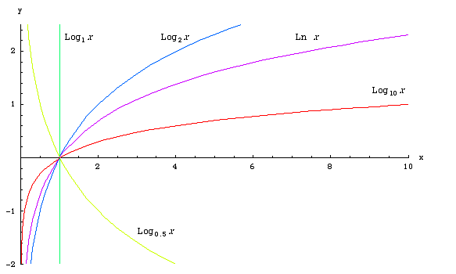

Slide 13
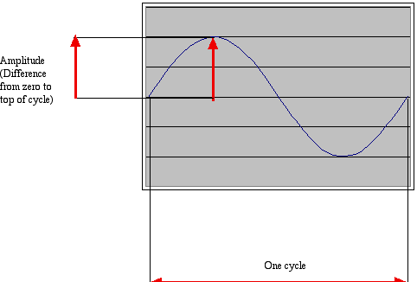
How sound works: Acoustics, the physics of sound
Sounds are waves of air pressure
Sound comes in cycles
The frequency of a wave is the number of cycles per second (cps), or Hertz
Complex sounds have more than one frequency in them.

Slide 14
How sound works: Acoustics, the physics of sound
Sounds are waves of air pressure
The amplitude is the maximum height of the wave

Slide 15
Volume Psychoacoustics, the psychology of sound
Our perception of volume is related (logarithmically) to changes in amplitude
Decibels give a logarithmic measure of ratio of volume relative to a base volume – roughly the least volume detectable by human ear – 0 dB
The decibel measure for a volume, v, is given by dB(v) = 10 log(v/v₀) where v₀ is the base volume.

Slide 16
Volume
dB(v) = 10 log(v/v₀)
If we increase volume 10-fold: db(10 v) = 10 log(10v/v₀) = 10(log10 + log(v/v₀)) = 10 + 10 log(v/v₀) = 10 + dB(v) so multiplying volume by 10 only adds 10 decibels.
Doubling adds about 3 decibels.

Slide 17
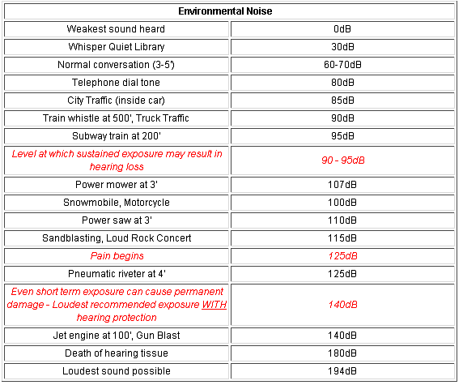

Slide 18
Pitch: Psychoacoustics, the psychology of sound
Our perception of pitch is related (logarithmically) to changes in frequency
Higher frequencies are perceived as higher pitches
We can hear between 5 Hz and 20,000 Hz (20 kHz)
A above middle C is 440 Hz

Slide 19
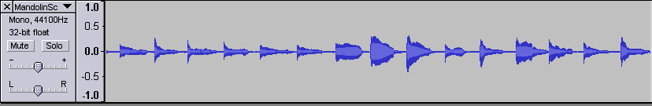
Mandolin Scale

Slide 20
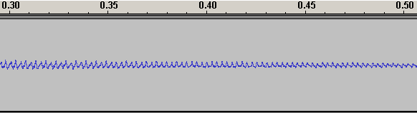
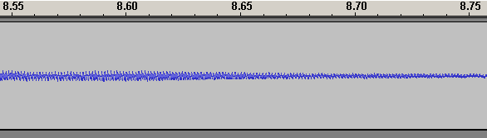
Mandolin Scale (Low G, High F#)

Slide 21
Digitizing Sound
Computer hardware can measure the amount of air pressure against a microphone, at any moment, as a single number. This is referred to as analog to digital conversion (ADC).
But sound is continuously changing; so how do we digitize this?

Slide 22
Digitizing Sound
The idea is to approximate the continuous sound by having many “sample” values giving discrete sound intervals. How many?
Note this is quite analogous to using discrete pixels in pictures.

Slide 23
Nyquist Theorem
We need twice as many samples as the maximum frequency in order to represent (and recreate, later) the original sound.
The number of samples recorded per second is the sampling rate
If we capture 8000 samples per second, the highest frequency we can capture is 4000 Hz
That’s how phones work
If we capture more than 44,000 samples per second, we capture everything that we can hear (max 22,000 Hz)
CD quality is 44,100 samples per second

Slide 24
Nyquist Theorem
We need twice as many samples as the maximum frequency in order to represent (and recreate, later) the original sound.
The number of samples recorded per second is the sampling rate.
If we capture 8000 samples per second, the highest frequency we can capture is 4000 Hz
That’s how phones work
If we capture more than 44,000 samples per second, we capture everything that we can hear (max 22,000 Hz)
CD quality is 44,100 samples per second

Slide 25
Samples
Each sample will be a 16-bit 2’s complement signed number.
Range: -2^{N-1} to -2^{N-1} – 1 or -32768 to 32767

Slide 26
Sound Picture (Analogies)
Both discrete models of continuous objects makePicture and makeSound list of Pixels and list of Samples getPixel and getSampleAt explore and explore setSampleValueAt and setColor getColor and getSampleValue getPixels and getSamples Etc.

Slide 27
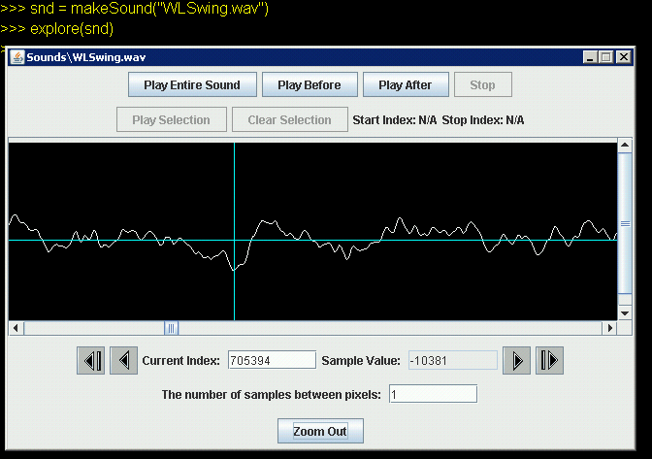

Slide 28
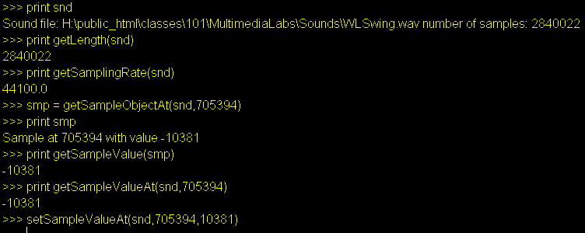
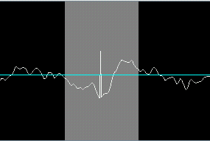

Slide 29
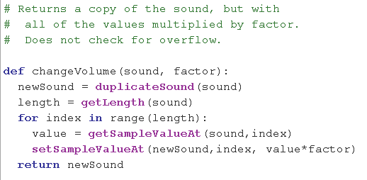
Change Volume

Slide 30
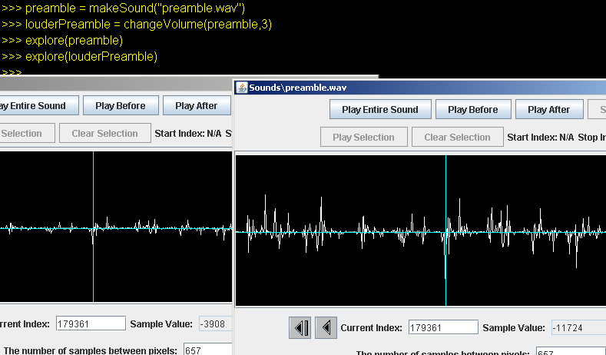

Slide 31
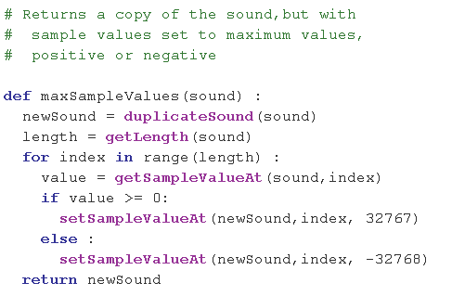
Maximizing Sample Values

Slide 32
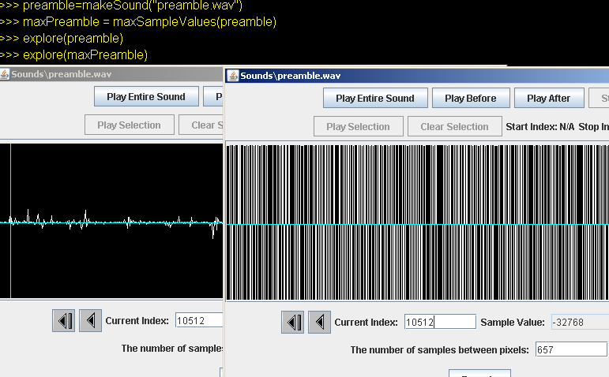

Slide 33
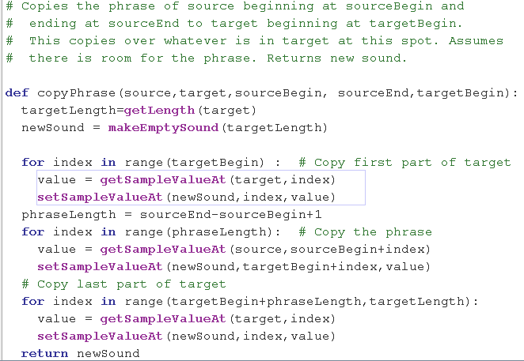
Copy a Phrase

Slide 34
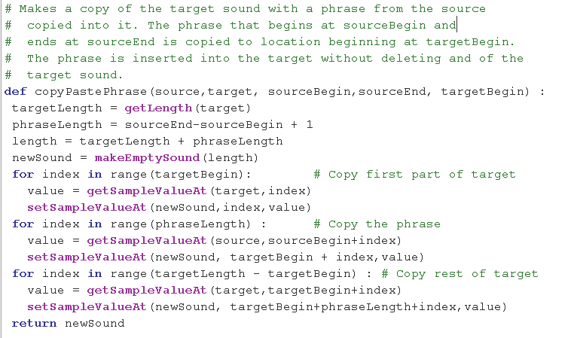
Copy and Paste

Slide 35
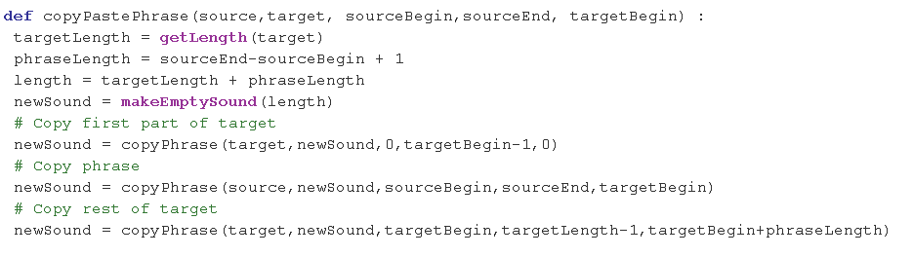
Shorter Version (slower)

Slide 36
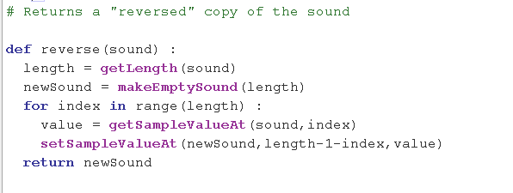
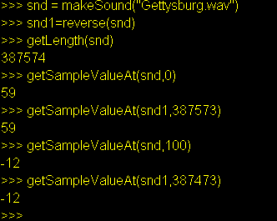
Reverse Sound

Slide 37
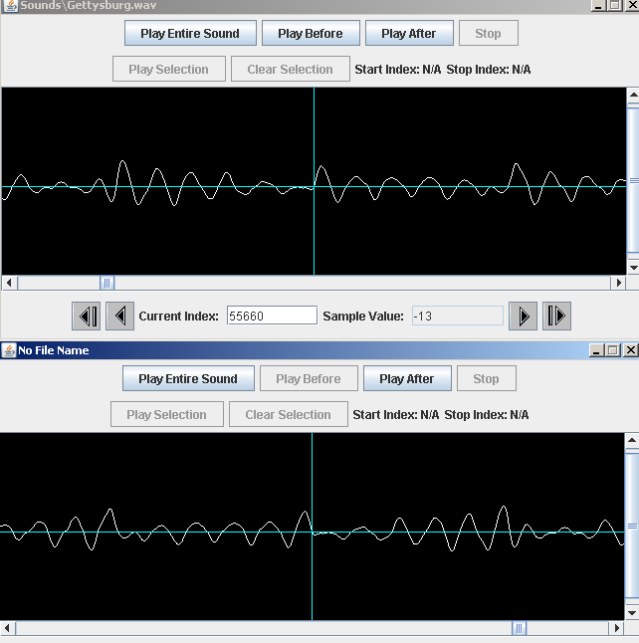

Slide 38
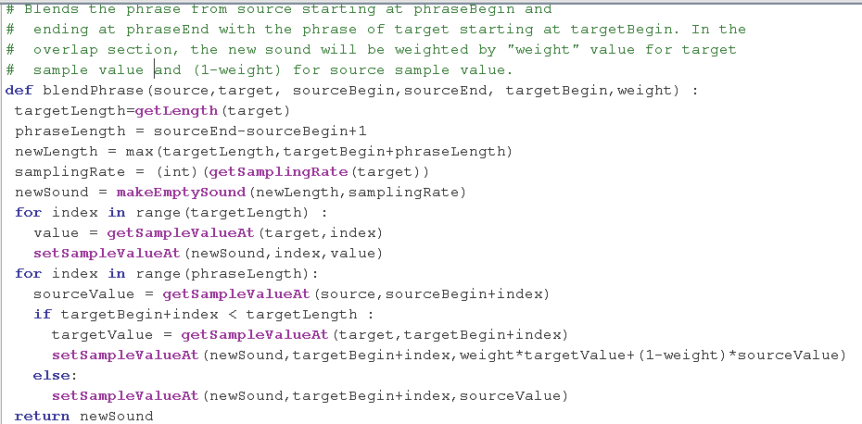
Blend Sounds

Slide 39
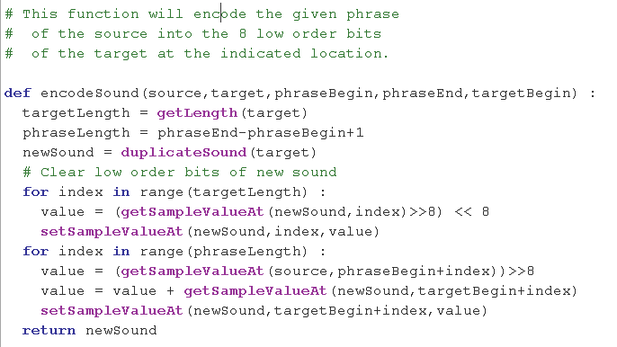
Encode Sound

Slide 40
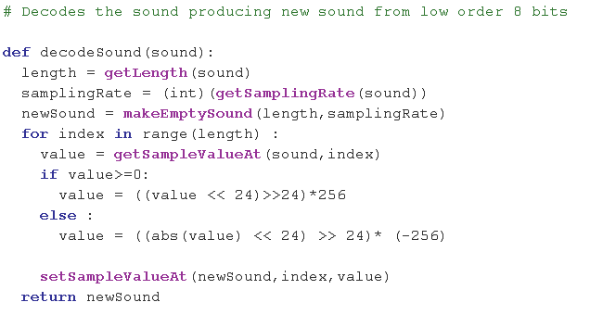
Decode Sound

