Slide 1

Diabetes Prediction: Identifying Key Factors
This presentation explores the key factors influencing diabetes risk, using a dataset of medical attributes. We will delve into the dataset, analyze its features, and apply machine learning to predict the likelihood of diabetes.
NS
by Nazeema Shaheen Sultana

Slide 2
Understanding the Dataset
Data Overview
Attributes
The dataset contains 768 instances, each representing a patient. Each instance has 9 attributes.
These attributes include demographic and medical factors, like age, glucose levels, and family history.

Slide 3
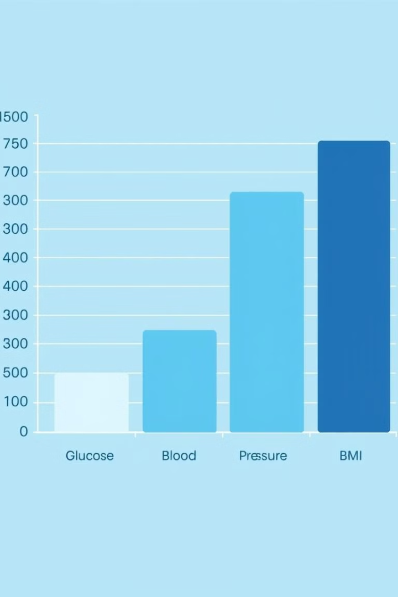
Feature Exploration: Numeric Attributes
Pregnancies
Glucose
The number of times a woman has been pregnant.
Plasma glucose concentration measured during an oral glucose tolerance test.
Blood Pressure
Skin Thickness
Diastolic blood pressure measured in millimeters of mercury.
Triceps skin fold thickness, a measure of body fat.

Slide 4
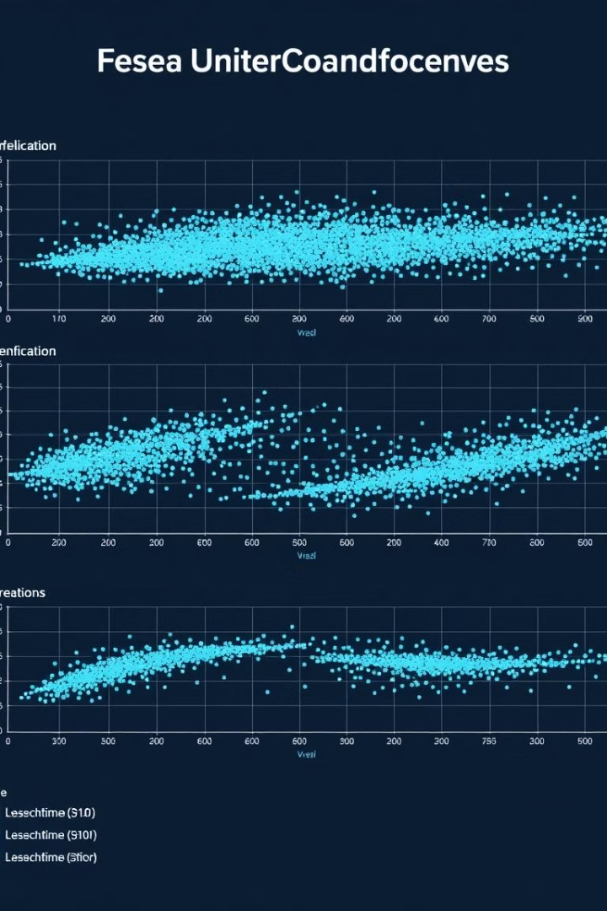


Correlations and Relationships
Glucose and Insulin
BMI and Insulin
A strong positive correlation suggests that higher glucose levels are associated with higher insulin levels.
Another positive correlation indicating a link between body mass index and insulin levels.

Slide 5
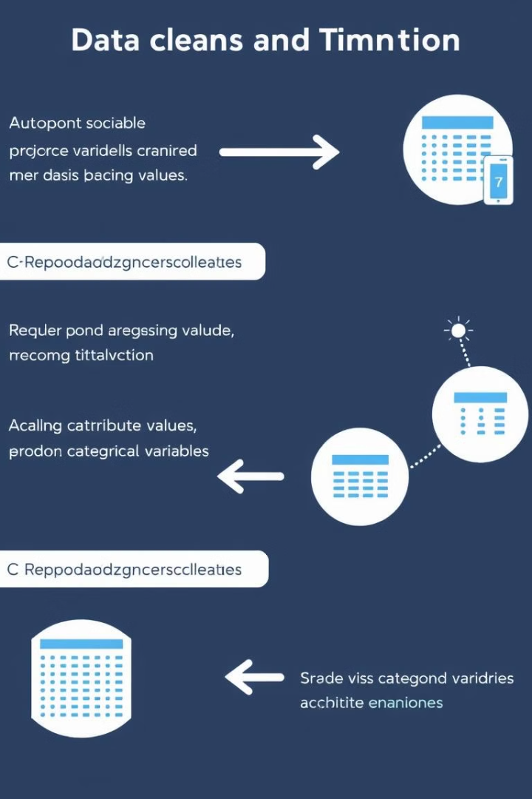
Preparing the Data for Analysis
1
Data cleaning: Addressing missing values, outliers, and inconsistencies in the dataset.
2
Feature scaling: Normalizing the range of numeric attributes to improve model performance.
3
Data splitting: Dividing the dataset into training and testing sets to evaluate model accuracy.

Slide 6




Applying Machine Learning Models
Logistic Regression
A linear model that estimates the probability of diabetes.
Decision Tree
A tree-based model that uses a series of rules to classify instances.
Support Vector Machine (SVM)
A powerful algorithm that finds the optimal hyperplane to separate classes.

Slide 7
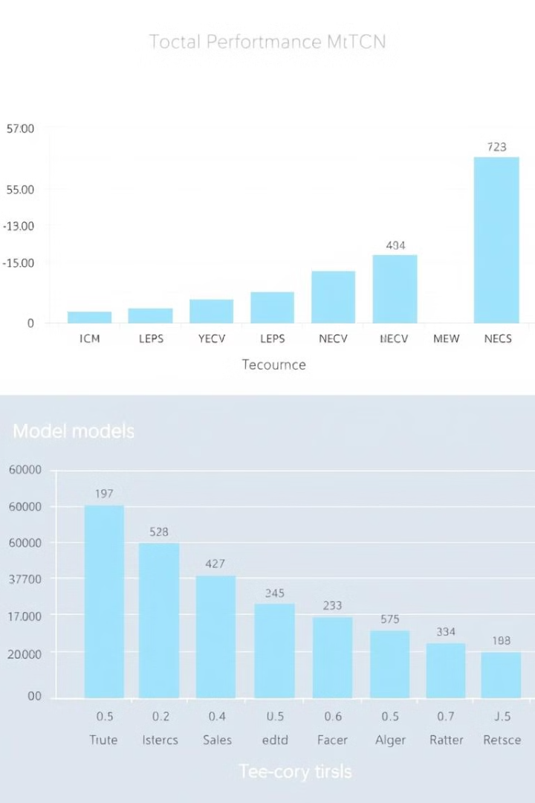
Evaluating Model Performance
0.75
0.80
Accuracy
Precision
The proportion of correctly predicted instances.
The ratio of correctly predicted positive instances to all predicted positive instances.

Slide 8

Insights and Next Steps
The analysis reveals that several factors contribute to diabetes risk, including glucose levels, BMI, and family history. These insights can guide interventions to prevent or manage diabetes.

