Slide 1
Data Analytics Project
Student Mathematics Performance Analytics
Team: [Shaheen Khan – 250301370263] · [Lipsha Dash – 250301370277]·
[Swadhin Kumar Lenka – 250301370290] ·[Sushree Adyasha Parida – 250301370292]
[Nibedita Sahoo – 250301370295]
[Data Analysis and Visualization using Python] · [Faculty name- Chandra Sekhar Jena] · [Semester-3]

Slide 2
Introduction & Problem Statement
Domain
Problem
Goal
Education & Academic Data Analytics
Identifying demographic, social and study-related factors that lead to poor academic performance
A data-driven foundation for early educational intervention

Slide 3
Dataset Description
Source
Size
UCI Machine Learning Repository / Kaggle (student-mat.csv)
395 rows × 33 columns
Demographics
Study habits
Grades
age, address
studytime, absences
G1, G2, G3

Slide 4
Data Cleaning & Preprocessing
Data Loading & Inspection
What this step does
Loads student-mat.csv (semicolon-separated) into a Pandas DataFrame
Checks the dataset shape: 395 rows × 33 columns
Previews the first 5 rows with head()
Reviews column types and non-null counts with info()
Summarises every numeric column with describe()
import pandas as pd
df = pd.read_csv("student-mat.csv", sep=";")
print("Dataset loaded successfully!")
print("\nDataset Shape:", df.shape)
print("\nFirst 5 Rows:")
display(df.head())
print("\nDataset Information:")
df.info()
print("\nStatistical Summary:")
display(df.describe())

Slide 5
Data Cleaning & Preprocessing
Data Cleaning & Standardization
Missing values
Median fill for age, absences, G3; mode fill for sex, address
Formats
Lowercase and trim text; f/m → female/male, u/r → urban/rural
Duplicates
Detect repeated rows and drop them, keeping the first
Data types
Cast age, absences and G3 to int64
Outliers
Drop rows with Z-score > 3 on age, absences, G3
import pandas as pd
#Handling Missing Values
print("Missing values percentage:\n", df.isnull().sum() / len(df) * 100)
age_median = int(df['age'].dropna().astype('int64').median())
absences_median = int(df['absences'].dropna().astype('int64').median())
g3_median = int(df['G3'].dropna().astype('int64').median())
df.fillna({'age': age_median, 'absences': absences_median, 'G3': g3_median}, inplace=True)
sex_mode = df['sex'].mode()[0]
address_mode = df['address'].mode()[0]
df.fillna({'sex': sex_mode, 'address': address_mode}, inplace=True)
print("\nMissing values after treatment:\n", df.isnull().sum())
#Fixing Inconsistent Formats
print("Unique 'sex' values before cleaning:", df['sex'].unique())
df['sex'] = df['sex'].str.lower().str.strip()
df['address'] = df['address'].str.lower().str.strip()
df.replace({'sex': {'f': 'female', 'm': 'male'}}, inplace=True)
df.replace({'address': {'u': 'urban', 'r': 'rural'}}, inplace=True)
print("Unique 'sex' values after cleaning:", df['sex'].unique())
print("Formats standardized.")
print("***Handling Duplicates***")
print("Duplicates found:", df[df.duplicated()].shape[0])
df.drop_duplicates(keep='first', inplace=True)
print("Dataset shape after duplicate removal:", df.shape)
print("***Correcting datatype***")
df['age'] = df['age'].astype('int64')
df['absences'] = df['absences'].astype('int64')
df['G3'] = df['G3'].astype('int64')
print(df[['age', 'absences', 'G3']].dtypes)
import numpy as np
from scipy import stats
print("***Handling Outliers***")
z_scores = np.abs(stats.zscore(df[['age', 'absences', 'G3']]))
df_clean = df[~(z_scores > 3).any(axis=1)]
print("Cleaned dataset shape:", df_clean.shape)

Slide 6
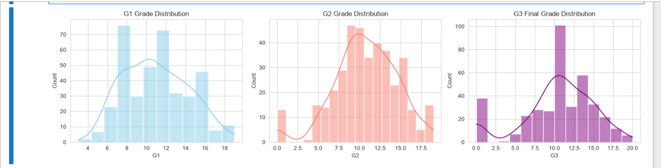
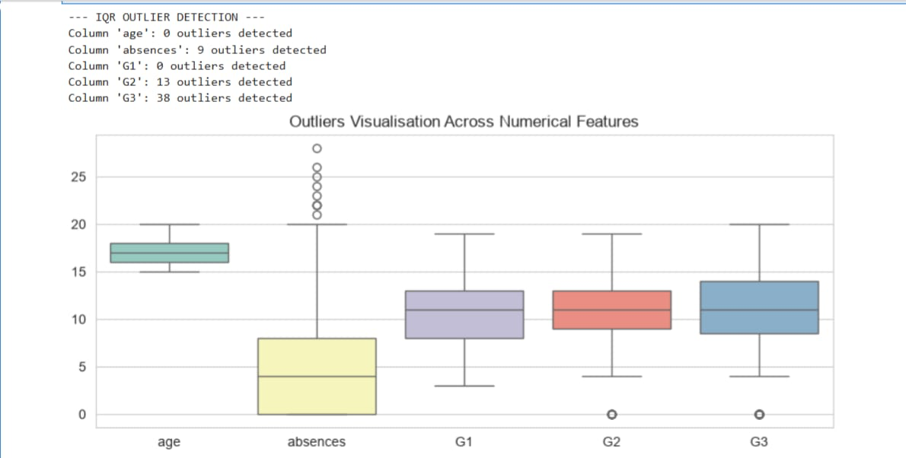
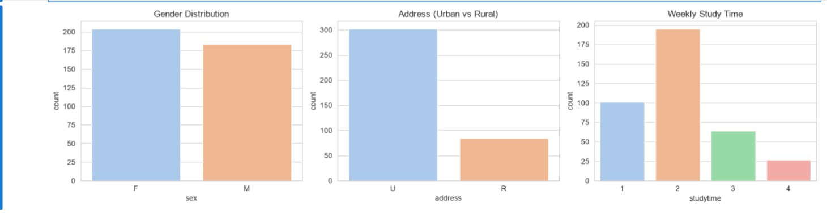
Univariate Analysis & Outliers
# A. Grades distribution
fig, axes = plt.subplots(1, 3, figsize=(15, 4))
sns.histplot(df['G1'], kde=True, ax=axes[0],
color='skyblue').set_title('G1 Grade Distribution')
sns.histplot(df['G2'], kde=True, ax=axes[1],
color='salmon').set_title('G2 Grade Distribution')
sns.histplot(df['G3'], kde=True, ax=axes[2],
color='purple').set_title('G3 Final Grade Distribution')
# B. IQR-based outlier detection
num_cols = ['age', 'absences', 'G1', 'G2', 'G3']
for col in num_cols:
Q1 = df[col].quantile(0.25)
Q3 = df[col].quantile(0.75)
IQR = Q3 - Q1
outliers = df[(df[col] < (Q1 - 1.5 * IQR)) |
(df[col] > (Q3 + 1.5 * IQR))]
print(f"Column '{col}': {len(outliers)} outliers detected")
plt.figure(figsize=(10, 4))
sns.boxplot(data=df[num_cols], palette='Set3')
plt.title('Outliers Visualisation Across Numerical Features')
# C. Categorical feature distributions
fig, axes = plt.subplots(1, 3, figsize=(15, 4))
sns.countplot(x='sex', data=df, ax=axes[0],
palette='pastel').set_title('Gender Distribution')
sns.countplot(x='address', data=df, ax=axes[1],
palette='pastel').set_title('Address (Urban vs Rural)')
sns.countplot(x='studytime', data=df, ax=axes[2],
palette='pastel').set_title('Weekly Study Time')
What it shows: each variable on its own: grade histograms, IQR outlier checks on the numeric columns, and category counts.
IQR flags 38 outliers in G3 (students with a final grade of 0), 13 in G2 and 9 in absences; age and G1 have none.

Slide 7
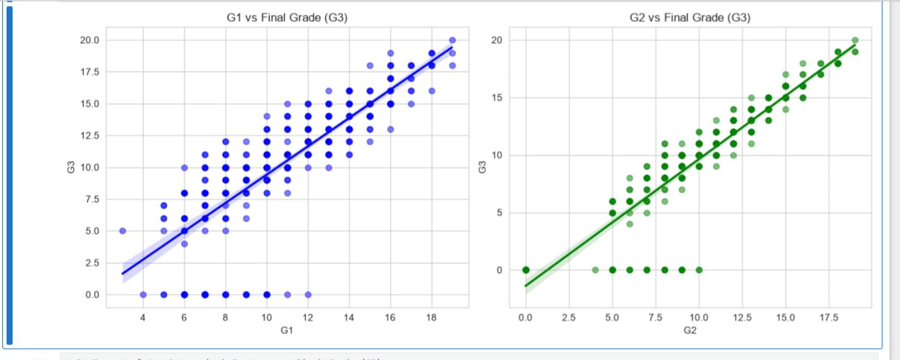
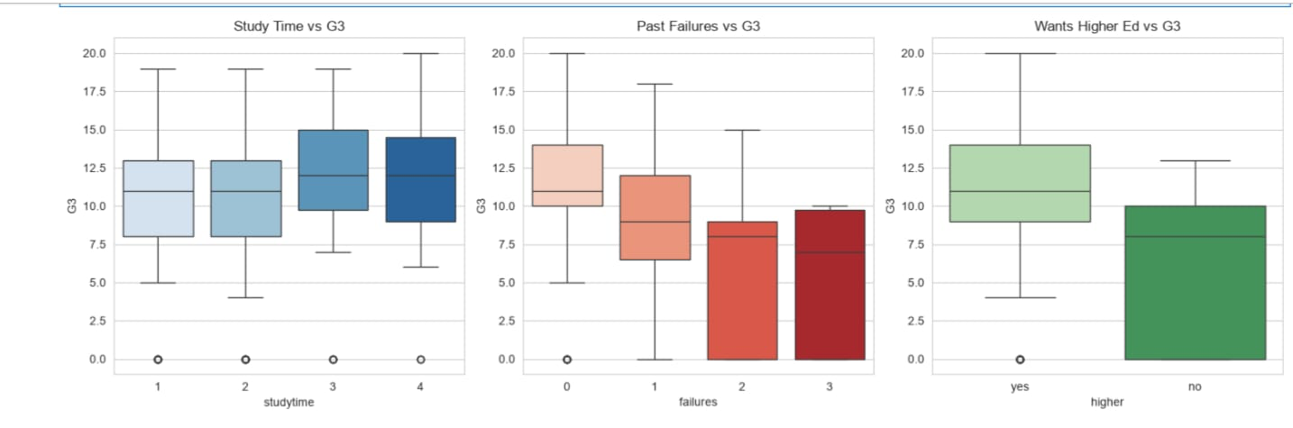
Bivariate Analysis
# A. Past grades (G1, G2) vs final grade (G3)
fig, axes = plt.subplots(1, 2, figsize=(12, 5))
sns.regplot(x='G1', y='G3', data=df, ax=axes[0], color='blue',
scatter_kws={'alpha':0.5})
axes[0].set_title('G1 vs Final Grade (G3)')
sns.regplot(x='G2', y='G3', data=df, ax=axes[1], color='green',
scatter_kws={'alpha':0.5})
axes[1].set_title('G2 vs Final Grade (G3)')
# B. Key categorical features vs final grade (G3)
fig, axes = plt.subplots(1, 3, figsize=(15, 5))
sns.boxplot(x='studytime', y='G3', data=df, ax=axes[0],
palette='Blues').set_title('Study Time vs G3')
sns.boxplot(x='failures', y='G3', data=df, ax=axes[1],
palette='Reds').set_title('Past Failures vs G3')
sns.boxplot(x='higher', y='G3', data=df, ax=axes[2],
palette='Greens').set_title('Wants Higher Ed vs G3')
What it shows: how each variable relates to the final grade (G3). The regression plots compare G1 and G2 with G3, and the boxplots compare G3 across study time, past failures and the wish for higher education.
G1 and G2 both rise almost linearly with G3. Median G3 falls as past failures increase and is higher for students who want higher education.

Slide 8
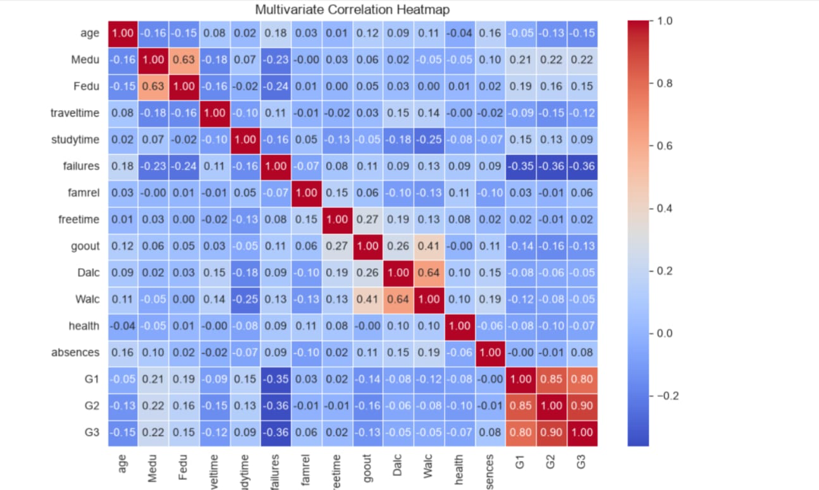
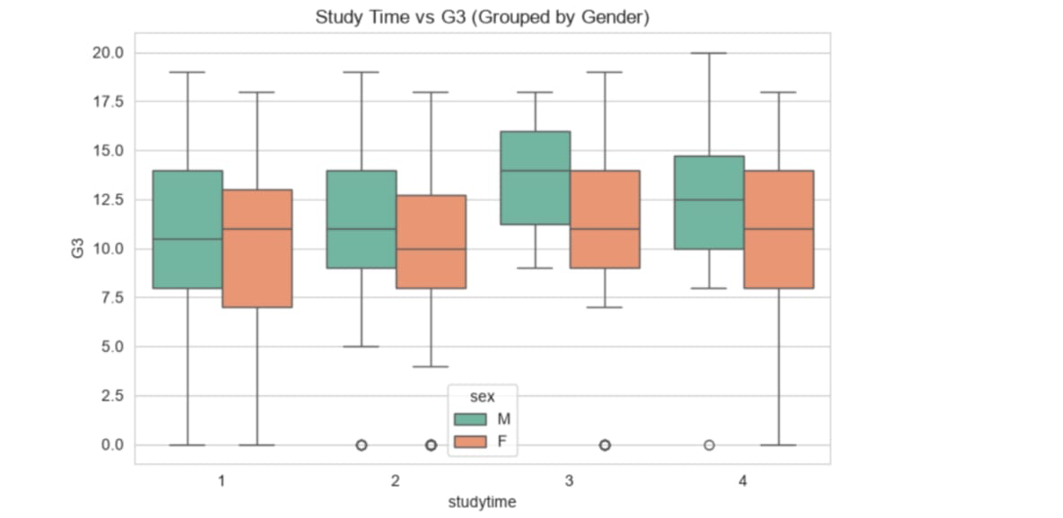
Multivariate Analysis
# A. Correlation heatmap
plt.figure(figsize=(10, 7))
numeric_df = df.select_dtypes(include=['int64', 'float64'])
sns.heatmap(numeric_df.corr(), annot=True, fmt='.2f',
cmap='coolwarm', linewidths=0.5)
plt.title('Multivariate Correlation Heatmap')
plt.show()
# B. Study time vs G3 segmented by gender
plt.figure(figsize=(8, 5))
sns.boxplot(x='studytime', y='G3', hue='sex',
data=df, palette='Set2')
plt.title('Study Time vs G3 (Grouped by Gender)')
plt.show()
What it shows: how several variables interact at once. The heatmap lists pairwise correlations between all numeric features, and the grouped boxplot compares G3 across study-time levels for male and female students.
G2–G3 correlation is 0.90 and G1–G3 is 0.80; past failures are the strongest negative factor (−0.36). Male students show a higher median G3 at study time 2–4.

Slide 9
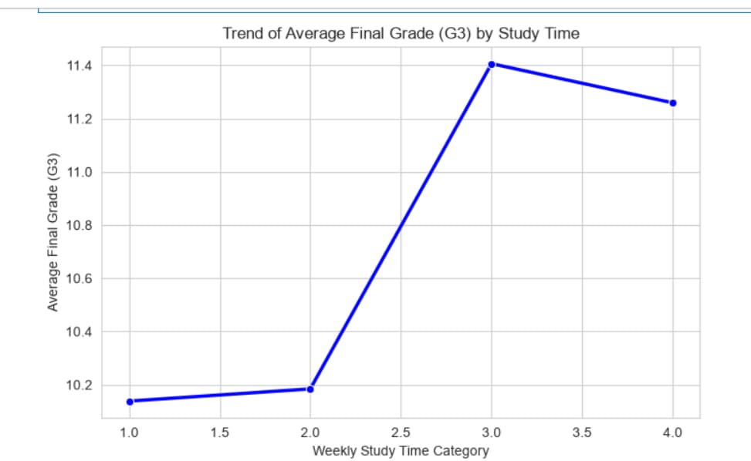
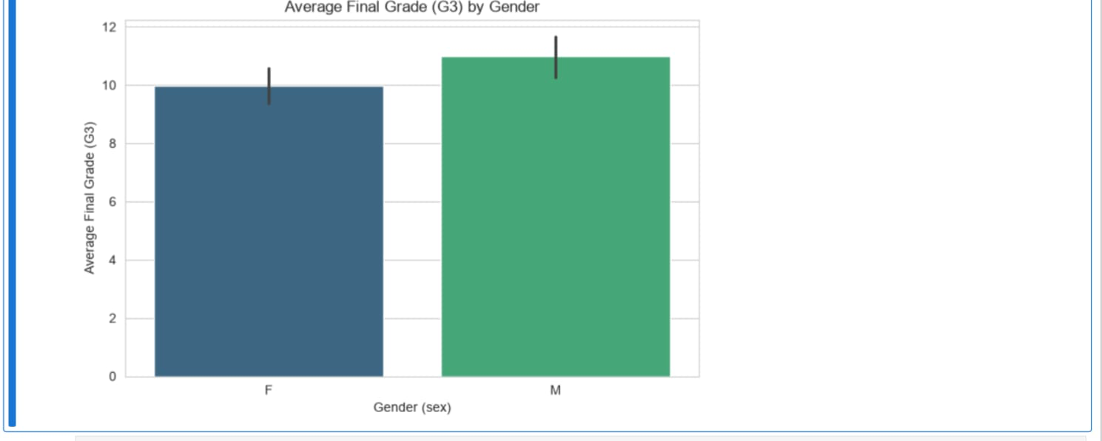
EDA: Academic Trends
Line chart · average G3 by weekly study-time category.
Bar chart · average G3 for female and male students.
Average final grade rises from about 10.1 to 11.4 as study time goes from category 1 to 3, then dips slightly at 4.
Male students average about 11 versus about 10 for female students.
import os
os.makedirs('reports', exist_ok=True)
plt.figure(figsize=(8, 5))
study_trend = df.groupby('studytime')['G3'].mean().reset_index()
sns.lineplot(x='studytime', y='G3', data=study_trend,
marker='o', color='b', linewidth=2.5)
plt.title('Trend of Average Final Grade (G3) by Study Time')
plt.xlabel('Weekly Study Time Category')
plt.ylabel('Average Final Grade (G3)')
plt.savefig('reports/linechart_studytime_g3.png', dpi=150,
bbox_inches='tight')
plt.figure(figsize=(8, 5))
sns.barplot(x='sex', y='G3', data=df, hue='sex',
palette='viridis', legend=False)
plt.title('Average Final Grade (G3) by Gender')
plt.xlabel('Gender (sex)')
plt.ylabel('Average Final Grade (G3)')
plt.savefig('reports/barplot_sex_g3.png', dpi=150,
bbox_inches='tight')

Slide 10
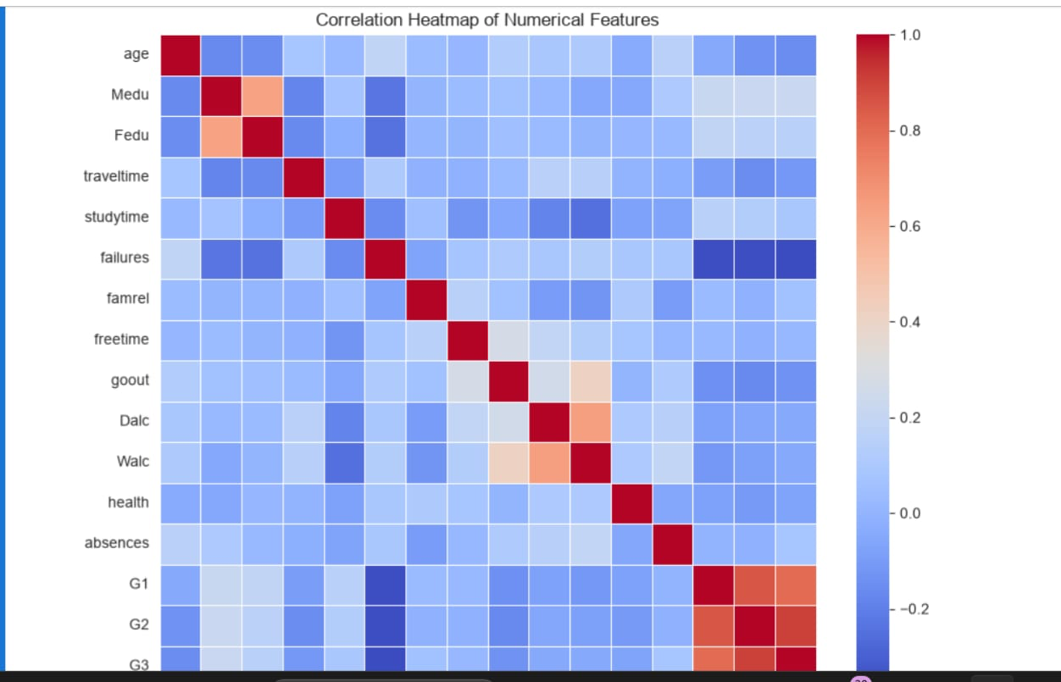
EDA: Correlations
G2 and G3 show a very strong correlation of about 0.90
G1 also tracks G3 closely
Past failures show the strongest negative correlation with grades
What it shows: pairwise correlations between all numeric features in the cleaned data. Red cells mark strong positive links and blue cells strong negative ones.
plt.figure(figsize=(10, 8))
numeric_df = df.select_dtypes(include=['float64', 'int64'])
sns.heatmap(numeric_df.corr(), annot=False,
cmap='coolwarm', linewidths=0.5)
plt.title('Correlation Heatmap of Numerical Features')
plt.savefig('reports/correlation_heatmap.png', dpi=150,
bbox_inches='tight')

Slide 11
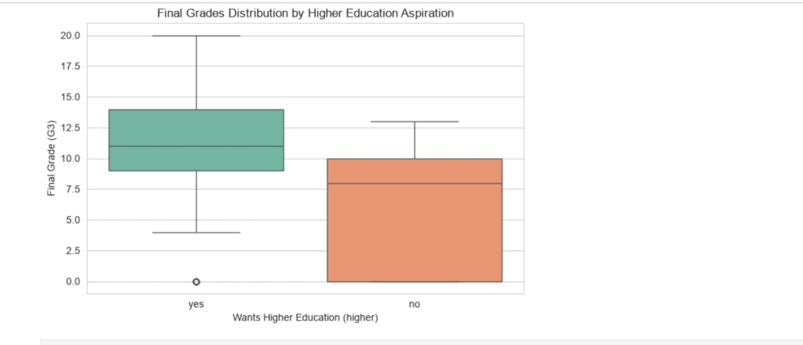
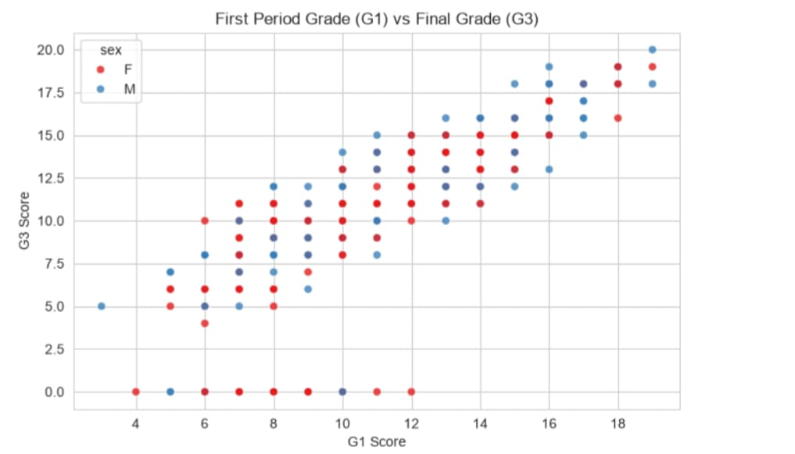
EDA: Aspiration & Early Performance
Boxplot · G3 by wish to pursue higher education.
Scatter plot · G1 against G3, coloured by gender.
Students who want higher education have a median G3 near 11, versus about 8 for those who do not.
G1 and G3 rise together almost linearly; a cluster of students end with G3 = 0 despite varied G1.
plt.figure(figsize=(8, 5))
sns.boxplot(x='higher', y='G3', data=df, hue='higher',
palette='Set2', legend=False)
plt.title('Final Grades Distribution by Higher Education Aspiration')
plt.xlabel('Wants Higher Education (higher)')
plt.ylabel('Final Grade (G3)')
plt.savefig('reports/boxplot_higher_g3.png', dpi=150,
bbox_inches='tight')
plt.figure(figsize=(8, 5))
sns.scatterplot(x='G1', y='G3', data=df, hue='sex',
palette='Set1', alpha=0.8)
plt.title('First Period Grade (G1) vs Final Grade (G3)')
plt.xlabel('G1 Score')
plt.ylabel('G3 Score')
plt.savefig('reports/scatter_g1_g3.png', dpi=150,
bbox_inches='tight')

Slide 12
AI Integration & Tools Used
Tech stack
AI usage
Python, Pandas, Seaborn, Plotly, Streamlit
Gemini helped with code syntax: dictionary replacements, Z-score logic, and removing error bars from Seaborn charts

Slide 13
Final Conclusions & Insights
Early success is the strongest predictor: G1 and G2 correlate above 0.80 with G3, so early intervention for at-risk students is critical.
Study time yields positive returns: students who study more hours per week generally reach higher average final grades.
Past failures are a major warning sign: they show the strongest negative correlation with G3 and are the biggest red flag for ongoing struggle.
Academic ambition drives success: students who plan higher education have a higher median G3 and stronger overall performance.
Demographic baselines matter: average G3 differs by gender, so future models and interventions should account for demographic variance.

Slide 14
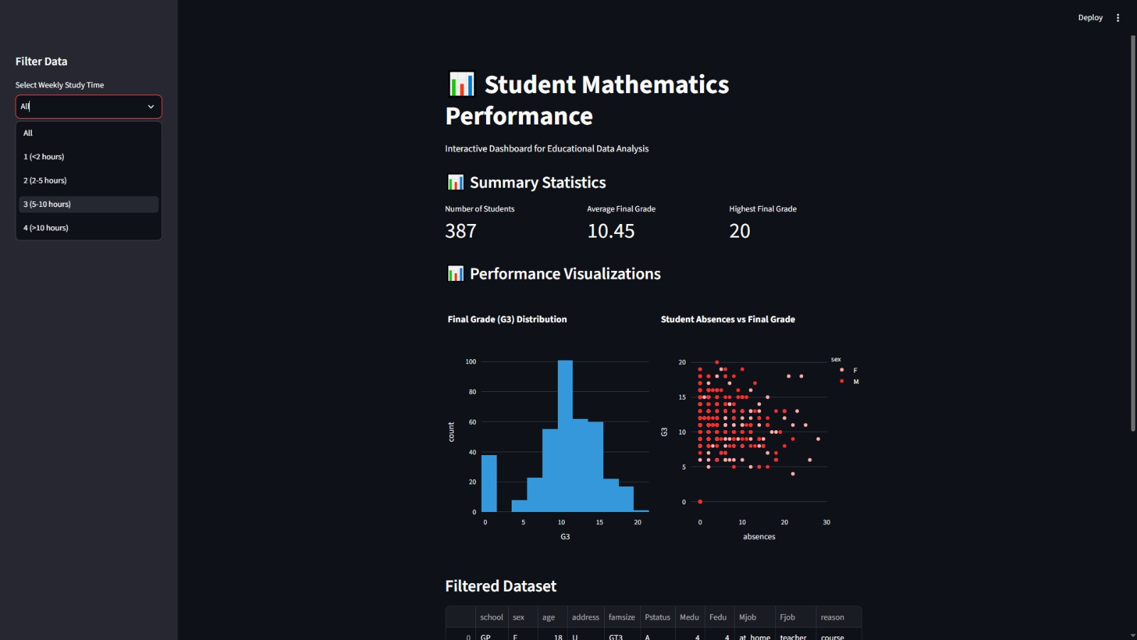
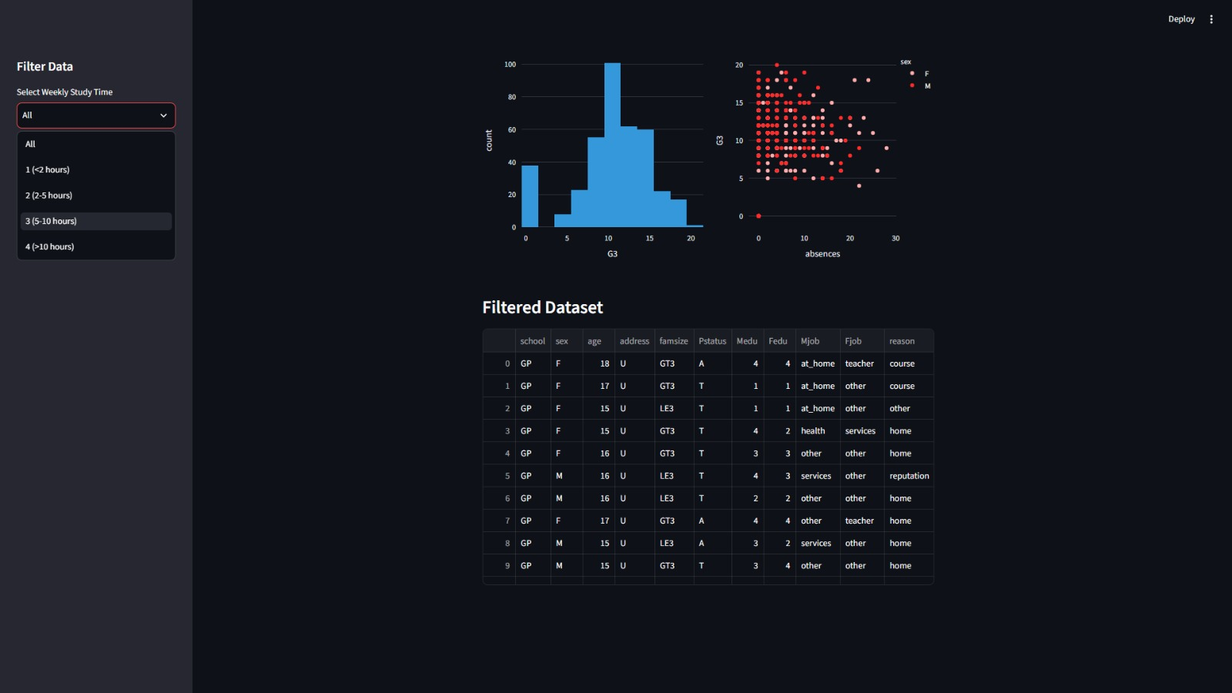
Interactive Dashboard
Dashboard summary
Interactive Streamlit dashboard for the student data
Summary: 387 students, average G3 10.45, highest G3 20
G3 histogram shows how final grades are distributed
Scatter plot compares absences with G3, split by gender
Filtered dataset table shows the matching student records
Study-time sidebar filter (All, 1–4) updates the view

Slide 15
Recommendations
Watch early grades
Support past failures
Flag weak G1 and G2 results as the earliest warning sign
Offer tutoring or mentoring to students who have failed before
Encourage steady study
Back long-term goals
Aim for moderate, consistent study time
Guidance for students aiming at higher education

Slide 16
Limitations & Future Work
Limitations
Next steps
Only 395 students, one subject, and correlation does not prove causation
Predictive models for G3, larger or multi-subject data, a richer dashboard with a risk indicator, and online deployment

Slide 17
Thank You
Questions & Discussion
Student Mathematics Performance Analytics

