Slide 1
Introduction and Overview
Shaheen Perveen
Working as a Senior Data Scientist for the past 3 years
Graduated IIT Kharagpur with Master’s and Bachelor’s degree
Motivation: Based on personal experience with public healthcare system
When a patient doesn’t show-up for a booked appointment, it not only wastes valuable time and money spent by government on Health-care but also deprives another patient of the opportunity
If we could predict likelihood of a patient bunking an appointment with high accuracy, we can come up with an arrangement to do tentative allocation of appointments to next day or next slot patients or we can come up with a system of cross check and confirm appointment before few hours
Kaggle link of dataset: https://www.kaggle.com/joniarroba/noshowappointments
Given above kaggle dataset, develop a model which could predict if a patient is likely to not show up for an appointment. I have developed a voting based ensemble model which is giving f1-score of 0.95
Objective: Predict if a patient is likely to not-show up for a medical appointment

Slide 2
ML based modeling pipeline
Data: Features in dataset
Population Data
Age, Gender
Appointment Data
Date of appointment, Date of scheduling appointment, SMS Reminder
Health related information: Alcoholism, Hypertension, Diabetes, Handicap
Target
If a patient shows up or not to the appointment
No NA values and no highly correlated variables are there in the data
There is one row with negative age which has been removed
Percentage of no-show cases wrt to all appointments is 20% i.e. 0.20193
Boxplots - Countplots - Barplots and Group by methods were used for exploratory analysis
Plots to check change in rate of no-show with given variables
Date based feature
Dummy’s for neighborhood
Day difference between Schedule and Appointment
Applied multiple ML techniques to predict probability
Visualization
Feature Engg. & Visualization
Attempts with Modeling
Achieved 0.95 f1-score
Modeling Techniques applied:
Ensemble
Logistic
Random Forest
GBM
XGBoost
MLP
Logistic
Random Forest
GBM
XGBoost
MLP
Final Model:
GBM applied on stacking output(probabilities) of other 5 models
Logistic Regression
Random Forest
Gradient Boosting Machine
XGBoost
Multi Layer Perceptron
Voting classifier based ensemble
Stacking based ensemble
Models used for voting classifier:
Probabilities used for stacking ensemble:

Slide 3
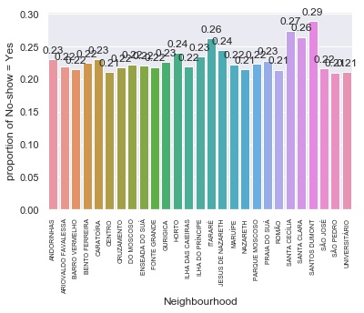
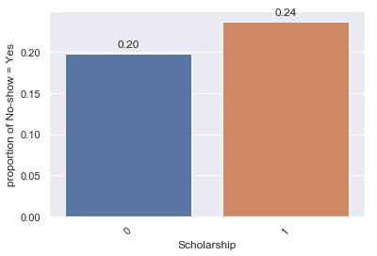
Visualization plots and insights
https://github.com/ShaheenPerveen/DataIncubator_Section3/blob/master/Plots/neighbourhood.jpg
https://github.com/ShaheenPerveen/DataIncubator_Section3/blob/master/Plots/Scholarship.jpg
Some neighborhoods have higher than average rate of no-show
People who have scholarship are more likely to to not show up for an appointment

Slide 4
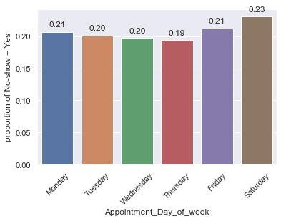
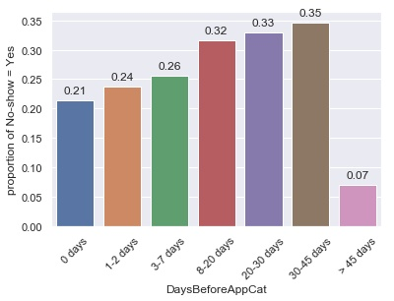
Visualization plots and insights
https://github.com/ShaheenPerveen/DataIncubator_Section3/blob/master/Plots/Appointment_Day_of_week.jpg
https://github.com/ShaheenPerveen/DataIncubator_Section3/blob/master/Plots/DaysBeforeAppCat.jpg
People are more likely to not show up for an appointment on Monday and Friday
The probability of not-showing up for an appointment increases with increase in wait time i.e. time between schedule and appointment

Slide 5
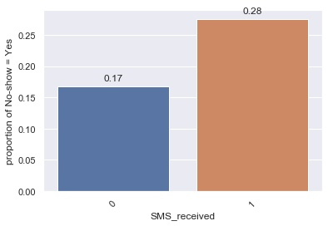
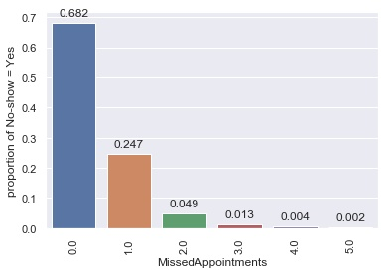
Visualization plots and insights
https://github.com/ShaheenPerveen/DataIncubator_Section3/blob/master/Plots/SMS_received.jpg
https://github.com/ShaheenPerveen/DataIncubator_Section3/blob/master/Plots/MissedAppointments.jpg
People who have received SMS are more likely to not show up for an appointment
Probability of not showing up for an appointment decreases as number of missed appointments in past by the patients increases

Slide 6
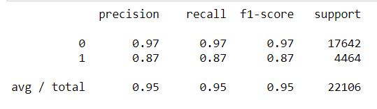
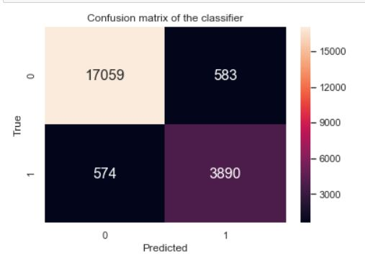
Modeling Output

