Slide 1
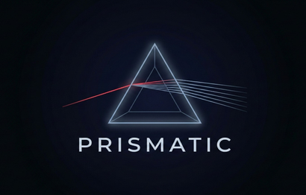

National-Level 24-Hour Hackathon
CROWDI
TEAM NAME : KINGS OF PROMPTS
DOMAIN : ARTIFICAL INTELLIGENCE AND MACHINE LEARNING
PROBLEM STATEMENT : URBAN CROWD FLOW & BREAKDOWN PREDICTION SYSTEM
COLLEGE NAME: PANIMALAR ENGINEERING COLLEGE
PRISMATIC 2K26
Slide 001

Slide 2
PROBLEM STATEMENT
National-Level 24-Hour Hackathon
URBAN CROWD FLOW & BREAKDOWN PREDICTION SYSTEM:
Rapid urbanization leads to high crowd density in public places (stations, malls, events)
Lack of real-time monitoring causes:
Congestion
Safety risks
Delayed response
Existing systems are reactive, not predictive
PROBLEM:
No efficient system to detect crowd density and predict congestion in real-time using multiple video sources
PRISMATIC 2K26
Slide 002

Slide 3
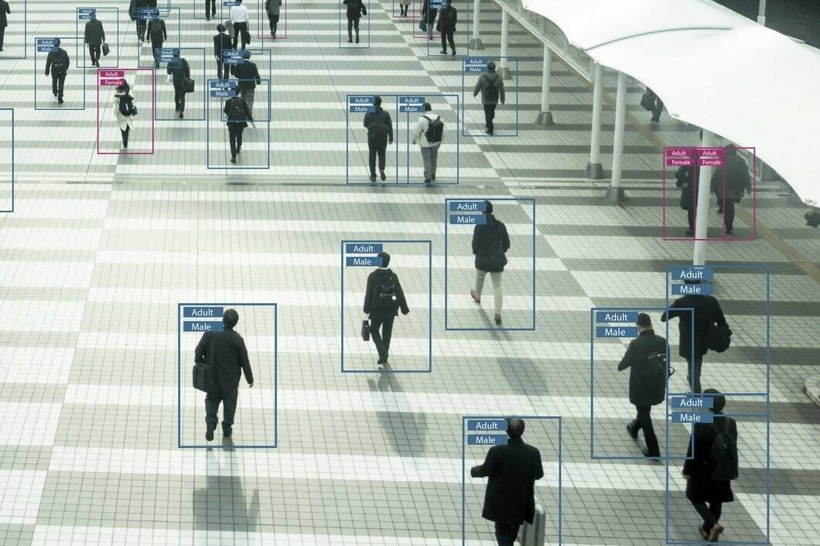
PROPOSED SOLUTION
National-Level 24-Hour Hackathon
The system is an AI-powered multi-camera crowd monitoring solution using live feeds from laptop and mobile cameras along with recorded video inputs.
SUPPORTS:
Live camera feeds (laptop + mobile)
Recorded video uploads
Uses computer vision to:
Detect people
Estimate density
Analyze movement
SYSTEM WILL:
Monitor crowd continuously
Predict congestion before it occurs
Send real-time alerts to guards/admin
PRISMATIC 2K26
Slide 003

Slide 4
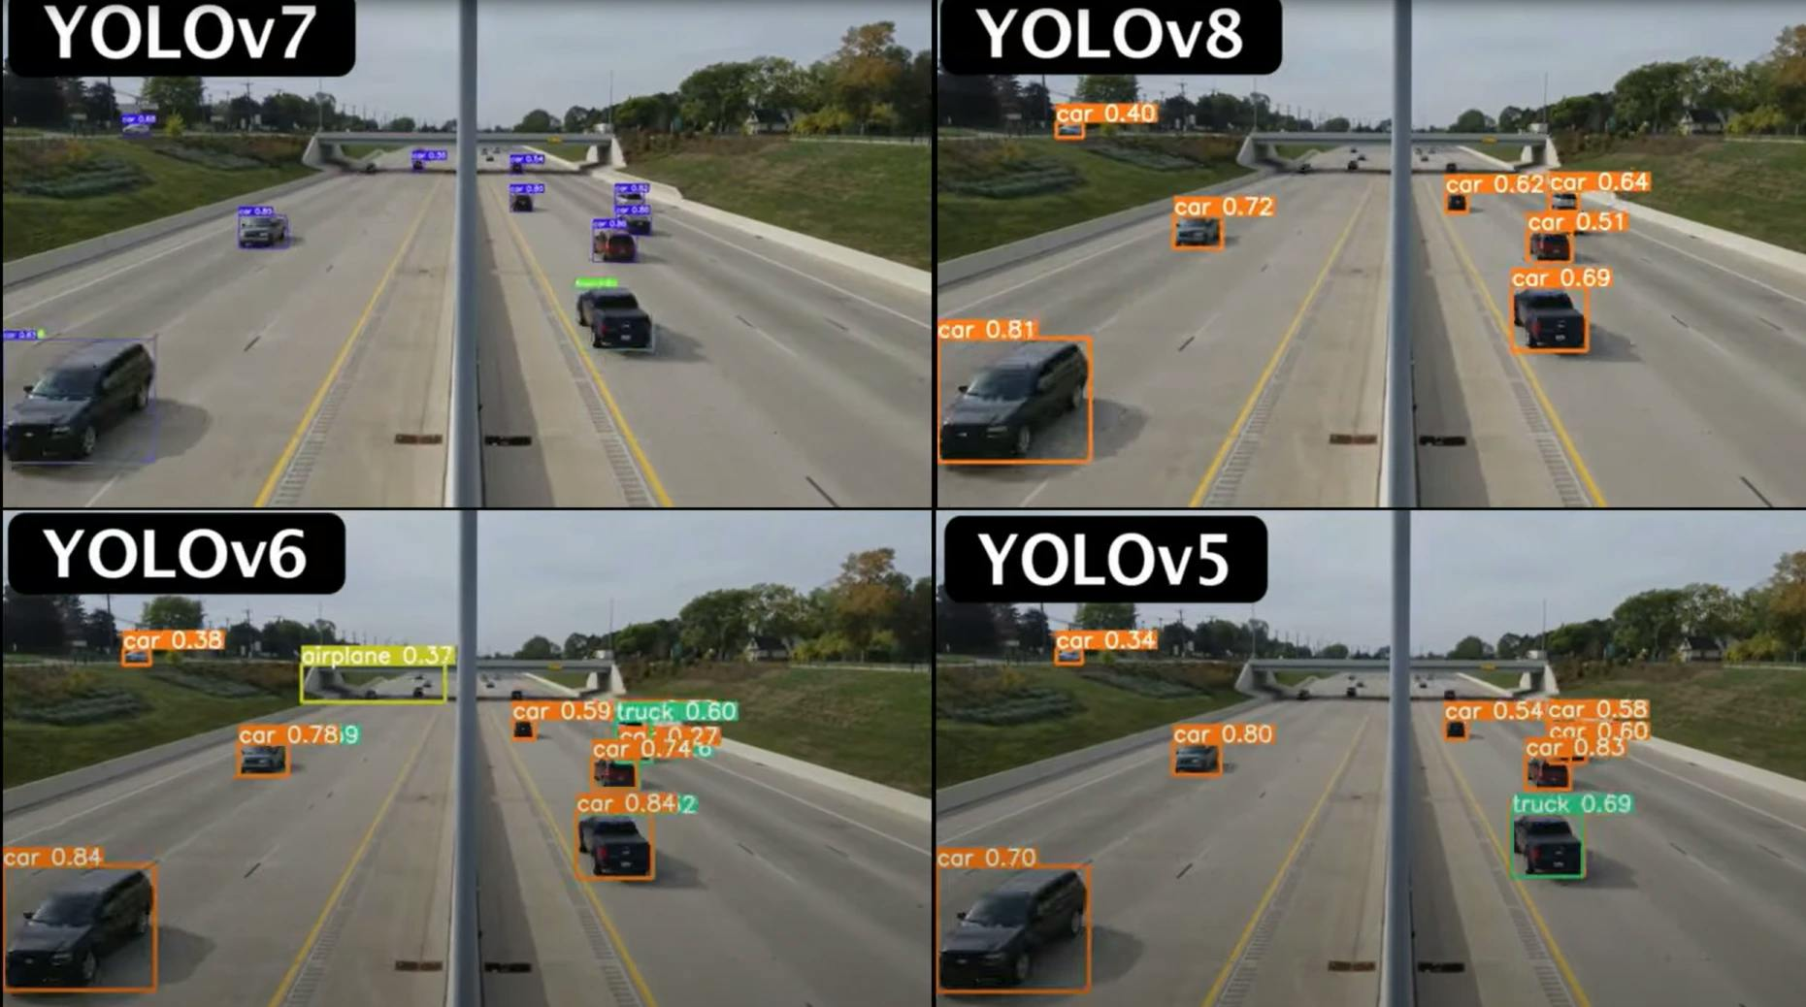

FEATURES & TECH STACK
National-Level 24-Hour Hackathon
Supports multi-input: webcam, mobile cameras, and video uploads .
Performs real-time people detection, counting, and crowd analysis .
Analyzes density and movement to predict congestion .
Generates smart, camera-wise alerts for quick action .
Provides role-based access for admin and guards .
TECH STACK:
Python (YOLOv8, OpenCV) , React.js , Tailwind CSS , Node.js ,Express.js , Socket.IO , MongoDB , IP Webcam .
PRISMATIC 2K26
Slide 004

Slide 5
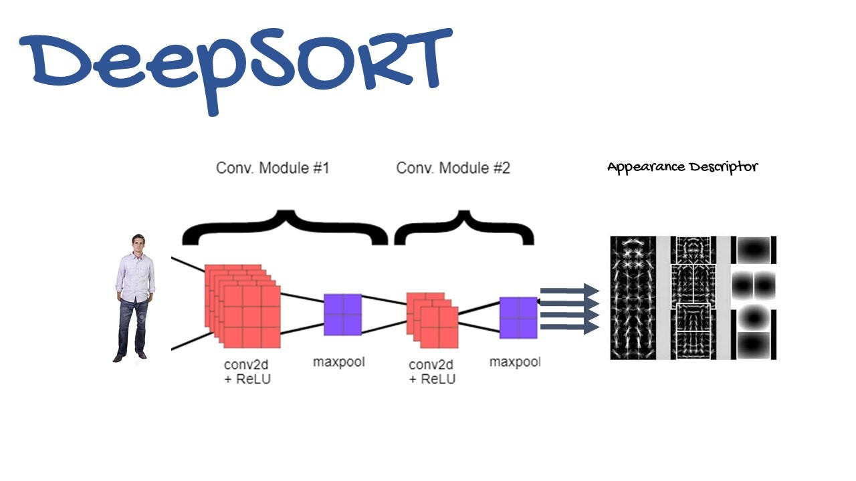
IMPACT & FUTURE SCOPE
National-Level 24-Hour Hackathon
Applicable in railway stations, bus stands, malls, stadiums, and public events .
Can be extended to smart city surveillance systems .
Improves public safety through continuous monitoring .
Enables early congestion detection and faster response .
Helps authorities take quick and effective action .
Reduces risks related to overcrowding .
FUTURE ENHANCEMENTS:
Crowd heatmaps, AI-based time prediction, CCTV integration, and mobile alert systems for guards .
PRISMATIC 2K26
Slide 005

