Slide 1




Crowd count using video analytics
Presented by-
Dhanush.S

Slide 2

INTRODUCTION
"Crowd Counting using Video Analytics" is an advanced computer vision project designed to automate the process of estimating the number of people in a specific area using digital images or video feeds. Unlike traditional manual counting, which is prone to human error and inefficiency, this project leverages Deep Learning and Artificial Intelligence to analyze visual data in real-time.
At its core, the system utilizes specialized algorithms—such as Convolutional Neural Networks (CNNs)—to detect human features and generate density maps.

Slide 3
Problem Statement
The Challenge of Occlusion: Traditional sensors and basic motion detection often fail when people overlap or stand behind objects, resulting in undercounting.
High Labor Costs: Continuous monitoring of CCTV feeds for crowd management is labor-intensive and expensive for large venues or public spaces.
Data Fragmentation: Without automated video analytics, there is no way to store and analyze long-term crowd trends for urban planning or retail optimization.
Traditional crowd counting: Involves manual methods like Jacobs' grid (dividing areas, averaging density, multiplying) or simple counting

Slide 4
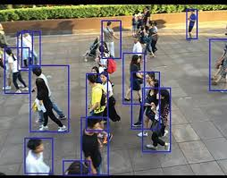
ADVANTAGES
High Precision and Accuracy: Unlike manual counting, AI models (like CNNs) can process pixels at a granular level, reducing human error.
Real-Time Processing & Automation: The system operates at high speeds (measured in FPS - Frames Per Second), providing instantaneous data.
Data-Driven Insights (Heatmapping): Beyond just a "number," video analytics can generate Density Heatmaps.
Enhanced Safety & Emergency Response: The system can be programmed to trigger automated alerts if a specific threshold is reached, preventing stampedes or overcrowding before they happen.

Slide 5
TECHNOLOGY STACK
Python – 3.10
Streamlit
YOLO V8
Computer Vision
Firebase
Deep-Sort algorithm
Numpy
Pandas

Slide 6
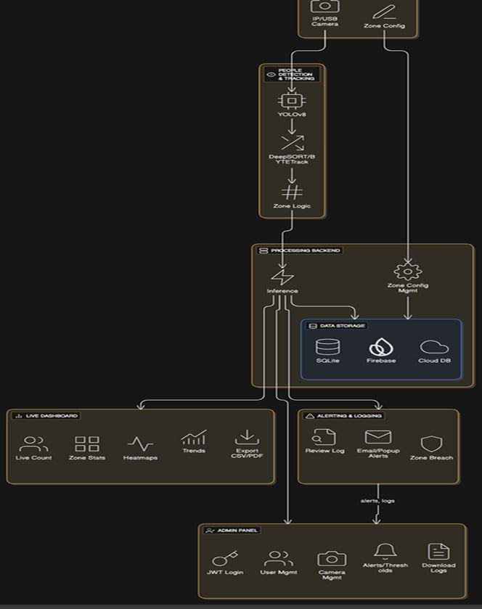
ARCHITECTURE DIAGRAM

Slide 7
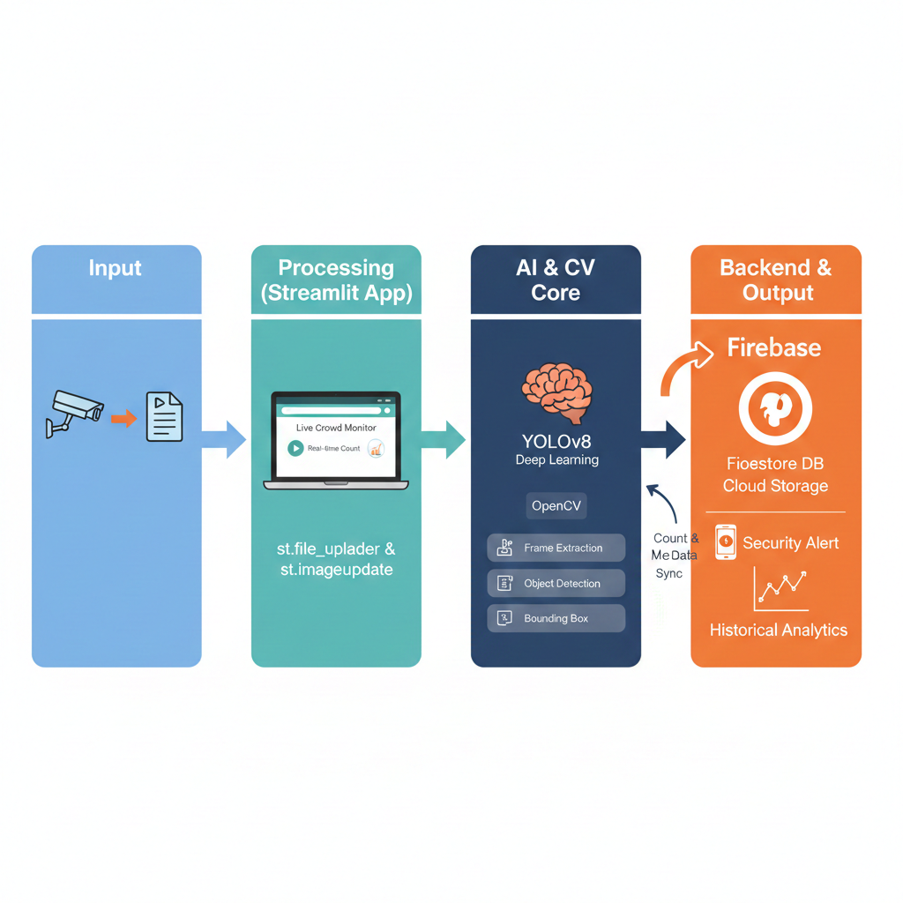
HOW IT WORKS ?
Input: User uploads a video or starts a webcam feed via the Streamlit interface.
Process: OpenCV extracts frames and sends them to the YOLOv8 model for detection.
Count Logic: Your Python script calculates the number of detections.
Sync: The final count is pushed to Firebase via the firebase-admin SDK.
Output: Streamlit pulls the latest data from Firebase to display a live line graph showing crowd trends over time.

Slide 8
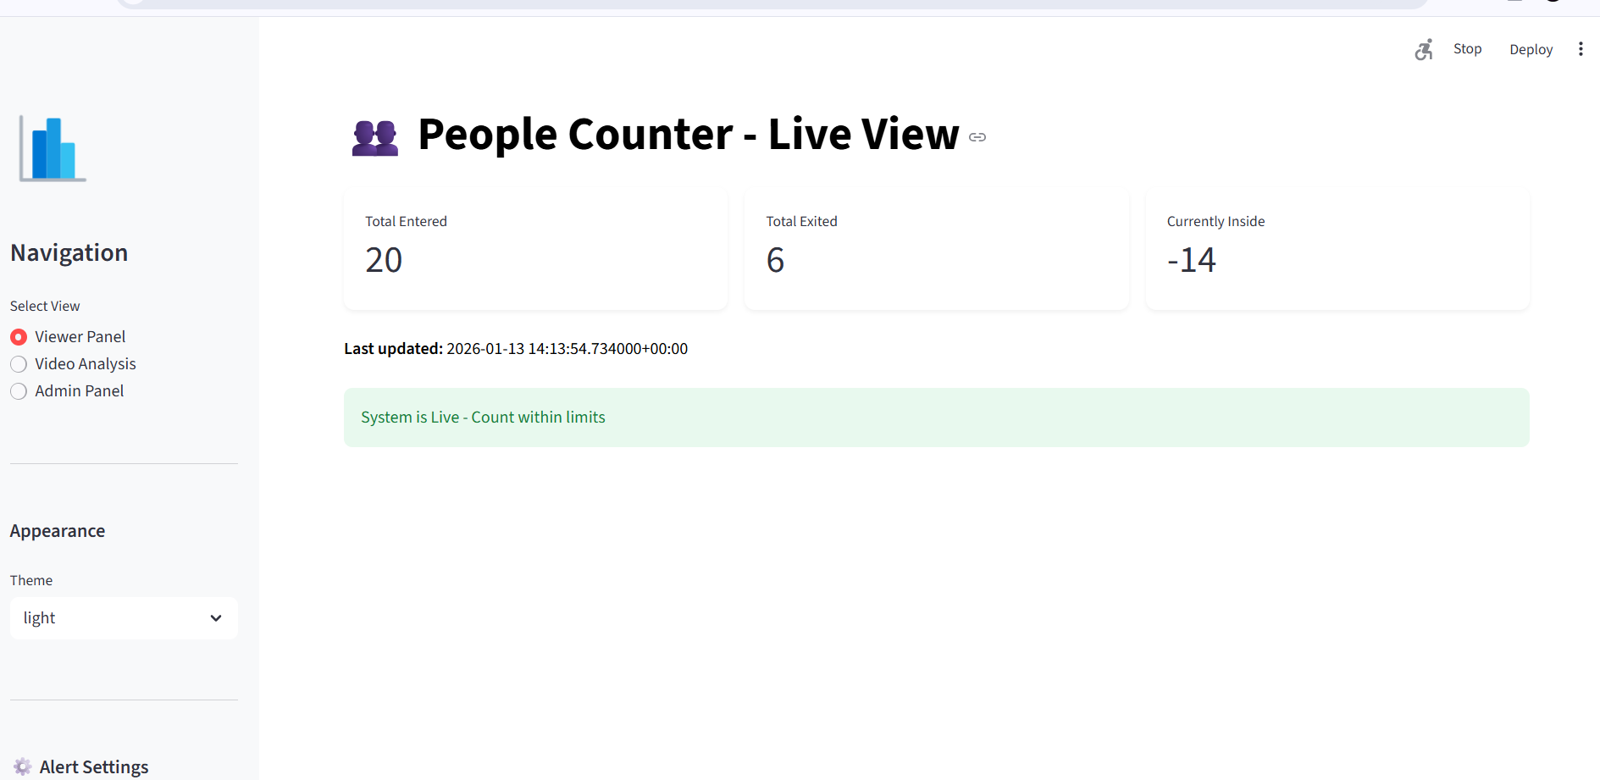
OUTPUTS

Slide 9
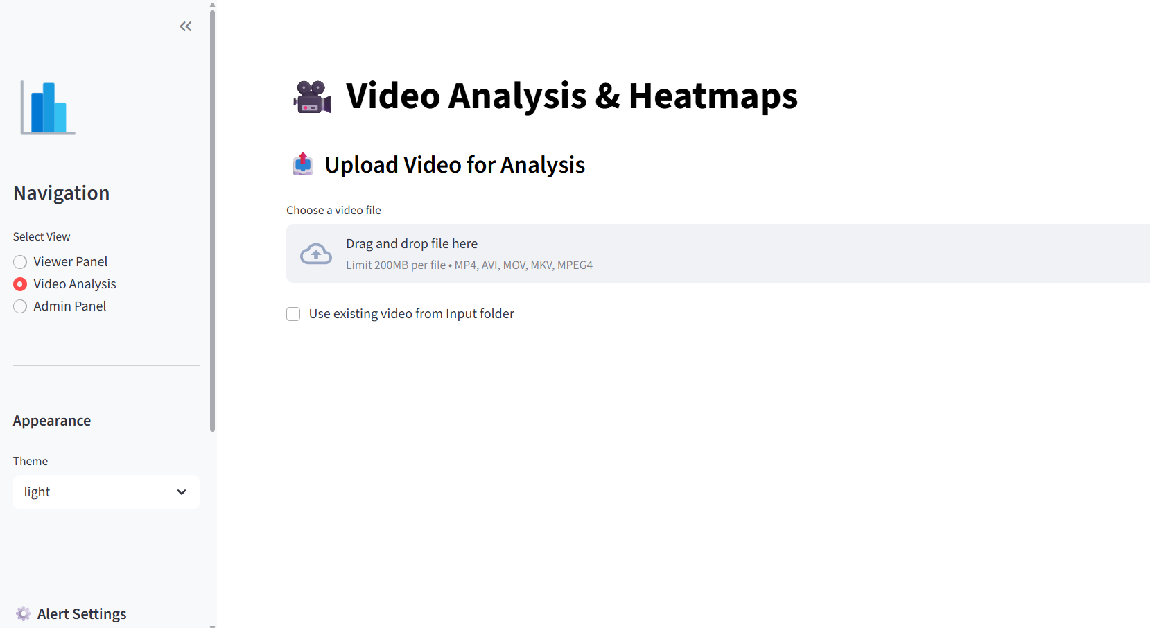

Slide 10
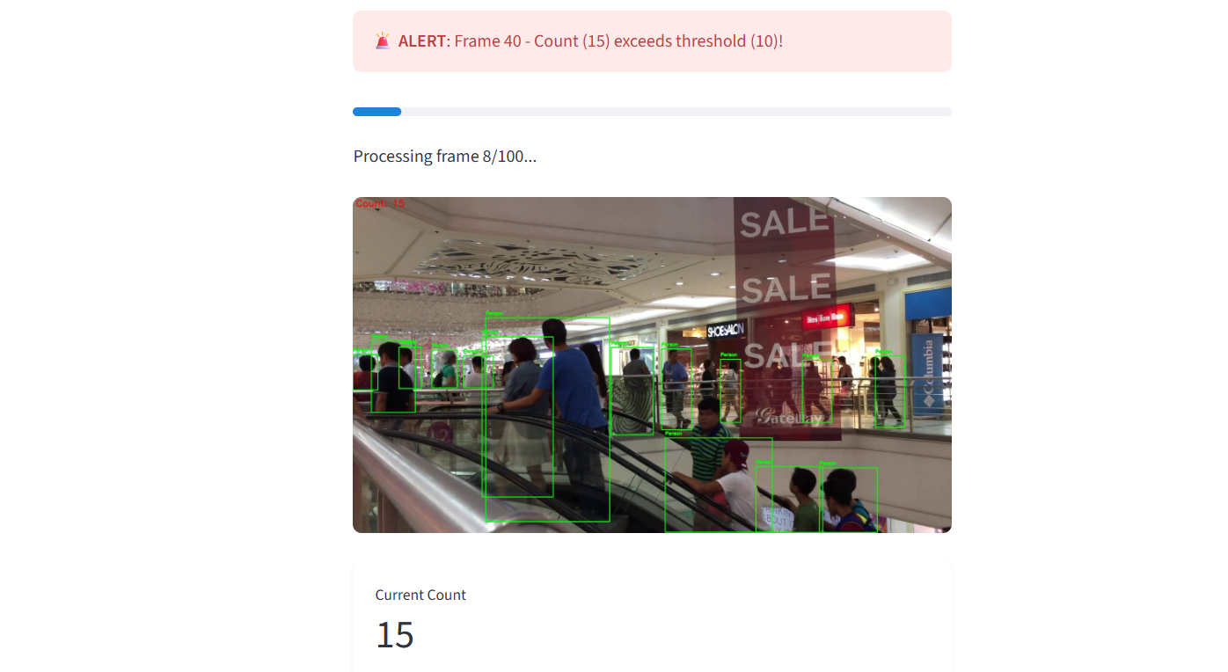

Slide 11
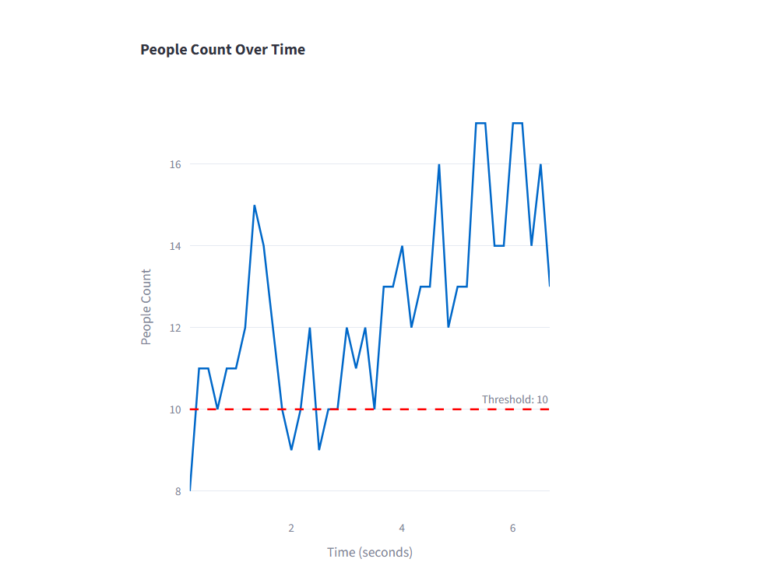
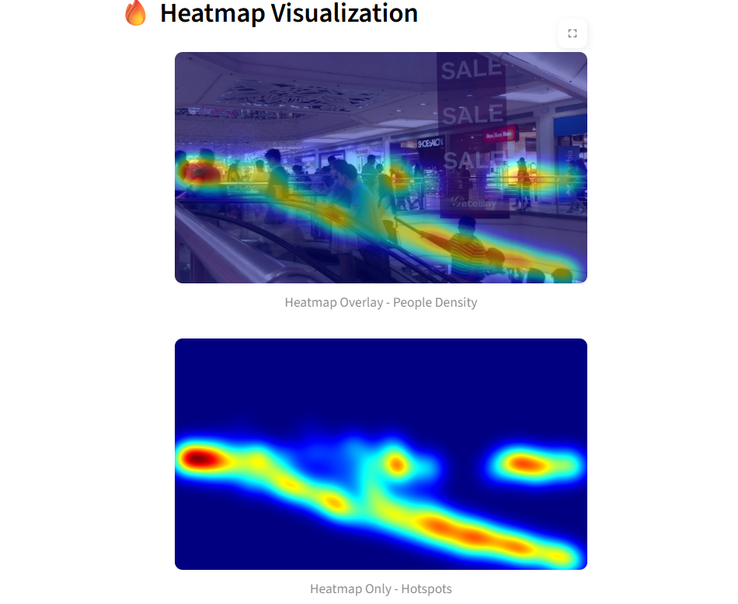
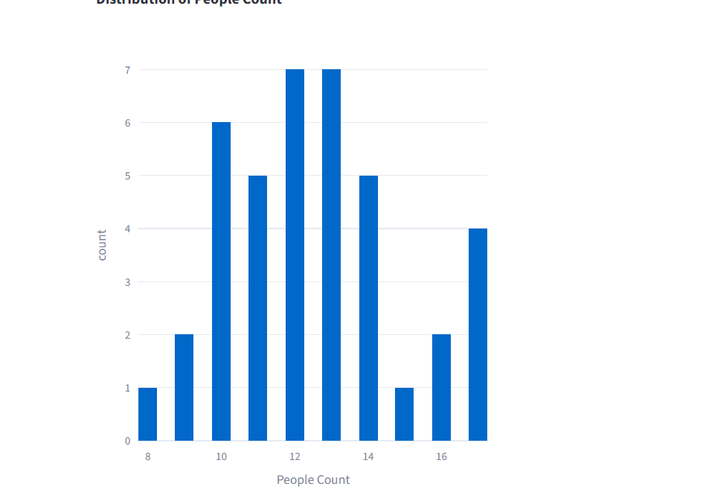

Slide 12
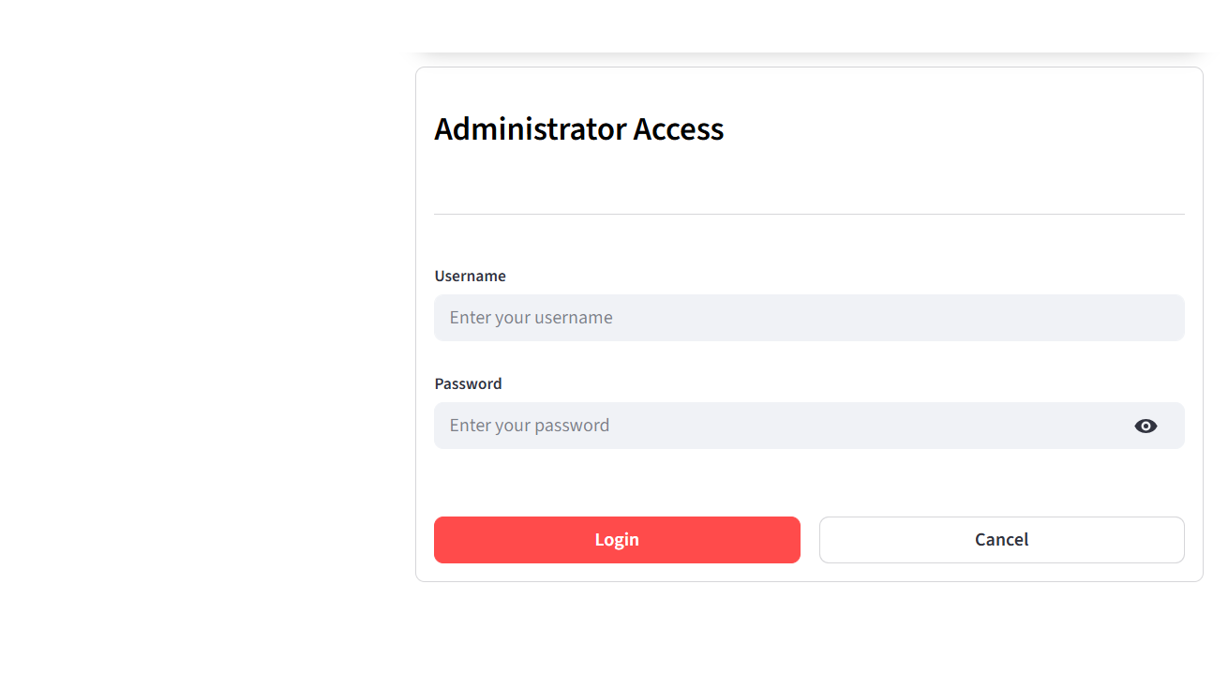

Slide 13

CONCLUSION
This project successfully demonstrates the integration of YOLOv8 for high-precision object detection with a scalable cloud backend using Firebase. By utilizing Streamlit, we created an accessible interface that bridges the gap between complex deep-learning models and end-user requirements. The system achieves real-time processing speeds, proving that AI-driven video analytics is a viable and efficient alternative to traditional manual crowd monitoring.

