Slide 1
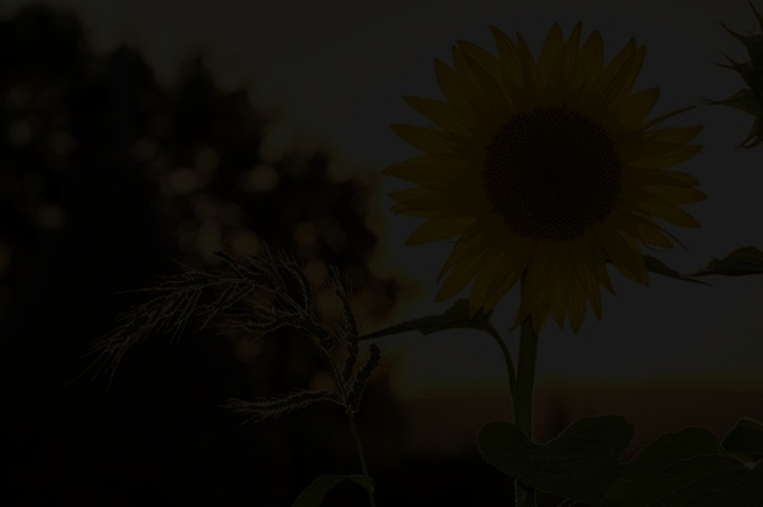
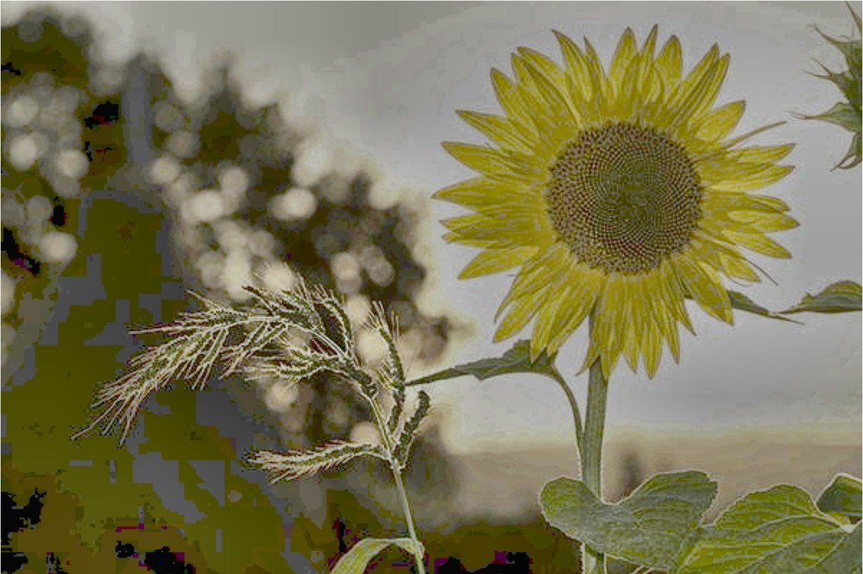
DIGITAL IMAGE PROCESSING · B.Tech RESEARCH PROJECT
Brightness and Contrast Guided Adaptive Enhancement for Low-Light Images
A Classical Digital Image Processing Approach
Severe low-light input
BCGAE output
Sample from the project evaluation set (IMG10_Sunflower, Severe level).
Student Name: Syed Shaheer Hussain
Register Number: 23BEC7146
Department: AI & ML
Institution: VIT-AP University
Course: Digital Image Processing
Faculty: Dr. M. Sucharitha
Academic Year: 2026–2027
Notes:
MAIN IDEA: Introduce the project and show one real input/output pair from my experiments.
- My project is "Brightness and Contrast Guided Adaptive Enhancement for Low-Light Images", or BCGAE for short.
- It is a classical Digital Image Processing approach: gamma correction and CLAHE, with parameters chosen from each image's own brightness and contrast. No neural-network training.
- The pair on the right is a real sample from my evaluation set: a severely darkened image and the BCGAE output.
TRANSITION: First, why does low-light enhancement matter?

Slide 2
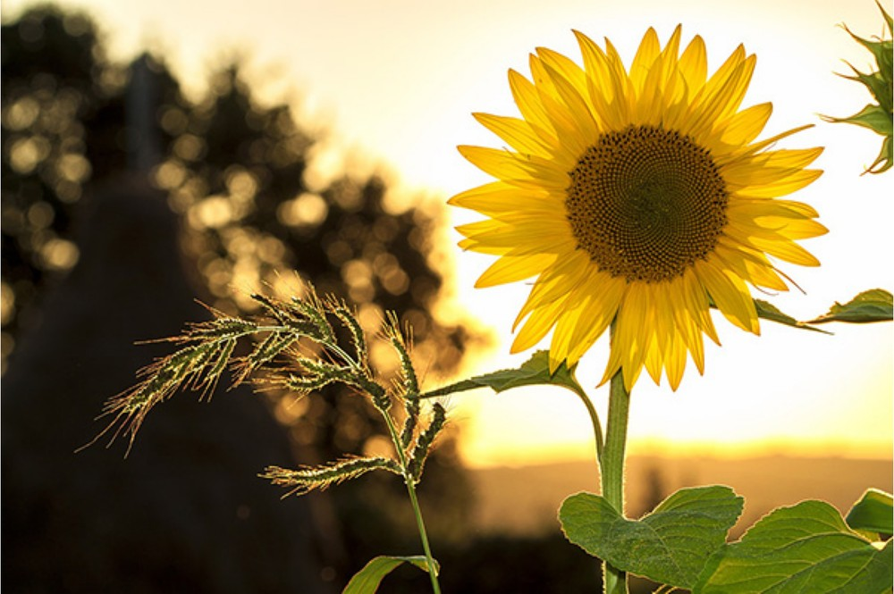
Introduction: Why Low-Light Enhancement Matters
Applications
Nighttime photography
Surveillance and security imaging
Road and traffic monitoring
Low-illumination indoor imaging
General photographic improvement
Normal illumination (reference)
Severe low-light input (synthetic)
Enhanced (BCGAE output)
Same scene in all panels: IMG10_Sunflower from the project dataset.
Insufficient illumination reduces visibility and can hide important details
Classical enhancement improves visibility of structures and intensity variations
Brightening alone does not recover lost information or guarantee better quality
Notes:
MAIN IDEA: Low light hides information, and simply making an image brighter is not the same as improving it.
- Applications: night photography, surveillance, road monitoring, dim indoor scenes, general photo improvement.
- The three panels show the same scene: the original, a severely darkened version, and the BCGAE result from my experiments.
- Classical enhancement reshapes intensities so structures become visible. But brightening cannot bring back detail that was lost, and it can add artifacts, which we will see in the results.
TECHNICAL TERM: Intensity = the brightness value of a pixel, 0 (black) to 255 (white) for 8-bit images.
TRANSITION: So what is wrong with the usual fixed-parameter methods?

Slide 3
Problem Statement and Motivation
PROBLEM STATEMENT
EXISTING: FIXED PARAMETERS
“Conventional low-light enhancement methods often use fixed parameters that may not perform consistently across images with different brightness and contrast characteristics. Excessive enhancement may introduce artifacts, amplify noise, or distort image appearance.”
Same gamma + CLAHE settings
Dark, moderate, bright images
Possibly inconsistent enhancement
PROPOSED: BCGAE
Limitations of fixed-parameter approaches
Measure brightness B and contrast C
Select parameters per image
Per-image adaptive enhancement
Global histogram equalization can over-enhance some regions
Fixed gamma correction does not adapt to each image
CLAHE results depend on clip limit and tile configuration
A fixed gamma + CLAHE combination may not suit all illumination conditions
Concept diagram. Existing methods do not fail in every case.
Research question: Can brightness- and contrast-guided parameter selection improve the consistency of classical low-light enhancement compared with fixed-parameter methods?
Notes:
MAIN IDEA: Fixed parameters are the weak point; this project asks whether adapting them to each image helps.
- A fixed method applies the same settings to a very dark image and a moderately dark one. That can under-enhance one and over-enhance another.
- Over-enhancement can show up as noise amplification, artifacts or unnatural appearance.
- I am not saying existing methods fail in every case. The research question is whether adaptive selection gives more CONSISTENT behaviour, and the results later in the deck test that.
TECHNICAL TERMS: CLAHE = Contrast Limited Adaptive Histogram Equalization. Clip limit = the cap on local contrast amplification.
TRANSITION: Here are my objectives, scope and evaluation setup.

Slide 4
Objectives, Scope and Evaluation Setup
Objectives
10
3
5
150
1
Study existing classical image enhancement techniques
images
degradation levels
methods
cases
2
Develop a brightness- and contrast-guided adaptive framework
Scope
Classical image processing only; no deep learning
Synthetic low-light levels: Mild, Moderate, Severe
Clean originals kept as reference images
Methods: HE, Gamma, CLAHE, fixed Gamma + CLAHE, BCGAE
Python and OpenCV; 10 images × 3 levels × 5 methods
3
Evaluate performance at multiple low-light degradation levels
4
Compare visual quality and quantitative measurements
5
Analyze limitations and trade-offs of the proposed method
Limitation of scope Synthetic darkening allows controlled comparison but may not represent real camera noise or color shifts.
Notes:
MAIN IDEA: Five objectives and a small, reproducible, controlled experiment.
- The evaluation uses 10 images, each darkened at 3 levels (Mild, Moderate, Severe), and processed by 5 methods. That gives 10 x 3 x 5 = 150 cases.
- The clean original of each image is the reference for the metrics.
- Scope is classical only. Synthetic darkening makes the comparison controlled but does not include real sensor noise or colour shifts, so results may not transfer directly to real camera images.
TRANSITION: What does the literature say?

Slide 5
Literature Review
Ref. | Type | Focus | Relevance to this project
[1] | Foundational paper (1987) | Adaptive histogram equalization and its variations | Local equalization; basis of the CLAHE baseline
[2] | Foundational algorithm (1994) | Contrast limited adaptive histogram equalization | Clip limit is a parameter BCGAE selects
[3] | Review (IEEE Access, 2020) | Experiment-based review of low-light enhancement methods | Places classical methods among many approaches
[4] | Survey (Heliyon, 2023) | Survey on image enhancement for low-light images | Recent overview for future comparison
Position of this project
BCGAE is a project-specific adaptive heuristic built from established classical tools (gamma correction and CLAHE). It is not claimed to be a new algorithm; the project measures how it behaves compared with fixed-parameter baselines.
Notes:
MAIN IDEA: The building blocks are established; this project combines and evaluates them.
- [1] Pizer et al. introduced adaptive histogram equalization and discussed its variations, which is where contrast-limited equalization comes from. [2] Zuiderveld gives the CLAHE algorithm with its clip limit; that clip limit is one of the two parameters BCGAE chooses.
- [3] Wang et al. and [4] Guo et al. are a review and a survey of low-light enhancement methods. They show the field is much wider than my four baselines, so I treat my work as a small classical study, not a state-of-the-art claim.
- BCGAE is a project-specific heuristic, not a new algorithm.
TRANSITION: Now the four baseline methods in detail.

Slide 6
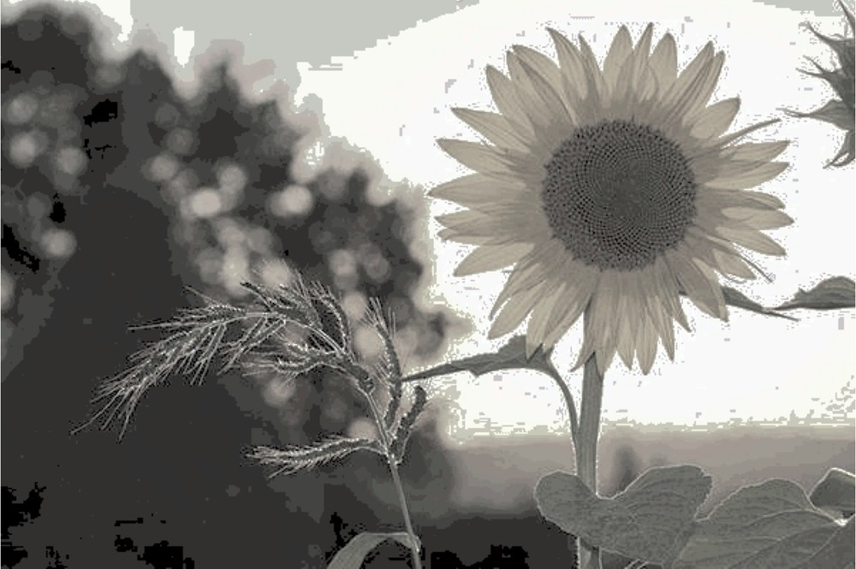
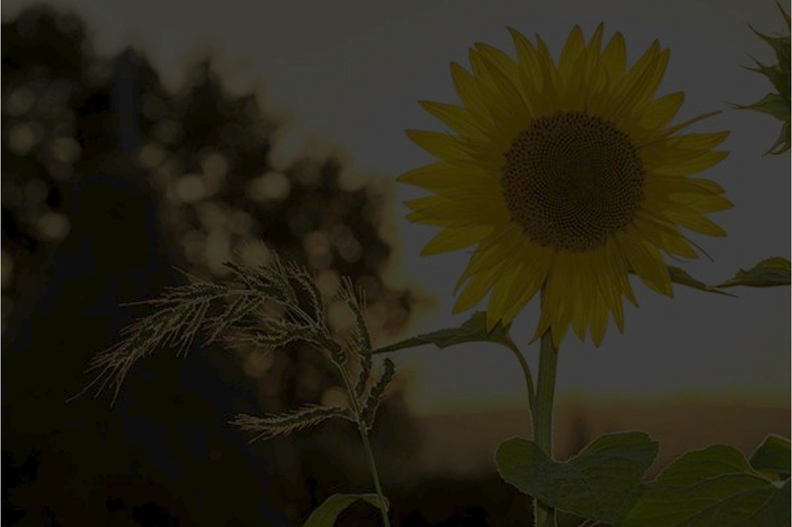
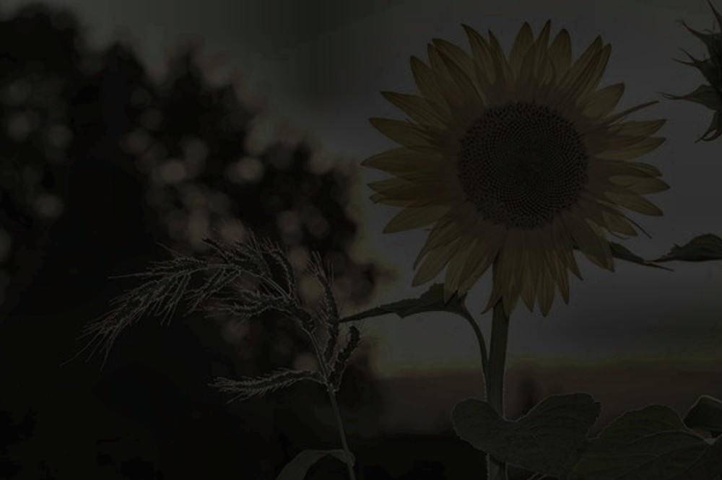
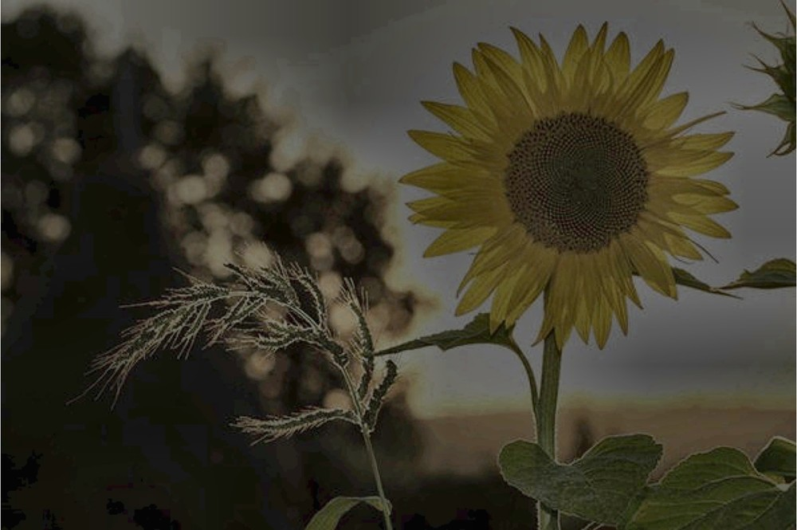
Existing Methodologies: Four Baselines
Method | Main advantage | Main limitation
1. Histogram equalization | Simple; improves global contrast | Can over-enhance; ignores local content
2. Gamma correction | Simple and fast; γ < 1 brightens | One fixed γ does not suit every image
3. CLAHE | Local detail; clip limit restrains amplification | Depends on clip limit and tiles; can amplify noise
4. Fixed gamma + CLAHE | Combines brightening with local contrast | Not guaranteed better; same settings for all images
Histogram eq.
Gamma
CLAHE
Gamma + CLAHE
Gamma correction
Method 4 pipeline
Actual outputs for one image: IMG10_Sunflower, Severe level.
I_{out} = I_{in}^{γ}
Input
Fixed γ
CLAHE
Output
Intensity normalized to [0, 1]. γ < 1 brightens; γ > 1 darkens.
Combining methods does not automatically guarantee better results.
Notes:
MAIN IDEA: Four standard methods that BCGAE is compared against.
- Histogram equalization spreads intensities over the full range; simple, but global, so it can over-enhance.
- Gamma correction: I_out = I_in raised to gamma, with intensity scaled to 0-1. Gamma below 1 brightens, above 1 darkens. One fixed gamma cannot suit all images.
- CLAHE equalizes small tiles and clips the histogram to limit noise amplification. Results depend on clip limit and tile size.
- Method 4 applies a fixed gamma then CLAHE. Combining does not automatically make it better.
- The small images are real outputs on one severely darkened image.
TRANSITION: BCGAE replaces the fixed settings with image-dependent ones.

Slide 7
Proposed Method: BCGAE Parameter Selection
Input low-light image
Luminance conversion
Measure brightness B and contrast C
Select gamma from B and C
Gamma correction
Select CLAHE clip limit from B and C
CLAHE and color reconstruction
Teal steps are the adaptive part of BCGAE; other steps are standard operations.
Brightness B
Contrast C
Parameter selection
B = (1/N) Σ I(x,y)
C = std. dev. of I(x,y)
γ, clip limit = f(B, C)
Mean luminance; N is the number of pixels.
Simple global contrast indicator; does not capture local contrast.
Darker inputs get stronger brightening. The rule is a project-specific heuristic, not claimed optimal.
Baselines: fixed settings for every image. BCGAE: gamma and clip limit chosen per image from B and C.
Notes:
MAIN IDEA: BCGAE measures each image first, then chooses gamma and the CLAHE clip limit from those measurements.
- Flow: convert to luminance, measure brightness B (mean) and contrast C (standard deviation), choose gamma, apply gamma, choose the CLAHE clip limit, apply CLAHE, then rebuild the colour image.
- B = (1/N) times the sum of I(x,y): the mean luminance. C is the standard deviation of luminance, a simple global contrast measure; it does not describe local contrast.
- The selection rule is written f(B, C): it is a project-specific heuristic. Darker images receive stronger brightening. I do not claim these settings are optimal.
- Difference from baselines: baselines use the same settings for every image; BCGAE lets each image decide.
TRANSITION: Let us look at what each method actually produced.

Slide 8
Visual Comparison: Severe Low-Light Example
Original reference
Severe low-light input
Histogram equalization
Gamma correction
Observations (this image)
HE: high contrast; bright areas saturate
Gamma, CLAHE: stay dark
Fixed Gamma + CLAHE: brighter, still dim
BCGAE: brightest recovery, with blocky tinted patches
CLAHE
Fixed gamma + CLAHE
Proposed BCGAE
IMG10_Sunflower, Severe level. A single example from the 10-image evaluation set; visual impression and similarity to the reference can disagree.
Notes:
MAIN IDEA: The same severely darkened image processed by every method, next to the clean reference.
- HE gives strong contrast but saturates the bright sky and looks flattened in places.
- Gamma and CLAHE leave much of the image dark at this severity.
- Fixed Gamma + CLAHE is brighter but still dim.
- BCGAE recovers the most brightness in dark regions, but the dark background shows blocky, colour-tinted patches. That is an artifact of the method on this image, and an honest limitation.
- This is a single example. The numbers on the next slides cover all 150 cases.
TRANSITION: Now the quantitative results.

Slide 9
Results I: Reference-Based Metrics (Mean of 10 Images)
MSE: mean squared pixel difference from the clean reference.
PSNR: pixel-level fidelity to the reference, in dB.
SSIM: structural similarity to the reference; 1 means identical.
Histogram Equalization
Gamma Correction
CLAHE
Fixed Gamma + CLAHE
Proposed BCGAE
Notes:
MAIN IDEA: How close each method's output is to the clean reference, at each degradation level (mean of 10 images).
- MSE: lower is better. At Severe, BCGAE has the lowest MSE (1473.5), HE is next (1704.6), and CLAHE is far higher (11137.4).
- PSNR: higher is better. At Severe, HE is slightly higher (17.30 dB) than BCGAE (17.06 dB).
- SSIM: higher is better. At Severe, BCGAE is highest (0.816). At Mild, CLAHE is highest (0.912) and BCGAE is lowest (0.832).
- Notice how the baselines (especially CLAHE and Gamma) fall sharply as degradation gets worse, while BCGAE's SSIM barely changes.
TRANSITION: Next, the descriptive metrics and runtime.

Slide 10
Results II: Entropy, Contrast and Runtime
Entropy: spread of intensity information. Higher is not always better.
Contrast: luminance standard deviation. Higher is not always better.
Measured runtime depends on hardware and software environment.
Histogram Equalization
Gamma Correction
CLAHE
Fixed Gamma + CLAHE
Proposed BCGAE
Notes:
MAIN IDEA: Descriptive metrics and cost. These are not "higher is better" scores.
- Entropy: HE is highest at Mild and Moderate (7.75 and 7.39). At Severe, BCGAE has the highest entropy (6.89).
- Contrast (luminance standard deviation): HE stays around 71 to 72 at every level, which reflects a very strong stretch, and in the sample image that came with saturated regions. BCGAE ranges from 47.1 (Mild) to 33.6 (Severe).
- Runtime (mean over 30 timings per method: 10 images x 3 levels): Gamma 0.54 ms, HE 3.17, CLAHE 3.31, fixed Gamma + CLAHE 3.89, BCGAE 6.77 ms mean (3.77 ms median). So BCGAE is about 2.1 times HE in mean time. One image (IMG3_Elephant) took much longer for every method, which pulls the means above the medians.
- Timing depends on the hardware and software environment, so treat it as relative cost, not an absolute speed claim.
TRANSITION: Here is everything in one table.

Slide 11
Quantitative Summary
Method | MSE ↓ |  |  | PSNR (dB) ↑ |  |  | SSIM ↑
 | Mild | Moderate | Severe | Mild | Moderate | Severe | Mild | Moderate | Severe
Histogram Equalization | 1246.1 | 1330.9 | 1704.6 | 18.31 | 18.13 | 17.30 | 0.840 | 0.819 | 0.736
Gamma Correction | 985.1 | 3903.4 | 8184.6 | 18.83 | 12.65 | 9.33 | 0.903 | 0.739 | 0.459
CLAHE | 1865.8 | 5830.9 | 11137.4 | 16.53 | 10.92 | 7.97 | 0.912 | 0.656 | 0.279
Fixed Gamma + CLAHE | 994.3 | 2083.1 | 5333.0 | 18.83 | 15.91 | 11.47 | 0.890 | 0.895 | 0.709
Proposed BCGAE | 1917.5 | 1873.4 | 1473.5 | 16.04 | 15.83 | 17.06 | 0.832 | 0.826 | 0.816
Mean over 10 images per level. Shaded bold teal = best value in that column.
Severe: BCGAE has the lowest MSE (1473.5) and highest SSIM (0.816); HE has the highest PSNR (17.30 dB vs 17.06 dB).
Moderate: HE leads on MSE and PSNR; fixed Gamma + CLAHE leads on SSIM (0.895); BCGAE is second on MSE and SSIM.
Mild: BCGAE ranks last of five on MSE, PSNR and SSIM; Gamma (MSE), fixed Gamma + CLAHE (PSNR) and CLAHE (SSIM) are best.
Notes:
MAIN IDEA: One table with the mean MSE, PSNR and SSIM for every method at every level. BCGAE is best on some severe-level metrics, not on all.
- Read it level by level, using the three bullets at the bottom.
- Remember: MSE lower is better; PSNR and SSIM higher is better.
- The table is rounded for display; values come directly from mean_metrics_by_level.csv.
FULL MEAN VALUES (from the CSV):
Mild: Histogram Equalization MSE 1246.0920, PSNR 18.3136 dB, SSIM 0.840239, Entropy 7.7468, Contrast 71.9813; Gamma Correction MSE 985.0557, PSNR 18.8263 dB, SSIM 0.902780, Entropy 6.7769, Contrast 33.7282; CLAHE MSE 1865.7865, PSNR 16.5337 dB, SSIM 0.912110, Entropy 7.1835, Contrast 43.4678; Fixed Gamma + CLAHE MSE 994.3484, PSNR 18.8342 dB, SSIM 0.889972, Entropy 7.3625, Contrast 45.5767; Proposed BCGAE MSE 1917.4904, PSNR 16.0388 dB, SSIM 0.831858, Entropy 7.4144, Contrast 47.0555
Moderate: Histogram Equalization MSE 1330.8520, PSNR 18.1321 dB, SSIM 0.819167, Entropy 7.3945, Contrast 71.6135; Gamma Correction MSE 3903.4195, PSNR 12.6479 dB, SSIM 0.738660, Entropy 6.1731, Contrast 22.2997; CLAHE MSE 5830.8677, PSNR 10.9156 dB, SSIM 0.655559, Entropy 6.3769, Contrast 26.0687; Fixed Gamma + CLAHE MSE 2083.1435, PSNR 15.9055 dB, SSIM 0.894620, Entropy 6.9819, Contrast 35.4116; Proposed BCGAE MSE 1873.4041, PSNR 15.8319 dB, SSIM 0.826134, Entropy 7.1769, Contrast 40.9100
Severe: Histogram Equalization MSE 1704.5814, PSNR 17.2952 dB, SSIM 0.736227, Entropy 6.1842, Contrast 70.9118; Gamma Correction MSE 8184.5969, PSNR 9.3312 dB, SSIM 0.459438, Entropy 5.3257, Contrast 13.0592; CLAHE MSE 11137.4465, PSNR 7.9743 dB, SSIM 0.279216, Entropy 4.9646, Contrast 9.1773; Fixed Gamma + CLAHE MSE 5332.9527, PSNR 11.4743 dB, SSIM 0.708777, Entropy 6.2992, Contrast 22.7855; Proposed BCGAE MSE 1473.5183, PSNR 17.0632 dB, SSIM 0.815612, Entropy 6.8913, Contrast 33.5700
TRANSITION: What does this tell us about trade-offs?

Slide 12
Discussion: Trade-offs in the Measurements
Visibility vs similarity
Consistency across levels
MSE, PSNR and SSIM measure closeness to the clean reference, not how visible details look. In the sample image, HE gives high contrast but saturates bright areas; Gamma and CLAHE stay dark; BCGAE brightens most but adds blocky tinted patches.
BCGAE's mean SSIM stays between 0.816 and 0.832 over the three levels (range 0.016). The range is 0.104 for HE, 0.186 for fixed Gamma + CLAHE and 0.633 for CLAHE. HE is also steady in PSNR (range 1.0 dB vs 1.2 dB for BCGAE).
Where BCGAE helps and where it does not
Descriptive metrics and cost
Severe: best SSIM on 7 of 10 images and lowest MSE on 4 of 10. Mild: not the best on any of the 10 images for SSIM or MSE, so fixed methods fit the reference better when degradation is light.
Entropy and contrast are descriptive: HE has contrast 70.9–72.0 at every level, BCGAE 47.1 falling to 33.6. BCGAE runtime is about 2.1× HE in mean time (6.77 vs 3.17 ms) and about 1.7× fixed Gamma + CLAHE; timing depends on the environment.
Notes:
MAIN IDEA: BCGAE is competitive and consistent, not universally best.
- Visibility vs similarity: a method can look brighter and still be less similar to the clean reference, and the reverse. I report both.
- Consistency: BCGAE's SSIM changes by only 0.016 across levels, compared with 0.104 for HE, 0.186 for fixed Gamma + CLAHE and 0.633 for CLAHE. That supports the idea of image-dependent parameters. HE is similarly steady in PSNR, so I do not claim consistency as an advantage on every metric.
- Per-image: at Severe, BCGAE has the best SSIM on 7 of 10 images and the lowest MSE on 4 of 10. At Mild it is best on none, so simpler methods are better when the image is only lightly degraded.
- Entropy and contrast are descriptive. Very high contrast, as in HE, does not mean a better image.
- Cost: BCGAE is about 2.1 times HE in mean runtime (6.77 vs 3.17 ms), measured in my environment.
TRANSITION: Finally, the limitations and what comes next.

Slide 13
Limitations, Future Work and Conclusion
Limitations
Future work
Synthetic darkening: no real sensor noise or color shifts
Only 10 images and 3 degradation levels
BCGAE heuristic is not tuned or validated beyond this set
Visible blocky, tinted artifacts in dark regions of the sample
Reference-based metrics may not match perceived quality
Test on real low-light photographs
Local brightness estimation and noise-aware selection
Tune and validate the rule on held-out images
Reduce artifacts and improve color preservation
Larger dataset, perceptual metrics, other method families [3], [4]
Conclusion On synthetic low-light images, BCGAE was competitive at Severe degradation (lowest MSE, highest SSIM), and its SSIM was the most stable across levels. It was not best on all metrics and ranked last at Mild. It is a project-specific heuristic, not a new algorithm.
Notes:
MAIN IDEA: Be honest about the limits, then summarise.
- Limitations: darkening is synthetic; only 10 images and 3 levels; the heuristic is not tuned or validated beyond this set; the sample shows visible artifacts; and reference-based metrics do not capture everything about perceived quality.
- Future work: real low-light photos, local brightness estimation, noise-aware parameters, validation on held-out images, artifact reduction, a larger dataset and perceptual metrics, and comparison with other method families reviewed in [3] and [4].
- Conclusion: BCGAE was competitive at Severe degradation and most stable in SSIM, but not best on all metrics, and worst at Mild. It is a project-specific heuristic, not a new algorithm.
TRANSITION: These are my references. Thank you; I am happy to take questions.

Slide 14
References
[1] S. M. Pizer et al., “Adaptive histogram equalization and its variations,” Computer Vision, Graphics, and Image Processing, vol. 39, no. 3, pp. 355–368, 1987, doi: 10.1016/S0734-189X(87)80186-X.
[2] K. Zuiderveld, “Contrast Limited Adaptive Histogram Equalization,” in Graphics Gems IV, pp. 474–485, 1994, doi: 10.1016/B978-0-12-336156-1.50061-6.
[3] W. Wang, X. Wu, X. Yuan, and Z. Gao, “An Experiment-Based Review of Low-Light Image Enhancement Methods,” IEEE Access, vol. 8, pp. 87884–87917, 2020, doi: 10.1109/ACCESS.2020.2992749.
[4] J. Guo, J. Ma, Á. F. García-Fernández, Y. Zhang, and H. Liang, “A survey on image enhancement for Low-light images,” Heliyon, vol. 9, no. 4, Art. no. e14558, 2023, doi: 10.1016/j.heliyon.2023.e14558.
Thank you.
Notes:
MAIN IDEA: Every in-slide citation [1]-[4] maps to one entry here.
- [1] and [2] are the foundational adaptive histogram equalization and CLAHE references; [3] and [4] are a review and a survey of low-light enhancement.
- Close by thanking the audience and inviting questions.
POSSIBLE QUESTIONS: Why is BCGAE worse at Mild? (The data show it; a possible reason is that light degradation needs little correction while the heuristic still adjusts the image. That is a hypothesis I have not tested.) Why synthetic darkening? (It gives a clean reference for controlled comparison; real images are future work.) Why is runtime higher? (It computes B and C and selects parameters before enhancing.)

