Slide 1
Data Pipeline
Bootcamp Student Edition
By Shaheer Khan

Slide 2
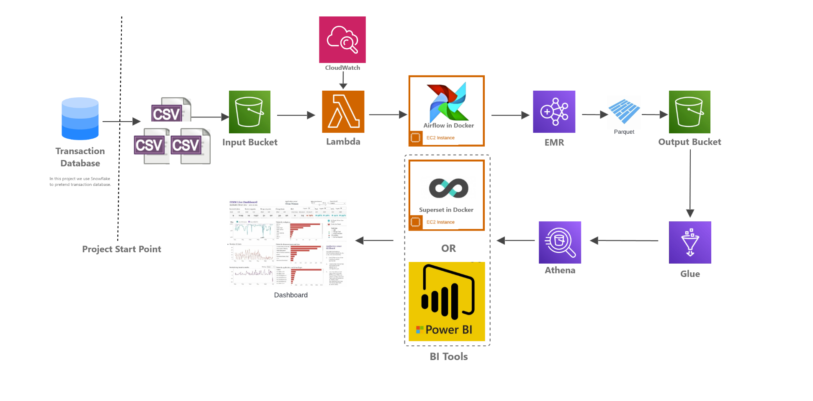
Architecture 1

Slide 3
Table of Contents
Architecture: 1
Tool: Airflow
1
Problem Statement
Tool: EMR
2
Tool: S3 Bucket
Tool: Athena and Glue
3
Tool: Cloudwatch + Lambda
BI Tools (Superset)

Slide 4

Architecture 1
We are here

Slide 5
Transactional Database: Snowflake
Tasks
Part B: Creating Integrations with S3 for data dump
Create a staging layer
Grant the appropriate permissions and Roles
The following tasks were completed in snowflake to set up data extraction from the makeshift transactional database (Snowflake):
Part A: Setting up
Set up a warehouse
Create and use databases
Create and use schema
Create and use the tables for sales, product, store, calendar, inventory
Part C: Creating Stored Procedure using Python to automate data dumping to S3 from Snowflake
Show demo of the script

Slide 6
Architecture 1
We are here

Slide 7
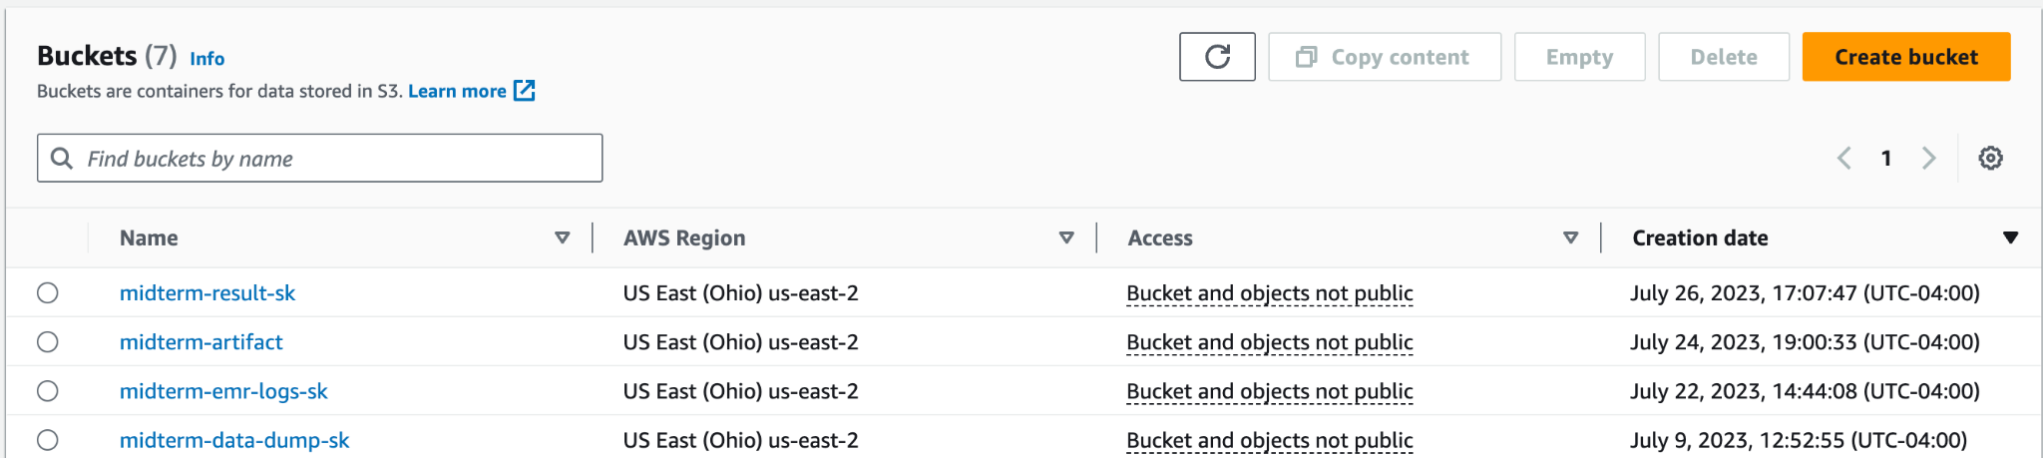
Data Lake: S3 Bucket
Tasks
Tip:
Don't forget to store the latest pyspark code in the midterm-artifact bucket using the CLI command in terminal
aws s3 cp transformation.py s3://midterm-artifact
The following buckets were created:
midterm-result-sk: to store output files from emr transformation
midterm-artifact: to store the pyspark code
midterm-emr-logs-sk: to store logs from the emr cluster
midterm-data-dump-sk: to store csvs from snowflake (our transactional database/OLTP)

Slide 8
Architecture 1
We are here

Slide 9
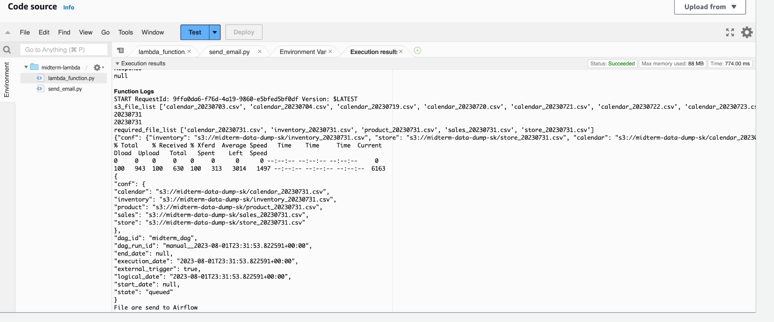
Cloudwatch + Lambda
Tasks
Output
Part A: Check Files are ready for EMR
Scan S3 bucket to check if all ‘today’s’ files are ready, when all are ready, send a signal to airflow to start EMR;
Part B: Email Alert
If files are not ready, send an email to inform you that today’s files are not ready

Slide 10
Architecture 1
We are here

Slide 11
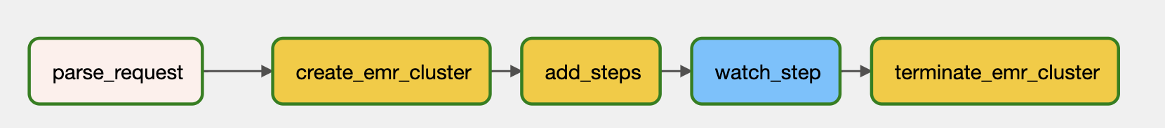
Airflow
Tasks
Problems/Things Learned
After Lambda sends a signal to Airflow, the Airflow will unpack the data from Lambda as the parameter for EMR and store in xcoms.
The following tasks were done in airflow:
Once signal from Lambda is received, then automatically start the EMR cluster
Then execute the steps in EMR to transform the data
Then terminate the EMR cluster once the transformation is done
I ran into the following problems:
Debugging Errors in the dags (show demo)
Permission Errors
Creating AWS connections in Airflow
Automating cluster creation and termination
Printing output of tasks in airflow (show demo)
Use this command in cloud shell to get cluster details to help automate the creation of cluster
aws emr describe-cluster --cluster-id j-1K48XXXXXXHCB

Slide 12
Architecture 1
We are here

Slide 13
EMR
Task
Problems/Things Learned
Next Steps:
The following tasks were carried out using AWS EMR:
Read data from S3 using xcom values ingested using Spark Steps arguments (show demo)
TO BE CONTINUED: Do data transformation process to generate a dataframe to meet the business requirement
TO BE CONTINUED: After transformation, save the final dataframe as a parquet file to a new S3 output bucket. Copy the files of store, product and calendar (previously dumped to S3 bucket) to the new output S3 bucket. So the new parquet file together with the store, product and calendar files in the output folder will be used for later data analysis with Athena
Using argparse library to read in Airflow xcoms (show demo)
Debugging roles and permissions for EC2 and S3 and EMR
Running Spark Jobs locally instead of an EMR to test code (show demo)
Doing transformation work on Databricks for ease of use
Get a new data set and do the transformations
Save the transformed data as a parquet file
Use the same infrastructure and refine pyspark code

Slide 14
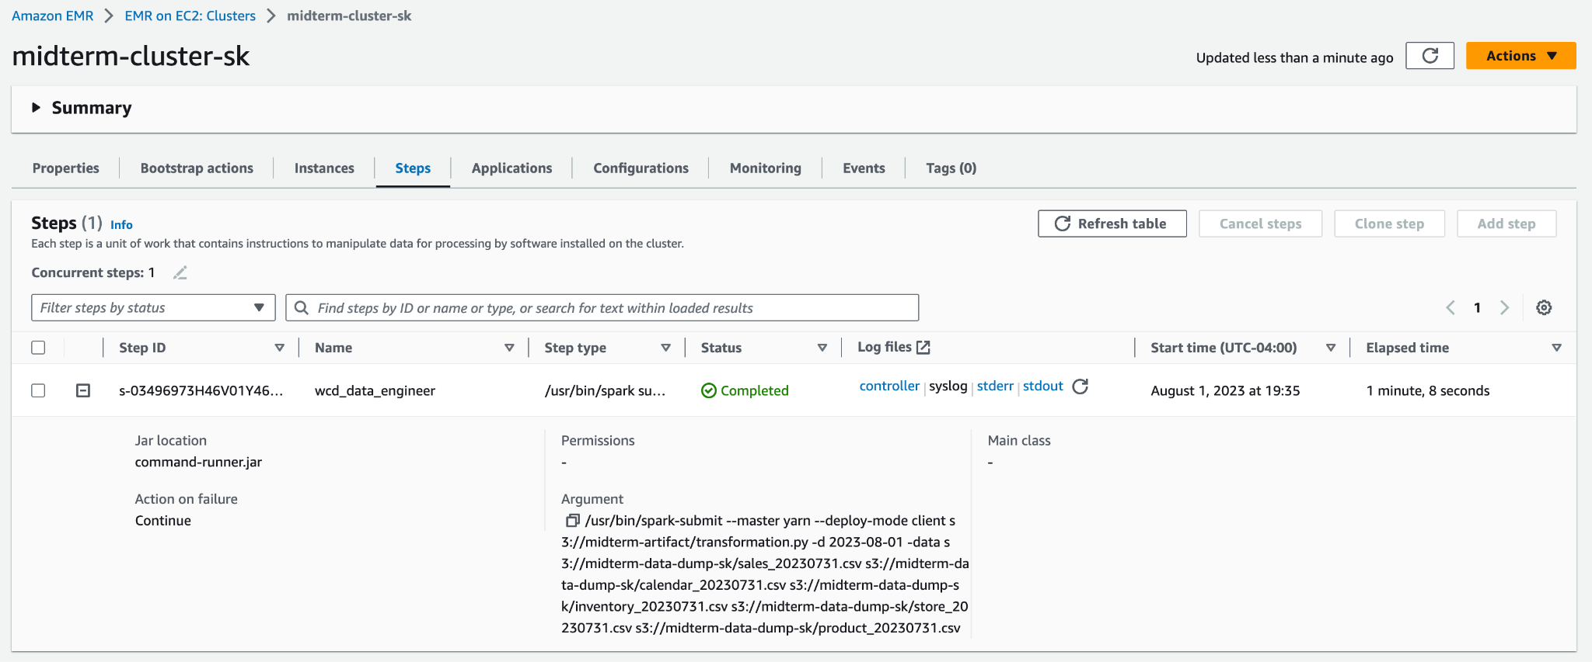
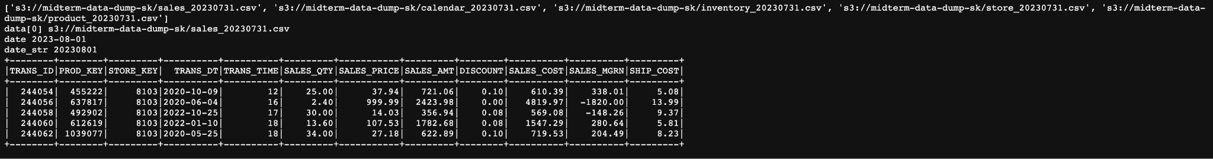
EMR
Snippets of Output

Slide 15
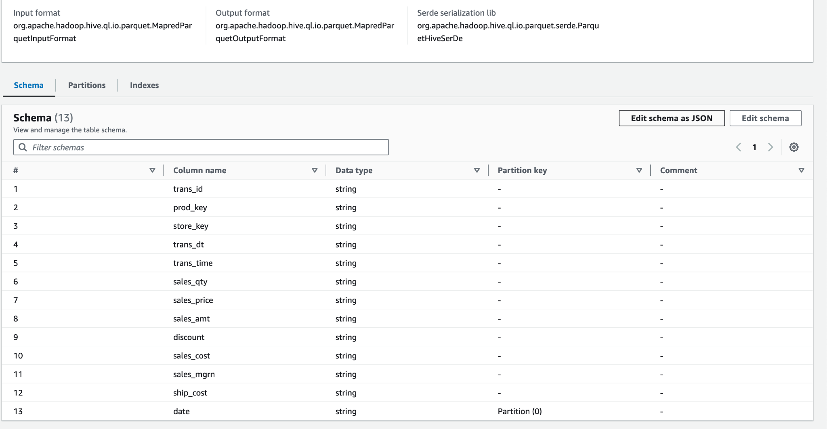
Athena and Glue
Explore fixing schema in Glue to get better insights

Slide 16
BI Tools (Superset)
Unfortunately was not able to get to this part

