Slide 1


SMART INDIA HACKATHON 2024
Problem Statement ID – SIH1587
Problem Statement Title- Student Innovation
Theme- Disaster Management
PS Category- Software Team Name- Disentangle Final output of Theme-App
Theme Name- Disaster-Retter

Slide 2


DISASTER - RETTER
Disentangle
Introducing the AI-Enhanced Disaster Management Application, a powerful solution that uses AI to improve disaster management. It provides up-to-date,
accurate information in emergencies. Here’s a quick overview:
Our approach involves:
Using AI for real-time disaster alerts, weather updates, and news.
Providing tools for locating shelters, hospitals, and coordinating volunteers and donations.
Supporting animal rescue, offering emergency contacts, transport info, and health and safety guidelines, including CPR and first aid instructions.
Ensuring offline access to essential features during connectivity issues.
Benefits include real-time AI-driven updates, improved resource management, and streamlined donations and volunteer coordination with offline access and health guidelines.

Slide 3
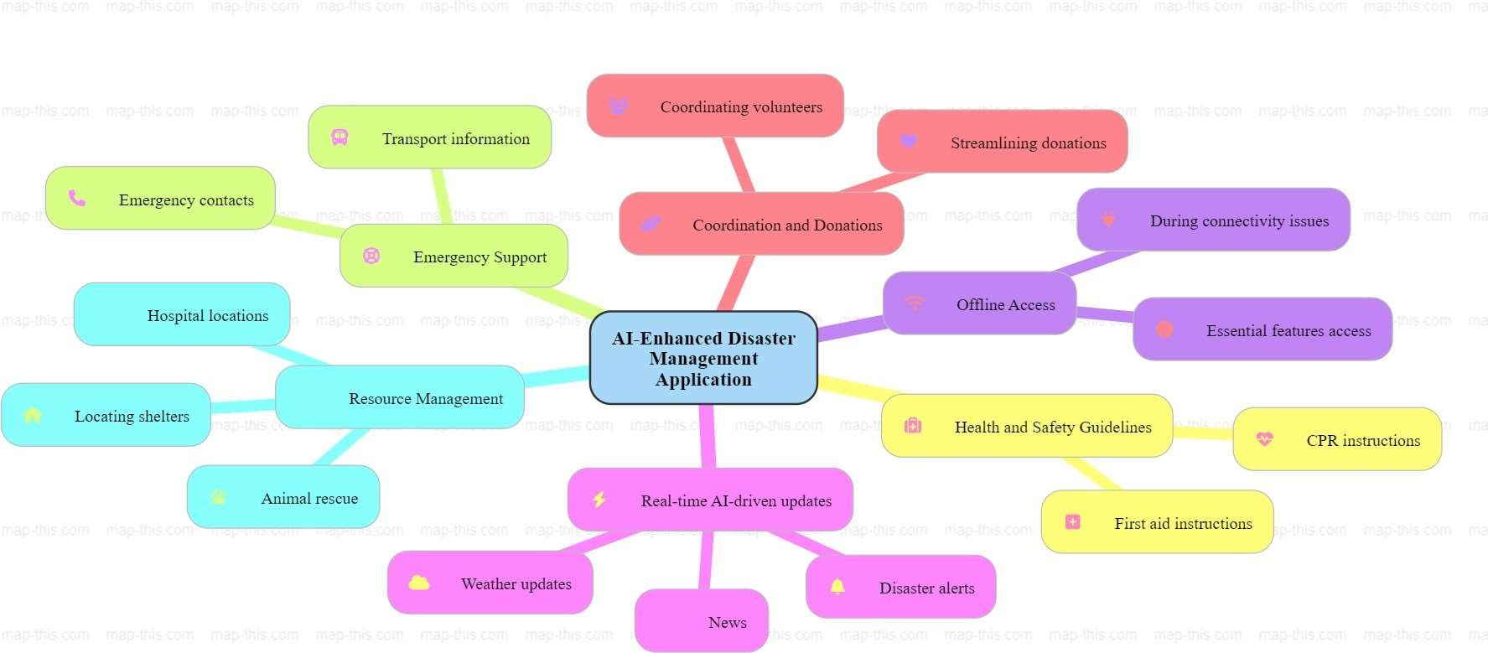
TECHNICAL APPROACH
Disentangle
Technologies Used 1.AITools: TensorFlow,PyTorch 2.Languages & Frameworks: Python,JavaScript, React Native 3.Cloud&Databases: AWS,GoogleCloud, SQL, NoSQL
4.APIs&OfflineAccess
GPS,WeatherAPIs, Service Workers 5.Security&Design: OAuth,HTTPS,Adobe XD, Figma

Slide 4
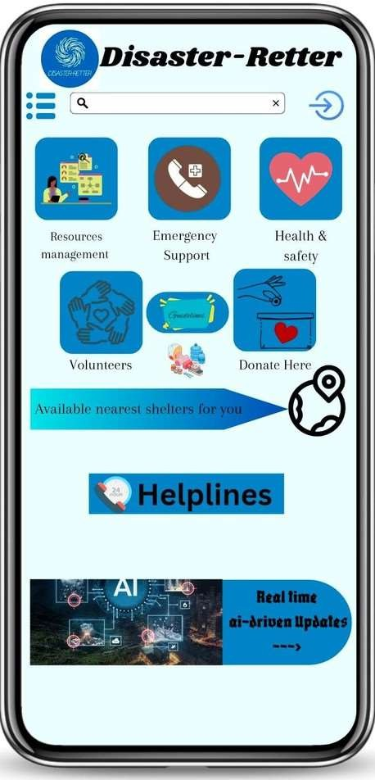
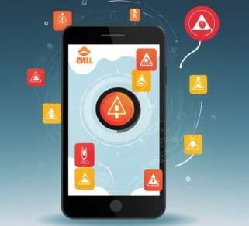
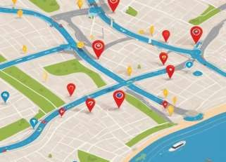

FEASIBILITY AND VIABILITY
Disentangle
Feasibility :
Technological Infrastructure:
Uses AI and cloud computing.
Requires stable internet and data integration.
Integrates with existing emergency systems
Human Resources:
Needs IT expertise for development and maintenance.
Requires user training.
Viability :
Efficiency and Transparency:
Streamlines disaster response.
Enhances accountability with real-time updates.
Stakeholder Acceptance:
Ensures adoption by users and emergency services.

Slide 5
IMPACT AND BENEFITS
Disentangle
Potential Impact on the Target Audience
Greater Protection: Provides immediate updates and essential guidance in emergencies.
Efficient Management: Enhances coordination between emergency
services and volunteers.
Benefits of the Solution
Social: Boosts safety and community involvement.
Economic: Cuts down disaster costs and minimizes resource wastage.
Environmental: Helps reduce ecological damage and improves resource efficiency.

Slide 6
RESEARCH AND REFERENCES
Disentangle
Research Summary
Real-Time Disaster Alerts: Timely alerts improve disaster response. (Gao et al., 2018) Animal Rescue Operations: Tech enhances animal rescue efficiency. (Smith et al., 2020) Shelter Coordination: Digital tools streamline shelter management. (Harrison et al., 2019) Health and Safety Guidelines: Essential for effective response. (Wilson & Lewis, 2021) Offline Functionality: Ensures app access during outages. (Cheng et al., 2017)
References
Gao, H. et al. (2018). Journal of Computer Applications.
Smith, T. et al. (2020). International Journal of Disaster Risk Reduction. Harrison, S. et al. (2019). Emergency Management Review.
Wilson, J. & Lewis, R. (2021). Journal of Emergency Medical Services. Cheng, H. et al. (2017). IEEE Transactions on Mobile Computing.

