Slide 1
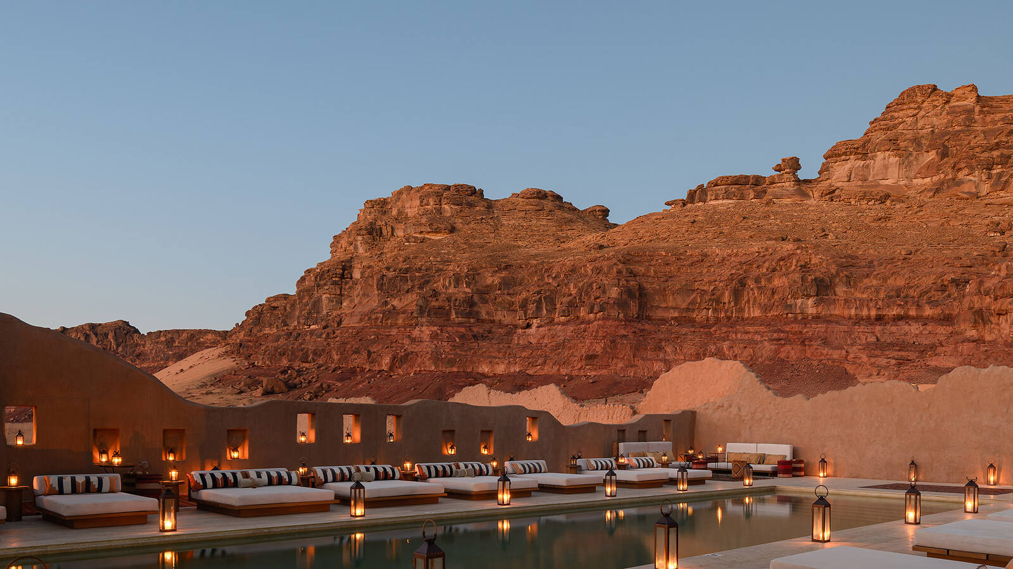
Quinta do Vale Verde, Arrábida, by The Atrium.

Slide 2

The opening line
Wake to cork oak and vineyard rows, thirty minutes from Lisbon. The asset will be developed as an integrated branded luxury destination, combining complementary hospitality and lifestyle components within the estate, one experience under The Atrium.
‹#›
|

Slide 3
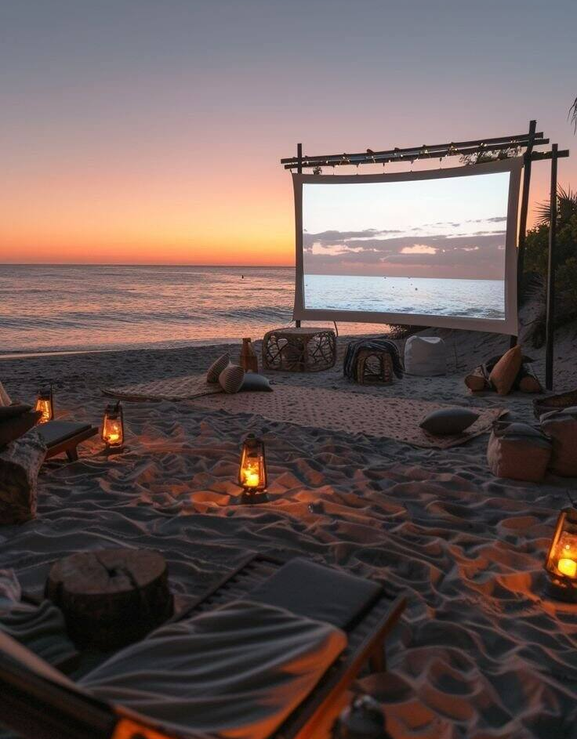
Vision
Quinta do Vale Verde is an Arrábida estate still being drawn, not delivered finished. Thirty minutes from Lisbon, it keeps guests, residents and neighbours at one table and in the same open air, whatever shape its villas, wellness and clubhouse take.
‹#›
|

Slide 4
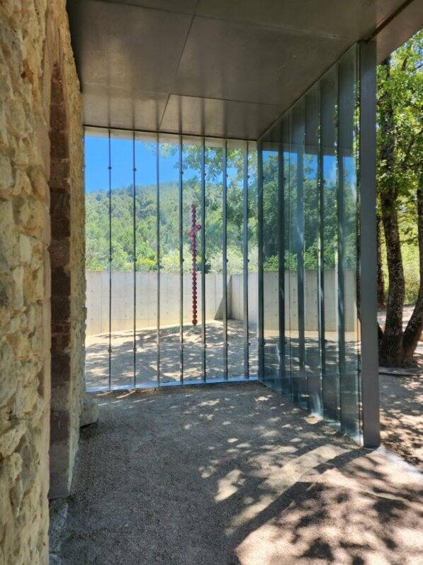
Mission
To make the proposed villas, wellness space and clubhouse work as one plan, not three ventures, the estate would run under a single brand and one operating standard for every guest, owner and member. For Larkfield, new to hospitality, that means one system, not three.
‹#›
|

Slide 5
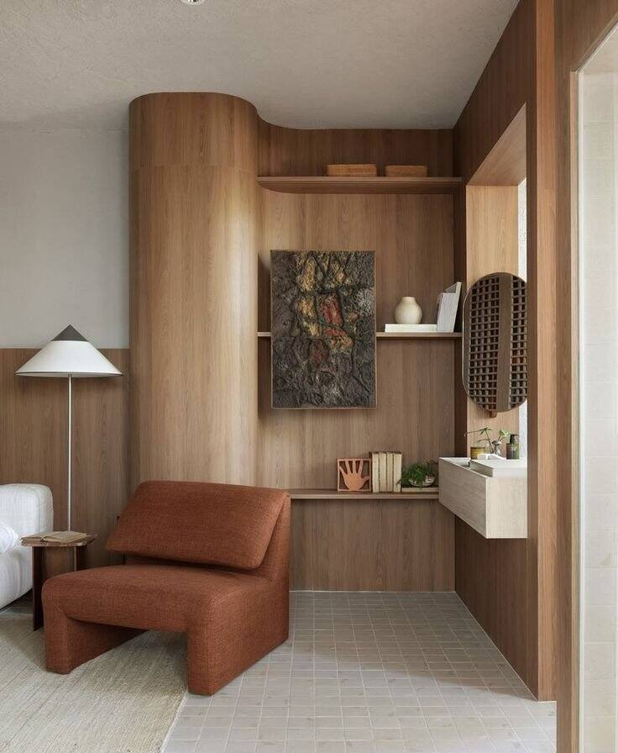
Residences & villas
A gate, then vineyard rows, then a villa door standing open. Twenty-five villas proposed alongside twenty-eight suites, one estate meant to be sold, filled and run under a single brand and a single operating model.
‹#›
|

Slide 6
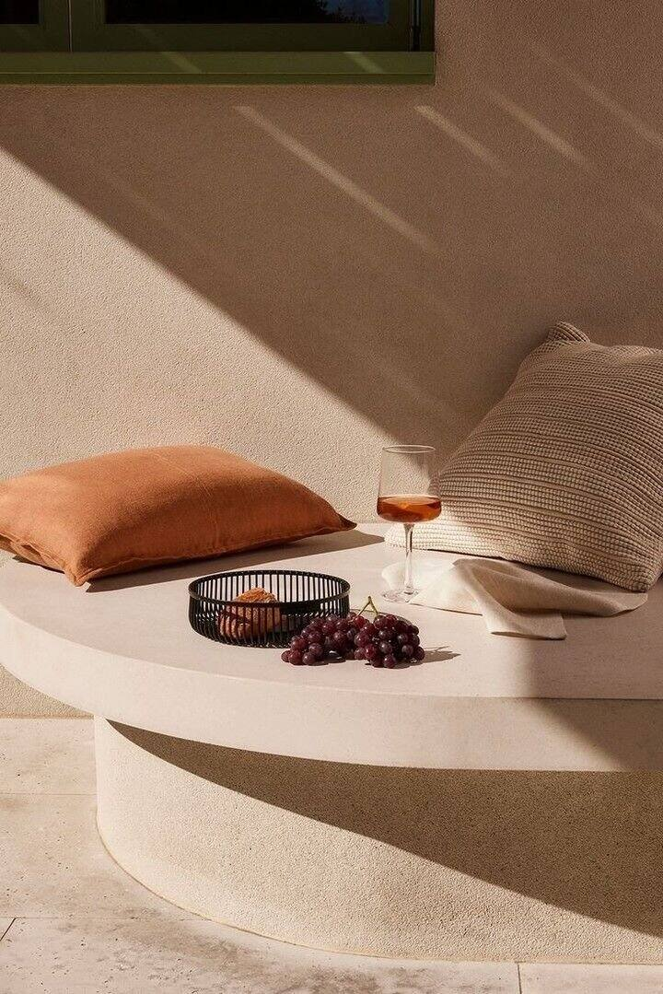
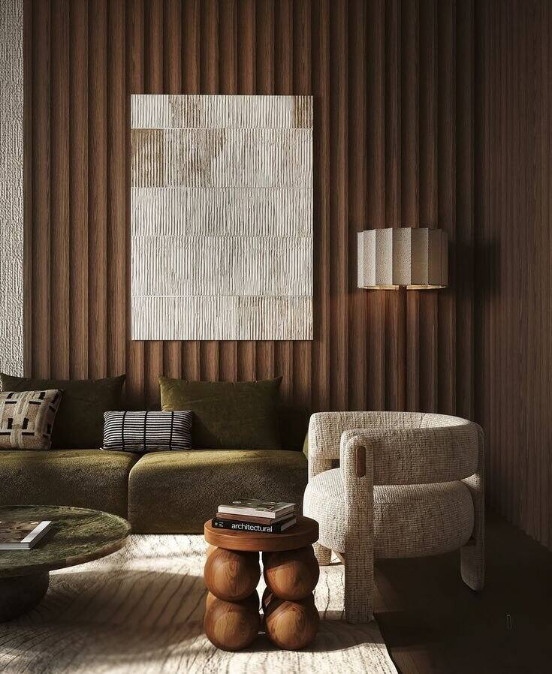
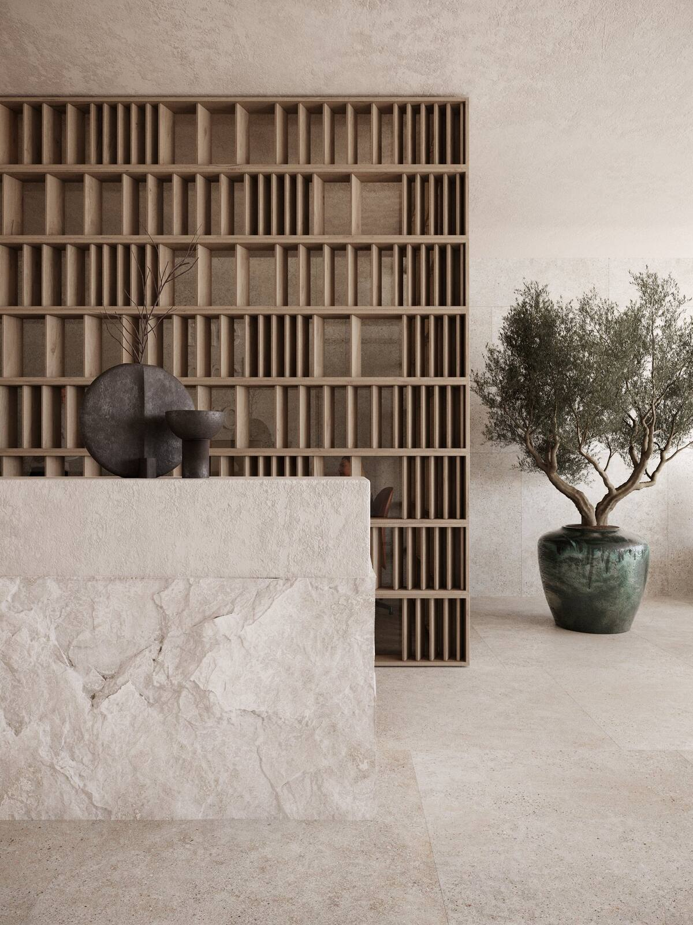
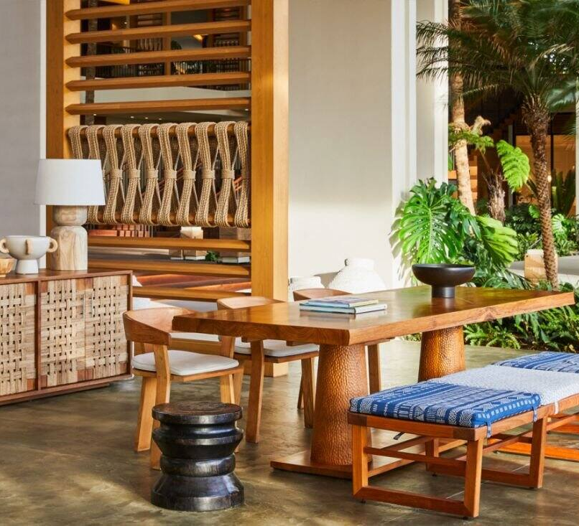
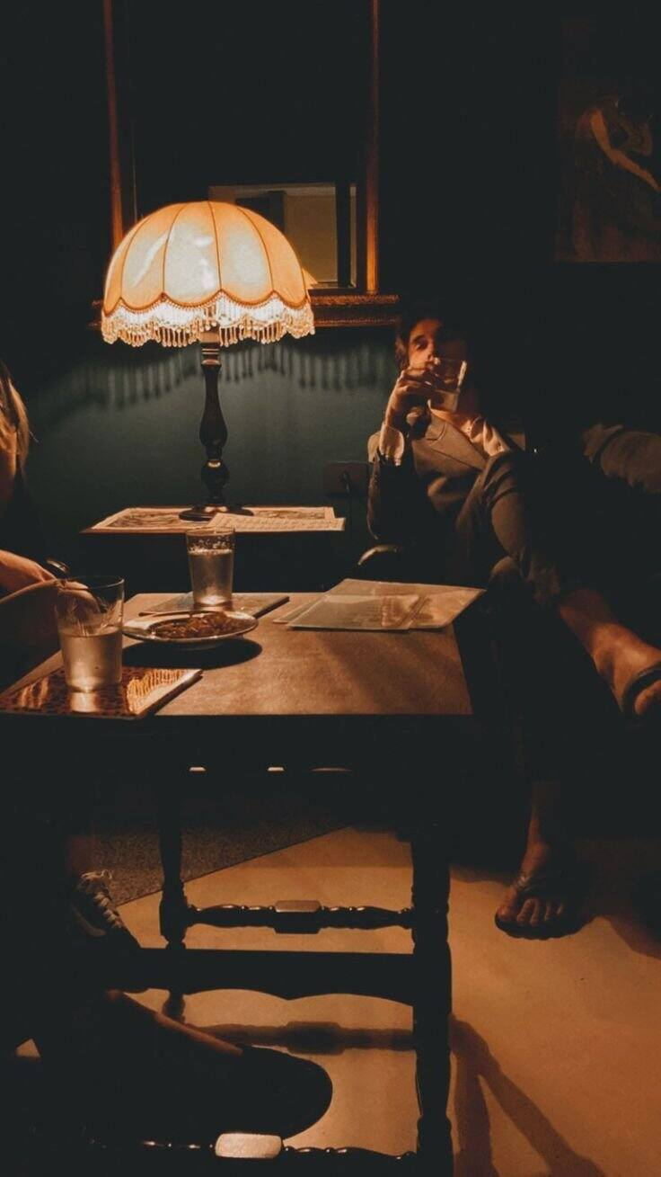
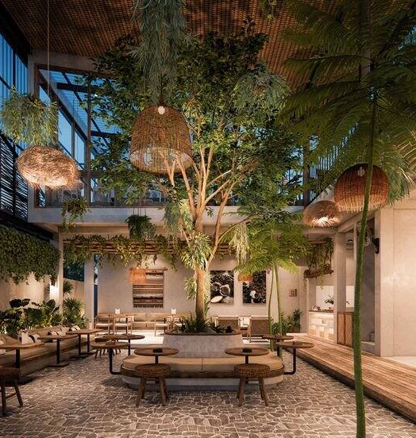
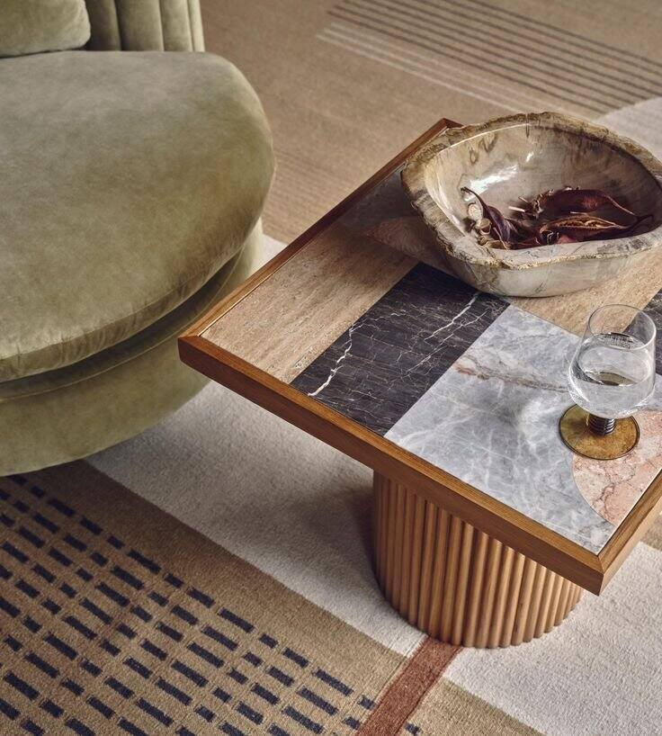
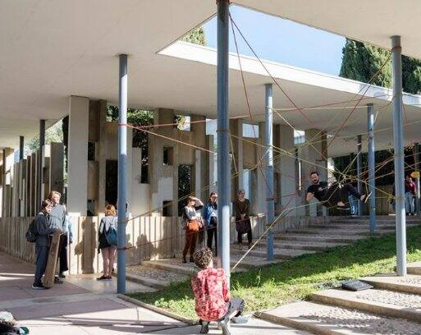
Lobby & Common Areas
‹#›
|

Slide 7
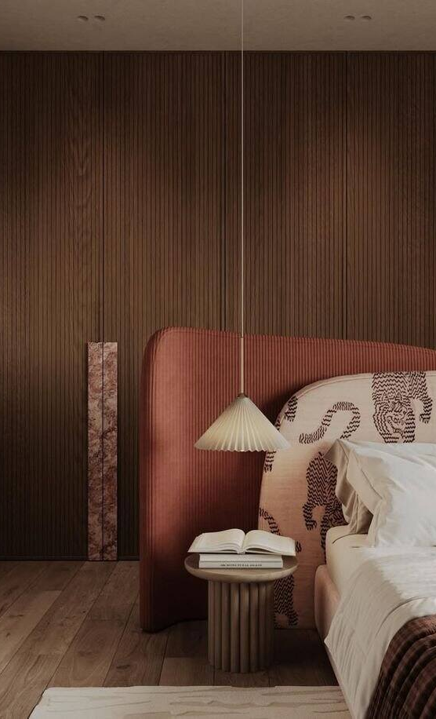
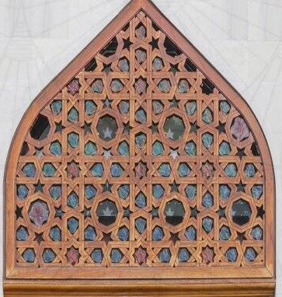
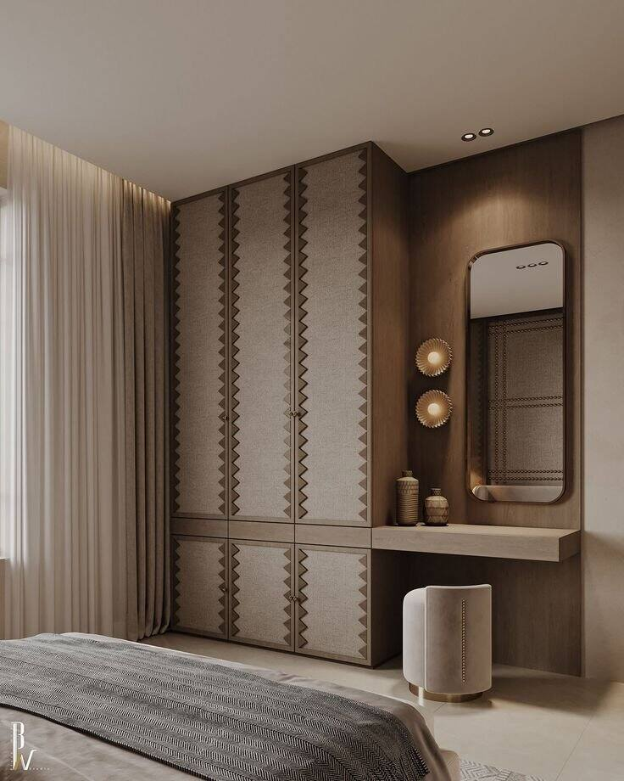

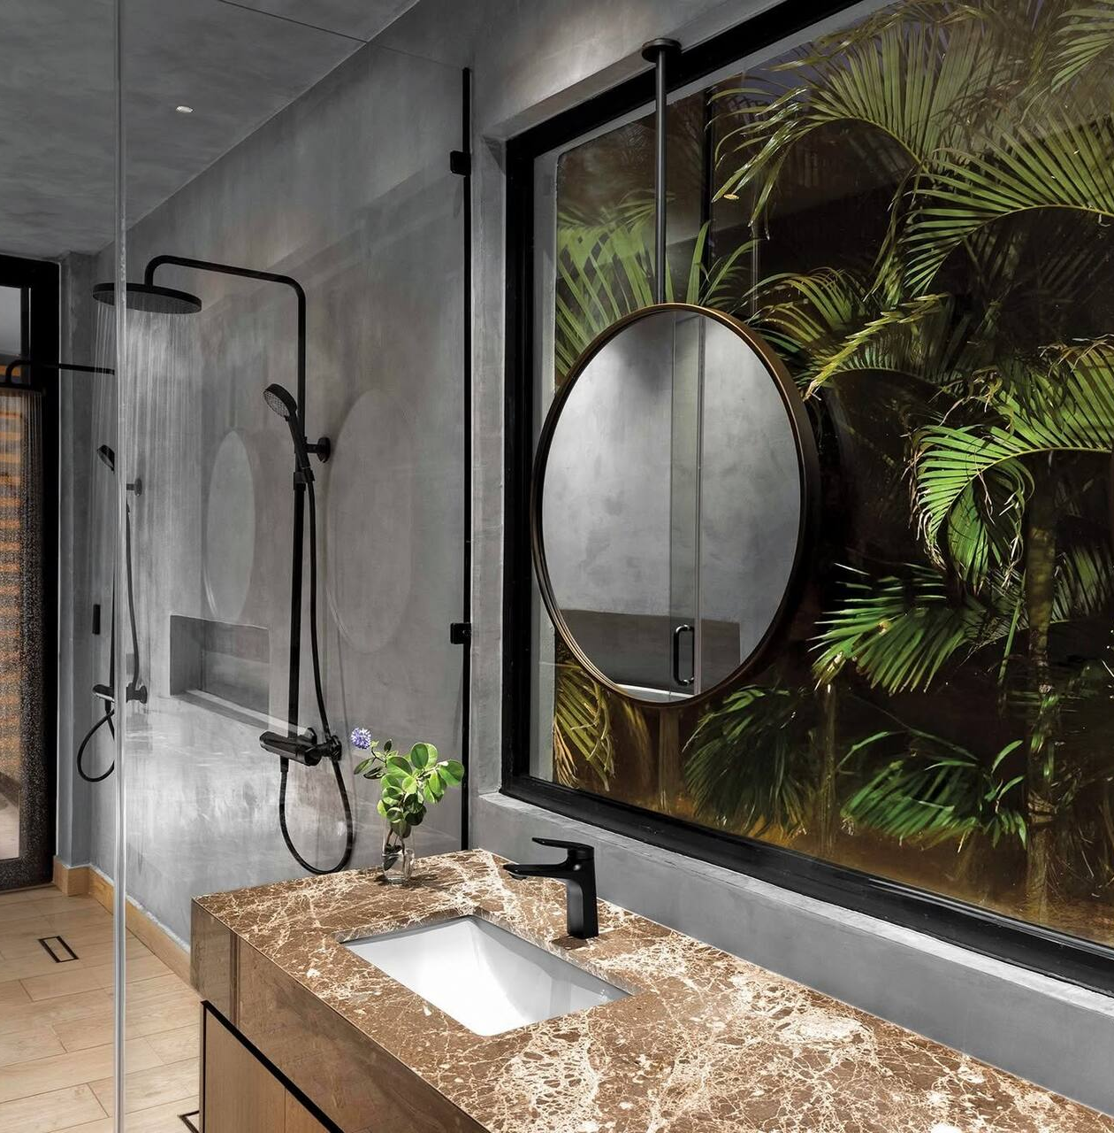
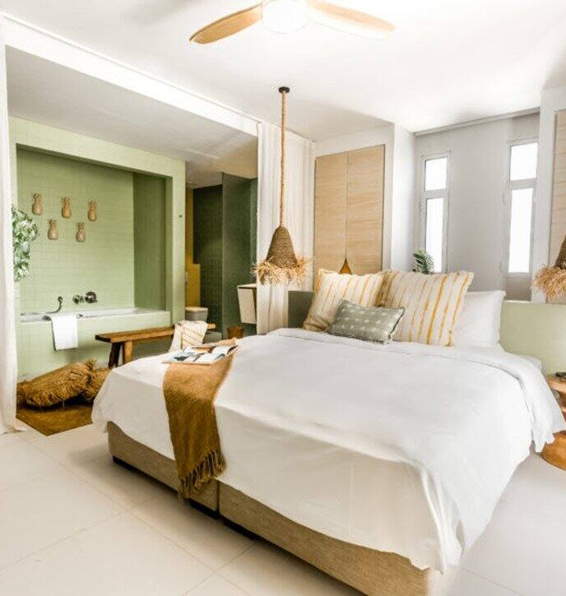
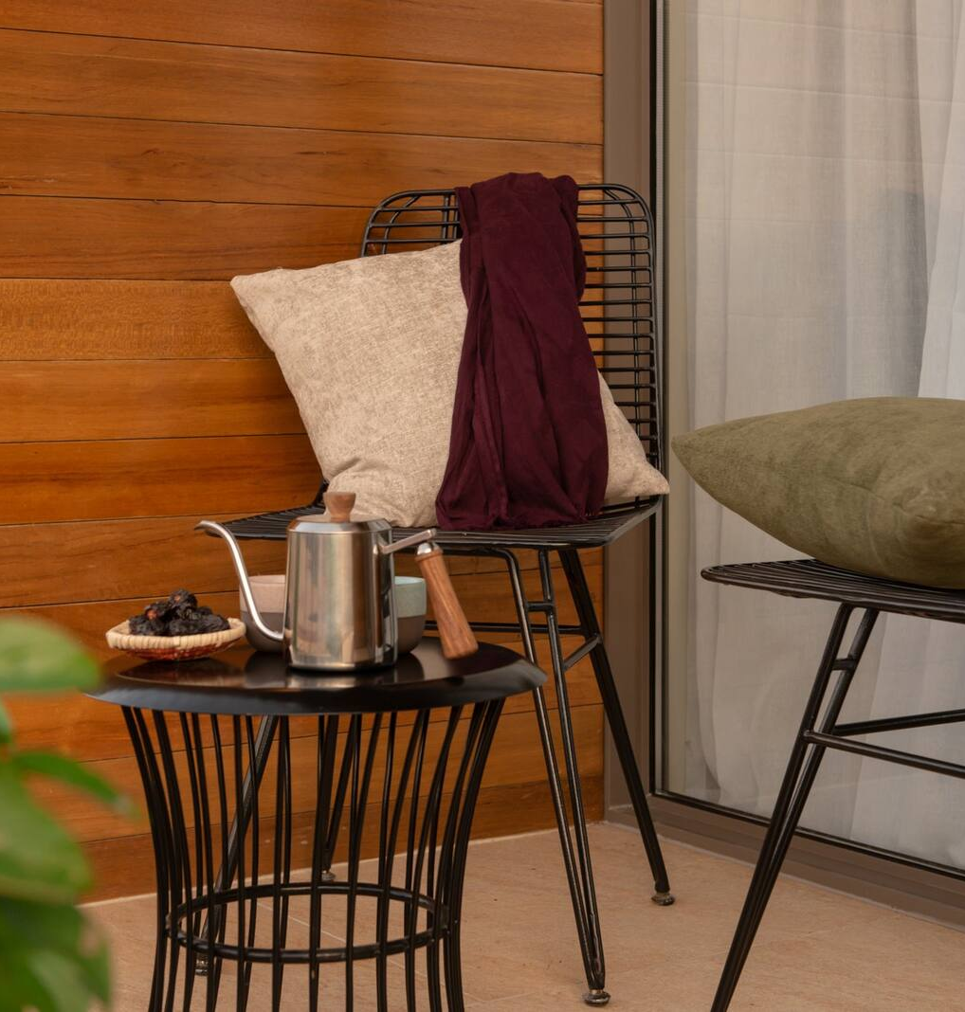
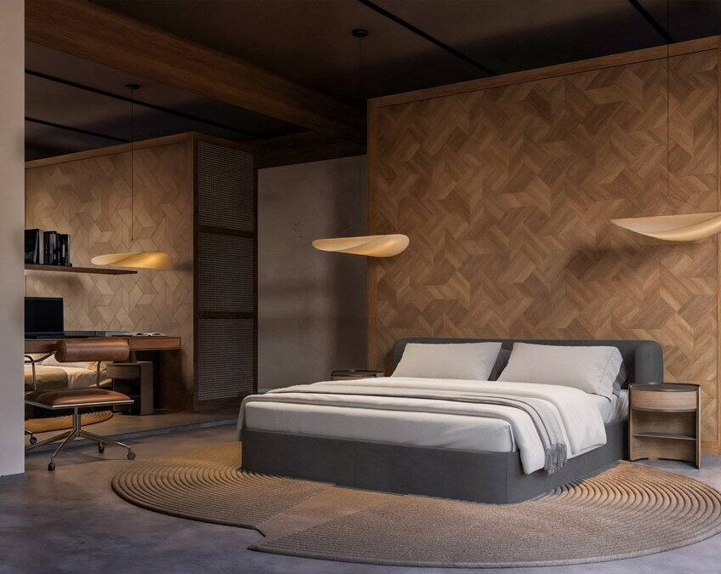
Rooms & Suites
‹#›
|

Slide 8
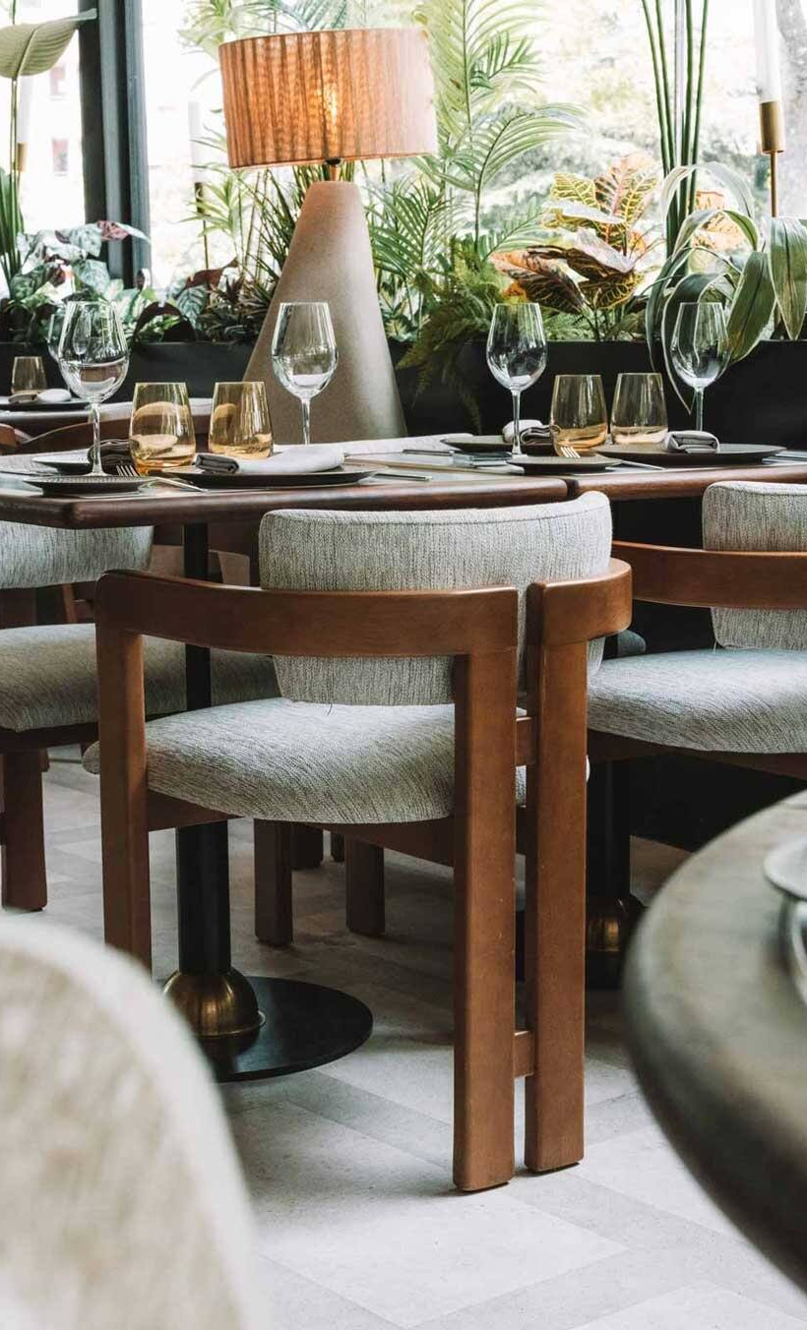
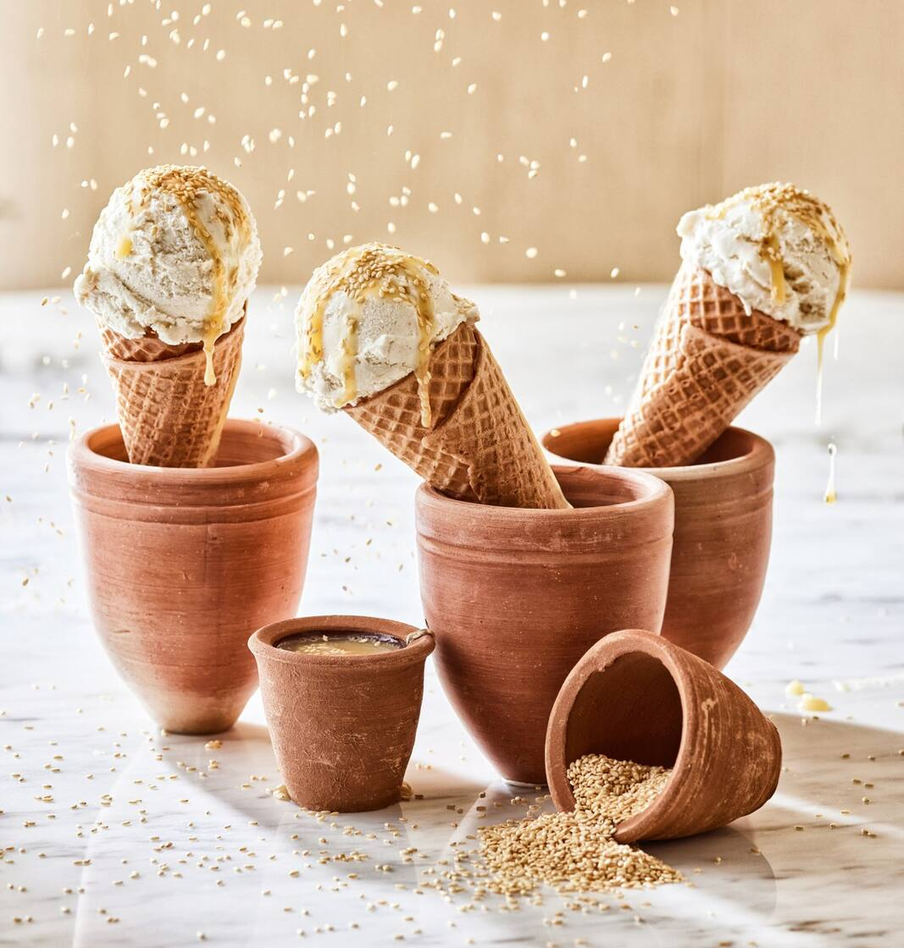
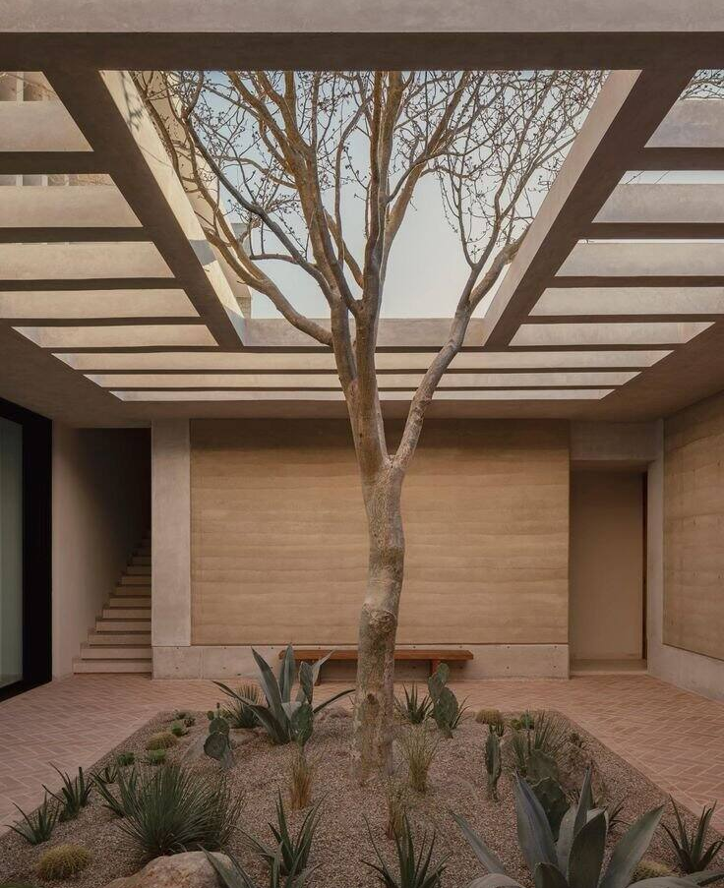
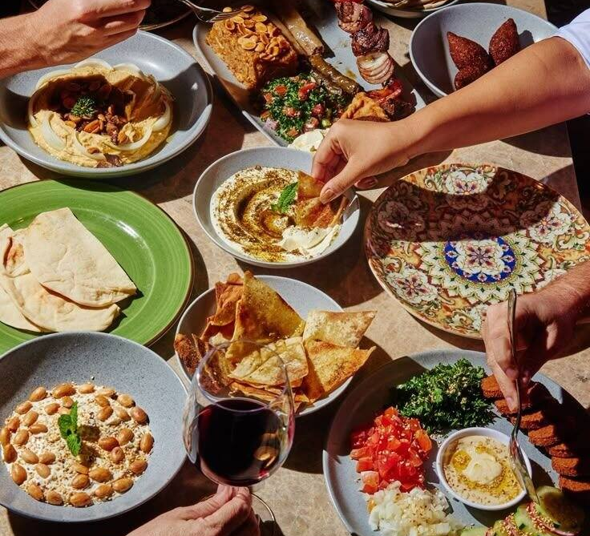
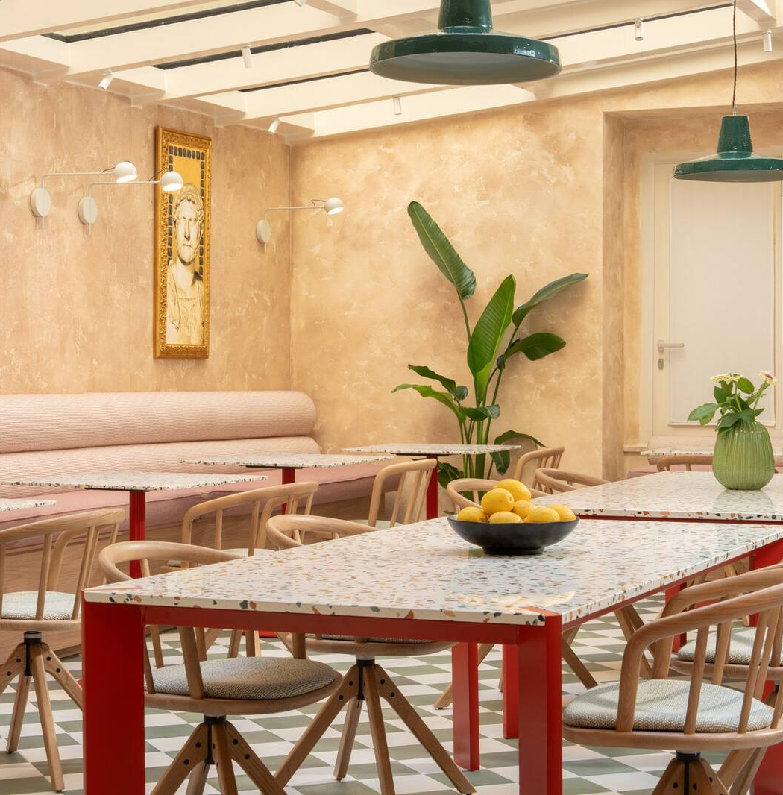
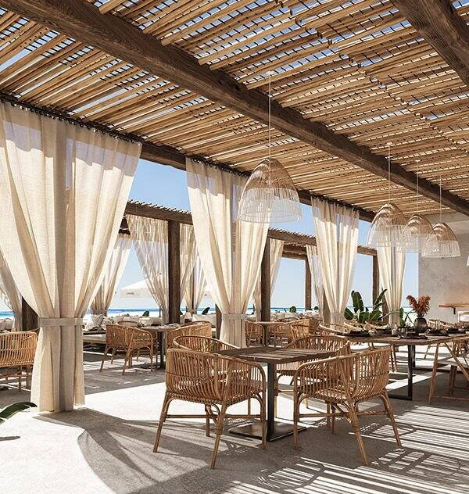
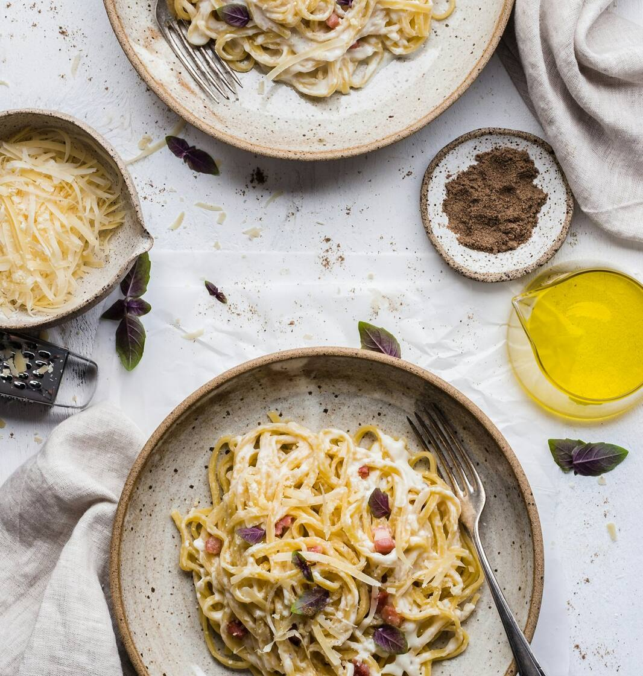
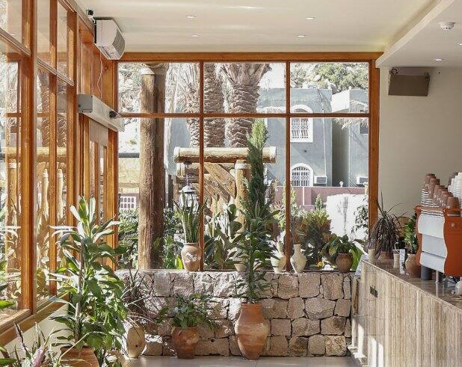
F&B Areas
‹#›
|

Slide 9
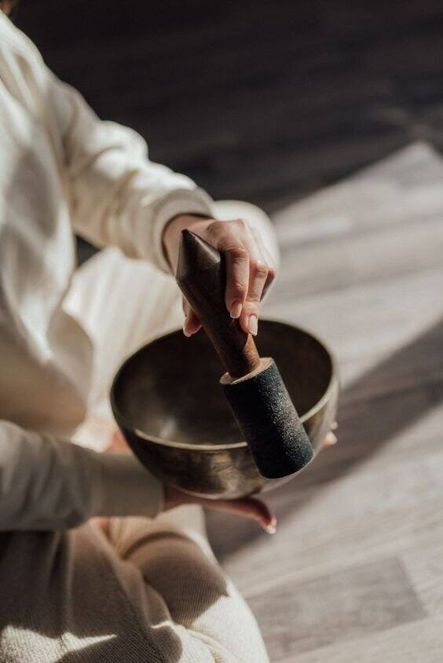
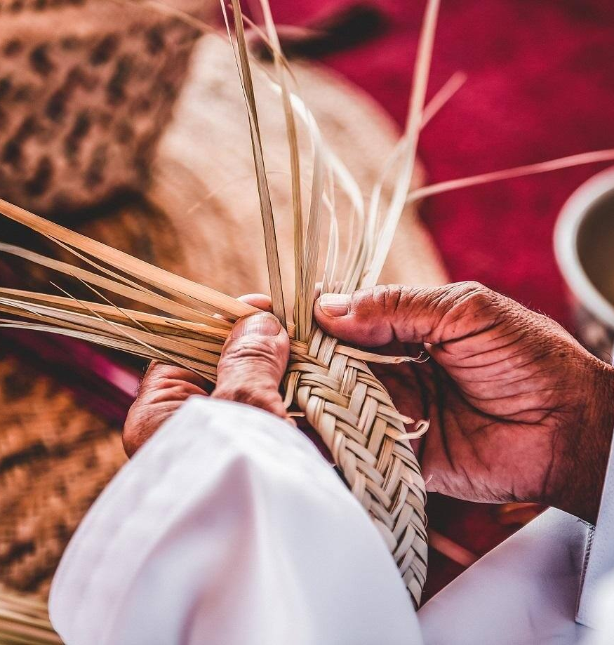
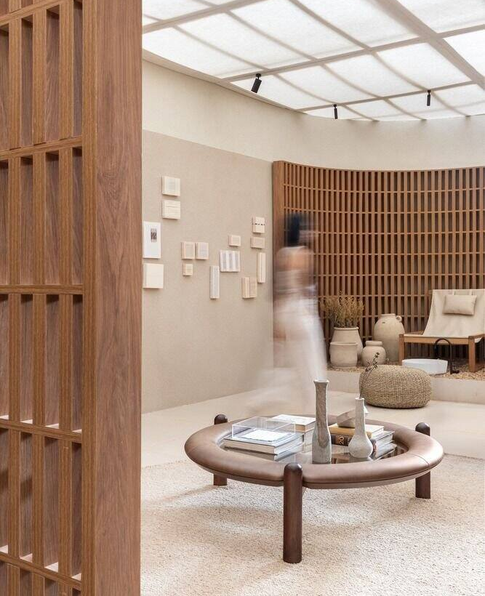
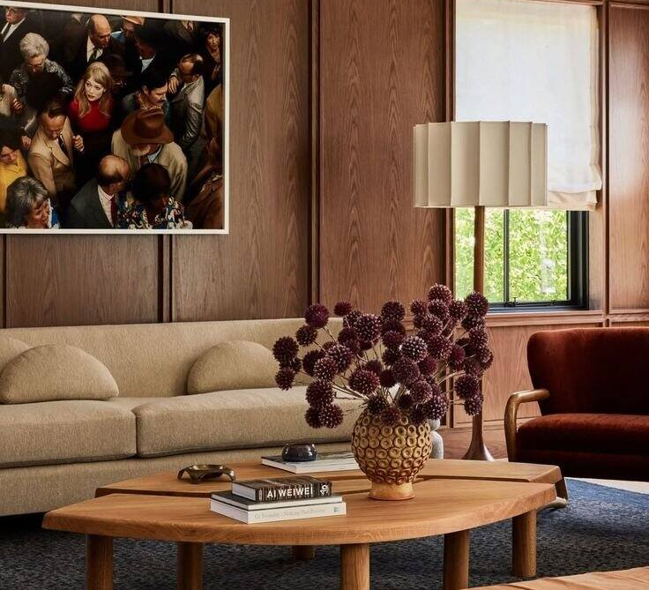

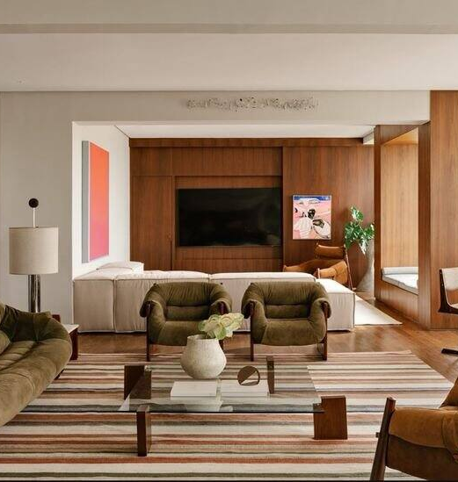

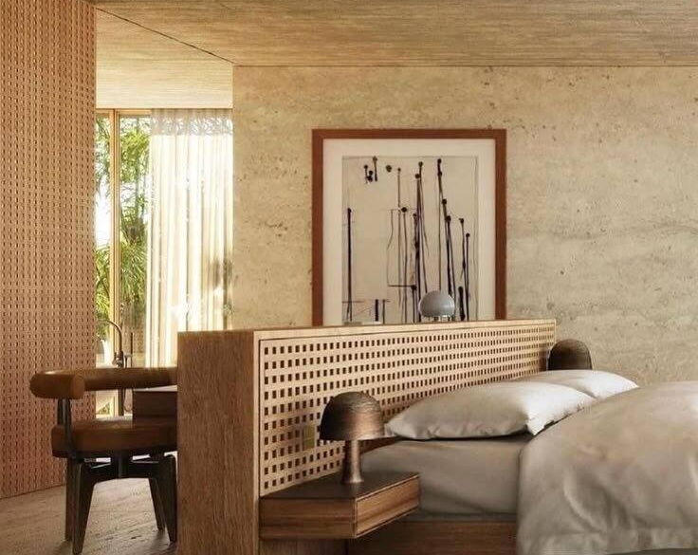
Fitness & Gym
‹#›
|

Slide 10

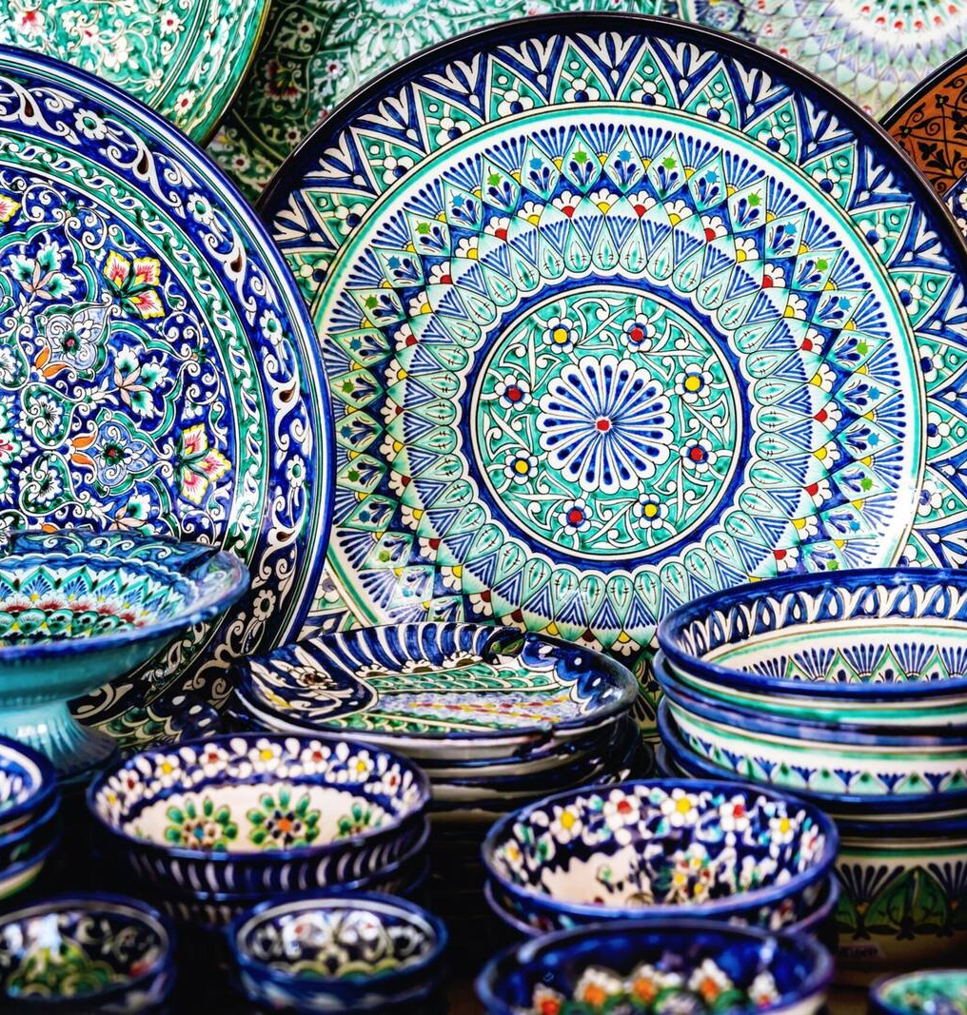
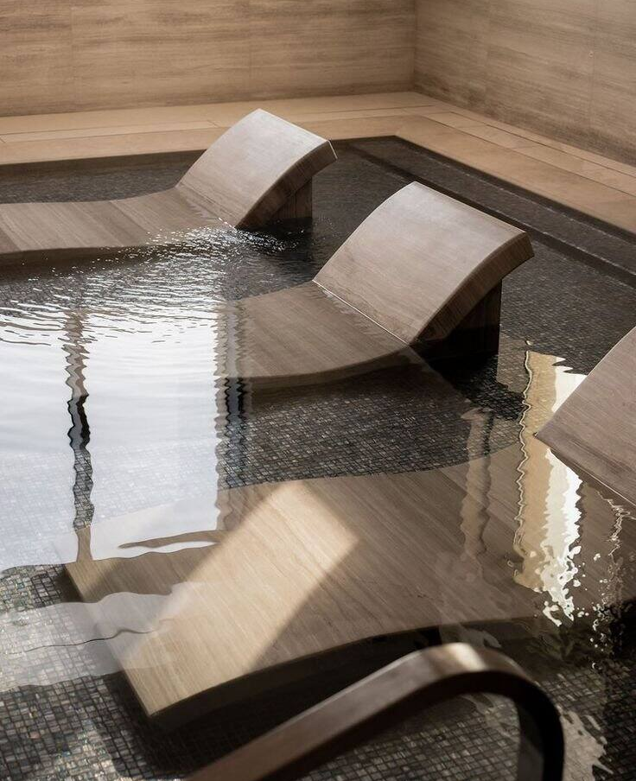
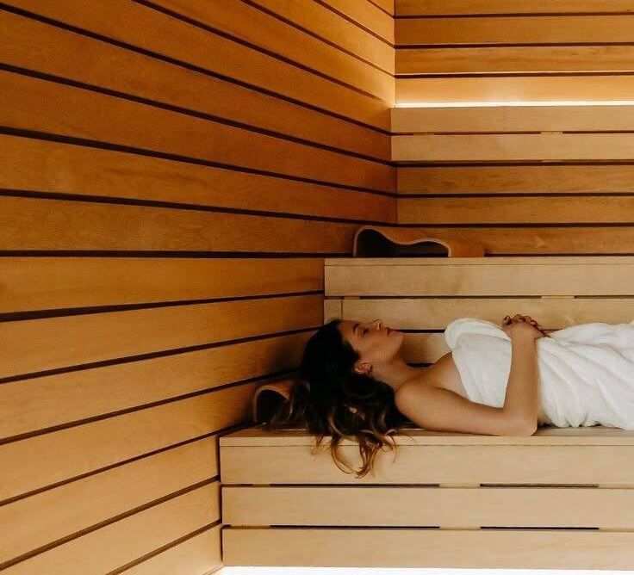
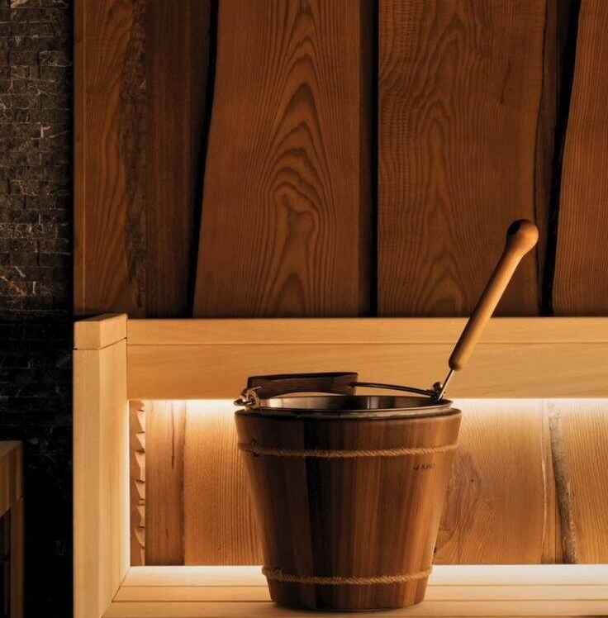
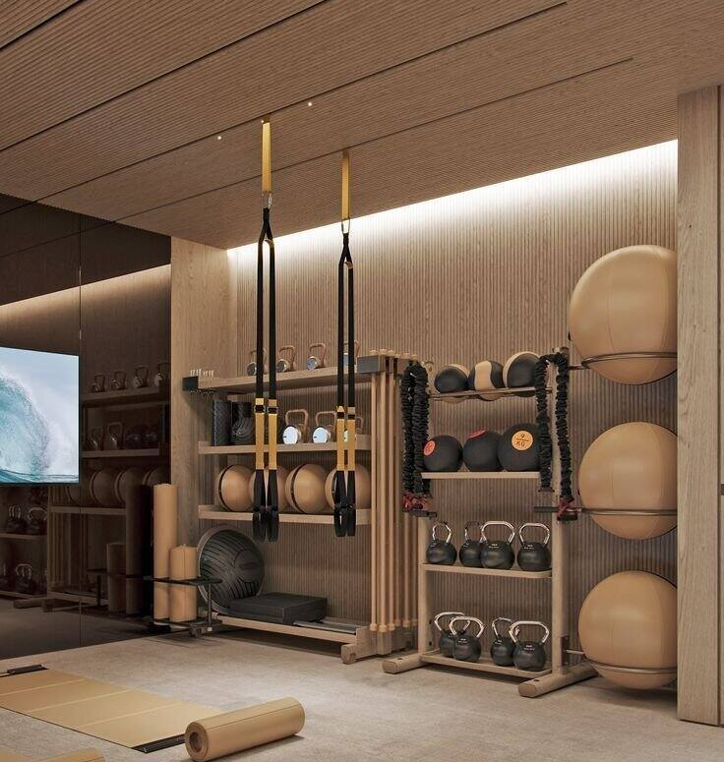
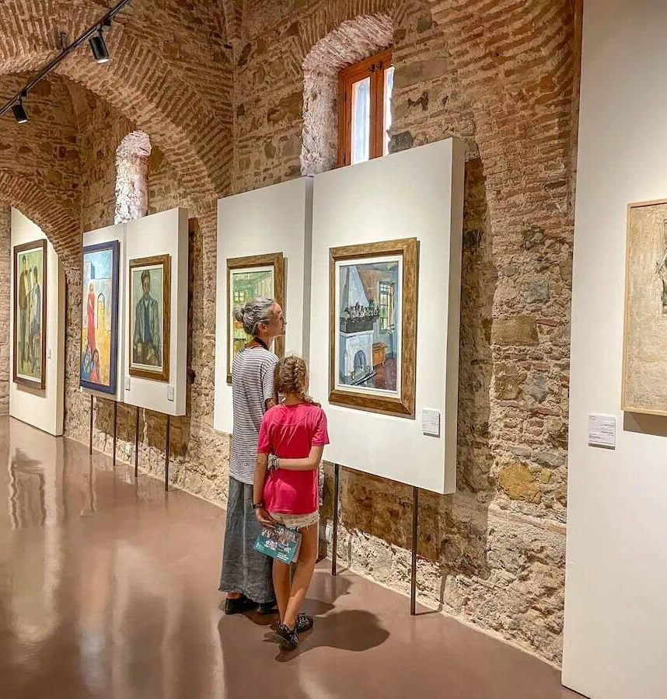
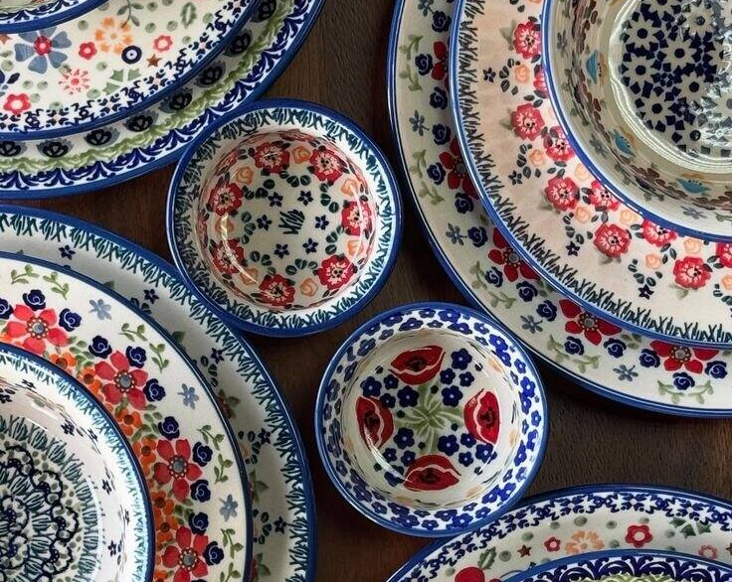
Spa / Wellbeing
‹#›
|

Slide 11
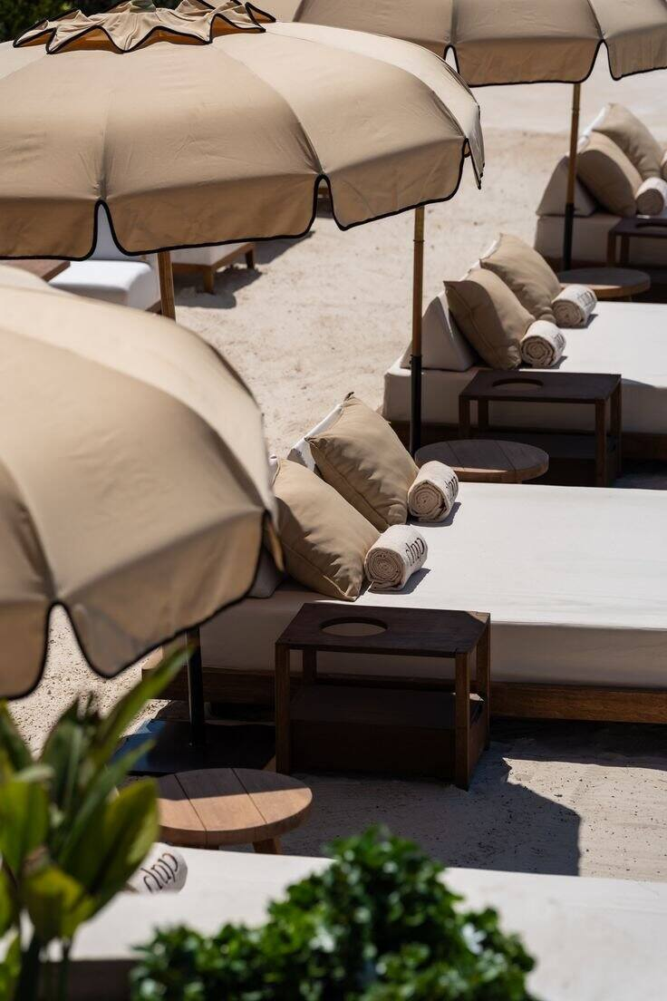
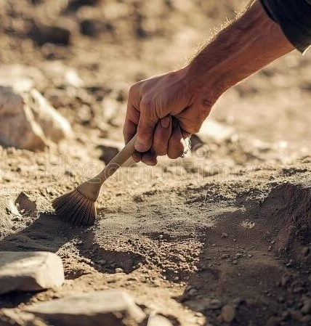
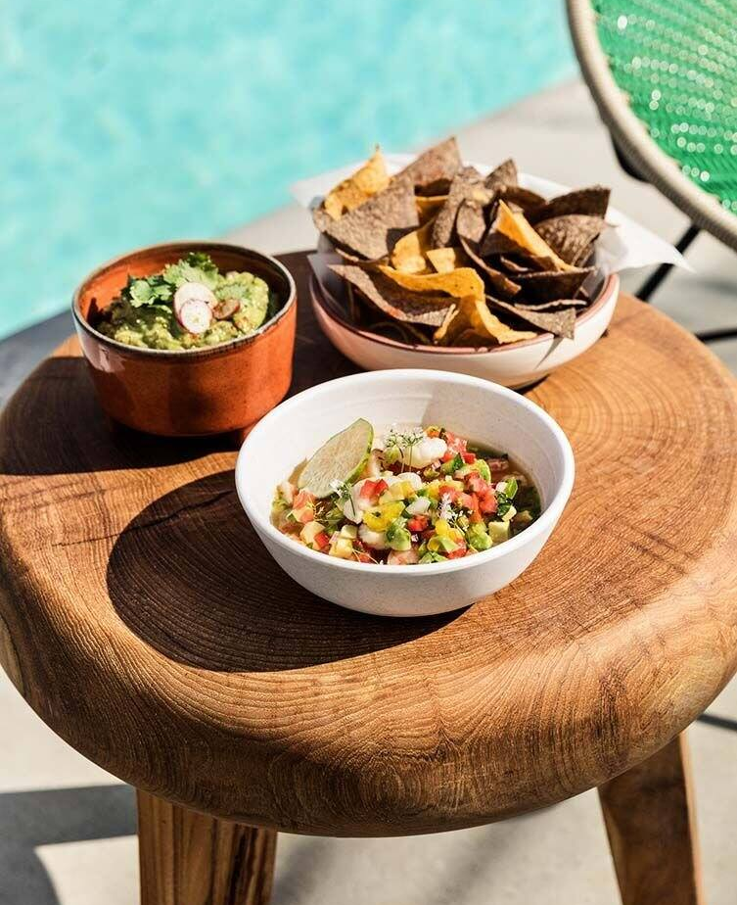
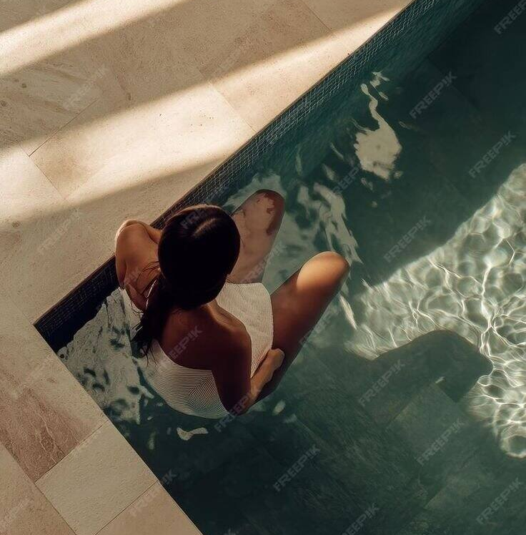
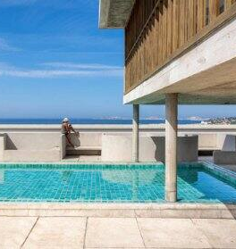

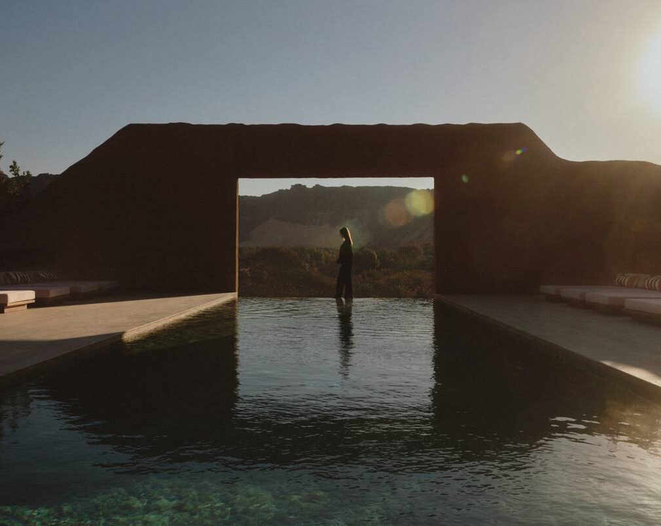
Pool
‹#›
|

Slide 12
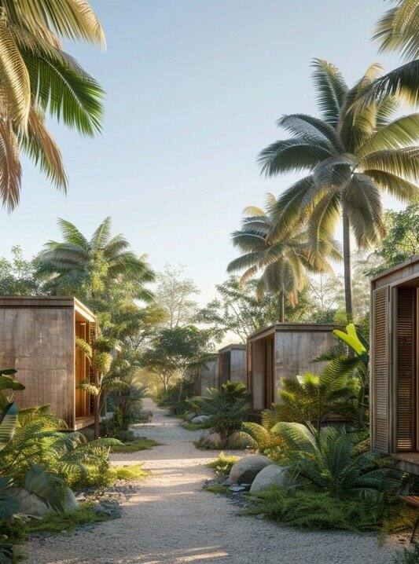
The Residences
Twenty-five villas proposed as branded residences, each carrying The Atrium's standard of service into private ownership. One brand, one operating model, one point of sale, so Larkfield can sell villas and fill rooms without separate contracts for every piece.
‹#›
|

Slide 13
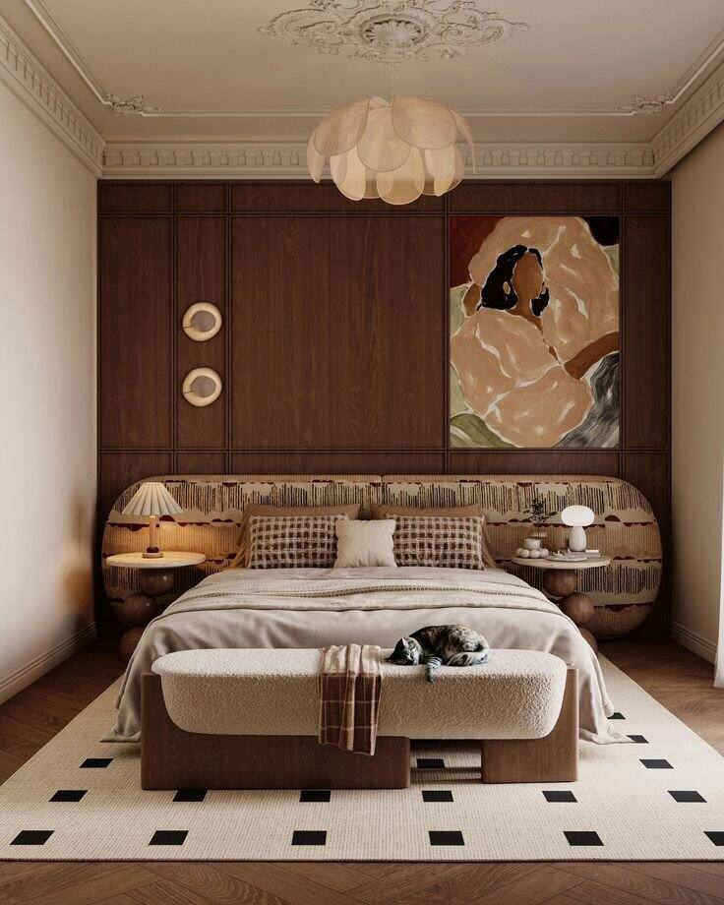
Align Villas and Rooms Under One Atrium Hotel Standard
The same welcome at a suite door and a villa door, the same standard behind both, written once. A villa buyer signs up for exactly what the guest next door already receives, nothing renegotiated per key.
‹#›
|

Slide 14
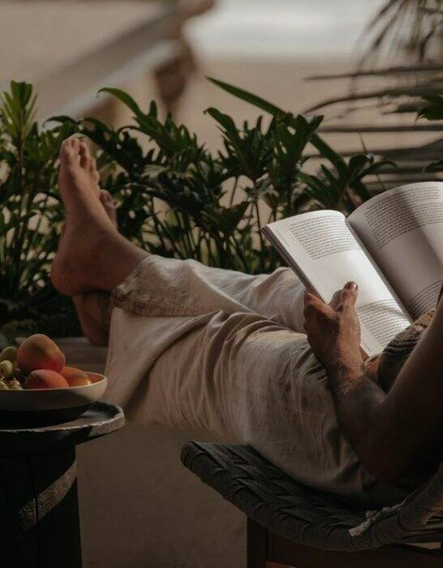
One Commercial Structure for Villa Sales and the Rental Pool
A villa that is home for a few weeks a year and hotel inventory the rest of it. One structure moves it from owner's door to guest's key, no separate sales office, no separate operator.
‹#›
|

Slide 15
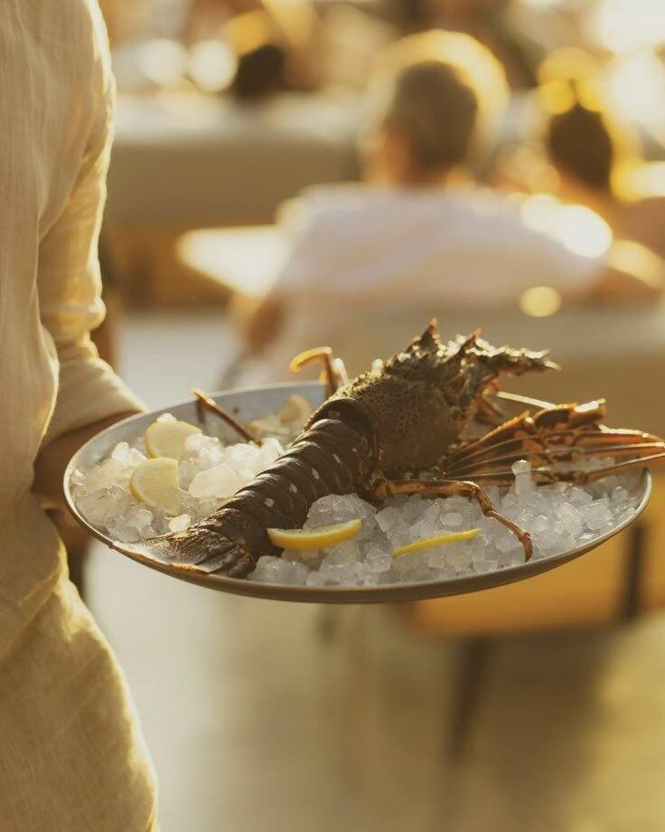
Charcood
Coals banked from the estate's own cork oak, the grill lit before the dining room fills. Whole-animal Bísaro pork and fish caught in the Sado, cooked over open flame with the kitchen set where every table can watch it work.
‹#›
|

Slide 16

Joontos
Joontos
‹#›
|

Slide 17
Nakhati
A scoop counter tucked into the estate's retail corner, built on its own pantry. Moscatel, cardoon honey, a ripple of Azeitão cheese, gelato for the guest heading upstairs and the passer-through who just followed the smell.
‹#›
|

Slide 18

The Cardo Table
Below ground, a single tasting menu that never leaves the peninsula. Sheep's-milk cheese, wild thistle and aged Moscatel, course after course, poured and plated for a table that already knows Azeitão by name.
‹#›
|

Slide 19

Livramento Counter
The catch bought that same morning at Setúbal's Livramento Market, dressed simply and served within sight of the kitchen. Nothing between the boat and the plate but a few hours and a knife.
‹#›
|

Slide 20

Quinta Farmhouse Table
Breakfast through late lunch, built from whatever the kitchen garden and the neighbours grew that week. No fixed menu, just the estate's own table set for whoever wanders in, early or late.
‹#›
|

Slide 21
Shape the Clubhouse as the Estate's Shared Social Hub
One address on the estate where a villa owner and a hotel guest end up in the same place, some evening neither planned. Not a sales office: the shared centre of the estate, for whoever is in residence that week.
‹#›
|

Slide 22



Arrábida's wild side
Cliffs of Endemism
Raptors of Arrábida
Sado Dolphin Watch
Convento da Arrábida Silence Walk
Botanist-led search for plant species found only between Sesimbra and Cabo Espichel
Ornithologist-led watch for Bonelli's eagles and peregrine falcons nesting on cliffs
Small-boat outing tracking the estuary's resident dolphin pod with a marine guide
Dusk walk to the monastery, framed around saudade rather than sightseeing
‹#›
|

Slide 23



Estate craft and table
The Azulejo Atelier
Thistle & Curd Dawn
Moscatel & Cardo Pairing Table
Founders' Table
Hand-paint your own tile with Azeitão's ceramicists, fired in the neighbouring workshop
Sunrise dairy visit to curdle Queijo de Azeitão using wild cardoon thistle
Seated tasting pairing aged Setúbal Moscatel against local cheeses with a winemaker
Seasonal dinner gathering villa owners, members and visiting winemakers at one table
‹#›
|

Slide 24

Dawn to nightfall
Rota dos Moinhos at First Light
Livramento Market Run
Cabo Espichel Cliff Ride
Fado Among the Vines
Guided sunrise walk along the windmill trail above the Sado estuary
Pre-dawn trip to Setúbal's market to choose the catch with a fishmonger
Horseback or e-bike ride along the Atlantic cliff road to the headland
Unplugged fado and classical guitar staged among the estate's own vineyard rows
‹#›
|

Slide 25
One Outdoor Programme for Guests and Villa Residents
One calendar, whether you're checked in for three nights or living on the estate year round. Arrábida doesn't need two programmes, one for guests and one for owners: just one way out onto the land, open to whoever is there.
‹#›
|

Slide 26
Mandatory Rental Pool
A mandatory rental pool program will be available for the residences, offering owners an income-generating opportunity while not in residence. Managed seamlessly by The Atrium Quinta do Vale Verde, the program provides professional marketing, booking, and guest services, ensuring a hassle-free experience for owners and a consistent, high-quality stay for guests.
‹#›
|

Slide 27
The Atrium Members' Club
A private membership program granting access to dedicated, members-only areas within The Atrium at Quinta do Vale Verde.
Members enjoy privileged access to curated social, cultural, wellbeing, and workspaces - designed as a year-round lifestyle destination.
Memberships will be offered through a range of packages, tailored to different patterns of use and engagement. Values, inclusions, and pricing to be defined and agreed together.
‹#›
|

Slide 28
Thank you
Thank you. Aster submits this proposal to Larkfield Real Estate, on behalf of the owner, as the starting point for shaping Quinta do Vale Verde together from here.
‹#›
|

