Slide 1


Slide 2

Community Food Wastage Reduction Portal (v2)

Slide 3
Group Members Introduction
Mohammad Ashir bc220408429) Supervisor: Hasnain Ahmed

Slide 4

INTRODUCTION OF PROJECT
Cities waste edible surplus food every day.
NGOs often cannot find donors in time.
Our portal connects donors with nearby NGOs.
Built with Laravel, Blade, Bootstrap, and MySQL.
Roles: donor, recipient, volunteer, admin.

Slide 5
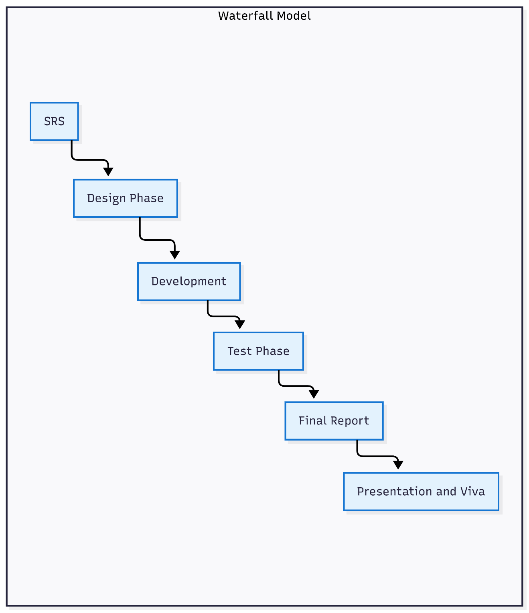

Slide 6
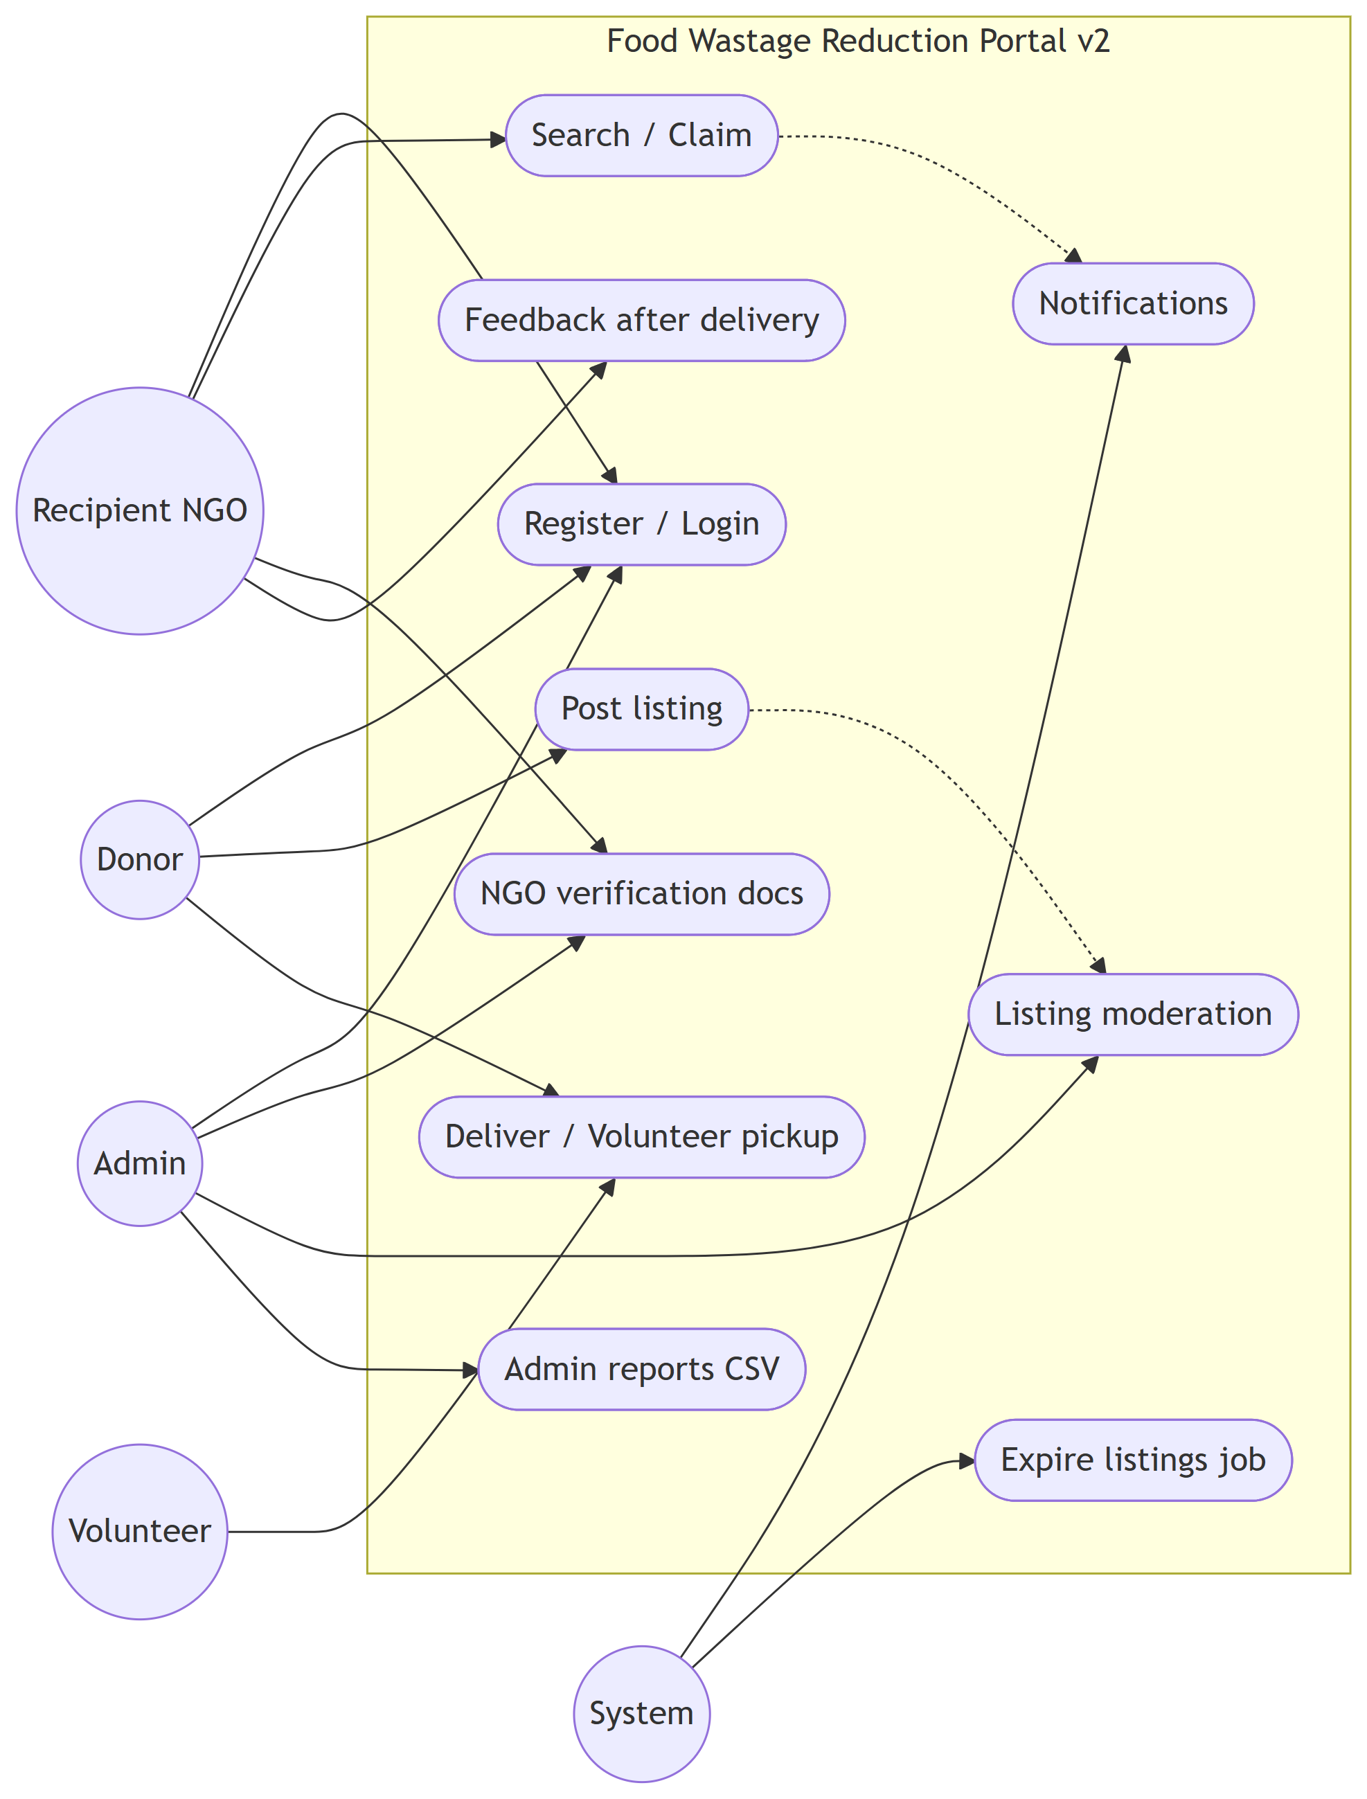
Use Case Diagram

Slide 7
Business Rules Catalog
Donors post food with expiry and location.
NGOs search by city or GPS radius.
Only one NGO can claim each listing.
Admin verifies NGOs and moderates listings.
Volunteers can mark pickup complete.
Dashboard notifications and CSV reports.

Slide 8
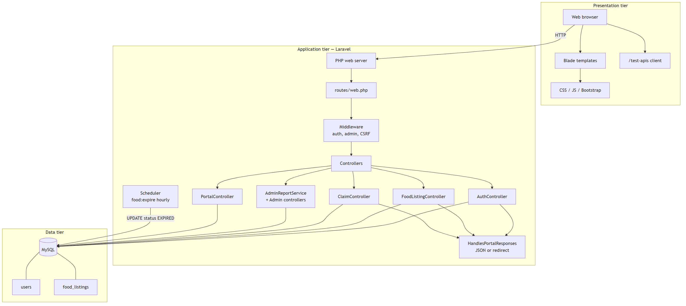
Architectural Design
Provide Architecture Diagram Here

Slide 9
Team Structure
Mohammad Ashir: SRS, auth, donor module, search, claim, admin reports, testing, diagrams, demo script.
Supervisor reviews each milestone.

Slide 10
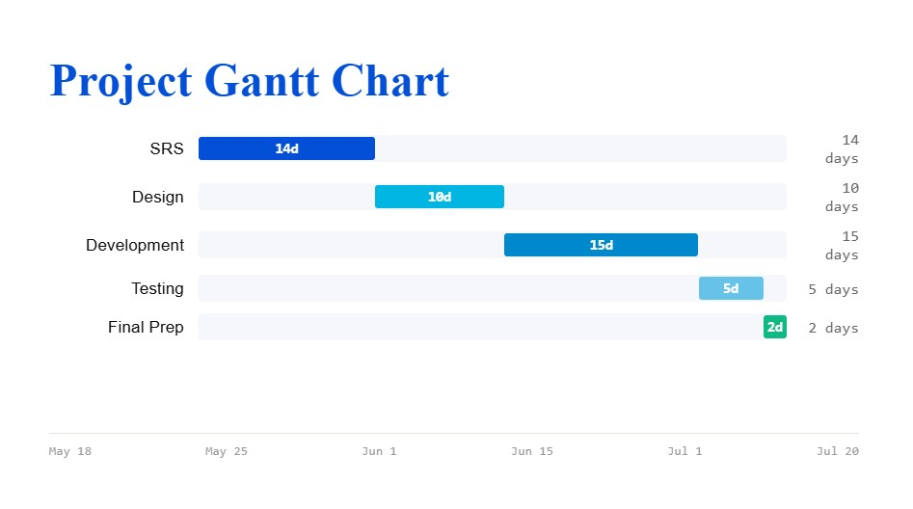
Project Schedule

Slide 11
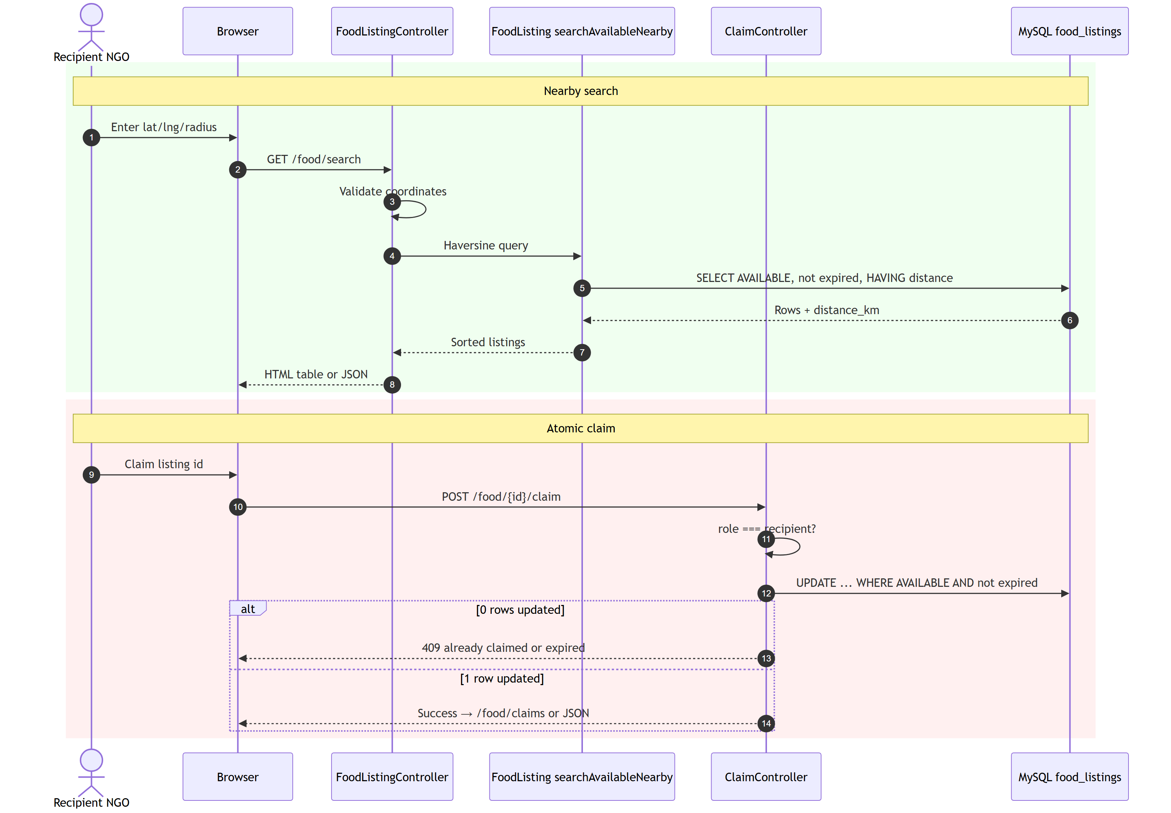
Sequence Diagrams

Slide 12
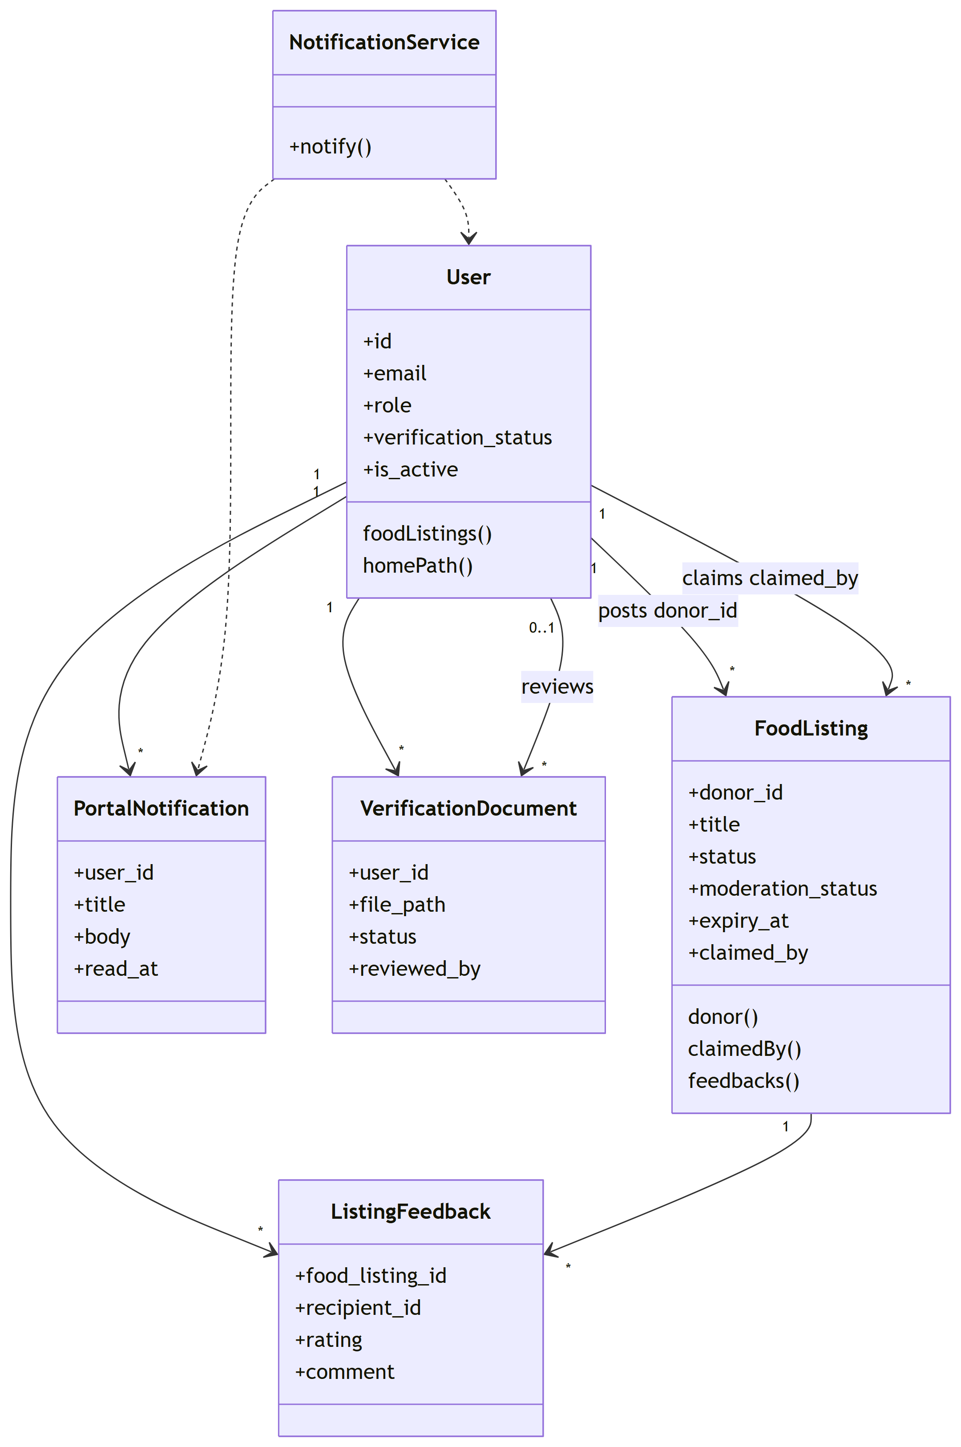
Logical Model/Class Diagram

Slide 13
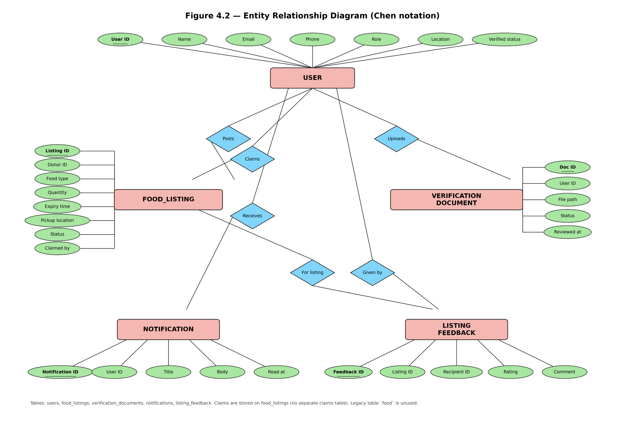
Entity-Relationship Diagram

Slide 14
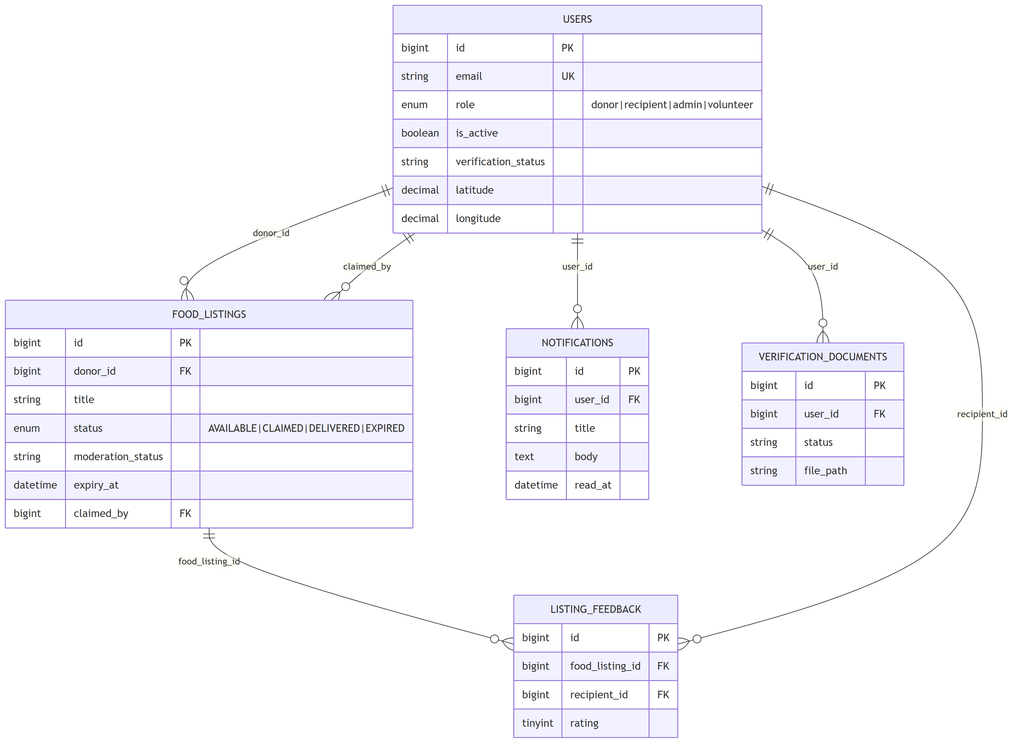
Database Diagram

Slide 15
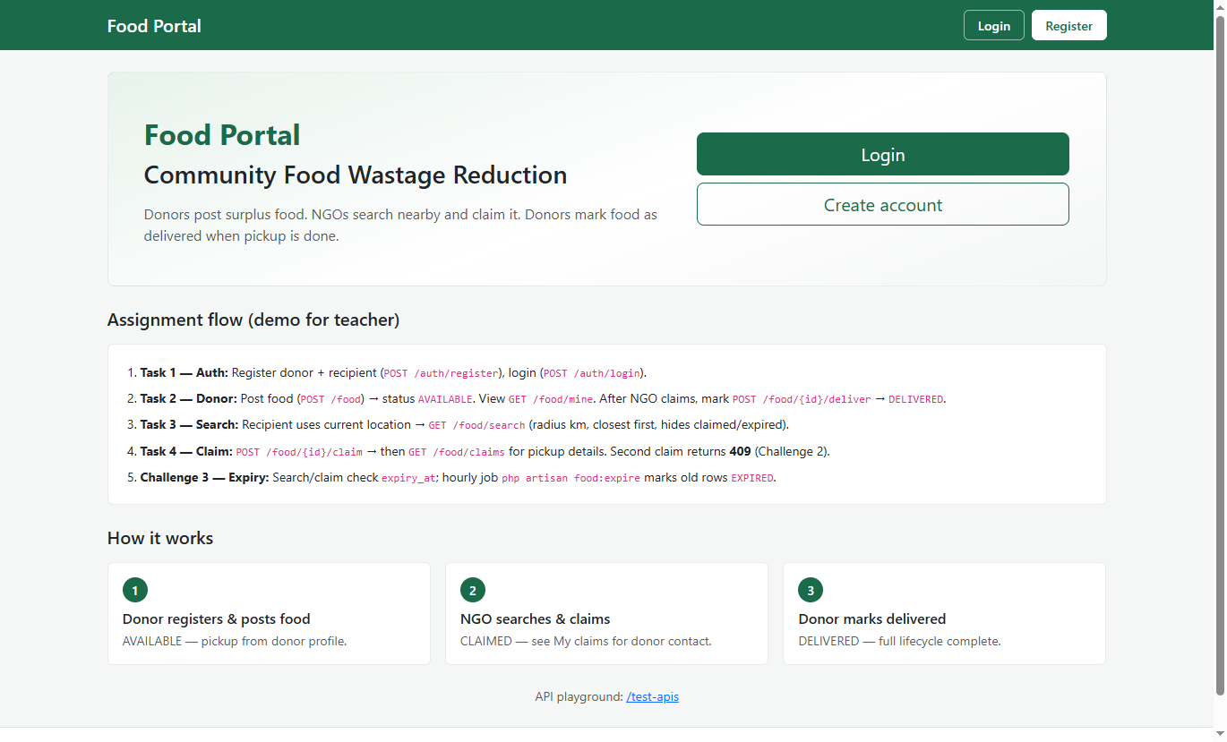
User Interfaces
Home Page

Slide 16
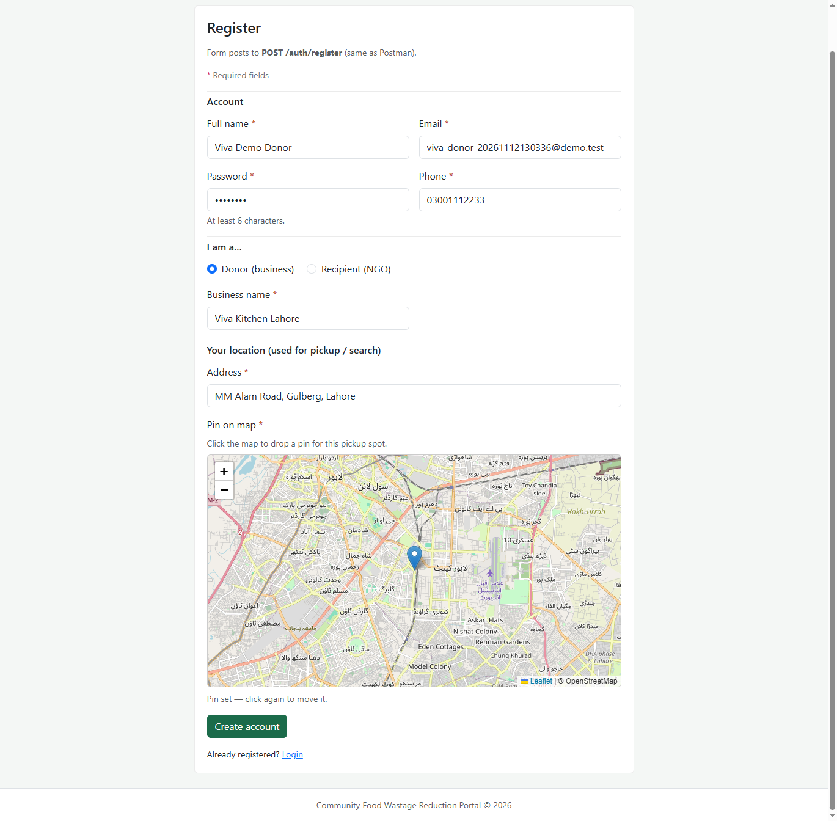
Donor Register

Slide 17
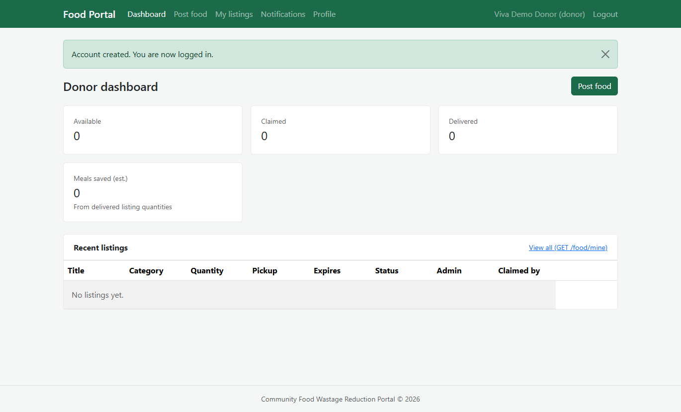
Donor Dashboard

Slide 18
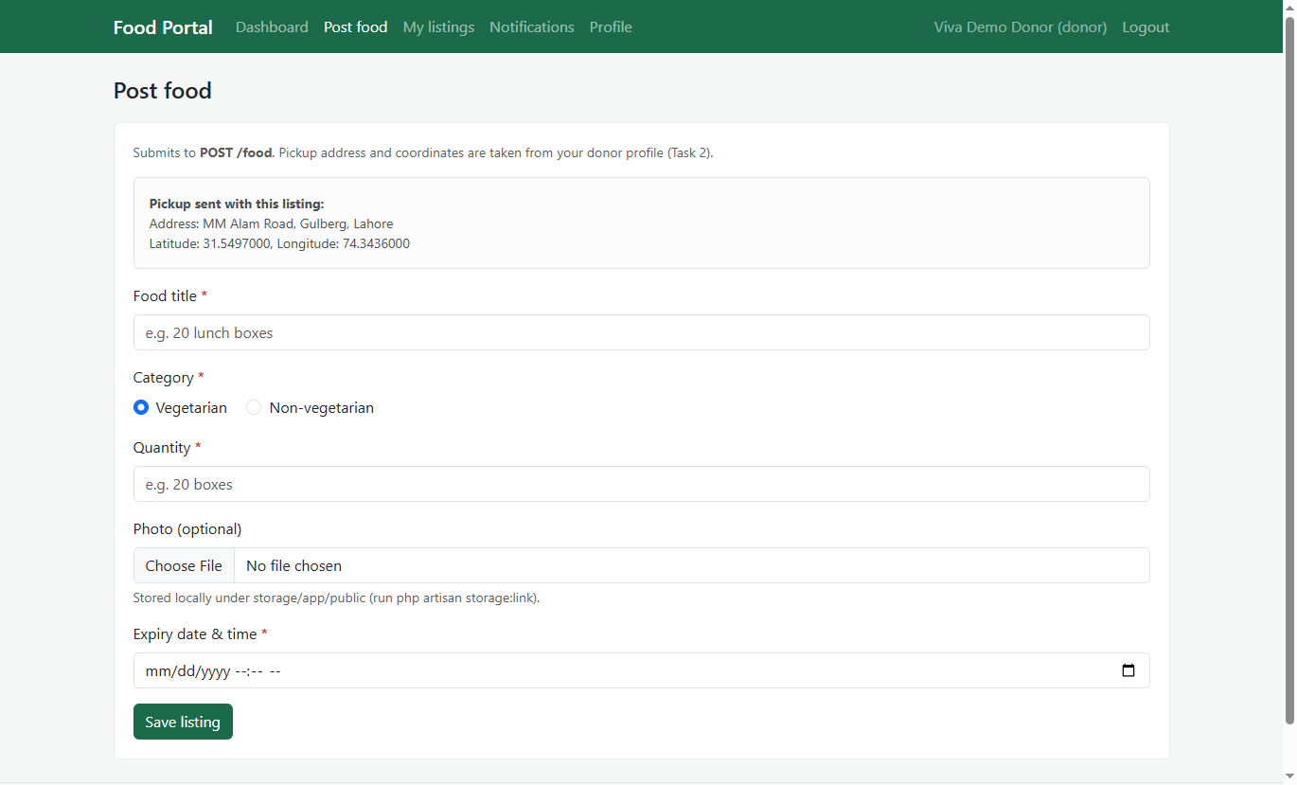
Donor: Food Posting

Slide 19
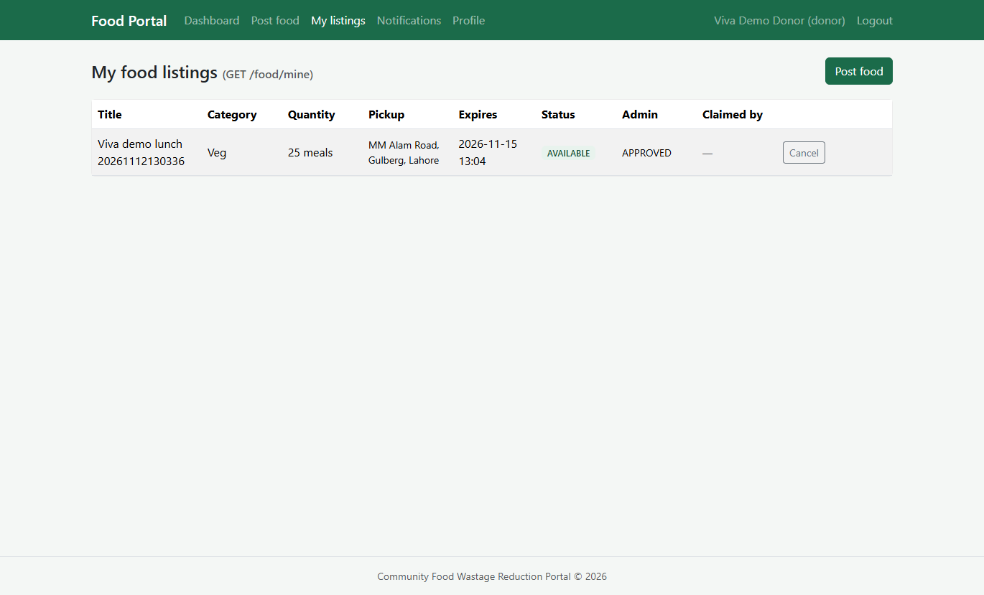
Donor: My Listing

Slide 20
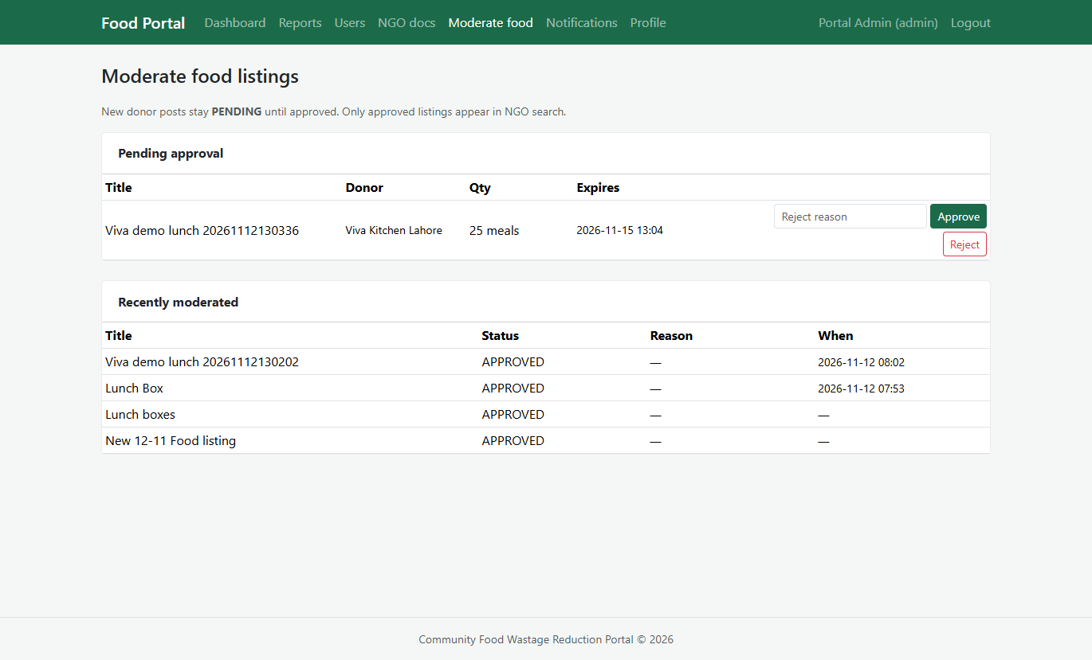
Admin: Pending Listing

Slide 21
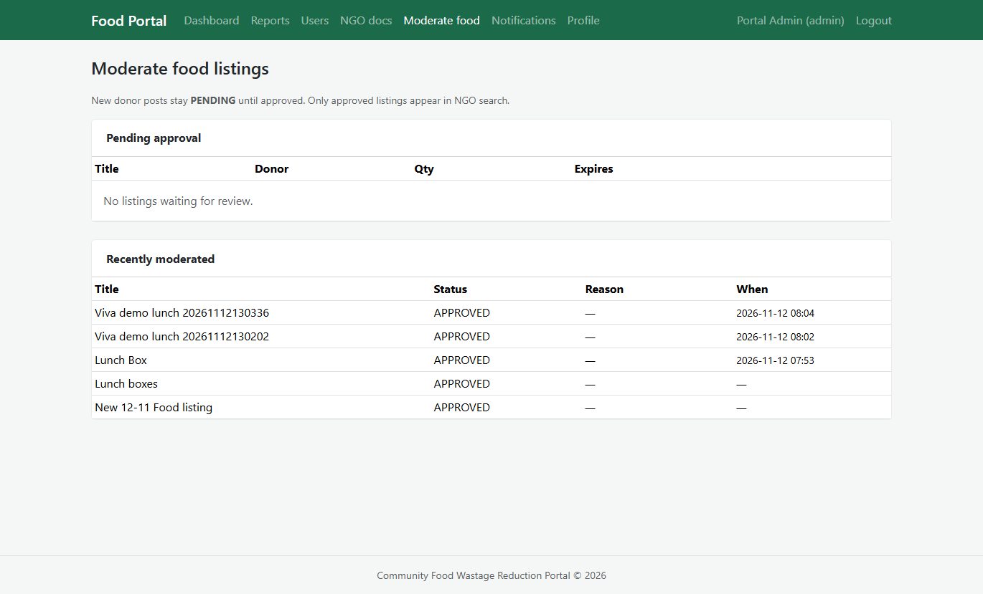
Admin: Approve Listing

Slide 22
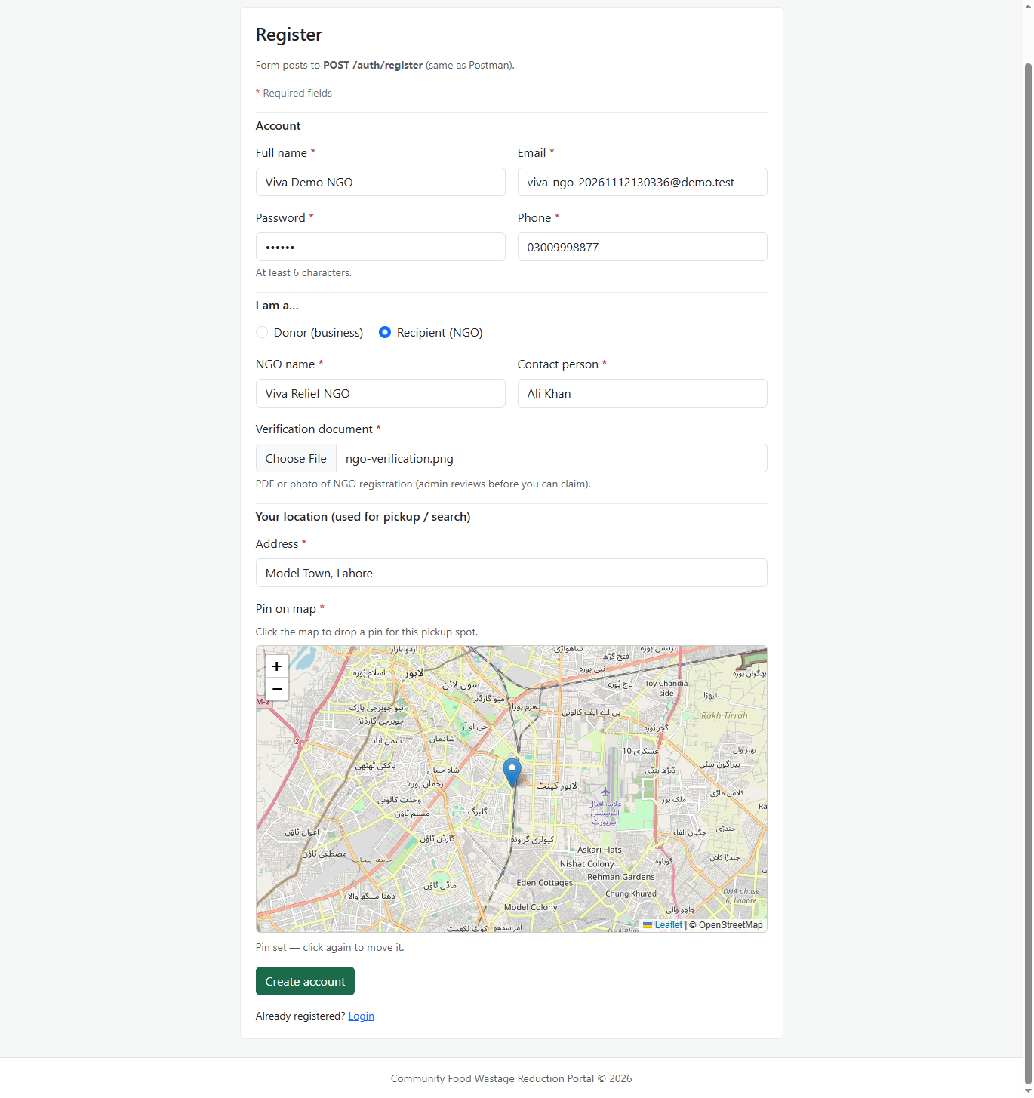
Register NGO

Slide 23
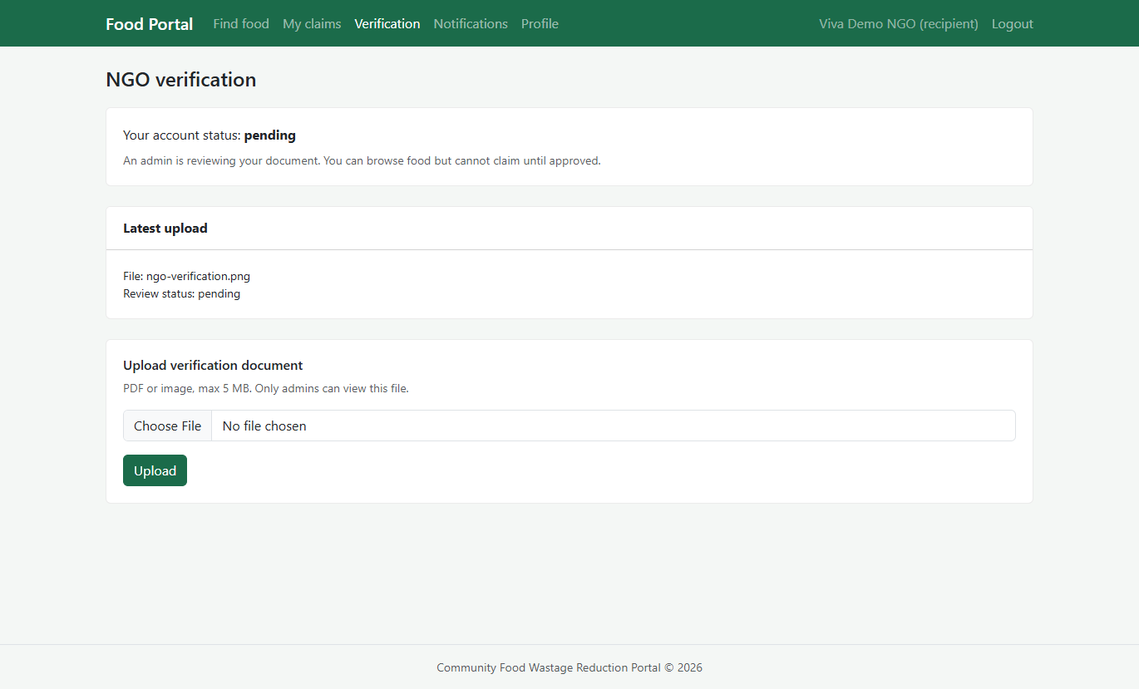
NGO: Verification

Slide 24
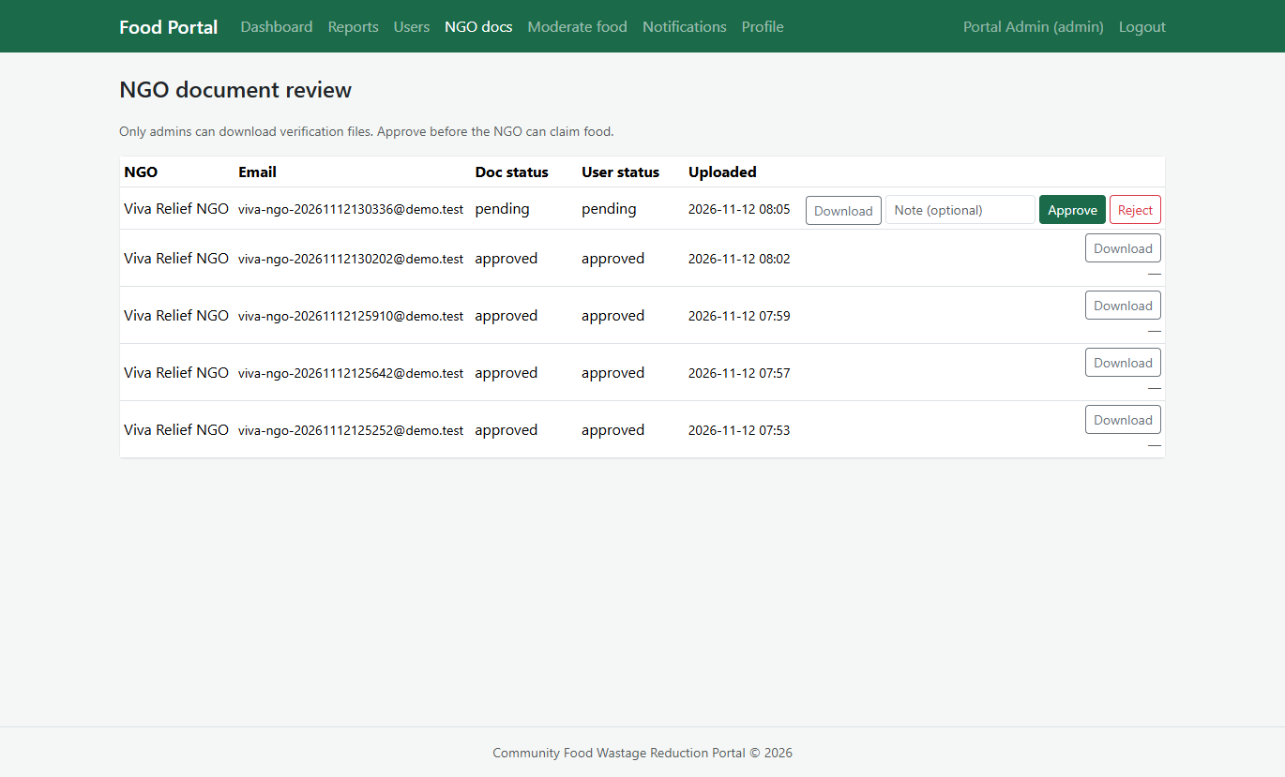
Admin: Pending Docs

Slide 25
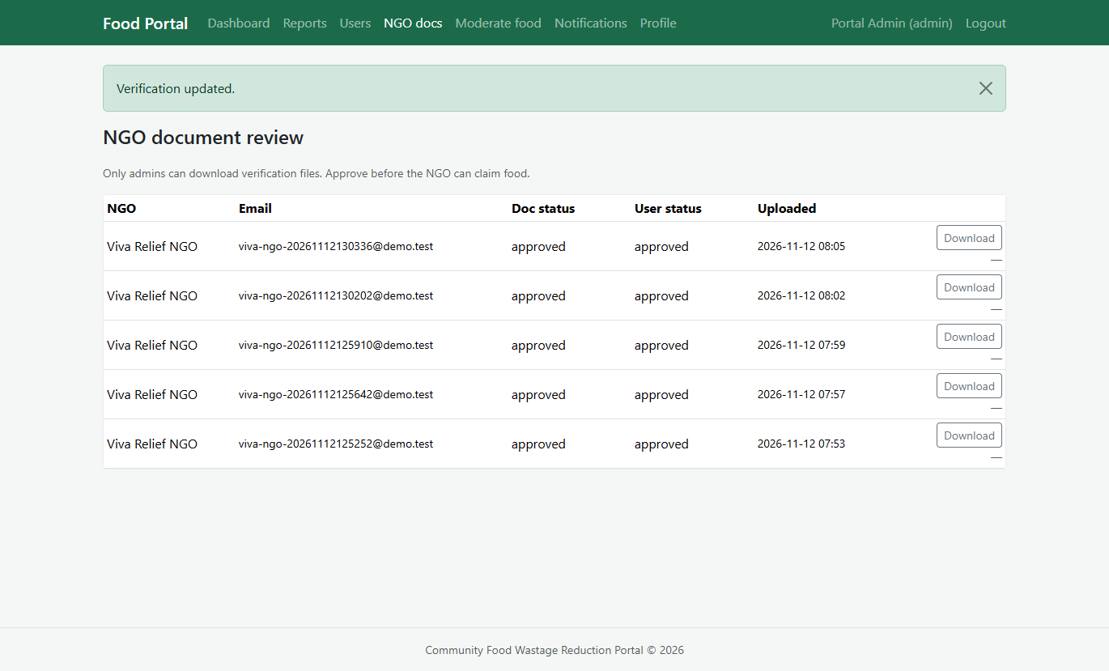
Admin: Approve Docs

Slide 26
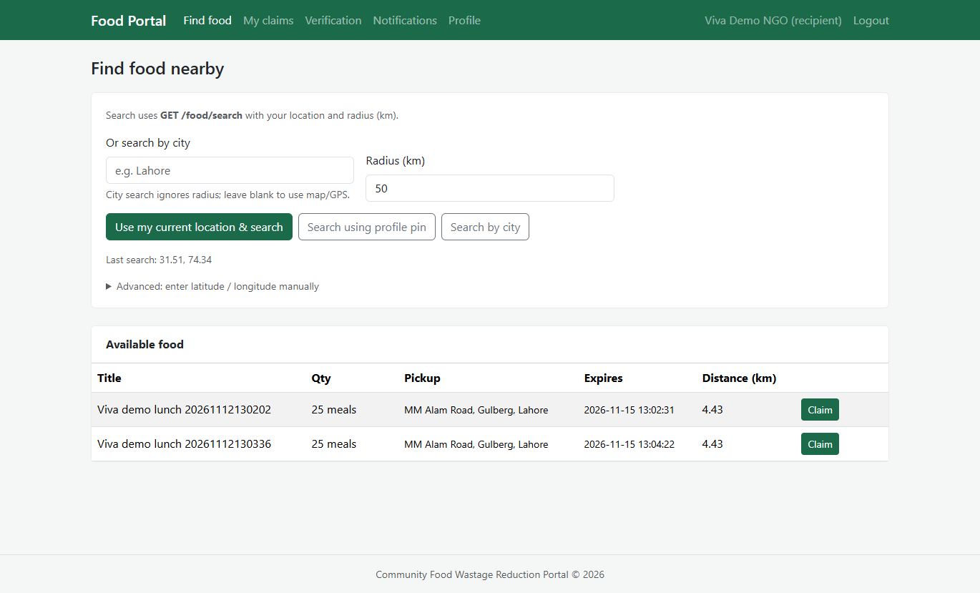
NGO: Search Listing and Claim

Slide 27
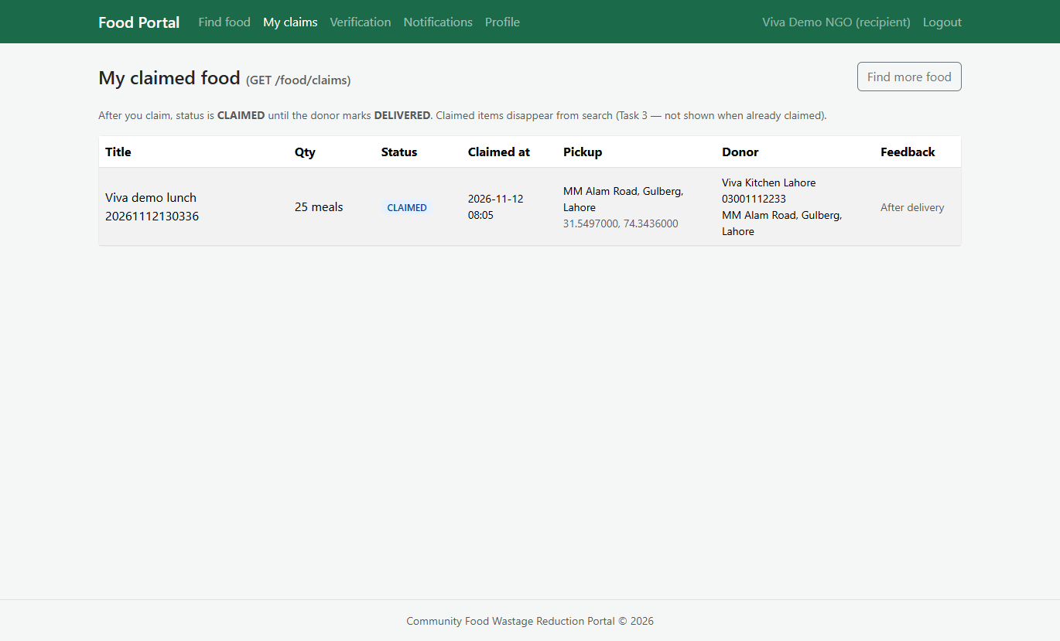
NGO: Claimed listing

Slide 28
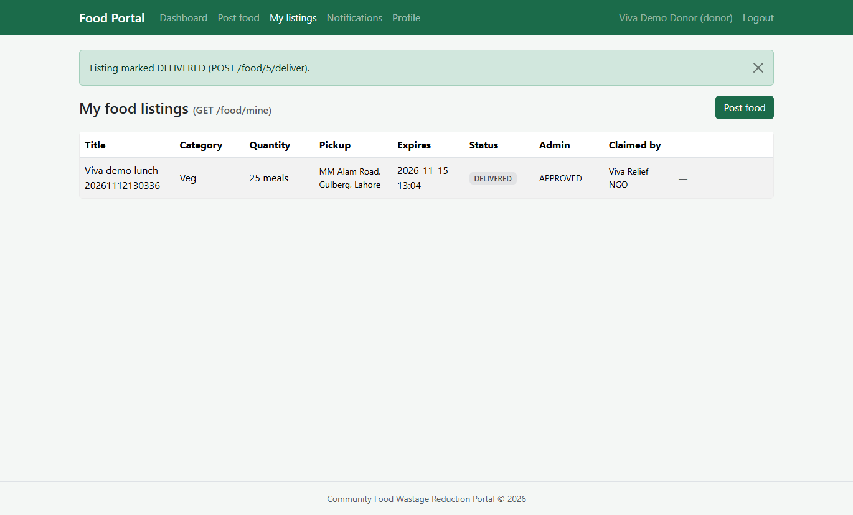
Donor: Deliver listing

Slide 29
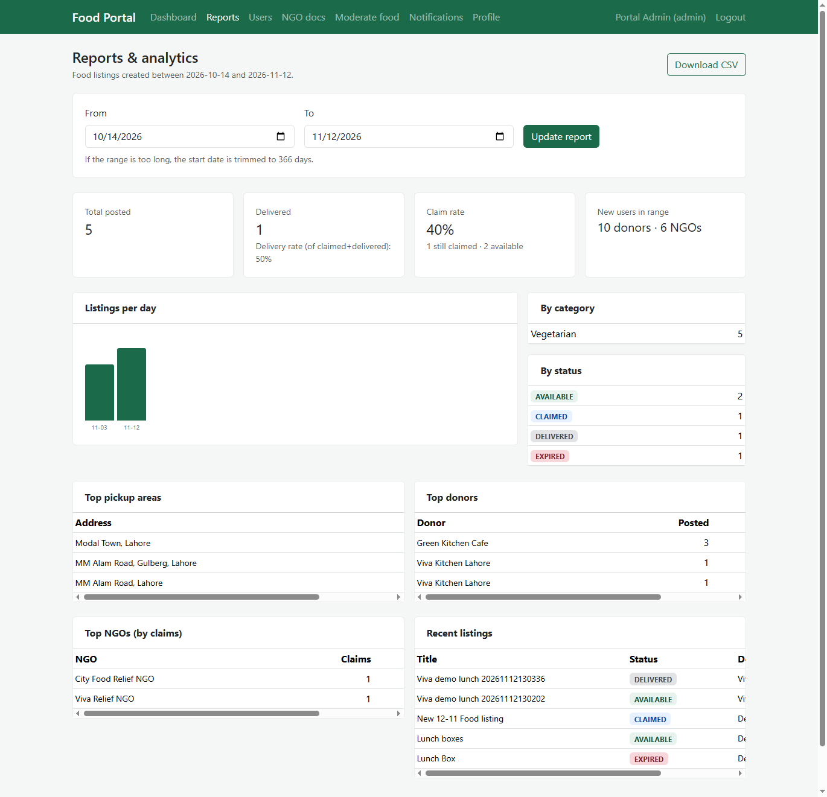
Admin: Reports

Slide 30
Tools
PHP 8, Laravel 9+, Composer
MySQL 8, Artisan migrations
Blade + Bootstrap 5
PHPUnit, Postman, /test-apis page
VS Code / Cursor, Git, XAMPP or Laragon

